Slide 1

Introduction to Proton Therapy
JAI Octoberfest, 3rd October 2014
Claire Timlin
Particle Therapy Cancer Research Institute, University of Oxford

Slide 2
Introduction to Radiotherapy and Proton Therapy

Slide 3
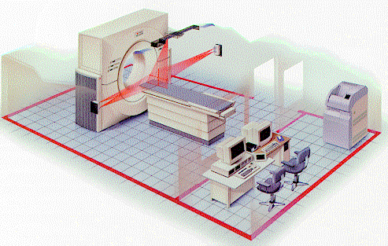
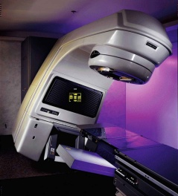
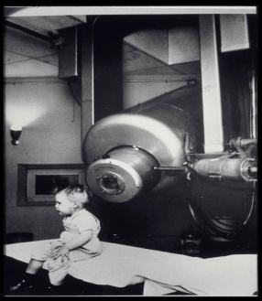
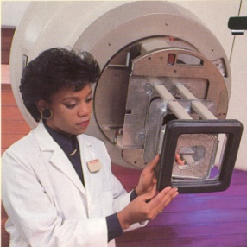
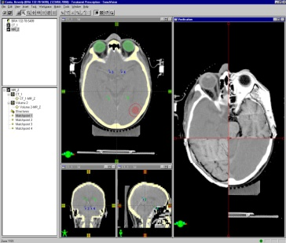
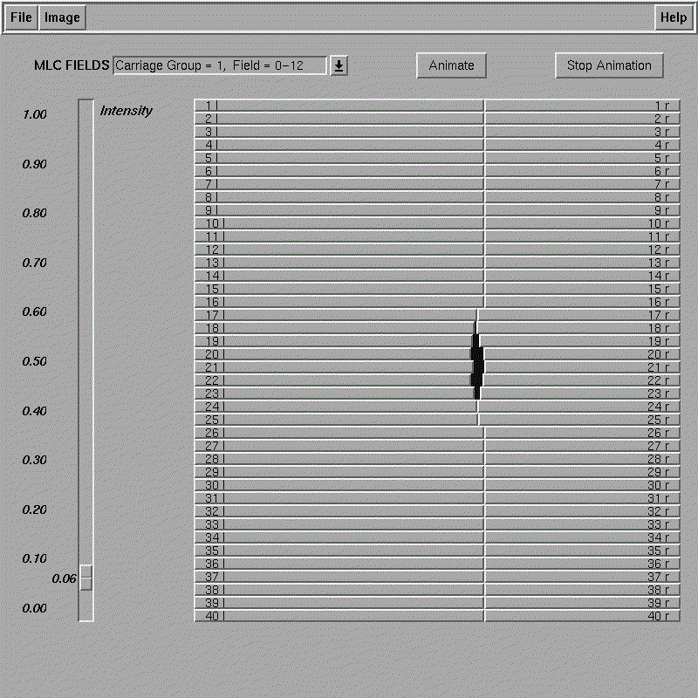
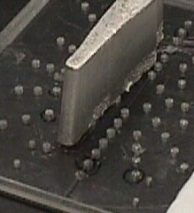
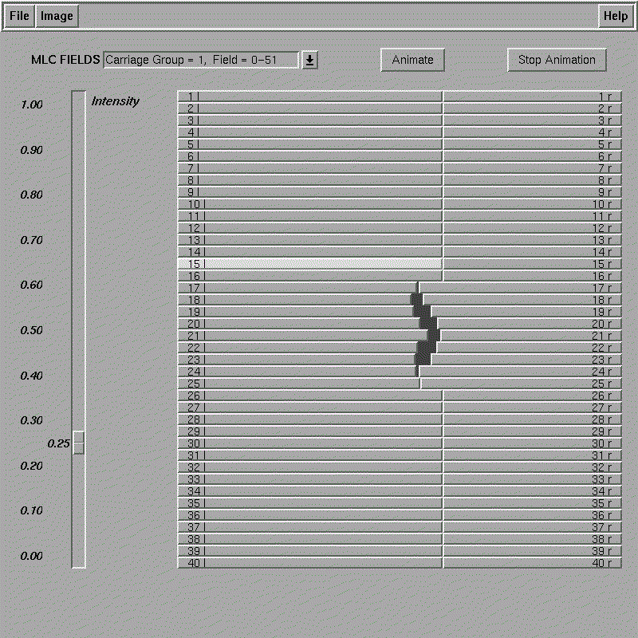
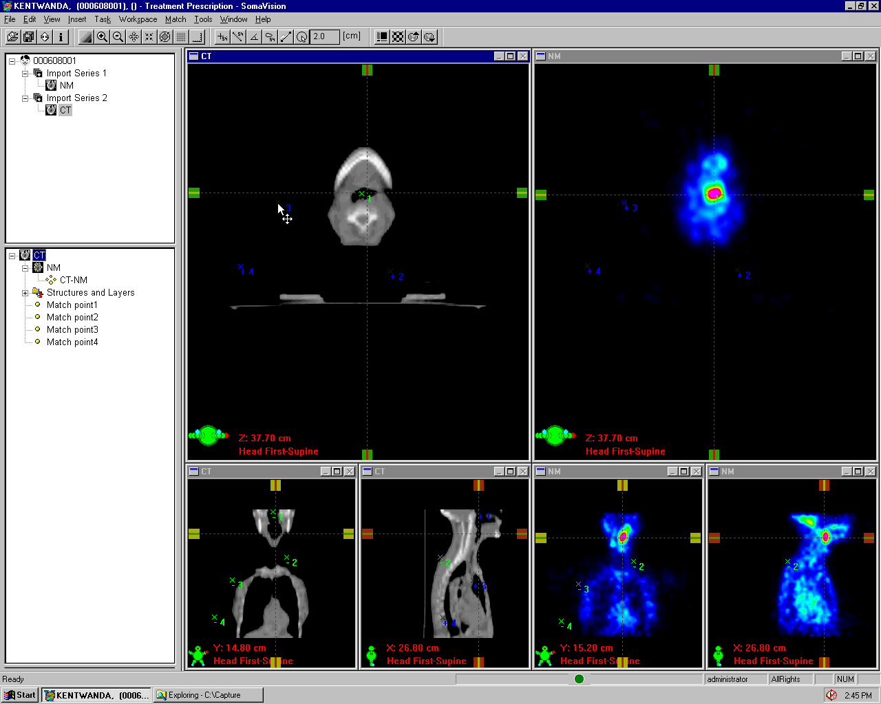
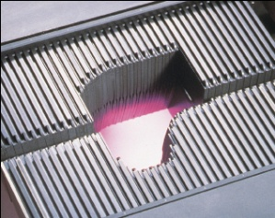
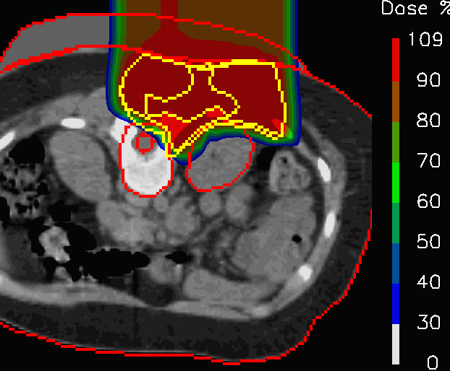
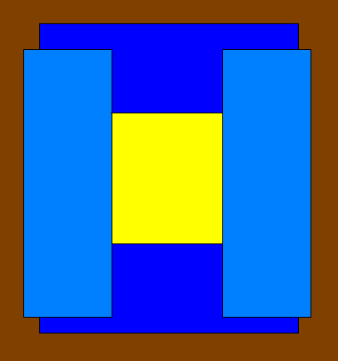
The Evolution of External Beam Radiation Therapy
1950’s
The First Cobalt Therapy Unit and Clinac
1990’s
2000’s?
1980’s
Computerized 3D CT Treatment Planning
1970’s
Functional
Imaging
Cerrobend Blocks Electron Therapy
Multileaf Collimator
Dynamic MLC
and IMRT
Standard Collimator
High resolution IGRT
Particle
Therapy
Slide courtesy of Prof. Gillies McKenna
Notes:
Key points to make:
Completely new carriage and leaf design to
Other improvements made:
Reduced Head Diameter by 10 cm from previous “Standard” MLC

Slide 4
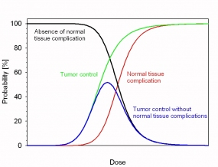
Goal of RT
Maximise Tumour Dose
Minimise Normal Tissue Dose
Radiation Induced Toxicity:
  Central Nervous System: blindness, deafness, paralysis, confusion, dementia
  Bowel: colostomy, chronic bleeding.
  Lung: shortness of breath, pneumonias
  Kidney: renal failure and hypertension
  Reproductive organs: sterility
  Everywhere: severe scarring in medium to high dose regions, possible increase in induced cancers in low-medium dose regions

Slide 5
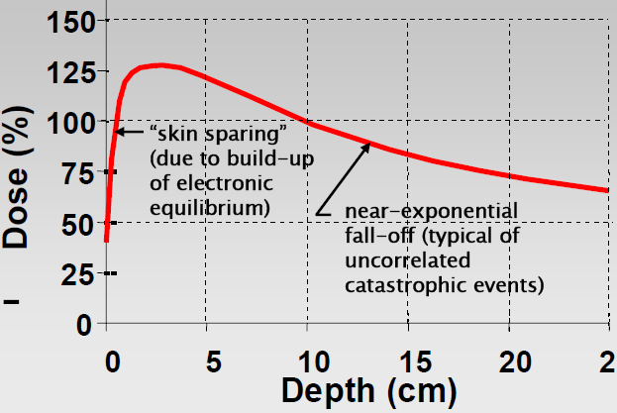
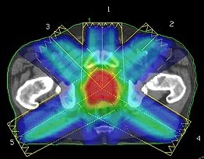
Photons/X-rays dose deposition
Depth-dose curve – single beam
RT dose plan – multiple beams beam
Multiple Beams:
Reduced dose to organs at risk
  Fewer complications
Increased tumour dose
  Higher probability of tumour control
However:
  Large volumes of low-intermediate dose

Slide 6
History of Proton Therapy
1946: Therapy proposed - Robert R. Wilson, Harvard Physics
1955: 1st Proton Therapy - Lawrence Tobias University of California, Berkeley
1955-73: Single dose irradiation of benign CNS lesions - Uppsala, MGH, St Petersburg, Moscow

Slide 7
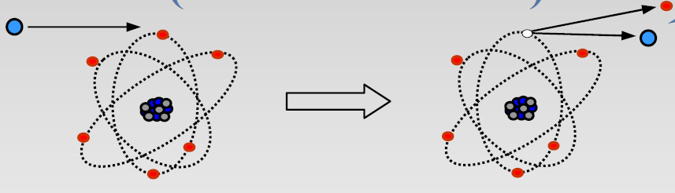
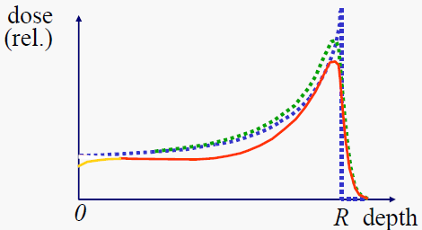
The Bragg Peak
Components of the proton depth dose curve:
  Bethe-Bloch formula
    Coulomb interactions with atomic electrons
  Scattering, energy spread and interactions with atomic nuclei
Dose
Depth
Illustrations from M. Goitein “Radiation Oncology: A Physicist’s-Eye View” © Springer, 2007

Slide 8
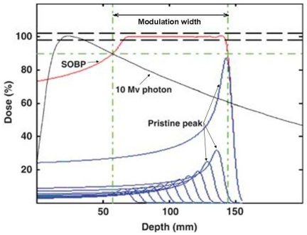
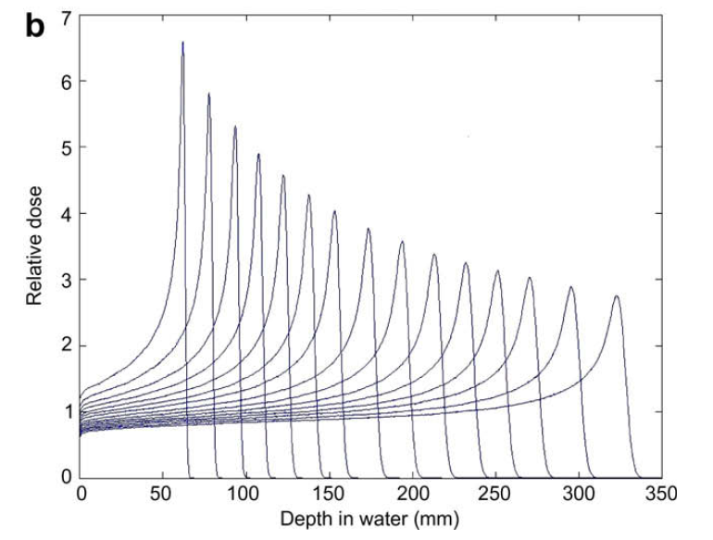
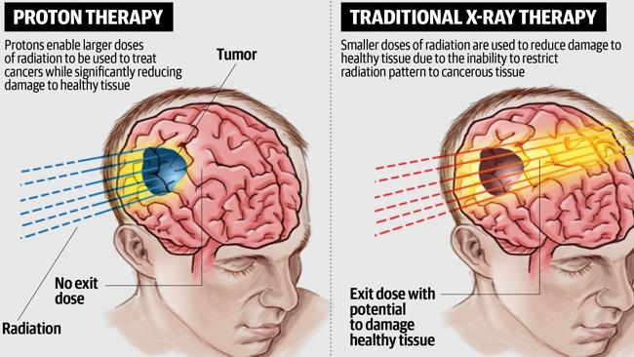
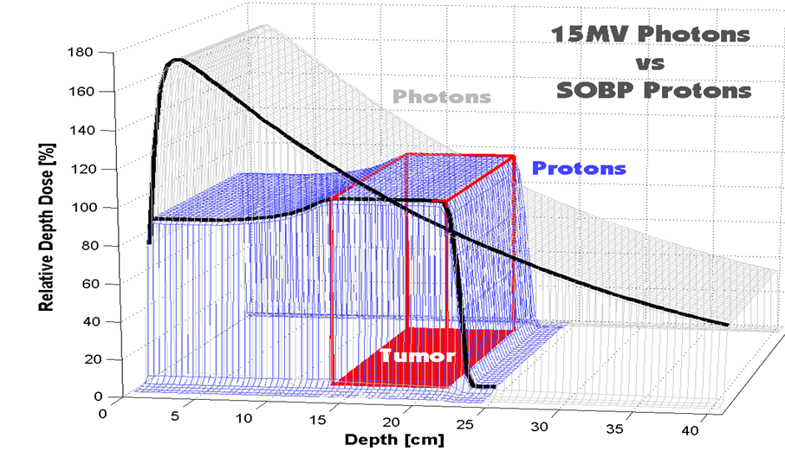
Proton dose deposition
Incident energy is modulated to form Spread Out Bragg Peak the cover the tumour
Unnecessary dose
Unnecessary dose
The Daily Telegraph Australia

Slide 9
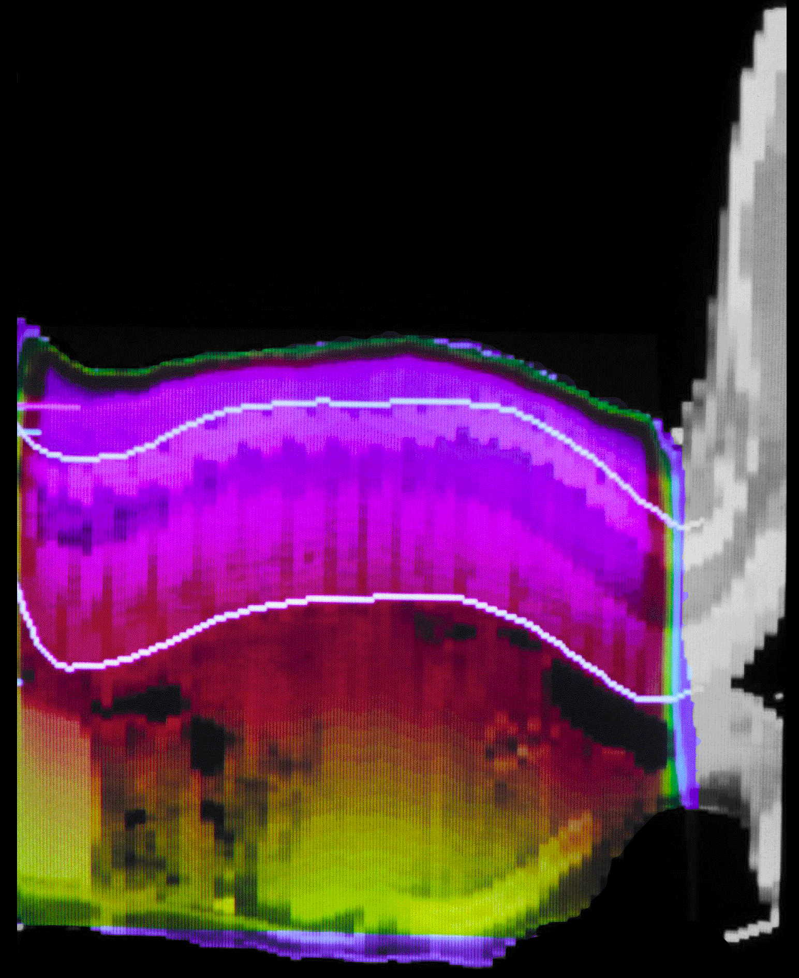
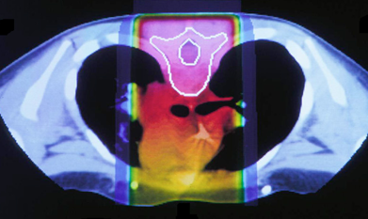
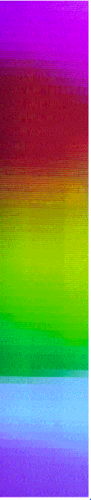
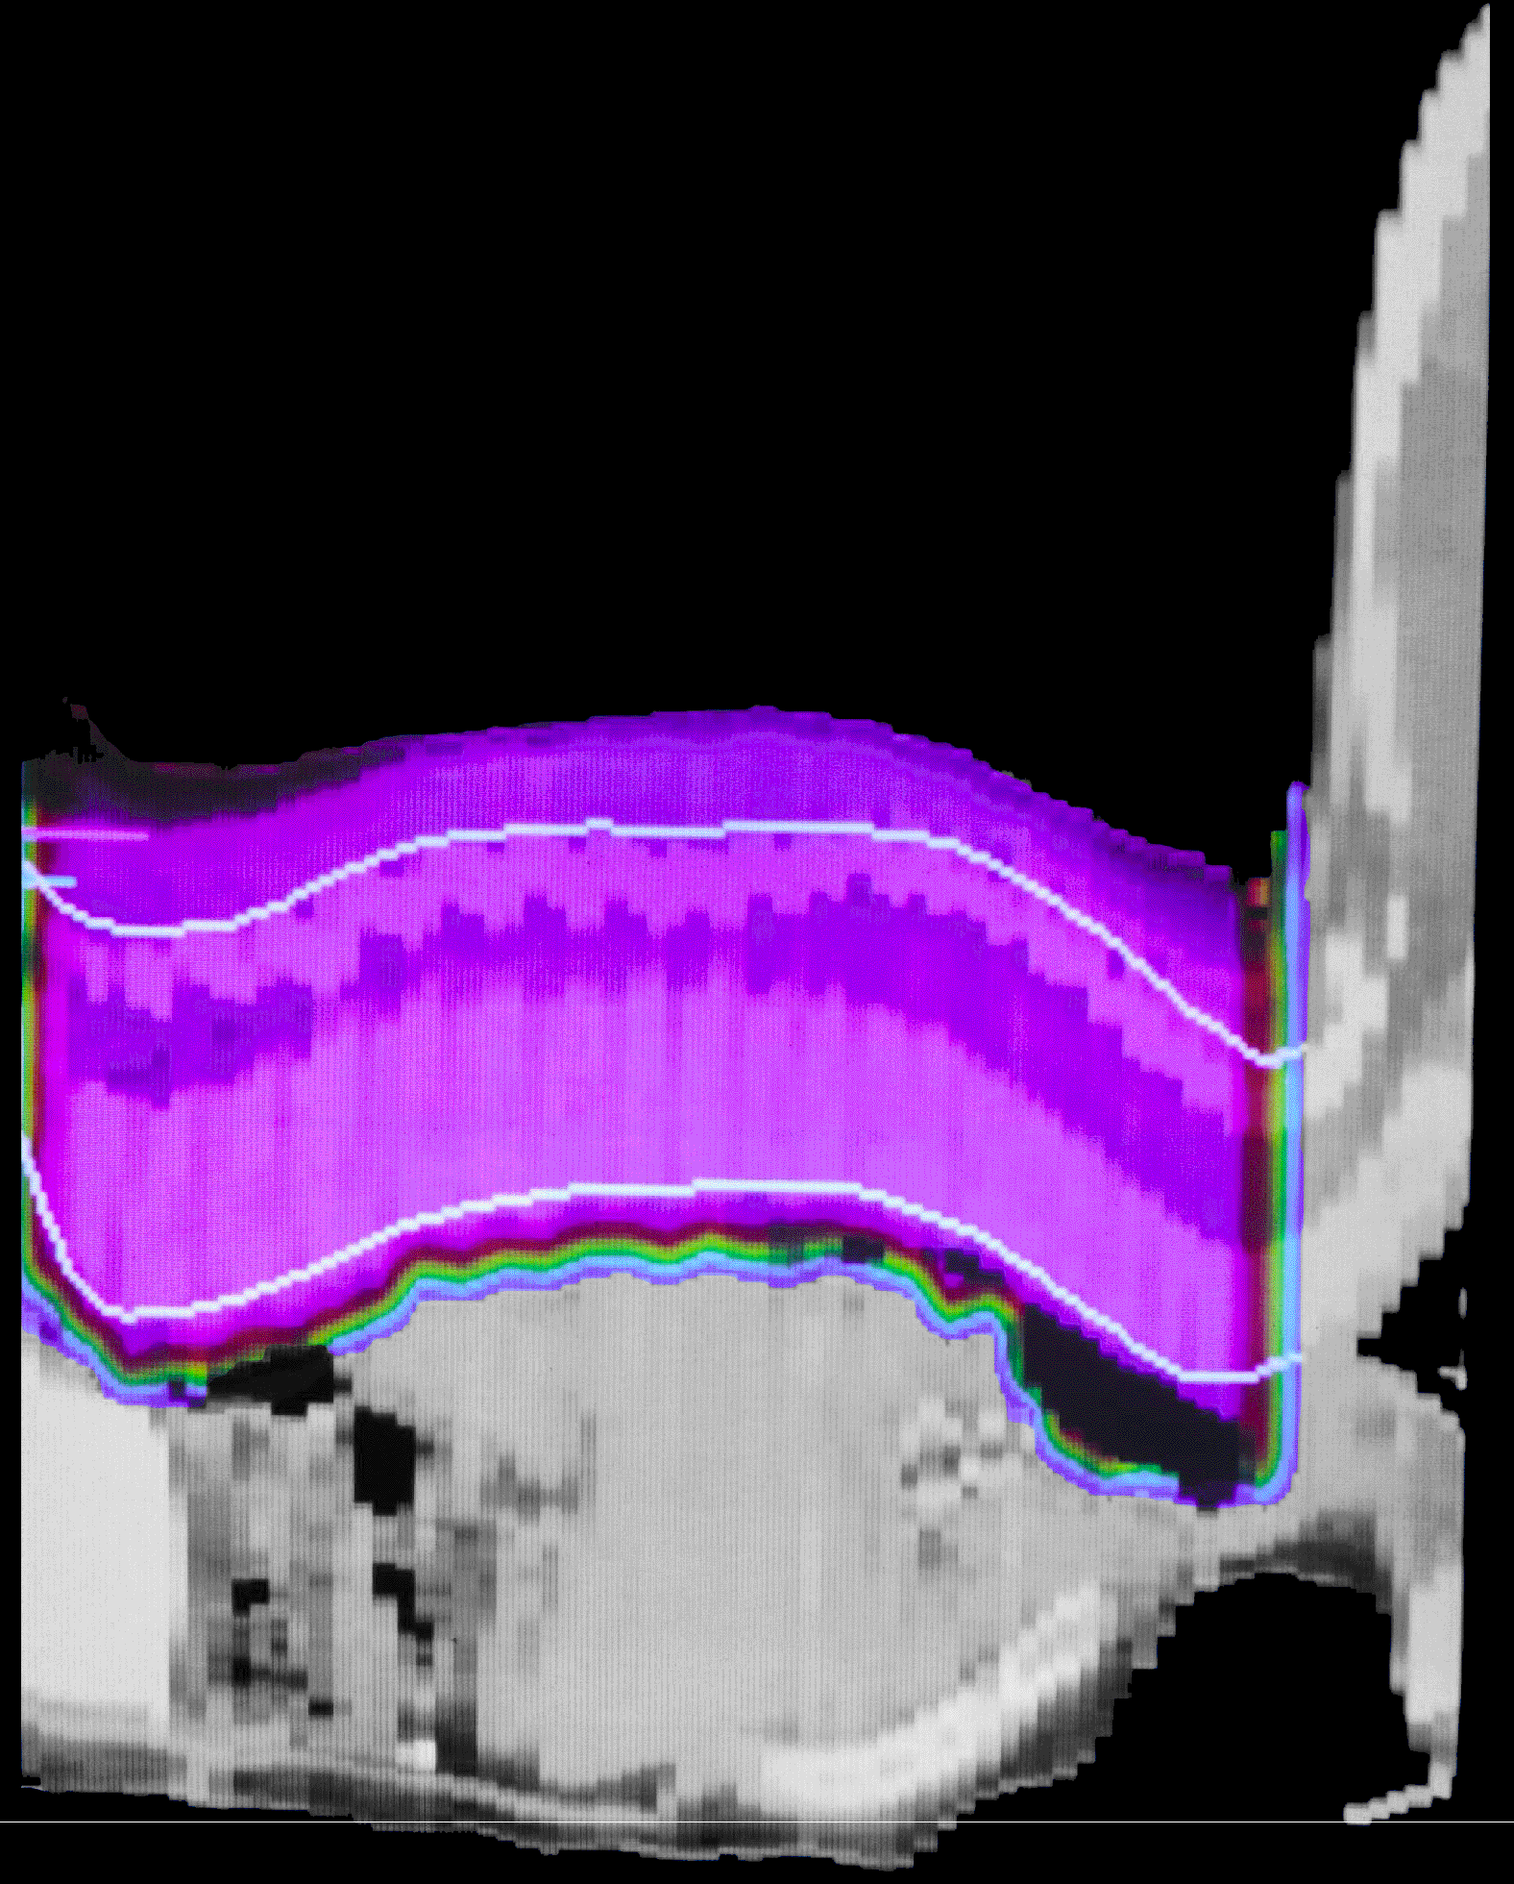
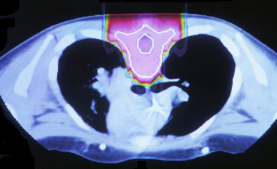
Medulloblastoma in a Child
X-rays
100
60
10
With X-rays
With Protons

Slide 10
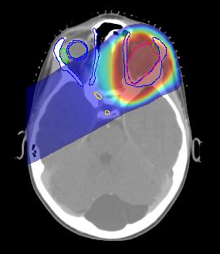

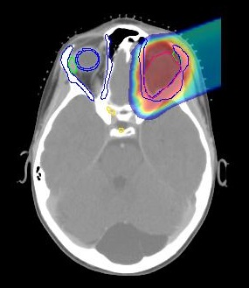
Orbital Rhabdomyosarcoma
X-Rays
Protons/Ions
Courtesy T. Yock, N. Tarbell, J. Adams

Slide 11
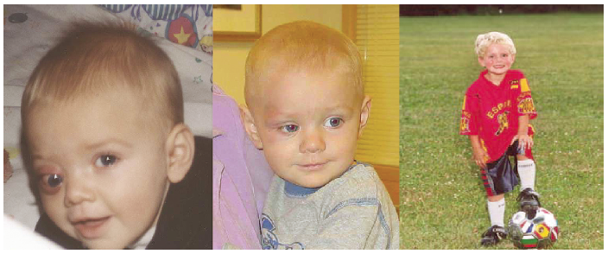
Proton Therapy in Action
Anaplastic Ependymoma Brain Tumour http://news.bbc.co.uk:80/1/hi/england/7784003.stm http://news.bbc.co.uk/1/hi/england/7795909.stm http://news.bbc.co.uk/1/hi/england/7906084.stm
Pre-treatment
During-treatment
Post-treatment
CPC, Friedmann, NEJM, 350:494, 2004
Slide courtesy of Prof. Gillies McKenna

Slide 12
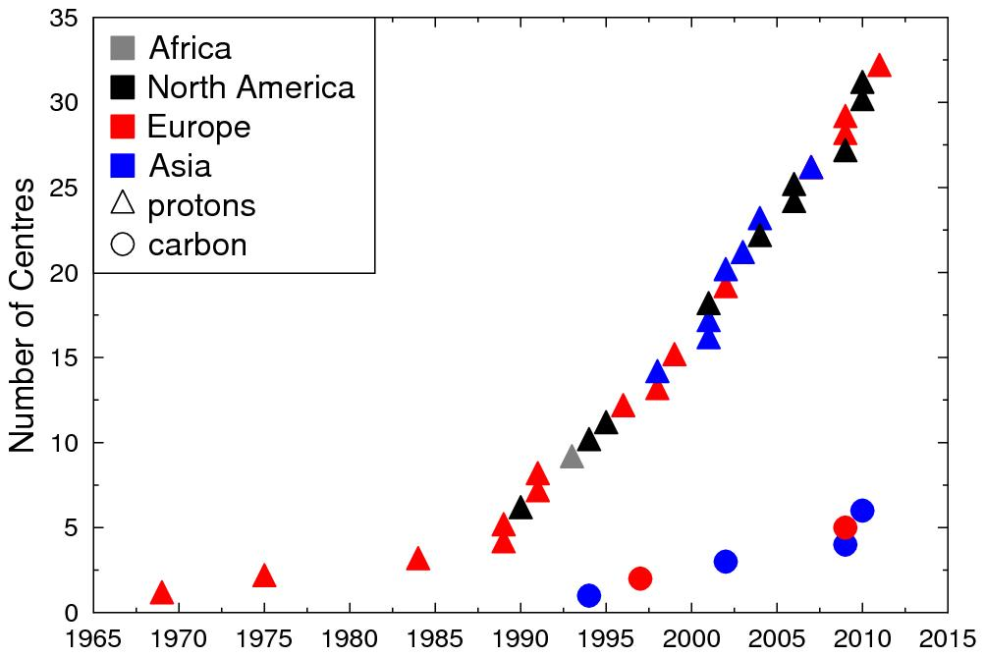
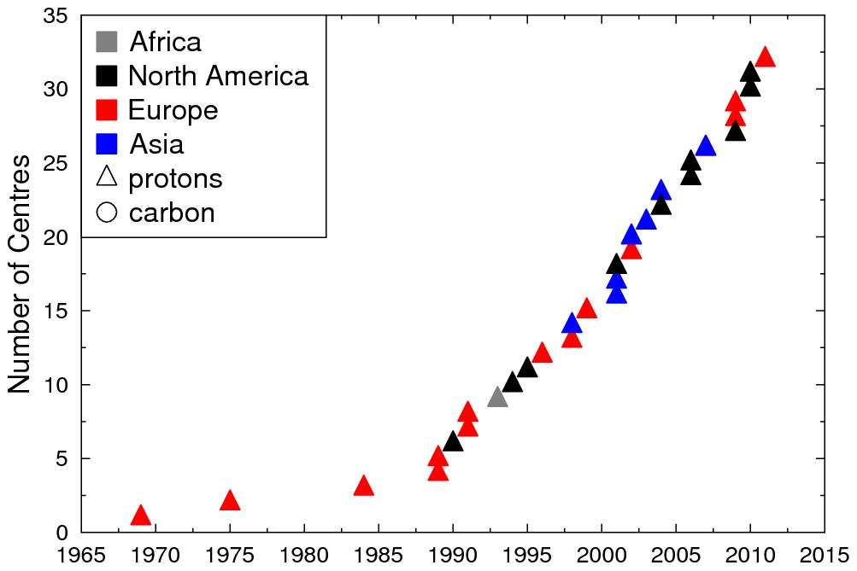
Number of treatment centres worldwide
Protons:
40 operational,
~ 40 in development
> 93,000 patients
carbon:
8 operational,
4 in development
> 10,000 patients

Slide 13
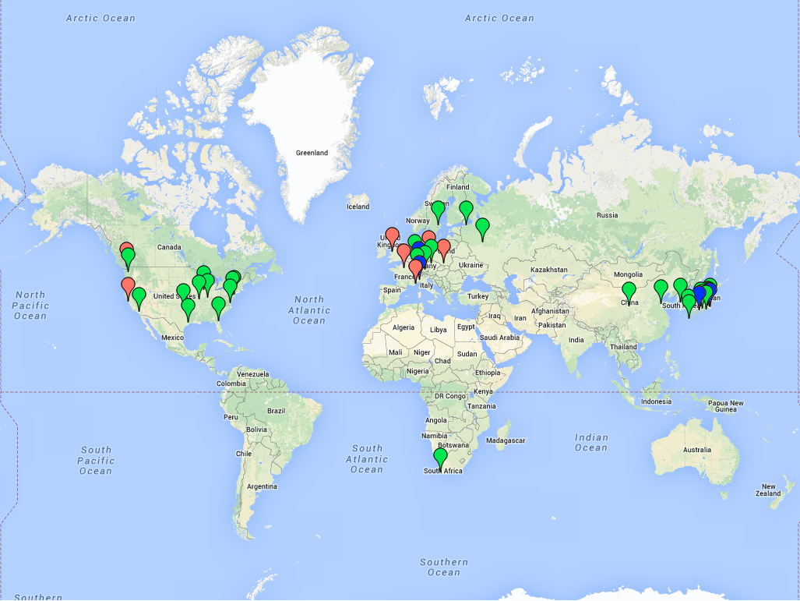
Proton Therapy Centre World Map
Protons - low energy
Protons – high energy
Carbons
Notes:
Philadelphia

Slide 14
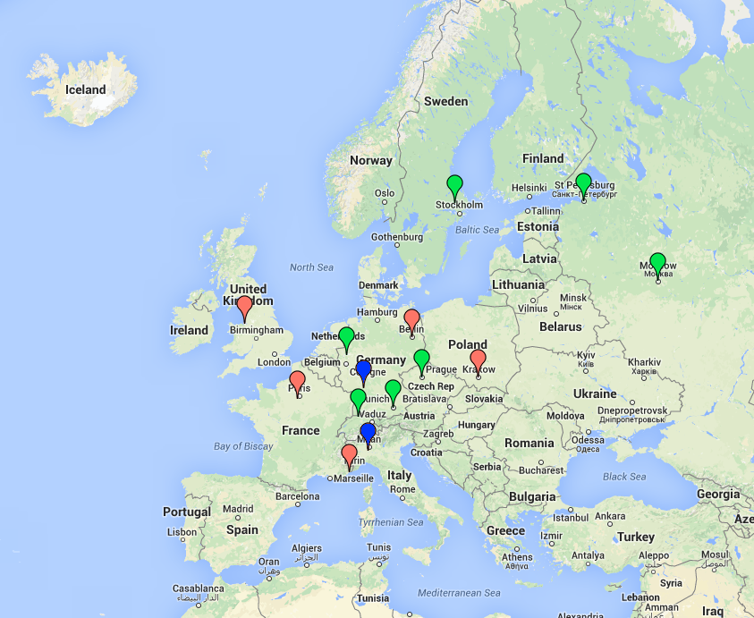
Proton Therapy Centre Europe Map
Protons - low energy
Protons – high energy
Carbons

Slide 15
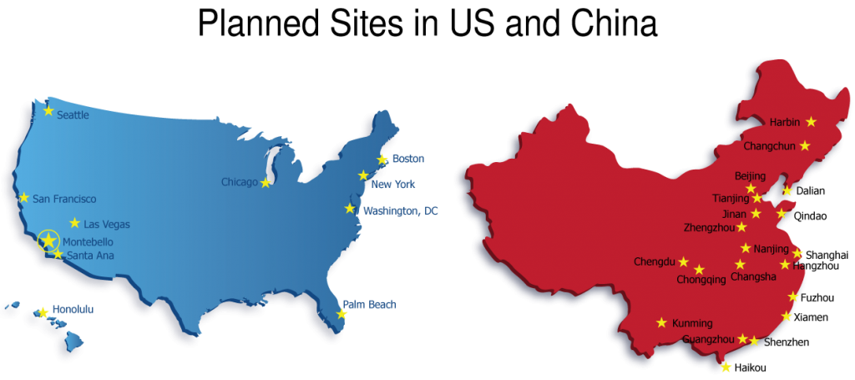
Many more in the planning stages….

Slide 16
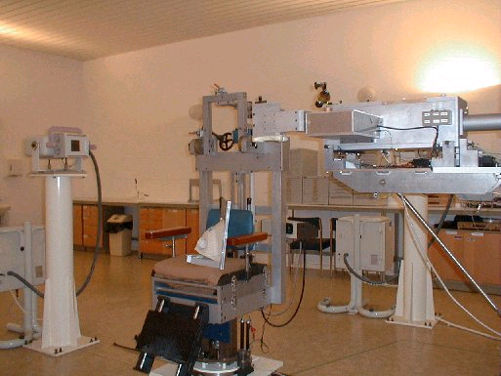
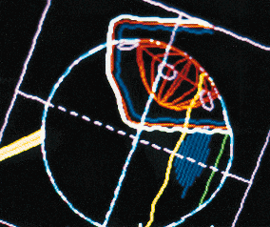
Proton Therapy in UK
Clatterbridge
  1989: First hospital based proton therapy at Clatterbridge, near Liverpool
  ~2500 patients with ocular melanoma; local control ~97%.
  Targets the cancer
  Avoids key parts of eye (optic nerve, macula, lens)
Simon to talk about UCLH and Manchester….

Slide 17
Production and Delivery of Medical Proton Beams

Slide 18
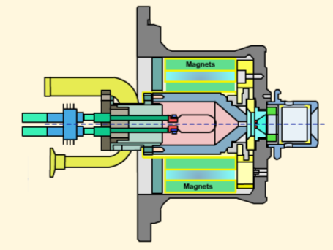
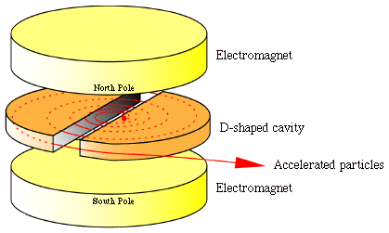
Beam Production and Acceleration
Ion source
  Plasma accelerated in electric field
Acceleration
  Cyclotron
    Fixed magnetic field
    Fixed energy
    Constant frequency
  Synchrotron
    Fixed radius
    Variable magnetic field
    Synchronous frequency
  Future accelerators that do the job better?
HIT, Germany
Notes:
Hydrogen gas
Plasma created via interaction with electrons form cathode

Slide 19
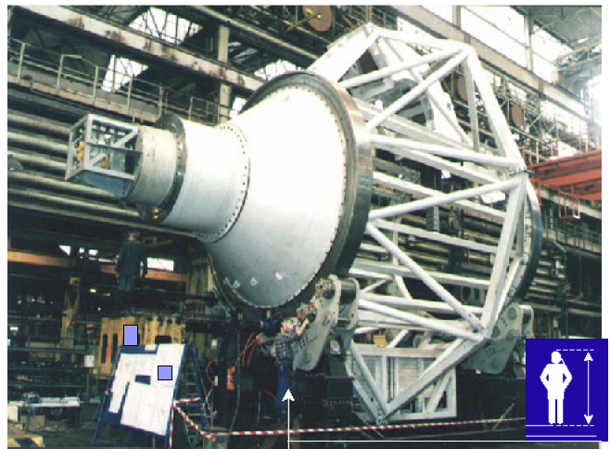
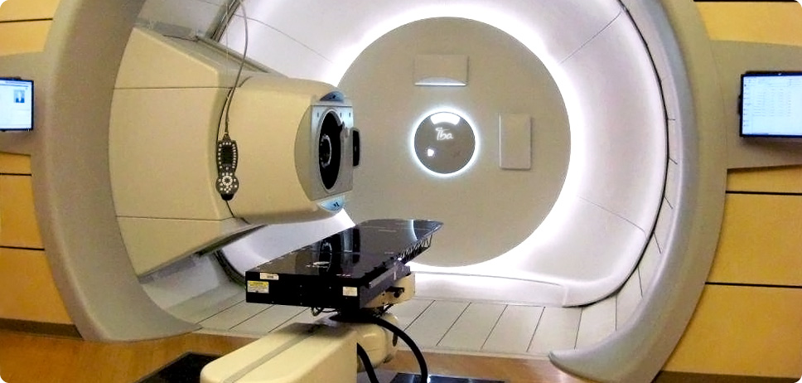
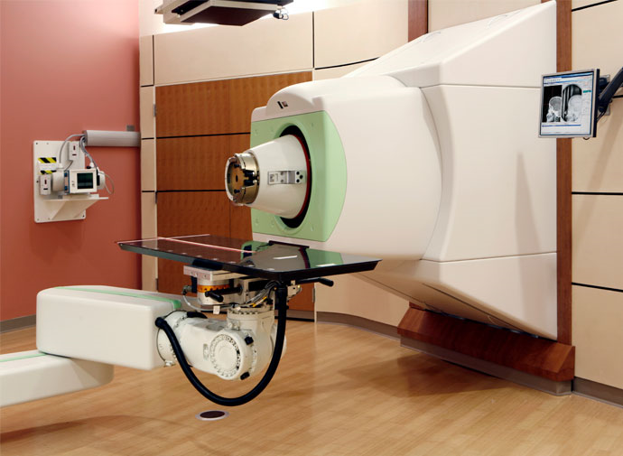
Beam Transport
Gantries
Fixed Beams
Clinical Indications
Flexibility
Space
Cost

Slide 20
Beam Delivery - Scattering
Courtesy of T. Lomax, PSI, Switzerland.

Slide 21
Beam Delivery - Scanning
  Exploiting depth control
  Exploiting charge
Beam direction
Target
Patient
Beam direction
Target
Patient

Slide 22
Some challenges in Proton Therapy
Acceleration and Beam transport:
  Faster spot scanning
  More compact accelerators and gantries
  Beam switching and splitting
Uncertainty in planned vs. delivered dose:
  Range uncertainties
  Relative biological effectiveness
Treatment delivery
  Organ motion
  Hypo-fractionation
Which clinical indications?
  Cost-effectiveness
  Ethics
Lack of data and models to predict late effects e.g. second cancers

Slide 23
Some possible solutions
Accelerator development
Radiobiological modelling and experiments
Advanced treatment planning and delivery techniques
  Novel, high resolution, minimally damaging imaging
  Dose validation/online dosimetry
Consistent data recording and data sharing
Clinical studies with long-term follow-up

Slide 24
University of Oxford’s hope for Protons

Slide 25
Targeted cancer treatment pathway
Early Stage Cancer Patient
Population Health Science
Structural
Genomics
Consortium
Molecular Stratification
Big Data
Institute
Target Discovery Institute
Experimental Cancer Medicine Centre
Precision Cancer
Medicine Institute
Oxford Cancer Imaging Centre
Increased Cures
Courtesy of Gillies McKenna

Slide 26
Precision Cancer Medicine
Physically Targeted
  Robotic Surgery
  Proton Therapy
  HIFU
Physiologically Targeted
  Molecular Imaging
Molecularly Targeted
  Deep Genomic Sequencing
  Biomarker Driven
  Biologically targeted
Courtesy of Gillies McKenna

Slide 27
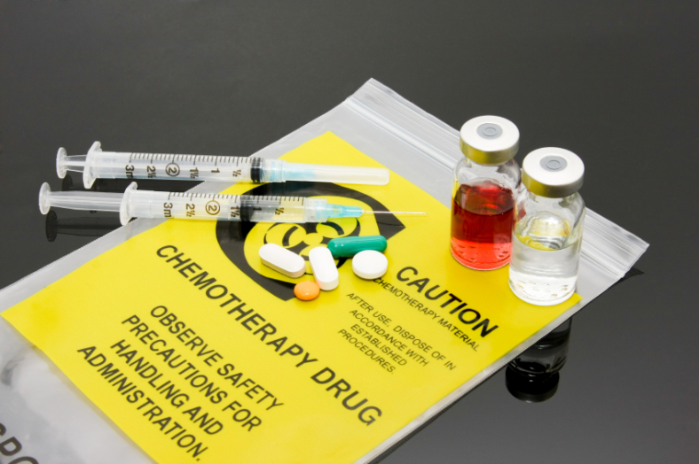
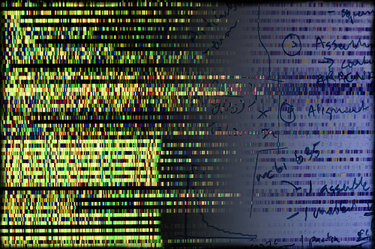
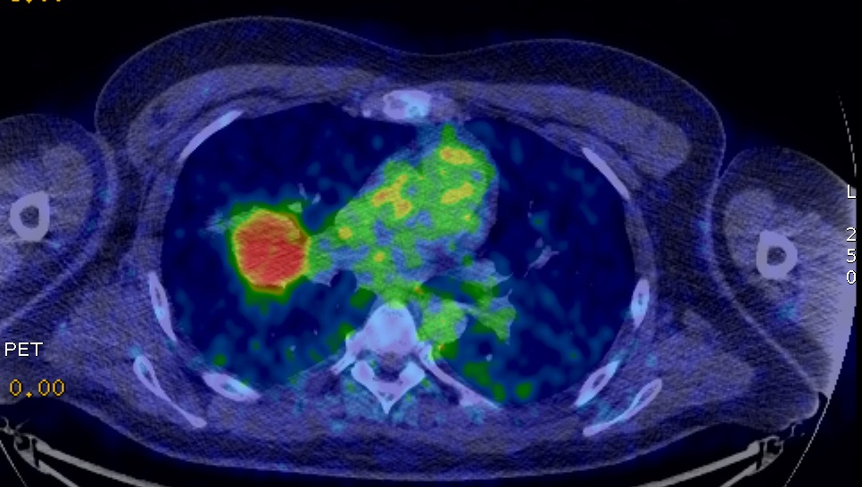
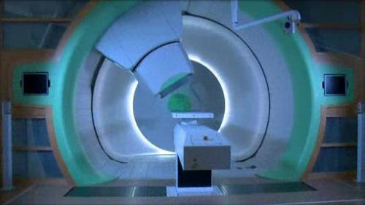
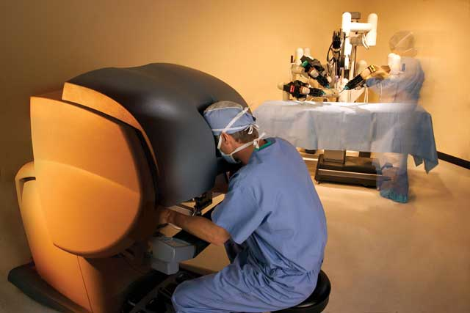
Oxford Precision Medicine Institute
Functional and Molecular Imaging
Genomics
Targeted
Agents
Particle Therapy
Robotic Surgery
Courtesy of Gillies McKenna

Slide 28
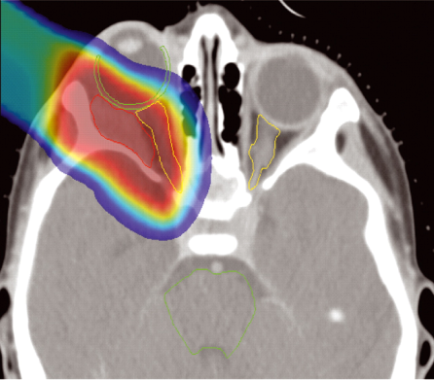
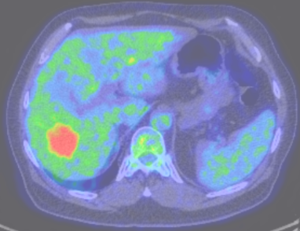
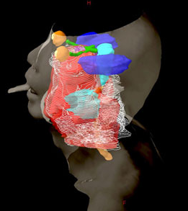
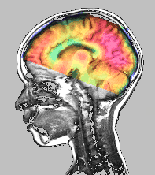





The Evolution of Cancer Therapy
Increased Effectiveness, Reduced Toxicity
Molecular Imaging
CT, MRI,
PET
Proton
Therapy
(CF₃)₁₈₀
Nanotechnology
1980 1990 2000 2010 2020
Robotics
Targeted
Agents
HIFU
Genomics
Courtesy of Gillies McKenna

Slide 29
Thank you….
            ……….any questions?

Slide 30
Extra Slides

Slide 31


Induction and cell kill
What is the form of the induction function? Linear, quadratic?
Induction
Cell killing
Form of cell killing function known with some certainty at clinical energies, the parameters are tissue dependent and can have large uncertainties.
Probability of transforming a cell
Probability the cell survives
Risk needs to be
  accurately modelled
  confirmed experimentally
  taken into account when deciding on the optimal treatment plan
Probability of inducing a potentially malignant mutation

Slide 32
Second cancer risk
IMRT
IMPT

Slide 33
Second cancer risk
IMRT
IMPT

Slide 34






Multiscale, voxelised TCP calculation for GBM
Cell Level
Voxel Level
Patient Level
Dose matrix
Radiobiological parameters e.g. α,β
Cellularity
Pre-treatment clonogenic cell density (CCD)
Tumour recurrence time
Clinical Data
Cell automaton model
Genetic heterogeneity: Stem vs. non-stem
Treatment plan DICOM files
Structure matrix
Tumour microenvironment: P0₂
Post treatment CCD
Predicted TCP
Number of fractions

Slide 35
Relative Biological Effectiveness
Photons and protons (at clinical energies) have similar biological effects
  Clinically a modifier (RBE) of 1.1 is applied to physical dose for protons
For heavier ions (e.g. C) RBE has large uncertainties
RBE needed* to calculate physical dose to administer to achieve prescribed biological dose
*maybe there is a better way?
New treatment regimes requiring new methods of optimisation?

Slide 36

RBE vs. Dose for Protons
Where does the 1.1 come from?
Paganetti et al.: Int. J. Radiat. Oncol. Biol. Phys. 2002; 53, 407

