Slide 1
Periodic Flow Hydrodynamic Resistance Parameters for ErPr Rare-Earth Regenerator Material at Cryogenic Temperatures
M.D. Perrella, S.M. Ghiaasiaan

Slide 2
Outline
Introduction
Past Work
Experimental Setup
  Cryogenic test chamber
  ErPr Regenerator test section
  Mass Flow Measurement
CFD Modeling Approach
Preliminary Results
Future Work

Slide 3
Introduction
The regenerator is a crucial component of pulse tube cryocoolers
Hydrodynamics and thermal transport within the regenerator are not fully understood
Hydrodynamic parameters determined at ambient temperature are assumed to be valid at cryogenic temps
Pressing need exists to determine hydrodynamic parameters at cryogenic temperatures and verify foregoing assumption

Slide 4
Previous Work at GT Cryolab
Mihir Pathak (2014)
Measurement and correlation of hydrodynamic resistance parameters for ErPr rare-Earth regenerator filler material under steady and oscillatory flow conditions in room temperature
Steady flow porous media hydrodynamic resistance parameters were different from their oscillatory flow counterparts
The objective in this study is to perform similar tests at cryogenic temperatures

Slide 5
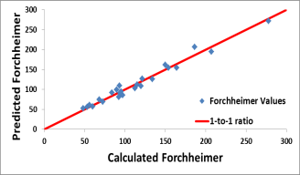
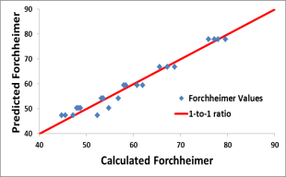
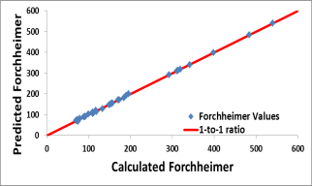


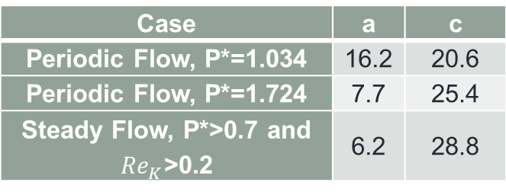
Room Temperature Correlations
$K=1.93×{10}^{−11}$m²
$$c_{f}=a{{∙Re}_{K}}^{b}+c$$
b = -1.4
Case | a | c
Periodic Flow, P*=1.034 | 16.2 | 20.6
Periodic Flow, P*=1.724 | 7.7 | 25.4
Steady Flow, P*>0.7 and ${Re}_{K}$>0.2 | 6.2 | 28.8
P* | a | b | c
0.345 | 91.9 | -0.52 | -119.4
0.517 | 0.4 | -2.05 | 98.1
0.689 | 3.4 | -1.38 | 56.4
0.862 | 4.7 | -1.32 | 45.8
1.034 | 5.5 | -1.26 | 43.4
1.379 | 3.1 | -1.53 | 50.8
1.724 | 2.2 | -1.71 | 63.4

Slide 6
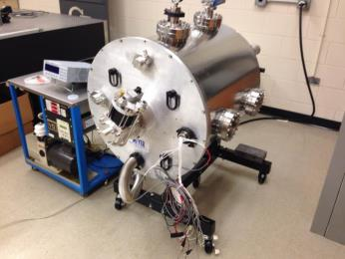
Cryogenic test chamber
Vacuum-sealed dewar with modular feedthroughs
Insulating vacuum of 1E-6 torr
Sumitiomo GM Cryocooler with 32K 1st stage and 6K 2nd stage cold heads

Slide 7
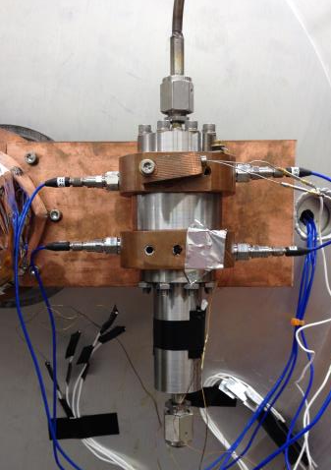
Regenerator Test Section
SS transfer tube to Pressure Wave Generator (PWG)
PCB 102A10 and 102A05 pressure sensors
Copper heat exchanger (CHX)
Regenerator
Thermal Bus Bar
50cc Surge Volume (SV)
Cryocon S900-A silicon temperature diode

Slide 8
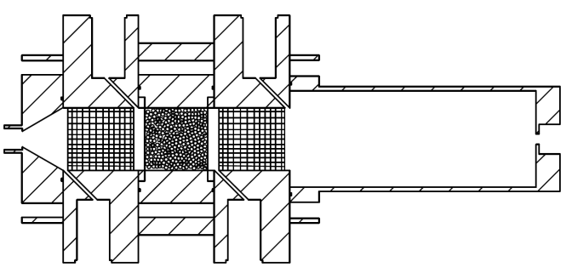


Regenerator Test Section cont.
#100 copper mesh
ErPr powder (55 μm diameter)
#60 SS and #400 SS mesh retaining wall
$$P_{d}, Φ_{P}$$
$${\dot{m}}_{d}, T$$

Slide 9


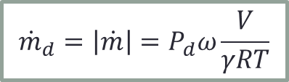
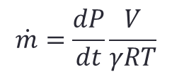


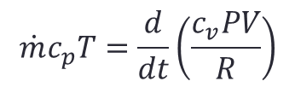
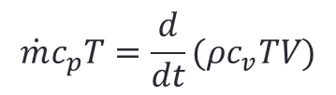

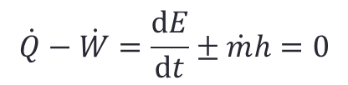

Mass Flow Measurement
$$\dot{Q}−\dot{W}=\frac{dE}{dt}±\dot{m}h=0$$
$$\dot{m}c_{p}T=\frac{d}{dt}(ρc_{v}TV)$$
$$\dot{m}$$
$$Pv=RT$$
$$\dot{m}c_{p}T=\frac{d}{dt}\left(\frac{c_{v}PV}{R}\right)$$
$$\dot{m}=\frac{V}{γRT}\frac{dP}{dt}$$
Hot-wire anemometry is not feasible at cryogenic temperatures
Indirect $\left|\dot{m}\right|$ measurement taken from instantaneous SV temperature and pressure
$$\dot{m}=\frac{dP}{dt}\frac{V}{γRT}$$
$${\dot{m}}_{d}=\left|\dot{m}\right|=P_{d}ω\frac{V}{γRT}$$
$$P\left(t\right)=P_{d}sin⁡(ωt+φ_{P})$$
$$\dot{m}\left(t\right)={\dot{m}}_{d}sin⁡(ωt+φ_{m})$$

Slide 10
Compressor Performance

Slide 11
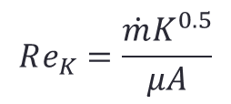
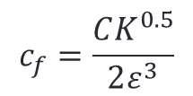
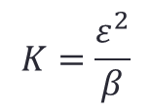
Porous Media Equations
Mass
Momentum
Permeability
Forchheimer
Pore-based Reynolds
$$K=\frac{ε^{2}}{β}$$
$$c_{f}=\frac{CK^{0.5}}{2ε^{3}}$$
$$Re_{K}=\frac{\dot{m}K^{0.5}}{μA}$$
Energy

Slide 12
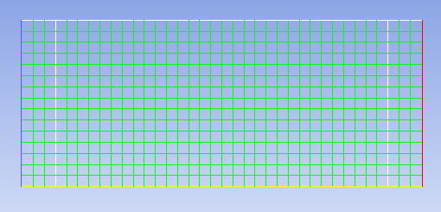
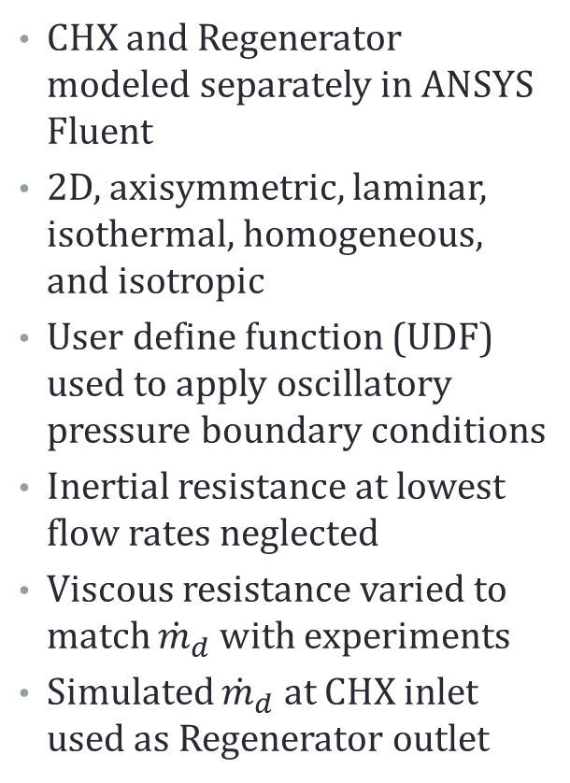
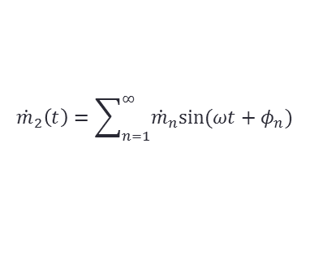
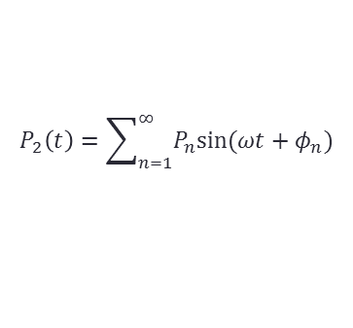
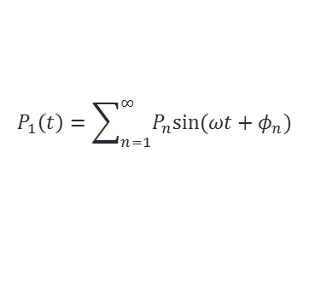
CFD Modeling
CHX and Regenerator modeled separately in ANSYS Fluent
2D, axisymmetric, laminar, isothermal, homogeneous, and isotropic
User define function (UDF) used to apply oscillatory pressure boundary conditions
Inertial resistance at lowest flow rates neglected
Viscous resistance varied to match ${\dot{m}}_{d}$ with experiments
Simulated ${\dot{m}}_{d}$ at CHX inlet used as Regenerator outlet
Porous Jump
$$P_{2}\left(t\right)=\sum_{n=1}^{∞}{P_{n}sin⁡(ωt+φ_{n})}$$
$$P_{1}\left(t\right)=\sum_{n=1}^{∞}{P_{n}sin⁡(ωt+φ_{n})}$$
$${\dot{m}}_{2}\left(t\right)=\sum_{n=1}^{∞}{{\dot{m}}_{n}sin⁡(ωt+φ_{n})}$$

Slide 13
Pressure and Mass Flow Rates

Slide 14
CHX Permeability

Slide 15
Regenerator Permeability

Slide 16
Future Work
Complete CFD analysis of CHX an Regenerator at 90K (Experiments completed)
Using high-flow data points determine inertial resistance for CHX and Regenerator at higher mass flow rates
Perform additional experiments and analysis to ascertain repeatability and correctness, and at other operating temperatures

