Slide 1

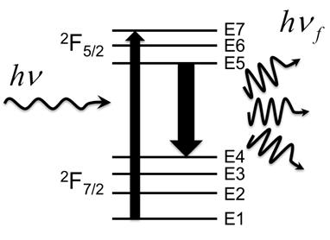
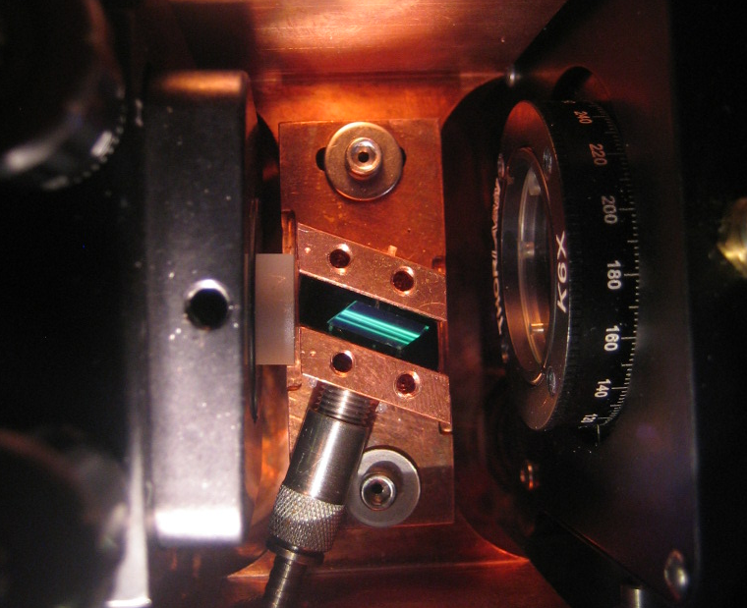
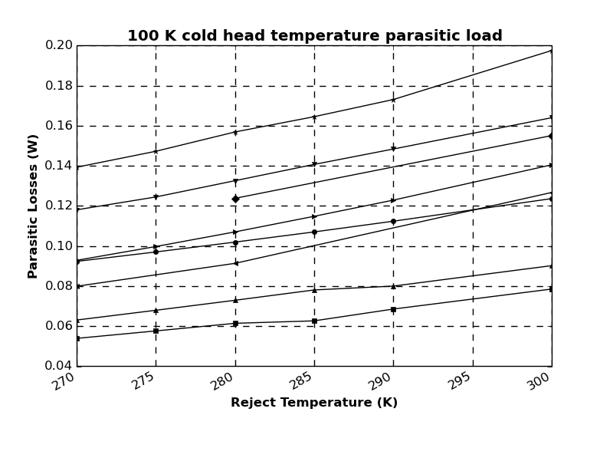
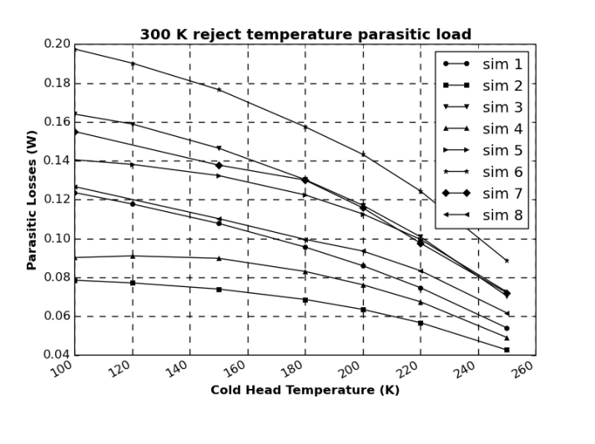
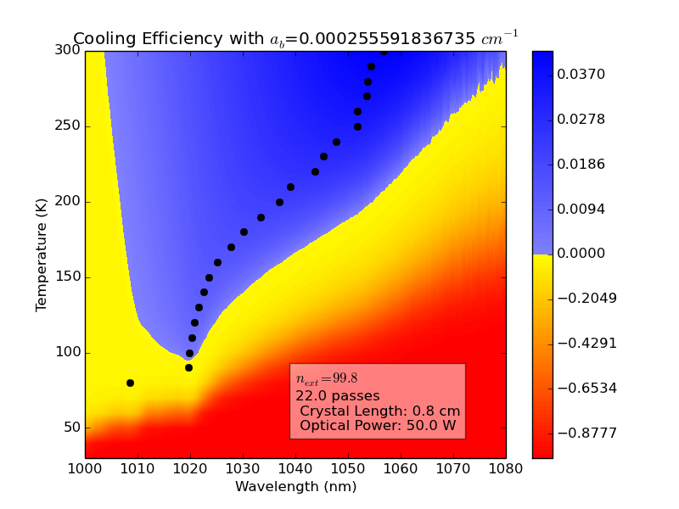
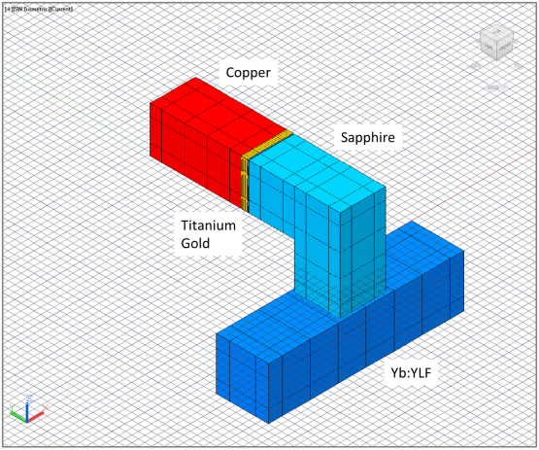

Modeling thermal parasitic load lines for an optical refrigerator
UNCLASSIFIED
K. W. Martin, J. Shomacker, T. Fraser and C. Dodson AFRL Space Vehicles Directorate Kirtland, AFB, NM
Abstract
Optical refrigeration is currently the only completely solid state cooling method capable of reaching cryogenic temperatures from room temperature. Optical cooling utilizing Yb:YLF as the refrigerant crystal has resulted in temperatures lower than 123K measured via a fluorescence thermometry technique. However, to be useful as a refrigerator this cooling crystal must be attached to a sensor or other payload. The phenomenology behind laser cooling, known as anti-Stokes fluorescence, has a relatively low efficiency which makes the system level optimization and limitation of parasitic losses imperative. We propose and model a variety of potential designs for a final optical refrigerator, enclosure and thermal link; calculate conductive and radiative losses, and estimate direct fluorescence reabsorption. We generate parasitic load-lines; these curves define temperature-dependent minimum heat lift thresholds that must be achieved to generate cooling for an eventual detector.
Optical Refrigeration
How it works: Absorption of laser light
promotes an electron from the
ground state to the excited
state manifold. The atom thermalizes,
spontaneously emits at a
frequency $ν_{f}> ν$. The atom
thermalizes to the E4 energy level and repeats.
Cooling efficiency of an optical refrigerator crystal (not system efficiency):
$$_{cool}=η_{ext}\left[\frac{1}{1+{α_{b}}/{α\left(λ,T\right)}}\right]\frac{λ}{λ_{f}\left(T\right)}−1$$
Simulation | Support | Link Geometry | Enclosure Geometry
1 | Aerogel | L-link | Tight
2 | Kevlar | L-link | Tight
3 | Aerogel | Tetris-link | Tight
4 | Kevlar | Tetris-link | Tight
5 | Kevlar | Tetris-link | Acktar Cube
6 | Aerogel | Tetris-link | Acktar Cube
7 | Aerogel | L-link | Acktar Cube
8 | Kevlar | L-link | Acktar Cube
Results
Optical refrigerator experiment at the University of New Mexico
Melgaard, S.D., Albrect, A., Hehlan M. P. ,Seletskiy, D.V., and M., Sheik-Bahae, M., Optical refrigeration cools below 100 K. IEEE Lasers and Electro-Optics CLEO (2014)
Minimum Achievable Temperature (MAT) map
Fluorescence (heat)
Conclusions
Kevlar Cat’s cradle suspension best minimizes conductive losses.
An Aerogel support could not be completely eliminated
The “L” link supported with a Kevlar cat’s cradle system in a tight enclosure best minimized the radiative and conductive losses.
A reduction of reject temperature from 300K to 271 K at 93 K cold tip temperature accounts for additional losses of between 25 and 60 mW. This could help UNM estimate their parasitic losses.
A prototype design with a simple “L” link with Kevlar support and larger, properly heat sunk enclosure could be built with relatively low losses and should be the first step towards a fully functioning all solid-state optical refrigerator.
laser
COLD
Our Model
Two Link geometries studies: Tetris and “L”
Two enclosure types (each coated with Acktar Nano-Black): tight and box of 40 mm on a side
Two suspension systems: Aerogel and Kevlar
“L” link detailing the materials used for the thermal link in the simulation
Tetris link with Kevlar suspension in a tight enclosure
All portions of this poster are UNCLASSIFIED
DISTRIBUTION A. Approved for public release: distribution unlimited.
Notes:
Please contact Michele Sager (6-1897) with any format questions

