Slide 1
LIU-PSB Configuration Management
EDMS Documentation, Layout and ECRs
Thomas Birtwistle EN-MEF-DC

Slide 2
Content
Documentation Changes (EDMS)
Handling Documentation
Hardware Baseline
Layout Database
Engineering Change Requests (ECRs)

Slide 3
Content
Documentation Changes (EDMS)
Handling Documentation
Hardware Baseline
Layout Database
Engineering Change Requests (ECRs)

Slide 4
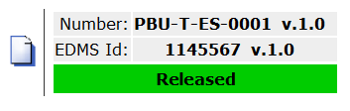
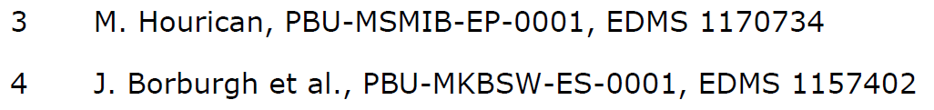
Documentation Changes (EDMS)
All document references will now use PSB, as these documents will be relevant to the machine in the future.
  Example: PSB-T-ES-0001
  Existing files have dual references (PBU and PSB) to match existing file references, and for accurate EDMS searches.
EDMS ‘release procedures’ reviewed and modified to match standard procedures for existing hardware baselines…

Slide 5
Content
Documentation Changes (EDMS)
Handling Documentation
Hardware Baseline
Layout Database
Engineering Change Requests (ECRs)

Slide 6
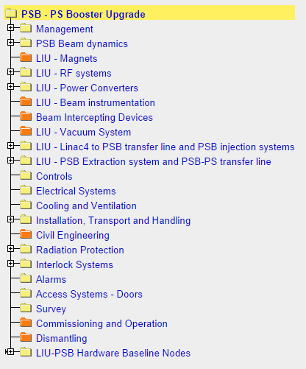

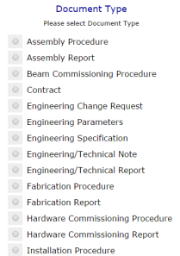
Handling Documentation (1/3)
As agreed with Bettina for this pilot project (PSB), Gian Piero Di Giovanni is the main point of contact for assistance with EDMS documentation.
  He can handle documents on your behalf… OR…
  Create a document in the appropriate EDMS node of the LIU-PSB Project
Select the correct document type from the list

Slide 7
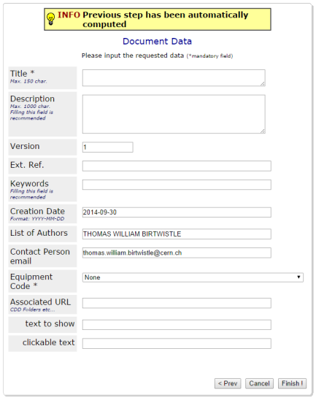

Handling Documentation (2/3)
The first version should always be 0.1 (not the default value!)
Future draft versions: 0.2, 0.3, 0.4 etc.
First released version: 1.0
See A&T Seminar from P. Bonnal on 15th May 2014 – Indico 317617
0.1
Select an appropriate equipment code.
  If a suitable code doesn’t exist, cancel the registration and contact: Accelerators-naming.service@cern.ch
  All equipment codes are stored here
If you encounter any problems, please contact Gian-Piero or Thomas Birtwistle

Slide 8
Handling Documentation (3/3)
Access rights allow all project members to create documents.
Project members can put documents through an ‘engineering check’ process.
A decision is made as to whether a document is long term or not by Project Management.
  All long term documents (e.g. engineering specifications, reports etc.) must undergo a formal approval (‘under approval’) before ‘release’. The approval process is handled by a restricted group.
  First point of contact is Gian-Piero for this pilot project, then Configuration Management (EN-MEF-DC), or Cecile Noels.

Slide 9
Content
Documentation Changes (EDMS)
Handling Documentation
Hardware Baseline
Layout Database
Engineering Change Requests (ECRs)

Slide 10
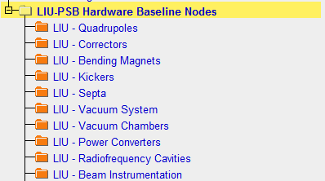
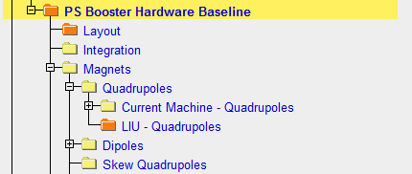
Hardware Baseline Organisation
Long term ‘archive’ for documentation relevant to a machine.
If an LIU document is considered ‘long term’ (i.e. it is still applicable after the project finishes), it will be stored in the appropriate LIU Hardware Baseline Node.
When the project is completed, and the machine is updated:
  All LIU documentation in the LIU nodes will be copied to the operational machine Hardware Baseline.
These nodes are the same

Slide 11
Content
Documentation Changes (EDMS)
Handling Documentation
Hardware Baseline
Layout Database
Engineering Change Requests (ECRs)

Slide 12
Layout Database (LIU-PSB)
The current machine and transfer lines are available in the layout database: https://www.cern.ch/layout/
A parallel study version for the future PSB and transfer lines (and also HL-LHC) is being developed (BE-CO), and will be available ~end November.
Data entry is planned to be completed ~end January 2015.
At the moment it is foreseen only to contain the main optics information in the future study version
More detailed information could be added as the project develops.
See next slide

Slide 13
Layout Database Versioning
Date
Current machine version
2GeV ‘upgraded’ machine version
2014
Post LS1
Situation after the upgrade
ECRs!
Changes
After Technical Stop
Project Changes
Optics
Changes
Design Changes
Changes
After Technical Stop
Changes
LS2
Upgrade Complete
Final change will come from only one side

Slide 14
Content
Documentation Changes (EDMS)
Handling Documentation
Hardware Baseline
Layout Database
Engineering Change Requests (ECRs)

Slide 15
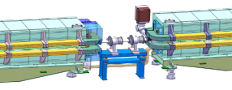

ECRs – Machine and Project
Important tool to ensure that all changes are captured and the impact properly assessed in advance
All changes to the machine (and project) that will impact the beam should be documented by ECRs
  Includes: powering, vacuum, re-naming…
Templates are available on MS Word, ‘New’, ‘My Templates’, PS Complex tab (LIU and operational machine templates)
Send to ecr-configuration@cern.ch

Slide 16
Large Changes (e.g. Injection Section)
One ECR detailing the overall layout changes and describing what will be changed and why.
It can reference existing documentation for the ‘sub-parts’
Integration study should be included and documented with a dedicated drawing.
Written by whoever is managing the specific change (or by someone mandated on their behalf) – they should collect the required information from the concerned equipment groups.
Circulated to the entire project team for review and comments collection (by ecr-configuration@cern.ch).
Approval by the project leader prior to release and implementation.

Slide 17
Conclusions
Pilot project for PSB, to ensure that information is captured and the machine correctly documented and represented. Part of the MEF-DC mandate.
The points presented here are in line with other upgrades (e.g. HL-LHC).
  Dividing hardware baselines (operational and upgrade nodes).
  Parallel layout database machine versions.
  ECR scope (operational machine and project)
Also in line with other operational machines.
  Configuration, layout and integration should remain consistent.

Slide 18
Thank you for your attention
Questions?

