Slide 1
LIU Configuration Management
EDMS Documentation, Layout and ECRs
This presentation follows the LIU-PSB specific presentation done on 9th October 2014
Thomas Birtwistle EN-MEF-DC

Slide 2
Content
Documentation in EDMS
Layout Database
Engineering Change Requests (ECRs)

Slide 3
Content
Documentation in EDMS
Layout Database
Engineering Change Requests (ECRs)

Slide 4
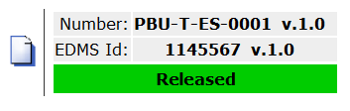
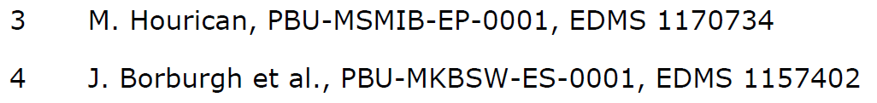
Documentation in EDMS
Pilot project in LIU-PSB for documentation handling.
In the past, project documents have used a specific code prefix like PBU, PSU, SPU. All references should use the machine code; PS, PSB, SPS, as project documents will be relevant to the machine in the future.
  Example: PSB-T-ES-0001
  Dual codes for existing files (PBU and PSB) to match file references, and for accurate EDMS searches.
EDMS ‘release procedures’ reviewed and modified to match standard procedures for existing hardware baselines…

Slide 5
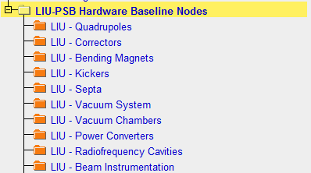
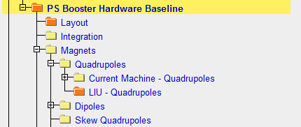
LIU-PSB Pilot Project Documentation
Project structures available with access rights for all project members (already in place).
Hardware baseline is a long term ‘archive’ for documentation relevant to a machine. It has been then split into current machine nodes and LIU nodes.
If an LIU document is considered ‘long term’ (i.e. it is still applicable after the project finishes), it will be stored in the appropriate LIU Hardware Baseline Node. For LIU-PSB we have a dedicated person from the management team for this.
These nodes are the same

Slide 6
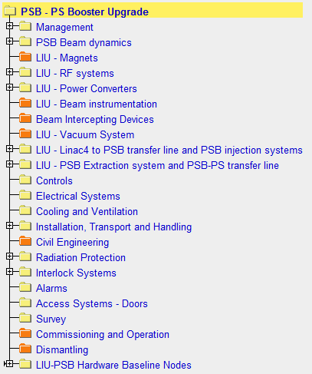

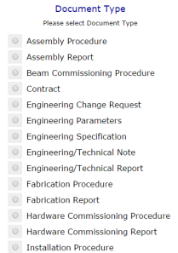
LIU-PSB Pilot Project Documentation
Each project member can create their own documents as normal:
  Create a document in the appropriate EDMS node of the LIU Project structure
Select the correct document type from the list

Slide 7
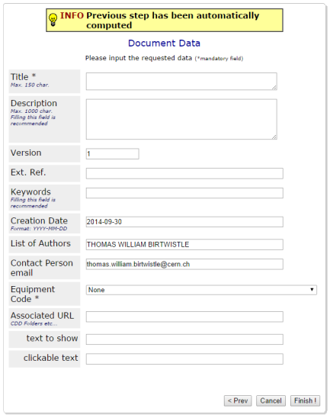
LIU-PSB Pilot Project Documentation
The first version should always be 0.1 (not the default value!)
Future draft versions: 0.2, 0.3, 0.4 etc.
First released version: 1.0
See A&T Seminar from P. Bonnal on 15th May 2014 – Indico 317617
0.1
Select an appropriate equipment code.
  If a suitable code doesn’t exist, cancel the registration and contact: Accelerators-naming.service@cern.ch
  All equipment codes are stored here

Slide 8
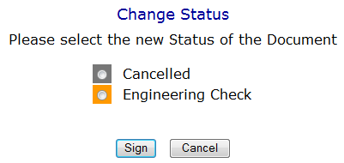
LIU-PSB Pilot Project Documentation
Each project member can create their own documents as normal:
  Create a document in the appropriate EDMS node of the LIU Project structure
  Project members can put documents through an ‘engineering check’ process
In order to add any comments into the document file, following the engineering check, a new version should be created, taking note of the versioning rules described previously…
Cancel the current version, then click ‘New Version’

Slide 9
LIU-PSB Pilot Project Documentation
Each project member can create their own documents as normal:
  Create a document in the appropriate EDMS node of the LIU Project structure
  Project members can put documents through an ‘engineering check’ process
  All long term documents (e.g. engineering specifications, reports etc.) must undergo a formal approval (‘under approval’) before ‘release’. The approval process is handled by a restricted group.
  First point of contact is the project document handler, then Configuration Management (EN-MEF-DC).

Slide 10
Project Documentation
There is a contact point in the LIU-PSB project management team for documentation handling.
For the other projects, the discussion is open
  Beneficial to have a person from the project as the first point of contact, as they can better understand which documents are long-term/short-term.
  The Configuration Management (MEF-DC) team could also handle these documents.

Slide 11
Content
Documentation in EDMS
Layout Database
Engineering Change Requests (ECRs)

Slide 12
Layout Database (LIU-PSB)
The current machines and transfer lines are available in the layout database: https://www.cern.ch/layout/
A parallel study version for the future PSB and transfer lines (and also HL-LHC) is being developed (BE-CO), and will be available ~end November.
Data entry is planned to be completed for LIU-PSB ~end January 2015.
At the moment it is foreseen only to contain the main optics information in the future study version
More detailed information could be added as the project develops.
See next slide

Slide 13
Layout Database Versioning (LIU-PSB)
Date
Current machine version
2GeV ‘upgraded’ machine version
2014
Post LS1
Situation after the upgrade
ECRs!
Changes
After Technical Stop
Project Changes
Optics
Changes
Design Changes
Changes
After Technical Stop
Changes
LS2
Upgrade Complete
Final change will come from only one side

Slide 14
Other Projects – PS, SPS, Ions(?)
Need to analyse the need for parallel database versioning for the other projects (PS, SPS)
  Depends on the complexity and number of foreseen changes.
  Project management team offline decision (discussion with MEF-DC).
Ions scope - the required machines/lines (if any) for parallel layout database versions is not clear.

Slide 15
Content
Documentation in EDMS
Layout Database
Engineering Change Requests (ECRs)

Slide 16
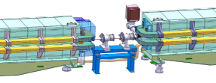

ECRs – Machine and Project
Important tool to ensure that all changes are captured and the impact properly assessed in advance
All changes to the machine (and project) that will impact the beam should be documented by ECRs
  Includes: powering, vacuum, re-naming…
Templates available on MS Word, ‘New’, ‘My Templates’
Send to ecr-configuration@cern.ch
From HL-LHC; there is also the possibility of using ‘Space Reservation’ documents (essentially a simple ECR).

Slide 17
Conclusions
Pilot project for PSB, to ensure that information is captured and the machine correctly documented and represented.
Extend the presented points to the other LIU Projects
  Dividing hardware baselines (operational and upgrade nodes).
  Open point - Parallel layout database machine versions.
  ECR scope (operational machine and project)
In line with HL-LHC
  Consistent approach across all machines for configuration, integration, layout.

Slide 18
Thank you for your attention
Questions?

