Slide 1
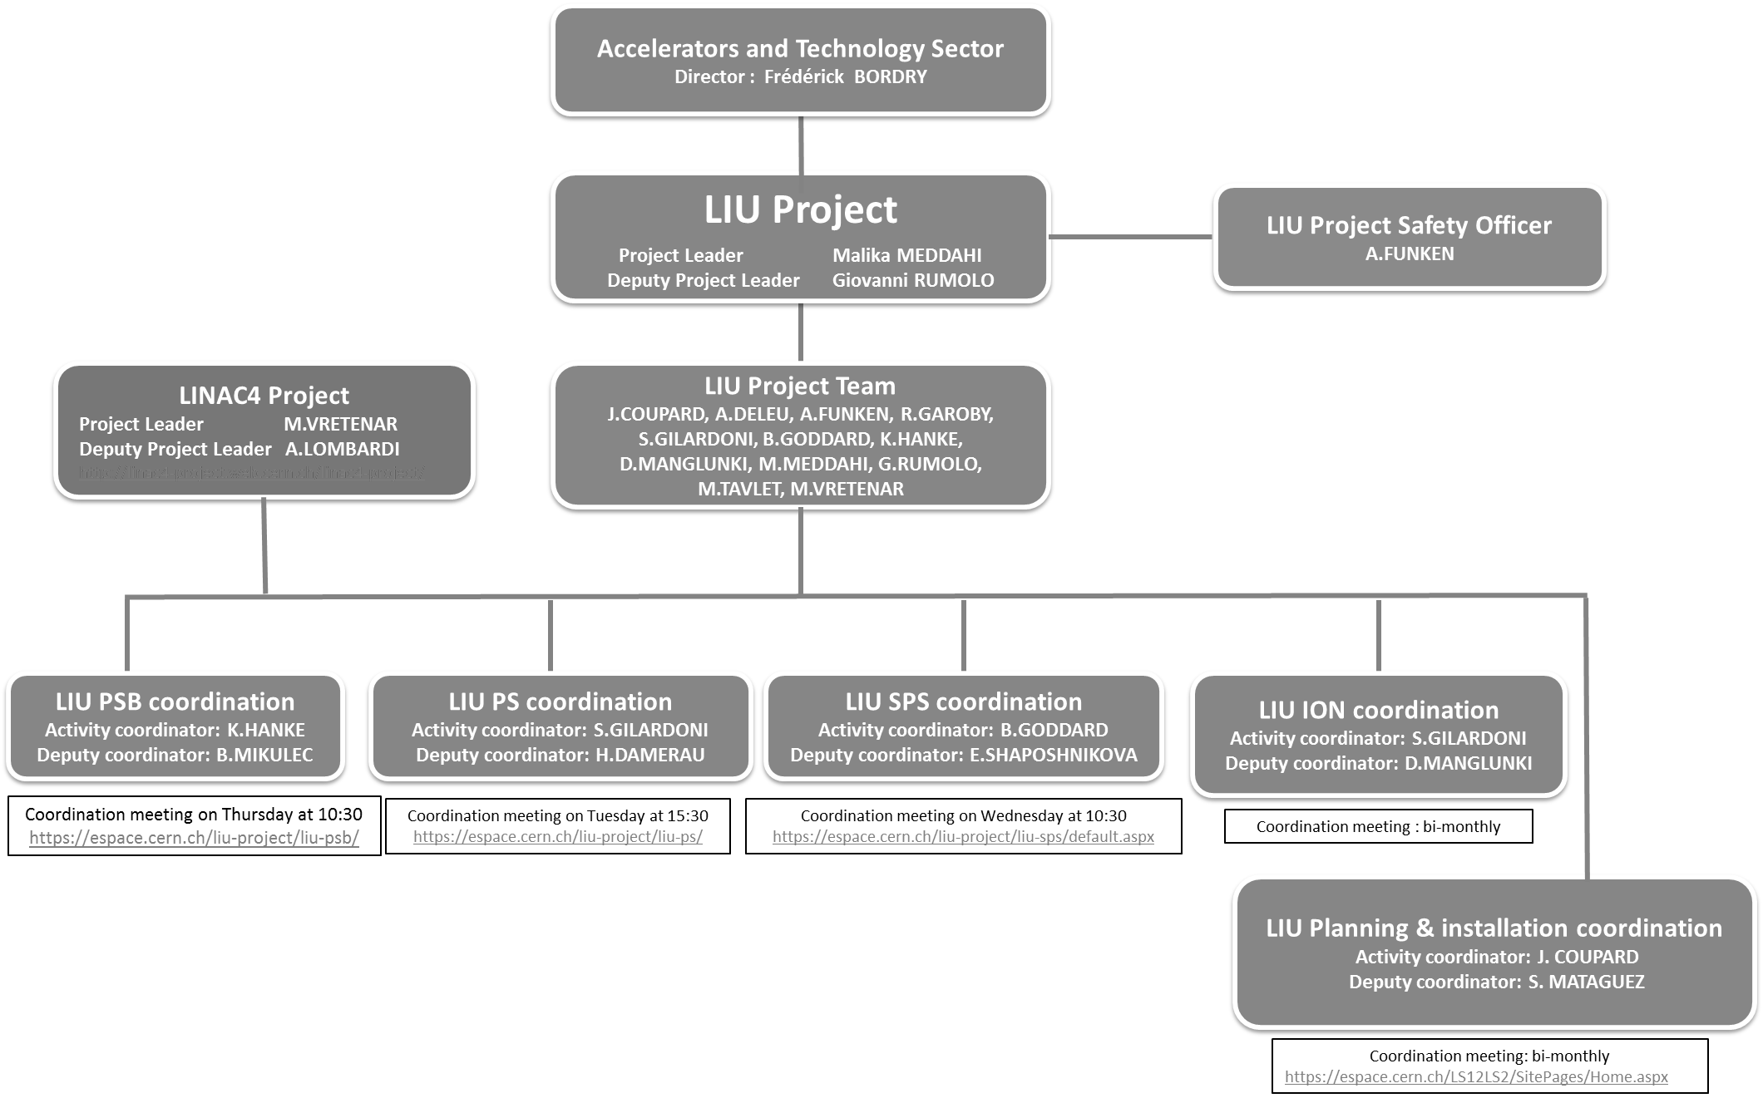
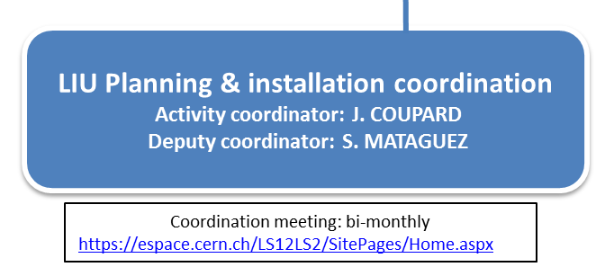
Planning & Installation meeting
New working group
EDMS 1403771

Slide 2
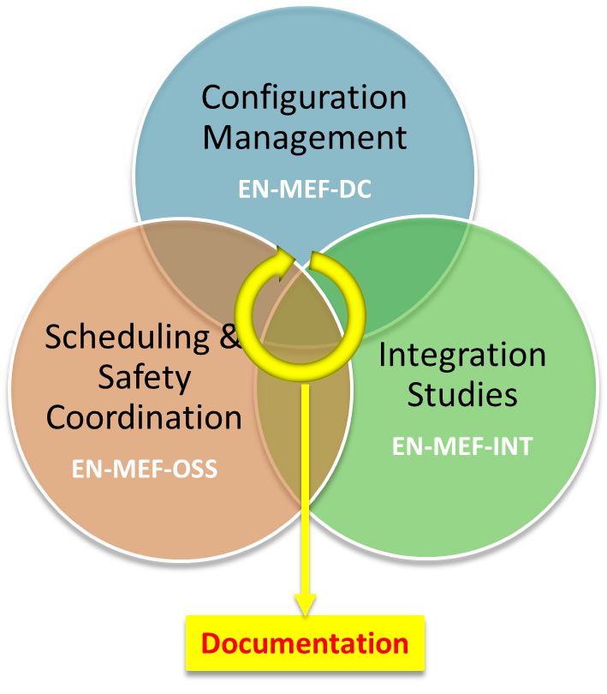
Planning & Installation meeting
The mandate
EDMS 1410283
(extract)
Generate the detailed schedule of the hardware works relative to the LIU project within the assigned time constraints;
Plan the necessary manpower and coordinate the different teams in order to set up the logistics and permit the smooth execution of the works;
Ensure that the so defined time and manpower planning does not clash with all other concurrent activities potentially involving access to the same zones and/or the same teams;
Manage and follow-up the scheduled work during shutdowns and technical stops.
LIU Planning & installation coordination
Activity coordinator: J. COUPARD
Deputy coordinator: S. MATAGUEZ
Coordination meeting: bi-monthly
https://espace.cern.ch/LS12LS2/SitePages/Home.aspx

Slide 3
Planning & Installation meeting
Work Packages
LIU- Ions
S. Gilardoni
D. Manglunki
LIU- PSB
K. Hanke
B. Mikulec
LIU- PS
S. Gilardoni
H. Damerau
LIU- SPS
B. Goddard
E. Chapochnikova
Linac3
LEIR
Linac2
Linac4
Surface build.
Integration
Y. Muttoni
J-M. Lacroix
S. Maridor
F. Galleazzi
A. Kosmicki*
J-M. Lacroix
S. Maridor
J-M. Lacroix
J-P. Corso
A. Kosmicki
WBS 1.5
Layout Database & Config. Management
S. Chemli
T. Birtwistle
T. Birtwistle
S. Bartolome
T. Birtwistle
T. Birtwistle
T. Birtwistle
S. Bartolome
WBS 1.7
Organization, Scheduling and Safety
J. Coupard
+ safety coord.
Scheduling
D. Hay
Safety Coord.
C. Bedel
Scheduling
S. Mataguez
Safety Coord.
Y. Beraud
Scheduling
D. McFarlane
Safety Coord.
E. Paulat
Scheduling
D. Kuchler
Safety Coord.
Y. Beraud
Scheduling
J. Axensalva
Safety Coord.
Y. Beraud
Scheduling
C. Mastrostefano
Safety Coord.
Y. Beraud
Scheduling
J. Coupard
Safety Coord.
E. Paulat
WBS 1.8
LIU Planning and Installation Meeting
J. Coupard
Deputy: S. Mataguez
LIU-PSB
Coordination Meeting
LIU-PS
Coordination Meeting
LIU-SPS
Coordination Meeting
LIU-Ions
Coordination Meeting
Linac4
Coordination Meeting

Slide 4
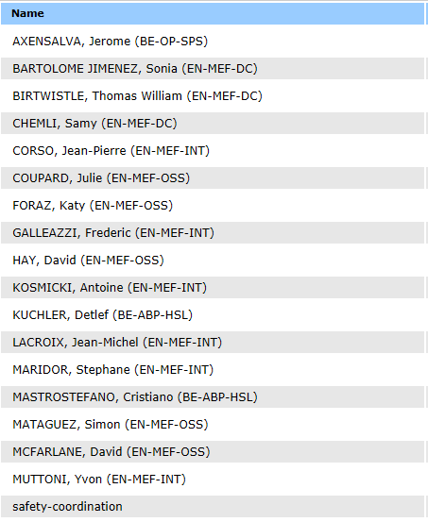
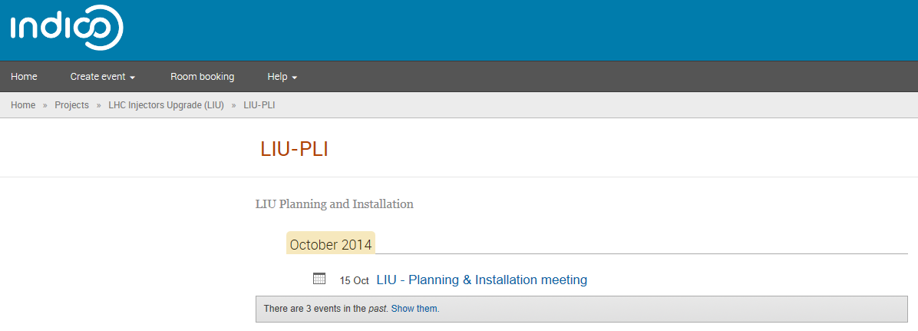
Planning & Installation meeting
E-group LIU-PLI Team Members
@: LIU-PLI-Team-Members
The PLI meeting will be organized with PLI Team Members and dedicated Work Packages.
Indico
http://indico.cern.ch/category/5706/

Slide 5
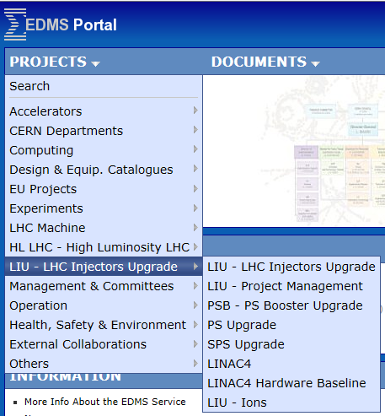
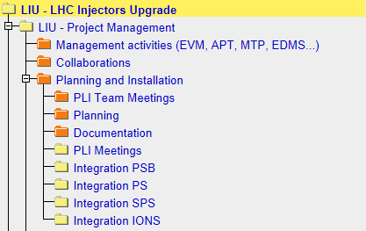
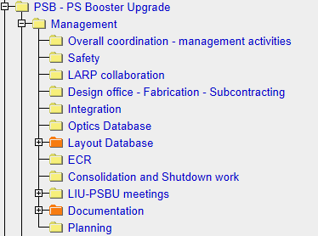
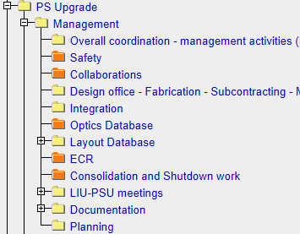
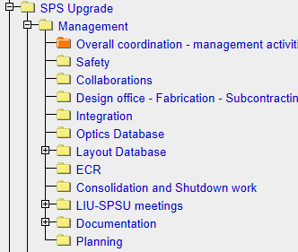
Planning & Installation meeting
EDMS documentation
Nodes have been created under LIU – Project Management
  Planning (for approval)
  Integration studies presentations
Integration and Planning nodes have also been created under Management of each LIU-PSB Upgrade, LI-PS, Upgrade, LIU-SPS Upgrade and LIU-Ions

Slide 6
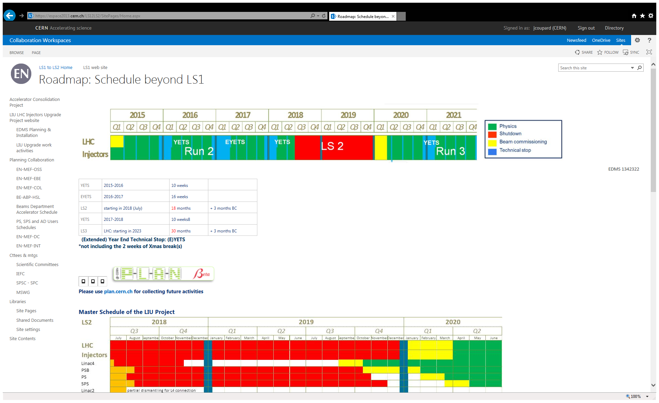
Planning & Installation meeting
General information webpage (Draft)
https://espace2013.cern.ch/LS12LS2/SitePages/Home.aspx

Slide 7
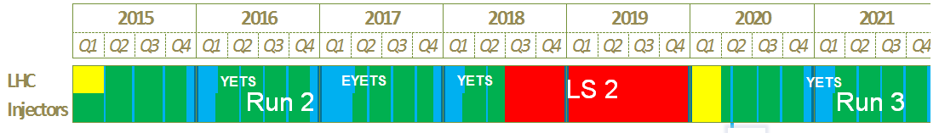
Planning & Installation meeting
PLAN tool
Even if PLAN tool will be reviewed and made available for April 2015, LIU-Project is well advanced and general lists of activities are available (EDMS 1296785).
We will start to write the document from now (Space reservation, Engineering Change Request, Functional Specification, Engineering Specification, Work Package Analysis, Installation Procedure, Tests Procedure)
Information will be integrated into PLAN tool in due time.
LS1
Post
Mortem
LS2
Day
LS2
Day
LS2
Day
PLAN
is made
available

Slide 8
Planning & Installation meeting
Planning & Installation meeting
“Bi-monthly” meeting
  2014 : 4 meetings
    October 15th : General Information, Configuration Management, Open Questions
    November 5th
    November 19th
    December 3rd
  2015 : 20 meetings
    January 14th
    …
  2016 : 20 meetings
  2017 : 20 meetings

Slide 9
Planning & Installation meeting
For next agenda:
  Follow-up of the documentation (Space reservation, Engineering Change Request, Functional Specification, Engineering Specification, Installation Procedure, Tests Procedure etc…)
  Specific subjects
    Configuration Management infrastructure for PS, SPS and IONs : decision on the EDMS structure
    Layout Database for all : decision on the versioning
    aC coating for SPS : specification of the work and groups involved
    200 MHz for SPS : specification of the work and groups involved
  Group activities for the whole LIU Project (Linacs, LEIR, PSB, PS, SPS)
    Listing of the activities per machine and Identification of the contributing groups
    Work Package Analysis
Magnets | TE-MSC | RF systems | BE-RF | Beam Intercepting Devices | EN-STI | Civil Engineering | GS-SE | Radiation Protection | HSE-RP
Power convertors | TE-EPC | Beam Instrumentation | BE-BI | Electrical systems | EN-EL | Alarms, Access systems | GE-ASE
Vacuums | TE-VSC | Controls | BE-CO | Cooling and Ventilation | EN-CV
Injection/Extraction | TE-ABT |  |  | Transport and Handling | EN-HE
Machine Interlock | TE-MPE |  |  | Survey | EN-MEF

