Slide 1
Message Passing Computing
Lecture 2
Message Passing
Helvi Hartmann
FIAS
Inverted CERN School of Computing, 23-24 February 2015

Slide 2
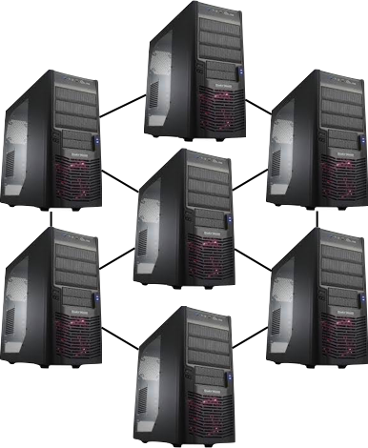
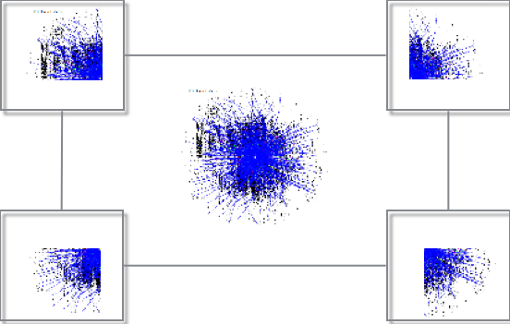
Cluster Computing
parallel computing on systems with distributed memory

Slide 3
ZMQ, PVM, MPI, HPX, OpenMP
Any questions?

Slide 4
What Methods of Message Passing do you know?

Slide 5
Inter Process Communication
File
From every process accessible information
Signal
Asynchrounous notification of an event
output of each process streams directly as input for another process
Pipe

Slide 6
Inter Process Communication
File
From every process accessible information
Signal
Asynchrounous notification of an event
output of each process streams directly as input for another process
Pipe
Shared Memory
Processes access same data in memory
OpenMP

Slide 7
Inter Process Communication
File
From every process accessible information
Signal
Asynchrounous notification of an event
output of each process streams directly as input for another process
Pipe
Shared Memory
Processes access same data in memory
OpenMP
Socket
Data is send to specific sockets
ZMQ

Slide 8
Inter Process Communication
File
From every process accessible information
Signal
Asynchrounous notification of an event
output of each process streams directly as input for another process
Pipe
Shared Memory
Processes access same data in memory
OpenMP
Socket
Data is send to specific sockets
ZMQ
PVM
Message Passing
Data is send to specific sockets
MPI

Slide 9
Inter Process Communication
File
From every process accessible information
Signal
Asynchrounous notification of an event
output of each process streams directly as input for another process
Pipe
Shared Memory
Processes access same data in memory
OpenMP
Socket
Data is send to specific sockets
ZMQ
PVM
Message Passing
Data is send to specific sockets
MPI
Processes outsource work to subroutines
Remote Procedure Call
ZMQ

Slide 10
Inter Process Communication
File
From every process accessible information
Signal
Asynchrounous notification of an event
output of each process streams directly as input for another process
Pipe
Shared Memory
Processes access same data in memory
OpenMP
Socket
Data is send to specific sockets
ZMQ
PVM
Message Passing
Data is send to specific sockets
MPI
Processes outsource work to subroutines
Remote Procedure Call
ZMQ

Slide 11
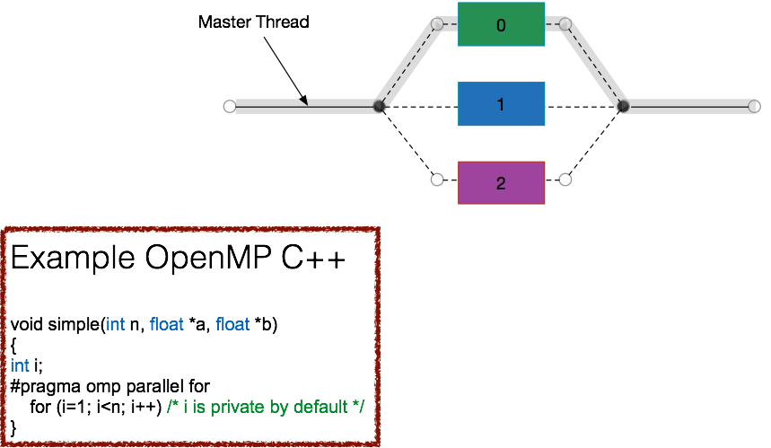
OpenMP

Slide 12
Inter Process Communication
File
From every process accessible information
Signal
Asynchrounous notification of an event
output of each process streams directly as input for another process
Pipe
Shared Memory
Processes access same data in memory
OpenMP
Socket
Data is send to specific sockets
ZMQ
PVM
Message Passing
Data is send to specific sockets
MPI
Processes outsource work to subroutines
Remote Procedure Call
ZMQ

Slide 13

Socket Programming

Slide 14
ZMQ
automatically reconnects to peers
queues messages at sender and receiver
routes messages
handles sockets errors
does all I/O in background threads
lock free techniques for communication

Slide 15
ZMQ – Socket Types
Request/Reply
blocking

Slide 16
ZMQ – Socket Types
Push/Pull
nonblocking

Slide 17
ZMQ – Socket Types
Publish/Subscribe

Slide 18
Inter Process Communication
File
From every process accessible information
Signal
Asynchrounous notification of an event
output of each process streams directly as input for another process
Pipe
Shared Memory
Processes access same data in memory
OpenMP
Socket
Data is send to specific sockets
ZMQ
PVM
Message Passing
Data is send to specific sockets
MPI
Processes outsource work to subroutines
Remote Procedure Call
ZMQ

Slide 19

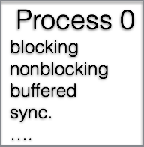

Message Passing

Slide 20
PVM
Process 0
Master
Process 0
Process 1
Slave
Slave
Process 2
Process 1
Process 2

Slide 21
MPI
node0
Process 0
Processes
ressource manager
node1
Process 1

Slide 22
MPI - Blocking
Processes
Processes
send
send
receive
receive

Slide 23
MPI - Blocking
Synchronous Send (MPI_Ssend)

Slide 24
MPI - Blocking
Buffered Send (MPI_Bsend)

Slide 25
MPI - Blocking

Slide 26
MPI - Blocking
Synchronous Send
(MPI_Ssend)
Buffered Send
(MPI_Bsend)

Slide 27
MPI - Blocking
Processes
Processes
send
send
receive
receive
function returns immediately

Slide 28
MPI - Nonblocking

Slide 29
MPI - Nonblocking

Slide 30
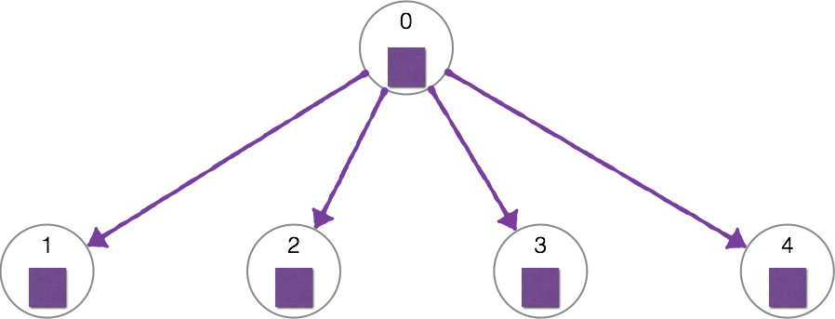
MPI – Collectives
Broadcast

Slide 31
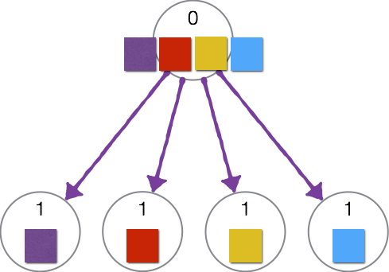
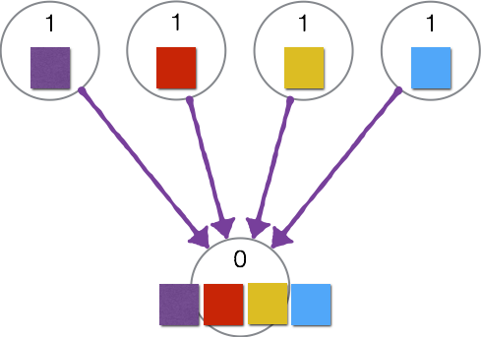
MPI – Collectives
Scatter
Gather

Slide 32
Inter Process Communication
File
From every process accessible information
Signal
Asynchrounous notification of an event
output of each process streams directly as input for another process
Pipe
Shared Memory
Processes access same data in memory
OpenMP
Socket
Data is send to specific sockets
ZMQ
PVM
Message Passing
Data is send to specific sockets
MPI
Processes outsource work to subroutines
Remote Procedure Call
ZMQ

Slide 33
Futures
locality 1
?
locality 2
?
locality 1
future
Time

Slide 34
Futures
locality 1
?
locality 2
locality 3
locality 4
?
?
?
locality 1
2
3
4
Time

Slide 35
Inter Process Communication
File
From every process accessible information
Signal
Asynchrounous notification of an event
output of each process streams directly as input for another process
Pipe
Shared Memory
Processes access same data in memory
OpenMP
Socket
Data is send to specific sockets
ZMQ
PVM
Message Passing
Data is send to specific sockets
MPI
Processes outsource work to subroutines
Remote Procedure Call
ZMQ

Slide 37
05.11.2014:
http://creatia2013.wordpress.com/2013/03/12/dna-is-like-a-computer-program-but-far-far-more-advanced-than-any-software-weve-ever-created-bill-gates/
http://www.lhc-facts.ch/index.php?page=datenverarbeitung
http://www.computerhistory.org/fellowawards/hall/bios/Gene,Amdahl/
http://www.heise.de/newsticker/meldung/AMD-bringt-neuen-Notebook-Prozessor-Llano-1259681.html
http://en.wikipedia.org/wiki/TBR1
http://www.adpic.de/lizenzfreie_bilder/Geld%20_und_%20Boerse/Euro/goldener_gitter_globus_253863.html

