Slide 1

Evidence for an hadronic origin of the Fermi Bubbles,
formed by outflows from star-forming regions
(Details in arXiv:1407.4114)
Wim de Boer, Iris Gebauer, Simon Kunz, Alexander Neumann, Karlsruhe Institute of Technology

Slide 2
What is different from other analysis?
Most analysis: take spatial templates from Galprop and parametrize CR distribution to fit data. Fit in each energy bin to see missing contributions
Here: take energy templates and fit not each energy bin, but complete energy spectrum (21 data points with only few parameters):
|total spectrum> = n₁|π⁰> + n₂|BR> + n₃|ΙC> + n₄|Fermi Bubble> +n₅|isotropic>
Templates depend on CR spectrum of protons and electrons, which can be parametrized with power laws using local CR spectra as first estimate and optimize them for gamma-ray sky
Big ADVANTAGE: high spatial resolution, because no spatially smoothed templates AND all components determined by fit, i.e. NO foreground subtraction. DO NOT HAVE TO MASK THE GALACTIC PLANE.

Slide 3
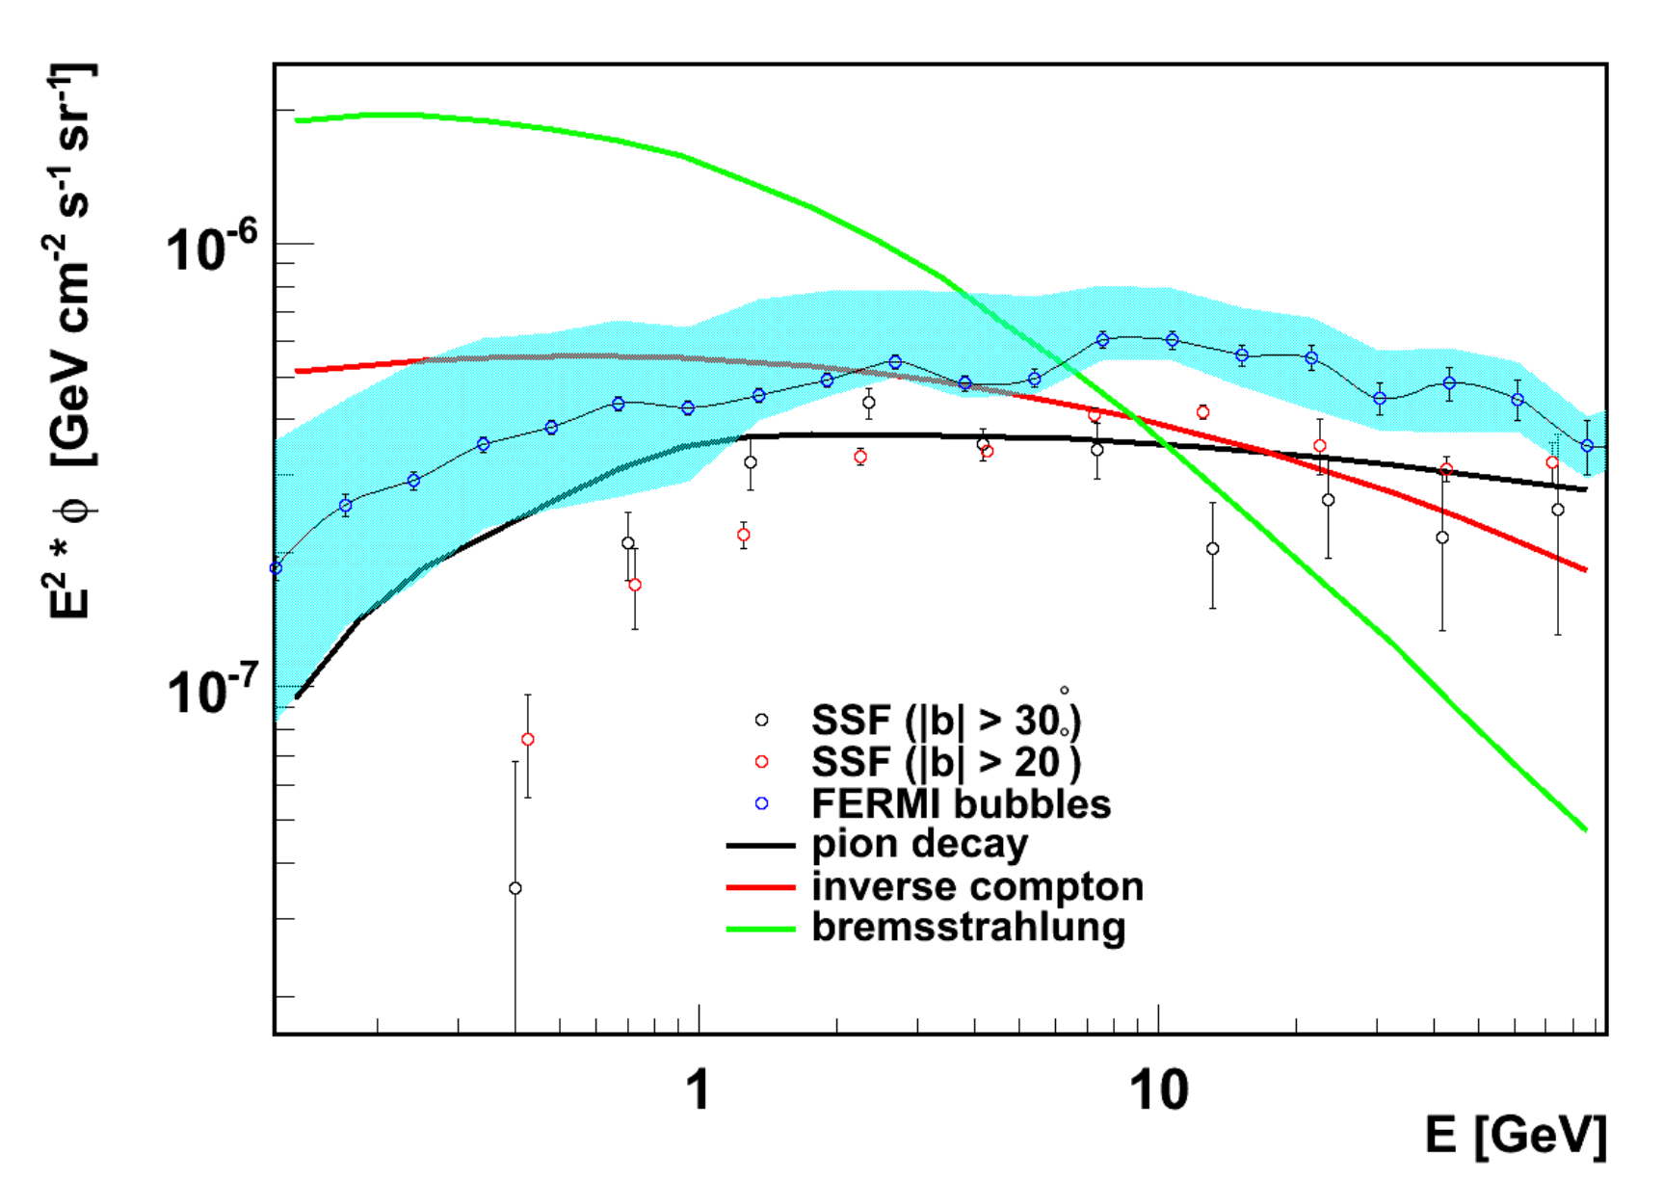
Bubble template
BR
Black line corresponds to “Source Cosmic Rays”, i.e. CRs producing π⁰s during acceleration, expected to correspond to a proton spectrum with slope 2.1 (Hillas, J. Phys. G31 (2005) 95).
This theoretically predicted contribution (Völk, Berezhko, 1309.3955) agrees with the Bubble spectrum from the Fermi Coll. (1407.7905) (blue band)
IC
Fall-off at low energies from
kinematics of pion mass
BR and IC do not produce
this characteristic fall-off
SSF=Su, Slayter, Finkbeiner, arXiv:1005.5480

Slide 4
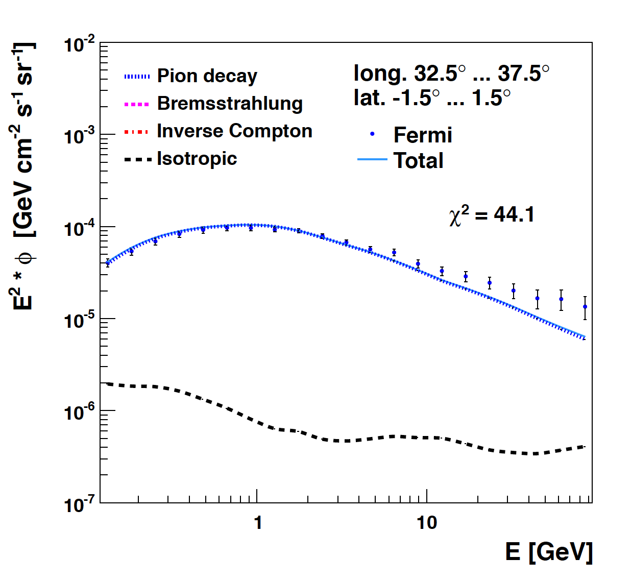
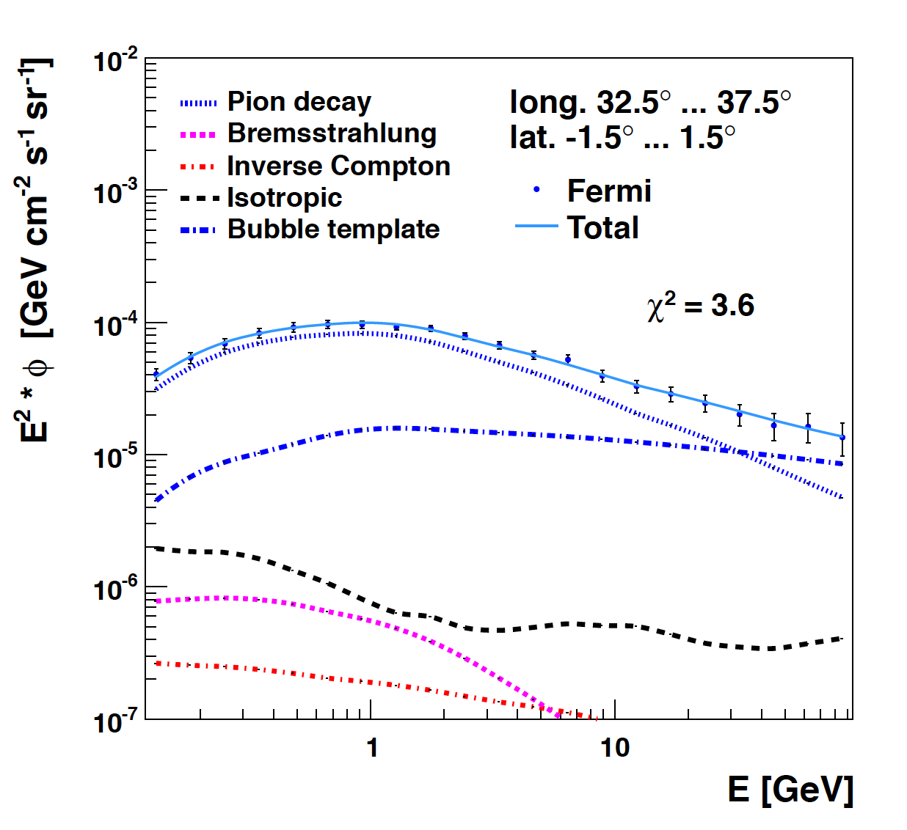
How does the template fit work?
Template fits to Fermi data (6 yr, Pass 7)
π⁰
bubble template
isotropic
Brems
IC
Adding bubble template improves χ² significantly!
1/E^{2.1} contribution shows up as bending of spectrum at high energies!

Slide 5
1. Fermi Bubble

Slide 6
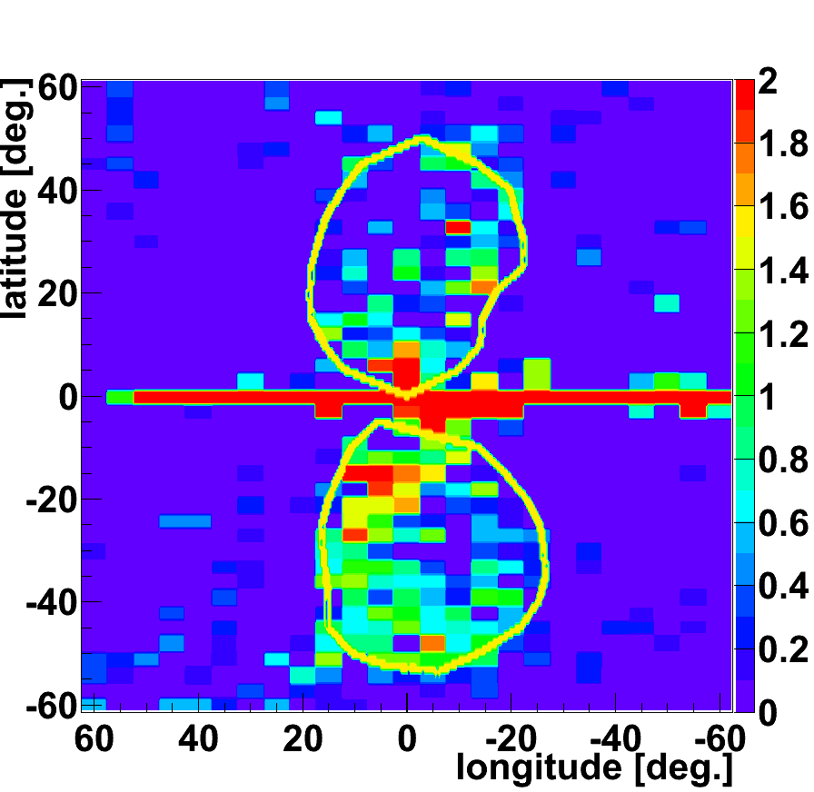
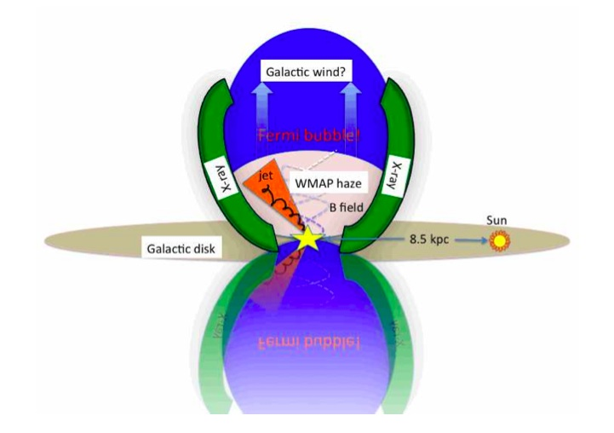
Strength of 1/E^{2.1} template
arXiv:1407.4114
Hard spectrum from neutral pion decay, so expect also electrons from muons produced in charged pion decay->
WMAP Haze from electron
induced radiation

Slide 7
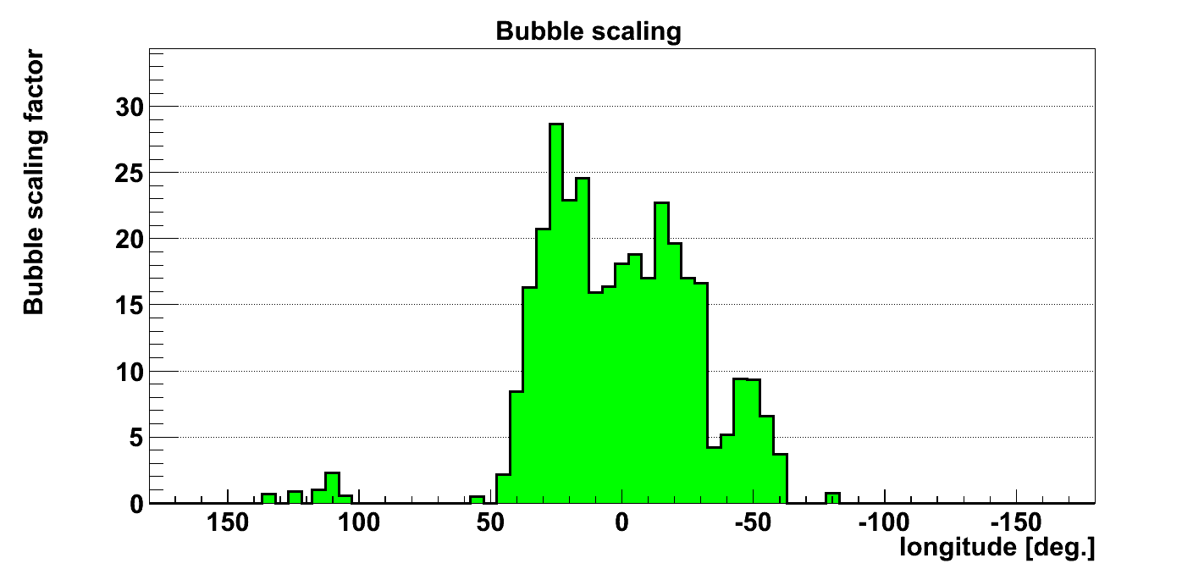
Strength of 1/E^{2.1} contribution
as function of longitude
(|Δb|<1⁰)
39⁰
-31⁰
Why sharp edges?
Why second peak?
Answers:
Endpoints of bar region
Tangent point of spiral arm

Slide 8
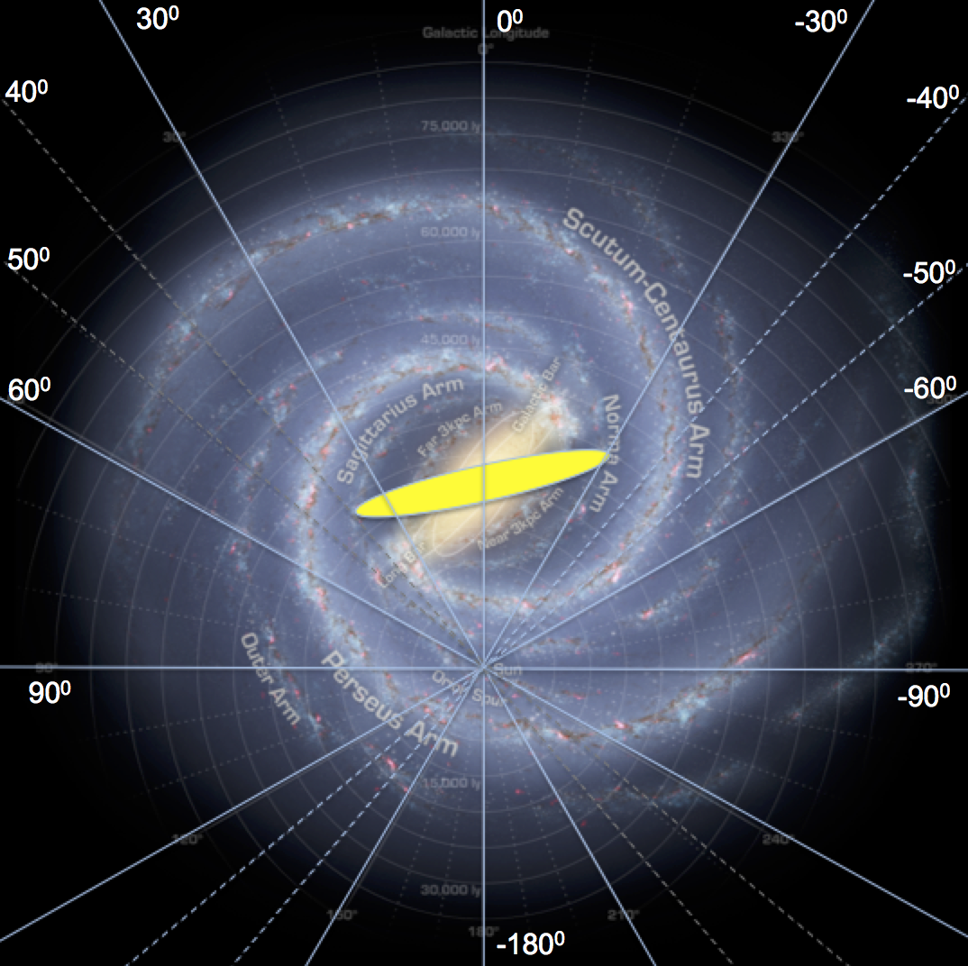
Central Bar in disc
-30⁰
-40⁰
Infrared sky maps of Spitzer Space Telescope showed lots of stars along the bar- Churchwell et al., “A New View of the Milky Way”, Publ.Astron.Soc.Pac. 121,213 (2009): Bar angle 44±10⁰
-50⁰
Peak at -50⁰ corresponds to
tangent point of spiral arm

Slide 9
2. Correlation with ²⁶Al
(proves that we are looking at SNRs)

Slide 10
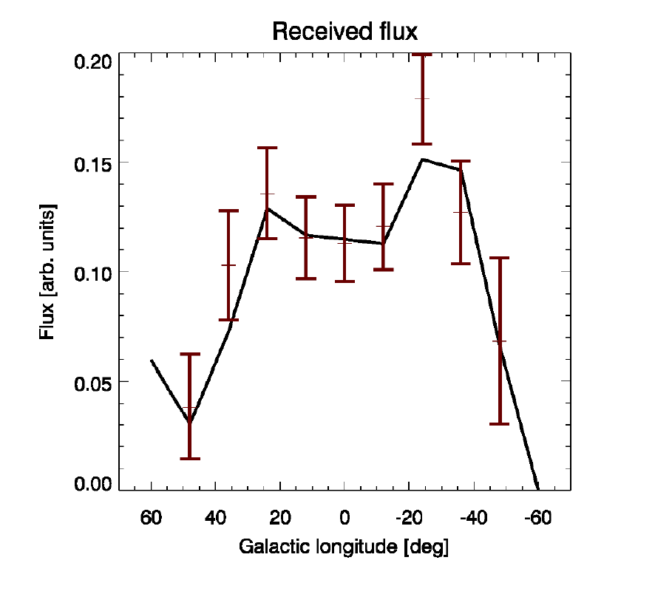
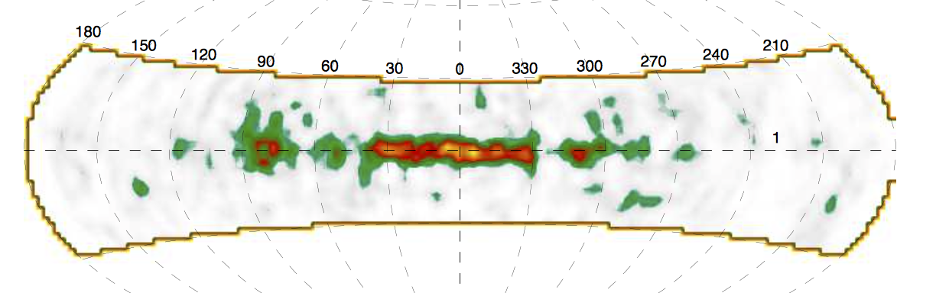
Comparison with ²⁶Al (tracer of SNRs)
Integral, 1309.4980.
(|Δb|<1⁰)
39⁰
-31⁰
²⁶Al map from Comptel, 1.6 degree resolution, 0104047.

Slide 11
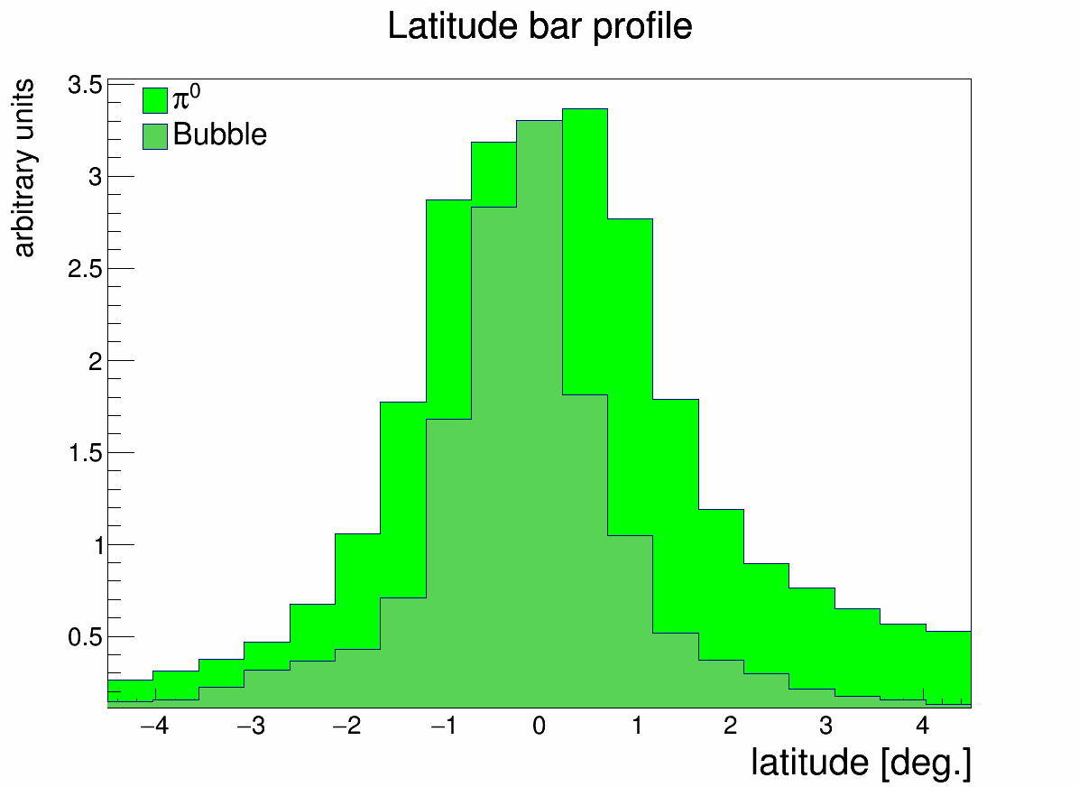
1/E^{2.1} intensity as function of latitude
(near Galactic Plane)
1/E^{2.1} template
in Plane has same
scale height as
molecular clouds
(=CO maps)

Slide 12
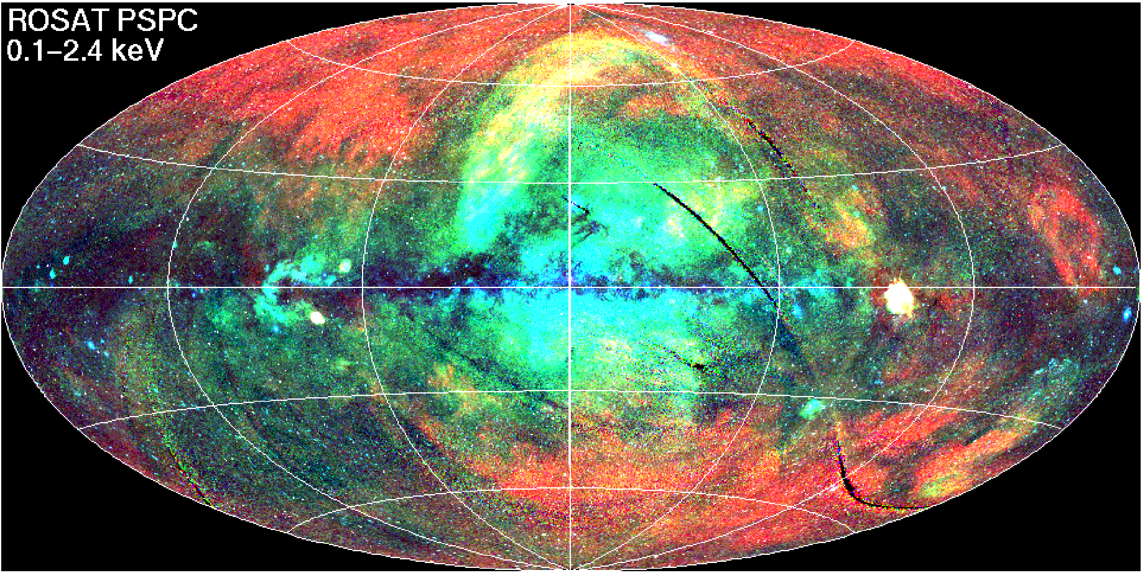
Possible origin of Bubbles in the halo
Planck
ROSAT X-rays
Easiest explanation
for Bubble: they are
outflows from star-forming
regions.
SCR spectrum is preserved
if CR are trapped in plasma,
so this explains why excess
in Plane and Bubbles are
identical.
Speeds of hot gas: up to 2000 km/s,
(Breitschwerdt:„Blown away by CRs“,
Nature 452(2008)826)
(see also 0905.3071, 0905.0431)

Slide 13
3. The Fermi few GeV Excess

Slide 14
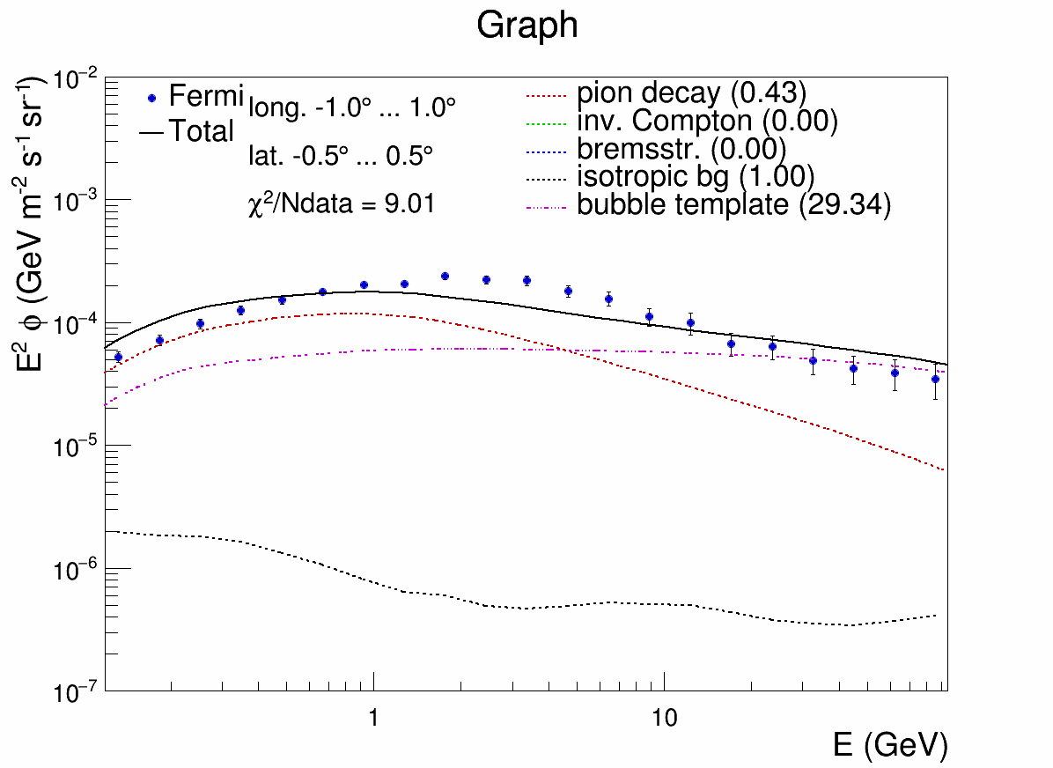
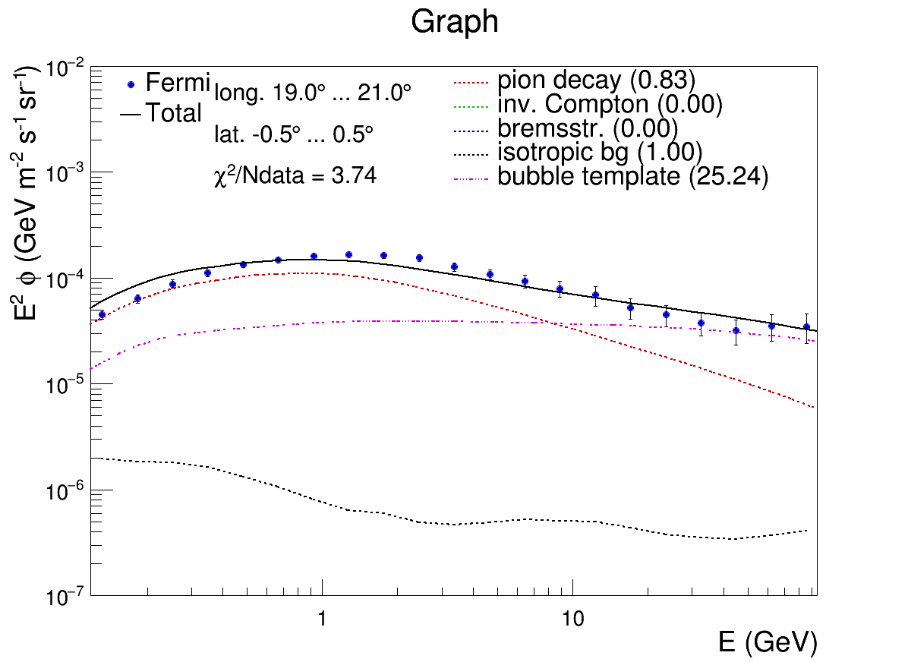
The GeV excess
GeV excess
clearly seen in GC
But everywhere
where 1/E^{2.1} is strong
1/E^{2.1} contribution and GeV excess have Molecular Clouds in common! MCs have factor 100x energy losses than expected, see talk by Gabici yesterday.

Slide 15
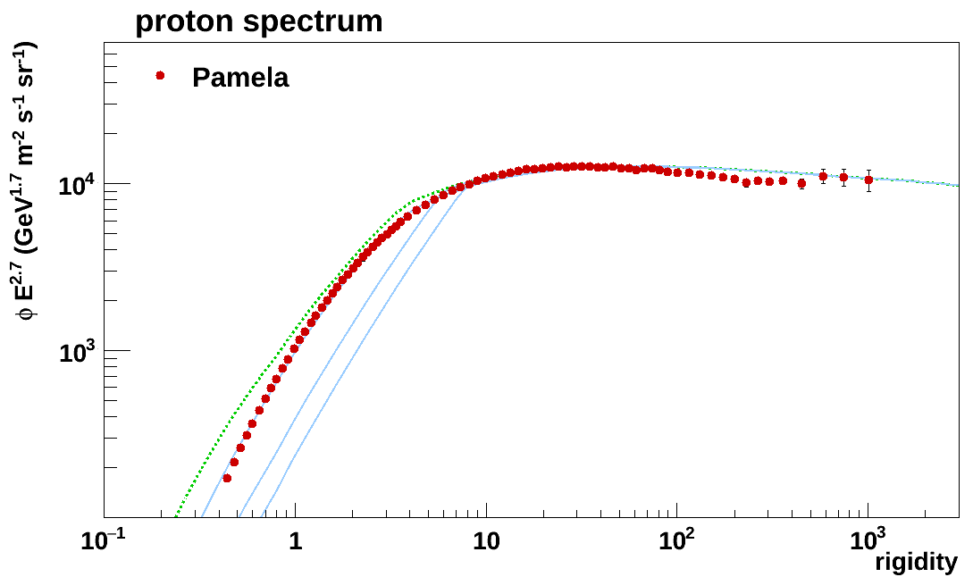
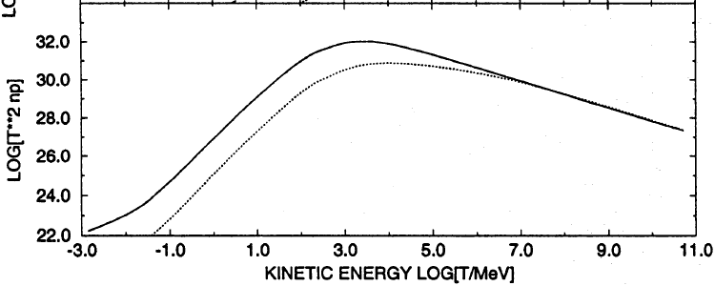
Energy losses and proton spectrum
.
Ionization losses deplete proton spectra
below 7 GV for 100 atoms/cm³
(Mannheim, Schlickeiser, A&A 286 (1994) 983)
1/cm³
100/cm³
100 GeV
1 GeV
Depletion of protons below 7 GeV for a factor 100 more energy loss

Slide 16
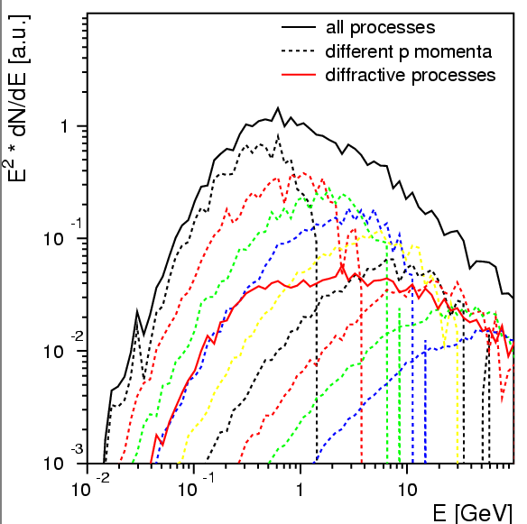
Gamma spectrum from slices of proton spectrum
2 GeV
4
8
16
32
64
diff.

Slide 17
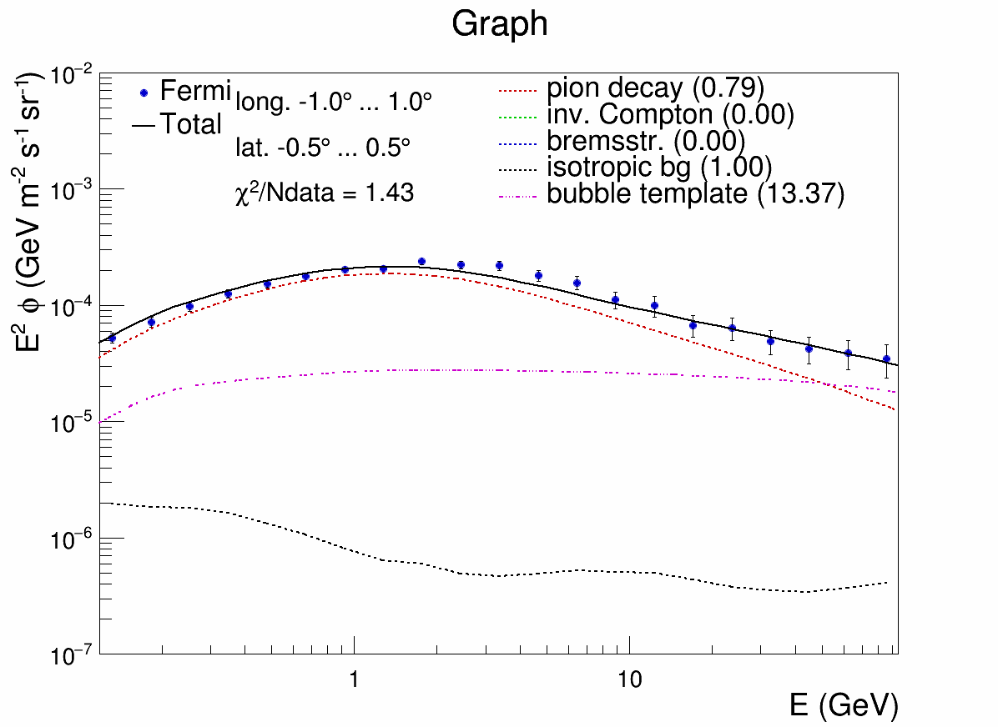
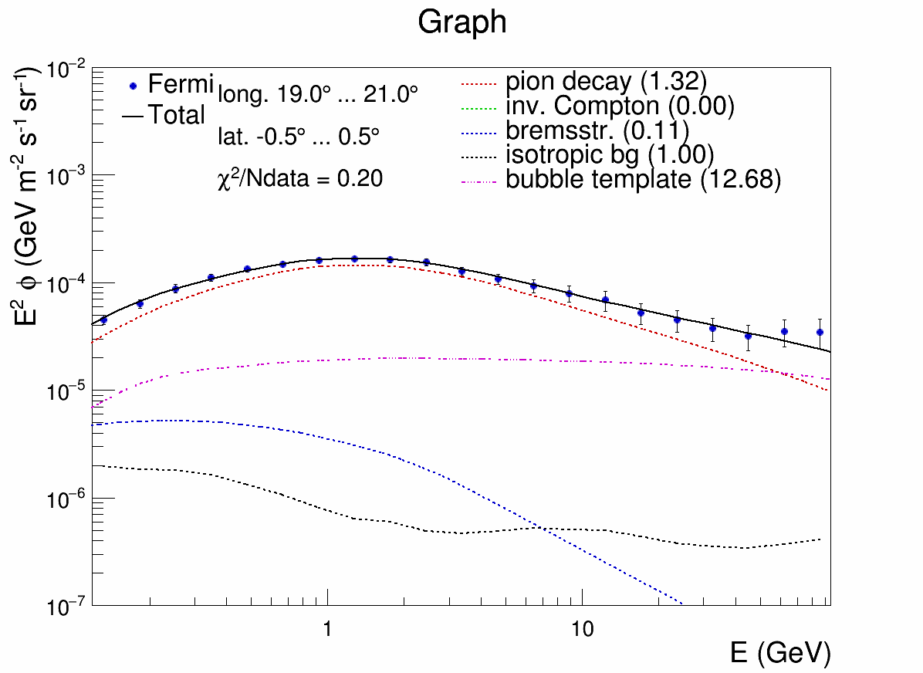
2 GeV excess
clearly seen in GC
But everywhere
where 1/E^{2.1} is strong
Excess disappears everywhere, if energy losses
in MCs are taken into account

Slide 18
Questions
Q: Why we do not see the excess in the well studied gamma ray spectra of the Orion MCs?
Answer: they are too young: 3 million years only, energy loss times for protons are more like 100 million yrs.
Q: Why we do not see extensive emissivity of MCs, if protons stick there to loose energy?
Answer: this depends on the filling factor of the cloudlets inside MCs

Slide 19
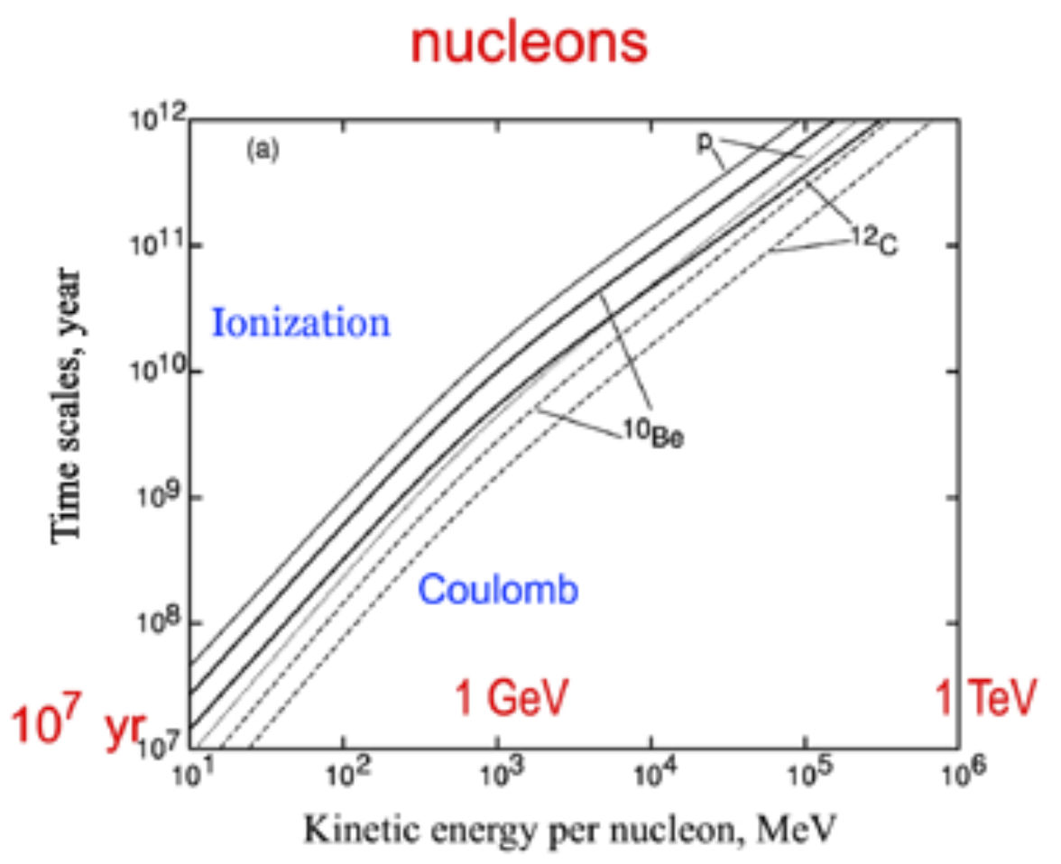
Energy loss times for 1 atom /cm³
Galprop
Manual

Slide 20
Summary
Observe 1/E^{2.1} contribution not only in Bubbles, but also in star-forming regions of the Galactic Plane: GC, bar region, spiral arms
Latitude of 1/E^{2.1} contribution restricted to scale height of Molecular Clouds
AND highly correlated with ²⁶Al maps, which is a tracer of SNRs
1/E^{2.1} contribution EXPECTED from Source Cosmic Rays, producing π⁰s during acceleration (Hillas,2005 for index, Berezhko, Völk for pred. 0404307)
Since Bubbles and star-forming regions have an identical 1/E^{2.1} spectrum ➔ easiest explanation: bubbles are outflows from star-forming regions.
MC regions better described by depletion of proton spectrum below 7 GeV, as expected because of higher energy losses in Molecular Clouds (MCs)
With this depletion below 7 GeV: 2 GeV excess disappears
Summary of summary: Allowing for SCRs and additional energy losses in MCs provides an excellent fit for every region of the gamma ray sky, unfortunately w.o. DM

