Slide 1
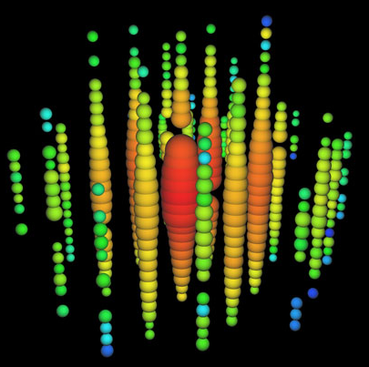
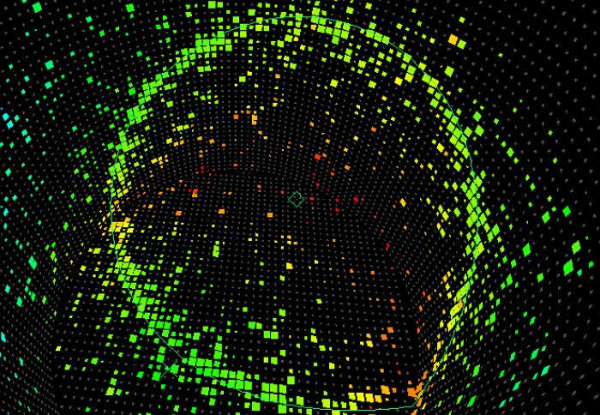

Neutrino properties
Mass hierarchy and
CP-violation
A. Yu. Smirnov
Max-Planck Institute for Nuclear Physics,
Heidelberg, Germany
& ICTP
ICRC , August 5, 2015,
The Hague

Slide 2
Outline
Brief summary of what we know
1. Neutrino properties
Next big in neutrino
physics?
2. Mass hierarchy
3. CP-violation
Ultimate goal;
connected to mass hierarchy
determination
4. Summary
with emphasis on
astrophysical/
astroparticle methods

Slide 3
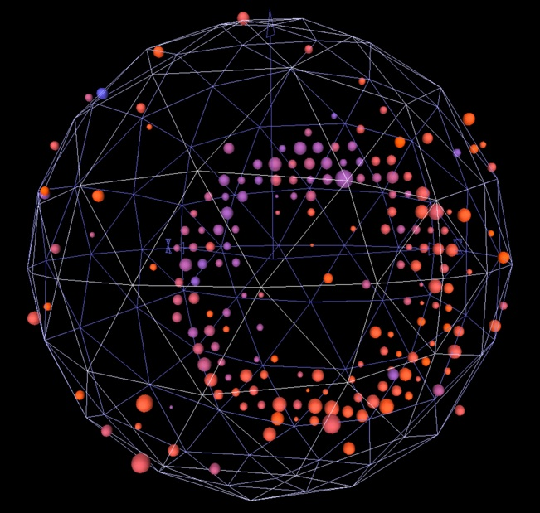
Neutrino
properties

Slide 4
3 paradigm:
ν
All well established/confirmed
results fit well a framework
with
- three neutrinos
- interactions described
by the standard model
- with masses and mixing
It is widely believed that peculiar properties
Smallness
of masses
Zero conserved
connected
which admits
charges
Large
Majorana
mixing
unique
nature

Slide 5
Lepton Mixing
ν_{e}
ν_{μ}
ν_{τ}
Mixing parameters
|U_{μ3}|²
|U_{τ3}|²
tan²θ₁₂ = |U_{e2}|² / |U_{e1}|²
~ 1/2
ν₃
|U_{e3}|²
sin²θ₁₃ = |U_{e3}|²
= 0.022
MASS²
tan²θ₂₃ = |U_{μ3}|² / |U_{τ3}|²
~ 1.0
Δm²₃₁
TBM,
Symmetry?
|U_{e2}|²
CP
Mixing matrix:
ν₂
ν₁
Δm²₂₁
ν_{f} = U_{PMNS} ν_{mass}
|U_{e1}|²
ν_{e}
ν_{μ}
ν_{τ}
ν₁
ν₂
ν₃
FLAVOR
= U_{PMNS}
Normal mass hierarchy
Δm²_{ij} = m²_{i} - m²_{j}
Standard parametrization
U_{PMNS} = U₂₃I_{δ} U₁₃I_{−δ} U₁₂
Δm²₃₂ = 2.5 x 10⁻³ eV²
I_{δ} = diag (1, 1, e^{iδ} )
Δm²₂₁ = 7.5 x 10⁻⁵ eV²
CP-phase

Slide 6
Neutrino mass ordering
ν_{e}
ν_{μ}
ν_{τ}
Fixed by solar neutrinos
ν₃
ν₂
Δm²₂₁
ν₁
MASS²
MASS²
Δm²₃₂
Δm²₂₃
ν₂
ν₁
Δm²₂₁
ν₃
Normal mass hierarchy
Inverted mass hierarchy
Σ m > m_{h}
Σ m > 2 m_{h}
|Δm²₃₁| = |Δm²₃₂| + |Δm²₂₁|
|Δm²₃₁| = |Δm²₃₂| - |Δm²₂₁|
|Δm²_{ij}|
D_{ij} = 4|U_{ei}|²|U_{ej}|²
mass splittings
oscillation depth

Slide 7
TBM Mixing pattern
P. F. Harrison, D. H. Perkins,W. G. Scott
L. Wolfenstein
2/3 1/3 0
- 1/6 1/3 - 1/2
- 1/6 1/3 1/2
0.15
U_{tbm} =
U_{tbm} = U₂₃(π/4) U₁₂
0.62
sin²θ₁₂ = 1/3
0.78
0.30- 0.31
Not accidental
Accidental, numerology,
useful for bookkeeping
Lowest order approximation
which corresponds to weakly
broken (flavor) symmetry
of the Lagrangian
Accidental symmetry
(still useful)
with some other physics
and structures associated
There is no relation of mixing
with masses (mass ratios)
Parameters look like C-G coefficients

Slide 8
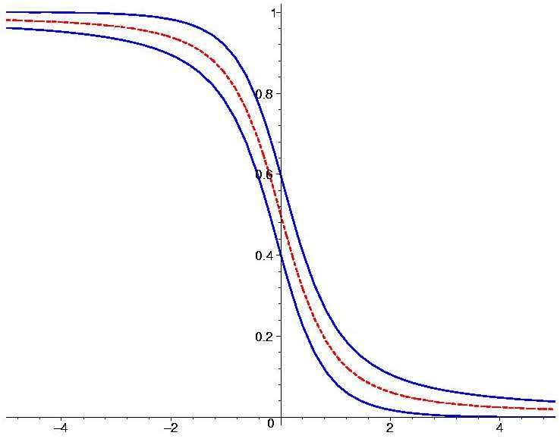
Solar
Global oscillation fit
neutrinos
KamLAND
MSW-effect
Atmospheric
2
neutrinos
Δ
m
Double Chooz
θ
Daya Bay
MINOS
RENO
Oscillations
K2K
Antares
Can be resonantly
enhanced in matter
T2K
DeepCore

Slide 9
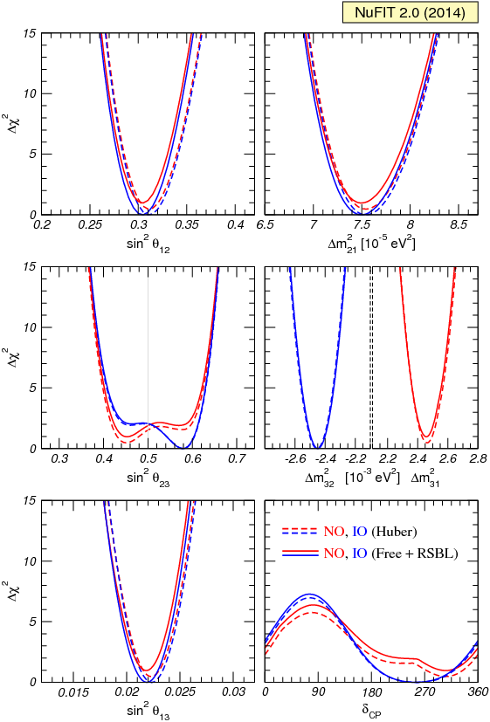
Global 3ν – fit
M.C. Gonzalez-Garcia, M. Maltoni,
T. Schwetz, JHEP 1411 (2014) 052,1409.5439 [hep-ph]
2-3 mixing:
asymmetric for NO and IO
sin²θ₂₃ = 0.45 (NO), = 0.58 (IO)
Small preference IO and
2nd quadrant

Slide 10
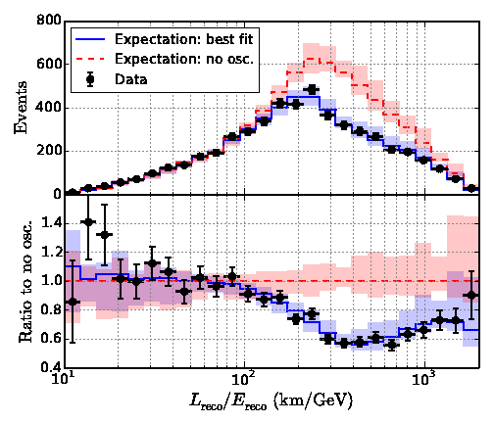
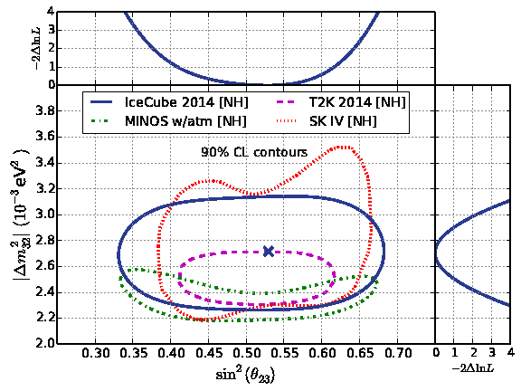
DeepCore oscillation result
atmospheric ν_{μ} disappearance,
3 years of data
Δm₃₂² = (2.72 +0.19/−0.20) 10⁻³ eV²
sin²θ₂₃ = 0.53 +0.09/−0.12 (NO)
IceCube Collaboration
(M.G. Aartsen et al.).
arXiv:1410.7227 [hep-ex] |
compatible and comparable in precision
with accelerator experiments

Slide 11
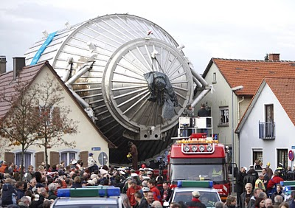
Neutrino mass scale
Kinematical methods
KATRIN
Oscillations:
10⁶
10⁵
10⁴
10³
10²
10¹
10⁰
10⁻¹
10 ⁻²
m_{e}
The heaviest
neutrino
m_{h} > Δm₃₁² > 0.045 eV
Pauli
~
m₂
m₃
Δm₂₁²
Δm₃₂²
the weakest mass
hierarchy,
related to large mixing
Fermi
>
= 0.18
~
m_{ν} , eV
Bergkvist
Cosmology:
ITEP
Zurich
Σ m < 0.136 eV (95 % CL)
Planck 2015 + BAO+ HST
Los Alamos
E. Di Valentino, et al
1507.08665 [astro-ph.CO]
Troitzk, Mainz
Σ m < (0.3 - 0.4) eV (95 % CL)
Oscillations,
& cosmology
KATRIN
2016
conservative
m_{h} ~(0.045 – 0.10) eV

Slide 12
Scales
28 orders of
magnitude
GUT - Planck
High scale seesaw
Quark- lepton
symmetry /analogy
GUT
of new
mass
V_{EW}²
m_{ν}
physics
PeV
Low scale seesaw,
radiative mechanisms, RPV,
high dimensional
operators
Electroweak –
LHC
Scale of neutrino masses themselves
Relation to dark
energy, MAVAN?
eV-
m
ν
sub-eV
Spurious scale?
Neutrino mass itself is the fundamental scale of new physics

Slide 13

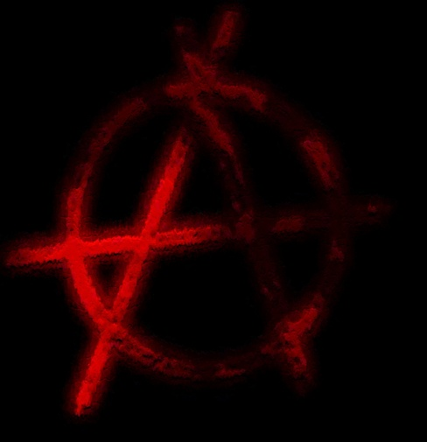


Mixing
Not much to add
- String landscape
- Multiverse?
from symmetry
to anarchy and
randomness
Complicated constructions,
especially if quarks are included

Slide 14
Quark mixing
my prejudice
PMNS & CKM
C. Giunti, M. Tanimoto
H. Minakata, A Y S
Z - Z. Xing
J Harada
S Antusch , S. F. King
Y Farzan, A Y S
M Picariello , … .
U_{PMNS} = U_{CKM}⁺ U_{X}
where
U_{CKM} ~ V_{CKM}
U_{X} has some special form
determined by symmetry
has similar hierarchical structure determined by powers of
related to mechanism
that explains smallness of neutrino mass
λ = sin θ_{C}
From the Dirac matrices of charged leptons and neutrinos
U_{X} ~ U₂₃(π/4) U₁₂
Prediction for
the 1-3 mixing
sin²θ₁₃ = sin²θ₂₃ sin²θ_{C} (1 + O(λ²))
in a good agreement with measurements
sin²θ₁₃ ~ ½ sin²θ_{C}

Slide 15
What does this mean?
if not accidental
Quarks and leptons know about each other,
Q L unification, GUT or/and
Common flavor symmetries
Some additional physics is involved in the lepton sector which explains smallness of neutrino mass and difference of the quark and lepton mixing patterns
CKM
Two types of new physics
Neutrino new physics
Indicates SO(10): no CKM mixing in the first approximation

Slide 16
Challenges and Anomalies
Determination of unknowns
Checks of Anomalies
within 3nu paradigm
and their explanations
Mass hierarchy/ordering
Reactor, Gallium source
Deficit of signal
Absolute values of masses,
type of spectrum
LSND, MiniBooNE
Excess of signal
CP-violation phase(s)
1 eV sterile neutrino: not a small perturbation of the 3ν picture
Nature of neutrino mass:
(Majorana-Dirac,
hard – soft (effective))
IceCube
High sensitivity
to steriles
Solar neutrino anomaly?
Absence of spectral
upturn, large DN asymmetry
steriles? NSI?

Slide 17
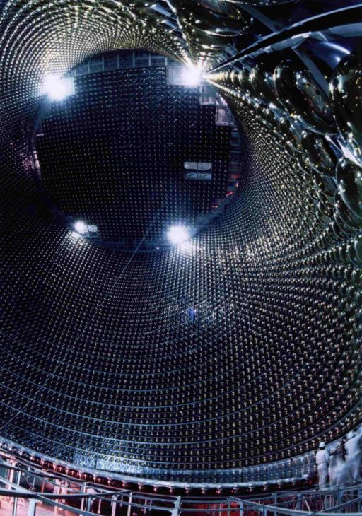
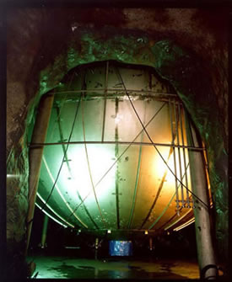
Mass hierarchy

Slide 18
Mass
Further advance
hierarchy
Step to discover CP
important by itself
Phenomenology
Theoretical
Supernova
Atmospheric
implications
neutrinos
neutrinos
bb0n decay
LBL
Solar neutrinos
Cosmology

Slide 19
Theoretical implications
generically
Quasi-degenerate
→ symmetry
Normal vs. special
m₂
m₃
Δm₂₁²
Δm₃₂²
Δm
m
Δm₂₁²
2 Δm₃₂²
~ = 0.18
~ = 1.6 10⁻²
the weakest
hierarchy
m₂
m₃
but 1-2 mixing strongly deviates from maximal
θ ~
Similar to quark spectrum
rescaling
Pseudo-Dirac + 1 Majorana
See-saw
Quark-lepton symmetry
Flavor symmetries
Broken L_{e} – L_{μ} – L_{τ} symmetry
Unification

Slide 20
Race for mass hierarchy
Matter effect
Precise
measurements
on 1-3 mixing
of Δm²
Cosmology
Oscillations, conversion
at reactors
Σm
JUNO, RENO-50
Double beta
Atmospheric
Supernova
decay
m_{ee}
LBL
neutrinos
neutrinos
experiments
Earth matter effects,
energy spectra
PINGU
NOvA
LBNF – DUNE
JPARC-HK
ORCA
INO

Slide 21
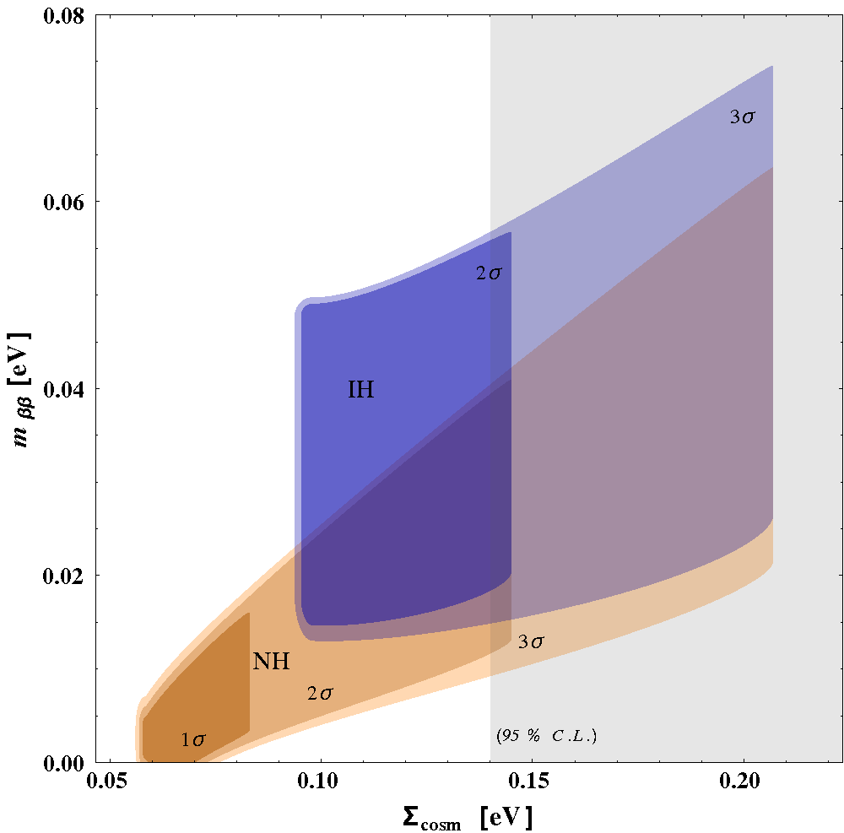
Double beta decay
m_{ββ} = U_{e1}² m₁ + U_{e2}² m₂ e^{ια} + U_{e3}² m₃ e^{ιφ}
p
n
W
e
Exclude IH
ν
x
m_{ββ}
e
W
n
p
S. Dell'Oro, et al,
1505.02722 [hep-ph]
Constraints from cosmological surveys and from oscillations.
The 1σ region for the IH case is not present at this confidence level.
The grey band is the 95% C.L. excluded region coming from Cosmology

Slide 22
Flavor in matter
ν_{e}
ν_{μ}
ν_{τ}
Density increase →
Normal mass hierarchy, neutrinos
ν_{3m}
ν_{2m}
ν_{1m}
1-2 resonance
1-3 resonance

Slide 23
Flavor in matter
ν_{e}
ν_{μ}
ν_{τ}
Density increase →
Inverted mass hierarchy, neutrinos
ν_{2m}
ν_{1m}
ν_{3m}
1-2 resonance

Slide 24
Supernova neutrinos
All these effects depend on the type
of mass hierarchy
Collective flavor
trasformation
Shock wave
effect on
conversion
MSW flavor
conversion
inside the star
Propagation
in vacuum
Oscillations
inside the Earth
With known 1-3 mixing all
MSW transitions are adiabatic

Slide 25
Time rise of the anti-ν_{e} burst initial phase: fast → IH
Hierarchy
P. Serpico et al
Strong suppression of
the ν_{e} peak → NH
affects
ν_{e} → ν₃
Permutation of the electron and
non-electron neutrino spectra
Dighe, A. S.
C. Lunardini
Earth matter effects
Shock wave
effect
in the antineutrino
channel only → NH
Neutrino collective
effects
in the neutrino
channel only → IH
in neutrino
channels → NH
in antineutrino
→ IH
Different for IH and NH cases;
spectral splits
at high energies
→ IH
If the earth matter effect is
observed for antineutrinos
NH is established!
G. Fuller, et al
R. Tomas et al
G. Fuller, et al
B. Dasgupta ,et al

Slide 26
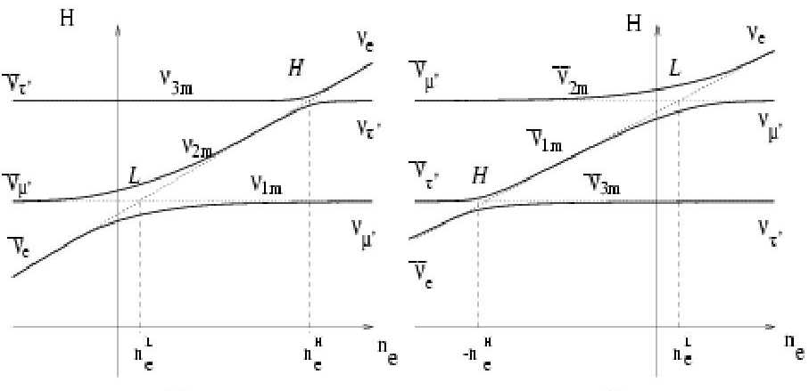
Earth matter effect and hierarchy
Adiabatic
evolution
Level crossings
Normal hierarchy
Inverted hierarchy
No Earth matter effect
provided that initial fluxes
of ν_{μ}‘ and ν_{τ}‘ are identical
Collective effects and shock waves
may change this.

Slide 27
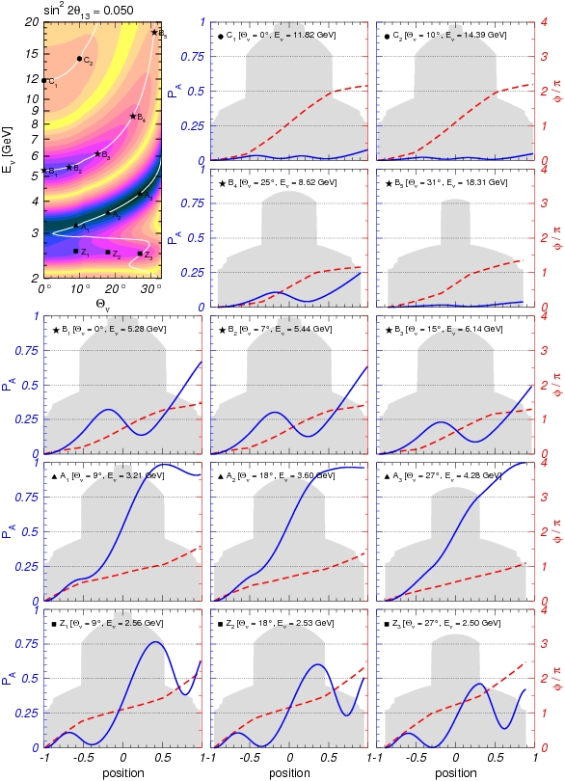
Atmospheric neutrinos
θ_{ν}
zenith
angle
Oscillations in the Earth
mantle
ν_{e} → ν_{μ} , ν_{τ}
1
0.75
0.50
0.25
0
Resonance
enhancement
of oscillations
Θ = 33º
probability
1
0.75
0.50
0.25
0
Parametric
enhancement
of oscillations
core
probability
core-crossing
trajectory

Slide 28
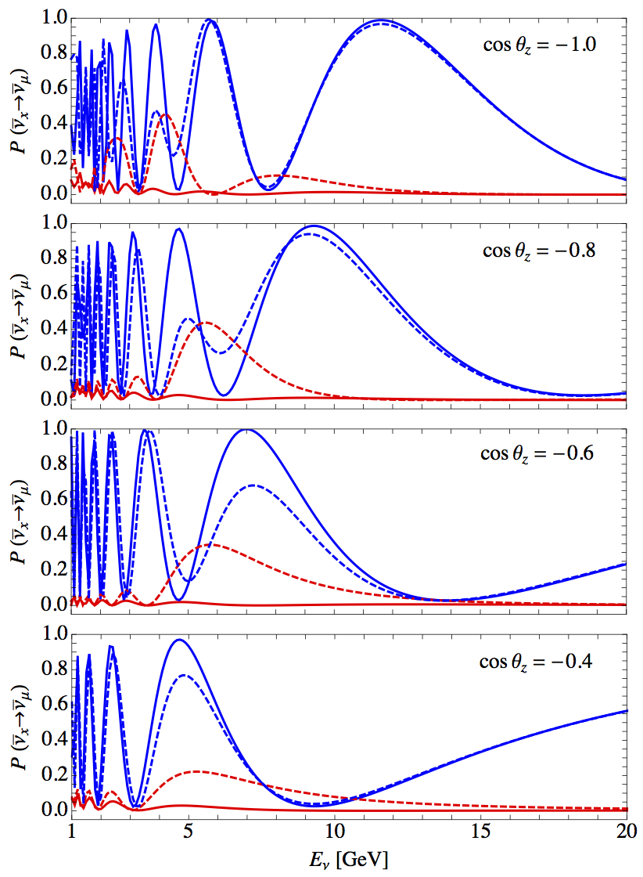
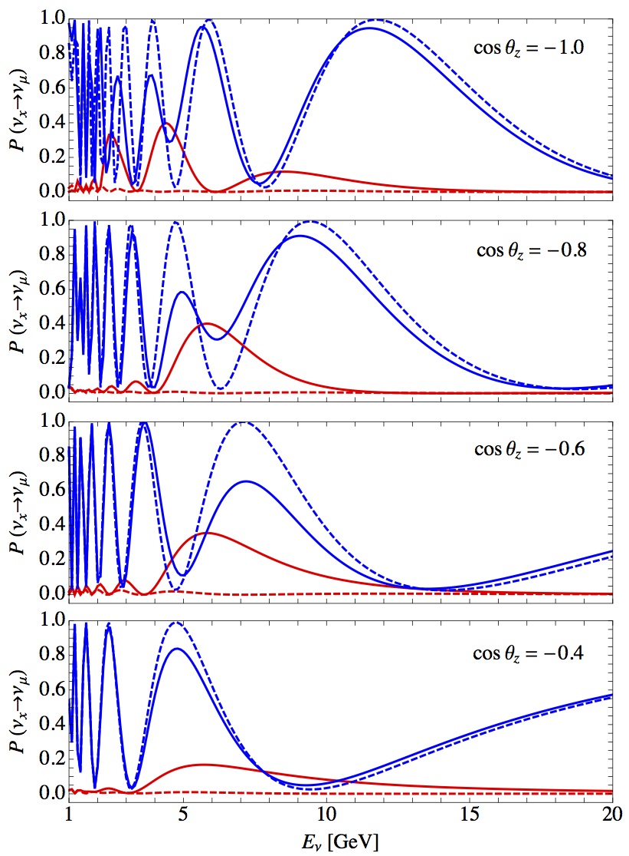
Probabilities
neutrinos
antineutrinos
NH – solid
IH – dashed
x = μ - blue
x = e - red

Slide 29
Method
Measurement of E - θ distributions of different type of events.
Compare events for the normal and inverted orderings
“tracks”
Measurements
muon track
E_{μ} θ_{μ} E_{h}
inelasticity
ν_{μ} + N → μ + h
+ cascade
E_{ν} = E_{μ} + E_{h}
ν_{τ} + N → τ + h
reconstruction
E_{h} E_{μ} θ_{μ} → θ_{ν}
→ μ + ν + ν
“cascades”
ν_{e} + N → e + h
ν_{α} + N → ν_{α} + h
cascades
E_{ν} θ_{ν}
reconstruction
ν_{τ} + N → τ + h
→ h + ν
→ e + ν + ν

Slide 30
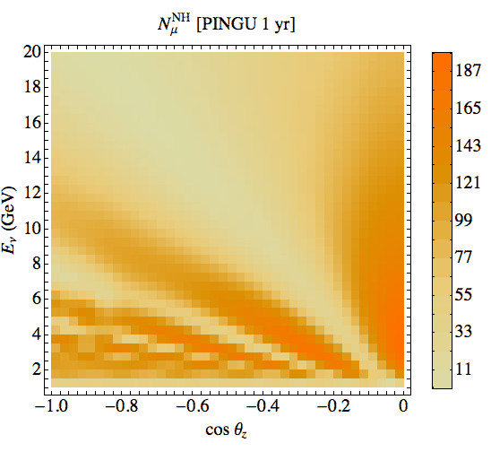
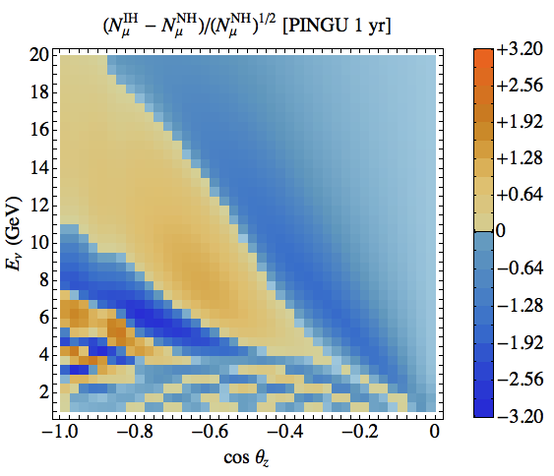
Track events
~ 10⁵ events/year
``Distinguishability’’
Estimator of sensitivity
S – asymmetry
|S| - significance

Slide 31
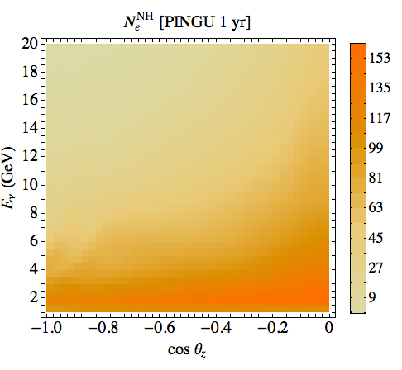
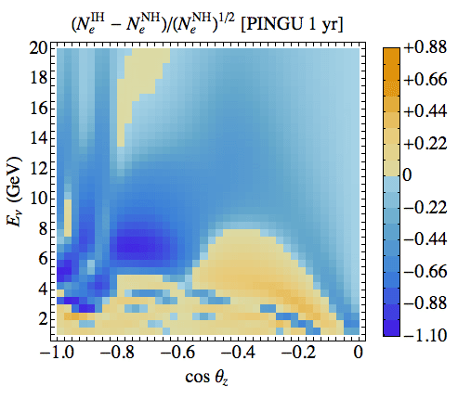
Cascade events
``Distinguishability’’
Statistical significance

Slide 32
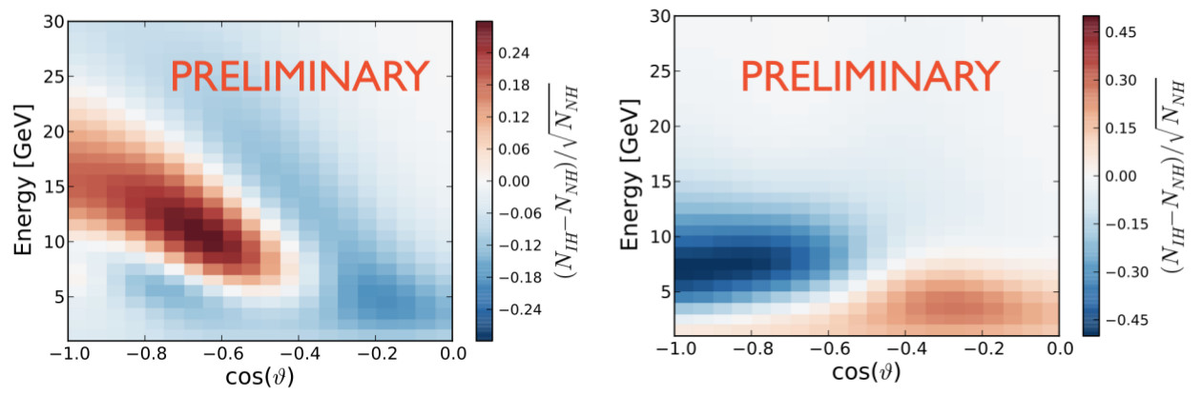
Smeared distributions
Ken Clark
Over energy and angle resolution functions
PINGU
tracks
cascades
distinguishability

Slide 33

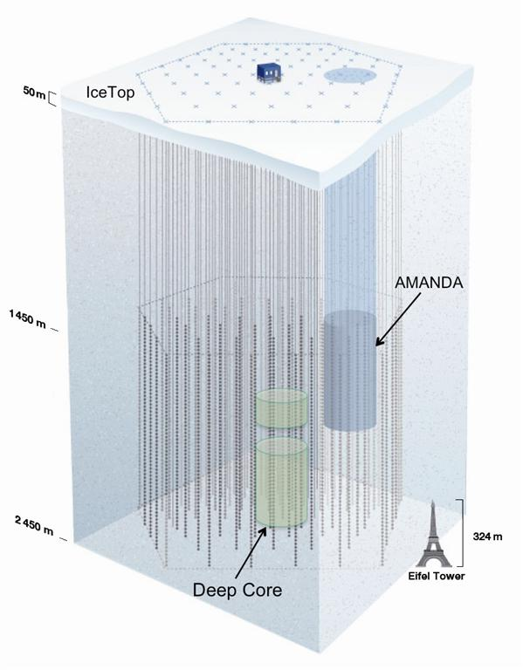
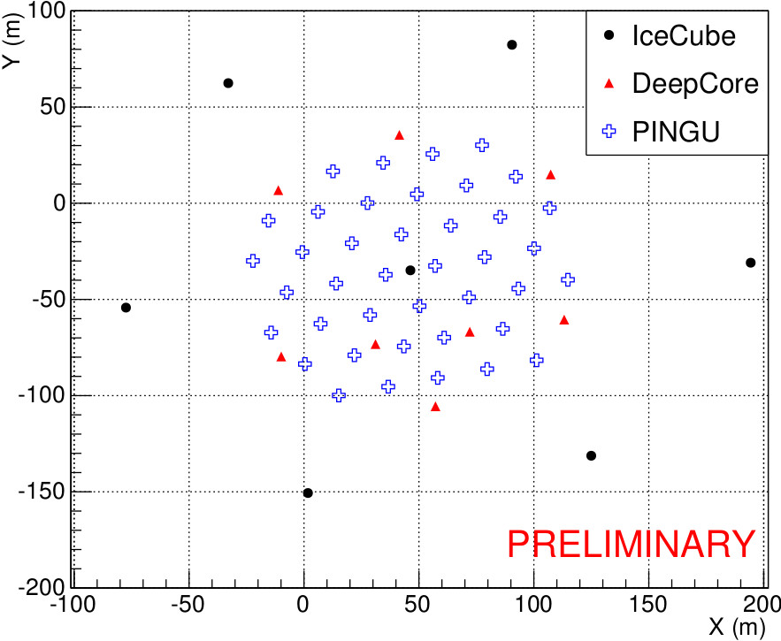
PINGU
Precision IceCube
Next Generation
Upgrade
K. Clark
40 strings
96 DOM’s per string
PINGU

Slide 34
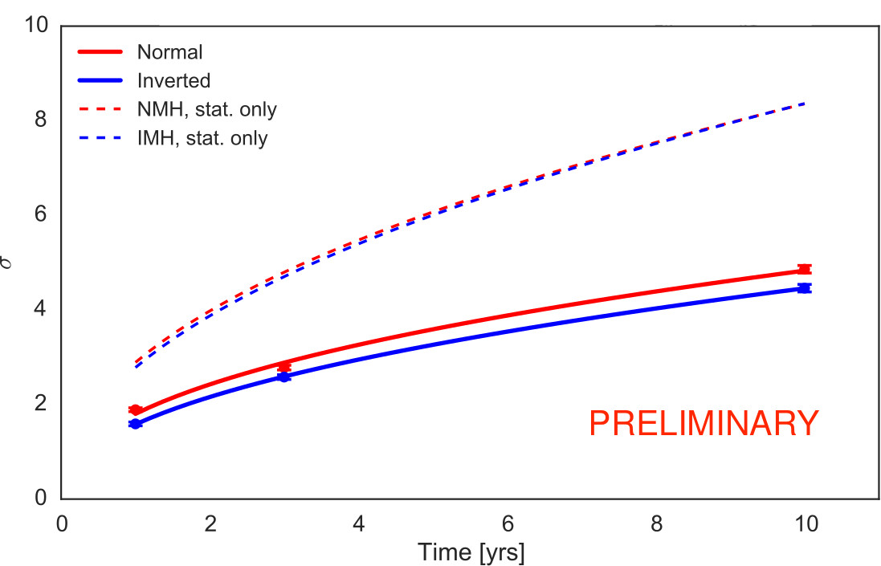
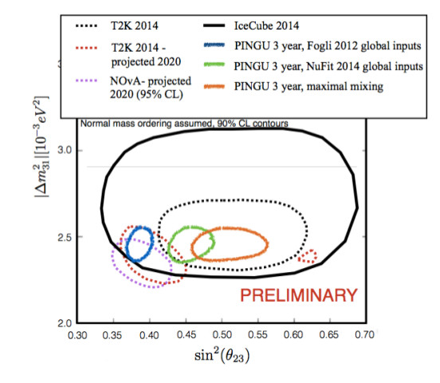
Sensitivity
K. Clark
Mass hierarchy
Parameters of the 2-3 sector
Deviation from maximal:
symmetry or no symmetry, Quadrant
Sensitivity to MH depends on

Slide 35

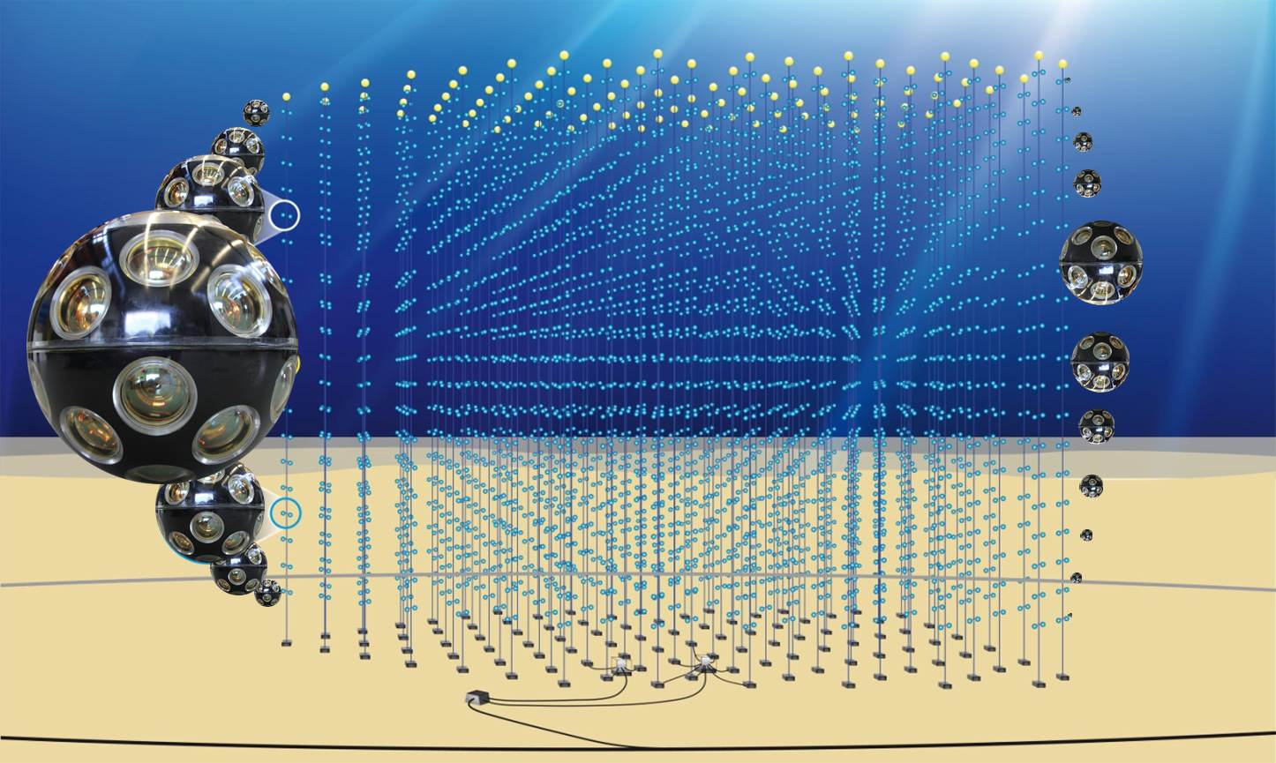
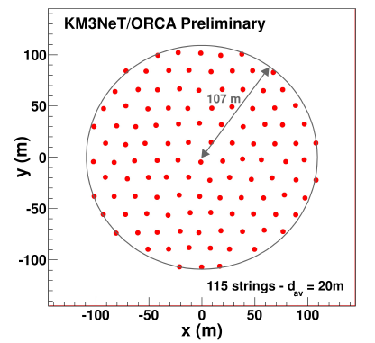
ORCA
Oscillation Research with
Cosmics in the Abyss
J. Brunner
Highlight talk: C. James
115 lines, 20m spaced,
18 DOMs/line, 6m spaced
Instrumented volume ~3.8 Mt,
2070 OM
450 m
31 3” PMTs
Digital photon counting
Directional information
Wide angle view
Poster : Ronald Bruijn

Slide 36
Sensitivity to MH
J. Brunner
Dependence of sensitivity on time
for fixed θ₂₃ values and
δ_{CP} fixed to zero
- Track vs shower event classification
- Full MC detector response matrices
including misidentified and NC events
- Atmospheric muon contamination
- Neutral current event contamination
- Various Systematic uncertainties
Poster : Martijn Jongen
Notes:
Each type of events
(determined by neutrino flavour, interaction type and particle ID) now has
dedicated resolutions.

Slide 37
Sensitivity to mass hierarchy
3 years
J. Brunner
Dependence of sensitivity on θ₂₃ .
Higher for NH than IH.
Second octant easier than first octant.
When fixing δ_{CP} to zero sensitivity
increases by ~0.5σ
Martijn JONGEN
Poster 935
Notes:
Each type of events
(determined by neutrino flavour, interaction type and particle ID) now has
dedicated resolutions.

Slide 38
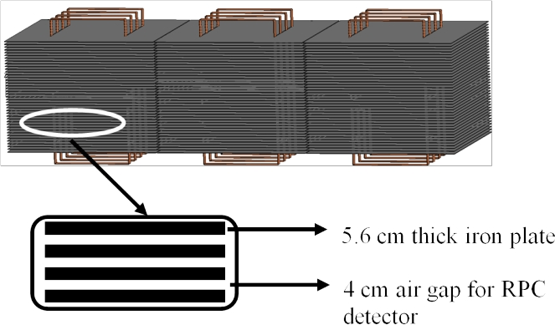
INO-ICAL
ICAL Collaboration (Ahmed Shakeel et al.) arXiv:1505.07380 [physics.ins-det]
The 50 kt magnetized iron calorimeter (ICAL) detector at the India-based Neutrino Observatory (INO)
Resistive plate
chambers
Energy and direction of the muons; energy of multi-GeV hadrons;
charge of muon
The energy and zenith angle dependence of the atmospheric neutrinos
in the multi-GeV range.

Slide 39
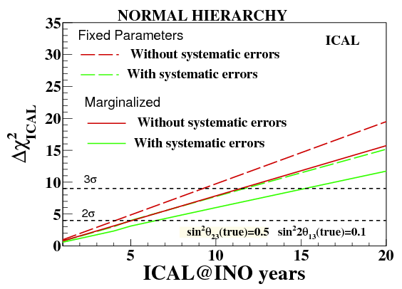
Sensitivity to hierarchy
ICAL Collaboration
(Ahmed Shakeel et al.) arXiv:1505.07380 [physics.ins-det]
10 -15 years
The impact of systematic uncertainties on mass hierarchy sensitivity.
The red (green) lines – without (with) systematic uncertainties
Long-dashed lines are for fixed values of parameters (1-3 mixing, 2-3 mixing, mass splitting ), solid -marginalized

Slide 40
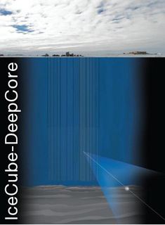
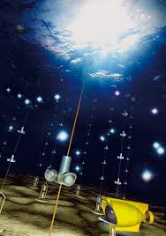
CP-violation

Slide 41
Measuring CP-phase
Global fit
Dedicated experiments
T2K + NOvA + reactors
J-PARC- HK
J-PARC- SK
DUNE LBNF
750 kw upgrade
ESS
Europeanspalation
source Lund
at 2- 3 σ
3π/2 from 0
~ 5 - 7 σ
result in 2030 - 2035
~ 2 bln US$
Long term and expensive commitment
Alternative?
All possible alternatives must be explored
and scenarios of developments in the next 20 years should be considered

Slide 42
Ice Cube
100 GeV
Deep Core
10 - 15 GeV
PINGU
Mass hierarchy
3 GeV
ORCA
3 times denser
array than PINGU
Super-PINGU
0.5 – 1 GeV
-ORCA
Few Mtons in sub-GeVrange
S. Razzaque, A.Y.S.
1406.1407 hep-ph
Megaton-scale
Ice
Cherenkov Array
MICA
0.01 GeV

Slide 43
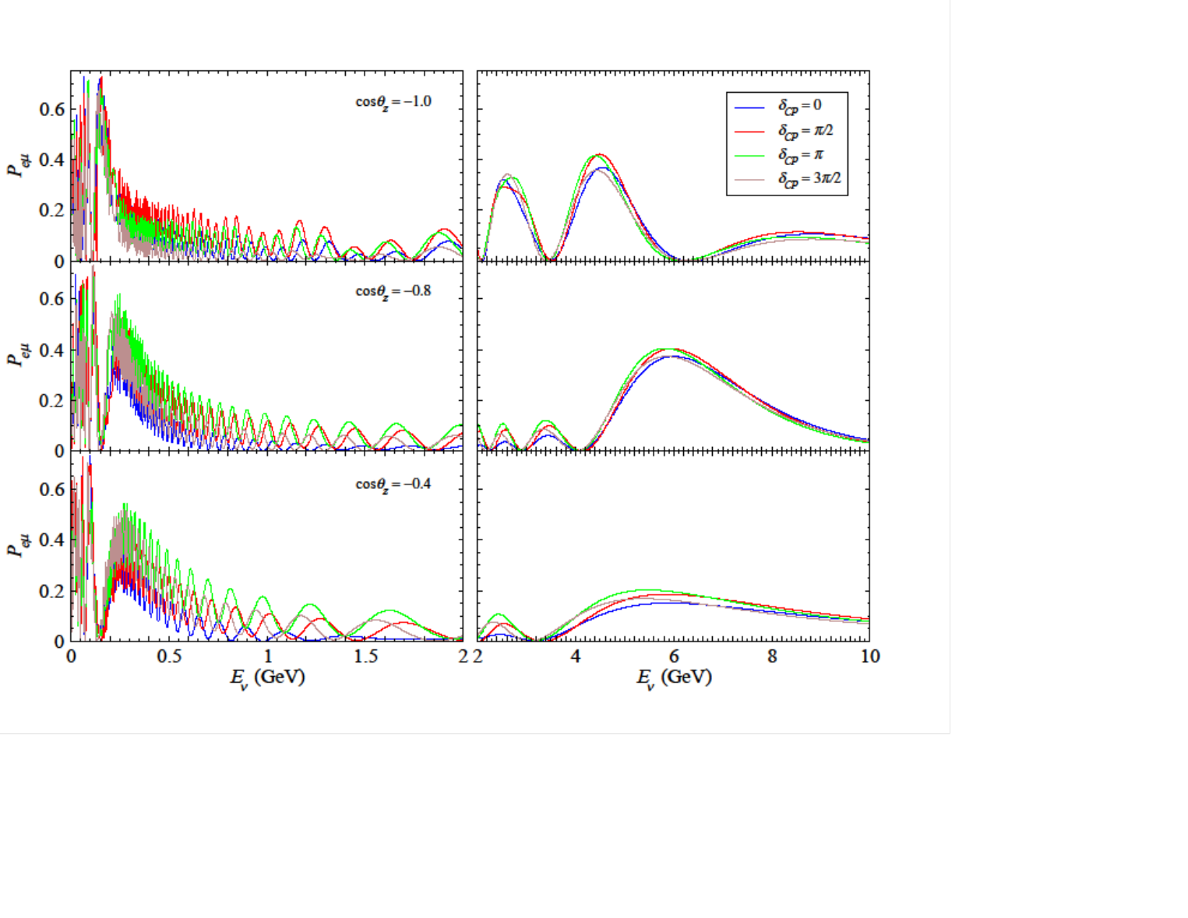
Probabilities
S. Razzaque, A.Y.S.
arXiv: 1406.1407 hep-ph
ν_{e} → ν_{μ}
NH
Large (10%) effect
at E ~ (0.5 – 1.5) GeV
Parametric effects
The key: with change of the phase
systematic shift
of curves,
the same for all zenith
angles in mantle
1-2 resonance
1-3 resonance
Averaging over
fast oscillations
and integration over zenith angle does not wash out CP phase effect

Slide 44
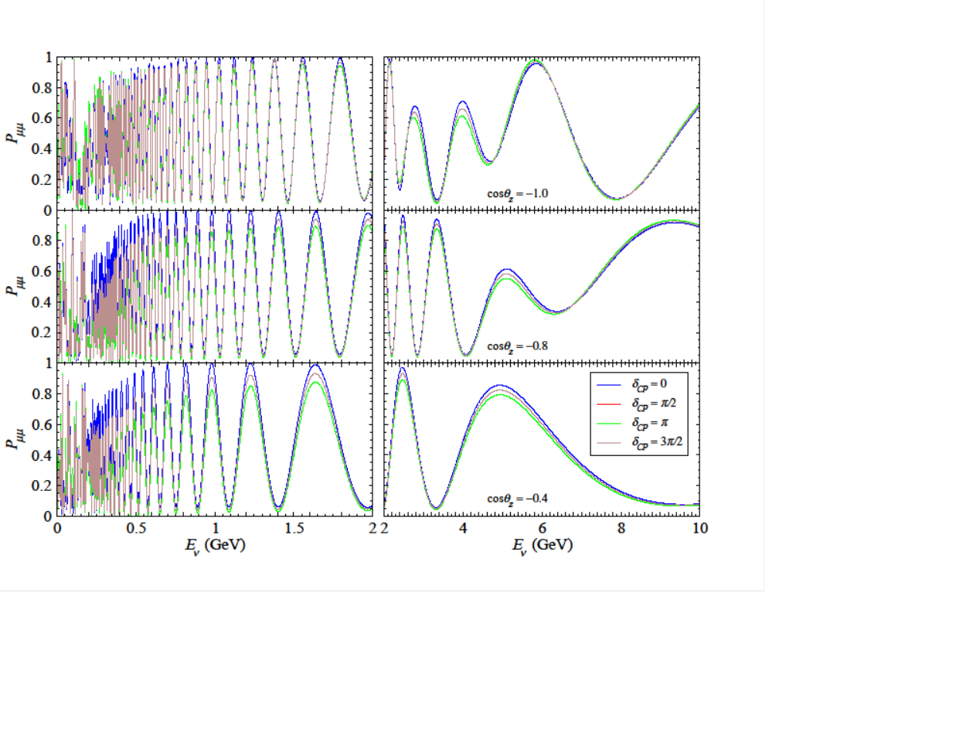
Probabilities
S. Razzaque A Y S
ν_{μ} → ν_{μ}
No phase shift
Effect is opposite
to ν_{e} → ν_{μ}
with change of δ
Flavor suppression
of effects for
ν_{μ} events
Flavor identification is crucial

Slide 45
Distinguishability for CP
Quick estimator (metric) of discovery potential
For each energy-zenith
angle bin ij
relative CP-difference
N_{ij} ^{δ} - N_{ij}^{δ = 0}
S_{ij} =
no fluctuations
N_{ij}^{δ = 0}
If is true value → N_{ij} ^{δ} corresponds to ``true’’ value of events
→ N_{ij}^{δ = 0} ``measured’’ number of events
|S_{ij}|
- distinguishability of different values of CP-phase
Total distinguishability
S^{tot} = [Σ _{ij} S_{ij}² ]^{1/2}

Slide 46
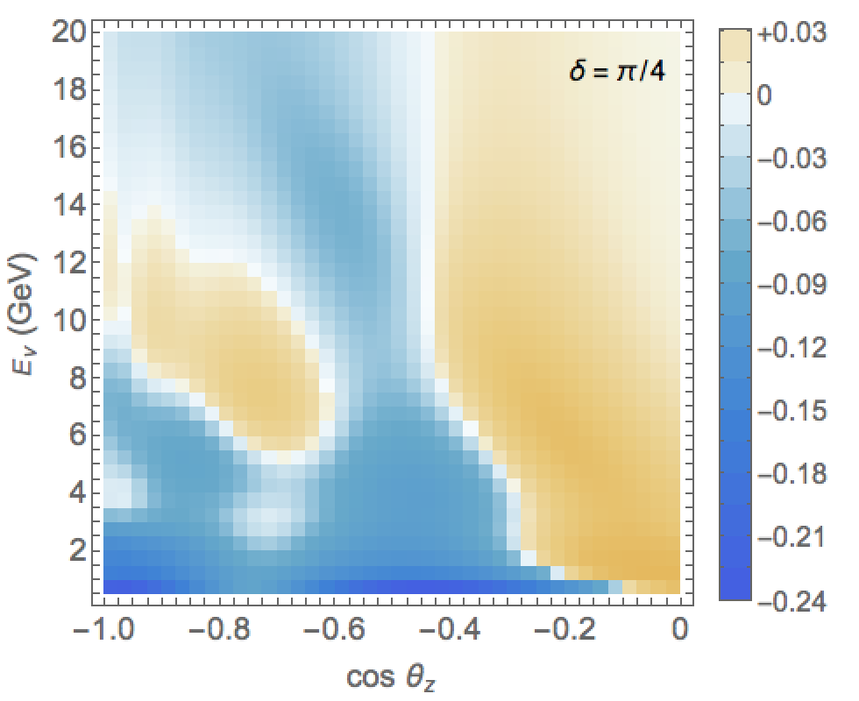
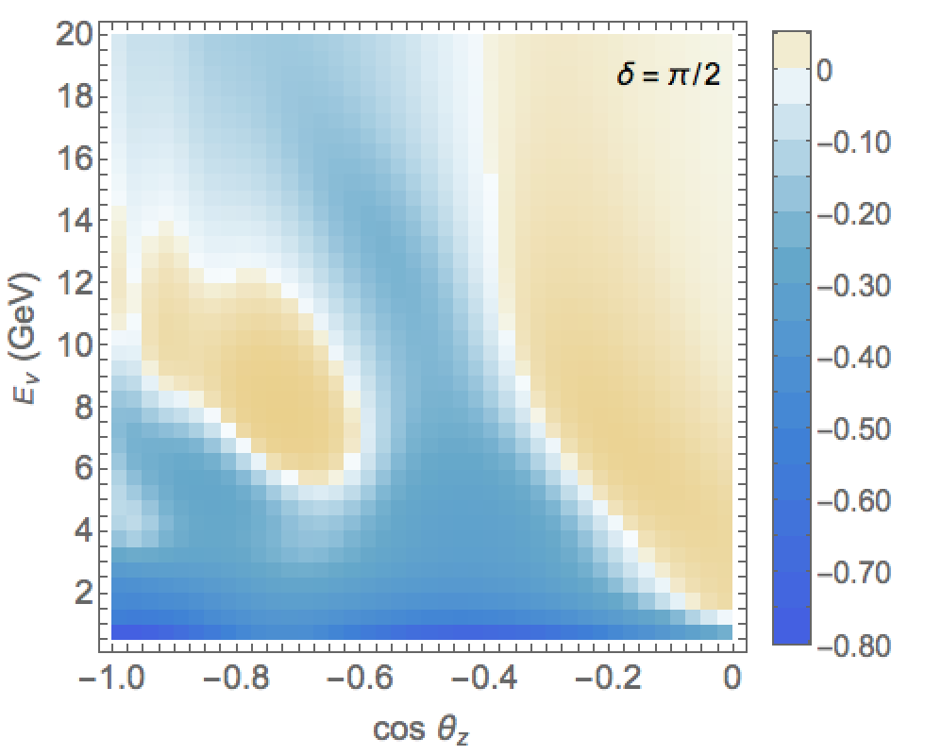
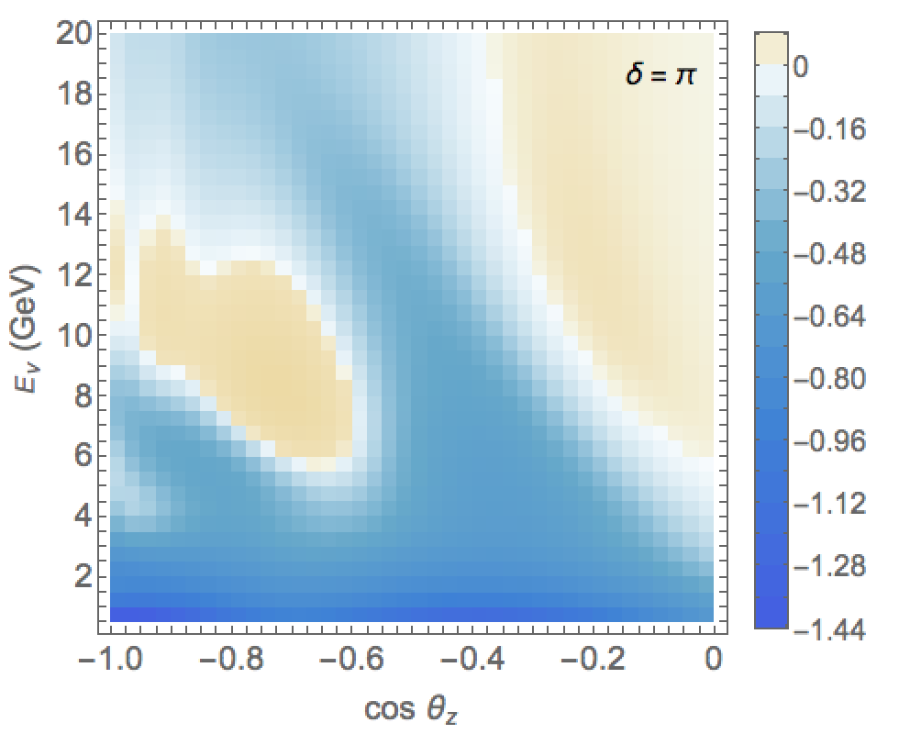
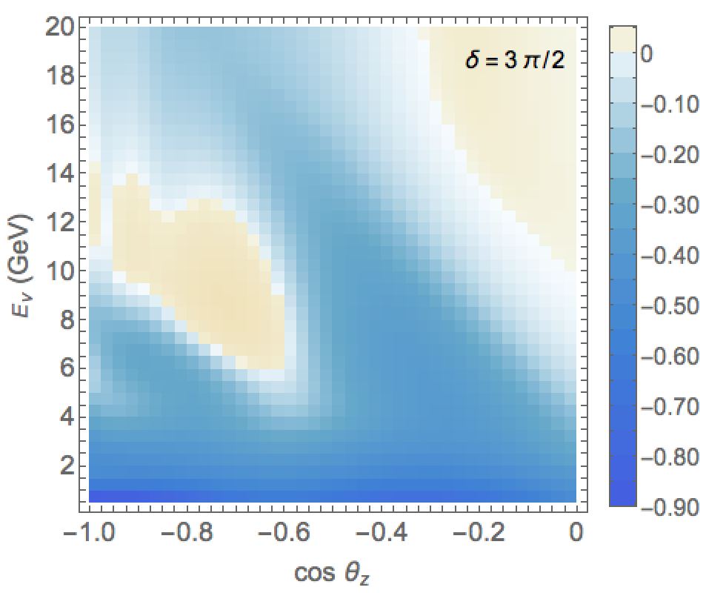
Neutrino images of the Earth
For different values of CP phase
ν_{μ}- CC events
(track + cascade)
S-distributions
for different
values of δ
Super PINGU
1 year
After smearing over neutrino energy and direction
S distributions
S. Razzaque, A.Y.S.
arXiv: 1406.1407 v2
hep-ph

Slide 47
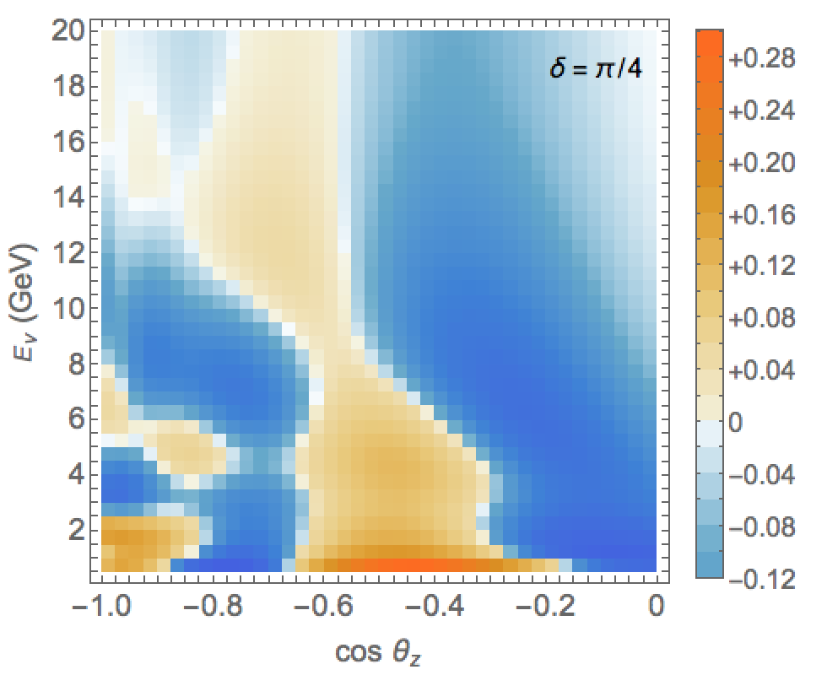
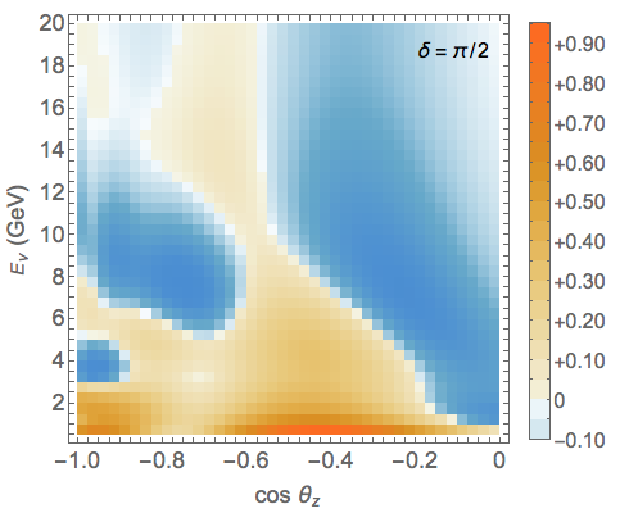
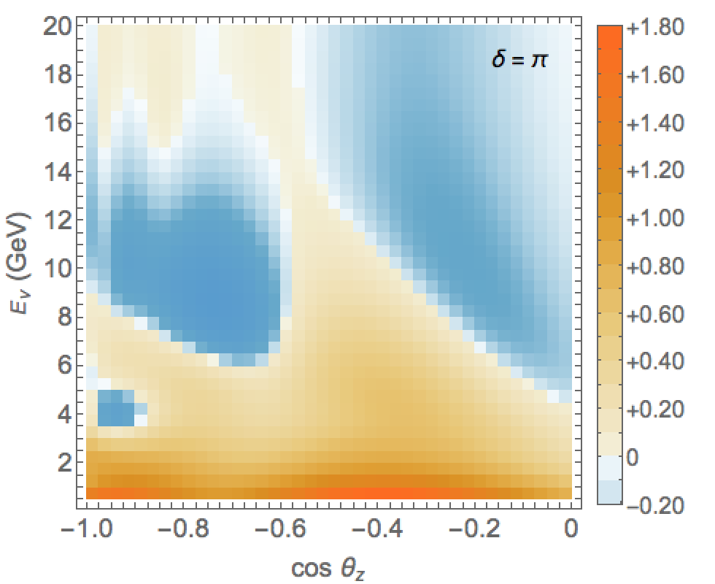
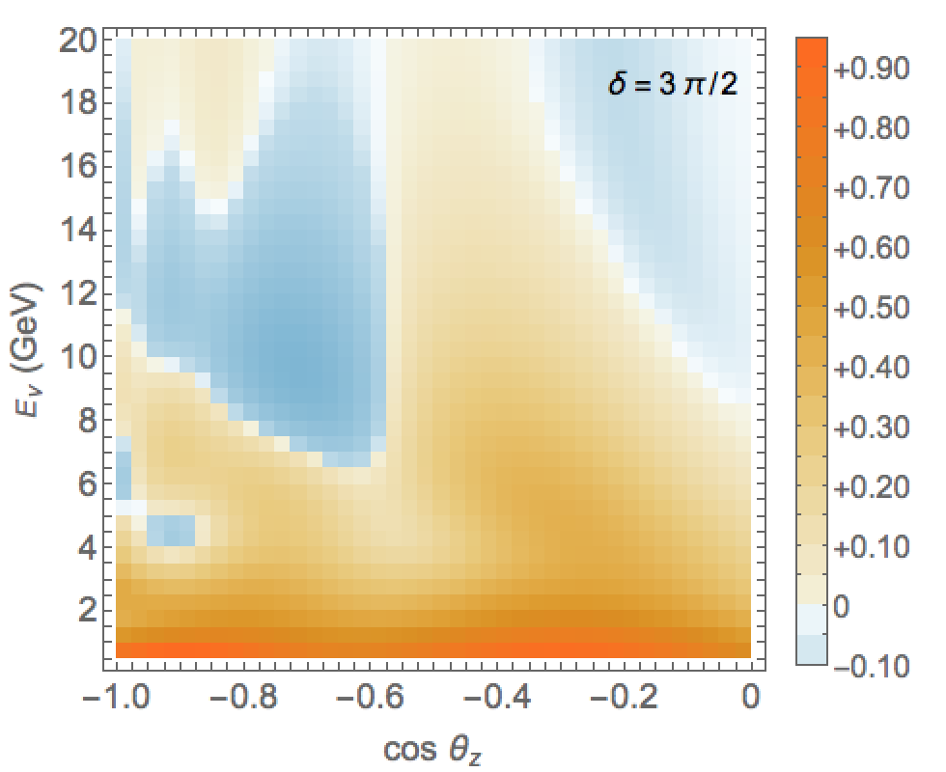
Neutrino images of the Earth
ν_{e} - CC events
(cascades)
S-distributions
for different
values of δ
Super PINGU
1 year
After smearing over neutrino energy and direction
S. Razzaque, A.Y.S.
arXiv: 1406.1407 v2
hep-ph
Can we measure this?

Slide 48
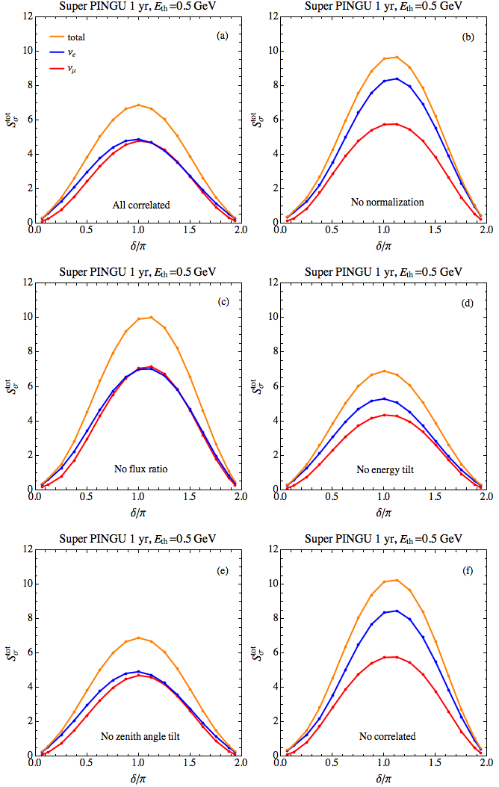
Sensitivity of
SuperPINGU
Effect of correlated systematic errors
Flavor misidentification can further reduce distinguishability by factor 1.5 - 2
Still S_{σ} ~ 3-4
for δ = π
after 4 years of exposure

Slide 49
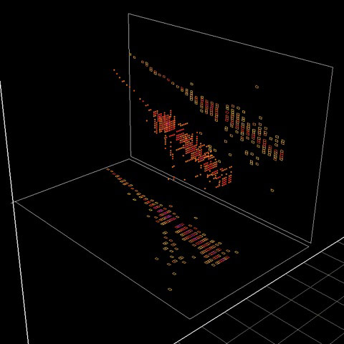
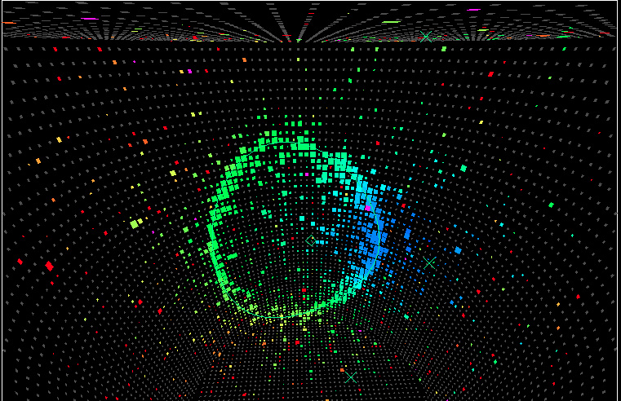
Summary

Slide 50
Enormous progress all mixing angles and mass splittings
in 3ν framework are measured
Still physics behind neutrino mass and mixing
is not yet identified
Few challenges imply existence of new neutrino states- sterile neutrinos
Measurements of missing parameters of the 3ν paradigm - mass hierarchy,
CP phase, as well as
searches physics beyond 3ν paradigm
may lead to breakthrough in the field.
Identification of the neutrino mass ordering –
next big in neutrino physics
Large atmospheric neutrino detectors with low (few GeV) energy threshold PINGU, ORCA may be first in this race.
Measurements of the Dirac CP-phase ultimate in oscillation neutrino experiments
A possibility to use further upgrade of PINGU, ORCA detectors to measure the CP phase should be explored

Slide 51
Race for mass hierarchy:
PINGU, ORCA
JUNO, RENO 50
T2K , NOvA
Supernova neutrino bursts
Cosmology
2022 – 2026 ?
Tomorrow? But require
better understanding collective effects
Fast developments of techniques of detection of low energy (atmospheric) neutrinos in multi Megaton detectors
Can address crucial issues in particle, neutrino physics:
- establishing neutrino mass ordering
- determination of the CP-phase
- searches for sterile neutrinos, and tests of existing hints
- searches for non-standard neutrino interactions, etc.
This may lead to major developments in the field

Slide 52
Backup slides

Slide 53
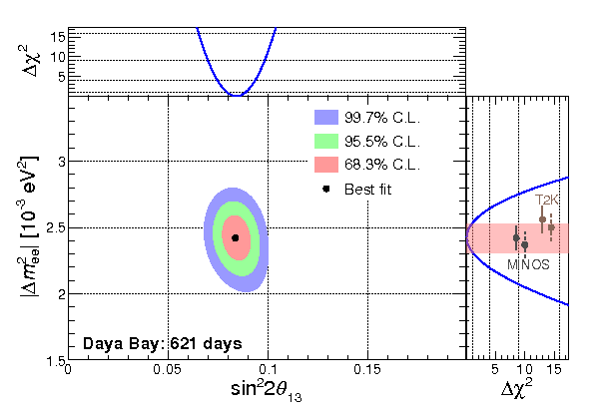
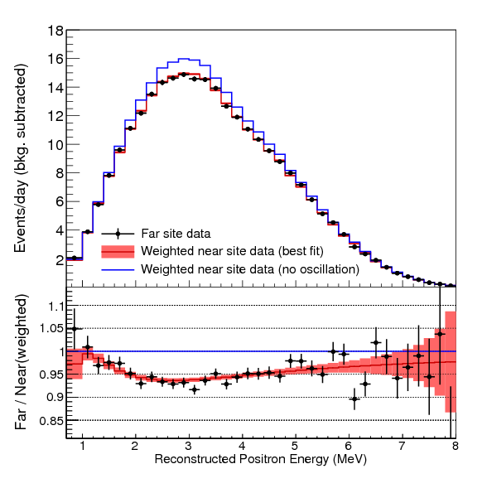
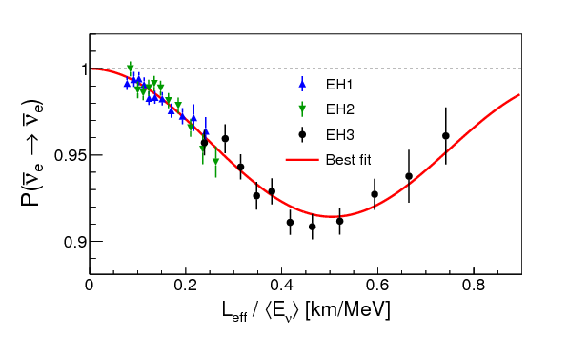
Daya Bay result
Daya Bay Collaboration
(An, F.P. et al.)
arXiv:1505.03456 [hep-ex]

Slide 54
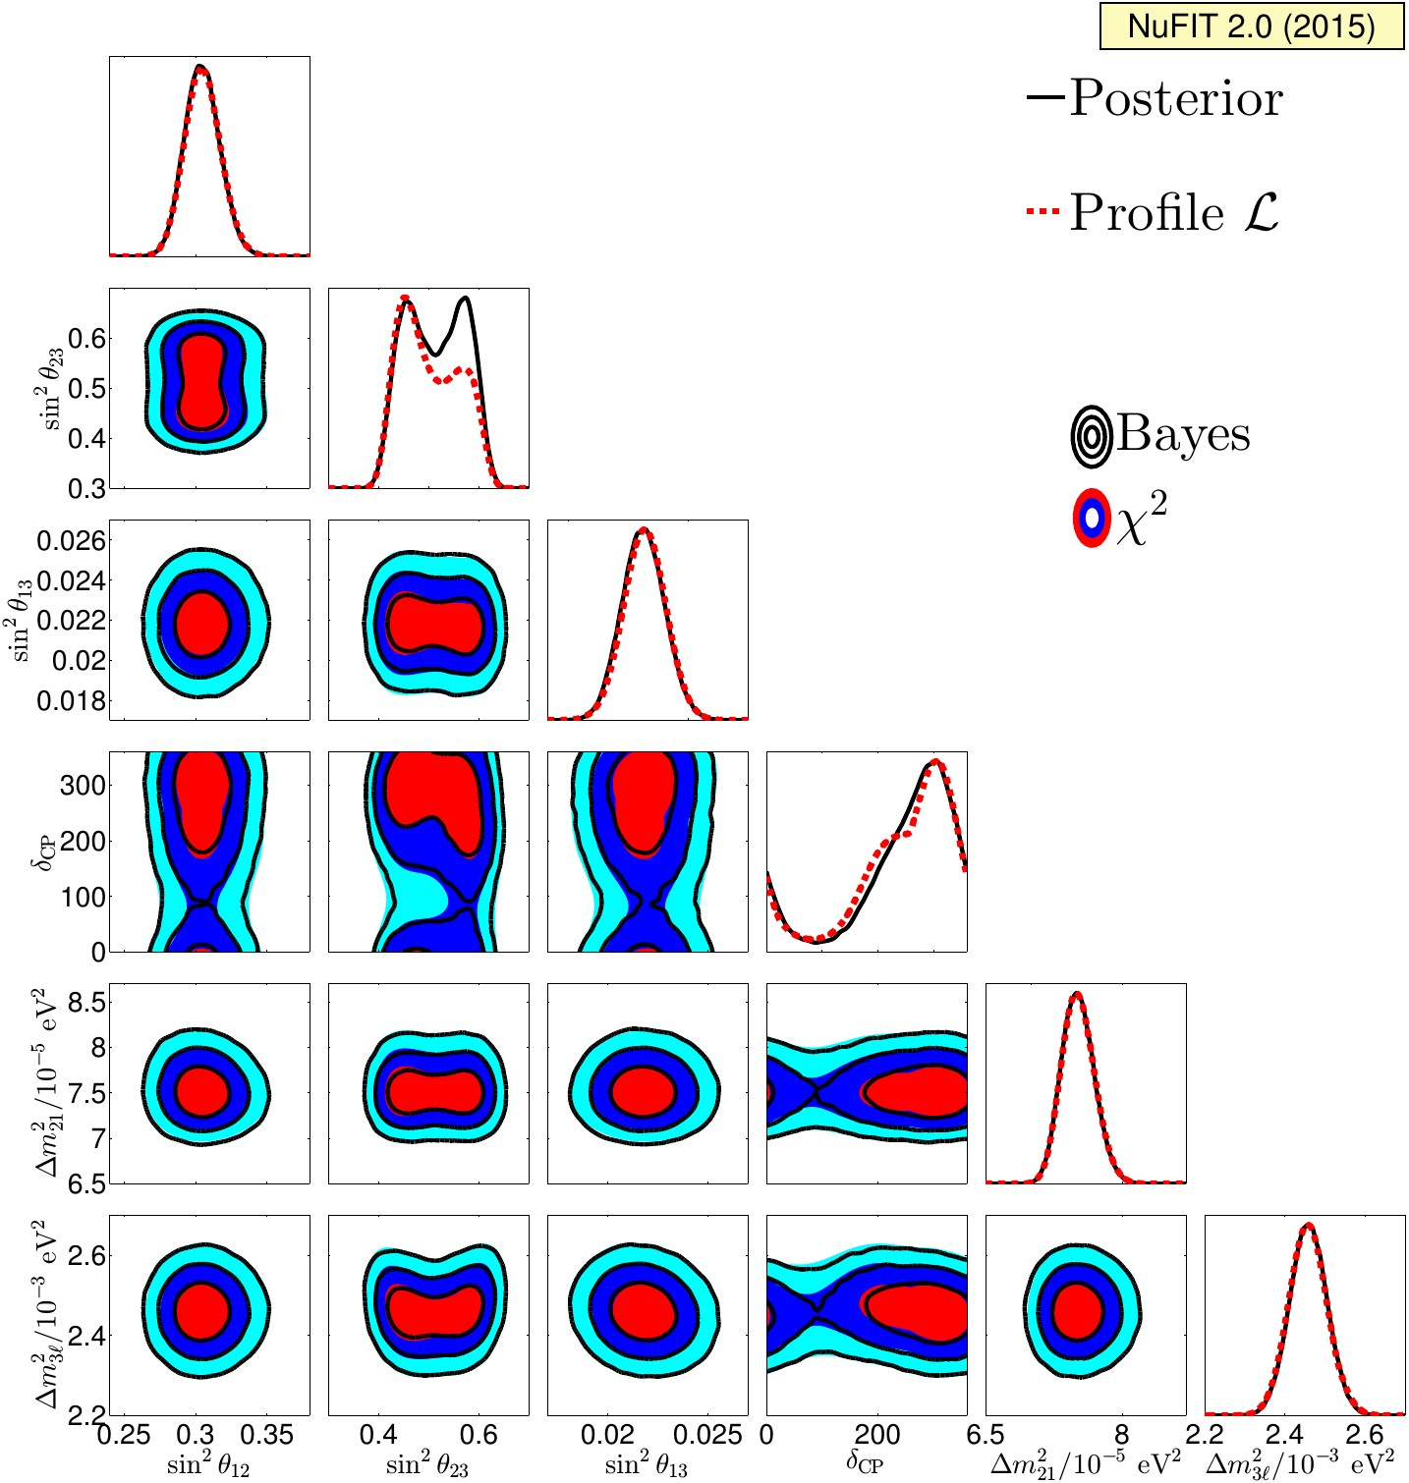
Global fit results
Normal ordering
J. Bergstrom, et al, 1507.0436 [hep-ph]

Slide 55

Global fit results
Inverted ordering

Slide 56
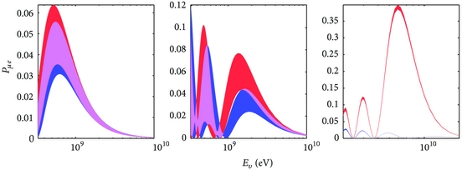
Hierarchy and CP
degeneracy
M. Blennow and A Y S, Advances in High Energy Physics , v. 2013 (2013), ID 972485
295 km
810 km
7500 km
The neutrino oscillation probability at baselines of 295 (left), 810 (middle), and 7500 km (right) as a function of the neutrino energy. The red (blue) band corresponds to the normal (inverted) mass hierarchy and the band width is obtained by varying the value of delta . The probabilities for antineutrinos look similar with the hierarchies interchanged. Note the different scales of the axes.

Slide 57
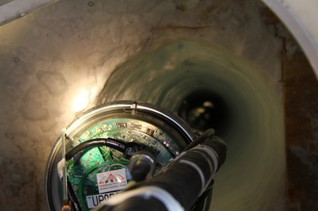

Neutrino Portal
Singlet of SM
symmetry group
SU(3)xSU(2) XU(1)
~
ν_{R}
(LH)
S
F is composite fermionic operator
F
ν
e
H⁺
H⁰
singlet of symmetry group of hidden sector
Non-local interactions which violate fundamental symmetries eg CPT

Slide 58
H-asymmetry and significance
Quick estimator (metric) of discovery potential
E. Kh. Akhmedov,
S. Razzaque, A. Y. S.
arXiv: 1205.7071
For each ij- bin
Hierarchy asymmetry
H-asymmetry
[ N_{ij}^{IH} - N_{ij}^{NH}]
S_{ij} =
N_{ij}^{NH}
``Distinguishability’’
If NH is true hierarchy → N_{ij}^{NH} ``experimental’’ number of events
→ N_{ij}^{IH} ``fit’’ number of events
|S_{ij}|
statistical significance of establishing true hierarchy
Uncorrelated systematic error
N_{ij}^{NH} → σ_{ij}² = N_{ij}^{NH} + (f N_{ij}^{NH}) ²
in denominator
Total distinguishability
S^{tot} = [Σ _{ij} S_{ij}² ]^{1/2}

Slide 59

Status and hint
Marginalized over 2-3 mixing
J-PARC (beam upgrade)
Super-Kamiokande
p.o.t. 6 10²⁰ → 7.8 10²¹
by 2018
i.e. 13 times higher statistics
sensitivity to the phase δ_{CP} at 90% C.L.
or better over
−115∘ < δ_{CP} < −60∘ for NH
+50∘ < δ_{CP} < +130∘ for IH.
if θ₂₃ = 45∘
T2K Collaboration (K. Abe, et al.). arXiv:1409.7469 [hep-ex]
NOvA
further substantial improvements
Distinguishing - π/2 from 0 at > 3σ level?
PDG (reactors)

Slide 60



Other physics
dms_23
Non-standard
interactions
Sterile nu
theta_23
sin² θ_{32, fit} = 0.50
sin² θ_{32, true} = 0.42

Slide 61
Mass ordering with reactors
ν_{e}
ν_{μ}
ν_{τ}
Normal hierarchy
Inverted hierarchy
Oscillation
frequency
ω₃₂
ν₃
ω_{ij} = Δm²_{ij} /2E
ν₂
ν₁
MASS
ω₃₂
Oscillation depth:
D₃₁ = 4|U_{e1}|²|U_{e3}|²
ω₃₁
ν₂
ν₁
D₃₁ ~ 2D₃₂
ν₃
ω₃₁
ω₃₁ > ω₃₂
ω₃₁ < ω₃₂
Fourier
analysis
S. Petcov M. Piai
ω
ω
Higher frequency -
larger depth
Higher frequency –
smaller depth
D₃₂ = 4|U_{e2}|²|U_{e3}|²

Slide 62



JUNO
Also RENO-50
Jiangmen Underground
Neutrino Observatory
d = 700 m, L = 53 km, P = 36 GW
20 kt LAB scintillator
n + p → d + γ
Key requirement:
energy resolution 3% at 1 MeV
Operation in 2020
(3 - 4)σ in 6 years

Slide 63
Leptons versus quarks
special
normal
ν₃
t
mass
mass
ν₂
c
ν₁
u
Leptons
Quarks
ν_{f} = U_{PMNS} ν_{mass}
U_{d} = V_{CKM}⁺ U
U = (u, c, t)
combination of down-quarks
produced with a given up quark

Slide 64
Solar neutrinos: 1-2 normal ordering
Determined with matter effects
on the solar neutrinos
suppression at high energies
is smaller than at low energies
|U_{e2}|² ~ sin²θ₁₂ ~ 0.3 for NH
P_{ee} =
|U_{e1}|² ~ cos²θ₁₂ ~ 0.7 for IH
The problem is to determine the 1-3 or 2-3 ordering
Solar neutrinos are not sensitive to 1-3 ordering due to very small matter effect on 1-3 mixing:
sin θ^{m}₁₃ = sin θ₁₃ 1 +/-
2EV cos 2θ₁₃
Δm²₃₁
NH / IH
few 10⁻²

Slide 65
Suppression of effects
different flavors:
ν_{e} and ν_{μ}
Screening
factors
(1 - r s₂₃² )
Original
fluxes
neutrinos and
antineutrinos
(1 - κ_{e} )
(1 – κ_{μ})
Reduces CP-asymmetry
Integration
averaging
averaging and smoothing effects
reconstruction of neutrino energy
and direction
Detection
identification of flavor

Slide 66


INO-ICAL
ICAL Collaboration (Ahmed Shakeel et al.) arXiv:1505.07380 [physics.ins-det]
The hierarchy sensitivity of ICAL with input normal hierarchy including correlated hadron energy information, with |Δm2eff|, sin2θ23 and sin22θ13 marginalised over their 3σ ranges . Improvement with the inclusion of hadron energy is significant.\chisqmh as a function of the exposure assuming NH (left panel) and IH (right panel) as true hierarchy.

Slide 67

Cascade events e + nutau
S. Razzque and A.Y.S.,

Slide 68

T2K
T2K Collaboration (K. Abe et al.). Phys.Rev. D91 (2015) 7, 072010
arXiv:1502.01550 [hep-ex]
Oscillation probabilities
0 1 2 3
E (GeV)

Slide 69



NOVA
FNAL – Ash River
L = 810 km, 14 kton
off axis 3.3º
E = 1 - 3 GeV
ν_{μ} − ν_{e}
oscillations in matter

Slide 70


NOvA and T2K sensitivity
T2K Collaboration (K. Abe et al.). Phys.Rev. D91 (2015) 7, 072010
arXiv:1502.01550 [hep-ex]
0 1 2 3
E (GeV)

Slide 71

CP-phase from global fit
M.C. Gonzalez-Garcia, M. Maltoni,
T. Schwetz, JHEP 1411 (2014) 052,1409.5439 [hep-ph]
Inverted
Normal
Contribution of different sets of experimental results to the determination of the mass ordering, the octant of θ₂₃ and of the CP violating phase.
Genesis of determination
Solar
Reactors
MINOS dis
+
T2K - Dis
+
T2K-App
+
MINOS-App
Atm nu contribution: excess of sub GeV nue events
+
Atmospheric

Slide 72




LBNF-DUNE
L = 1300km, LAr TPC 35 kt

Slide 73
λ
Mass hierarchies
at m_{Z}
up down charged neutrinos
quarks quarks leptons
1
m₂
m₃
>
Δm₂₁²
Δm₃₂²
10⁻¹
~ 0.18
10⁻²
mass ratios
Neutrinos have
the weakest mass
hierarchy (if any)
among fermions
10⁻³
10⁻⁴
Related to large
lepton mixing?
10⁻⁵
Koide
relation
m_{u} m_{t} = m_{c}²
sinθ_{C} ~ m_{d}/m_{s}
Gatto–Sartori-Tonin relation

Slide 74

Sensitivity to MH
Notes:
Each type of events
(determined by neutrino flavour, interaction type and particle ID) now has
dedicated resolutions.

Slide 75
CP-violation and CP-phase
Dirac CP-phase in the standard parametrization of the PMNS matrix
ν_{f} = U_{PMNS} ν_{mass}
U_{PMNS} = U₂₃I_{δ} U₁₃I_{−δ} U₁₂
I_{δ} = diag (1, 1, e^{iδ} )
CP- transformations:
ν → ν^{c}
ν^{c} = i γ₀ γ₂ ν ⁺
upto Majorana phase
Under CP-transformations:
Matter potential
U_{PMNS} → U_{PMNS} *
δ → - δ
V → - V
usual medium is C-asymmetric which
leads to CP asymmetry of interactions
Degeneracy of effects:
Matter can imitate CP-violation

Slide 76


Global Fit

Slide 77




Smeared distributions
J. Brunner [532]
Muon- and electron-channels contribute to net hierarchy asymmetry.
Electron channel more robust against detector resolution effects:
E, θ smearing
(kinematics
+ detector
resolution)

Slide 78

Sensitivity
K. Clark

Slide 79
Sensitivity to 2-3 mixing
Deviation from maximal symmetry or no symmetry
Quadrant
Sensitivity to MH depends on
K. Clark, [1379]
sin² θ_{32, fit} = 0.50
sin² θ_{32, true} = 0.42

Slide 80
Smeared distributions
J. Brunner
Muon- and electron-channels contribute to net hierarchy asymmetry.
Electron channel more robust against detector resolution effects:

Slide 81
Symmetries of Hidden sector

