Slide 1
b508
.
Magdalena Kowalska

Slide 2
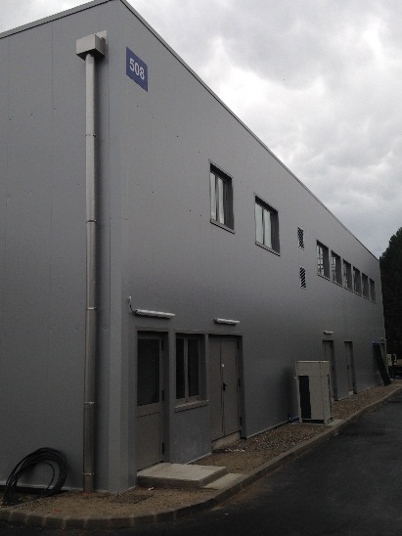
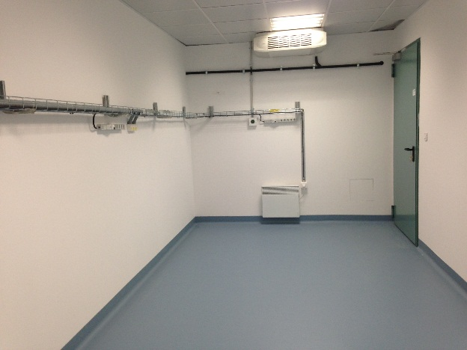
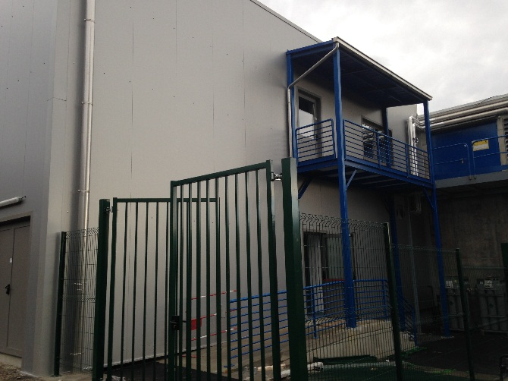
b508
Hand-over meetings:
  Civil engineering and cooling&ventillations – last week; points to be resolved identified
  Electricity – this Wednesday
  Safety – to be scheduled
Remaining:
  Closed cooling water system
  Vacuum gas exhaust
  Opening for SSP gases and fume cupboard
Move in
  Laser tables for COLLAPS and CRIS – this week
  CRIS laser setup by a technician – next week
  Proper move of all users - January

