Slide 1
Experiments, Schedule & Access to the hall
.
Magdalena Kowalska

Slide 2
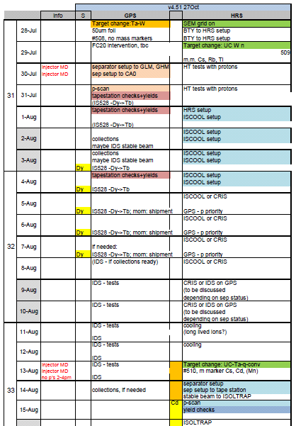
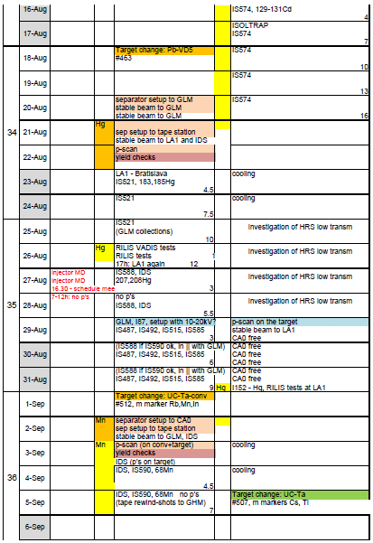
ISOLDE schedule – part 1
GPS startup on schedule (end July);
HRS – 2 weeks buffer eaten up and physics delayed by ca 1 week (CRIS and IDS runs changed into tests)
Magnet cycling and slit position problems

Slide 3
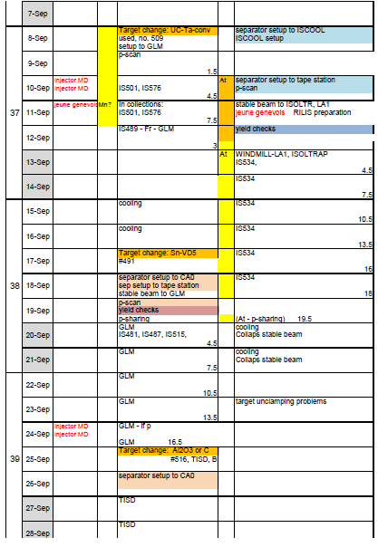
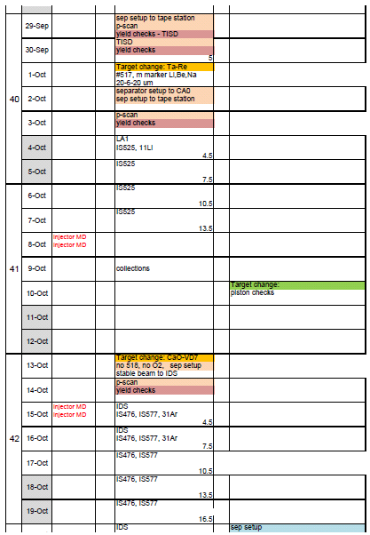
ISOLDE schedule – part 1
GPS rather ok
HRS: only one smooth run and then target piston problem – rescheduling

Slide 4
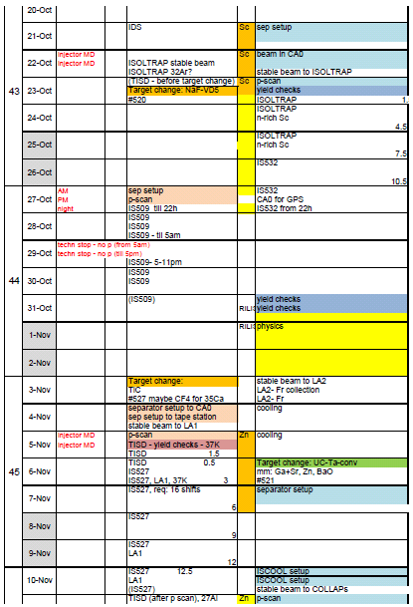
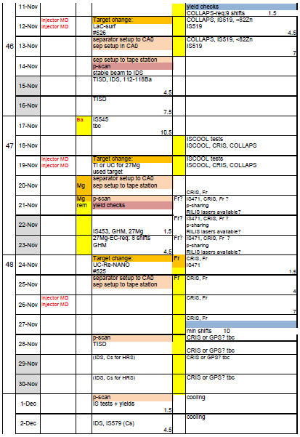

ISOLDE schedule – part 2
GPS: several new or prototype targets
HRS: COLLAPS and CRIS – require ISCOOl bunching

Slide 5
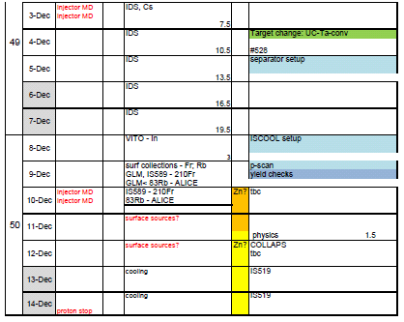
ISOLDE schedule – summary
Very difficult start-up
  Still debugging in the online period
HRS piston problem
HRS multipoles on – no beam
B508 delayed – CRIS, COLLAPS, SSP
Policy: give some beam to every group
=> many changes to the schedule
Some nice physics in spite of problems
Rare-earth collections of medical isotopes for PSI, Denmark, Lausanne
ISOLTRAP: mass of 130-132Cd – 2/3 of programme in 1/3 of time, no Cs contasmination
206Hg for IDS – reasonable transmission
The TATRA setup from Bratislava – new ISOLDE group and setup
Solid-state studies with molten Pb and Sn targets
In-source spectroscopy of At – WINDMILL and ISOLTRAP
11Li for Caen and Madrid groups – 1000 ions/s for > week, neutron detectors at LA1
31Ar at IDS, 1-2 ions/s for > week, target survived CERN-wide 3h power cut
TISD: boron beams, molten salt, …

Slide 6
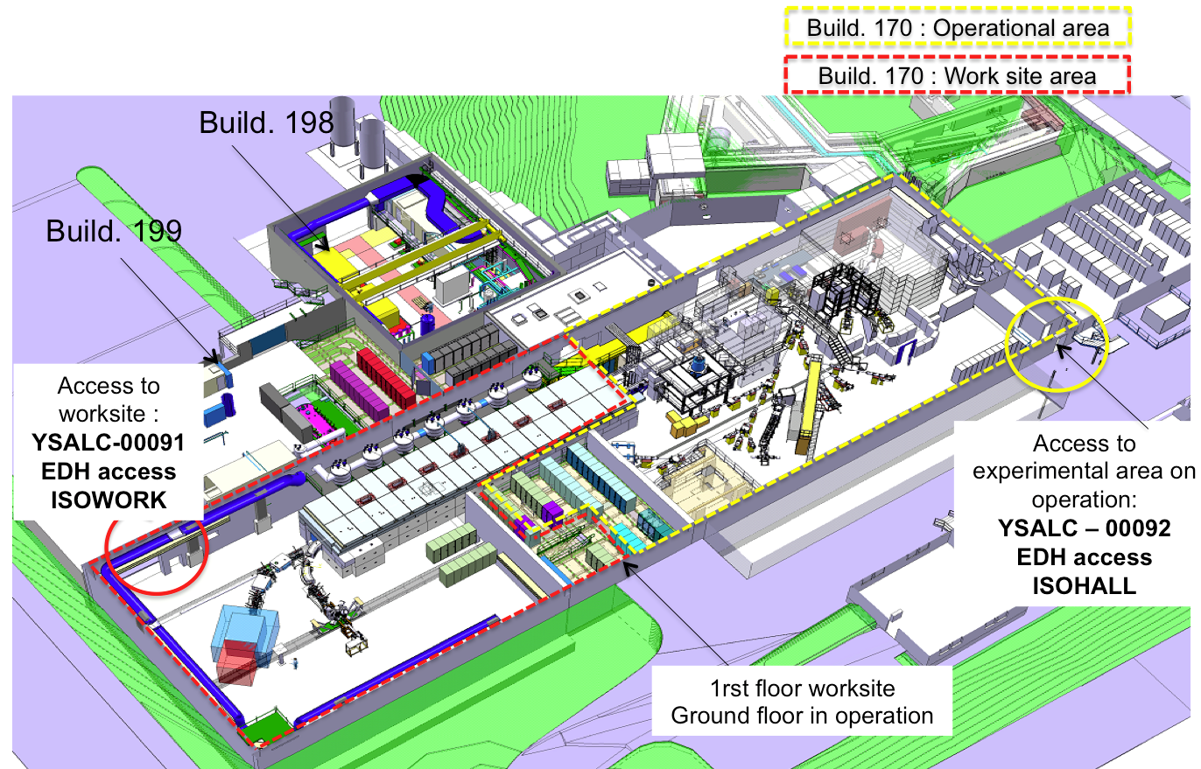
Access to ISOLDE
From beginning of July:
  Access to HIE-ISOLDE worksite: only local physicists when moving equipment
  Access for users from Jura side

Slide 7
Access to ISOLDE
Users requesting dosimeter after Jul 1st: (www.cern.ch/isolde/get-access-isolde-facility)
No temporary dosimeters possible
To obtain dosimeter:
  Follow online courses on general safety (as before)
  Follow online RP course on Supervised Areas (as before)
  Follow ISOLDE online RP course – NEW, no complaints until now
  Present RP form signed by home institute – NEW, only 1 complaint until now
To access ISOLDE:
  Follow 2-h RP ISOLDE practical course – NEW (2pm Tue, Fri, no complaints until now)
  Follow online electrical awareness course - NEW
CERN staff requesting dosimeters: as before (online courses + 1-day course)
Users and staff with valid dosimeters:
    After July 1st: Follow ISOLDE online RP and electrical awareness course
    Follow new procedure when present medical certificate expires
Access to ISOLDE via dosimeter (once tourniquet behind ISOLDE is ready),
until then – with CERN card

Slide 8
Safety at ISOLDE
3 electrical incidents this year – safety teams looking closely
Safety contacts at ISOLDE
  General safety aspects, travelling experiments – GLIMOS (me)
  For fixed-setups: Safety person for every aspect assigned -> CERN courses have to be followed
Do not perform tasks for which you are not trained or at least briefed
  Connecting electronics and cabling (before powering up)– no problem
  Work with open circuits -> CERN “habilitation electrique” (2-day course) needed
  Filling LN2 – use cryo gloves and safety glasses, get a briefing from the local cryo-safety person
Electronics tests – electronics lab in b275, detector lab to come in b508
To come:
  Short safety file to be prepared by travelling experiments before running
  “light” safety check before taking beam (started last month)
  Ppt with electrical good practices – to be prepared by CERN safety by Jan2015
  Electrical safety at ISOLDE – online course and 1-h class course (joined with RP course) – for Jan2015

Slide 9
When at ISOLDE - practicalities
Toolbox for (mostly) travelling experiments refilled:
  Mechanical tools
  Safety equipment: glasses, cryo-gloves, LN2 tubes, electrical insulating gloves and mat
  Ask before taking tools of other experiments
Mechanical workshop
  Soon in b508
  Before - self-service workshop in Prevessin – contact Ramon Folch
Make sure that other respect safety rules:
  E.g. HIE-ISOLDE workers closing the SAS door and the door to the worksite
  E.g. users filling LN2 in flip-flops

