Slide 1
Acceptance studies of the ISOLDE beam lines with MADX
Elisa Rapisarda
PH Division

Slide 2
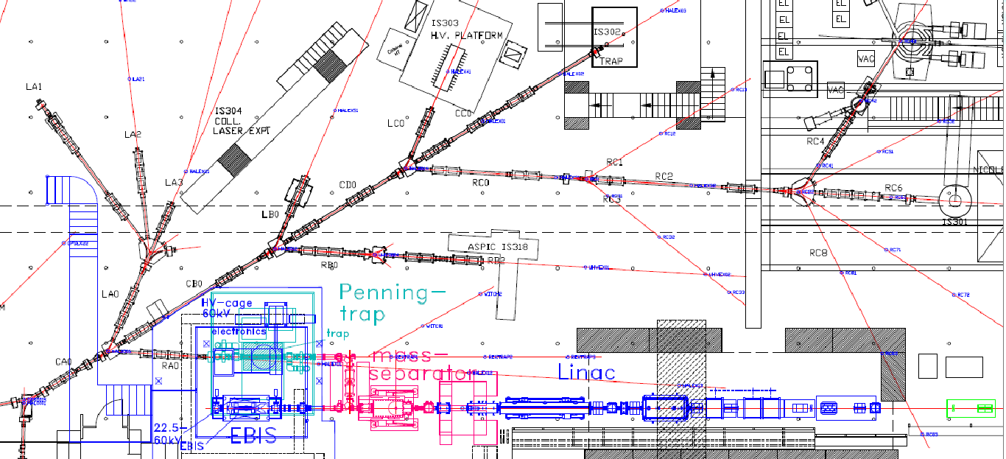
Motivation I
Transmission to RC4:
Design of the latest part
ISOLDE Decay Station
x
RC4
∼30 meters of beamline
31 elements (21 QUADs, 5 kickers, 5 deflectors)

Slide 3
Motivation II
Last Survey done in 2013 (Mateusz Boruchowski ) shows significant misalignments in the beamlines
Horizontal
8.7 mm
Vertical
These misalignments act on the beam transport to the experiment but it is not clear how large the effect is
Main question
Should the beam line be realigned?

Slide 4
Acceptance Study
What area in the initial phase-space makes it through the beam line from CA0 to the RC4 (IDS position)
Main unknowns:
beam emittance
Initial beam parameters
Different ion sources at ISOLDE, full characterization is missing
Approach:
Uniform distribution in phase-space (X,X’) and (Y,Y’)
Track particles using an experimental beam line setting
Add apertures
      Circular for quadrupoles ∅ = 15cm
      Rectangular for kickers (x=±20 mm) and Switchyards (x=±15mm)
      Check the fraction of the initial distribution that goes through
Three different configurations:
1) no misalignments are included in the definition of the beam line
2) With misalignments according to survey → trajectories are distorted
3) Correct the trajectories by using the steering power
QUESTION:
What the effect of the misalignment on the trajectories?
Can we recover the acceptance before the misalignment?
What will be the difference between the 1st and 3rd configuration? → quantify the effects of misalignment in the BEAM TRANSPORT
Notes:
Is the steering power strong enough? Are the steerers well placed to allow the recover?

Slide 5
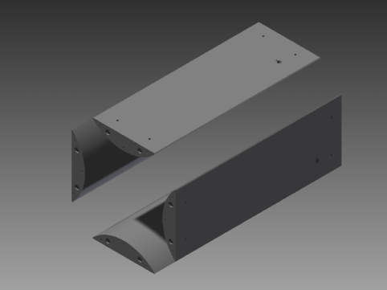
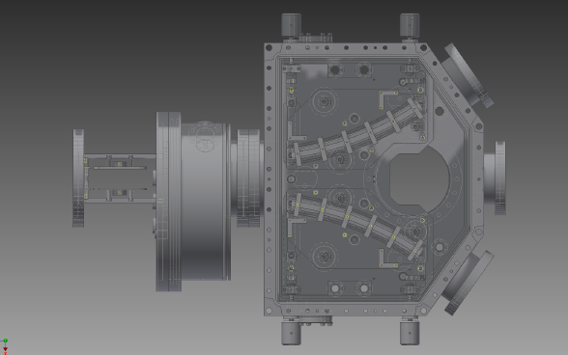
Method: MADX
MAD-X (Methodical Accelerator Design) is a software for particle accelerator simulations
based on transfer matrix formalism
Issues:
Only magnetic elements are implemented in MAD-X
ISOLDE has only electrostatic elements: quadrupole, kicker, deflector
Electrostatic Quadrupole vs Magnetic Quadrupole?
Effective lengths of the elements need to be adjusted?
Electrostatic deflector vs magnet?
Careful cross-check with SIMION for Quadrupoles, kickers and deflector
2 Summer Students: Casey D. McGrath, Vasil Karayonchev

Slide 6
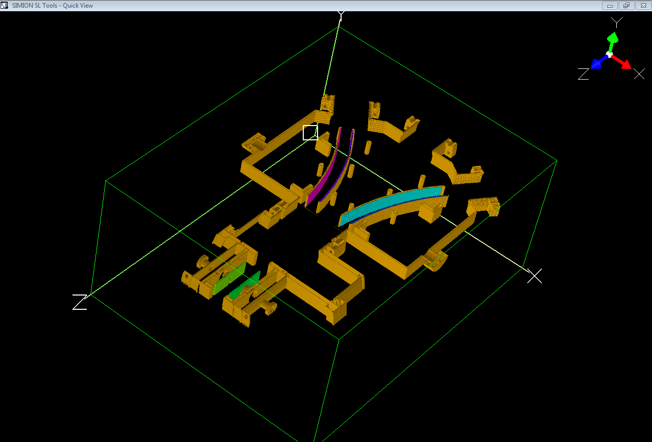
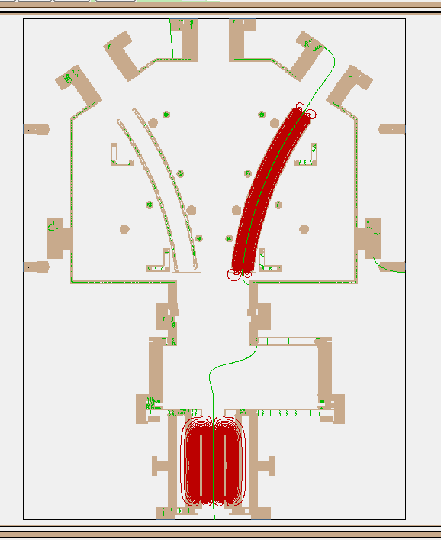
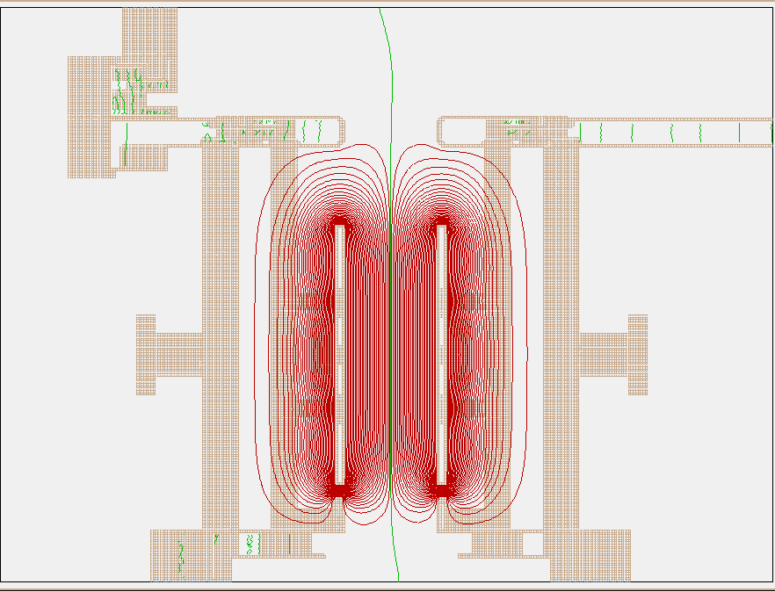
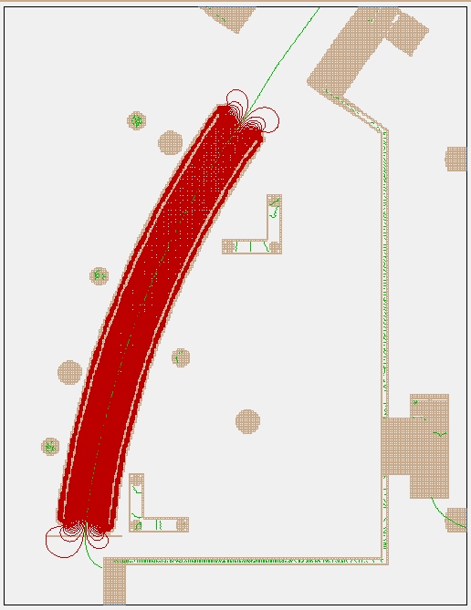
3-ways switchyard

Slide 7
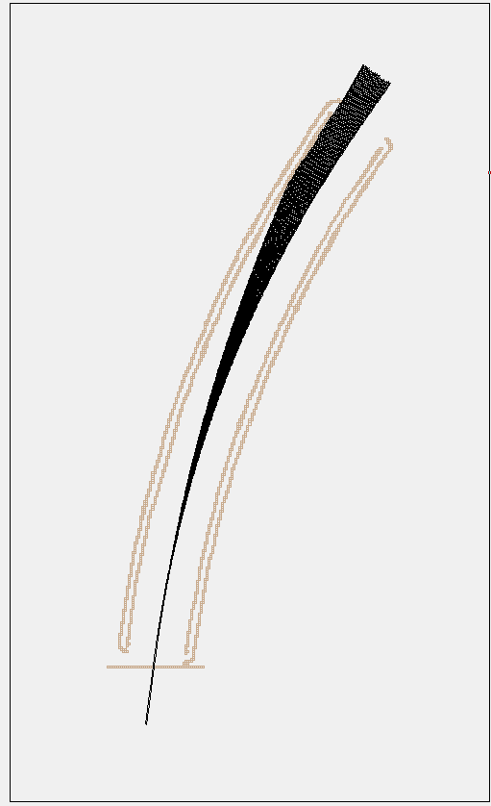
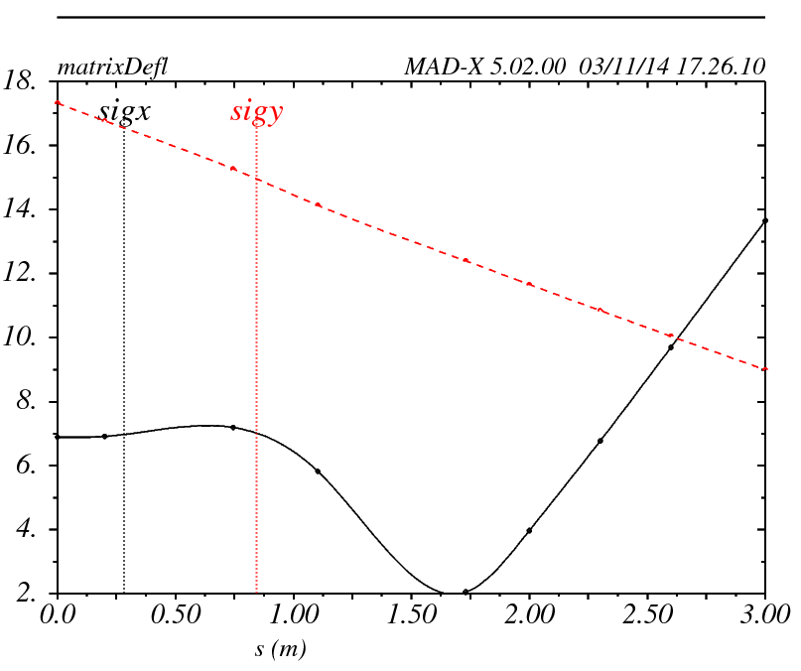
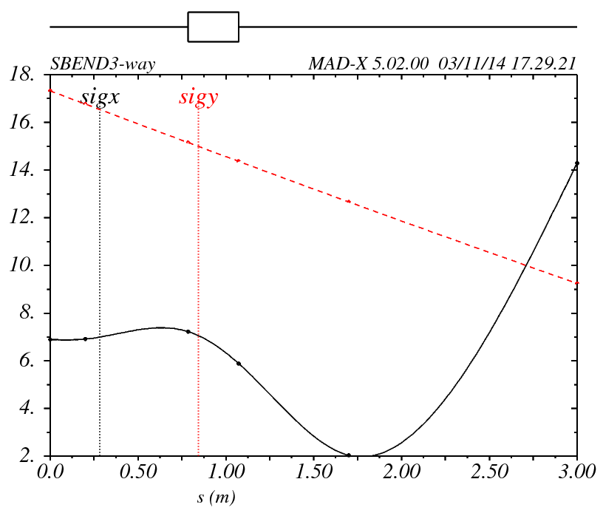

Track particles
Transfer matrix
Input in MADX
Electric bending radius = 600 mm
Electric bending angle = 27.5 deg
Electrostatic deflector behaves as a SBEND (magnet)
Magnetic radius = Electric radius (mm) / $√2$
Magnetic bending angle = Electric bending angle * $√2$
! Not for the dispersion (negligible at ISOLDE)
We have a correct model in MADX
BUT not well suited for dispersion studies

Slide 8
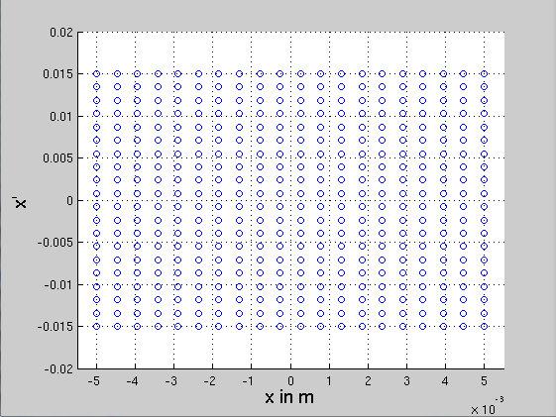
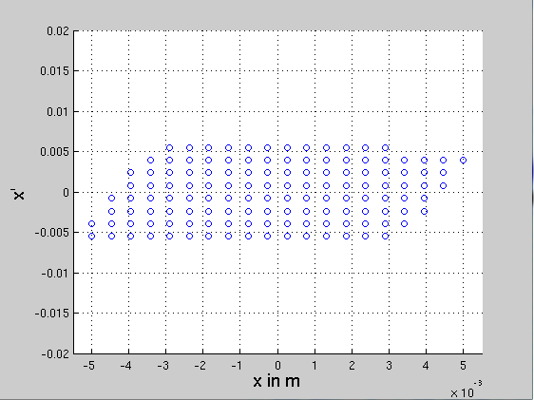
Nominal transport:
HRS_RC4_used142208_0359_voltages.madx
Acceptance Study (1)
Beam line without misalignments
Field strengths of the elements from used voltages in the experiment (without steerers) @30kV
No corrections of the beam are made
IN
OUT
±15 mrad
±5.0 mm
Emittance ε ∼20π mm mrad
(a) Tested phase-space
(b) Accepted phase-space
References:
Emittance ε_{_x} = 10 π mm mrad at 60kV → E. Kugler, Hyperfine Interactions 129 (2000) 23–42
Emittance ε_{_x} = 12-14 π mm mrad (surface source)at 30kV
Emittance ε_{_x} = 8 - 10 π mm mrad (plasma source) at 30kV
F. Wenander et al., Nucl. Instr. Meth. B204 (2003) 261
Notes:
It looks like the beam line (using the file from August) is able to transmit around 20pi [mm mrad] of emittance in X
According to the references the emittance is around 10 to 14π [mm mrad] according to the type of the source. For the surface source, the measured values translate to 10πmm mrad at 60kV
The match emittance of the beam – acceptance of the beam line is very close, this explains why we have always trouble to transport the beam, and at the best we get 80%, after hours and hours of tuning

Slide 9
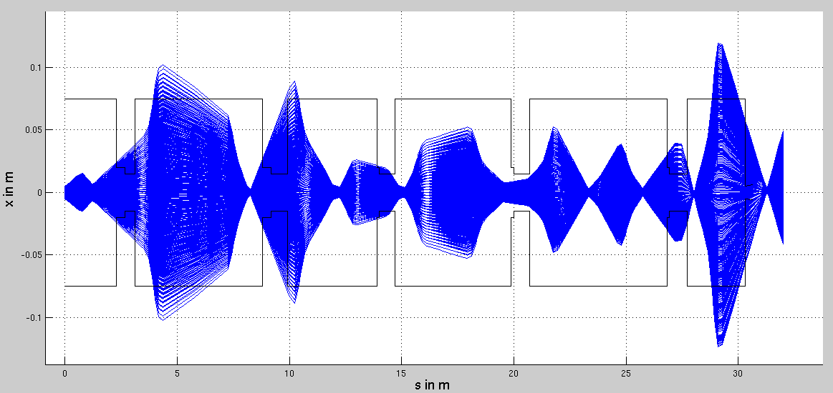
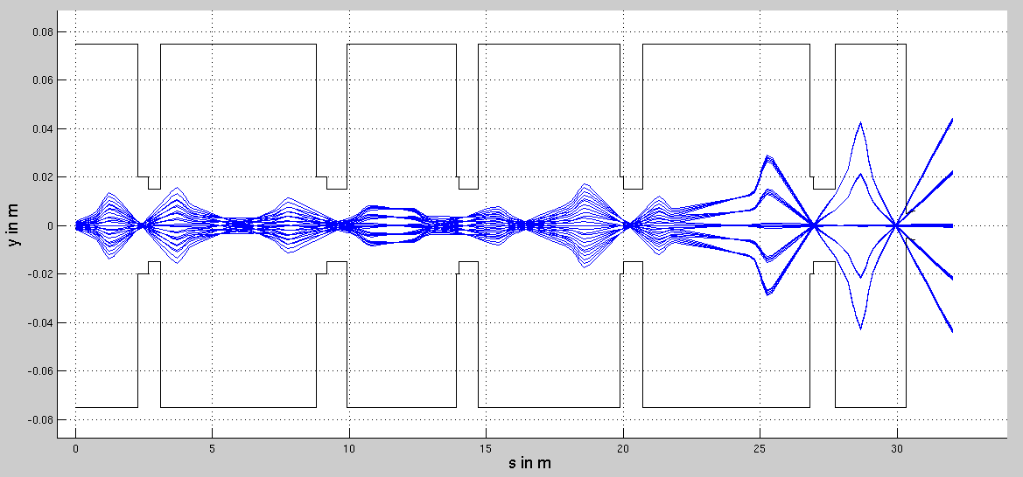
RC4
CA0
CB0
CC0
RC0
RC2
X envelope
Nominal transport:
HRS_RC4_used142208_0359_voltages.madx
Here the beam turns right
Quadrupole aperture
Deflector aperture
Y envelope
Notes:
Nominal optics of the beam line, using experimental values from a beam transport done on 22 August 2014. (29.88 keV, ¹³²Xe), 52% transmission

Slide 10
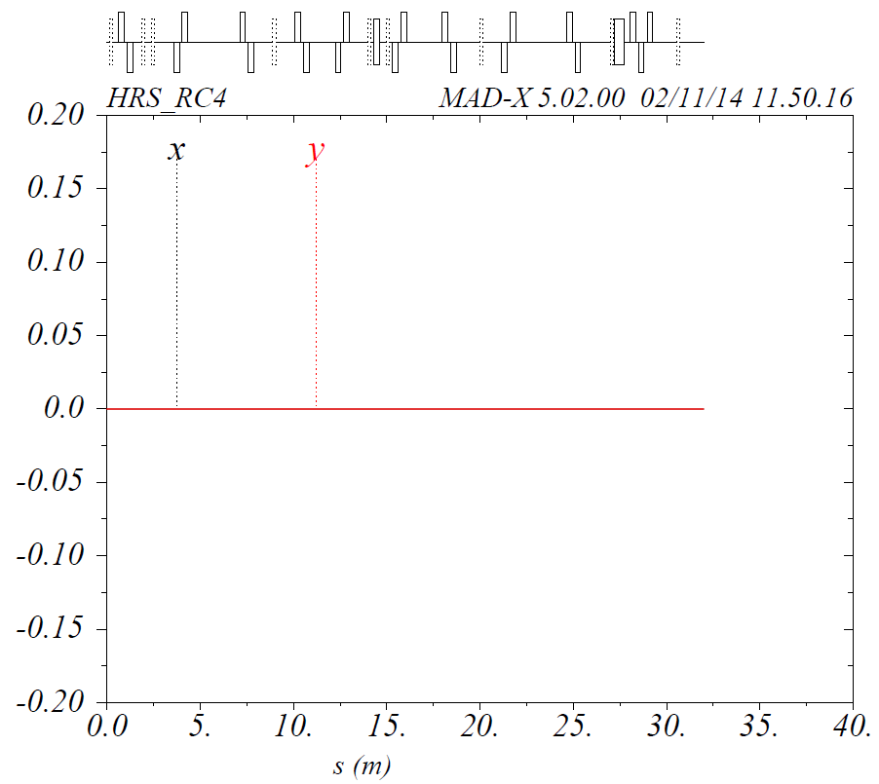
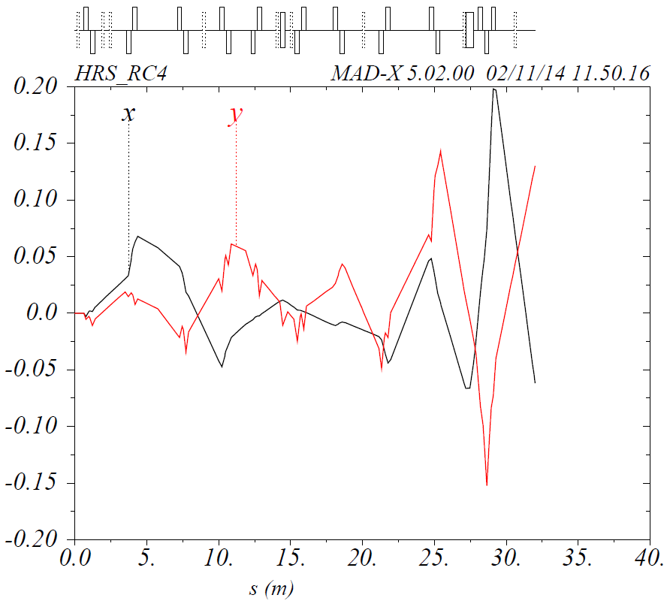
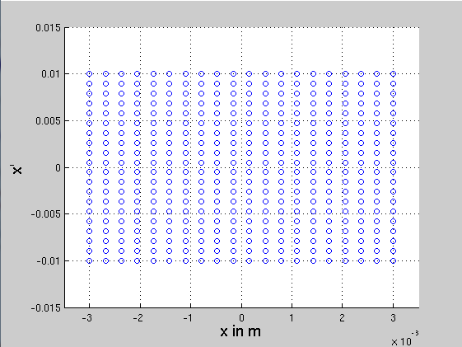
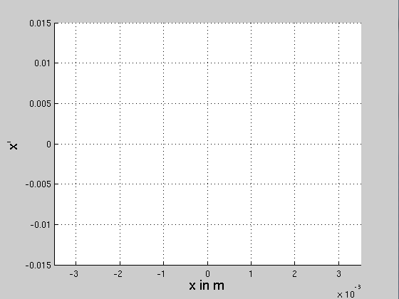
Acceptance Study (2) →add misalignments
Beam line WITH misalignments from survey 2013
Field strengths of the elements from used voltages in the experiment (without steerers)
No corrections of the beam are made
Expected:
Accepted phase-space will be much smaller than without misalignments
Central Trajectory (x,y)
No misalignment
BAD ORBITS
Central Trajectory (x,y)
With misalignment
(a) Tested phase-space
(b) Accepted phase-space
±10 mrad
±3.0 mm

Slide 11
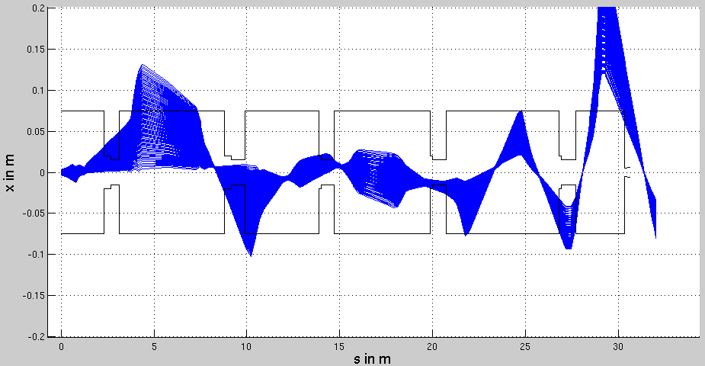
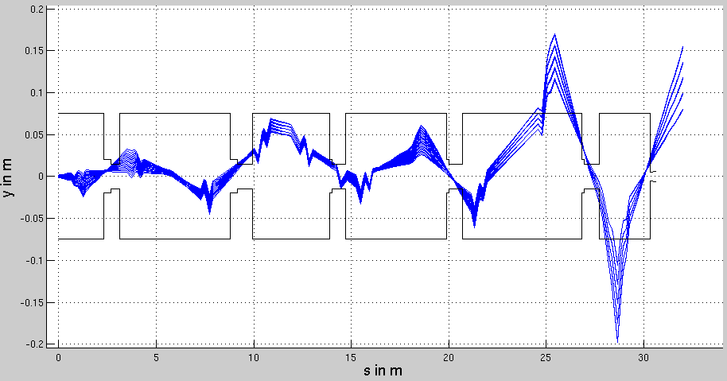
Acceptance Study (2)
X envelope
Y envelope

Slide 12
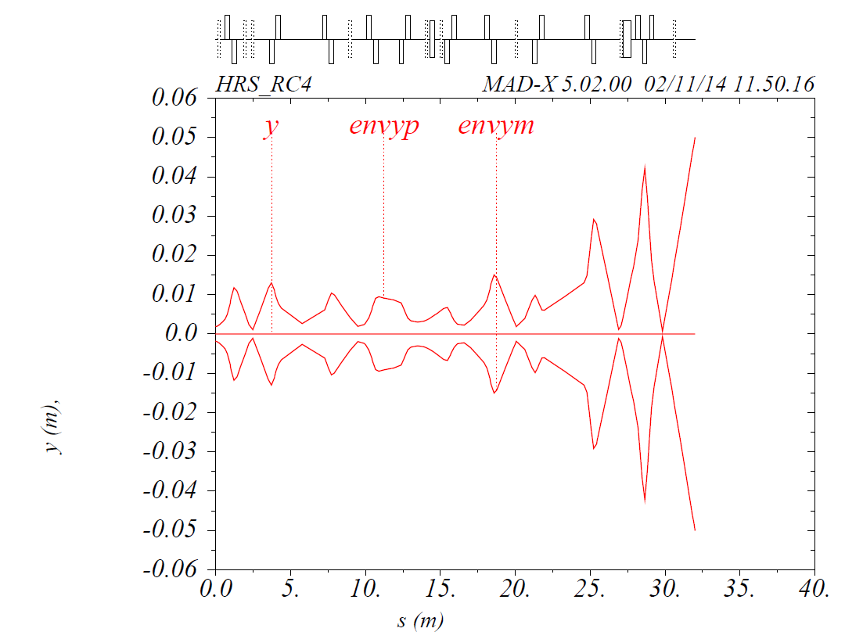
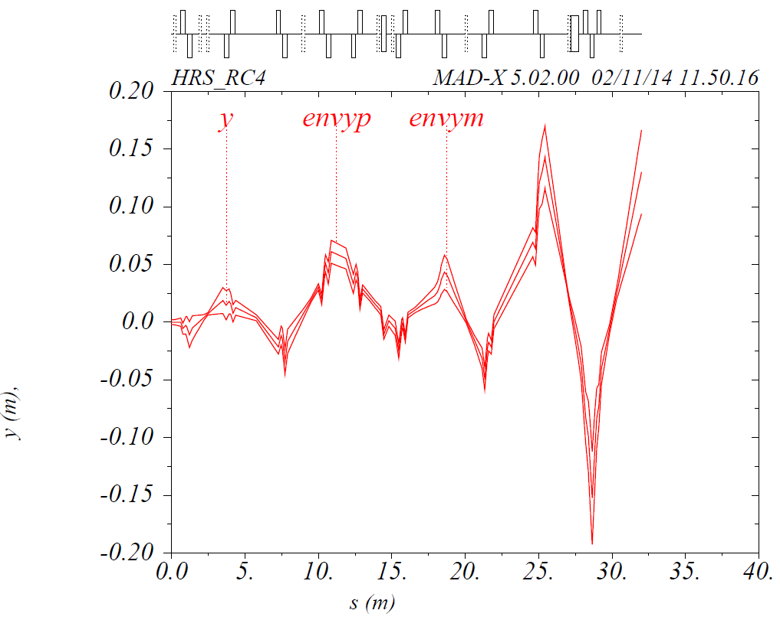
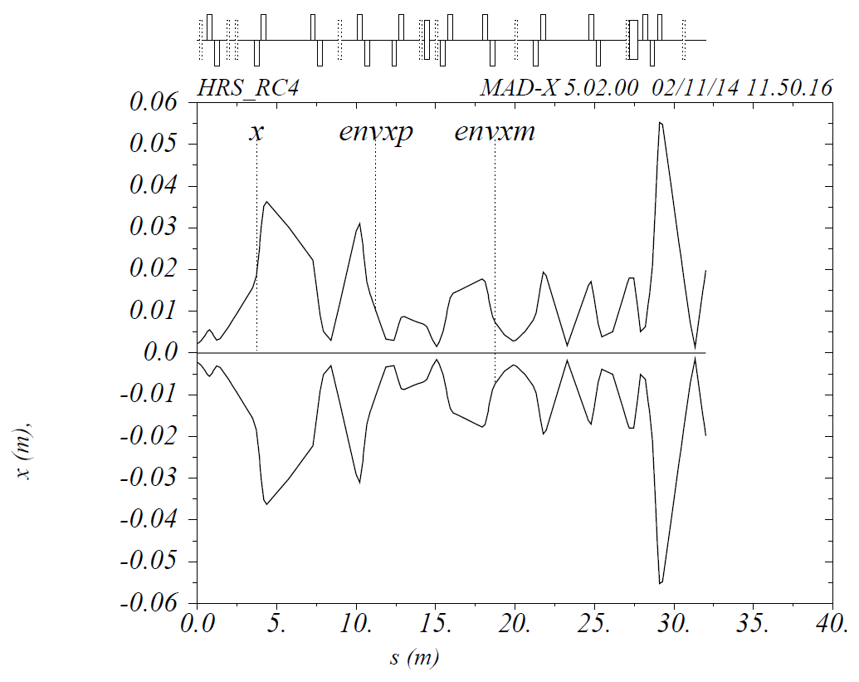
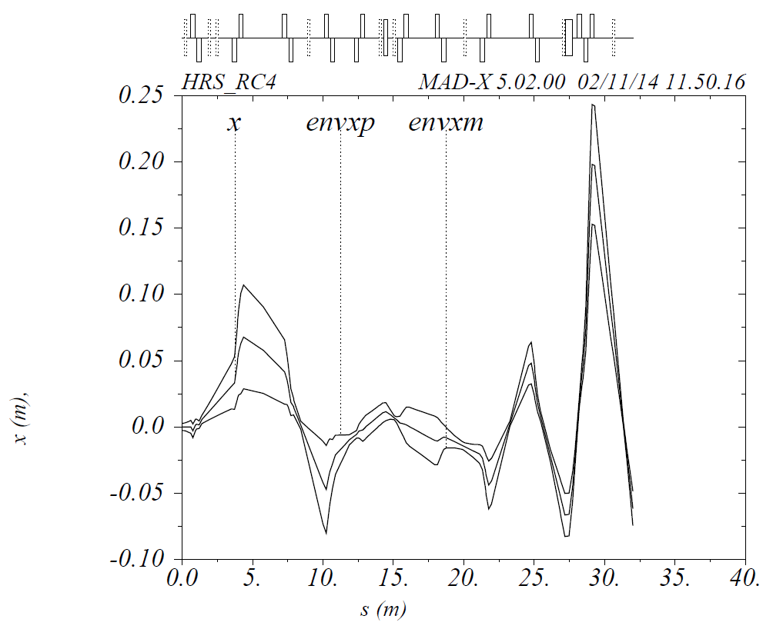
No misalignment
Add misalignment → BAD ORBITS
m
m
1σ
1σ
1σ
1σ
Kicker aperture
Quadrupole aperture

Slide 13
Acceptance Study (3) → Add misalignments
→add correction to misalignments
Beam line WITH misalignments from survey 2013
Field strengths of the elements from used voltages in the experiment (without steerers)
Corrections of the beam are made by using the steerers
Expected:
Accepted phase-space will be smaller than without misalignments
Accepted phase-space will be somewhere between the 1st and 2nd configuration
Trajectories correction algorithms
Global correction is performed using MADX Micado correction algorithms
Monitors are added in the beam line at the position of the Diagnostic Boxes (n.9 Diagnostic Boxes)
Correctors are the Quadrupoles steerers (n.8 Horizontal and Vertical Steerers)
The algorithms minimize the trajectory distortion at the monitors

Slide 14
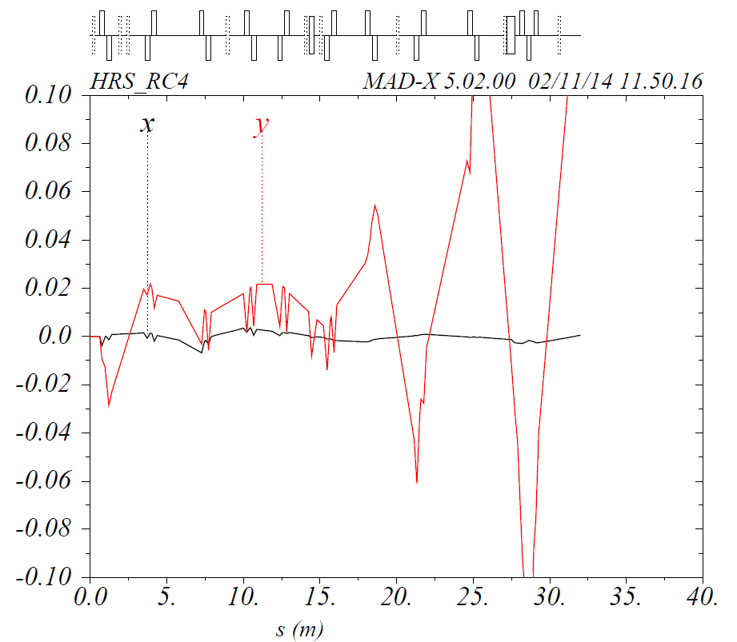
Central Trajectories (x,y)
No misalignment
with misalignment
->bad orbits
with misalignment
+ correction
X trajectory is recovered
@ NAME %04s "CORR"
@ TYPE %04s "CORR"
@ TITLE %07s "HRS_RC4"
@ ORIGIN %22s "MAD-X 5.02.00 Linux 64"
@ DATE %08s "02/11/14"
@ TIME %08s "11.50.16"
* NAME PX.OLD PY.OLD PX.CORRECTION PY.CORRECTION
$ %s %le %le %le %le
"CA0.QS40.1" 0 0 -0.006061917782 0
"CB0.QS30.1" 0 0 -0.002992806435 0
"CC0.QS50.1" 0 0 0.00163374579 0
"RC4.QS40.1" 0 0 -0.002733865499 0
Steerer Strenghts are within the steering powers
Correction (mrad) | Control Room Voltages (V)
- 6.1 | - 71.5
- 3.0 | -35.1
1.6 | 18.8
- 2.7 | -31.6
!!!! Y trajectory is not recovered (not yet)
(*) E_{beam}= 50keV

Slide 15
Acceptance Study (3) → Add misalignments
→add correction to misalignments
Trajectories correction algorithms
Global correction algorithm does not work fine for the trajectory Y where misalignment is larger
(n. 9 monitors (diagnostic boxes), n.8 correctors (quadrupoles steerers) too large phase space of parameters
PIECEWISE correction: combination of segment-by-segment correction
Enabling steerers over a short-range one by one, and checking the position at the next monitor downstream.
Still in progress
Notes:
Probably due to the fact that the vertical misalignment is pretty large

Slide 16
Conclusions
☺ Reliable model of the ISOLDE beam lines in MADX
☺ Integration with the HIE-ISOLDE beam transport simulations done also with MADX
☺ Easy implementation of other ISOLDE beam lines (LA1, LA2, VITO, …)
☺ Horizontal trajectory distortions generated by the misalignment can be corrected with the steerers
😐 Vertical trajectory distortions under analysis → PIECEWISE
TO BE DONE: quantify beam losses after trajectory correction
Thanks
J. Kurcewicz
M. Fraser
D. Voulot
3 Summer Students: Marcel Diem, Casey D. McGrath, Vasil Karayonchev

Slide 17
Does MAD-X work for us?
MAD-X includes only magnetic elements
At ISOLDE only electrostatic elements are present.
Quadrupoles? Switchyards (kicker+deflector) ?

Slide 18

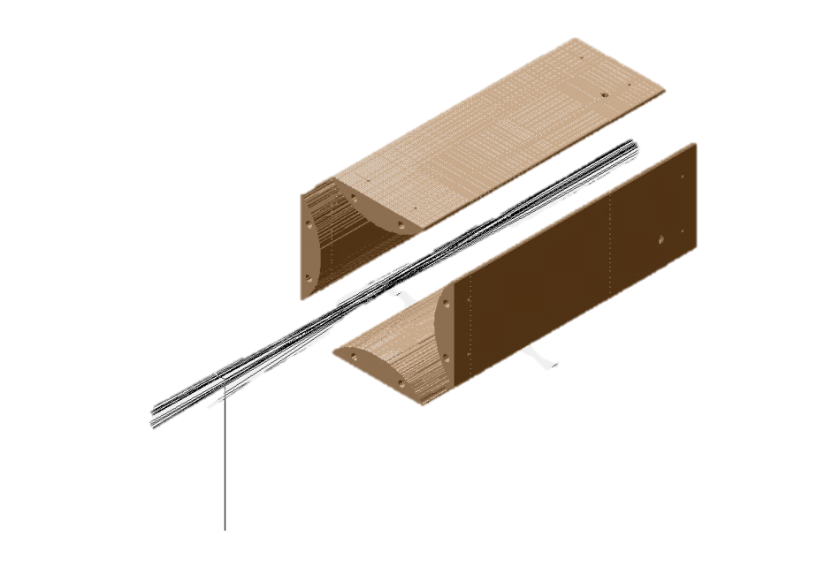
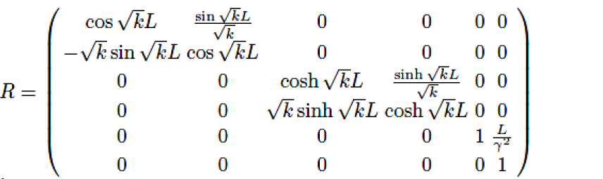
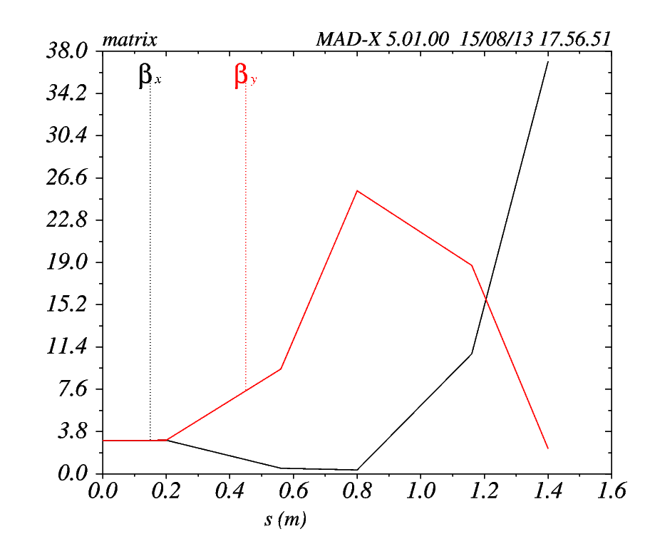
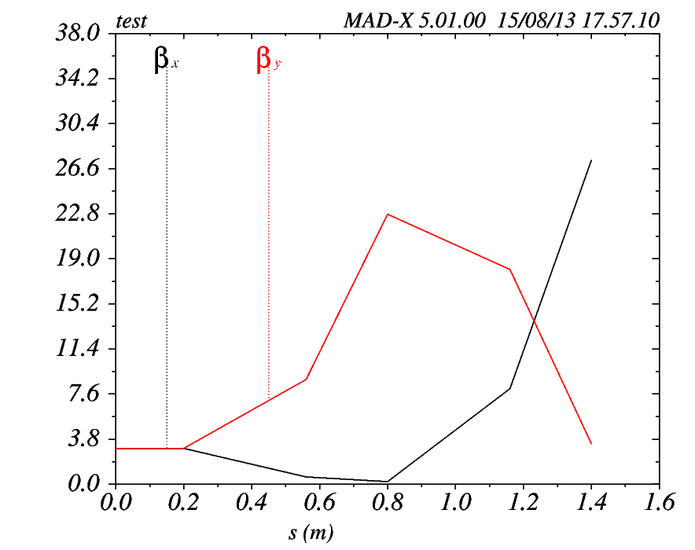
MAD-X Quadruples
MAD-X Quadruple
SIMION transfer matrix

Slide 19
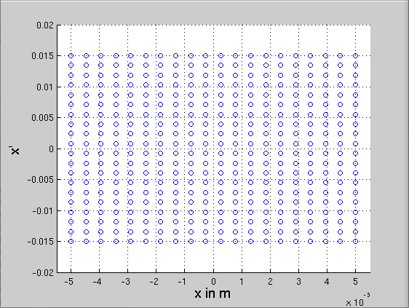
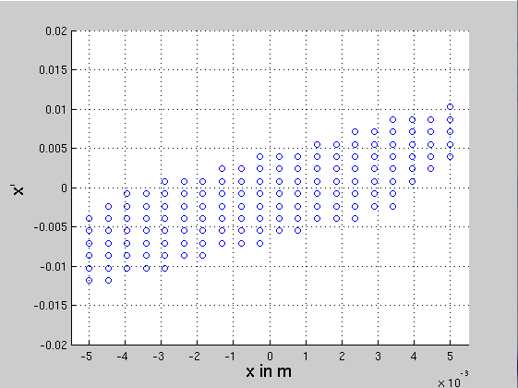
Nominal transport
HRS_RC4_used140905_1705_voltages.madx @ 50kV
±15 mrad
±5.0 mm
Emittance ε ∼25 mm mrad

Slide 20
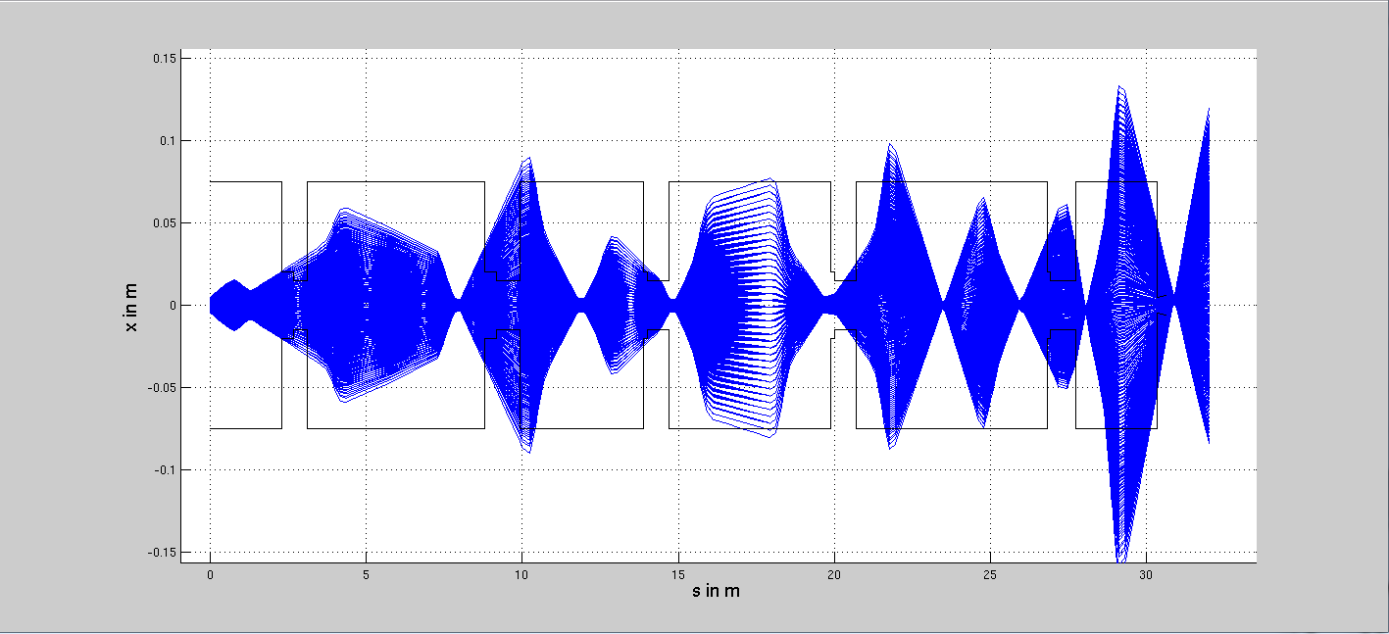
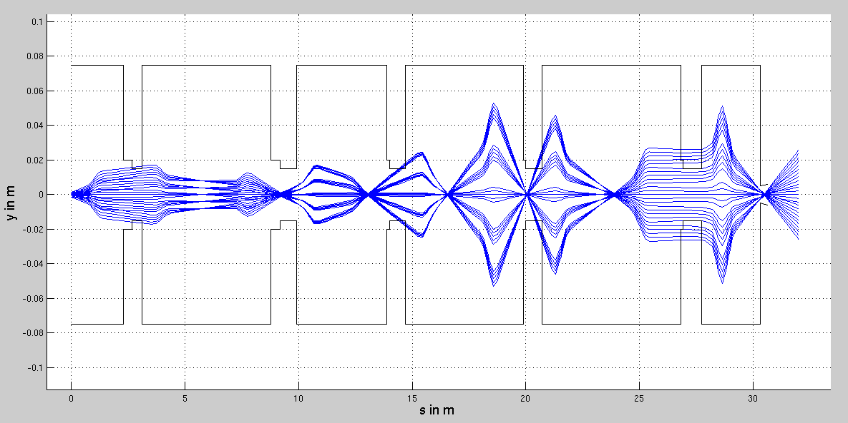
CA0
CB0
CC0
RC0
RC2
RC4
X envelope
Here the beam turns right
Nominal transport:
HRS_RC4_used140905_1705_voltages.madx
Quadrupole aperture
Deflector aperture
Y envelope
Notes:
Envelopes using experimental values from a beam transport done on 05 September 2014.
UCx #512 @ GPS to FC inside IDS setup, with 115In for Is590 - 77% from GSP.FC490 and 85% from GSP.558 /MLB. ER, LMF/

Slide 21
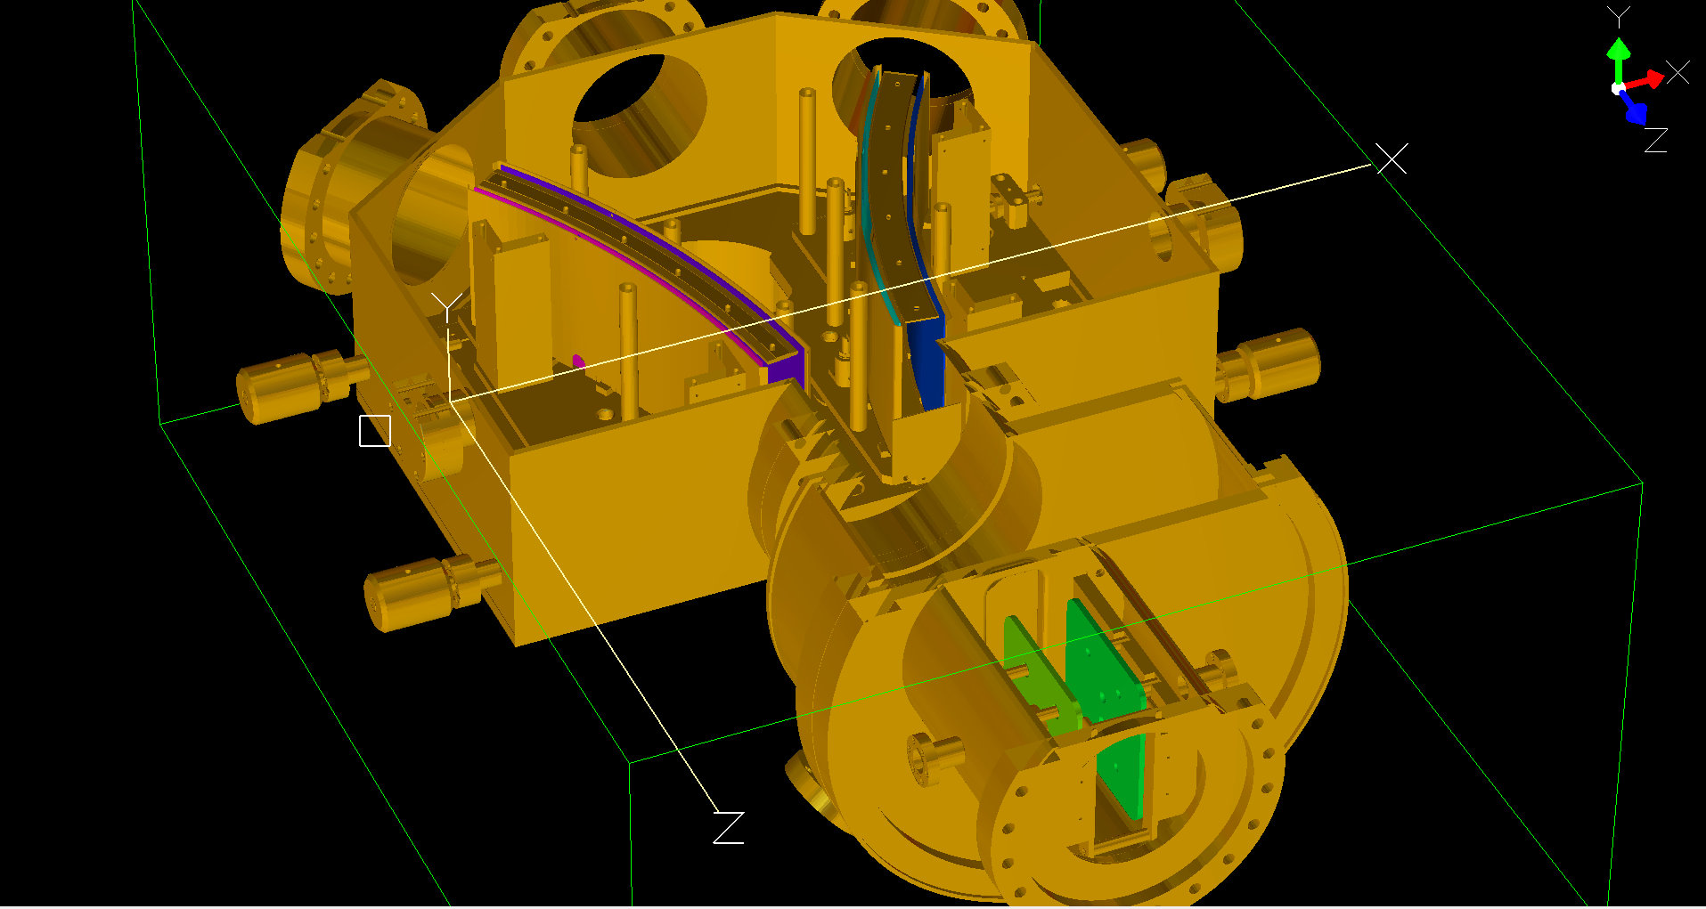
30mm
120mm
40mm
110mm

Slide 22
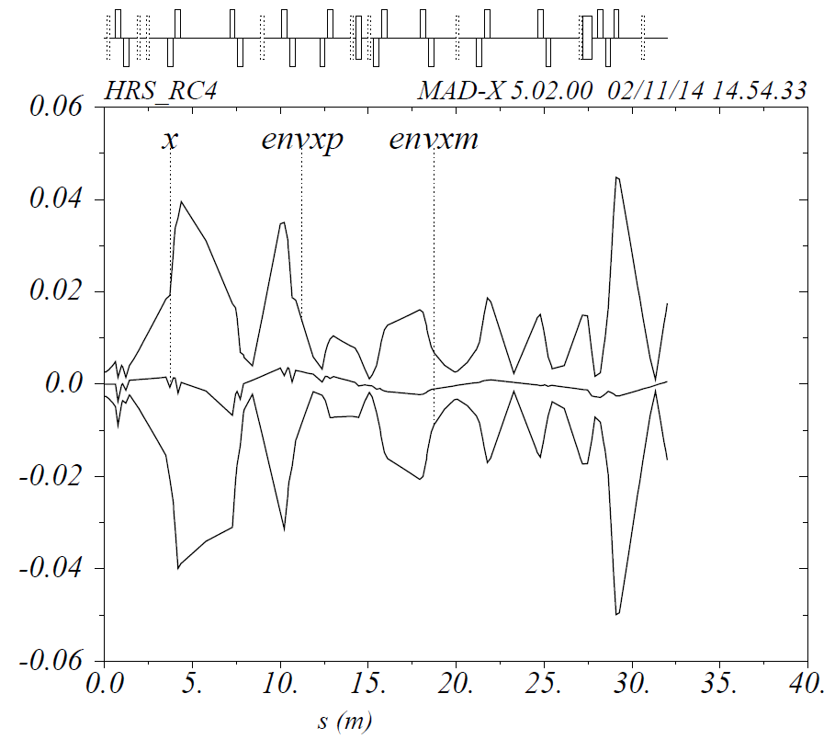
Beam envelope X
1σ
1σ
No misalignment
with misalignment + steerer corrections
!!!! To BE DONE: Quantify the acceptance that is lost
Notes:
Overall the beam envelope is recovered, but it appears distorted. Quantify the acceptance lost after the correction. This is done at 1sigma emittance, where emittance in x is 17pi mm mrad

