Slide 1
News of the Group
Maria J. G. Borge
4th November 2014

Slide 2
Outline
Fellows Associates and students
Courses and workshops during 2014
ENSAR / ENSAR 2
EURISOL MoU / EURISOL DF
Status of the new beam lines: IDS, VITO
Financial situation of the collaboration
Collaboration Matters:
  Norwegian Contract
Letter of Intend to host AGATA@HIE-ISOLDE
  Period of 2017-2018 assigned to GANIL, prolongation of the present stay of AGATA.

Slide 3

Fellows, Associates & Students
Associates (March)
Claes Fahlander July – Dec 2014 + 1 month
  New Applications: Palle Gunnlaugsson, Costel Petrarche,…
Corresponding Associates (March)
  Amandina Lima Lopes July-Cctober 2014
  New Applications: Janne Pakarinen July-Dec 2015
Fellows: (~3th of March 2015)
    Susanne Kreim, Dec 2014 (ground state properties)
    Elisa Rapisarda, Dec 2014 (Nuclear structure) + 5 months
    Monika Stachura, April 2013- March 2015 ( Applied Sciences)
    Miguel Madurga ( June 2014 – May 2016) (Nuclear structure)
    Stephan Ettenbauer (June 2014 – Jan 2017, COLLAPS, Polarisastion beams)
    Akira Miyazaki (June 2014- May 2016, SC cavities)
    Kara Lynch ( Jan 2015 – Dec 2017)
    Good Candidates are requested to apply in March 2015
    Doctoral student: Next deadline.
    Doctoral Student CERN for IDS: Razvan Lica
    Doctoral Program with Greece for life sciences (50% GR, 50% CERN):
      Stavroula Pallada (March 2014 - Feb 2017)
    Doctoral Program with Germany
      Laura Grob Jun2014 –
User support: Jennifer Wetterings (50% Col + 50% PH) → Contract finishes April 2015
Notes:
discussion with Ph to get a Limited term contract 50% collaboration + 50% PH

Slide 4
Courses / Workshops
Courses
Separator courses in April-May 2015
Workshop
ISOLDE Workshop 15 – 17 December 2014
One session Wednesday 17th in the morning dedicated to celebrate
the 50 years anniversary of ISOLDE approval.
Posters prize
SASc-ISOLDE Spring Workshop on GEANT4 (SWG 2015),
will be held on April 26 - May 1, 2015 in Casta-Papiernicka in Slovakia.
Institute of Physics, Slovak Academy of Sciences and ISOLDE collaboration

Slide 5
ENSAR / ENSAR 2
ENSAR stand for European Nuclear Structure and Application Research
  Started 1st Sep 2010 ends in 31st Dec 2014
  The TNA money used this year for young newcomers : 237 days distributed this year.
ENSAR 2 Application submitted 2nd of September. News expected for the end of January 2015
  Mushin Harakeh coordinator
  10 Meuros
GANIL (France)
    GSI (Germany)
    LNL / LNS (Italy)
    JYFL (Finland)
    ISOLDE – CERN (Switzerland)
    712.000 Euros (10 M)/ 543.380 (8M) Euros
    ALTO – CNRS (France)
    KVI (The Netherlands)
    SLCJ-HIL / IFJ PAN (Poland)
    ELI-NP / IFIN-HH (Romania)
    ECT* (Italy)
    10 TNAs
    7 JRAs
    8 NAs
EC financial contribution request: 10 M€
    Transnational Access Activities: 47.5%
    Joint Research Activities: 37.2%
    Networking Activities: 15.3%
NEW

Slide 6
JRA / NA
All Integrating Activity (IA) should be for the benefit of the Research Infrastructures (RIs) within the IA. The Trans National Access Activities (TNAs) are to serve the community by offering access to the advanced unique RIs of an IA.
NAs @ ENSAR² : 15.3 %
FISCO: Management NA
    NUSPRA: Network of facilities to propose common DAQ, electronics..
    MEDINET: nuclear applications (medical applications, e.g., hadrontherapy?)
    ENSAF: small scale facilities
    NUSPIN: Nuclear spectroscopy Instr
    GDS: Active targets +TPC
    MIDAS: ECR ion sources
    NuPIA: Nuclear Physics Innovation
The JRAs @ ENSAR² : 37.2 %
    TheoS(Nuclear Structure & Reactions)
    PSeGe: AGATA detector + applications
    TecHIBA: stable ion beams + medical isotopes (CERN)
    EURISOL facility (all stages) (CERN)
    RESIST: resonant ionisation techniques for separators (CERN)
    PASPAG: particle and gamma detection
    SiNuRSE2: simulations
~ 11% for CERN

Slide 7

EURISOL MoU / EURISOL DF
Steps towards EURISOL:
  5th framework: EURISOL Research and Technical Development Study.
    Conceptual Design Report (2004)
  6th framework: EURISOL Design Study
    Reference Design report & preliminary Cost Estimate (2009)
Supported by Long Range Plan 2010, A MoU was created to launch a collaborative effort to continue the development of EURISOL R&D and Cost
Parties: CERN, GANIL(2011), COPIN (Poland) (2012), BEC (belgium) 12/7/2014, INFN(2014). Valid 3 years → July 2017.
Steering Committee: Borge, M. Lewitowitz (project leader), A. Maj, L. Popescu, Sara Pirrone and A. Bracco (Nuppec Chair, ex-officio member)
Fee 3000 euros/ y
EURISOL DF:
Enter in ESFRI list (3 countries) and obtain funds.
  Plan for call 2018
To be define:
  Members: GANIL, ISOLDE, SPES (+ISOL@MYRRHA)
  Small scale ISOL facilities: ALTO, Jyvaskyla
Legal structure, coordination, responsibilities…
CERN?
Propose in Lisbon Oct2012
Discussed in York July 2014

Slide 8
ISOLDE Towards EURISOL-DF
Concentrate in the Intensity, purity and emittance of the radioactive beams . Target + ION SOURCE
  EBIS+REBUNCHER
  HRS new design
    Design of new beam dumps to face the increase in energy
  Cost estimated in 10 MCHF
Implementation of the TSR (?) as part of the Instrumentation
  Study done
  Cost estimated 15 MCHF
Steps taken:
  1. Preliminary discussion with DG-EU : Svetlomir Stavrev 17 oct 2014
    Contact the Swiss representative to get their support.
    Prepare a 1 page description of the project for swiss.
    To be approved by Council.
  Consult the CERN legal service, DG-LS: Eva Maria Groniger-Voss
  Scientific Deputy Director: Sergio Bertolucci 6 Nov 2014
    Most probably CERN cannot be member of ERIC

Slide 9
News on the Beam Lines

Slide 10
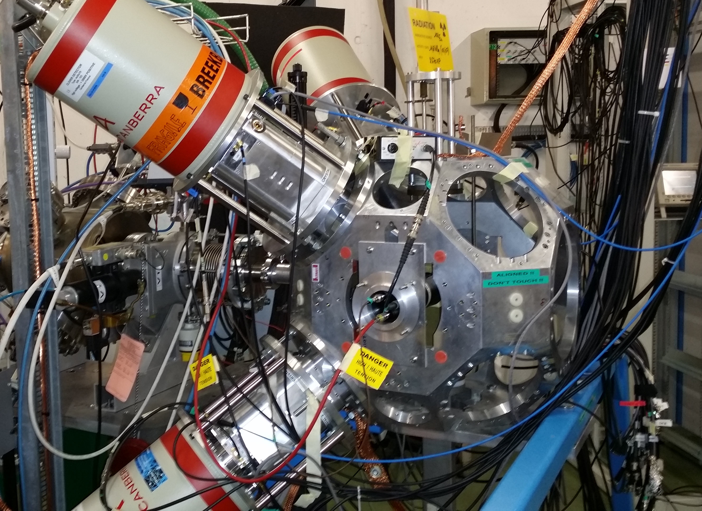
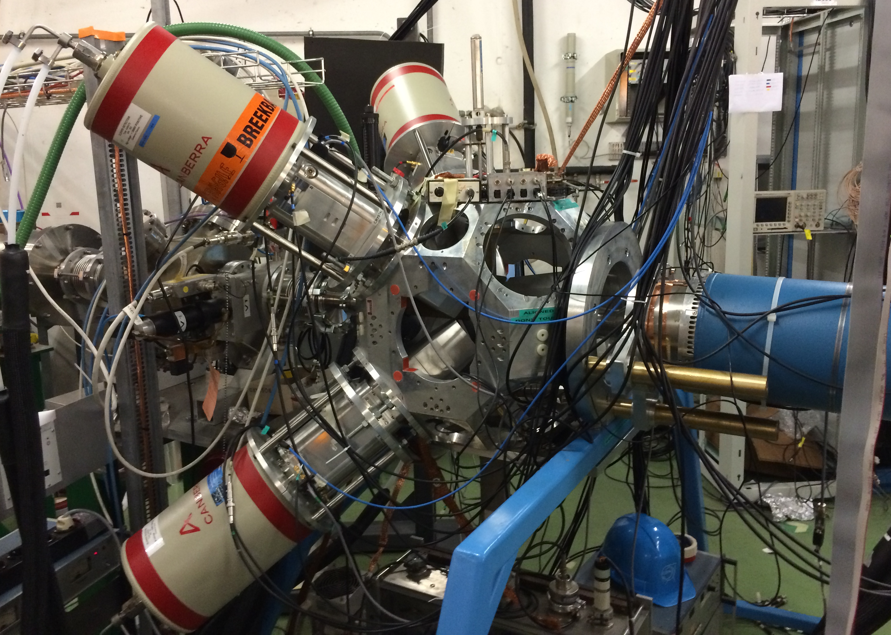
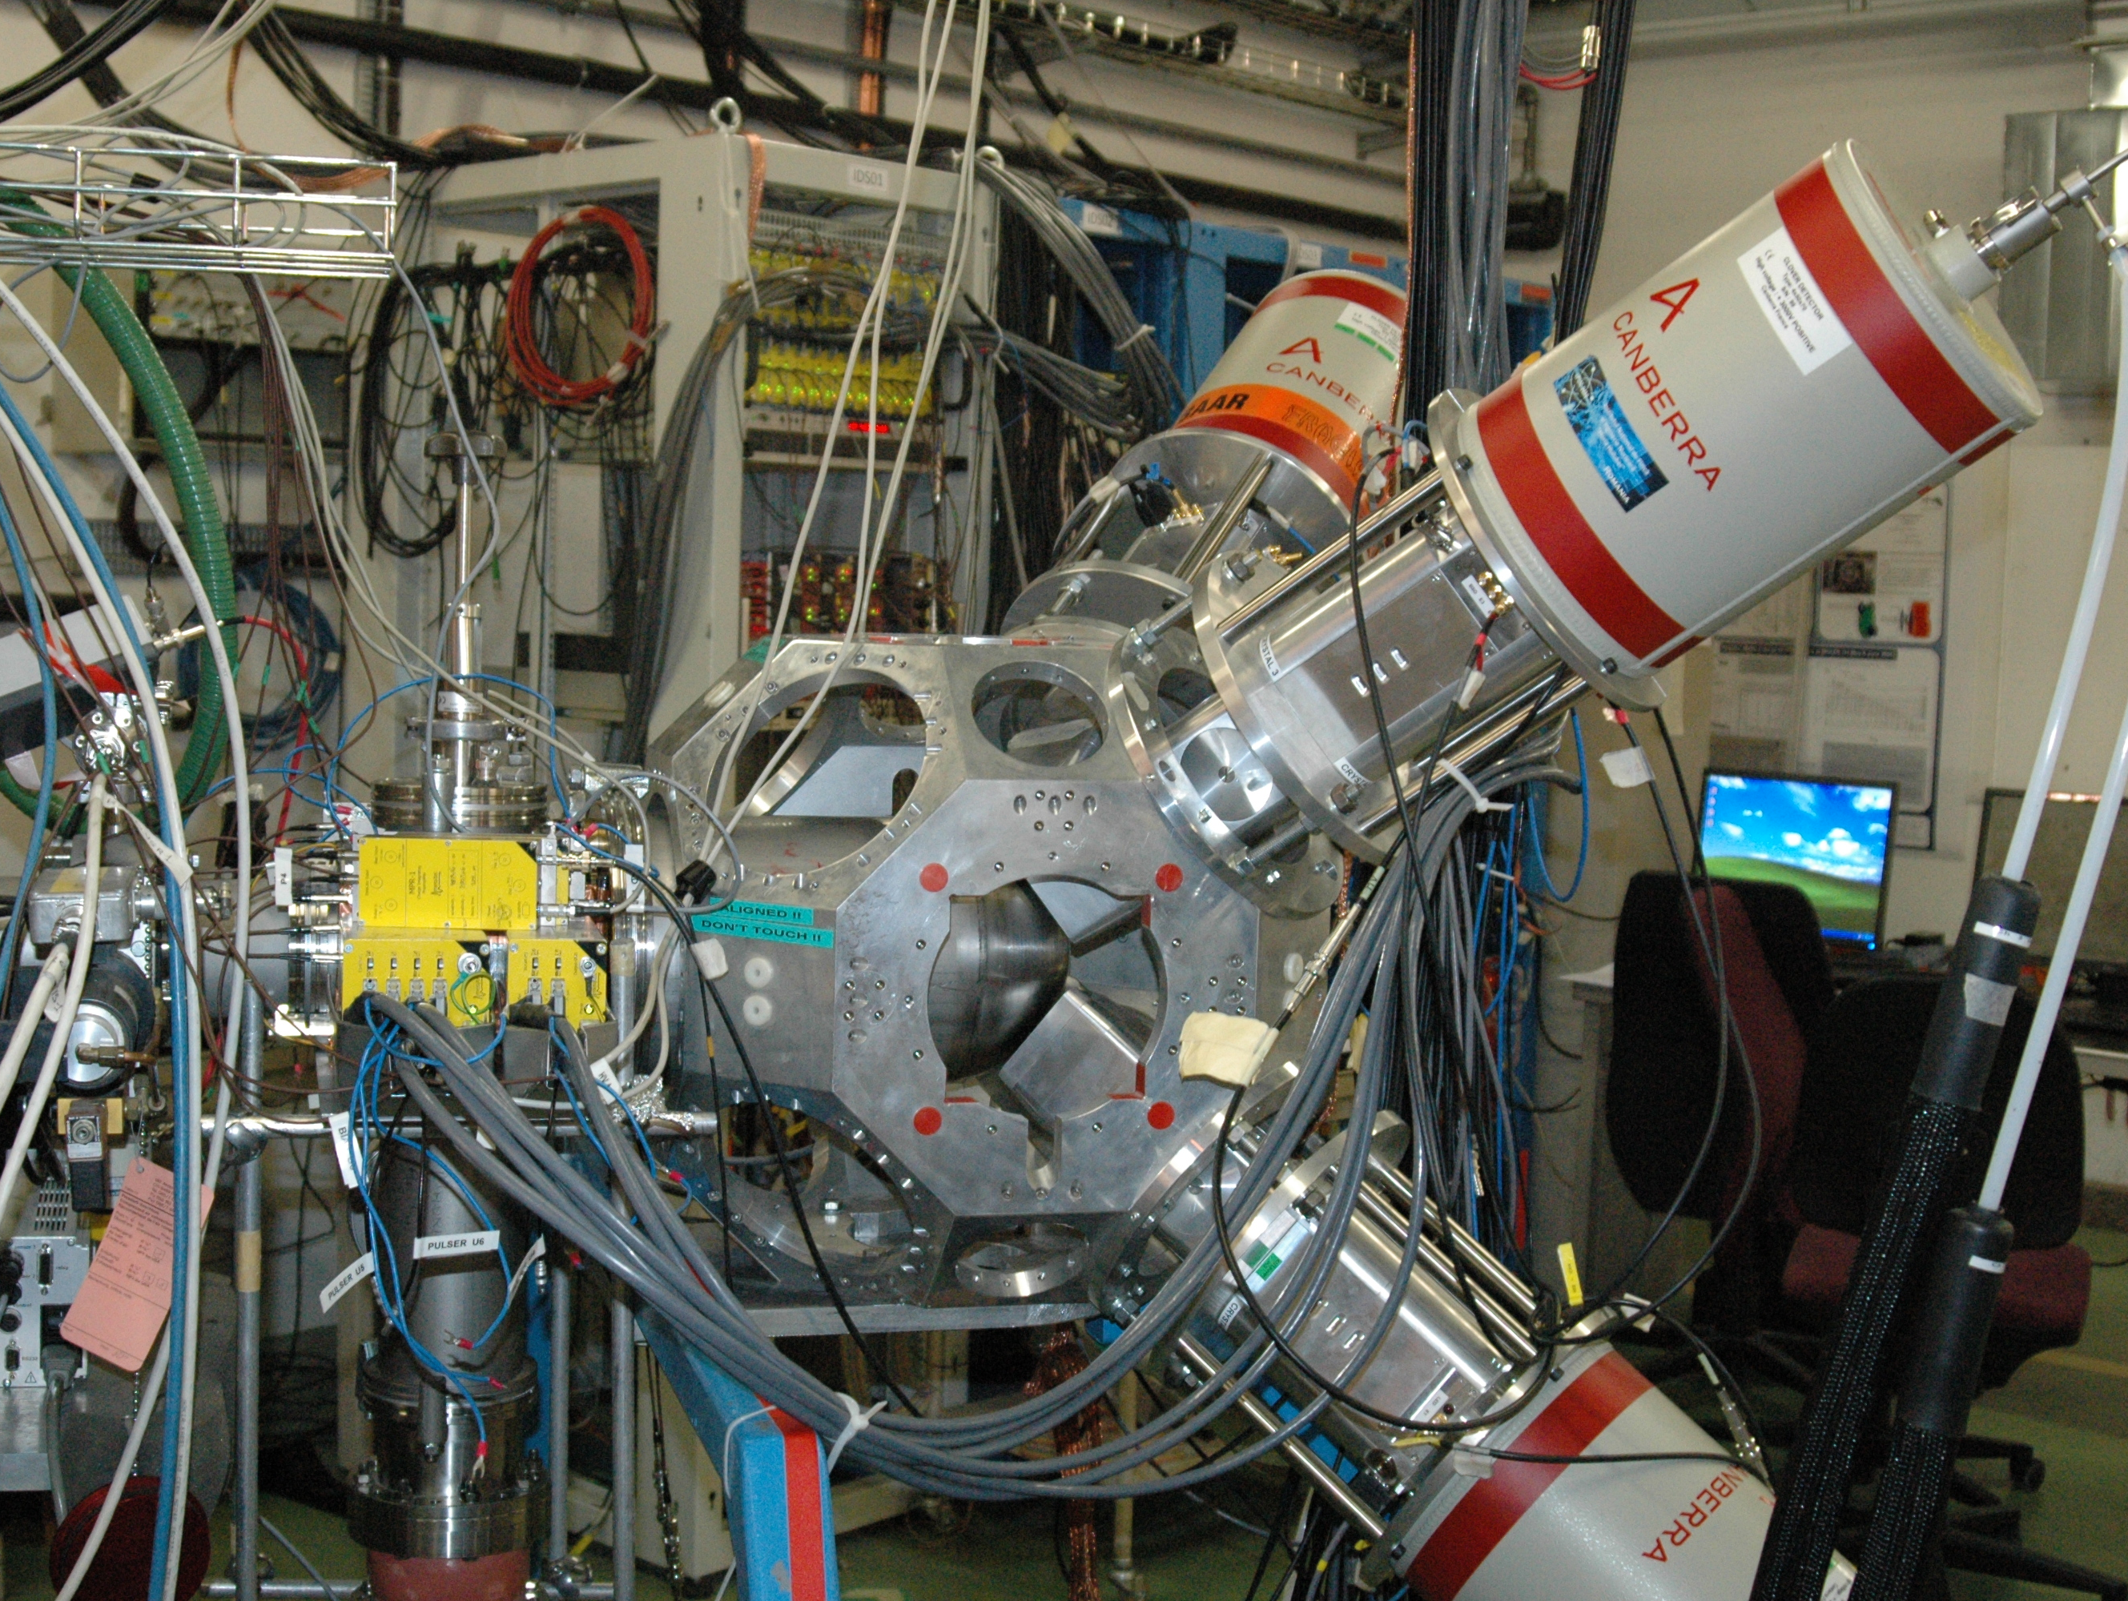
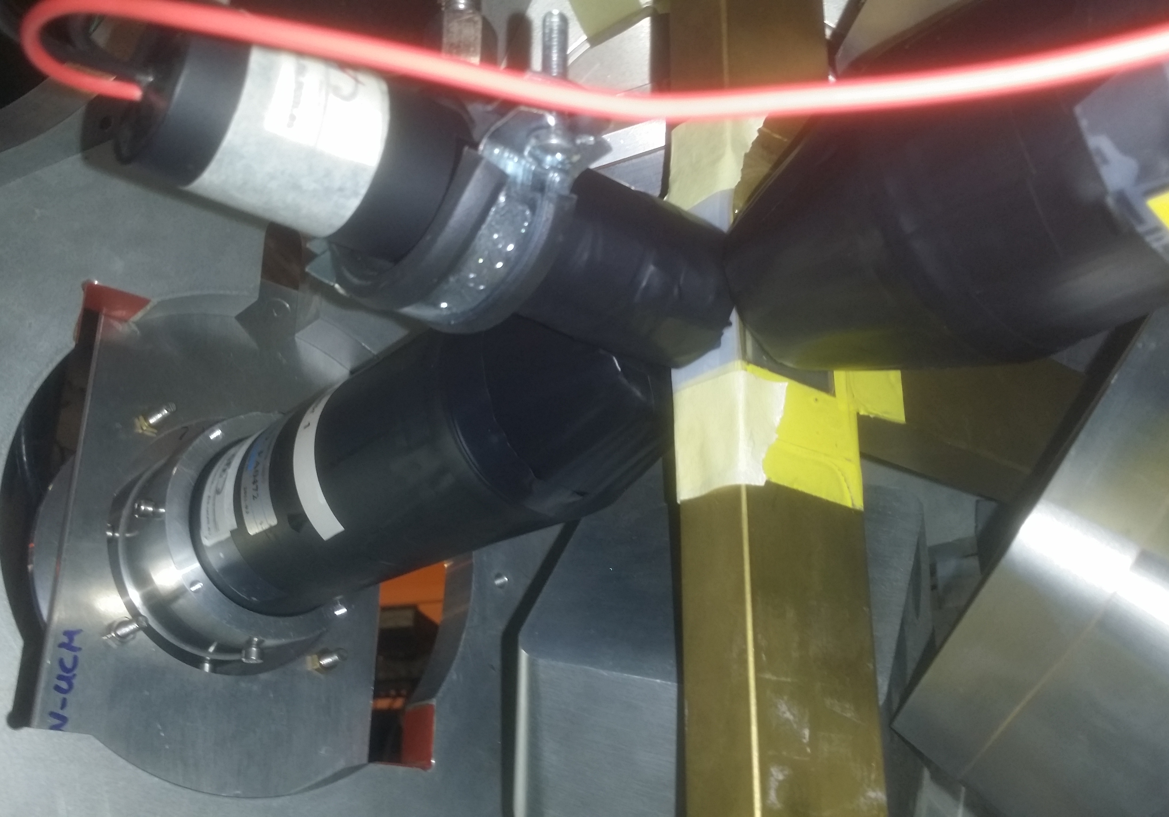
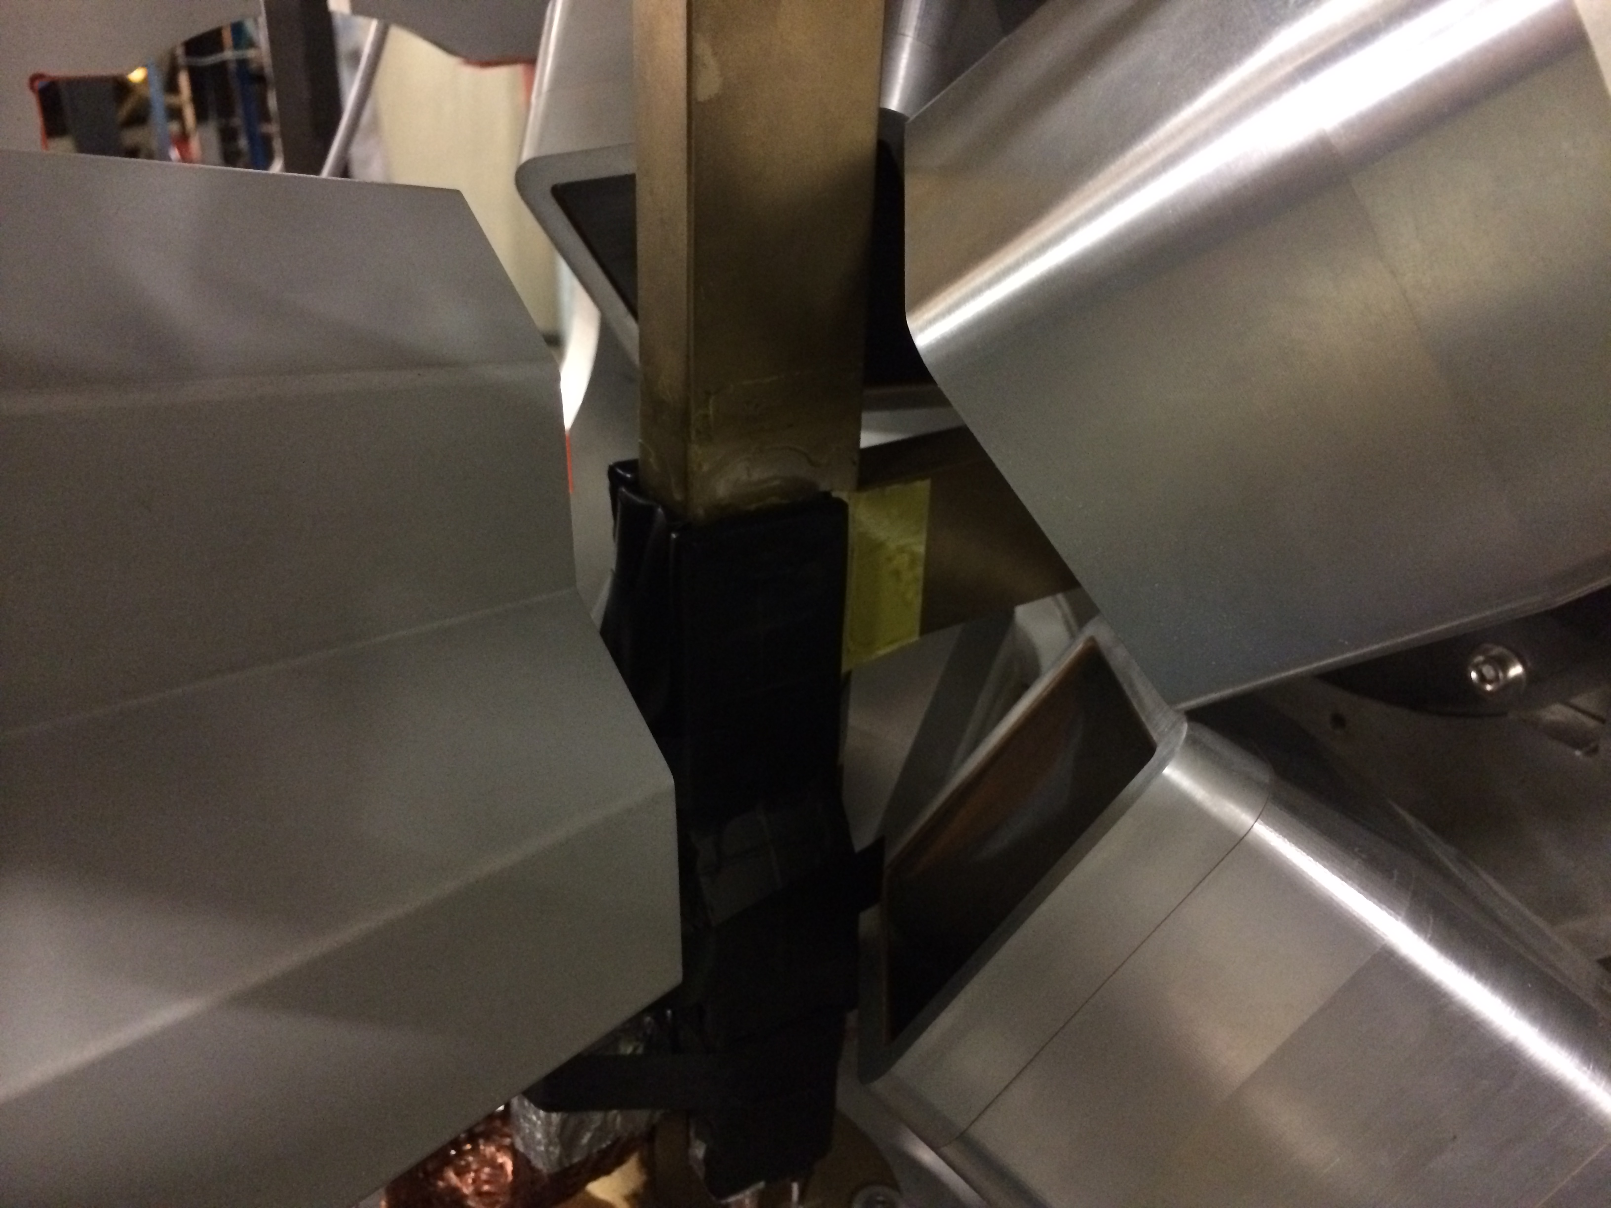
IDS operative and working
Life Time Measurements
High efficiency Gamma Spectroscopy
Charged Particle Spectroscopy
Implantation on Tape
4 Ge Clovers at Backward angles
2 LaBr3
1 plastic scintillator
IS579,590, No Mn
Data on ¹²⁹In
Implantation on Tape
4 Ge Clovers at Backward angles
1Miniball Detector (triple cluster)
3 plastic scintillators
IS588 ^{207,208}Hg
Implantation on C foil
4 Ge Clovers at Forward angles
Si box
IS476⁺ ³¹Ar
Courtesy E. Rapisarda

Slide 11
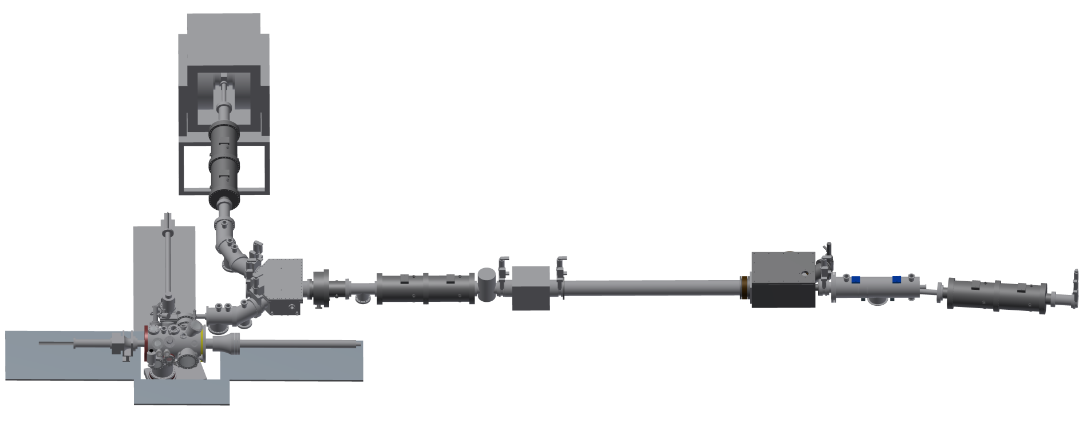
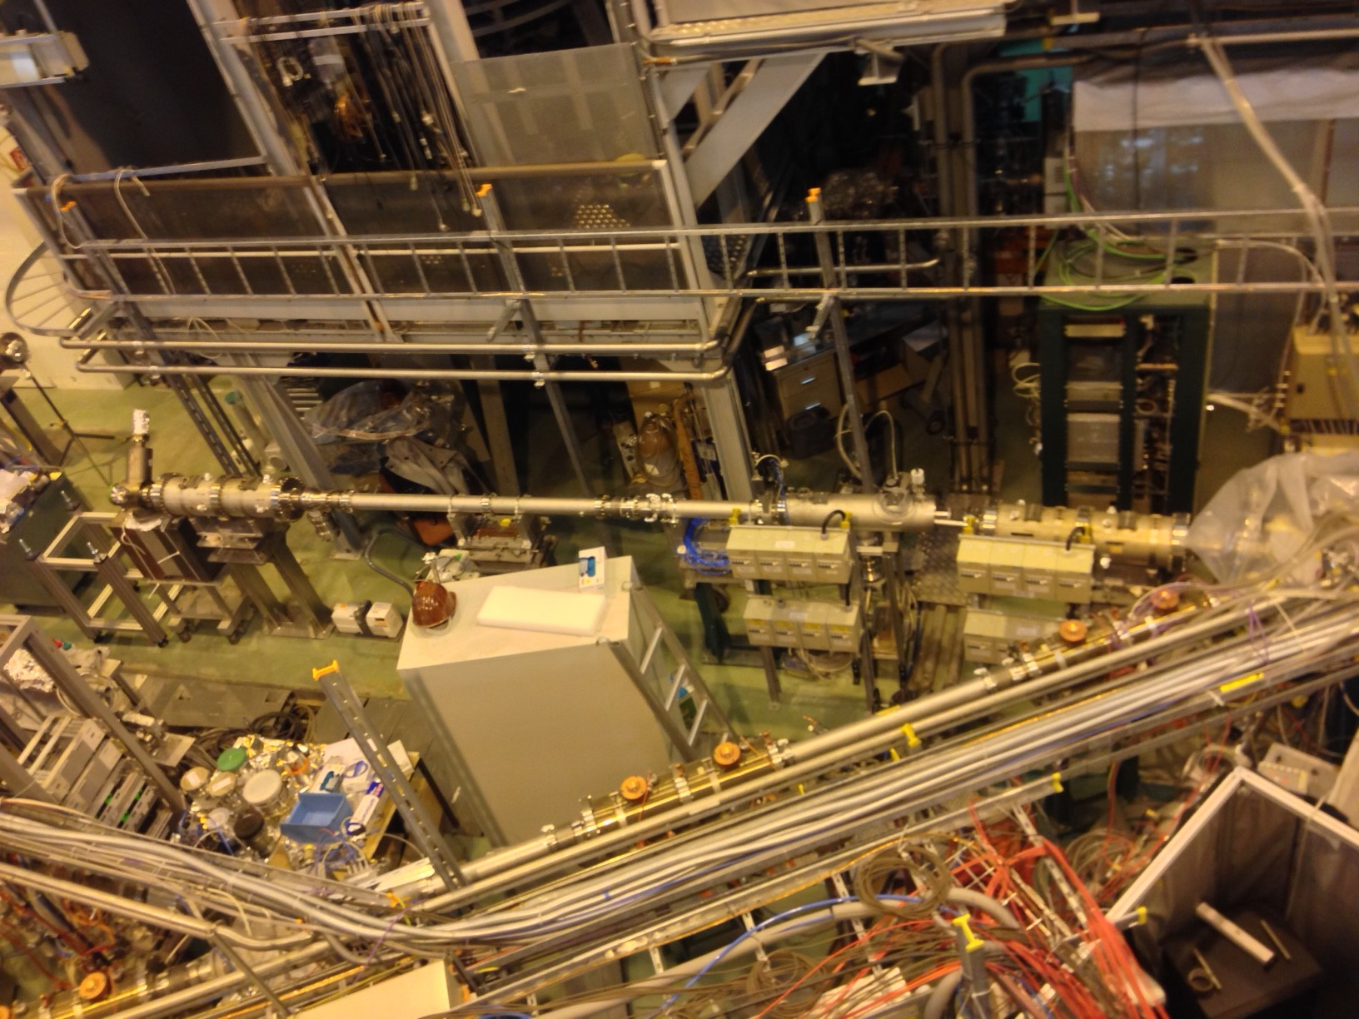
VITO Beam Line On going
β-NMR end-station
5° deflector
polarizer from COLLAPS
Status:
Beamline pumped down and checked for leaks
Switchyard mounted last Friday
→ small adjustments needed for better stability
Waiting for PS (to be mounted this week)
Radioactive beam: ¹¹¹In in Dec 2014 (PAC @ VITO)
Problems:
ASPIC TM pump broken
Missing 35° deflector
ASPIC end-station
spacer for the polarizer

Slide 12
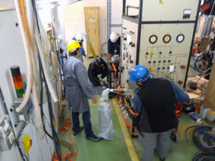
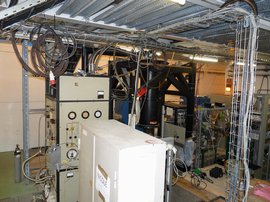
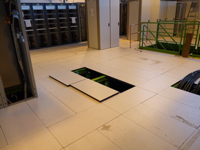
NICOLE Status
Set the fridge at the beam line roughly.
Reassemble the main unit of the fridge.
Vacuum test at the LN2 temperature.
Next step:
  He transfer test with the new supports (now drawing) and test the fridge at He temperature.
  Connect the fridge to the beam line (fine alignment)

Slide 13
Collaboration Matters

Slide 14
Income of the collaboration
Country | Amount per year (CHF) | 2013 contribution Received | 2014 contribution Received
Belgium | 60.000 | ✔ | ✔
CERN | 60.000 | ✔ | ✔
Denmark | 60.000 | ✔ | ✔
Finland | 60.000 | ✔
France | 60.000 | ✔
Germany | 60.000 | ✔ | ✔
Greece
India | 40.000
Ireland | 10.000
Italy | 60.000 | ✔ | ✔
Norway | 60.000 | ✔ | ✔
Romania | 60.000 | ✔ | On the way
Spain | 60.000 | On the way
Sweden | 60.000 | ✔ | ✔
United Kingdom | 60.000 | ✔ | ✔
Bulgaria has agreed with the ISOLDE-MoU & Sergio Bertolucci has signed the 21st of March 2014, pending the Bulgaria side.
Poland is in the process to apply.
South Africa is in the process to apply.
Algeria is interested in joining.
Problems with India contribution
Paid 2010-2011
Notes:
The committee agrees that until Greece signs the updated MoU and has paid its outstanding fees it will no longer be considered a member of the ISOLDE collaboration.

Slide 15
Expenditure Collaboration
Contribution 2013 and 2014 to HIE-ISOLDE already transferred.
Minimum Expenditure foreseen for 2014 250.00 – 300.000
(presently: 216.459 CHF)
Balance 1st November 2014 466. 773 CHF
Contribution 2012 96,2 % received
Contributions 2013 80 % received
Contributions 2014 59 % received
Subsistance
2014

