Slide 1
HIE-ISOLDE Status Report
71st ISOLDE Collaboration Committee Meeting
Y. KADI
on behalf of the HIE-ISOLDE Project Team

Slide 2
Outline
Project re-organization
Technical Status
Schedule
Financial Situation
Strategy for Phase 2
Conclusions

Slide 3
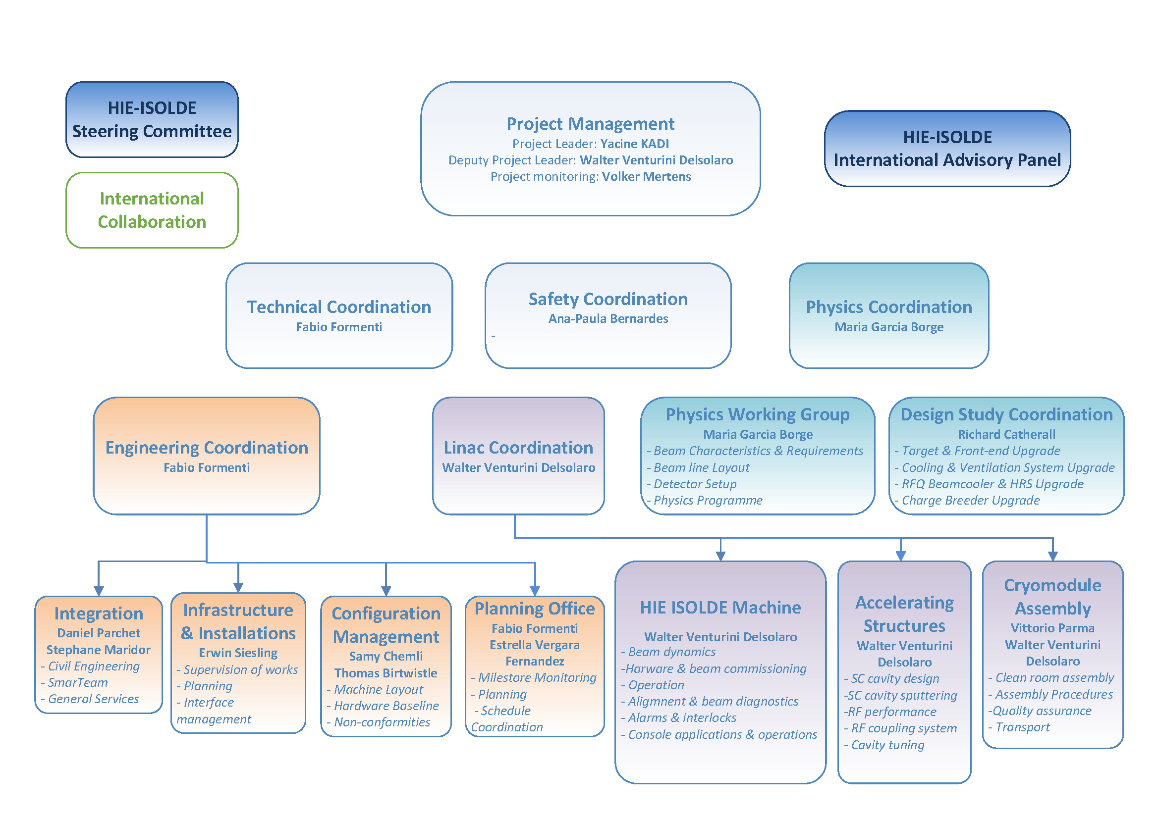
Situation in Oct. 2014
Project Structure was re-organized

Slide 4
Industry contract for high 𝛽 cavity substrates
Order for 15 pieces placed 25.05.2013 (with +5 in option)
Production planning: first prototype was due by November 2013
QS1 delivered in June 2014: 7 months delay
QS1 non conformities: weld projections, geometry
QS2 delivered July 2014
QS2 non conformities: traces of foreign material, geometry
QS3 delivered August 2014 (5th substrate, including QP2/QP3)
QS3 non conformities: defects close to the weld HAZ
QS4 delivered in October 2014, conform to specifications
QS5 expected week 45
QS6 expected w47
One cavity/3weeks till QS15

Slide 5
Series cavity performance (W. Venturini)

Slide 6
CM 1 operational scenario (first iteration)
 | Eacc (MV/m) | Q0 | Voltage (MV) | Pcav (W) | Tuning plate
QP2.1 | 5.98 | 6.23E+08 | 1.79 | 7.6 | Special
QP3.2 | 6.01 | 4.91E+08 | 1.80 | 9.7 | Special
QS1.1 | 5.99 | 3.78E+08 | 1.80 | 12.5 | Standard
QS2.1 | 6.00 | 2.63E+08 | 1.80 | 18.1 | Standard
QS3.1 | 6.00 | 3.22E+08 | 1.80 | 14.8 | Special
Total |  |  | 8.99 | 62.7
uniform field option
This is already within the cryogenics margin
 | Eacc (MV/m) | Q0 | Voltage (MV) | Pcav (W) | Tuning plate
QP2.1 | 6.61 | 5.40E+08 | 1.98 | 10.6 | Special
QP3.2 | 6.15 | 4.64E+08 | 1.85 | 10.7 | Special
QS1.1 | 5.73 | 3.97E+08 | 1.72 | 10.9 | Standard
QS2.1 | 4.99 | 3.14E+08 | 1.50 | 10.5 | Standard
QS3.1 | 5.29 | 3.62E+08 | 1.59 | 10.2 | Special
Total |  |  | 8.63 | 53
uniform power option

Slide 7
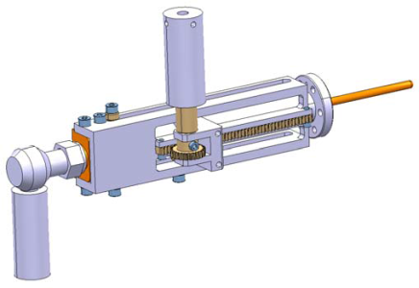
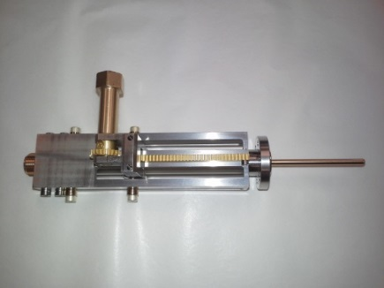
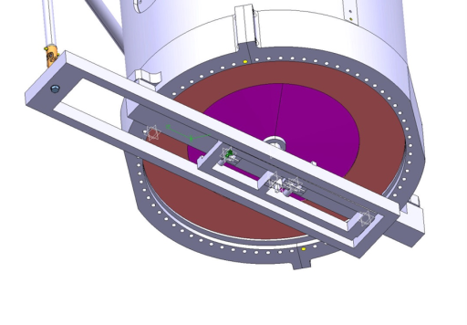
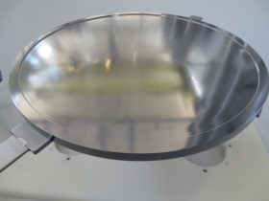
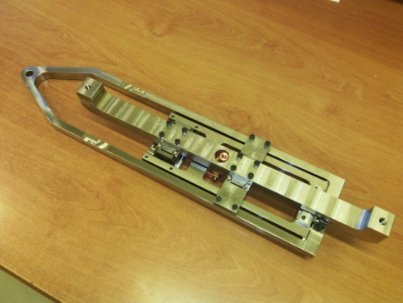
Cavity Ancillaries Status
Coupling systems
  15 couplers available
  15 coupling system sets
  Pre-assembly and conditioning ongoing
Tuning systems
  10 systems available (phase 1 only)
  Pre-assembly and conditioning ongoing

Slide 8
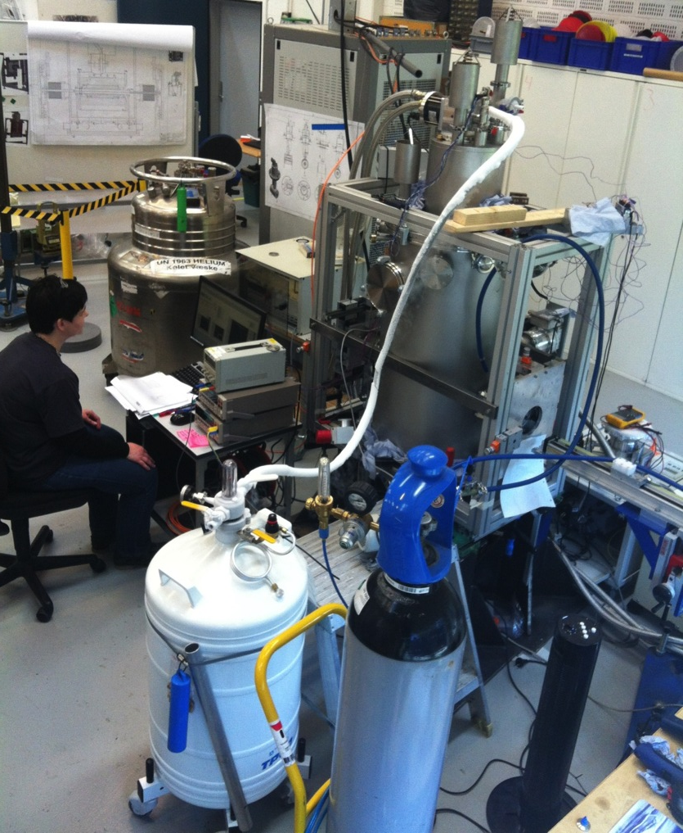
Qualification test results solenoid1
Training performance
Magnetic field measurements

Slide 9
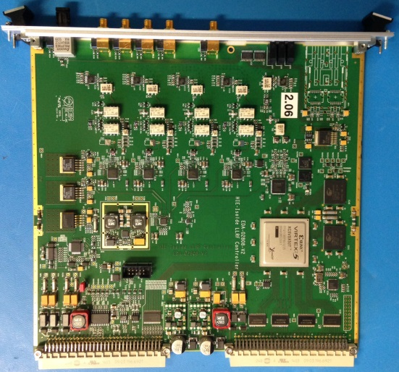
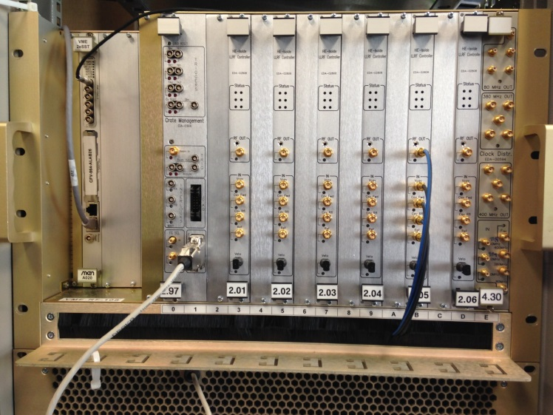

RF systems (Power and LLRF)
LLRF controller for one cavity
Low microphonics; sensitivity to He pressure
~ 0.01 Hz/mbar, no beam loading → high Q_{L} in operation
→ Eased design for the input coupler
→ 700 W solid state RF amplifiers
State of the art digital LLRF system
  Direct RF sampling
  Digital quadrature demodulation
  Direct RF generation by DAC
  VME form factor, 1 LLRF controller card per cavity
LLRF system installed in 14 shielded racks
Reference RF phase distributed over the length of linac
to allow automatic cavity phasing for different species
LLRF system for a complete cryomodule
(6 cavities)

Slide 10
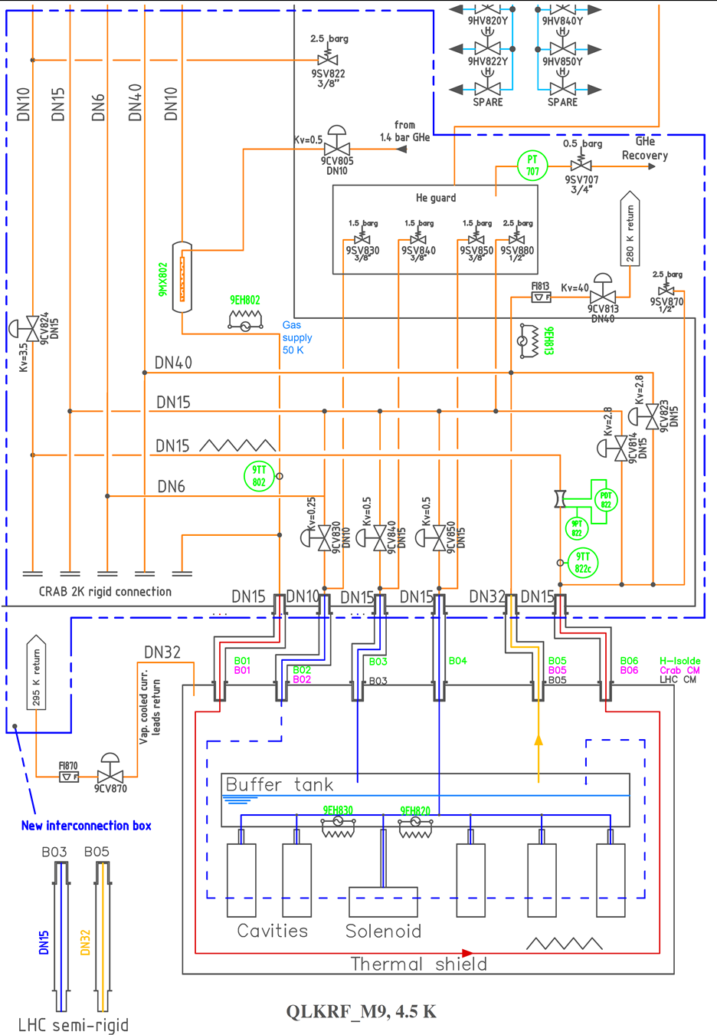
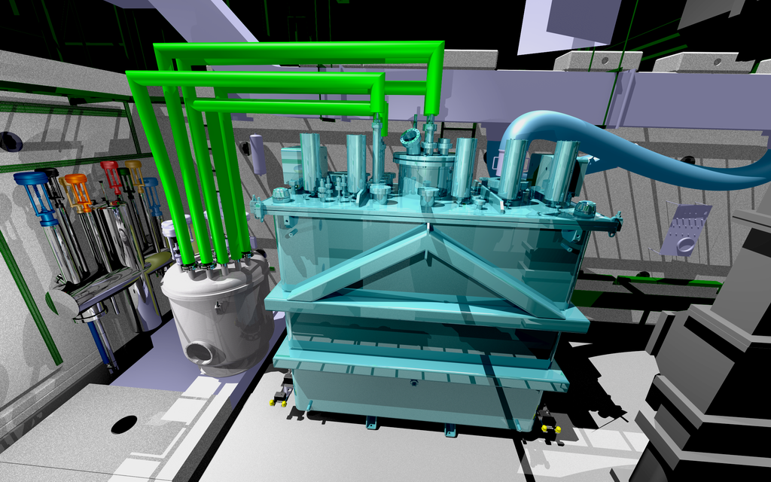
SM18 test infrastructure for CM
Integration study done
Reshuffling M9 bunker roof: October 2014
Racks installation and RF cabling by end 2014
Cryogenics valve box installation and commissioning: January 2015

Slide 11
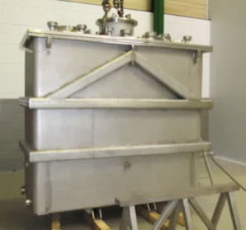
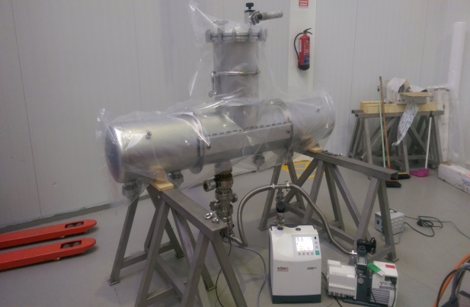
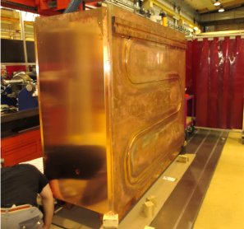
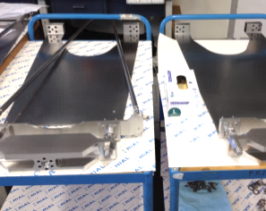
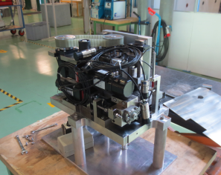
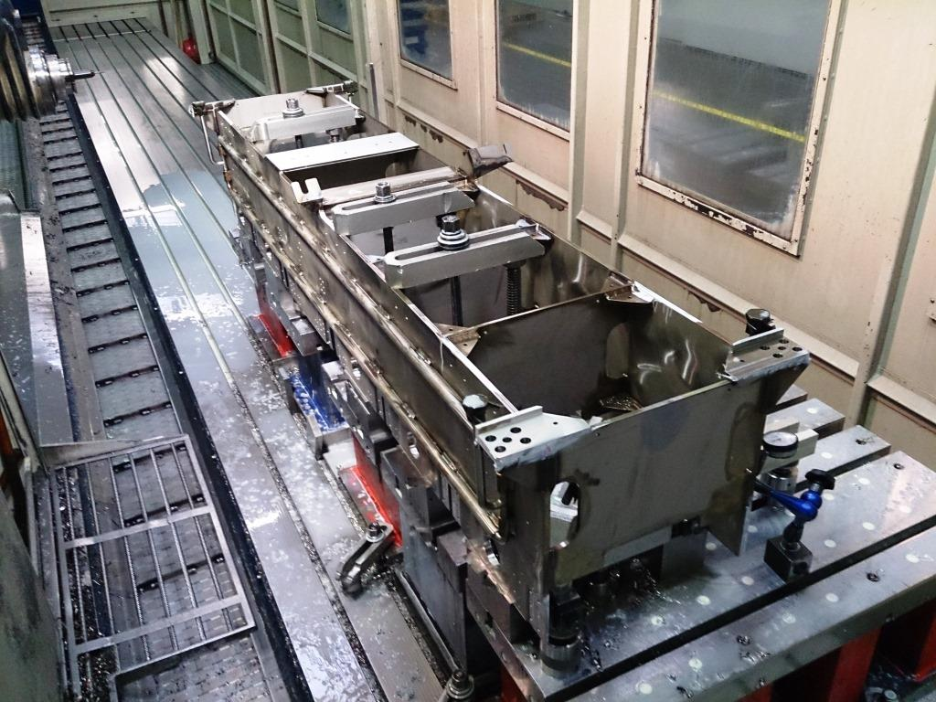
Procurement of CM components
Main components
Helium vessel
(Cadinox, Spain)
Vacuum vessel
(Cadinox, Spain)
Thermal shield
(EN/MME+contracting)
Supporting system
(EN-MME, subcontracting
Rodofil-RIAL, Italy)
Motorized Frame adjusting device
(Kircholm, DK, through CATE)
Cavity/solenoid Frame
(Kinkele, Germany)

Slide 12
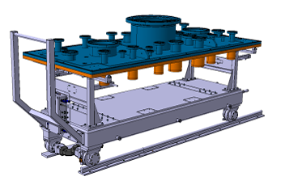
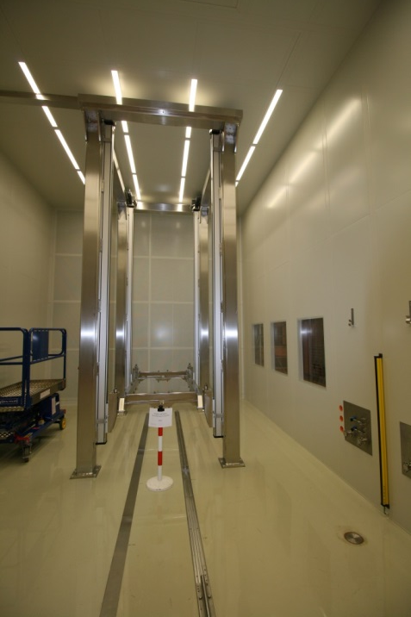
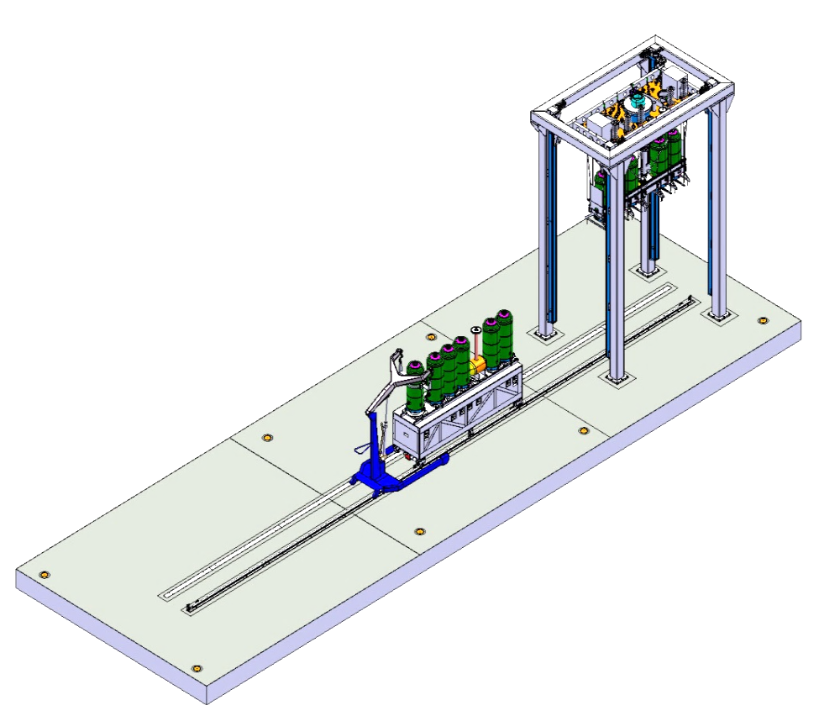
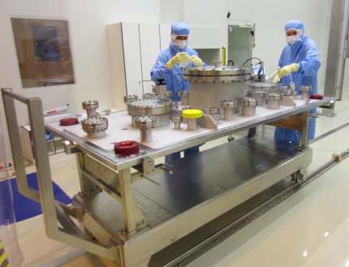
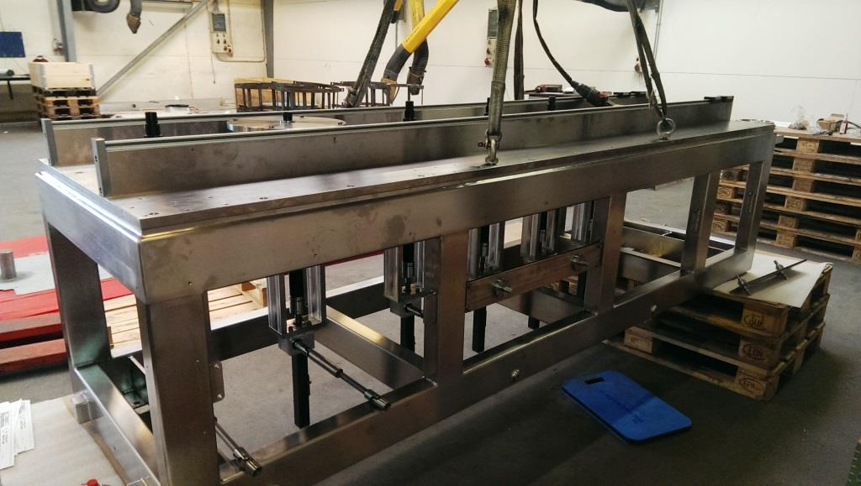
CM assembly infrastructure and specific tooling
Main assembly tooling
(design & procurement:
EN-MME+TE-MSC )
Assembly frame
Cavity /Solenoid
Assembly trolley
Assembly Frame
Multi-purpose trolley
(top plate preparation)
Class ISO5
Rails
Class ISO7
Preparation area
Cavity/Solenoid trolley (delivered today)

Slide 13
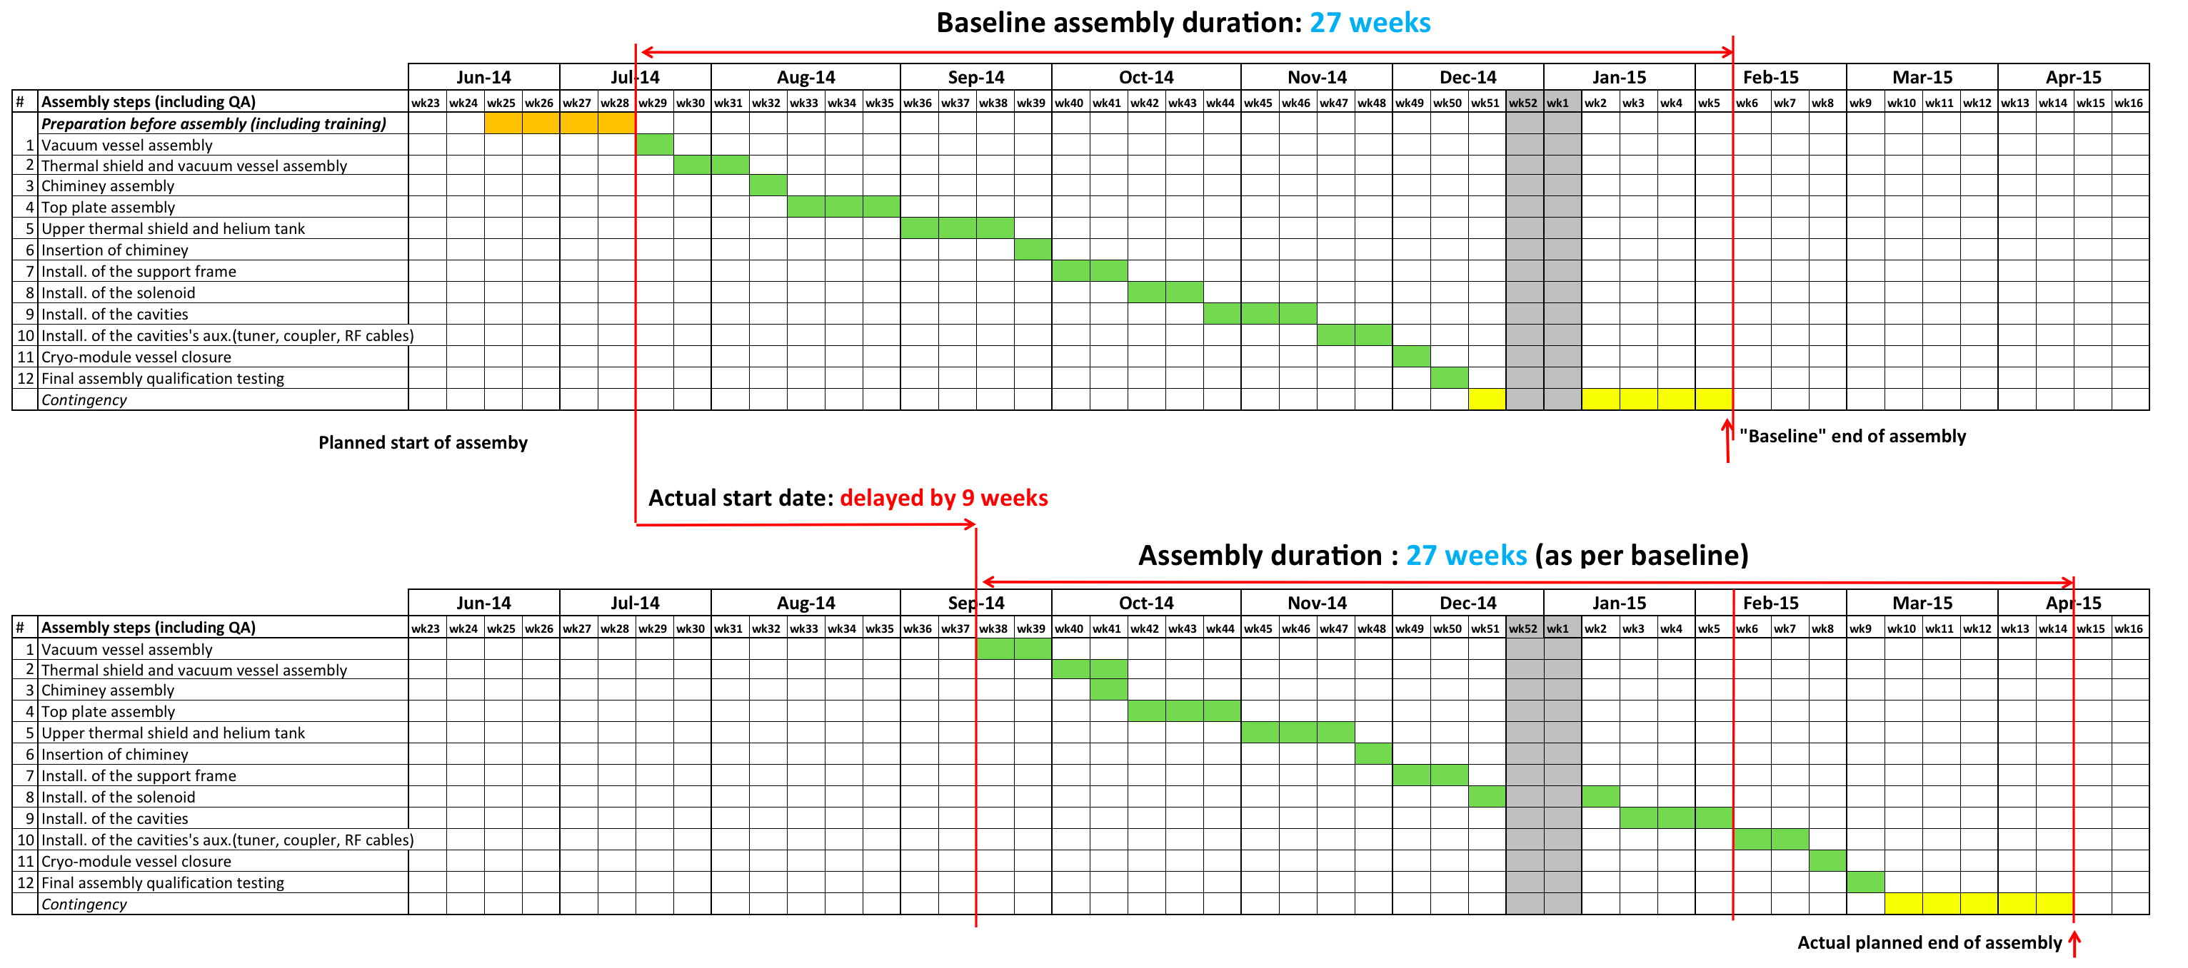
Assembly Schedule: from Baseline to Actual
Actual: start of assembly delayed by 9 weeks, due to:
SM18 clean-rooms infrastructure ready 2nd week Sept. → +12 weeks delay
The 2 AL4030 technicians joined in August (weeks 33 and 36) → more than +8 weeks delay
Training of clean-room team started between August (occasionally) and September, done during assembly → more than +8 weeks delay
Vacuum vessel arrival delayed (+ 4weeks) → start assembly not possible earlier than mid August
Also thermal shield preparation (Ni plating) suffered a delay → arrived end Sept.
Actual assembly schedule:
Preserve 27 weeks of assembly, assembly windows ends mid April 2015 (+ 9 weeks on baseline)
Keep steps durations (no learning curve) → challenging start-up considering learning + training

Slide 14
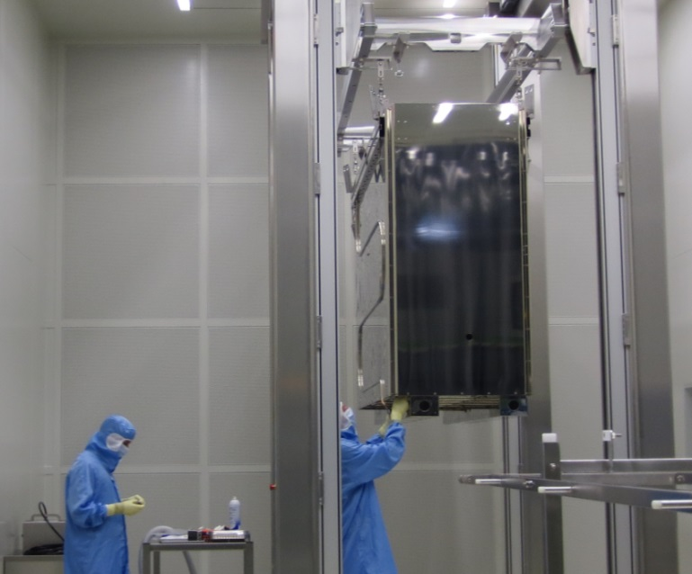
Thermal shield ready

Slide 15
Assembly Schedule: progress tracking
Status, after 7 (out of 27) weeks of assembly:
Step 3 (Chimney assembly): Delay factor: ~1.2
Step 1 (Vacuum vessel assembly): delay factor: ~2.2
Step 2 (thermal shield and vacuum vessel assy): delay factor: ~1.7
Average delay factor so far: 1.7

Slide 16
Extrapolating to the future
Present steps (1-3), have been mainly affected by the start-up (learning, training) but also by NC on tools and components: => No major assembly issue encountered
Extrapolating with the presently accumulated delay (orange path) leads to week 13
Considering increasing extent of blank assemblies wherever possible
Increase clean-room workforce from 4 persons to 4 FTE.
Continuous monitoring is in place
Still too early to assess a global trend. More time needed (~4 weeks ?) for a better estimate, when most of the “new” tools will be under control.

Slide 17
HIE-ISOLDE in 2015
Miniball
Multipurpose beamline
REX Low energy part (charge breeder)
NC linac
SC linac (1 CM/5 cavities)
HEBT : 2 beamlines

Slide 18
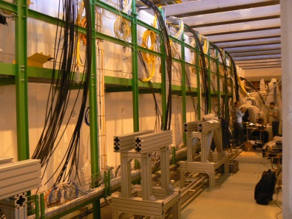
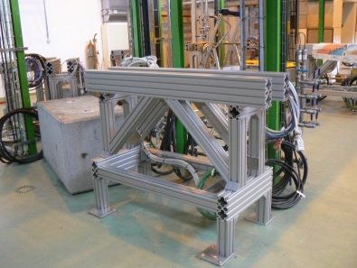
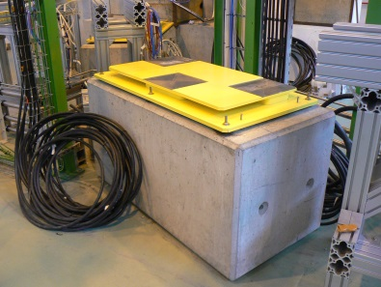
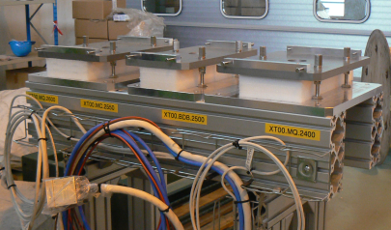
Infrastructure and mechanical supports
Cabling
  All cable-trays installed
  DC cables, vacuum controls and instrumentation -> done
  RF cabling and cryogenics instrumentation - > ongoing
Piping for cooling and gasses
  Cooling water (demi & mixed) -> done
  Vacuum lines, N2 (venting) and He (conditioning) lines -> done
  Remaining:
    Compressed air along SC linac and HEBT (ongoing)
    Flanges for roughing/backing vacuum connections
    Existing REX magnetic elements to be connected to demi water circuit
Mechanical supports
  All equipment delivered and ready for installation
  Except:
    Adjustment tables for the SDB-steerer assemblies (14/11)
    Cryomodule supports (in production, expected end November)
    Supports for inter-tanks (design finished, to be manufactured, expected December)
  All supports in place for magnets and diagnostics
  Remaining: adjustment tables installation
Notes:
Highlight remaining

Slide 19
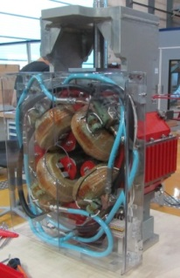
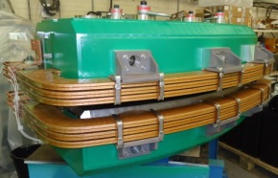
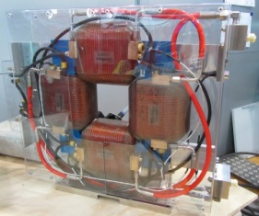
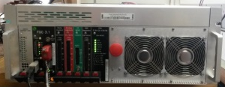
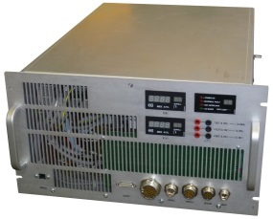
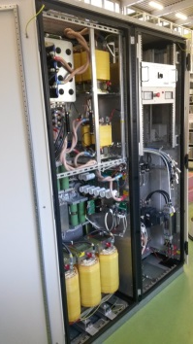
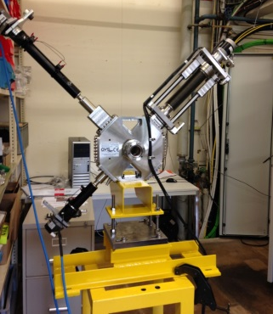
Procurement status
Magnets
  First unit already at CERN
  All magnets will be delivered by end of January
Power converters
  MC supplies at CERN, 2 MB supplies already assembled, installation pending
  Some quality issue on MQ supplies (COBALT), 4 months delay,
  Expect first 4 units by mid December, 14 units by end of January
Beam instrumentation
  All short-DBs are at CERN (6 units), last units under acceptance tests
  Long-DB in production, first units end of October, full contract end of November (9 units)
Vacuum components
  Pump, valves, gauges, already at CERN
  Vacuum chamber in production, expect final delivery before Christmas
Notes:
MC option ?
Non onform =red

Slide 20
Control, interlocks and low-level control software
Control hardware (BE-CO)
  Network (WorldFIP, Ethernet)
  Front End Computers (industrial PC, VME crates)
  Timing
  -> All request done, equipment available, waiting for racks installation to complete control installation (expected mid-November)
Interlocks
  Warm magnet interlocks (WIC)
  -> Design ready, equipment available, deployment expected before December
  Interlocks: vacuum, cryogenics, RF
  -> Interlocks logic specified (HIE-ISOLDE note: HIE-CIH-ES-0001)
  -> Cabling ready, need controls (cryogenics and vacuum) for finalisation
Low level control software (FESA classes, INCA)
  EPC control ready (except for MB field regulation) 15/1/2015
  BI control ready end of December
  Vacuum control ready (PVSS) 30/1/2015
  Cryogenics control ready (PVSS) 13/4/15
  SRF control 3/2/15
Notes:
Cryo rf = linac

Slide 21
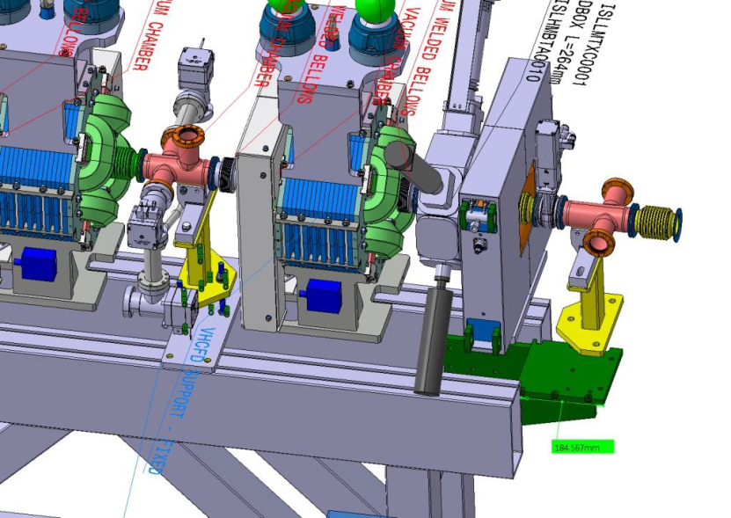
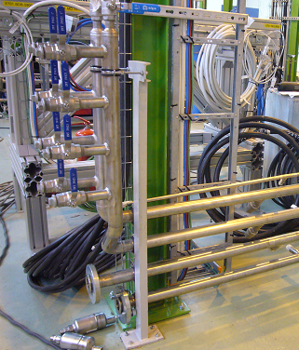
Interface with experiments
Vacuum transition with instrumentation
  need vacuum gauges to interlock the opening of experiment gate valve
  trigger for SC linac fast valves
  Standard: ISO-KF DN50
A patch panel with the different services is foreseen at each experimental station:
  Physics network
    Synchronisation signals: T1, T2, EBIS, GPS beam gate, HRS beam gate, RILIS
    2 spare channels (connection to P13)
  Compressed air
  Dry N2 for venting
  Exhaust line
  Power outlet (2-phase / 3-phase)
  Water cooling manifold (already in place)

Slide 22
Commissioning planning
Goal: first HIE-ISOLDE physics 12/10/15
Main milestones:
8/12/14 start HW tests on first beamline (XT00-XT01)
  (-> At least one doublet with LDB and one MD installed and operational)
20/4/15 finish HW tests on second beamline (XT02) -> HEBT handover to BE-OP
13/4 – 12/6/15 CM1 installation
1/6/15 REX charge breeder and NC linac ready
24/7/15 machine ‘ready-to-go’
  At this point the machine should be fully operational!
Commissioning scenario
Periodic dry-runs
  Periodic test of the machine in realistic conditions (≠ hardware tests)
  Start as soon as the first equipment become available (Dec 14)
  Increasing step by step the scope of the dry-runs
  Document the progress, follow-up bugs and problems
  Objective: debug most of the hardware ahead of the machine check-out
Machine check out: 4 weeks
  1st dry run with all the components (including SCRF)
  Some buffer time for debugging
Beam commissioning: 7 weeks
12/10/15 to 14/12 /15 HIE-ISOLDE Physics with 1 cryomodule (9 weeks of physics)
Not taking into account the possible 8 weeks delay for CM1

Slide 23
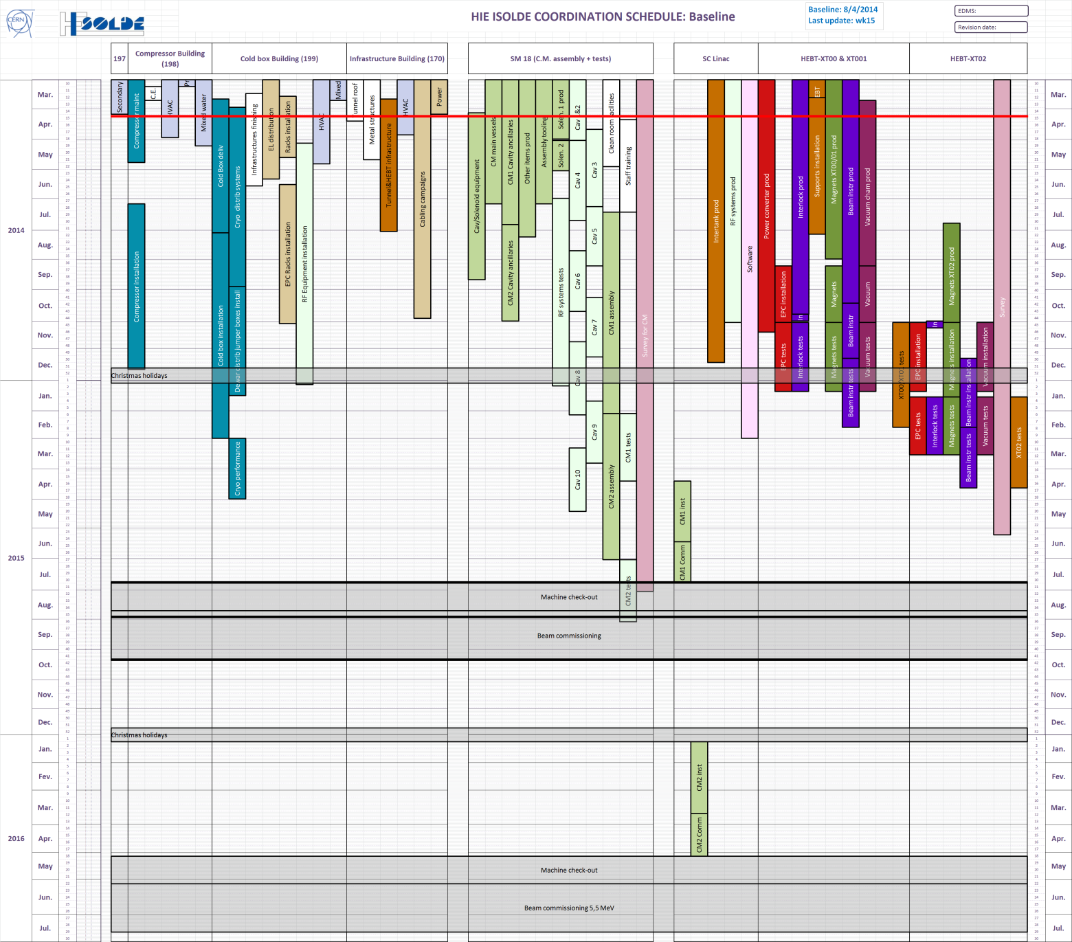
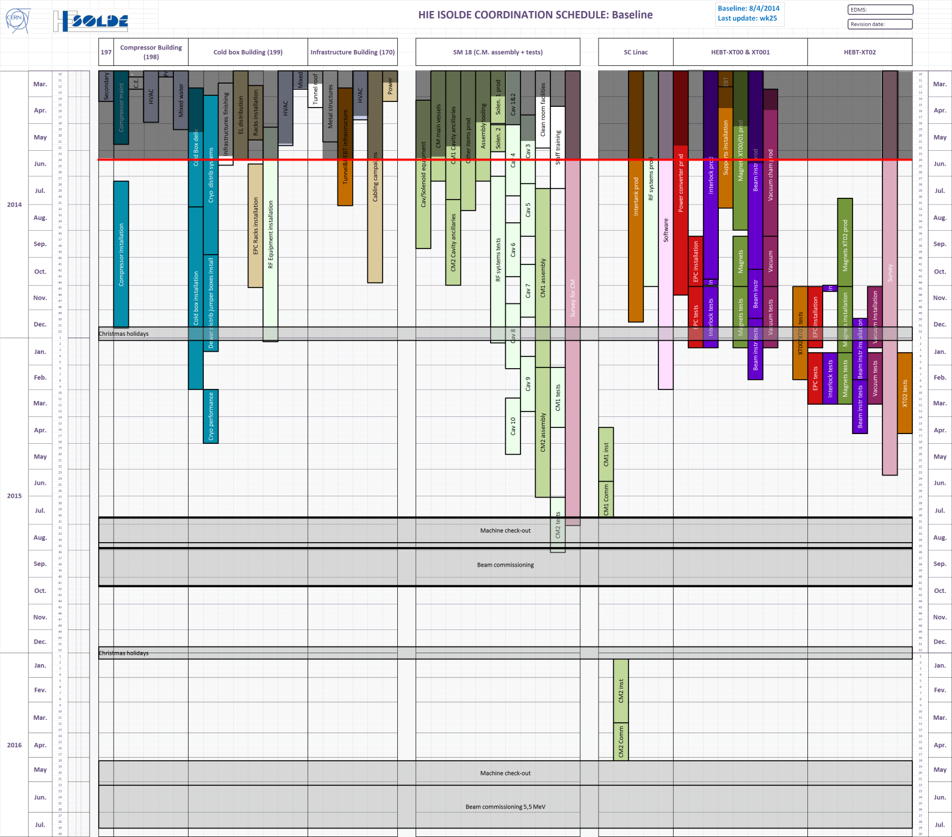
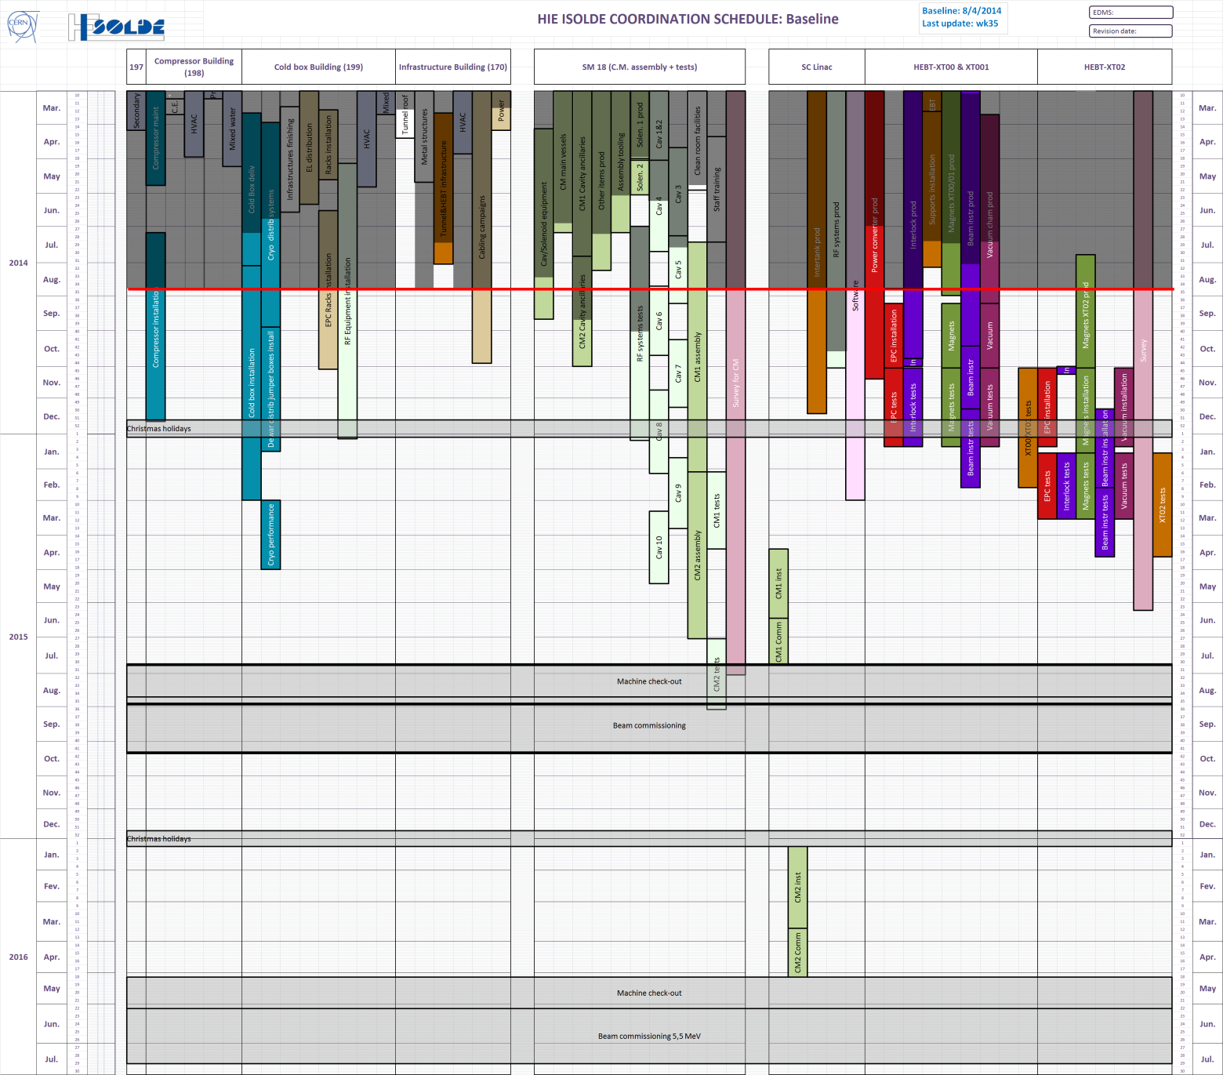
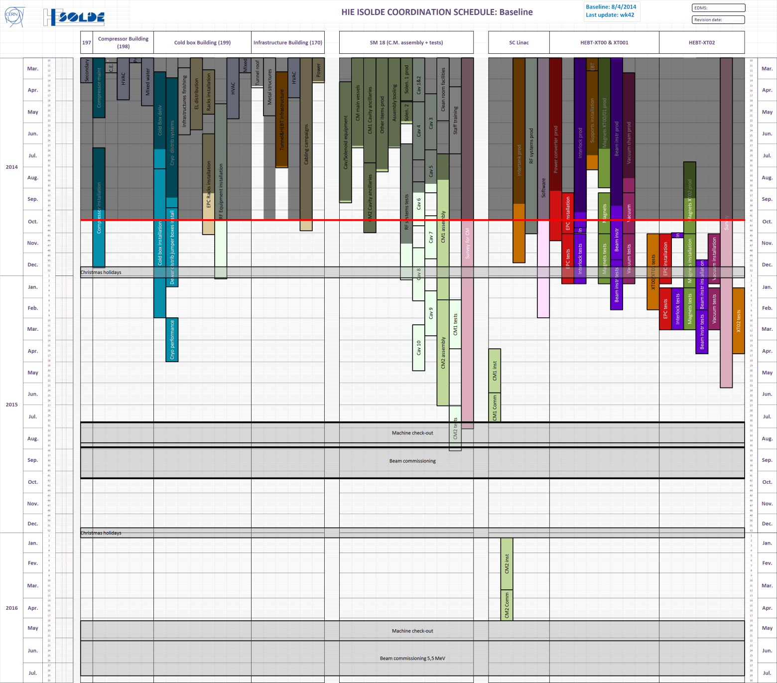
HIE-ISOLDE global planning progress (Phase1)
08/4
24/6
26/8
24/10
The project is not yet out of the critical path
Progress in the activities can be acknowledged
Efforts to catch up with delays are noticeable

Slide 24
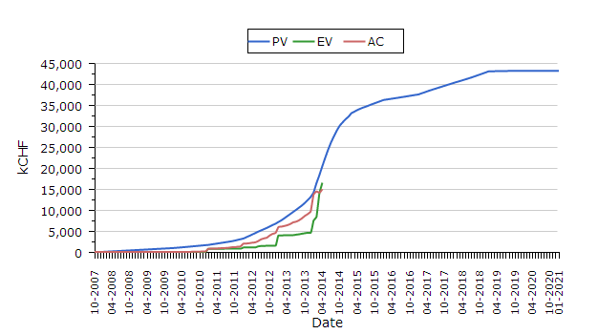
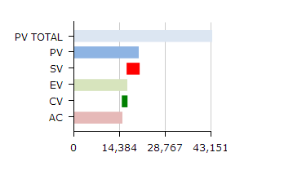
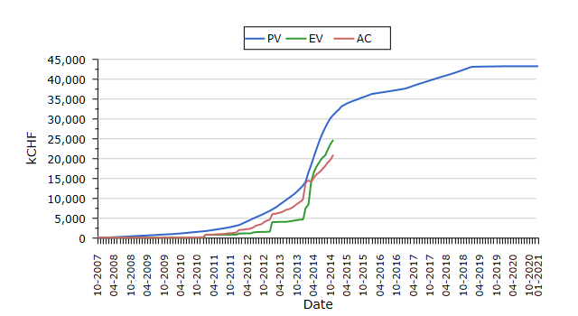
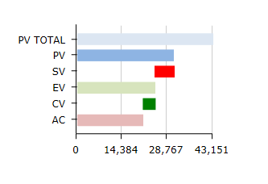
EVM evolution (Apr - Oct 2014)
April 2014
October 2014

Slide 25
Situation of the Infrastructure Part
Accounting situation on 20-oct-14
Remaining budget (3.7 MCHF)
Charges | Commitments + pipeline | Cost to Completion
12.7 MCHF | 17.5 MCHF | 21.2 MCHF
60% | 83%
Vacuum infrastructure 0.5 MCHF | Transport & handling 0.4 MCHF | DC cabling 0.4 MCHF
SC cavity test 0.3 MCHF | Control & Electronics - Power Converters 0.3 MCHF | Electrical systems 0.2 MCHF
SC cavity sputtering R&D 0.2 MCHF | Survey & Alignment 0.2 MCHF | Cooling & ventilation 0.2 MCHF

Slide 26
Situation of the Infrastructure Part
Extrapolation of the final Cost to Completion: between 21.0 and 21.5 MCHF
  No contingency reserve
  Some cost overruns already included in the actual estimate
  Low risk of major cost overrun (remaining budget: multiple on-going activities with small amount each)
  Savings and cost overruns linked to end-of-project works

Slide 27
Situation of the Machine Part
Cost by Phase
  Savings for Phase 1 : CATHI budget & beam instrumentation
  Refined cost estimate for Phases 2 & 3 based on experience
In MCHF | Phase 1 | Phase 2 | Phase 3 | Total
October 14 | 12.6 | 3.8 | 5.6 | 22.0
October 13 | 13.1 | 3.7 | 5.2 | 22.0
Delta cost | -0.5 | +0.1 | +0.4

Slide 28
Situation of the Machine Part
Accounting situation on 20-oct-14
Remaining budget Phases 1 & 2
(4.6 MCHF)
In MCHF | Charges |  | With Committments + pipeline |  | Cost to Completion
Full project | 8.0 | 36% | 11.8 | 54% | 22.0
Phases 1 & 2 | 8.0 | 49% | 11.8 | 72% | 16.4
SC Cryomodule Series Production 2.0 MCHF (54% budget) | SC Cavity RF 0.5 MCHF | Beam instrumentation 0.4 MCHF
SC Cavity manufacturing 0.4 MCHF | SC Cavity sputtering 0.3 MCHF | Machine vacuum 0.3 MCHF

Slide 29
Situation of the Machine Part
Extrapolation of the final Cost to Completion Phases 1 & 2: between 16.2 and 17.0 MCHF
  R&D and design completed
  Risk of cost overrun linked to manufacturing of SC Cryomodules
  Savings and cost overruns linked to end-of-project works

Slide 30
Situation of the Machine Part
  Cash balance Collaboration Phases 1 & 2
  With CERN contribution of 4.5 MCHF
In MCHF | From | To
Expenses | 16.2 | 17.0
Funding secured by the Collaboration | 10.8 | 10.8
In-kind contribution | 0.4 | 0.4
Cash balance Collaboration | -5.0 | -5.8
In MCHF | From | To
Cash balance Phases 1 & 2 | -0.5 | -1.3
Shortfall

Slide 31
Status of Phase 1
Today Phase 1 is almost completed
    Infrastructure is 83% completed, remains
        Installation of Cryogenic plant
        Power converters, RF system
        Some cabling
    Machine components is 72% completed
        Delays in procurement
        > 70% success rate for the cavity sputtering
Technical Risks are still present:
    Series cavities performance
    Re-work / re-engineering
    CM1 remains a prototype !

Slide 32
What is needed for Phase 2
Additional Infrastructure
      Jumper boxes x 2 ✔
      Solenoid power converters x 2 ✔
      Cryomodule supports x 2 ✔
      Vacuum chambers
SC Linac components:
      Cavity substrates x 10 ✔ 3 add. options needed from RI
      Coupler system x 10 ✔ 5 add. Units
      Tuner system x 10
      Solenoids x 2 ✔
      Cryostats x 2
      Intertanks x 2 ✔
      RF systems (LLRF, RF amplifiers) x 2

Slide 33
Procurement Strategy
Procurement for CM3 and CM4 will have to be re-launched (exceptions: adjusters and a few other minor parts)
Activate Options on 3 of main components → only covers need for CM3
Need to place new orders for CM4 (re-negotiation of existing contracts ?)
Phase 2 CMs are identical to Phase 1, so the cost estimate applies. But…
      Phase 1 CMs: aggressive prices for 3 main orders → foresee contingency plan for Phase 2

Slide 34
Resources to be secured
Will profit from Phase 1 experience
Count on AT Sector to secure resources for:
      CM assembly & testing
      RF system installation
Remaining groups for:
      Production follow-up
      Transport, installation and alignment
      Vacuum connection
      Re-commissioning
Project team should remain in place for:
      Technical coordination
      Planning & budget monitoring

Slide 35
Risks for Phase 2
Re-negotiation of contracts for a single CM
      Cost and different supplier
Running cost for FSU workforce if CERN manpower not firmly assigned
Performance of the refurbished cryo plant
      Cooling power margin to be re-assessed => April / May 2015 !
      Reliability of the plant to be assessed

Slide 36
Conclusions
  Budget analysis & monitoring tools are in place. Financial reports issued every semester
  Planning monitoring tools are in place. Progress reports reviewed every week
  Global Manpower needs have been assessed and reviewed this year.
  Resource needs are revised every quarter
  Specific issues are reported and addressed to AT Sector Management (V. Mertens)

Slide 37
Conclusions
Major Issue: 8 weeks delay in CM1 assembly => Physics in 2015
Risk of cost overrun linked to manufacturing and assembly of SC Cryomodules
Phase-2
  Funding shortfall of 0.5 to 1.3 MCH
  Cash shortfall of a maximum of 2 to 3 MCHF in 2016
  Provided the resources are secured, CM3 and CM4 can be produced within the time window of ISOLDE physics run1
  Installations can take place during Xmas shutdown periods of ISOLDE

Slide 38
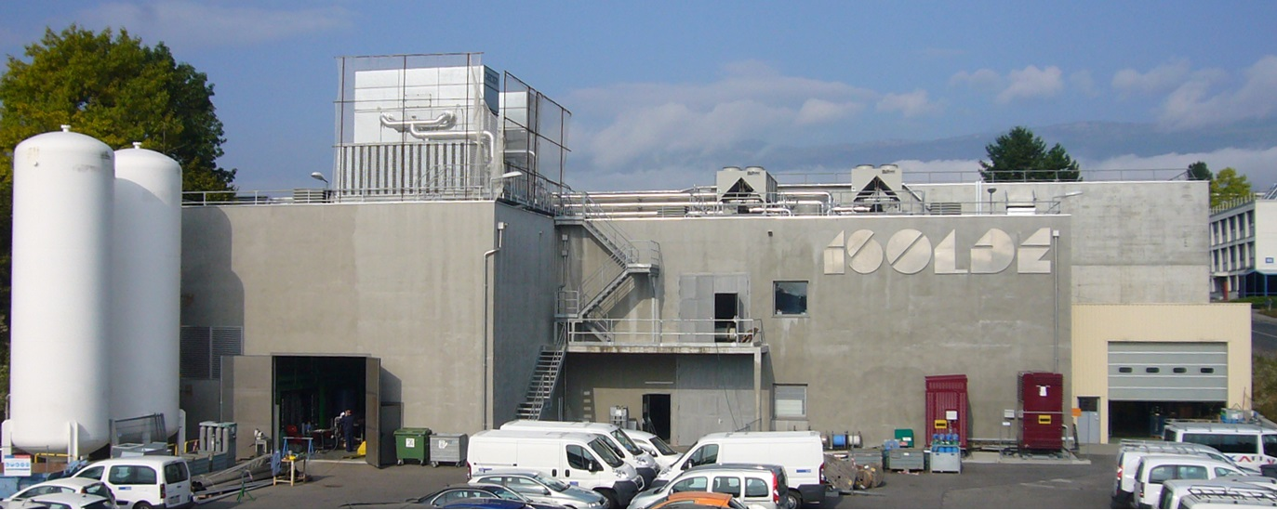
Thank you for your attention

