Slide 1

ISOLDE Technical Report
71st Meeting of the ISCC
4th November 2014
Richard Catherall, EN-STI

Slide 2
Start-up Issues

Slide 3
Outline
Why were we late?
  Robots and services
  MEDICIS shielding
  GPS.FC20
  Summary of delayed start-up
Start-up issues
  HRS
    Magnet controls, transmission, target coupling
RILIS
REX (TwinEBIS)
Consolidation
  Chamonix 2014

Slide 4
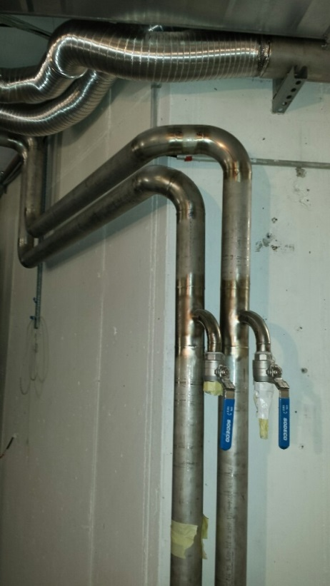
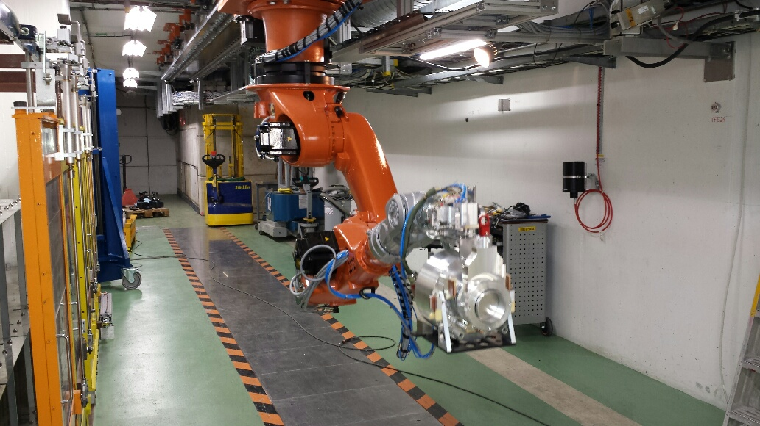
Robots
Accumulated delay caused mainly by the inability to correctly weld the service tubes
Robots were tested to the very end making the most of available time
  Co-activities

Slide 5
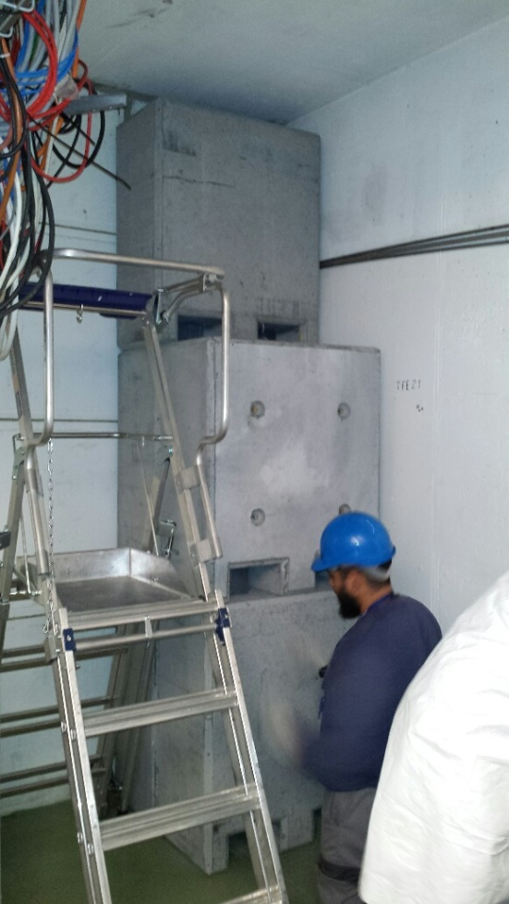
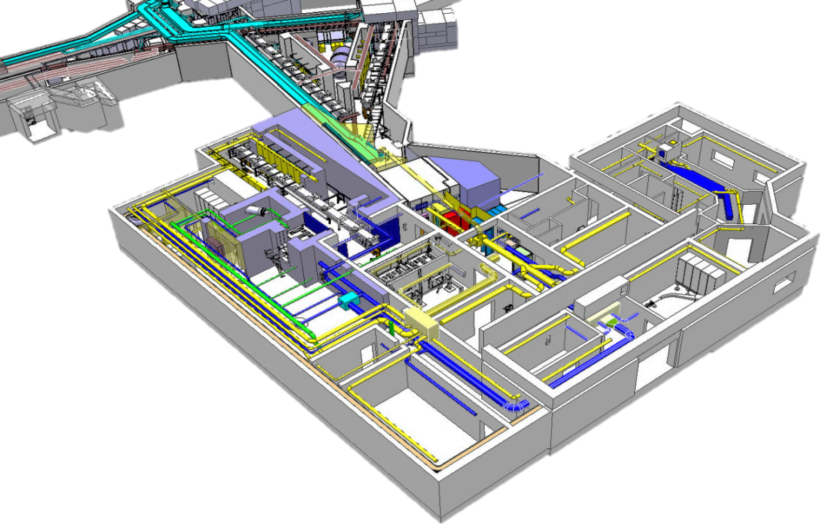
MEDICIS Shielding
To be done in order to continue work on the MEDICIS side
1.7µSv measured while taking 2µA of p-beam on HRS
Also used for benchmarking Fluka simulations

Slide 6
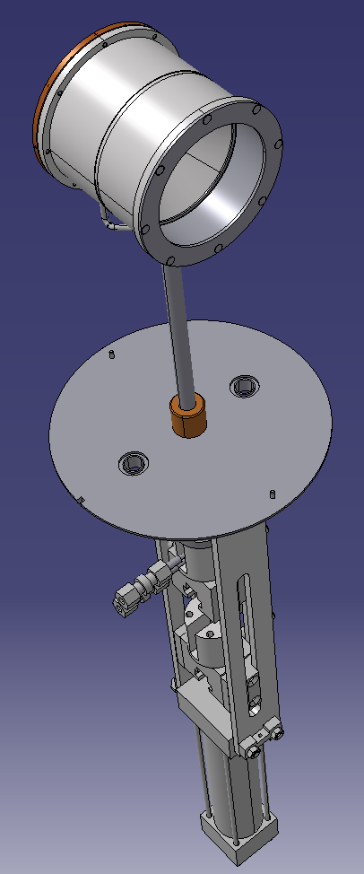
GPS.FC20
Last on the list of things to do
Spare parts were available
But..
They were poorly made (as were the original parts)
New pieces had to be manufactured in extremis
Combined effort by many groups

Slide 7
Summary about delayed start-up
Under-estimated the amount of work and the impact of co-activities
  3 maximum and only 1 when contamination risk
Knock-on effects due to “unknowns”
  Welding of pipes (> 2 weeks)
  HRS vacuum leak (> 2 weeks)
IMPACT documents
  >180 done for ISOLDE…delays in signatures/prolongations
  122 for the ISOLDE tunnel and building 179
Service group availability – priorities elsewhere
Planning
  What planning?

Slide 8
HRS Magnet controls
New controls compatible with FESA 3 class
  Little time to de-bug before hand due to HRS being down
Repeatability issues
Teslameter communication with nmr probes
  the GPIB-to-Ethernet converters replaced
Actions
  improve the existing FESA NMR class to eliminate possible communication bottlenecks.
    Now being launched to reduce time between changing masses
  Test a new National Instruments model of GPIB-to-Ethernet converter.
  (M. Colciago)
  Send the PT2025 units to Metrolab for the periodic calibration during the end 2014
  Test the newly released teslameter PT2026 as a possible replacement for long-term
  Speed up the time it takes to change mass
    Re-write the FESA 3 Class for the power supplies.

Slide 9
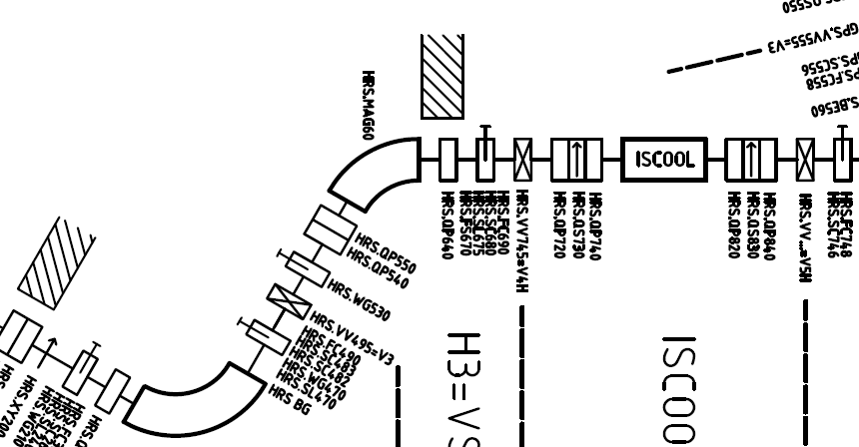
Transmission through RFQ
Anywhere between 40% and 80%
Doubts on alignment of HRS and RFQ
  Latter checked with lasers
  Also a lot of RFQ debugging due to HRS being down.
  In parallel with control problems
Tension found on 3 multipole elements
Transmission now at 100%

Slide 10
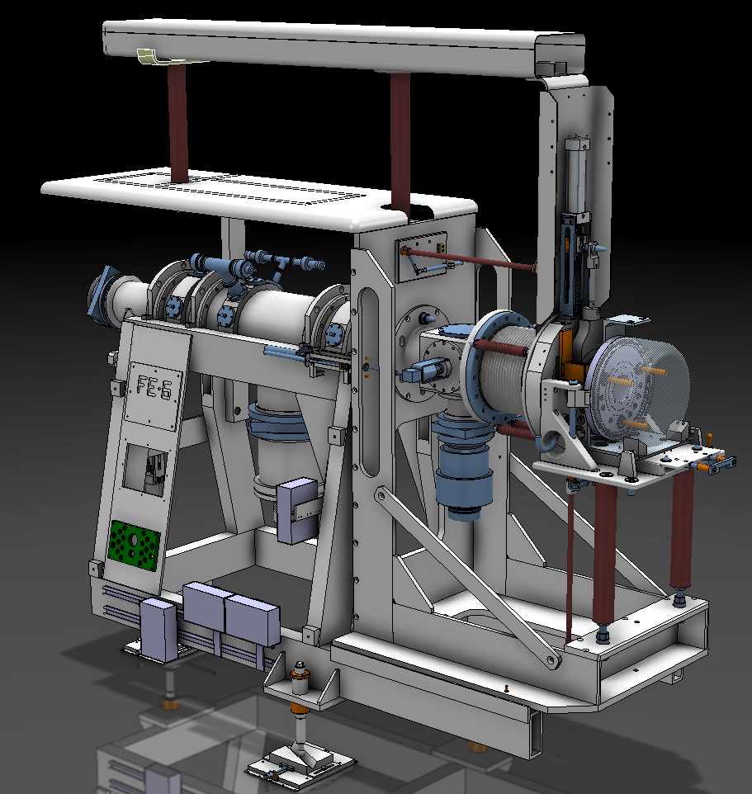
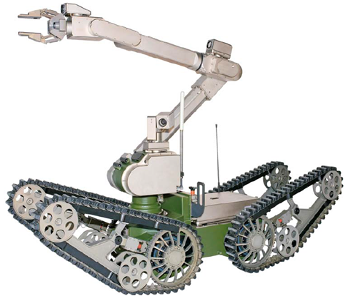
HRS Frontend coupling table
Target #507 UC2-C
Protons taken on target – 4.4E18
22-09-14. Inability to unclamp target on Frontend for target change
  First thought to be problem with FE controls
    Fast response by EN-STI-ECE
  Then compressed air was investigated
    Found faulty electro-valve that had to be replaced
23-09-14. Dose rates too high to intervene manually for visual inspection
  (30mSvh⁻¹@40cm)
  Telemax robot sent in to investigate
  No visually apparent problem
  Pressure of compressed air increased from 6 – 9Bar
24-09-14. Attempted to pump FE but failed
29-09-14. Intervention to manually assist target removal with 10Bar
  Discovered in situ that the target had uncoupled itself
  Removed by ISOLDE robot and placed on shelf
  Dose rate at FE now at 3.7 mSvh⁻¹@40cm

Slide 11
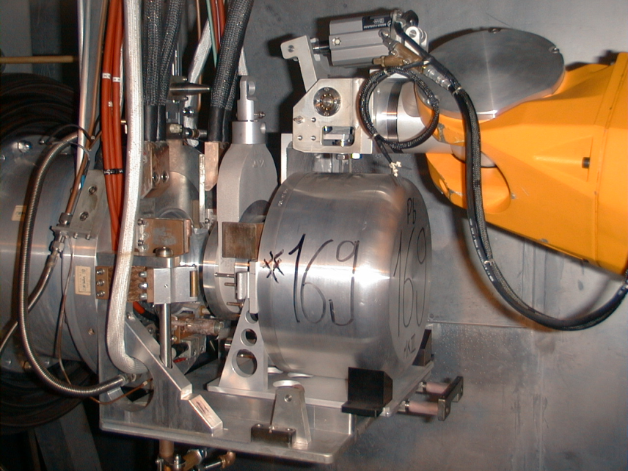
Coupling tables
Both FE coupling tables were modified during the LS1 period
To avoid unnecessary contact between the FE and the robots
The previous coupling table was a simple plate on linear rollers
Robot was used to push and pull the table
Interface identified as a potential cause for a critical failure scenario

Slide 12
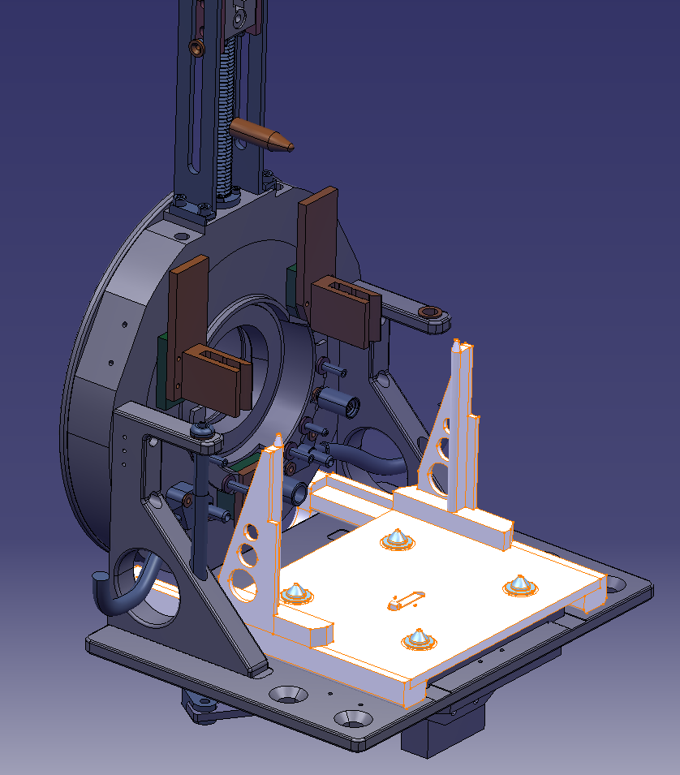
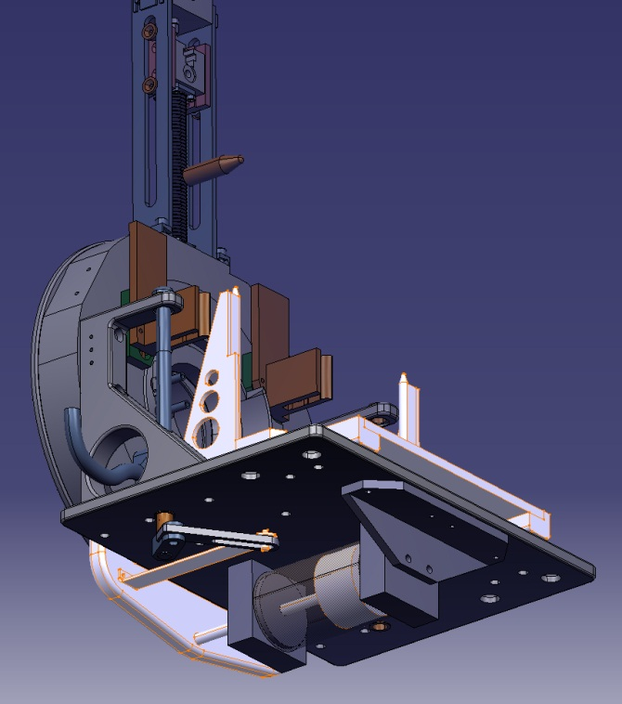
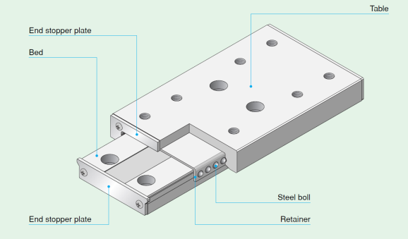
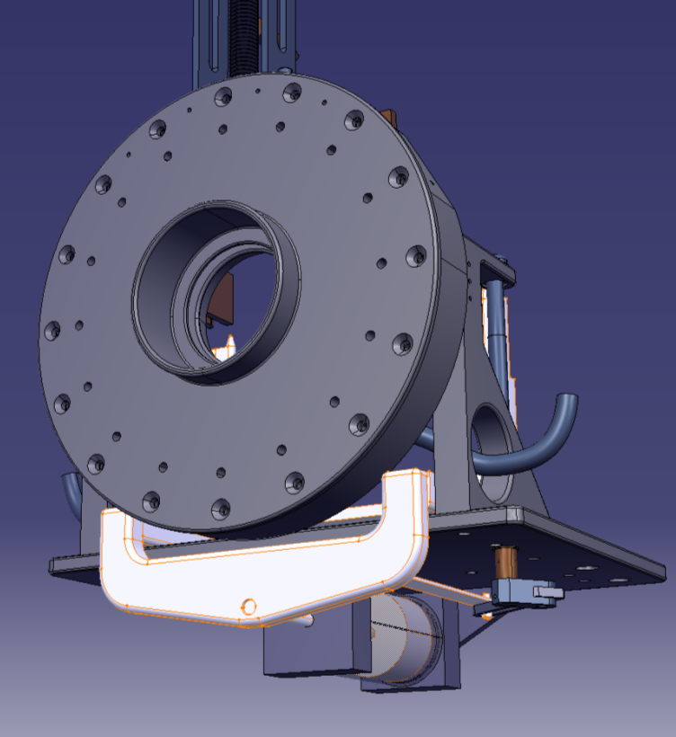
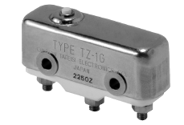
FE Modifications: Proposition
New clamps with linear movement
Install a radhard ceramic switch for target detection
Pneumatic piston diam.80
Use existing cam for table position feedback
S. Marzari

Slide 13
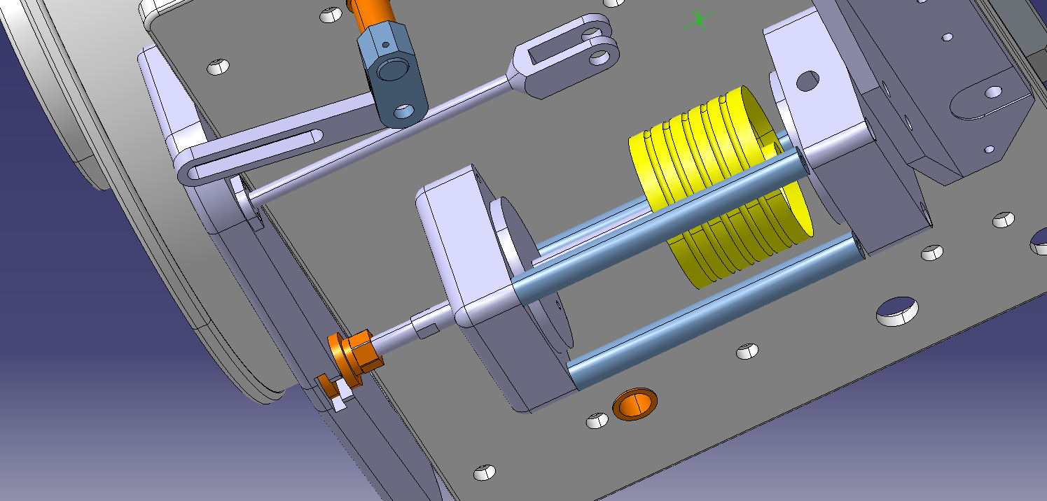
The Previous Design
Note that existing holes and fittings were used to minimize the amount of time for the installation of the new coupling table
“Floating connector”

Slide 14
History (suite)
Operated table movement at 6 Bar while monitoring with Telemax robot
Signs of shuddering and loud noise due to friction
Piston removed
  Found to be OK but tolerance on “floating” connection too tight
Tolerance of connectors on FE checked
  Found to be at a minimum
Table and linear slide units checked independently and OK
New modified “floating” connection of piston installed and piston put back
  Observations with Telemax show a clear improvement but still signs of friction
  Note that the rate of compressed air pressure increase is too slow

Slide 15
Assumptions and Decision
Assumptions
  There is a mis-alignment between the piston and the linear slide units.
    Effect reproduced on the off-line separator
    But only when compressed air rate was decreased
  The “floating” connection of the piston does not provide the required degree of freedom
  Cannot eliminate possible damage to the existing piston
    Titanox coating removed due to friction?
    Slightly bent piston axis after applying 10Bar?
Decision
  Design and manufacture a new piston + fittings

Slide 16
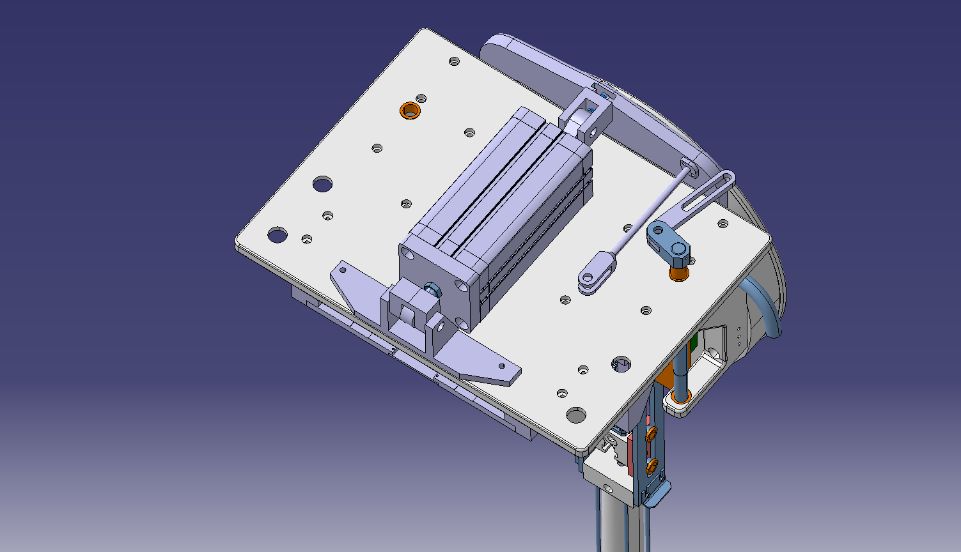
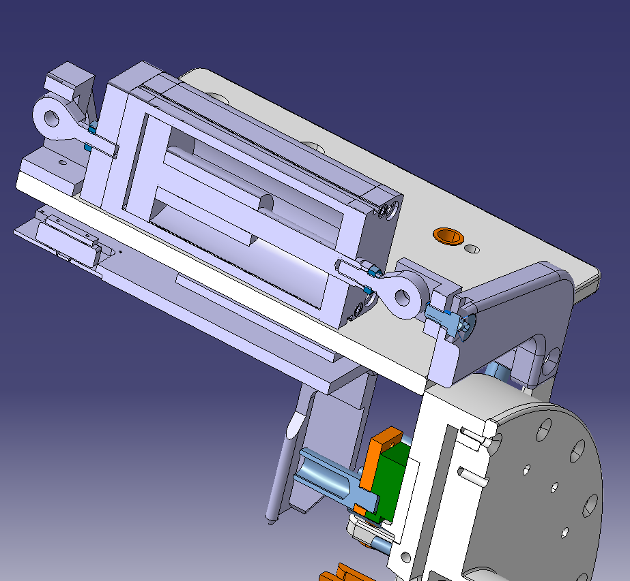
New design
Introduction of ball-and-socket joints

Slide 17
Conclusions
New design already manufactured
Independent review by external engineers within EN-STI
Repeatability tests under way on the off-line separator prior to installation
  With and without induced mis-alignment
WDP for installation already prepared
Collective dose accumulated so far
  ~400uSv for 3 persons
Estimated collective dose for installation
  235uSv for 2 persons

Slide 18


New industrial laser is now operational at RILIS
BLAZE laser: A high-power, high-quality, industrial Nd:YVO laser for non-resonant ionization
Better power transmission to the ion-source
Higher non-resonant ionization efficiency
Additional dye pump laser
Improved laser safety: we can now maintain fixed beam paths for the high power lasers.
B. Marsh et al., Suitability test of a high quality Nd:YVO industrial laser for the ISOLDE RILIS installation.
CERN-ATS-Note-2013-007 TECH

Slide 19
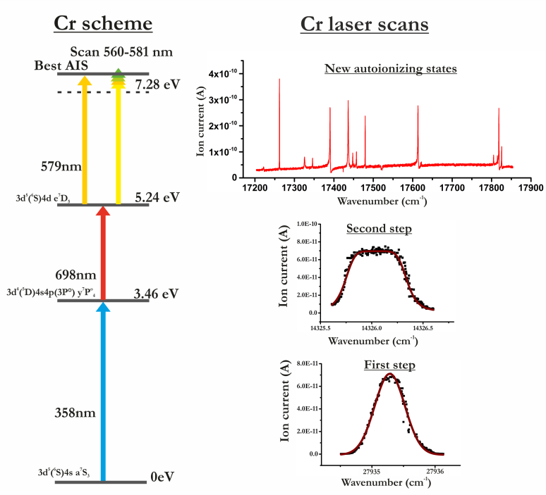
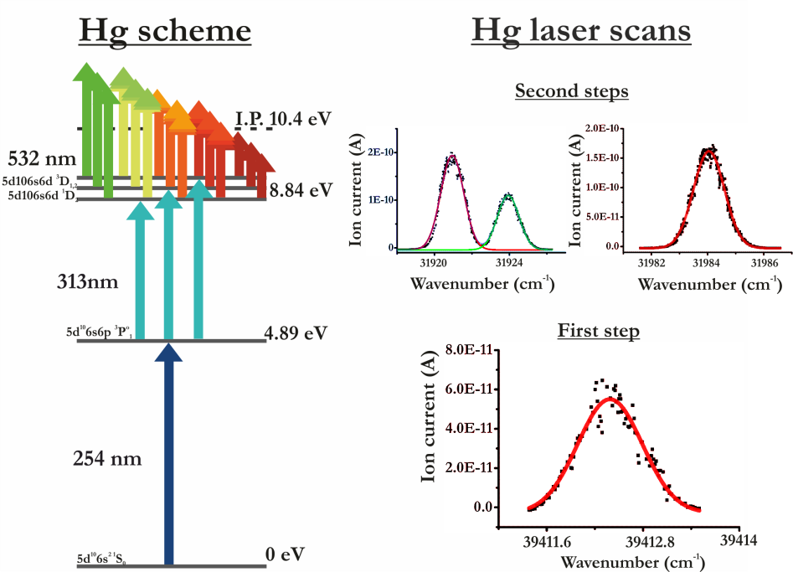
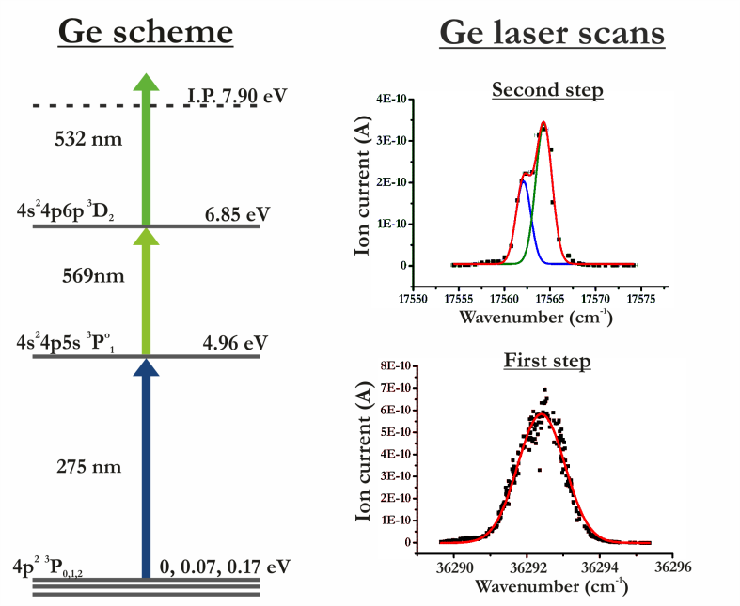
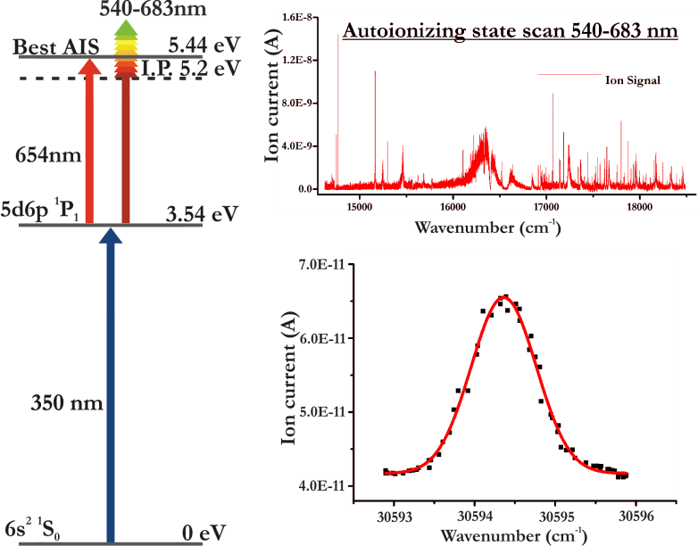

New RILIS elements
Ionization scheme development for Ba, Ba²⁺, Li, Cr, Ge and Hg
PhD work:
Tom Day
Goodacre

Slide 20
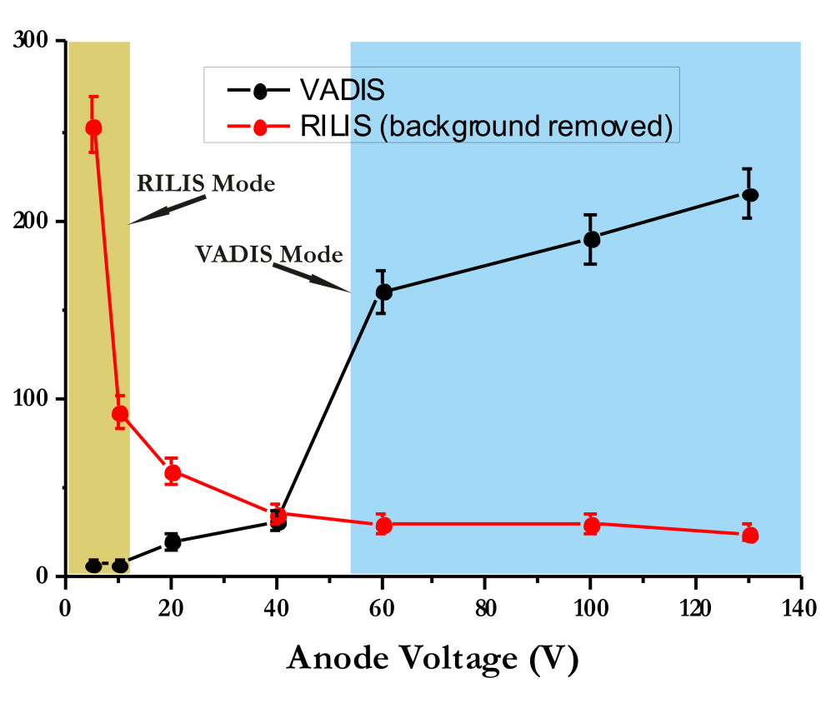
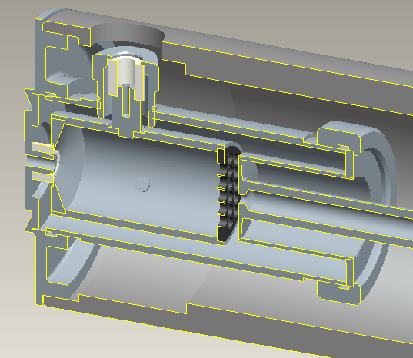
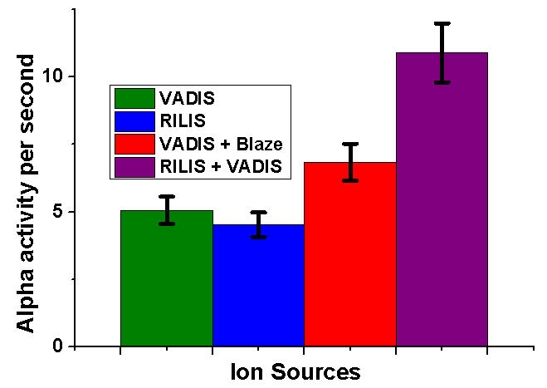
First on-line RILIS-mode VADIS operation
3D drawing from Alberto Andrighetto:
Cathi Meeting Sept ‘14
RILIS + VADIS is a new ISOLDE ion source option
First RILIS ions from molten Pb target
In-VADIS laser spectroscopy was demonstrated
Many potential future applications to be developed!
¹⁷⁸Hg Activity
More info:
https://edms.cern.ch/file/1429643/1/RILIS_FEBIAD_BM.pdf

Slide 21
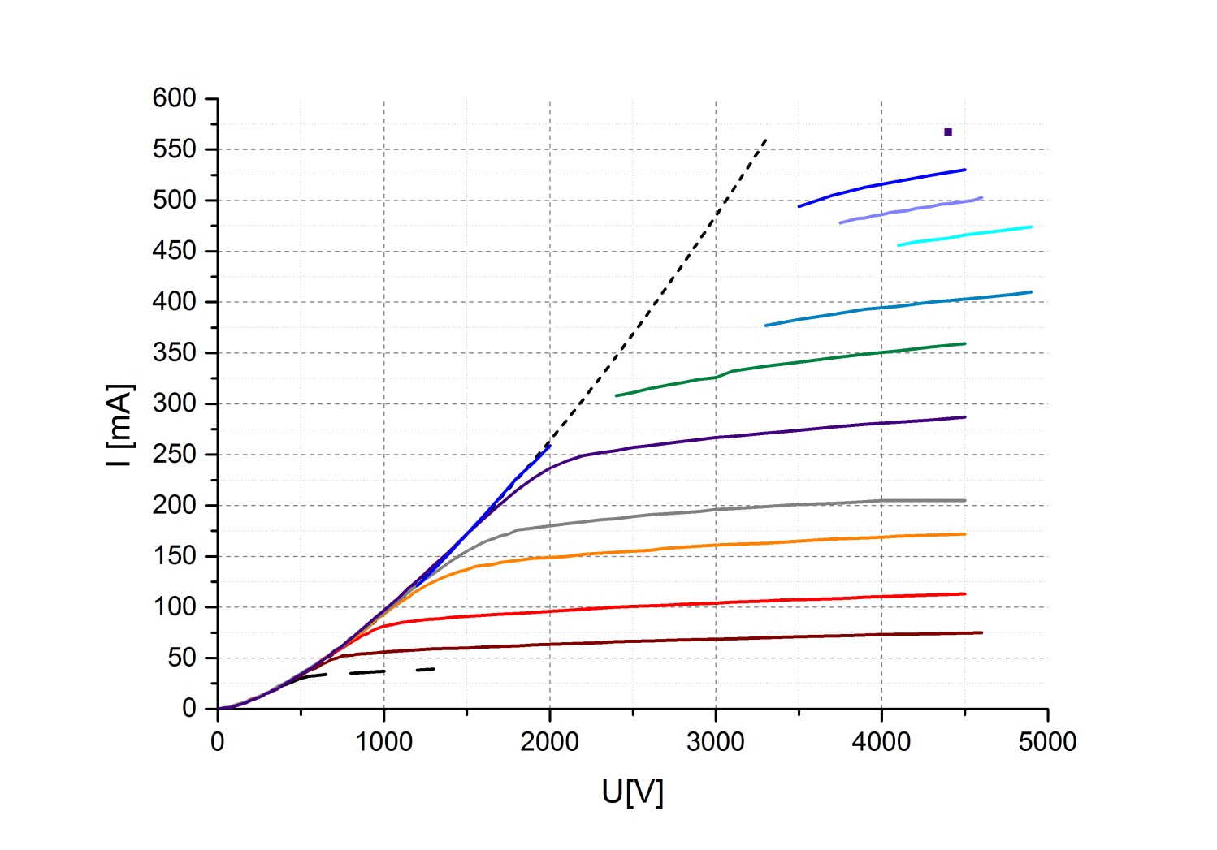
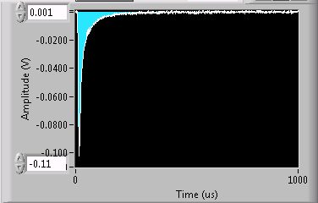
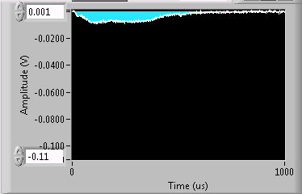
TwinEBIS results
Spare solenoid for REXEBIS
Spare e-gun, inner structure and collector
115% of the design value!!!
T ~ 2120 K
Cathode temperature measurement
calibration from manufacturer confirmed
Work function
found that LaB6 <310> crystal orientation
isn’t much better than <100> (cheaper)
Poisoning
same poisoning – even worse than at REXEBIS
T ~ 2020 K
T = 1814 K
T = 1655 K
New record electron beam current >550 mA
  stable operation but short lifetime though
Improved slow extraction of ions
Ion signal (a.u.)
Time (μs)

Slide 22
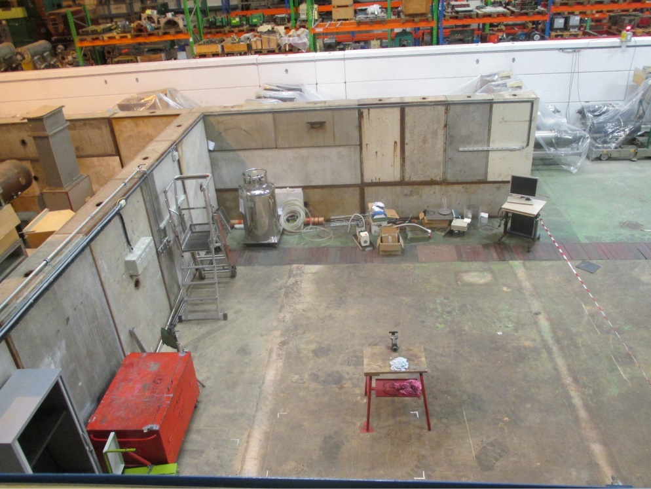
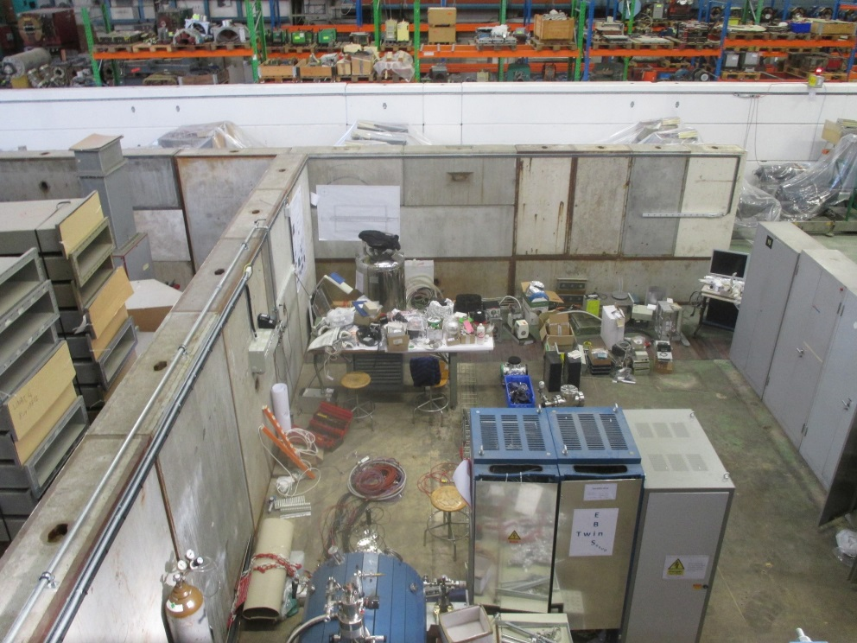
TwinEBIS phase 2
Afternoon 27/10
Noon 28/10
TwinEBIS moved to new larger experimental bunker in build 150
Future: continue with cathode and electron gun tests
build up extraction line with separator and later injection line (pending resources)

Slide 23

CONSOLIDATION
Introduction
Consolidation driven by the following criteria:
  Operation and performance of the facility
  Aging
    Radiation damage, corrosion, mechanical failures
  Difficulty to repair due to high dose rates and contamination
  Safety
    Radiation protection
Issues identified and addressed in HIE-ISOLDE Design Study
  Arrival of Linac 4 and a potential increase in p-beam intensity
    2 GeV upgrade of Booster ISOLDE?
Necessary and not approved not necessary necessary and approved part in HIE-ISOLDE

Slide 24
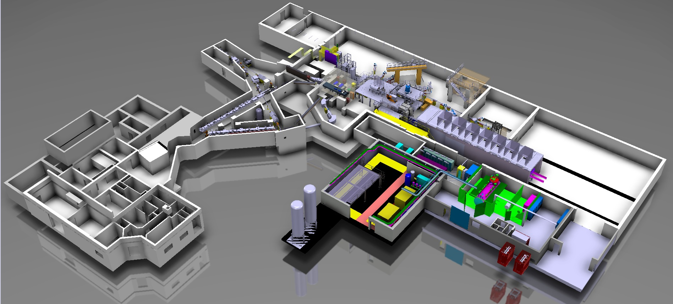
Introduction
RILIS
REX Low energy
Frontends
Beam dumps
shielding
Off-line separator
Magnets Vacuum High voltage CV controls Safety

Slide 25
Frontends
Both Frontends should be replaced during LS2
Frontend lifetime: 6 – 8 years
  HRS operational since March 2010
  GPS since March 2011
A failure of one Frontend during the operational period will reduce the physics program by 50%
Construction of 1 spare on-line Frontend
Take advantage of replacement to develop a new generation of Frontends requiring a minimum number of interventions
  E.g. - Modify extraction electrode system
Necessary and not approved not necessary necessary and approved part in HIE-ISOLDE

Slide 26
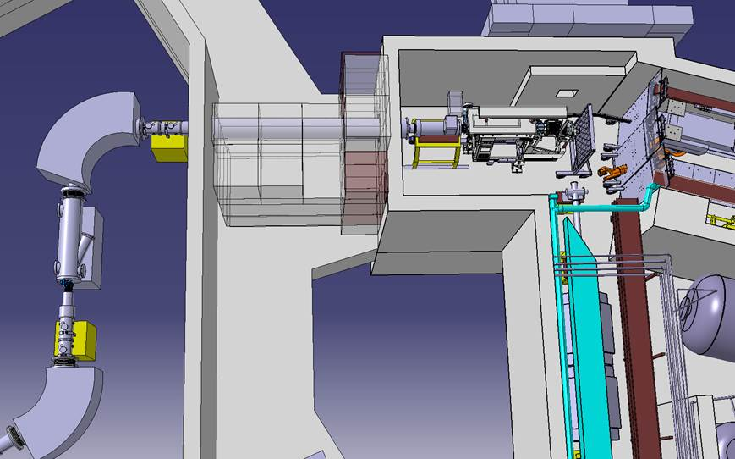
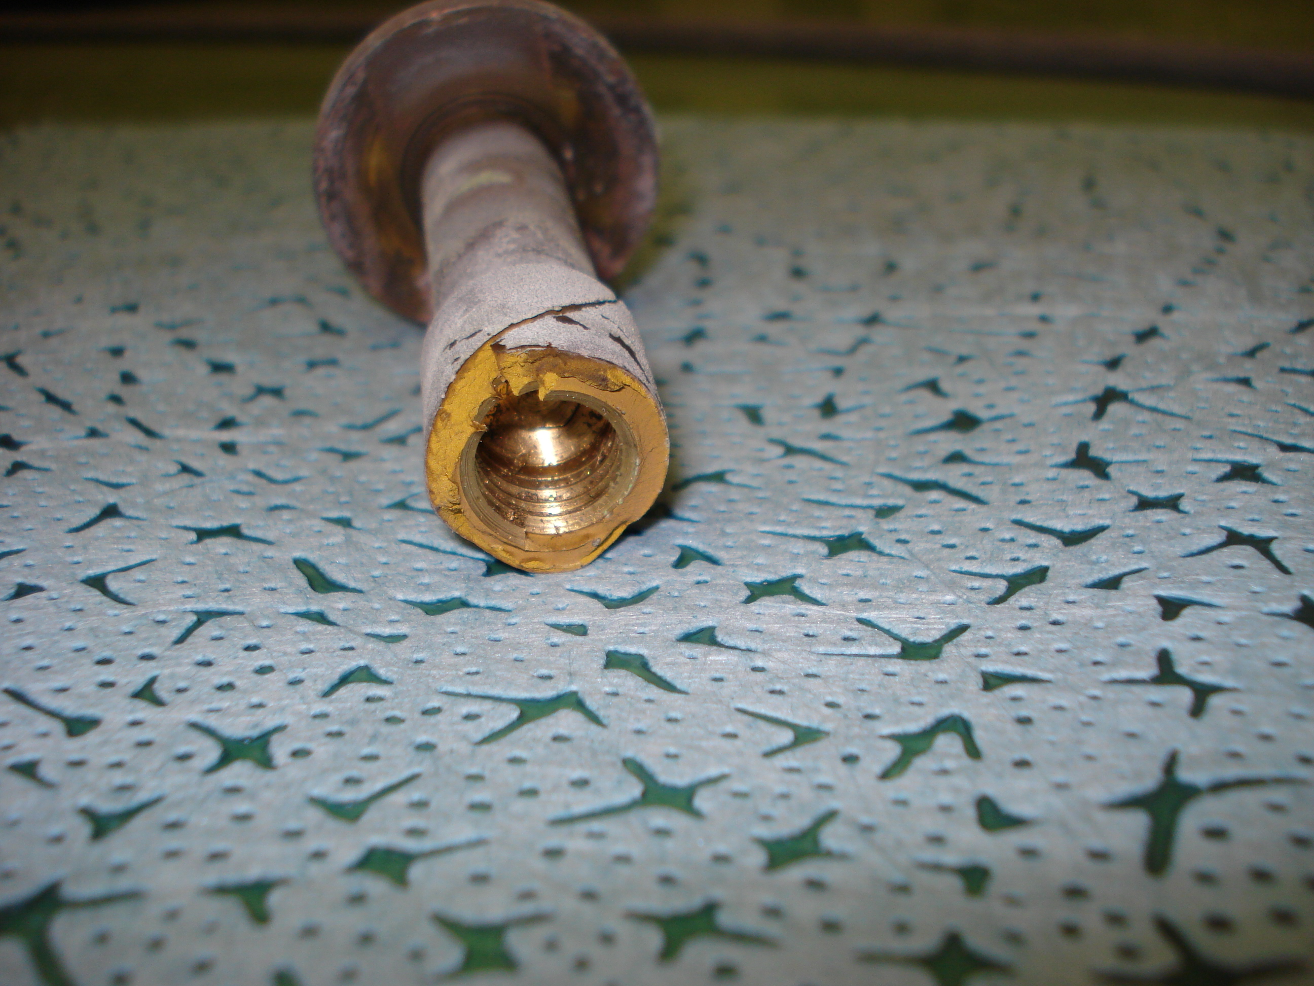
Vacuum TE-VSC
Replace first beam line chamber
Extension of exhaust gas containment
  Addition of a third tank
  ISOLDE pumping is stopped when the tanks are full
  Not always possible to release gases due to a lack of decay time
Replace beam line turbo pumps
Necessary and not approved not necessary necessary and approved part in HIE-ISOLDE

Slide 27
ISOLDE Beam Dumps
Replace/modify the ISOLDE beam dumps
  At the limit of operation in terms of thermal and compressive stresses
  Simulations done on assumed properties show that limits are exceeded for certain p-beam conditions
  A failure of the beam dump would stop the ISOLDE physics program for >12months
  Prevent any increase in p-beam intensity and energy
Should be replaced/modified during the LS2 period
  2 options considered
Necessary and not approved not necessary necessary and approved part in HIE-ISOLDE

Slide 28
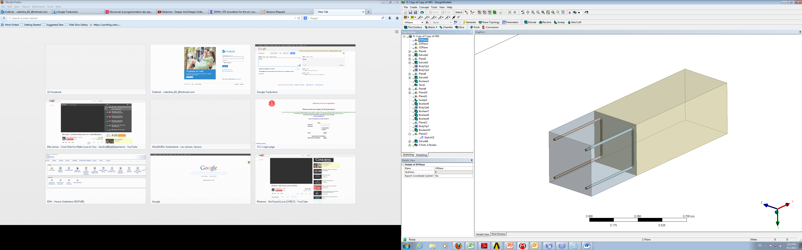
ISOLDE Beam Dumps Option 1
Insert a PSB like water-cooled beam dump in front of existing beam dumps.
  Advantages:
    Cheaper option
    Based on known design
    “easier” access
  Disadvantages
    Implementation and maintenance of a cooling system
      Activated water
    Contribution to target area air activation and consequent release to atmosphere.
    High dose rate for installation
Necessary and not approved not necessary necessary and approved part in HIE-ISOLDE

Slide 29
ISOLDE Beam Dumps
Option 2
Replace existing beam dumps
Advantages
  Low dose rate for installation
  Take advantage to improve shielding (see next slides)
  Reduction in air activation through new design
Disadvantages
  Removal, storage and replacement of ~3500m³ of earth, about half of which is activated.
  Handling and storage of radioactive beam dump
  Still require cooling and its associated disadvantages
Necessary and not approved not necessary necessary and approved part in HIE-ISOLDE

Slide 30
Shielding
Further shielding required to attenuate dose rates observed during operation and under certain conditions:
  2uA of p-beam on thick ISOLDE targets (>50gcm-2)
  Identified by RP in https://edms.cern.ch/document/1142606/1 CERN-DGS-2010-006-RP-SN
  Impact of p-beam intensity and energy increase on radiation dose rates outside the CERN perimeter to be assessed
Can be combined with an upgrade of the ISOLDE beam dumps
Requires major excavation work of activated earth
Necessary and not approved not necessary necessary and approved part in HIE-ISOLDE

Slide 31
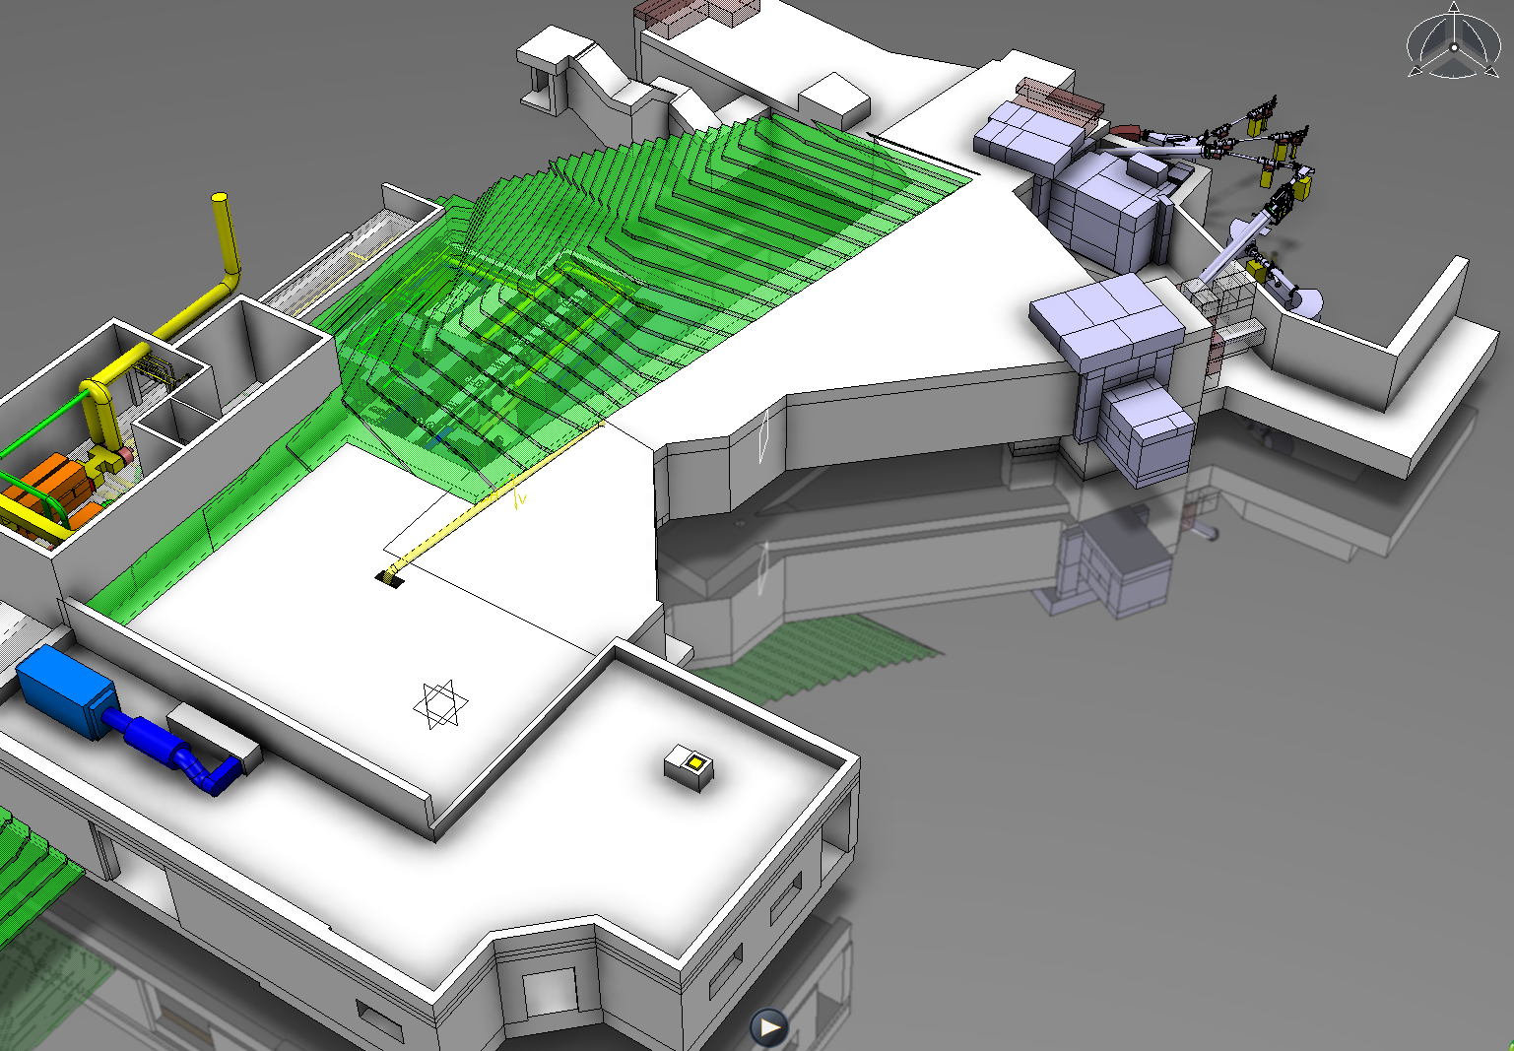
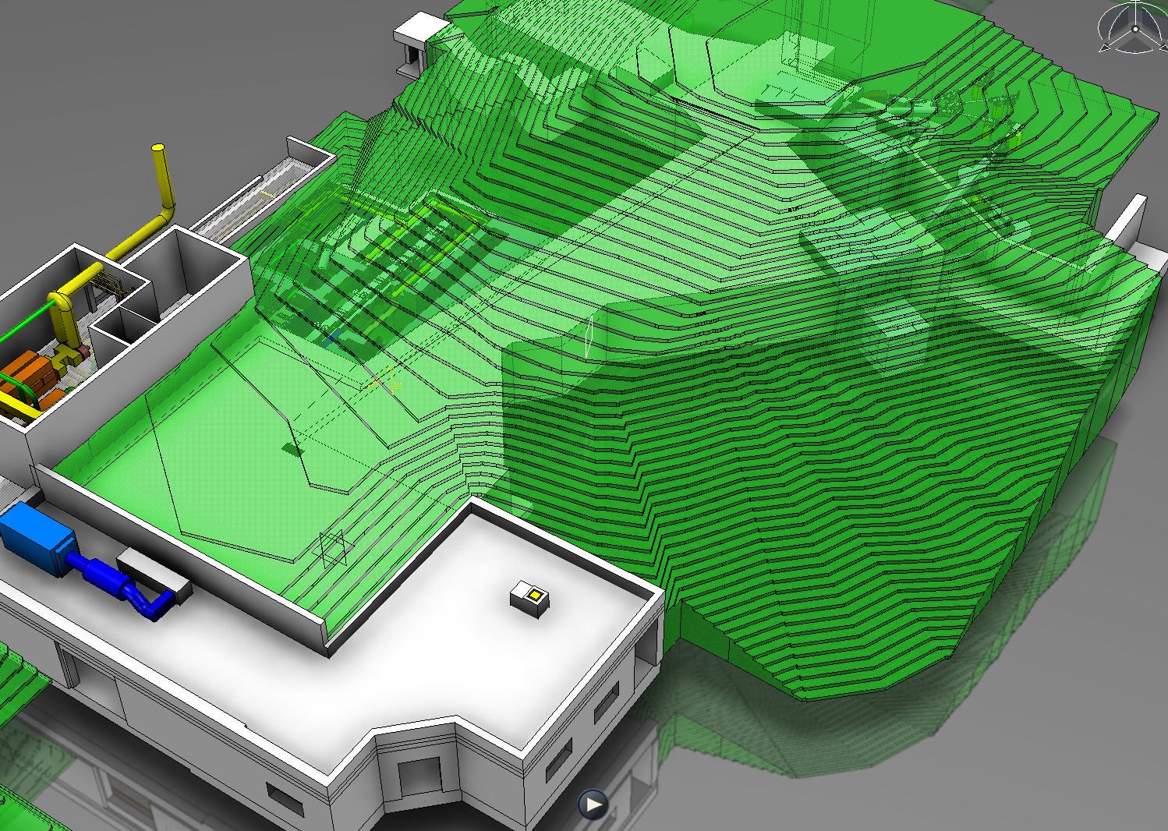
Shielding

Slide 32
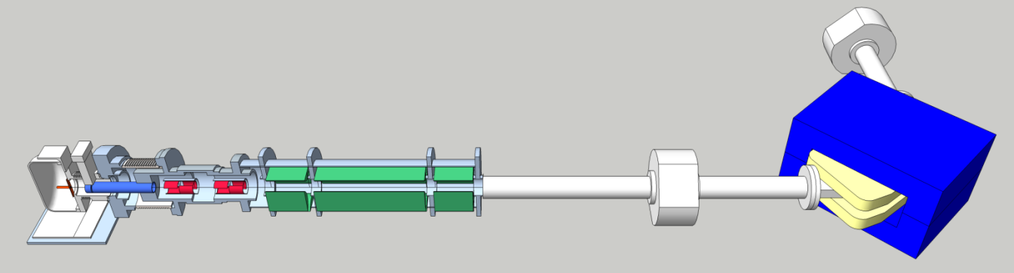
Off-line Separator
Construction of a dedicated off-line separator in the Class A laboratories
Prior to 2005 and the commissioning of the Class A laboratories at the ISOLDE Facility, all targets (non-actinide and actinide (UC₂-C)) underwent off-line testing in the ISOLDE laboratories in building 3 prior to operation on-line.
  Target characterization, stable beam mass scans, ionization efficiency measurements..etc
Since 2005
  All radioactive source handling (including actinide target preparation) is done in the Class A laboratories.
  To avoid cross contamination, only non-actinide targets continue to be tested in building 3
  A second dedicated off-line separator is required in the Class A laboratories for the testing of actinide targets .
The risk is poor on-line target performance leading to the cancellation of a physics run
  2 week loss of physics + time and travel of users
Spin off: Could be used for “winter physics”
  ⁷Be collections, long-lived isotope collections
Necessary and not approved not necessary necessary and approved part in HIE-ISOLDE

Slide 33
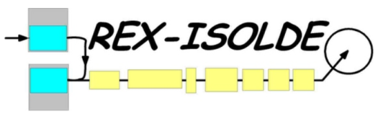
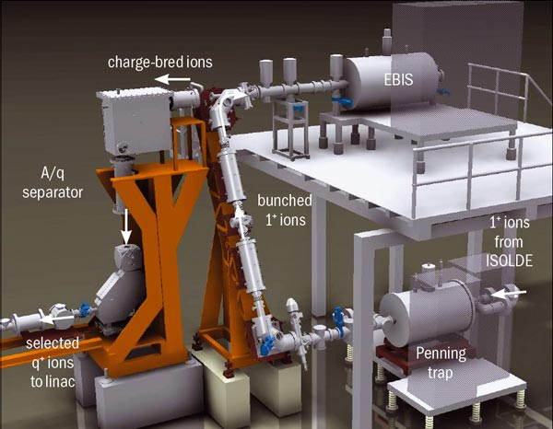
REX-ISOLDE
  The low energy part of REX cools, bunches and ionizes to a multi-charged state the singly-charged ion beams from ISOLDE before injecting into the REX-Linac
  REX-ISOLDE provides ~ 200 x 8 hour shifts per year of physics to the ISOLDE community
Consolidation implies replacement of critical components for the REXTRAP and REXEBIS
  Request 300kCHF over a period of 3 years
    2016-2017-2018
  May be integrated into a project to replace with an upgraded REXEBIS
Necessary and not approved not necessary necessary and approved part in HIE-ISOLDE

Slide 34
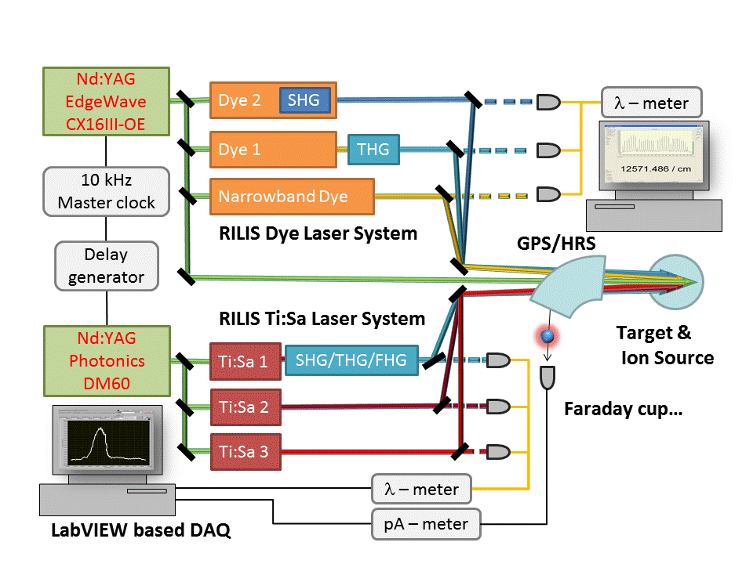
RILIS
RILIS is the Resonance Ionization Laser Ion Source, used to improve the selectivity of the ion sources in ISOLDE.
70% of the beams in ISOLDE are produced using RILIS.
Nd:YAG lasers have limited lifetime, and need to be replaced after about 15000 hour of operation (say, every 5 years).
We already see signs of degradation (output power reduced) of the YAG lasers (bought in 2007/2008), so it is time to replace them.

Slide 35
Impact of laser failure on operation
Spare lasers are used to replace faulty units
    ~ 2 failures per operation year, tending to increase with the age of lasers
    Spare units are becoming old, performance degrading
    Cost of repair is high as the warranty has expired
More RILIS beams are available after LS1
  More requests for RILIS from ISOLDE users
  Duration of runs will increase

Slide 36
Budget request for consolidation of RILIS lasers
Request 2013
Spending profile - was not approved
Laser model | Application | Year of purchase | Number | Estimated price/unit, kCHF
Lumera Blaze 532-40-HE | Highly efficient non-resonant ionization | 2014 | 1 | 110
EdgeWave Innoslab CX16III-OE + warranty extension | Pumping of dye lasers and non-resonant ionization | 2015 | 1 | 220
Photonics DM60 or similar | Pumping of TiSa lasers | 2015 | 1 | 75
Status / kCHF | 2014 | 2015 | Total
requested | 110 | 295 | 405

Slide 37
Current status of RILIS consolidation
Lumera laser purchased in 2014
  Funding gathered from other sources:
  Marie Curie ITN CATHI (50%) + STI operation (50%)
Photonics laser price increased to 105 kCHF
Updated budget request
Status / kCHF | 2014 | 2015 | Total
requested |  | 325 | 325
RILIS lasers require a recurrent consolidation every 5 years
~ 435 kCHF in 2020
Necessary and not approved not necessary necessary and approved part in HIE-ISOLDE

Slide 38
ISOLDE Magnets
Supply of spare magnets and coils for both ISOLDE and REX ISOLDE
Any failure of the magnets would result in considerable down time of the machine
  During operation the repair of 1 separator magnet would stop all operation due to access restrictions
SLOT | DESIGN | What? | How much (kCHF) | Comments?
GPS.MAG70 | PXMDSEAHWC | Spare coils | 100 | Any repair would currently need to be made insitu as there is no provision to remove the magnets from the line, considerable down time still expected!
HRS.MAG60 | PXMDSFACWC | Spare coils | 100 | Any repair would currently need to be made insitu as there is no provision to remove the magnets from the line, considerable down time still expected!
HRS.MAG90 | PXMDSGACWC | Spare coils | 100 | Any repair would currently need to be made insitu as there is no provision to remove the magnets from the line, considerable down time still expected!
XSEP.MD100 | PXMBXCAHWC | Spare magnet | 120 | Considering solid yoke construction a new magnet would be recommended
MQT1 + MQT2 | PXMQTACFWC & PXMQTADFWC | Spare magnets | 60 | Considering solid yoke construction a new magnet would be recommended
MQT3 | Not in Database | Spare magnets | 100 | Design makes coil replacement difficult, considerable down time expected!
MQT4 + MQT5.2 | PXMQTABFWC & PXMQTAAFWC & PXMQTAEFWC & PXMQTAFFWC | Spare magnets | 60 | Considering solid yoke construction a new magnet would be recommended
 |  |  | 640 | + 160 (2 FTE) = 800 KCHF
Necessary and not approved not necessary necessary and approved part in HIE-ISOLDE

Slide 39
High Voltage
Replace the four 60kV Astec power supplies.
Independent of the new modulator development within the HIE-Design Study
Present Astecs nearing the end of life and failure rates may become unacceptable between now and the installation of the new modulator (circa 2018?).
The Market Survey is nearing completion and with tender planned for next year.
Allocated expenditure of 93kCHF in 2015 and 100kCHF in 2016.
Necessary and not approved not necessary necessary and approved part in HIE-ISOLDE

Slide 40
CV
Modification of the ventilation controls for the original ISOLDE Facility after separation of the Class A laboratories
  Tunnel, HT room, control room and “old” hall
Should be synchronised with the coupling of the MEDICIS ventilation with the Class A labs
  Shutdown 2014/2015?
Requires modification of an old and obsolete ventilation control system
Necessary and not approved not necessary necessary and approved part in HIE-ISOLDE

Slide 41
Safety (First)
Request 120kCHF/year in order to cope with ALARA and planned interventions in sensitive areas.
  Assistance and follow-up of interventions.
Preparation of risk analysis associated with operation and intervention.
Necessary and not approved not necessary necessary and approved part in HIE-ISOLDE

Slide 42
Consolidation Expenditure Request
WU/kCHF | 2015 | 2016 | 2017 | 2018 | 2019 | 2020 | Groups
Frontends x2 Spare Frontend |  | 300 | 300 |  | 50 | 300 | EN-STI-RBS BE-BI TE-VSC
Beam dumps O1 O2 |  |  |  | 1000 ? | ? |  | EN-STI-TCD GS-SE? DGS-RP
Shielding |  |  |  | ? | ? |  | GS-SE DGS-RP
Off-line | 400 | 400 |  |  |  |  | EN-STI-RBS
REX |  | 100 | 100 | 100 |  |  | BE-ABP
RILIS | 325 |  |  |  |  | 400 | EN-STI-LP
Magnets | 200 | 300 | 300 |  |  |  | TE-MSC
Vacuum |  | 70 | 60 | 160 | 60 | 60 | TE-VSC
High Voltage | 93 | 100 |  |  |  |  | TE-ABT-EC
CV controls | ? |  |  |  |  |  | EN-CV
Safety | 120 | 120 | 120 | 120 | 120 | 120 | EN-STI

Slide 43
Acknowlegements
Bruce Marsh
Fredrik Wenander
S. Marzari
M. Vagnoni
Thank you for your attention…

