Slide 1
(TISD) Beam developments
‏
Thierry Stora

Slide 2
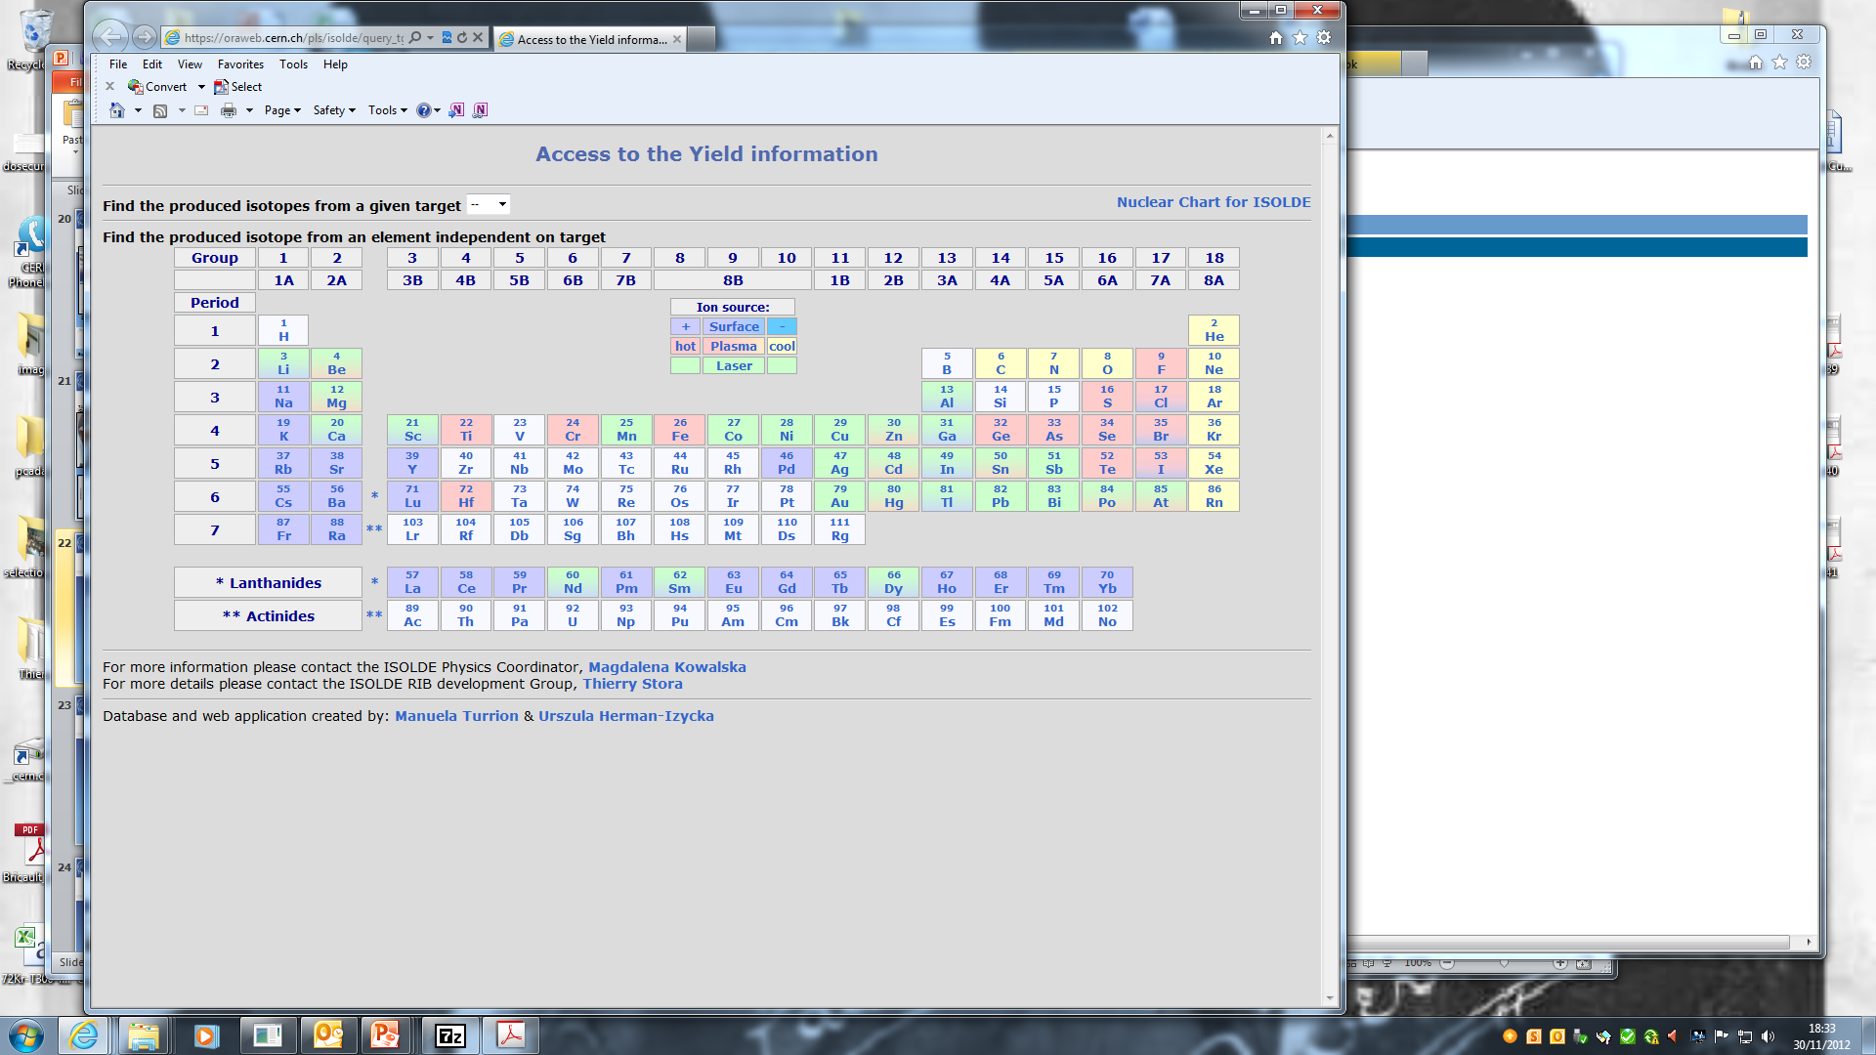
Beam developments in the past 5 years
X5 ³⁰Na Re ion source
X10 ^{20,21}Mg
sub-μm SiC
Molecular beams
Molten salt
target
¹⁷C as CO+
Helicon Ion source
⁷⁰⁺Ni beams
Purification
of ⁸⁰⁻⁸²Zn,¹³⁰Cd
with quartz
(ΔHads)‏
Nano UC_{x}
⁹Be(n,α)⁶He
⁴⁸Cr
x250
1st Fe RIB
Nano
CaO
Y₂O₃
⁴⁴TiF₃⁺
Au beams
by laser ionis.
X5 VADIS
X3-10
VADIS
Purif Fr, Ra
With LIST
Purification of lanthanide beams ¹⁴⁰Nd, ¹⁴⁰⁻¹⁴²Sm:
GdB₆ ion source cavity + RILIS

Slide 3
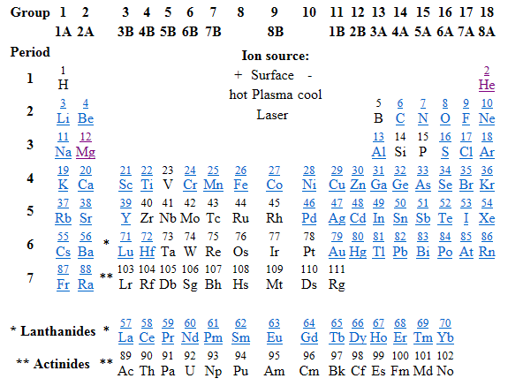
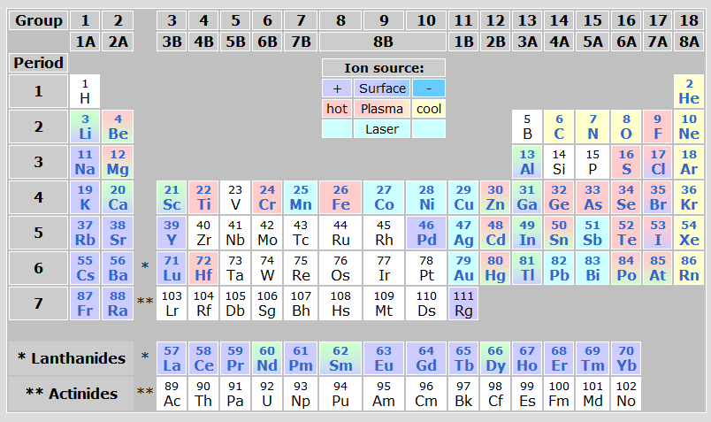
Update of the database
Update of yield data following recent developments and publications
Graphical restoration (lost with new ISOLDE website)
Cloned database for data update and analysis of the problems

Slide 4
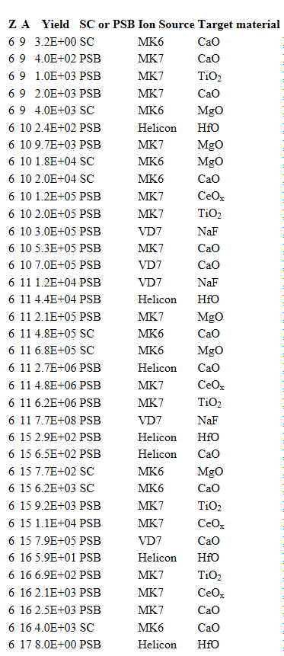
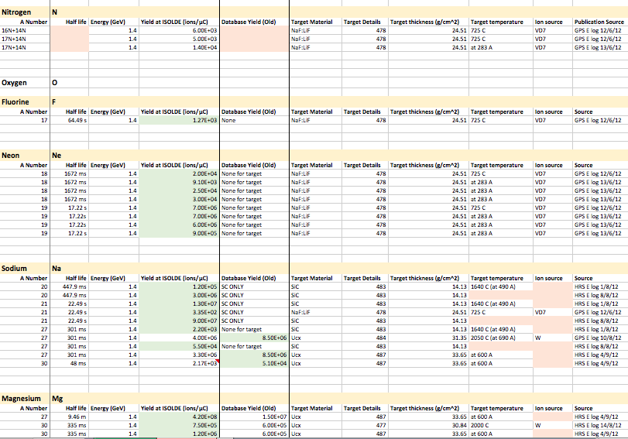
Yield data update
200+ Publications reviewed
205 Yield entries
2 Years of E-logs (~1,500 entries)
184 Unpublished yield entries
Hayley Osman – Summer Student Project 2014, T. Mendonca

Slide 5

List of beams under development (Group for Upgrade of Isolde)
8B
9C
37K
Pb/Bi target for EURISOL (LIEBE project)
nano-UCx (ActILab-ENSAR)
refractory molecular beams combined with RILIS
New neutron converter (with TRIUMF)
Ba beams

Slide 6
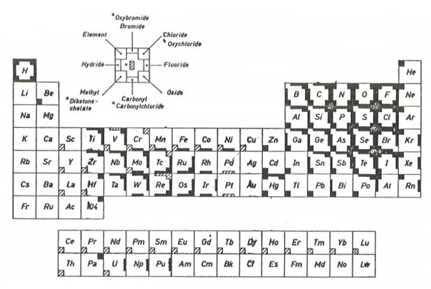

8B molecular beams
K. Baechmann. Chemical Problems of the On-Line
Separation of Short-Lived Nuclides. Forschungs-
bericht K70-28, BMBK-FB-L70-28, 1970. (EMIS !)

Slide 7
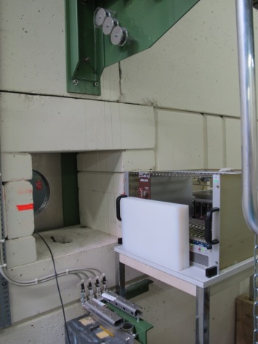
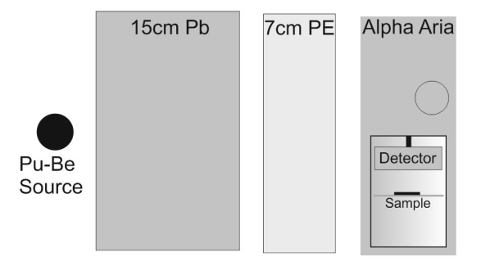
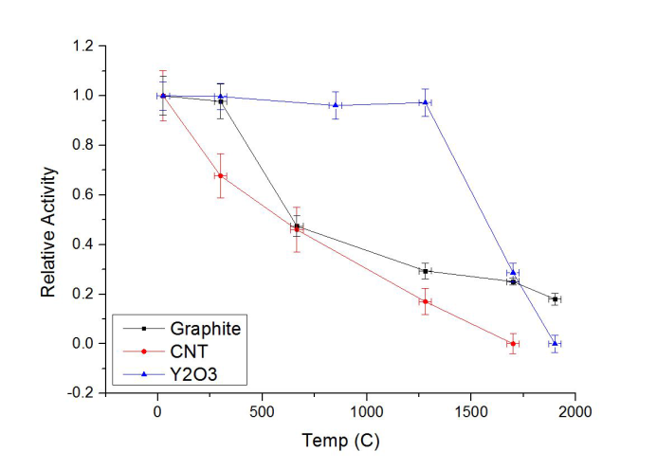
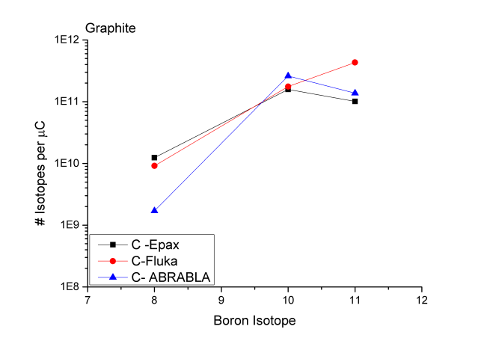
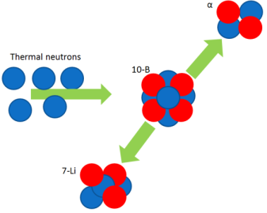
Beam development

Slide 8

8-B from Boron fluoride
Target 499:carbon nanotubes
cold transfer line, VADIS
SF6 into container
Positron activity corresponds to 3*102 1/uC
Proof that activity originates from 8B still pending
M. Gai et al.

Slide 9
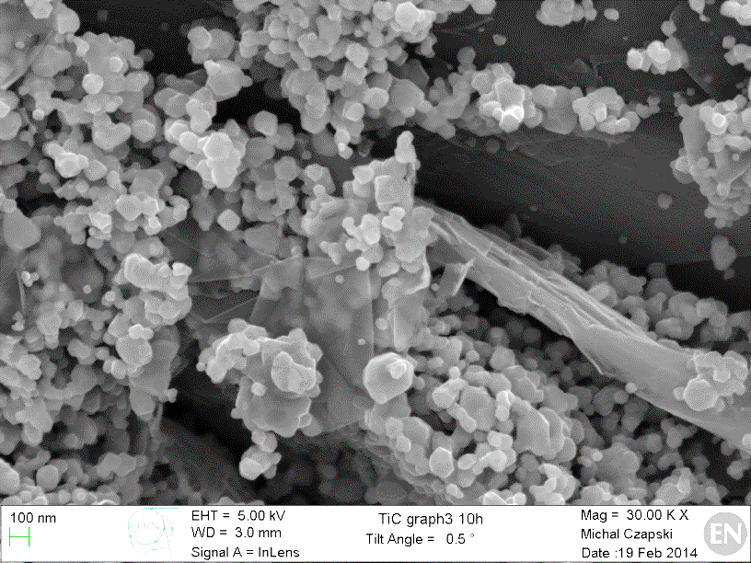
Titanium Carbide-Carbon Composites
Results of TiC nanostructural studies (37K)
Mixing TiC and Carbon (diferente vol. ratios)
TiC +Graphite
TiC + MWC nanotubes
TiC + Carbon black
Material Microstructure Study
Test for nanostructure stability at 1500, 1650 and 1800ºC
Keep these parameters at the highest possible temperature
Main quality parameters:
High surface area
High porosity (>30%)
Nanometric TiC grains
Fast diffusion and release of exotic isotopes
PhD Joao Pedro Ramos

Slide 10
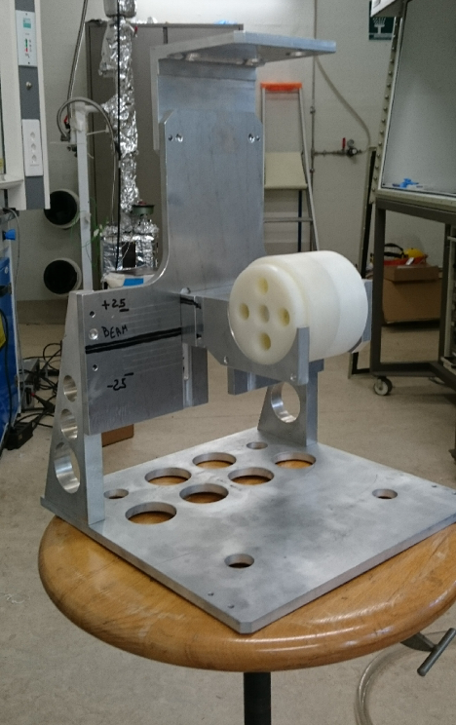
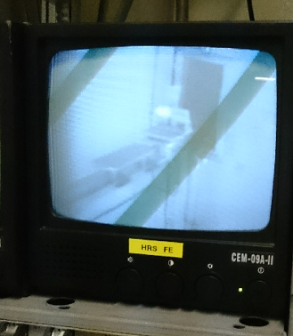
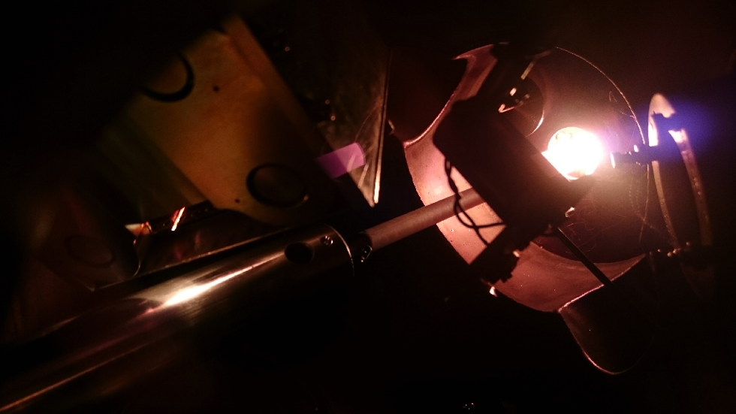
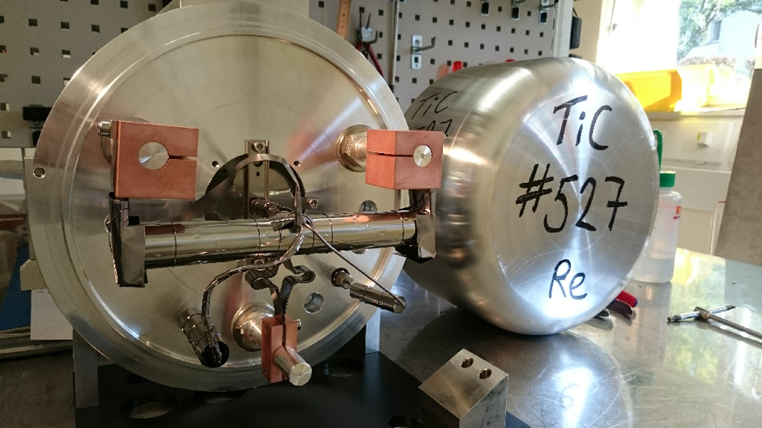
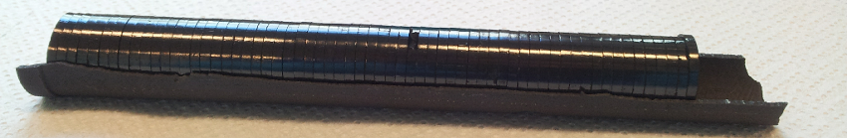
Titanium Carbide-Carbon Composites
Release studies and target prototype
The three most promising material nanostructures were selected, irradiated and studied in terms of release.
Release studies and target prototype
TiC + Carbon black (50 vol.%) nanostructure, which was stable up to 1800ºC, was selected to produce a full target prototype.
Target going online today!

Slide 11




Context of the Project
RNB intensities mainly depends on the target performances
UC_{X} target high performances are crucial for next generation facilities:
→ Better understanding material properties ⇔ release kinetics
+ Studying new synthesis techniques
From C. Lau
Last week IPNO
EURISOL Town meeting
Task #1: Synthesis of new actinide targets
Task #2: Characterization of new actinide targets
Task #3: Actinide targets properties after irradiation
Task #4: Online Tests of Actinide Targets
Project submitted with a budget request of 460 K€,
but finally initiated with 336 K€.
CERN | GANIL | INFN | IPNO | PSI
113 K€ | 38 K€ | 72 K€ | 55 K€ | 58 K€

Slide 12
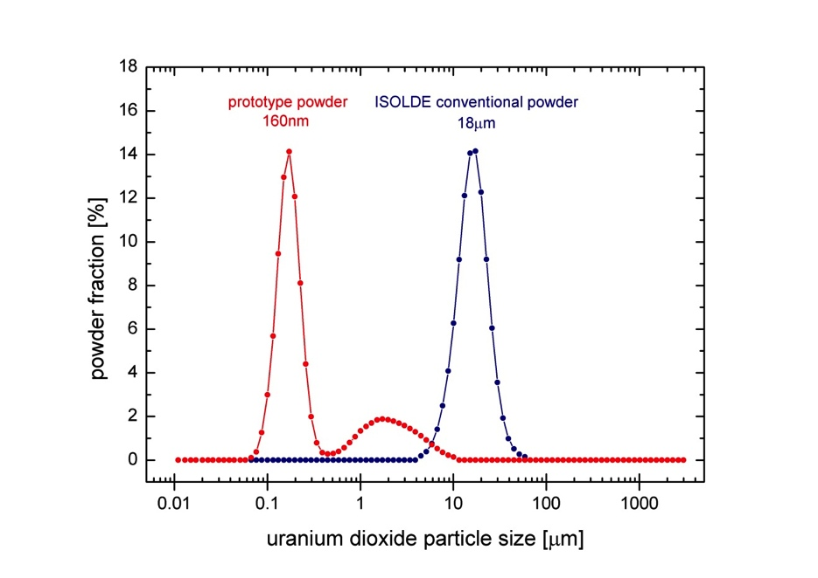
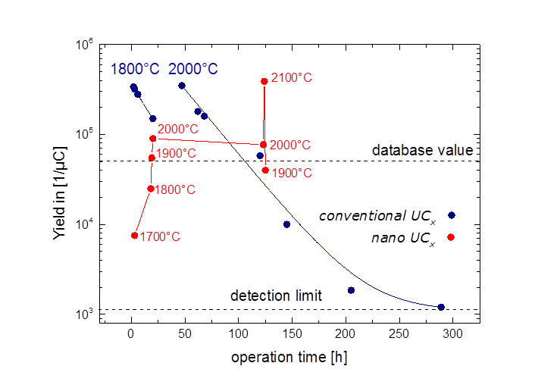
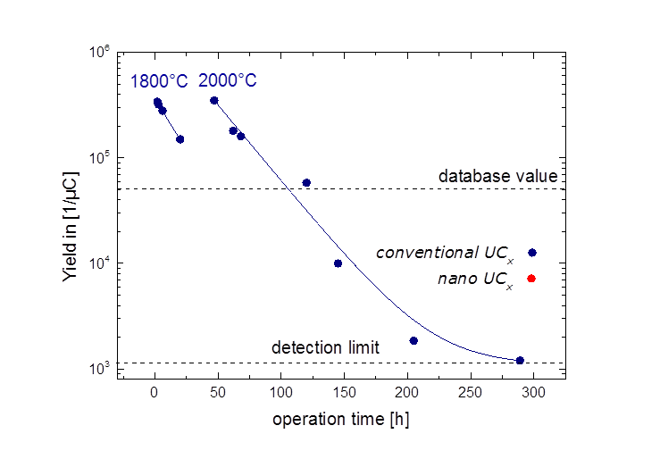
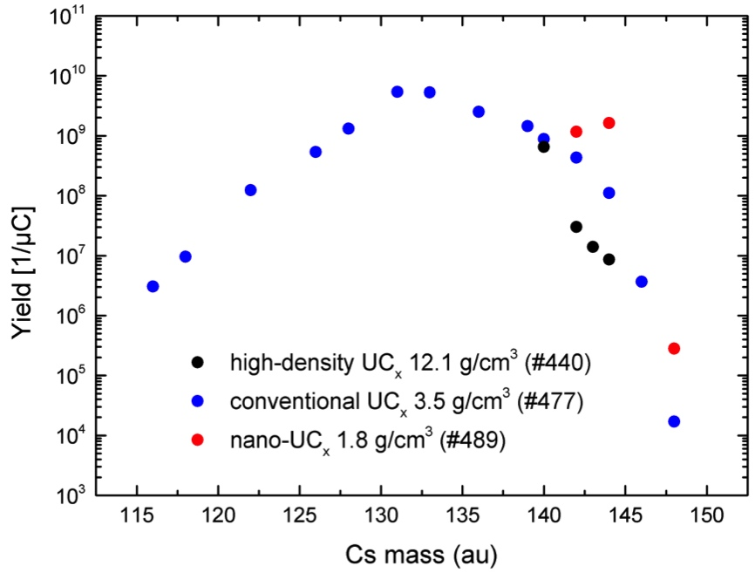
Composing a Recipe for Nano-Grained UO₂
Synthesis of de-novo designed uranium carbide matrixes:
Different microstructures, densities, grain sizes, crystal structures
tested → tailor-made matrix:
Suspension grinding of UO₂ powder to 160 nm
average particle size
Wet-mixing with multi-walled carbon nanotubes
Ultrasound drying of mixture and pressing to 1.6 g/cm³ pellets
Fast reactive sintering to mixed uranium carbide in carbon
nanotube matrix
two orders
of magnitude
Online tests in November
³⁰Na yield evolution under irradiation
A. Gottberg et al.

Slide 13
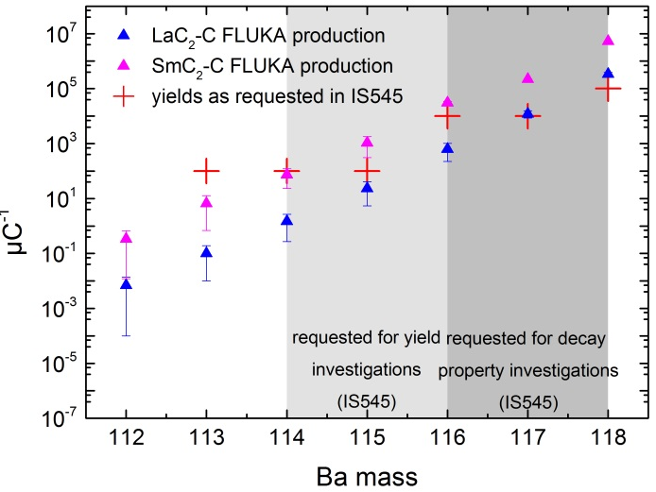
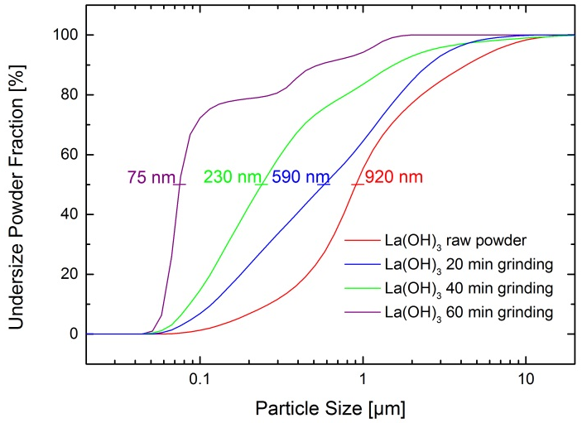
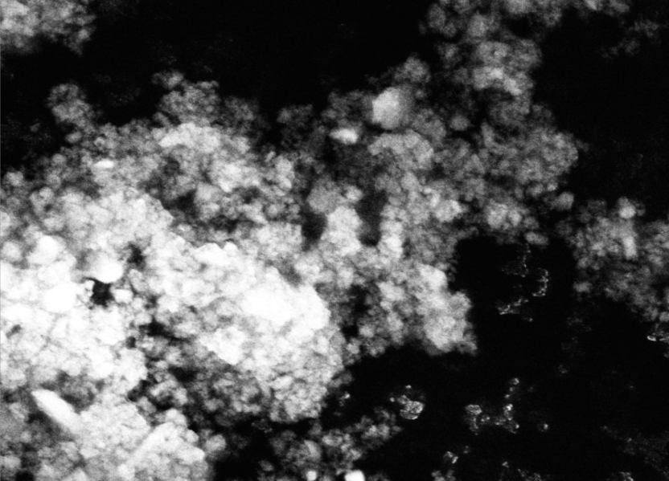
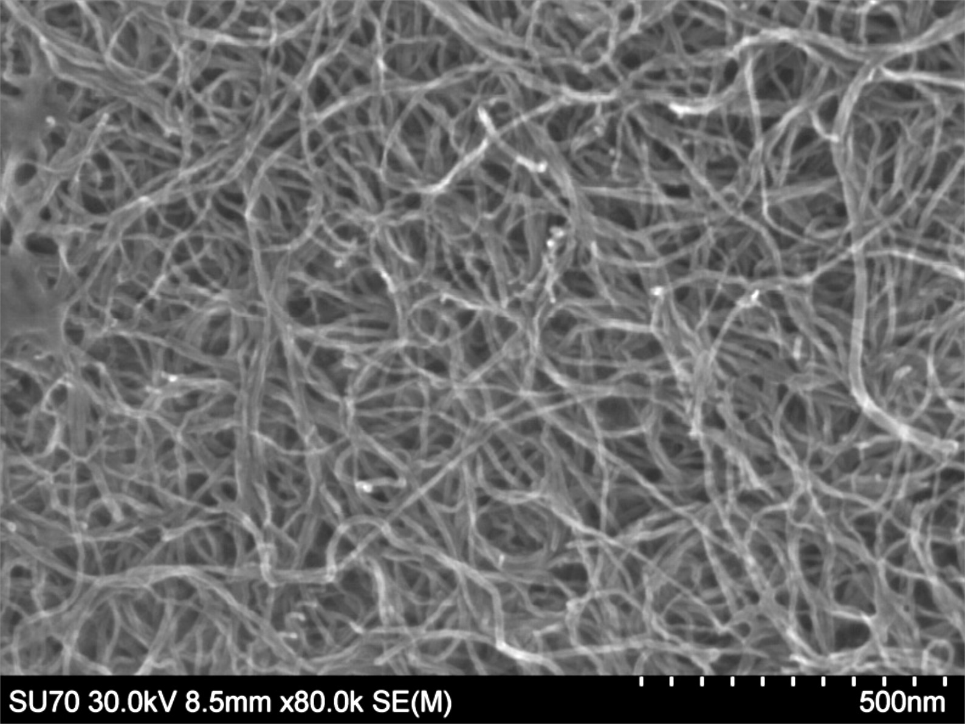
LaC₂–MWCNT Spallation Target Material
(Ba beams)
FLUKA Production Yields
after comparing all RE as possible spallation target nuclei
La(OH)₃ particle size reduction by suspension grinding
Online tests in November
LaC₂-MWCNT Nano Composite (After Carbo-Thermal Reduction)
Lanthanum Hydroxide Nanopowder
Ultrasound-Dispersed Multi-Walled Carbon Nanotubes
2 µm
500 nm
2 µm
200 nm
After 10 days at 1900°C
After 10 days at 1900°C
Microstructure of UC₂-MWCNT nano composite currently under investigation
J. Guillot, et al.
J. Guillot, Wonjoo Hwang, A. Gottberg

Slide 14
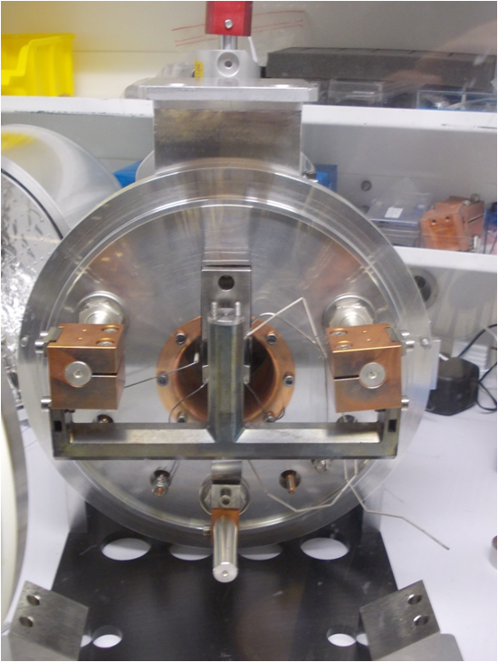
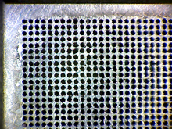
Molten salt unit
NaF520 (IS509)
Protons
Irradiation chamber
……….
NaF:LiF
700ºC
7 mA, 160 MeV
……….
……….
¹⁸Ne 10¹³/s
Diffusion chamber
Transfer line to ion source
Heat
Exchanger
Pump
21.6 cm
T. Mendonca et al.

Slide 15
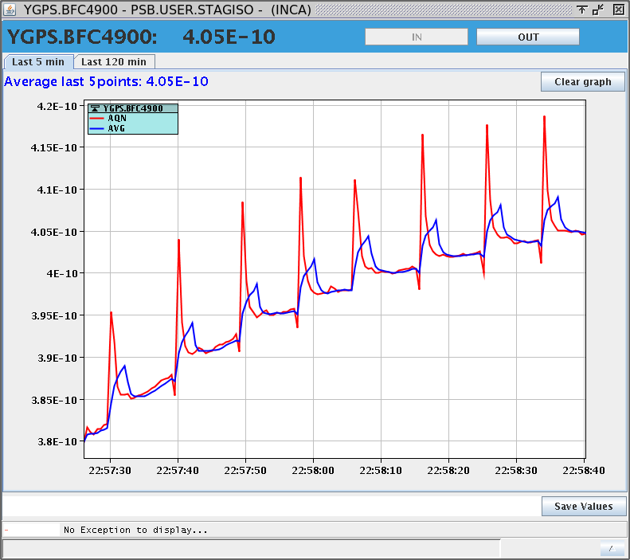
Molten salt unit
NaF520 (IS509)
11C as CO+ beam at intensity >1e8pps.
Results from 2012 confirmed this year with new target unit

Slide 16
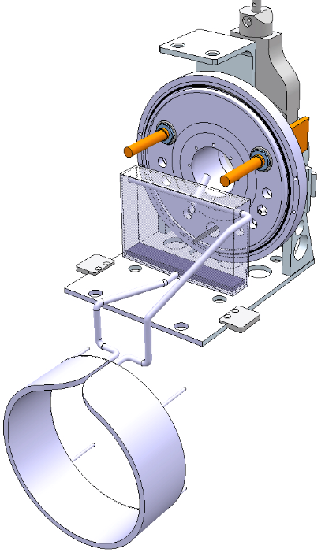
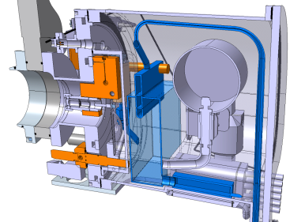
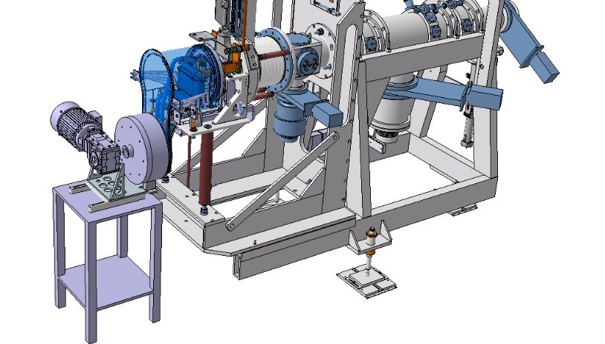
LIEBE project
Transfer line
Proton beam
Irradiation volume
Diffusion chamber
Electromagnetic pump
Reference isotope ¹⁷⁷Hg (T_{1/2}=130 ms)
Diameter/thickness shape: 100 μm
Sphere: 0.57
Cylinder:0.44
Foil:0.26
Design review in summer 2014
Courtesy of V. Barozier and M. Delonca

Slide 17
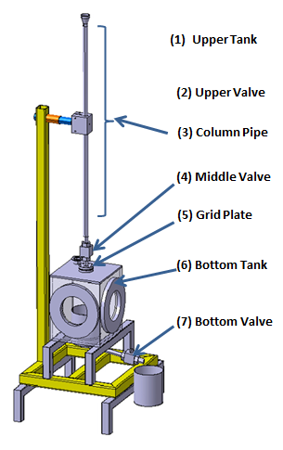
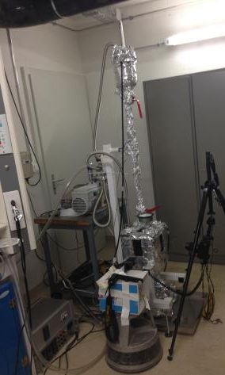
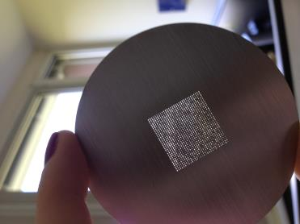
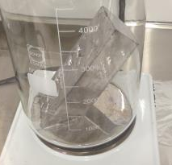
Prototyping phase of the LIEBE target
What is the proper spacing with LBE?
4 grids to be tested (different spacing from 1 mm up to 0.4 mm), holes diameter of 0.1 mm.
6 showers per grids
Grid samples
Vacuum pump
Camera
LBE liquefying

Slide 18
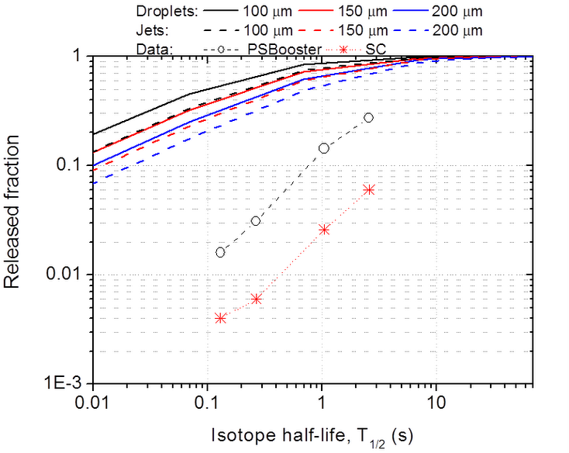
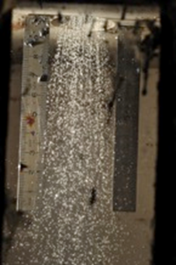
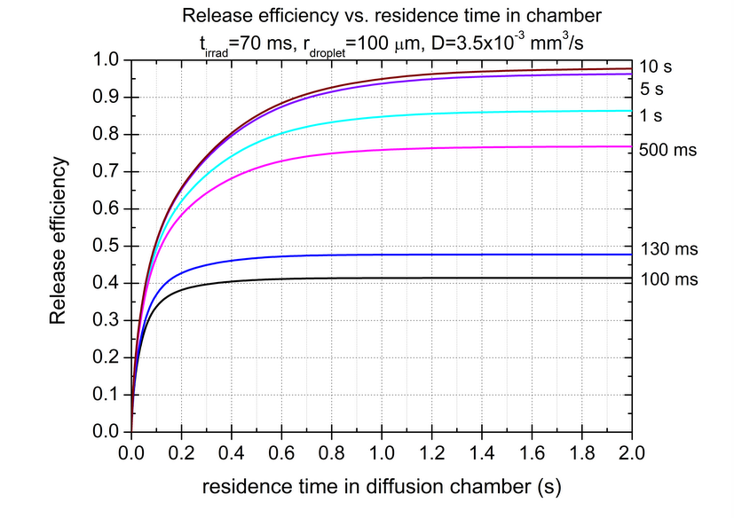
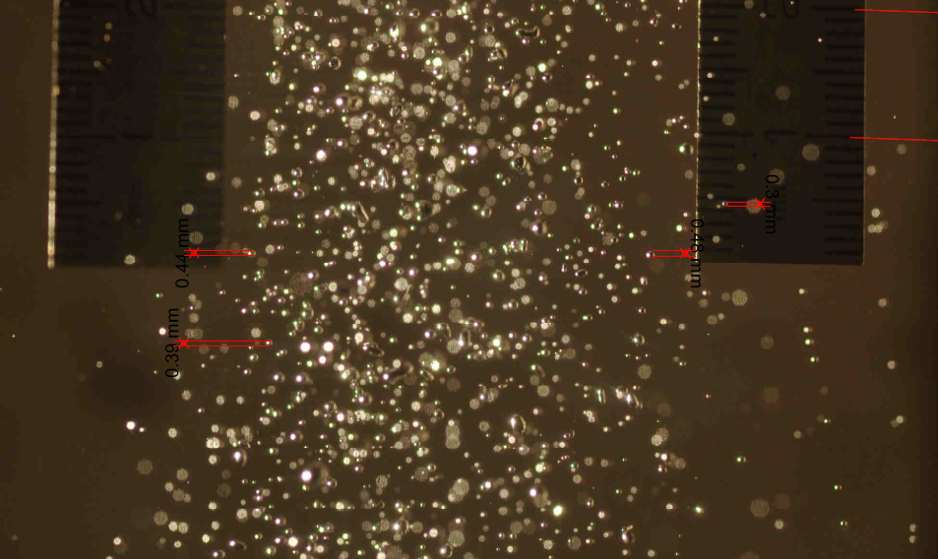
LIEBE project
Prototype phase started. Droplets 100μm grid 0.4mm confirmed.
Online likely shifted to 2016

Slide 19
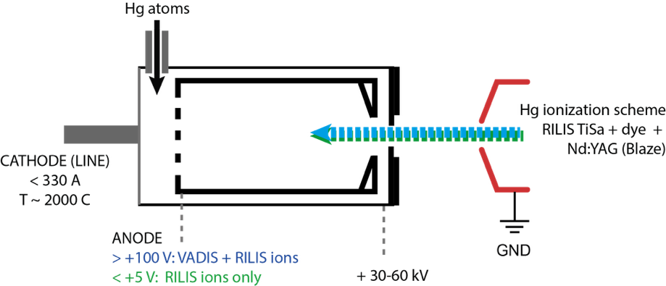
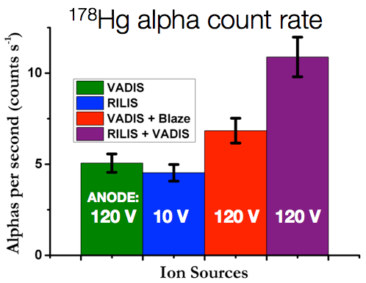
VADIS + RILIS Online with Liquid Pb Target
These measurements were obtained with a standard VADIS under normal operating conditions
➔ More optimization possible
T.D. Goodacre, B. Marsh, et al.

Slide 20
In conclusion
The TISD activity is ongoing and requests are prioritized through the GUI meeting
The TISD « team » will renewed to a large extent (Tania and Joao Pedro will still be there
next year, new fellow and PhD expected).
Some very exciting results : going nano, confirmed molten salt, high power molten target loop,
VADLIS, maybe 8B…
Some ISOL technical development activities relevant to ISOLDE will be ongoing
within a starting MEDICIS PROMED H2020 Marie Curie ETN network,
ie with Prof Novozelov (not necessarily at CERN, distributed throughout the network).

