Slide 1
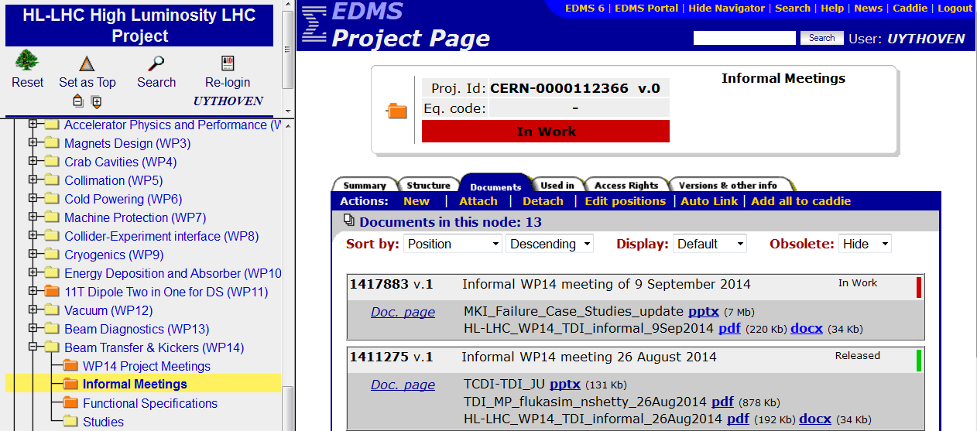
Overview WP14 Developments
Hardware
  Interferometry on the spare TDIs, planned to be installed Christmas stop 2015/2016. Final acceptance tests ongoing.
  MKI coating of ceramic chamber & cooling → see talk M.Barnes
Studies
  Discussed in many informal meetings (12x)
  Mainly concerning injection protection

Slide 2
Time Line
Injection protection for LIU beams
  To be installed in LS2
  Studies presently ongoing: This Meeting
  Aim to have a protection layout by the end of 2014
Injection kickers MKI
  Proto-type or dummy to be installed, possibly / latest LS2
Beam Dumping System related items
  To be installed in LS3
  Studies to start once injection protection studies done

Slide 3
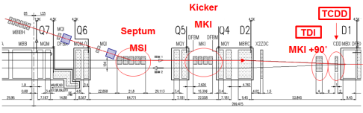
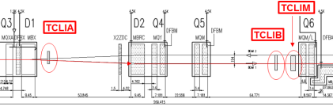
Injection protection: main topics of studies
IP
Survival of absorbers = TDI for 1 σ impact of 288 bunches BCMS beam
  Presentation by F.Lorenzo Maciariello
  Possibly limit the number of bunches per injection, V.Kain in Chamonix
    Common studies TCDI (LIU) and TDI. HiRadMat tests foreseen
    Search for new materials, HiRadMat tests
Protection of D1
  Presentation N.Shetty
  Mask TCDD not effective enough for grazing beams
  Aperture constraints mask: F.Velotti
Impact on auxiliary absorbers TCLIA and TCLIB: F.Velotti
  To be followed by Q6 protection studies
ZDC Aperture ALICE → A.Lechner
TDI in multi modules → TDIS (Segmented)
  Impedance vs. mechanical stability and heating
  Meetings with ABP impedance team. Defined cases being studied.

Slide 4
Beam Parameters: a moving target
LIU parameters 20 September 2013:
LHC Deliverable Report D1.3, table 10, from RLIUP meeting, October 2013:
HL-LHC parameter list ‘today’ from Webpage:
 | N_{bunch} [10¹¹ p/b) | ε_{x,y}
Standard | 2.32 | 2.08
BCMS | 2.00 | 1.37
 | N_{bunch} [10¹¹ p/b) | ε_{x,y}
Standard | 2.0 | 1.88
BCMS | 2.0 | 1.37
 | N_{bunch} [10¹¹ p/b) | ε_{x,y}
Standard | 2.3 | 2.0
BCMS | 2.3 | < 2.0*
* “For the BCMS scheme emittances down to 1.4 um have already been achieved at LHC injection which might be used ….”

Slide 5
Injection failure modes
Injection kicker failures protected by
  Beam Energy Tracking System: always the correct voltage on the MKI
  Erratic re-triggering of dump switch in case of erratic on main switch
  An MKI pulse as short as possible to limit number of stored bunches possibly affected
Worst failures modes – for the absorber AND protection: 1 σ impact or grazing
  Injected beam:
    Break down in magnet at 70 % of magnet length → one magnet at 140 % kick strength → system kick at 110 %, which is grazing impact of 288 bunches
    Idem break down at 30 % of magnet length → 90 % system kick
  Stored beam
    Switch erratic followed by re-triggering: 159 bunches ‘flat top’ at large angle plus sweep of bunches during rise and fall time of pulse
    Timing error: 288 bunches at full impact plus additional swept bunches
  Both beams simultaneously
    In the case of a timing error: 288 bunches top TDI jaw, plus 288 bunches (plus some swept) on the lower jaw. Full impact → not critical. Not for jaw survival nor for magnet protection (D1).

