Slide 1

LHCb SciFi
The new Fibre Tracker for LHCb
Christian Joram
CERN PH/DT
ECFA High Luminosity LHC Experiments Workshop - 2014
  The LHCb SciFi project: Brazil (CBPF) - China (Tsinghua) - France (LPC, LAL, LPNHE) - Germany (Aachen, Dortmund, Heidelberg, Rostock) - Netherlands (Nikhef) - Poland (Warsaw) - Russia (PNPI, ITEP, INR, IHEP, NRC KI) - Spain (Barcelona, Valencia) - Switzerland (CERN, EPFL) - UK (Imperial College)

Slide 2
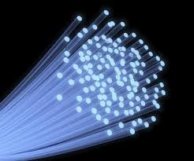
Scintillating fibre tracking: more than 30 years of history in HEP
UA2 upgrade, CHORUS, D0, ATLAS ALFA + many small scale experiments
high geometrical flexibility (planar, barrel, …) and in principle "edgeless"
good tracking performance (σ_{hit} < 100 μm), potentially high speed
very low and uniform material budget
Evolution of optical readout technology
image intensifiers (II) + CCD → (MA)PMT/HPD → VLPC → SiPM
very fast (LHC speed) readout is now possible
Unfortunately little progress in
scintillating fibres: few suppliers, limitations in light yield, attenuation length, rad. hardness
assembly technologies: no company produces high quality fibre mats
→ building a SciFi tracker is a labour-intense adventure
R.C. Ruchti
Annual Review of Nuclear and Particle Science, 1996

Slide 3
Outline
The LHCb SciFi Tracker
The main challenges
  Fibres with high light yield and attenuation length
  Building large-size detector modules
  Radiation damage to scintillating fibres
  Optimised SiPM detectors and their radiation hardness
  Fast readout with manageable data volume
  Integration (incl. operation at -40 °C)

Slide 4
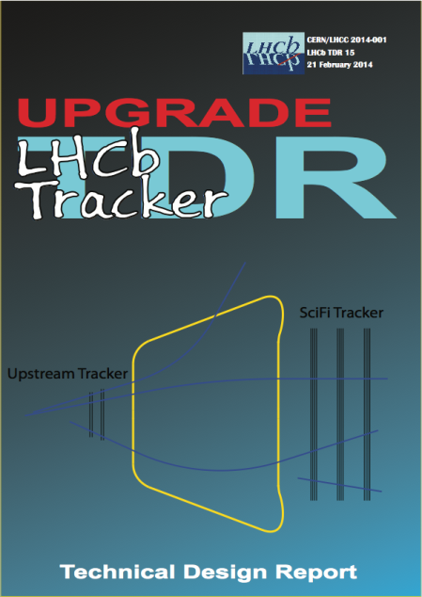
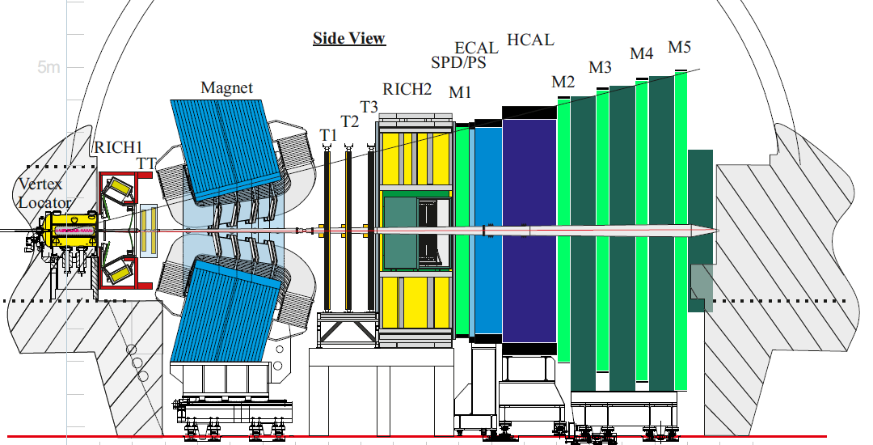
Reminder:
LHCb upgrade for running after LS2 (≥2020, 50fb⁻¹)
(see talk by G. Passaleva, yesterday)
The current
Outer Tracker (OT) = Straw tube gas detectors (Ø 4.9 mm)
Inner Tracker (IT) = Silicon μstrips (pitch = 200 μm)
will be replaced by a single fast and light technology:
SciFi tracker = scintillating fibres with SiPM readout.
LHCb Tracker Upgrade TDR
CERN/LHCC 2014-001
LHCb TDR 15
IT + OT → SciFi
Current LHCb

Slide 5
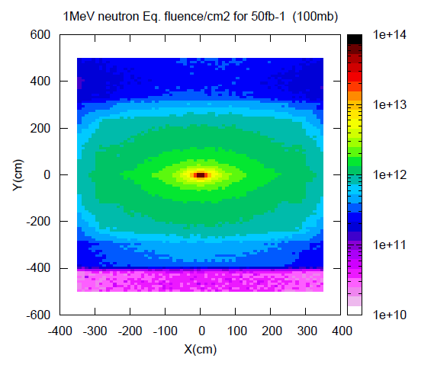
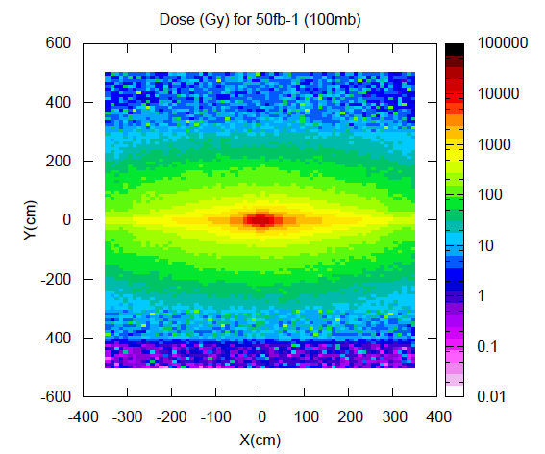
Main requirements on the SciFi tracker
LHCb FLUKA simulation
Detector intrinsic performance: measure x,x' (y,y') with
high hit efficiency(~99%)
low noise cluster rate (<10% of signal at any location)
σ_{x} < 100μm (bending plane)
X/X0 ≤ 1% per detection layer
Constraints
40MHz readout
geometrical coverage: 6(x) x 5(y) m²
fit in between magnet and RICH2
radiation environment:
      ≤ 10¹² 1MeV n_{eq} / cm² at the location of the
      photo-detectors
      ≤ 80Gy at the location of the photo-detectors
      ≤ 35kGy peak dose for the scintillating fibres
→low temperature operation of photodetectors

Slide 6
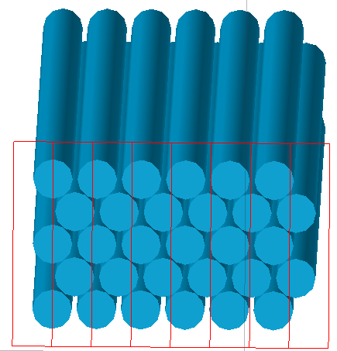
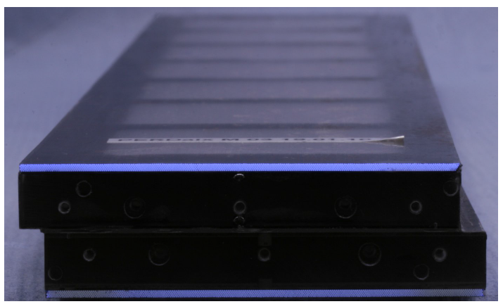
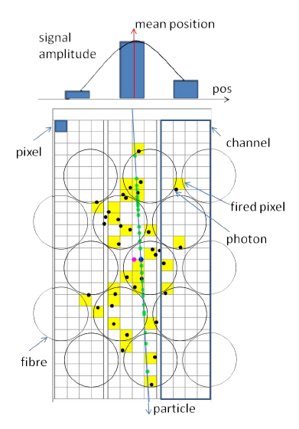
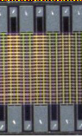
Technology: Fibres and photodetectors
The SciFi tracker is following the technology developed by the Aachen group for the PERDaix detector (prototype balloon experiment)
5 staggered layers of Ø250 μm fibres form a ribbon (or mat)
B. Beischer et al., A 622 (2010) 542–554
G.R. Yearwood, PhD thesis, Aachen, 2013
PERDaix: 32 mm wide bi-layer module in stereo geometry.
4 64-ch. SiPM arrays
Readout by arrays of SiPMs. 1 SiPM channel has the similar width as fibre pitch (~250 μm) and extends over the full height of the mat (~1.5 mm).
Hits consist of clusters with typical size = 2.
Allows for good resolution from COG and suppression of noise (= single hit pixel in 1 channel).

Slide 7
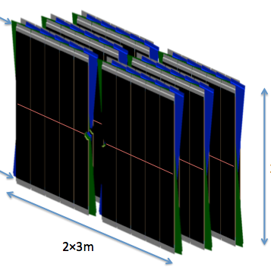
General layout of the detector
3 stations with 4 planes each X-U-V-X, stereo angle ± 5° (prel.)
T2
T3
T1
readout
10 or 12 (almost) identical modules per detection plane
fibre ribbons (mats) run in vertical direction.
fibres interrupted in mid-plane (y=0) and mirrored
fibres read out at top and bottom
photodetectors + FE electronics + services in a “Readout Box”
Very light and uniform material distribution
1 module
readout
2 x ~2.5 m
~540 mm
2 x ~3 m
X/X₀ = 2.6% per station

Slide 8
Main specifications of the SciFi tracker
SciFi module
item | specs
Scint. fibre | 0.25 mm Ø, double cladded, blue emitting. Baseline Kuraray SCSF-78 MJ
Photodetector | SiPM array, 128 ch., pitch 0.25 mm
Module dimensions | (2 x 250) x 54 cm, 40 mm thick, one end mirrored
Active surface | ~360 m²
Radiation | Non-uniform, up to 30 kGy, 10¹² n/cm²
Readout | 3-thresholds, clustered, 40 MHz
Environment | SiPM at -40°C, rest at ambient T
2 x 250 cm
Some rough numbers
3 M fibres (2.5 m long)
Total fibre length ~10,000 km of fibres (+ spares)
600 000 readout channels
54 cm

Slide 9
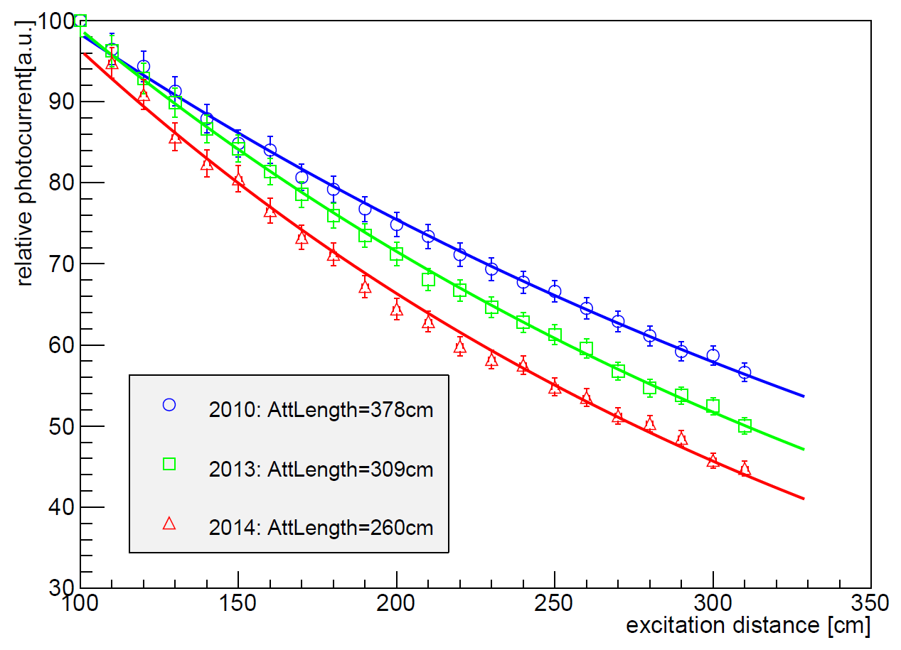
Challenge 1: Fibres with long attenuation length and high light yield
Kuraray SCSF-78 MJ
Attenuation Length
Kuraray SCSF-78 MJ
Scintillation Yield
Normalised @ 100 cm
Points at 60 cm not included in fit.
(cladding light , helical paths)
Extrapolation of the fits to d=0: same yield within ±5%
Scintillation light yield
of one 0.25 mm fibre ,
measured by a PMT
We are currently observing attenuation lengths
which are lower than for fibres bought in 2010.
Possible causes identified at recent meeting with
Kuraray in Japan. Expect improved batch in few weeks.
We aim for Λ_{att} > 3.5 m
The scintillation yields appear to be ~OK.

Slide 10
We are also exploring a new scintillation material
Nanostructured Organosilicon luminophores (NOLs)
S.A. Ponomarenko, Nature Scientific Report, 8 Oct 2014, doi:10.1038/srep06549
(Institute of Synthetic Polymeric Materials, Russia, S. Ponomarenko)
Chemical coupling of activator and WLS molecules increases scintillation yield.
Light output is 90-120% of that of anthracene ,
i.e. 50% higher than in standard plastic scintillator (like BC-408).
So far only tested on scintillator tiles, not on fibres!
Radiation hardness ?
To be tested!
polystyrene matrix
Spectral
shifter
Е
activator
L
(α, β or γ-
radiation)
L = 1 - 2 nm << R
Patent RU 2380726 (2010)
Material is highly interesting for inner region of SciFi tracker (strong 'natural' attenuation + high ionising dose).
Kuraray and ISPM have started to collaborate on the development of NOL based fibres. We expect first samples in about 1 month.

Slide 11
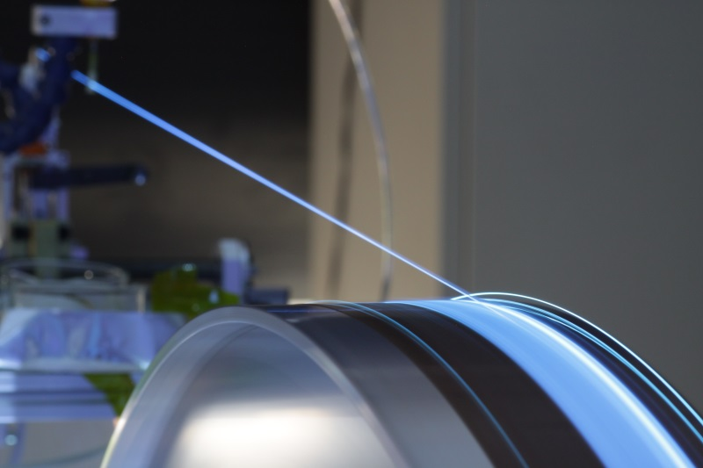
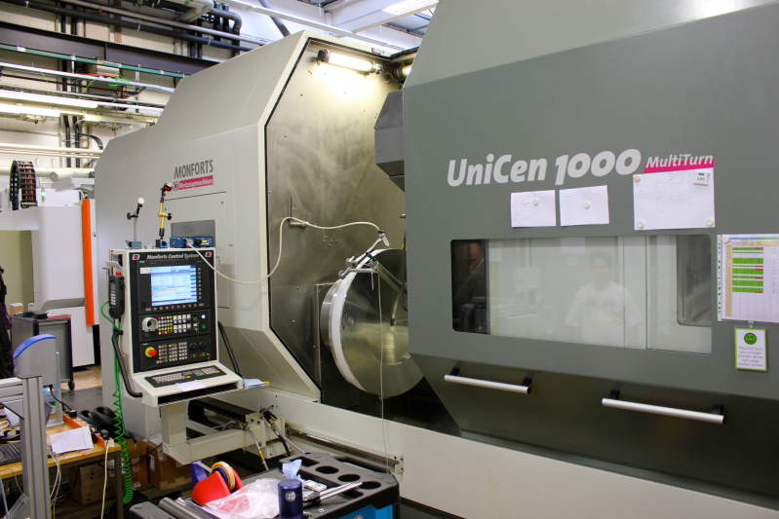
Challenge 2: Geometrical precision
Fibre mats are produced by winding fibres, layer by layer, on a fine-pitch threaded wheel
addition of very fluid epoxy glue, TiO2 loaded
feeder
After partial polymerisation, the mat is cut and flattened for full polymerisation.
~ Ø 900mm
p = 270 μm
~ 150 mm
~ 2800 mm
Fibre winding (at Univ. of Dortmund)
Dedicated machine, in-house production
Test winding (at Univ. of Aachen)
Use of a large CNC lathe.
~150 mm

Slide 12
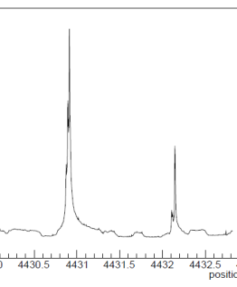
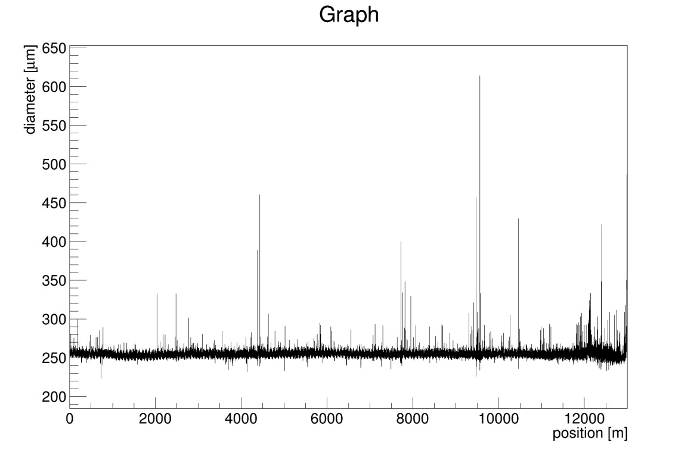
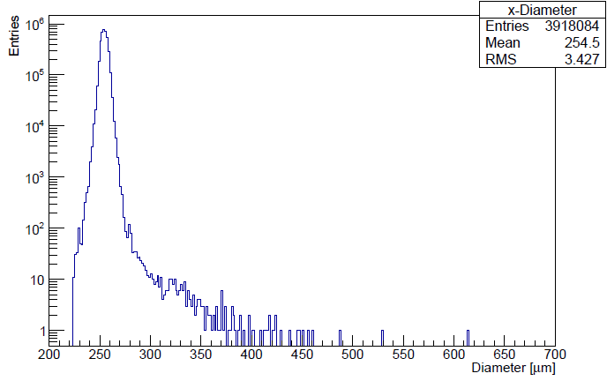
An important parameter: Fibre diameter (non-)uniformity
Over 99.9% of the length, the fibre diameter is within 250 ± few μm
Plots by
P. Hebler,
Dortmund.
~4 M measurements along 12.5 km fibre
(1 point every 3 mm), performed with a LASER micrometer.
However, typically once per km, the fibre diameter increases beyond acceptable limits (~300 μm).
Bump problem addressed together with Kuraray. Expect improvement in coming few months.
Bumps distort local winding pattern.
Occasional bumps can in principle be eliminated during winding, but this is time consuming.

Slide 13
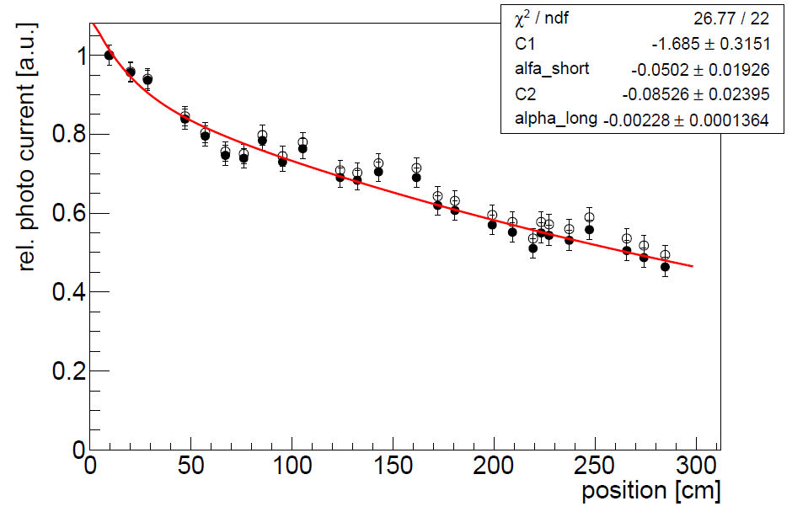
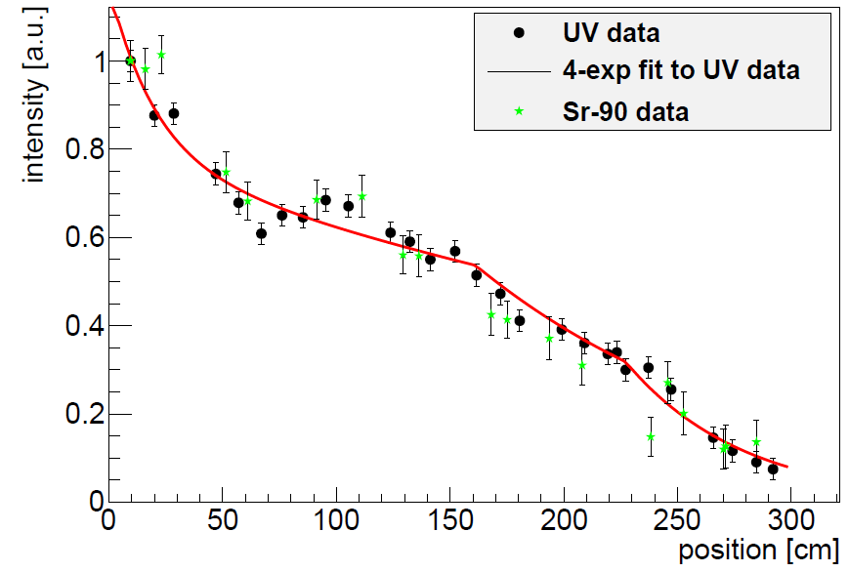
Challenge 3: Radiation damage to scintillating fibres
Complex subject. Literature relatively poor and contradictory → We perform our own irradiation tests under conditions which come close to the ones met in the experiment.
Ionising radiation degrades transparency of polystyrene core (shorter att. length), but doesn't affect scintillation + WLS mechanism.
Example: LHCb irradiation test (2012)
  3 m long SCSF-78 fibres (Ø 0.25 mm), embedded in glue (EPOTEK H301-2)
  irradiated at CERN PS with 24 GeV protons (+ background of 5·10¹² n/cm2)
before irradiation
after irradiation
Λ_{l} = 126 cm
Λ_{l} = 439 cm
Λ_{l} = 422 cm
Λ_{l} = 52 cm
0 kGy
3 kGy
at 6.25 Gy/s
22 kGy
at 1.4 Gy/s

Slide 14
More irradiations were performed at KIT (Karlsruhe) 10 MeV protons and in-situ in LHCb cavern.
There is no well-established model to describe Λ(D)/Λ₀ = f(Dose)
Hara model:
Λ(D)/Λ(0) = α+ β log(D)
K. Hara et al., NIM A411 (1998), no. 1 31 .
Hara model →
describes our high dose data well, but has some weaknesses (can’t include D=0, can become negative)
We are currently preparing several low-dose (1 kGy) irradiations to improve data situation.
Λ(D) ◊
Max. signal loss in region around beam pipe (35 kGy) of 27%

Slide 15
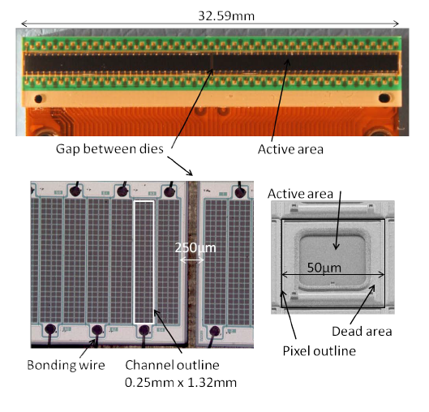
  Challenge 4: Optimised SiPM detectors and their radiation hardness
We co-develop with Hamamatsu (JP) and KETEK (DE) 128-channels SiPM arrays, with very similar dimensions.
Photon detection efficiency
PDE = QE · ε_{geom} · ε_{avalanche}
2 x 64
channels
PCB
Flex cable
=f(OV)
ε_{geom} can be optimised by increasing the pixel size.
ε_{avalanche} can be increased by higher OV.
Both effects must be counter-acted by efficient trenches to control pixel-to-pixel cross-talk.

Slide 16
PDE and cross talk measurements at CERN and EPFL
with trenches
with trenches
with new trenches
(X-talk and after
pulses removed)
(X-talk and after
pulses removed)
Expected scintillation spectrum after full dose in mid-plane
Received very recently also new Hamamatsu devices (under test)!

Slide 17
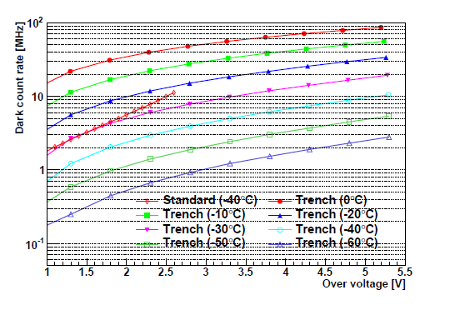
The SiPMs suffer mainly from the neutrons (NIEL)
The SiPMs are exposed to 1.2·10¹² n_{1Mev.eq.} /cm² (50 fb⁻¹)
A detailed FLUKA simulation showed that shielding (Polyethylene with 5% Boron) can halve this fluence → tests so far done for 6·10¹¹/cm² .
The SiPMs need to be cooled. Our default working point is -40°C. Noise reduced by factor ~64.
6·10¹¹ n/cm²
Dark counts are primary noise source.
Keep pixel-to-pixel cross-talk low → avoid double-noise hits (which can seed noise clusters)
Scaled to 0.33 mm²
Hamamatsu 2013 technology (single channel devices)

Slide 18
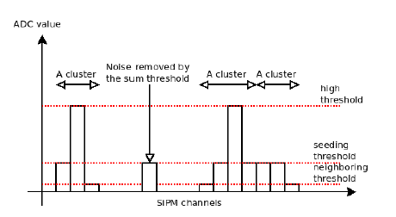
Challenge 5: Fast readout with manageable data volume
~0.6 M channels
40 MHz readout rate
Signal propagation time up to 5m · 6ns/m = 30ns → some spill over to next BC
No adequate (fast, low power) multi-channel ASIC available
LHCb develops its own ASIC, called PACIFIC, with 64 channels (130 nm CMOS, TSMC)
P ~ 8 mW/channel
3 hardware thresholds (=2 bits)
seed
neighbour
high
plus a sum threshold (FPGA) are a good compromise between precision (<100 μm), discrimination of noise and data volume.
Compared to analog (6 bit) readout, expect resolution to degrade from ~50 to 60 μm. Marginal impact on p-resolution.
Z_{in} ~20-40 Ω
f_{f} ~ 250 MHz

Slide 19
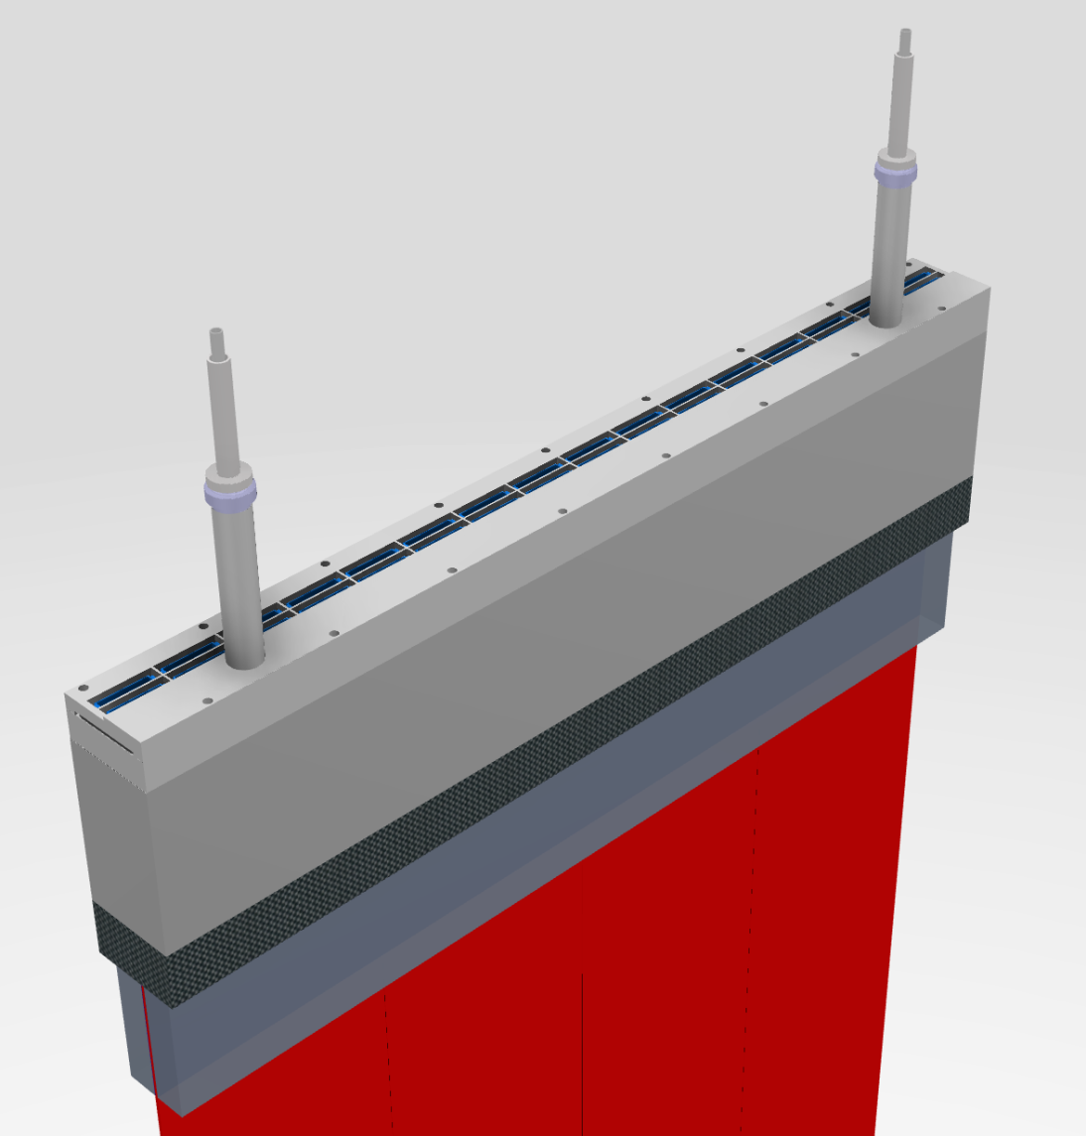
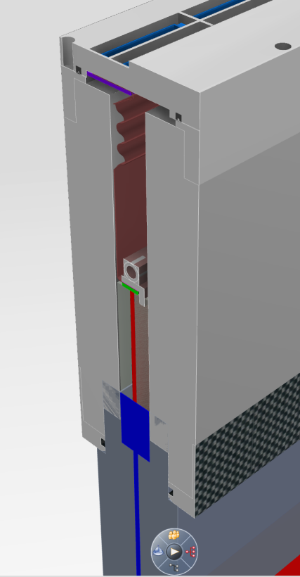
Challenge 6: Integration (incl. operation at -40 °C)
The principal integration element is the Read Out Box (ROB) at the end of every module.
Ensure precise optical coupling of cold SiPMs to fibres
House warm electronics
Ensure gas & light tightness and insulation.
Couple to mechanical frame structure.
Illustration of 'cold' part of ROB
Hybrid connectors
Coolant: C6F14 or Novec 649
SiPM cooling pipes
Mounting flange
Cooling pipe
~54 cm
SiPM
Insulation
(Rohacell with Mylar µ alu layer)
fibres
Heat load / ROB
~ 20 W

Slide 20
Where do we stand and what can we expect?
Non-irradiated 2.5 m long 5-layer mat + 2011 technology SiPM array,
measured with 1.5 MeV e⁻ in lab (from energy filtered Sr-90 source).
Expected loss due to radiation damage (50 fb⁻¹)
← expected gain from non-irradiated 6-layer mat, 2014 SiPM technology, H.E. hadrons
← measured in lab (Sr-90 e⁻)
SiPM
mirror
We expect this performance to be sufficient to guarantee 98-99% hit efficiency anywhere and after full radiation dose.
We just had 1 week of successful test beam at CERN H8. Full size fibre mats + latest SiPM technology.
Analysis in progress.

Slide 21
Status and Outlook
Fibre modules
SiPMs
RO electronics
Design
Production
Learned how to make 13 cm wide and >2.5 m long fibre mats. Current focus: machining and precision assembly of mats on panels. Several fibre mats successfully tested in H8 (1 week ago).
128-ch. SiPM arrays from KETEK successfully tested, but packaging needs to be improved. Increased PDE and(!) reduced XT.
New arrays from Hamamatsu just arrived, but already used in beam.
Single channel of PACIFIC successfully tested. 8-channel version fabricated, but had a minor design flaw. Full scale (64 ch.) prototype ASIC in 2015.
Efforts for overall detector design, Readout Box, mechanics now in full swing. Lots of challenges like beam pipe hole, cooling (insulation, condensation).
Starting to prepare tooling, logistics and QA. Mass production of fibre mats and modules will require sustained efforts (4 winding centres) and tight quality control.
→ Start of fibre mat and module production around end 2015.
→ Detector to be ready for installtion around mid 2018.

