Slide 1
ALICE Run 2 Readiness
WLCG Collaboration Workshop
Okinawa
Apr 11, 2015
Maarten Litmaath
CERN v1.2

Slide 2
Sources
ALICE Tier-1/Tier-2 Workshop,
Feb 23-25, 2015
  https://indico.cern.ch/event/354209/
ALICE Offline week,
March 18-20, 2015
  http://indico.cern.ch/event/379819/
With additions, adjustments and updates…

Slide 3

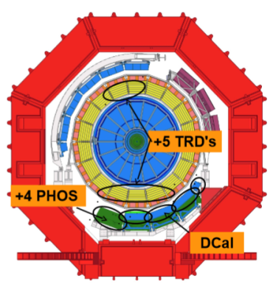
A
L
I
C
E
RUN 2 detector upgrades
TPC, TRD readout electronics consolidation
+5 TRD modules
  full azimuthal coverage
+1 PHOS calorimeter module
+ DCAL calorimeter
Double event rate => increased capacity of HLT system and DAQ
  Rate up to 8GB/sec to T0
3
Predrag Buncic
Plans for Run 2 & 3

Slide 4
A
L
I
C
E
Preparations for Run2
Expecting increased event size
  25% larger raw event size due to the additional detectors
  Higher track multiplicity with increased beam energy and event pileup
  Concentrated effort to improve performance of ALICE reconstruction software
    Improved TPC-TRD alignment
    TRD points used in track fit in order to improve momentum resolution for high p_{T} tracks
    Streamlined calibration procedure
    Reduced memory requirements during reconstruction and calibration (~500Mb, the resident memory is below 1.6GB and the virtual - below 2.4 GB)
4
Predrag Buncic
Plans for Run 2 & 3

Slide 5
A
L
I
C
E
Simulation
Geant4 v10 Physics Validation has started
  First test production (done) Pythia6, pp, 7 TeV
  QA in progress
CPU performance still 2x worse compared to simulation with G3
  Some gains that we made with G4 v9.6 are gone with v10
  But, we can use G4 multithreaded capabilities to put our hands on resources that would otherwise be out of reach
Next Step
  Comprehensive comparison of detector response with data
5
Predrag Buncic
Plans for Run 2 & 3

Slide 6
A
L
I
C
E
Distributed Computing & Analysis
No news is good news
  With occasional hiccups, things work and continue to grow
Switch to CVMFS is fully completed
  Including OCDB (calibration data) repository that is mirrored from AliEn
Consolidation of AliEn development branches is ongoing behind the scene
  Overall update of dependencies
  Becomes increasingly important in order to address security issues that seem to be more and more frequent
New AliEn/ARC interface
AliEn on HLT farm tested on development cluster
Work in progress
  CAF on demand
  AliEn in the box – virtualized site on OpenStack
  AliEn + PanDA on HPC
6
Predrag Buncic
Plans for Run 2 & 3

Slide 7
A
L
I
C
E
Data popularity
Cleanup campaigns work…
7
Predrag Buncic
Plans for Run 2 & 3

Slide 8
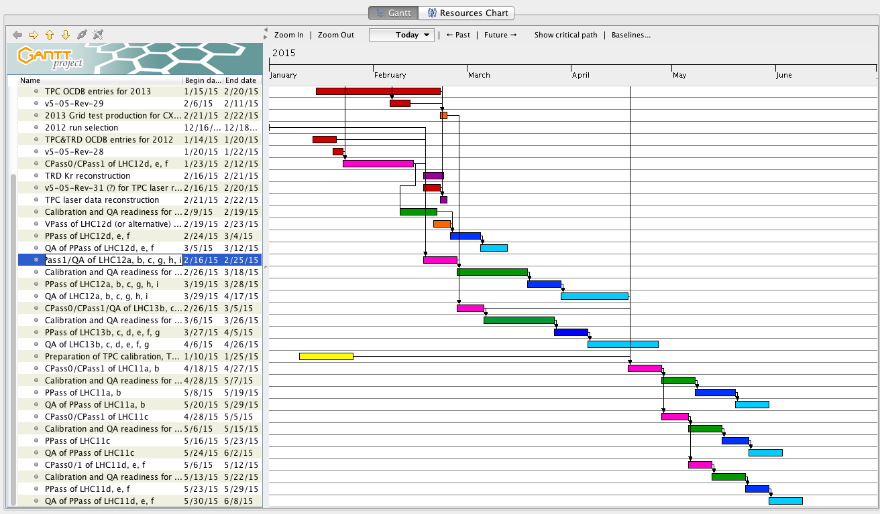
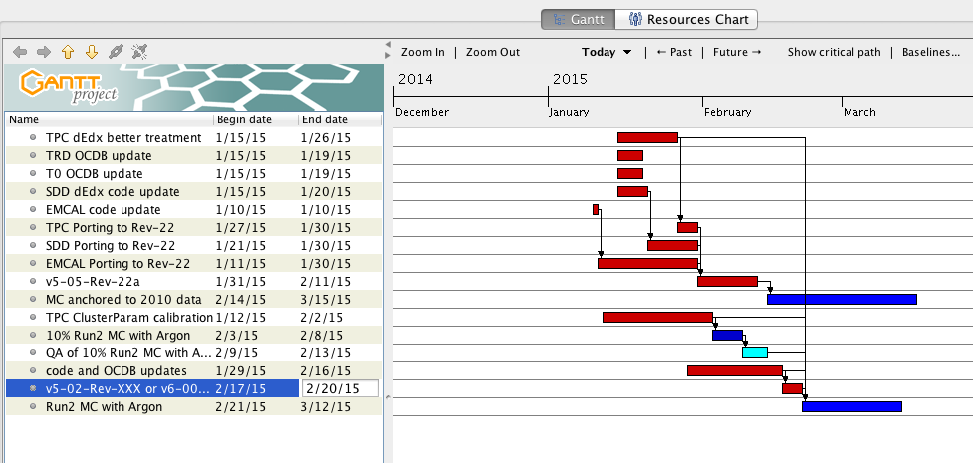
A
L
I
C
E
Re-processing & re-commissioning
Re-processing
  Steady RAW and MC activities
  Full detector re-calibration and 2 years worth of software updates
  All Run 1 RAW data processing with the same software
ALICE re-commissioning
  Test of upgraded detectors readout, Trigger, DAQ, new HLT farm
  Full data recording chain, with conditions data gathering
  Cosmics trigger data taking with Offline processing
8
Predrag Buncic
Plans for Run 2 & 3

Slide 9
A
L
I
C
E
CPU Resources in 2014
9
Predrag Buncic
Plans for Run 2 & 3

Slide 10
A
L
I
C
E
CPU Shares
10
Predrag Buncic
Plans for Run 2 & 3

Slide 11
A
L
I
C
E
CPU Efficiency 2014
11
Predrag Buncic
Plans for Run 2 & 3

Slide 12
A
L
I
C
E
Disk Resources in 2014
12
Predrag Buncic
Plans for Run 2 & 3

Slide 13
A
L
I
C
E
CPU Request 2013-2017
13
Predrag Buncic
Plans for Run 2 & 3

Slide 14
A
L
I
C
E
Disk Request 2013-2017
14
Predrag Buncic
Plans for Run 2 & 3

Slide 15
A
L
I
C
E
Tape Request 2013-2017
15
Predrag Buncic
Plans for Run 2 & 3

Slide 16
Growth at established and new sites
KISTI – OPN 2 → 10 Gbps this month
  Leadership role for network improvements in Asia
UNAM – MoU for T2 in Nov 2014, aiming for T1
WUT (Poland) in production since Sep 2014
RRC-KI-T1 in production since Jan 2014
ZA_CHPC capacity x 4 in Nov 2014
Bandung and Cibinong in production Sep 2014
Sao Paolo – largest T2 in LA, ideas for a T1
ORNL – will take over from LLNL in autumn
Hiroshima, Torino, … – significant increases
COMSATS – to become a big T2
…

Slide 17
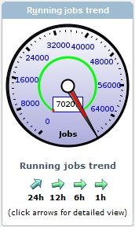
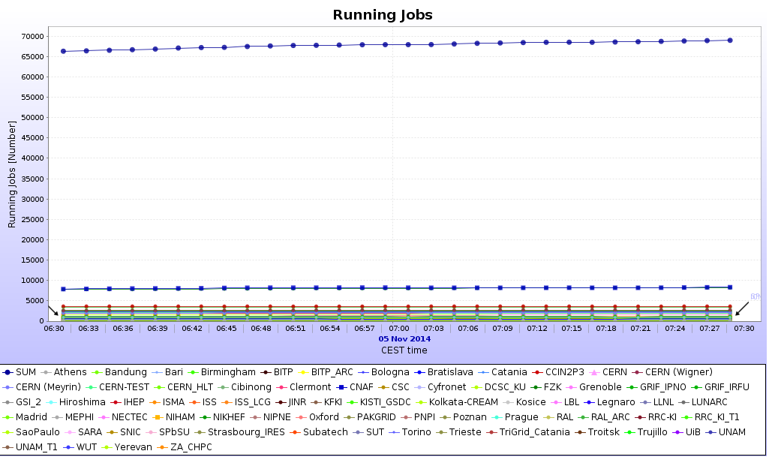
New job records
Nov 2014 – 70K concurrent jobs
… reached/exceeded multiple times this year
  Making use of opportunistic resources

Slide 18
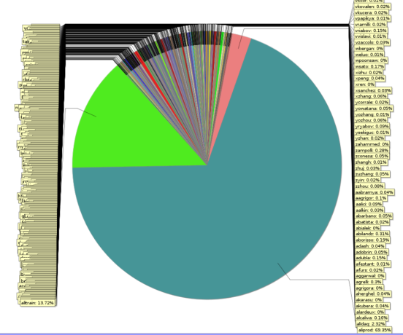
Wall time resources share 2014
Individual analysis: 12%
@all centres
432 users
RAW data processing: 3%
@ T0/T1s only
Organized analysis: 16%
@all centres
MC productions: 69%
@all centres

Slide 19
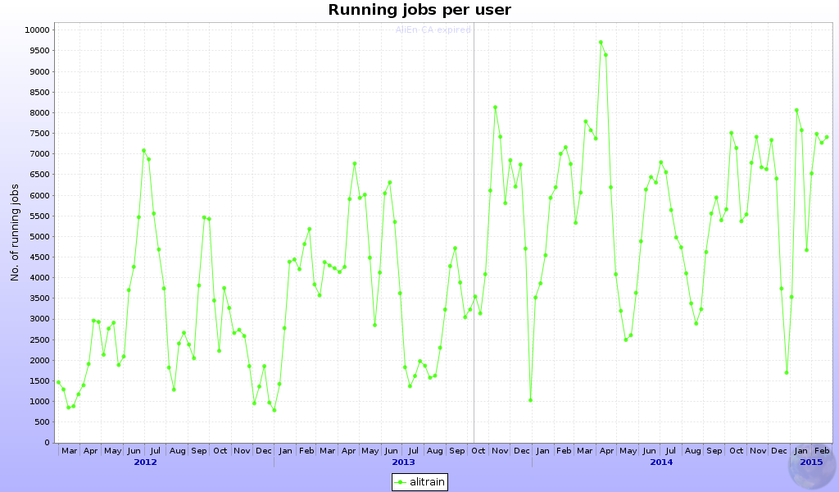
Organized analysis went up
5800 jobs
3000 jobs
4400 jobs
Year on year increase
+47%
+32%

Slide 20
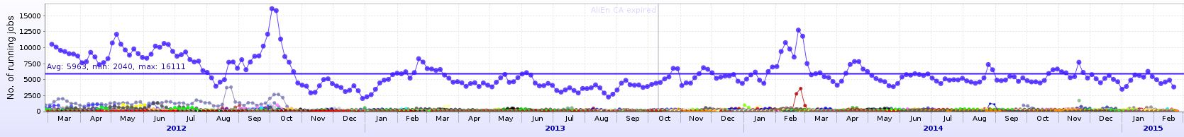
Individual analysis went down
6900 jobs
465 ind.users
4600 jobs
446 ind.users
4700 jobs
432 ind.users
Year on year increase
Individual analysis
-50%
+3%
Year on year increase
organized analysis
+47%
+32%

Slide 21
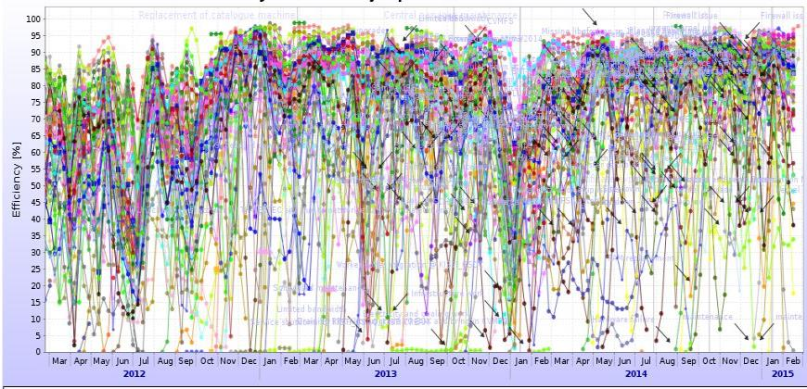
Grid efficiency went up
76%
84%
86%
Year on year change
+8%
+2%

Slide 22
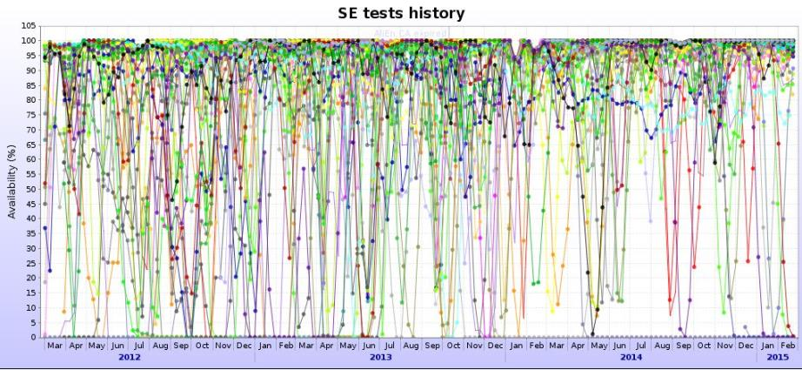
Also correlated with storage availability
83%
87%
91%
Year on year change
+4%
+4%

Slide 23
Replica discovery mechanism
Base logic of SE selection
Closest working replicas are used for both reading and writing
  Sorting the SEs by the network distance to the client making the request
  Combining network topology data with the geographical location
  Leaving as last resort the SEs that fail the respective functional test
  Weighted with their free space and recent reliability
Writing is slightly randomized for more ‘democratic’ data distribution
The SE selection criteria…

Slide 24
SE changes during Run 2
Xrootd 4
  IPv6 and other improvements
EOS
  4 external sites run it today, 1 T1
Xrootd proxy for new clusters w/o outbound network connectivity
  GSI
  Also useful for HPC workflows
    Titan @ ORNL

Slide 25
AliEn vs. RFC proxies
AliEn needs to move to newer OpenSSL to close a potential vulnerability on the VOBOX
Despite a big effort, recent OpenSSL builds for AliEn could not be made to work with Globus legacy proxies in use today
But RFC proxies work fine
We move WLCG VOBOXes to RFC proxies and then to the latest AliEn
  Most sites in progress or done – thanks!

Slide 26
SAM-3 Availability/Reliability computation (1)
http://wlcg-sam-alice.cern.ch/
SAM-Nagios machinery only tests CE
  Mostly CREAM, a few ARC (with more to come)
MonALISA forwards selected metrics to SAM
  VOBOX and SE tests
We now can and should include them in a new formula to determine if a site looks available / reliable for use by ALICE
In particular this will allow sites without a CE to appear (again) in the WLCG A/R reports
  Notably NDGF and OSG

Slide 27
SAM-3 Availability/Reliability computation (2)
Planned new A/R formula as of May:
  Computing = (any CE) || (!CE && VOBOX)
  Storage = all SE
  Value = Computing && Storage
Meaning
  If any CE is working → Computing OK
  If no CE is used and the VOBOX is working → Computing OK
  If all SE at the site are working → Storage OK
    A T1 has multiple (logical) SE
  If the site has no SE → Storage OK (!)
    For now…

Slide 28
Cloud activities
CERN
  HLT farm
  Validation cluster
  New CAF
UA-BITP + RU-SPbSU
  OpenStack + Ceph + Xrootd
Italy
  Virtual Analysis Facility
…

Slide 29
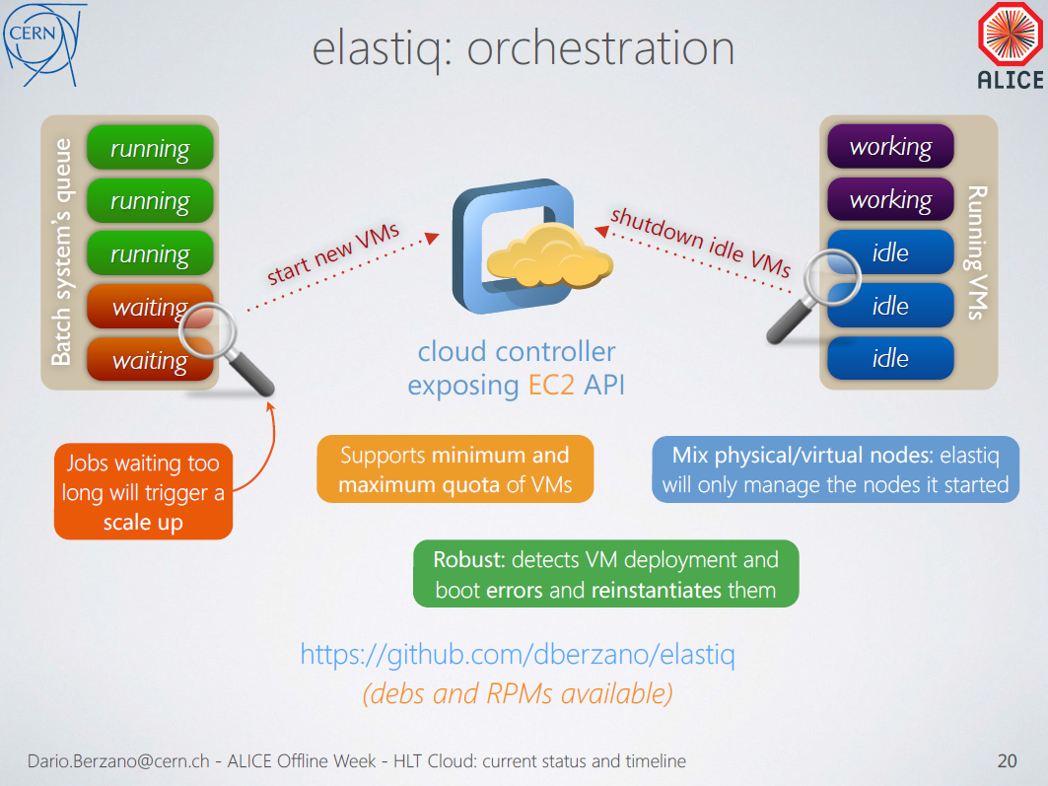

Slide 30
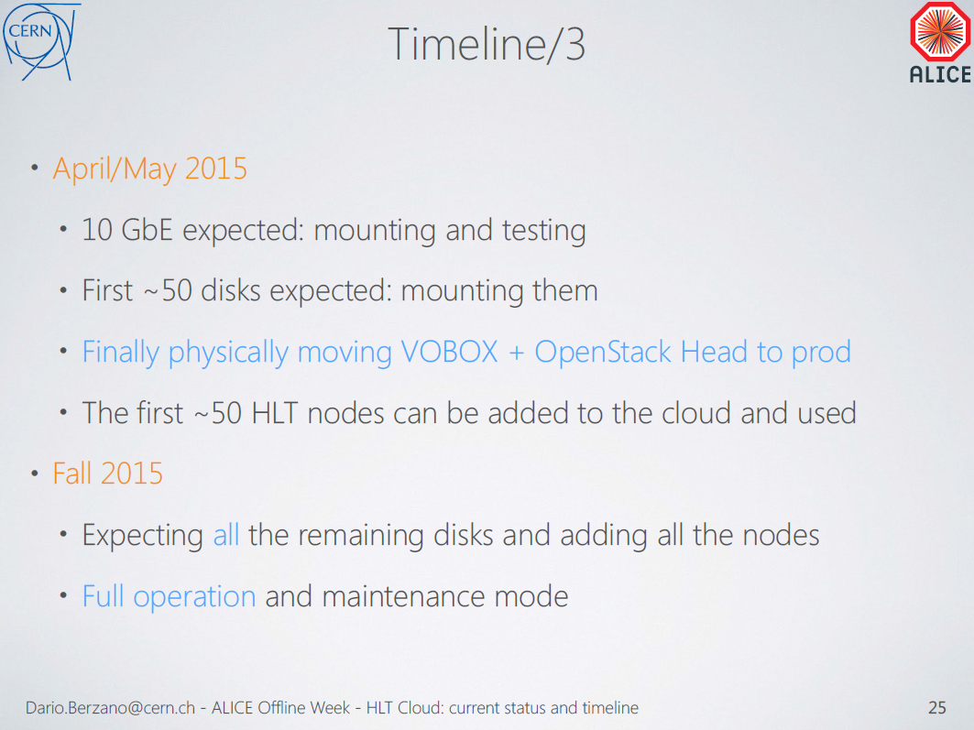

Slide 31
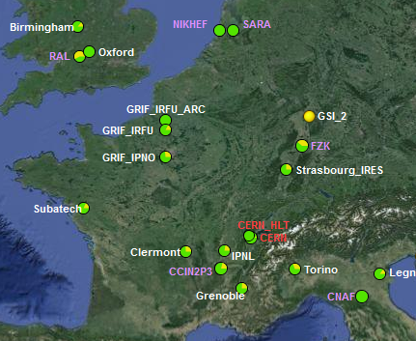
HLT farm used in production
About 60 job slots until the new HW is ready

Slide 32
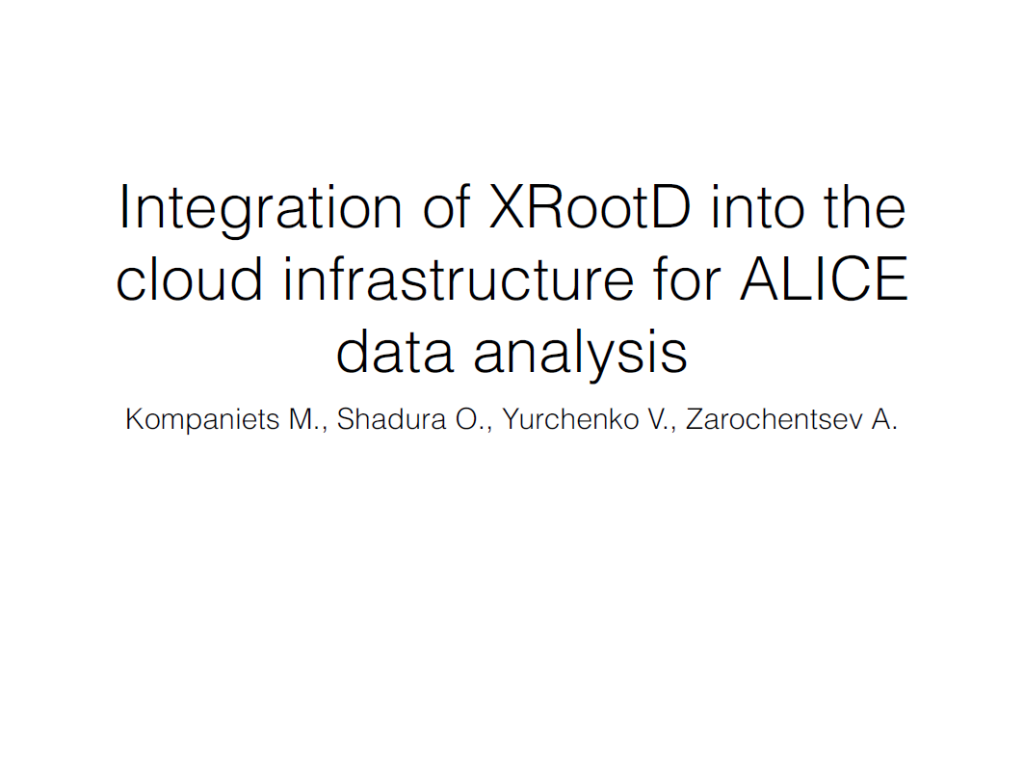

Slide 33
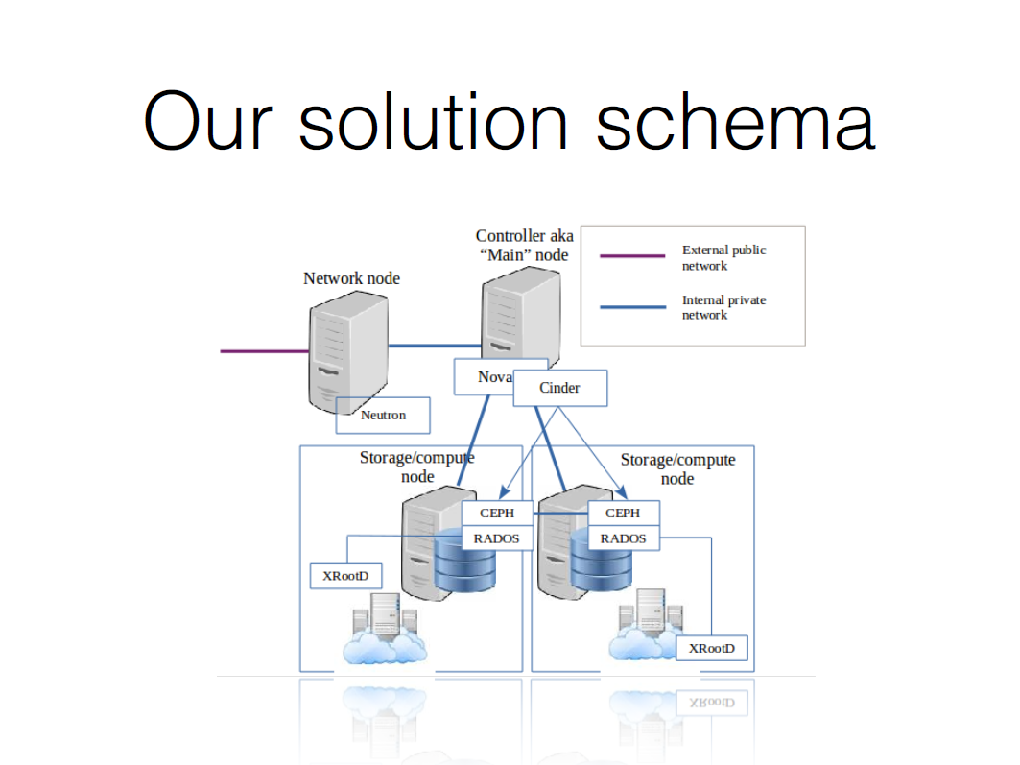

Slide 34
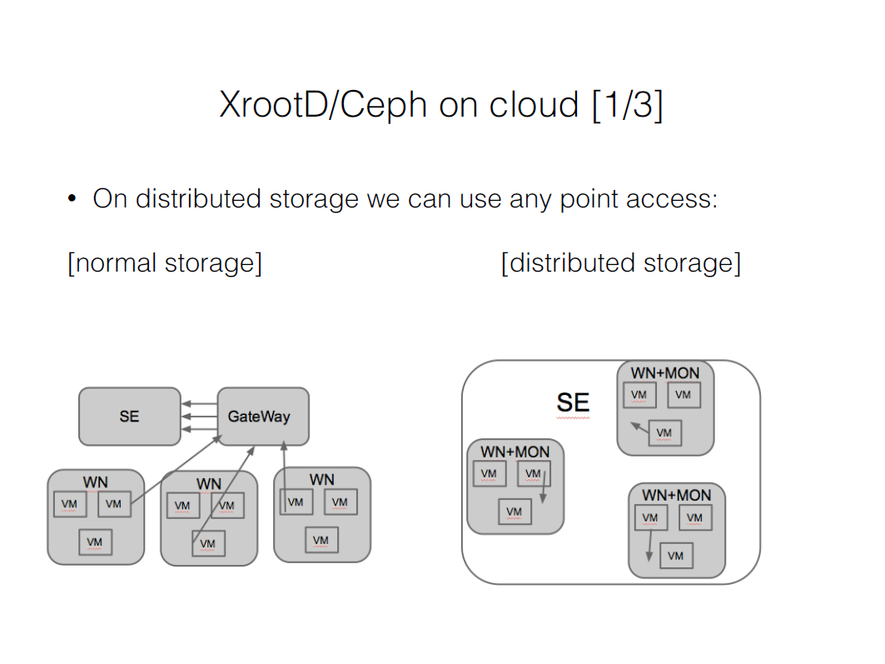

Slide 35
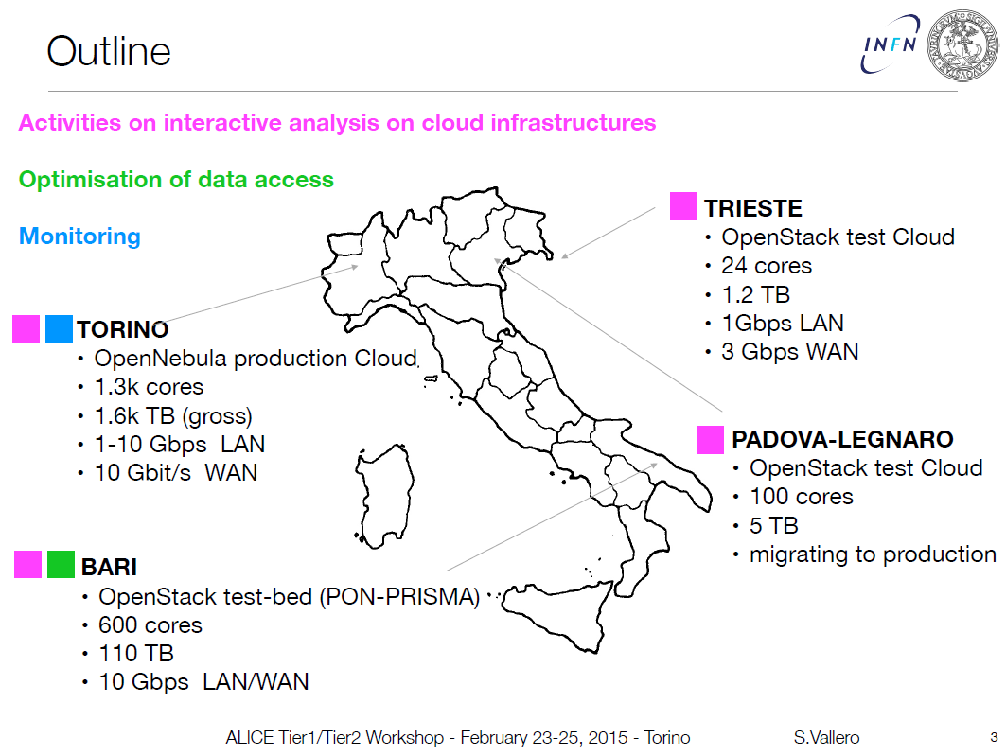

Slide 36
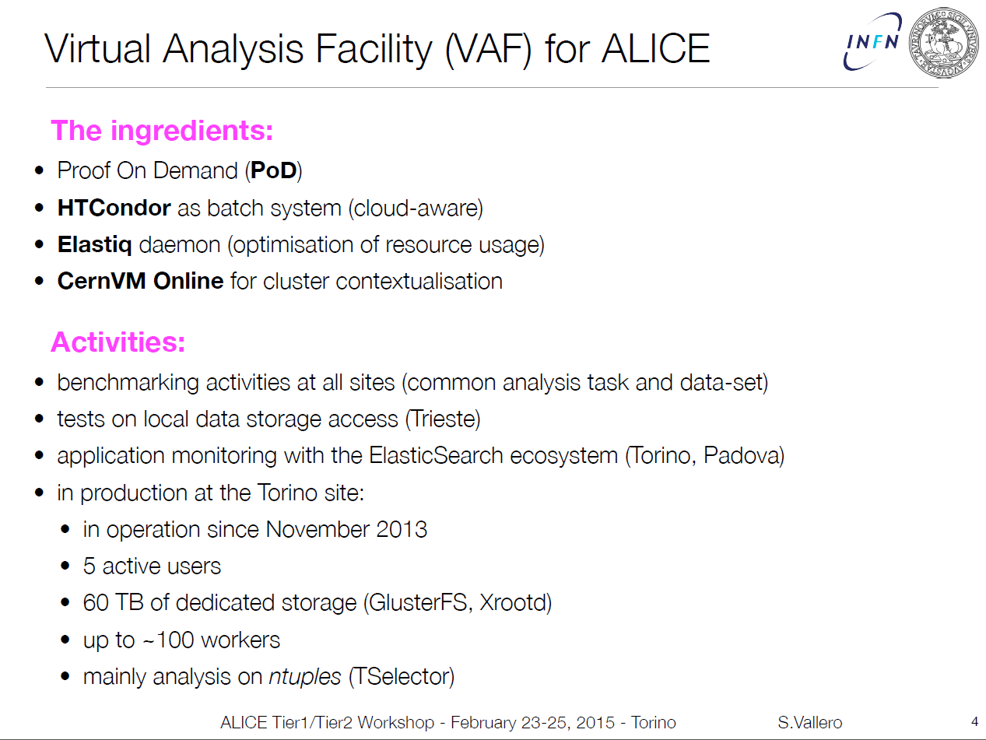

Slide 37
Conclusions
Higher data volumes in Run 2 are compensated by multiple improvements
  Better performance of reco/MC/analysis SW
  New calibration procedure
  Increased grid efficiency
Resource requests for 2015-2017 are modest
  Compatible with flat funding
New types of resources continue being integrated
  Cloud deployments
  HPC facilities
ALICE is ready for Run 2

