Slide 1
heppy
A lightweight python event processing framework for high-energy physics
Colin Bernet, IPNL/IN2P3

Slide 2
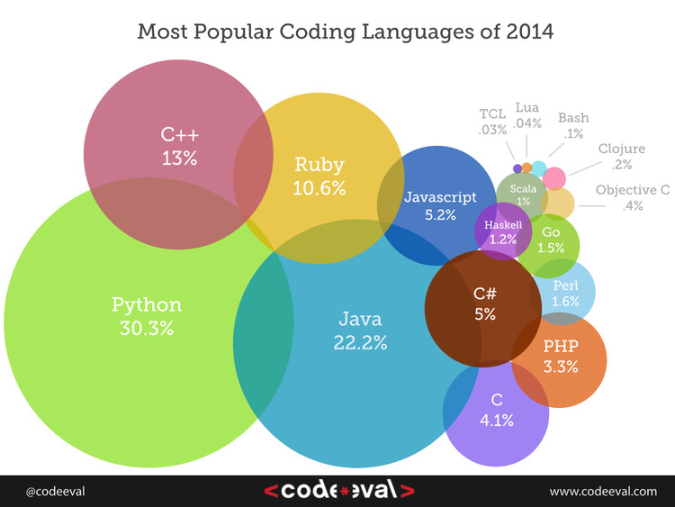
Why python?
Very large user base
Super easy to learn
Light & short code
Good performance
  usually drives C or C++ modules
Feature rich
  massive and easy-to-use
  standard library
Dynamic typing
  good for multichannel analyses
  code highly reusable
Productivity x 5-10 w/r C++
Forget about ROOT CINT
The « glue » between everything
Just a lot of fun!

Slide 3
Why not python?
Some arguments against it:
But in fact:
It would be slow
No compilation??
Still another language to learn
  C++ was enough of a pain in the @!#
Usually drives c or c++ libraries
Huge amount of time gained
  flexibility, high-level tools, code reusability, terse syntax
Lots of checks done at runtime
  Run, get exceptions, fix them
Takes less than a few days to become efficient, and you will love this one

Slide 4
Heppy
Python-based event processor for HEP
  Input: TTree
  Output: e.g. a flat ntuple for statistical analysis
  Lightweight : ~2000 lines of code
GitHub:
  Heppy: https://github.com/HEP-FCC/heppy
  Heppy_fcc: https://github.com/HEP-FCC/heppy_fcc
Documentation for FCC:
  https://twiki.cern.ch/twiki/bin/viewauth/FCC/FCCSoftwareHeppy

Slide 5
Users and Developers
Used in major CMS analyses
  H→ZZ→4 leptons
  H→ττ
  ttH → leptons
  SUSY searches (≥0 leptons)
  Top standard model analyses
  W mass measurement
  Particle flow performance measurements
And for the FCC already!
  CERN team TLEP analyses
  arxiv:1308.6176
Core framework developers
  C. B. (CMS), 2011
  Giovanni Petrucciani (CMS), 2014
  Andrea Rizzi (CMS), 2014
  Non-CMS people welcome ☺
Lots of new features being proposed and explored at the moment.

Slide 6
Short demo if network allows
To get started, follow:
  The python tutorial if not yet done (5 hours) https://docs.python.org/2/tutorial/
  The FCC heppy documentation (1 hour)
  https://twiki.cern.ch/twiki/bin/viewauth/FCC/FCCSoftwareHeppy

