Slide 1
PS Booster B-train upgrade
M Buzio, R Chritin, D Giloteaux, D Oberson (TE/MSC/MM)
Contents
1 – The PS B-train today
2 – Why upgrade ?
3 – CERN-wide B-train upgrade project
4 – The new PSB system
5 – Outlook

Slide 2
The PS B-train today

Slide 3
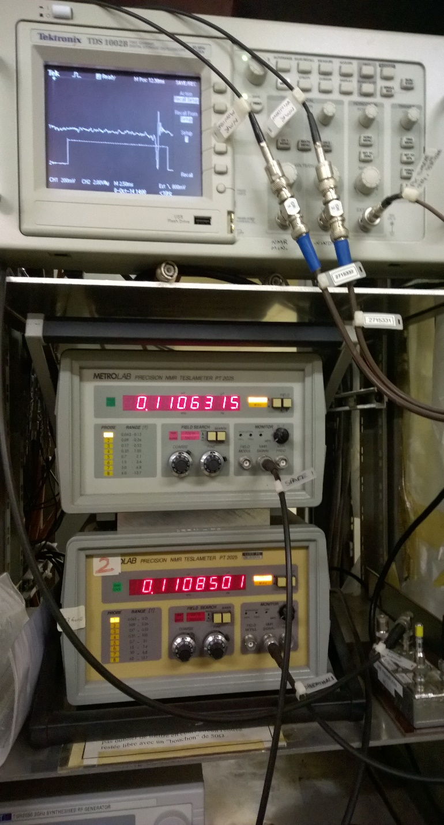
History of B-train versions
Mark I 1972 – 1981
no details known
Mark II 1981 – 1998
1 G resolution, 10⁻³ (∼10 G) stability
Used by beam diagnostics (longitudinal pick-up, β display …)
Ion cycles → new NMR field markers («peaking strip» mode)
Mark III 1998 –
New electronics by P Dreesen (same as for the PS, LEIR, AD)
0.1 G resolution (peak B_{UP} rate = 220 kHz @ 2.2 T/s),
Main users: RF, beam DCCT (MPS + trims in open loop)
All rings assumed to have same field: measurements show that up to 6 kA |B₁¹/B₁⁴-1|, |B₁²/B₁³-1|< 4⋅10⁻⁴
SPARE chain calibrated to give same results as OP
(NMRs set slightly apart to trigger at the same time in non-uniform field)
Current system works satisfactorily, no major problems
(interventions since 2006: missed NMR trigger solved by lowering threshold from 150 mV to 100 mV; pulse repeater replaced; over range noise on Ḃ solved by filtering new switched-mode converters)

Slide 4
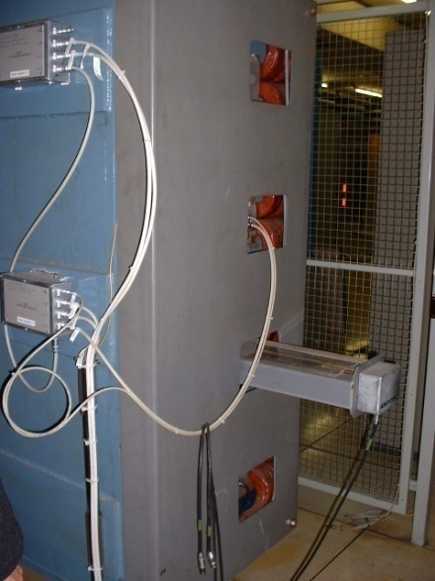
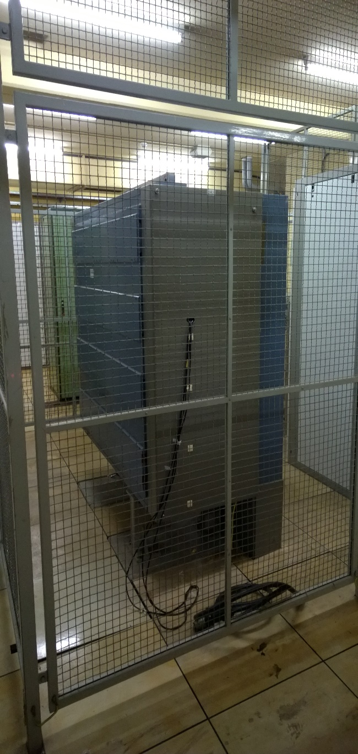
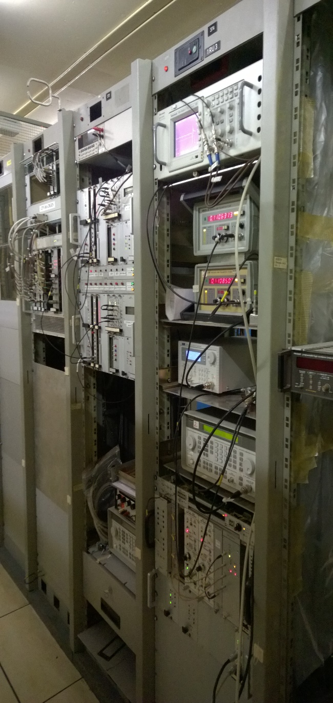
Current B-train system (361-1-201)
empty
(available for on-line tests)
B-train crates
(op + spare)
NMR signal
scope
(original) reference
pick-up coil
NMR
teslameters
Metrolab NMR probes
2× inrection (op + spare)
1× flat-top (unused)
combined pick-up coils
for fringe field detection
(unused)
V_{coil} (∝ B_{dot})
split towards
op/spare chains
via isolation amps
free space ?
Frequency generator
(marker resonance)
GPIB controlled by … ?
coil T sensors
(unused)
spare pick-up coil
(unused)
NMR output buffer
power supplies: new, old (scrap ?)

Slide 5
Why upgrade ?

Slide 6
Motivation for B-train system upgrade
Hard constraints
Present electronics cannot cope with 2× field ramp rates →
dB/dt = 4∼5 T/s → B_{UP}/B_{DOWN} rate = 400 ∼500 kHz (PS tests fail between 250 and 500 kHz)
reasons: the ADC-based integrator (AFEC card) saturates (register overflow)
the pulse repeaters (TTL→24V) have not enough bandwidth
Severe impact on accuracy
Higher saturation → 2× difference between inner and outer rings + larger cycling history-dependent fluctuations → fixed (or even f(I)) trims will not work → second system in the outer ring needed
Stronger eddy current effects + saturation-induced field profile change → fringe field more important → integral coils to get all the required information
Strategic considerations
Replace ageing electronics and sensors
Improve maintainability: conformity to upcoming CERN-wide B-train standard; stock fresh spares (in common with other machines); advanced in-built diagnostics and alarms; remote diagnostics and configurability via WhiteRabbit/FESA
Improved resolution and accuracy → free up margins elsewhere e.g. radial position loop
→ long-term operational flexibility

Slide 7
Repeatability – Inner rings
Repeatability as a function of cycling hystory: 2⋅10⁻⁴ @ 1 ↔ 1.4 GeV
5⋅10⁻⁴ @ 2 ↔ 1.4 GeV

Slide 8
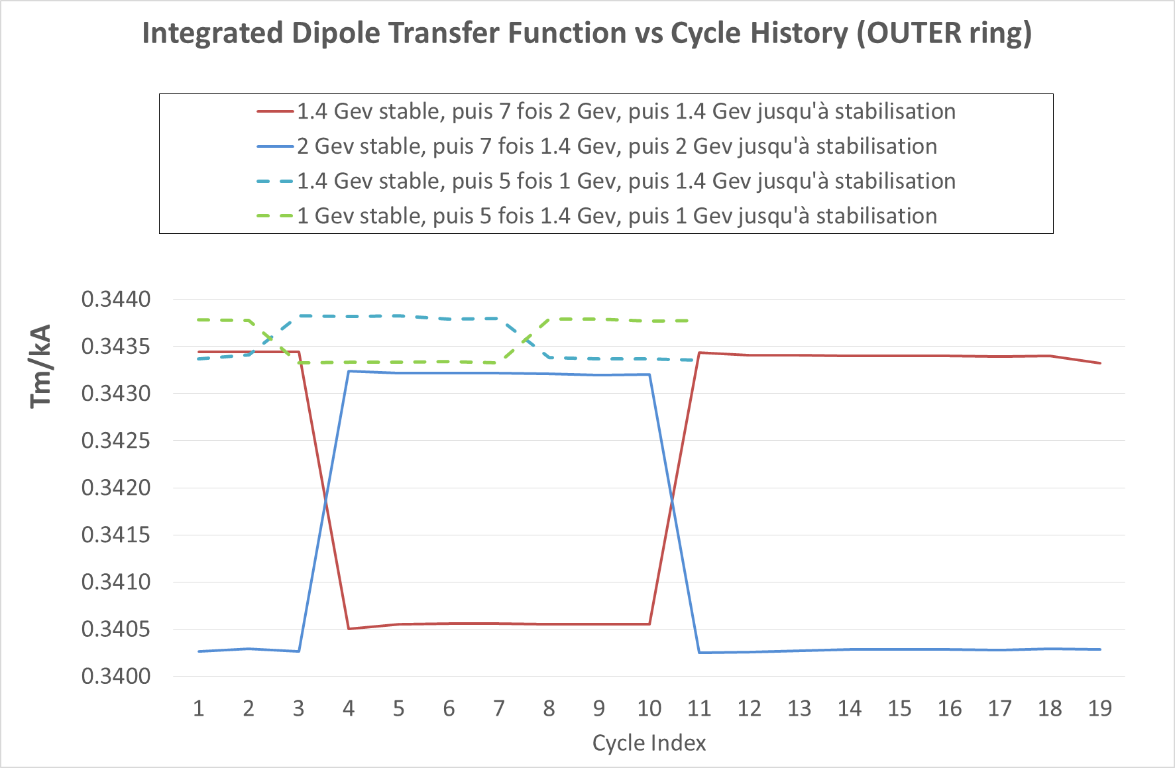
Repeatability – outer rings
Repeatability as a function of cycling history: 1⋅10⁻⁴ @ 1 ↔ 1.4 GeV
7⋅10⁻⁴ @ 2 ↔ 1.4 GeV

Slide 9
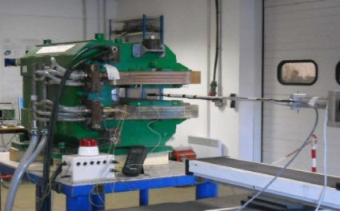
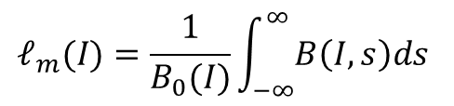
Why are fringe fields important ?
High-field saturation → longitudinal field profile flattens out → extrapolation from central to integral become less accurate
In short magnets, eddy currents in the end regions become the dominant dynamic effect
$$𝓁_{m}(I)=\frac{1}{B_{0}(I)}\int_{−∞}^{∞}{B\left(I,s\right)ds}$$
saturation

Slide 10
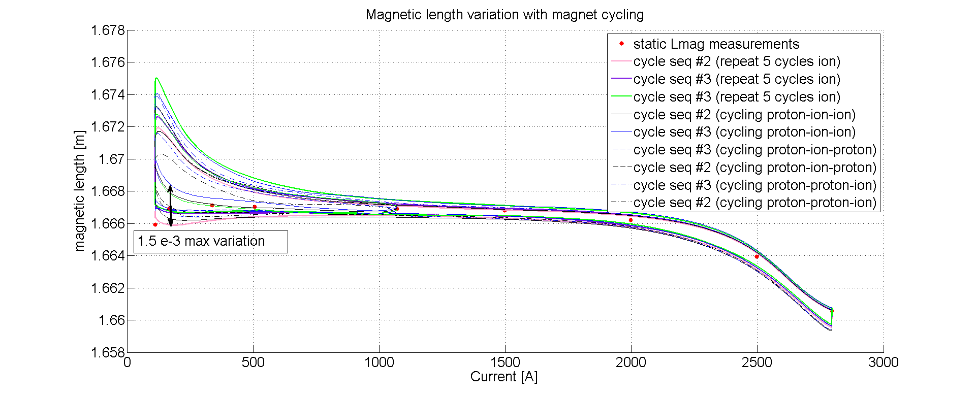
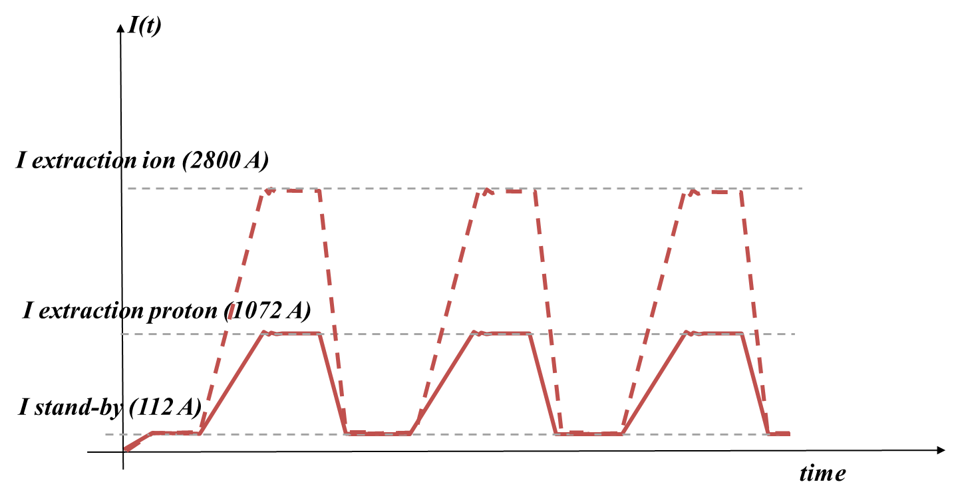
Repeatability of magnetic length
  Recent tests for MedAustron B-train evidence clearly that the magnetic length is much more history-dependent at low than high field ⇒ increased precision by marking at the flat-top for drift correction
  To be evaluated: trade-off with larger integrator drift during ramp-up
  To be evaluated: trade-off with smaller dynamic range for gain correction (mid-level marker is best ?)
Courtesy G. Golluccio

Slide 11
CERN-wide
B-train upgrade
project

Slide 12
Functional specifications
Project originally motivated by performance limits of the PS system + need of long-term consolidation
Reliability
→ new markers as a long-term alternative for difficult-to-replace peaking strips
→ reduction of down time due to timing conflicts
(synchronization between peaking strip window and current cycles; internal integrator recalibration)
→ more robust signal transmission
→ remote diagnostics
Operational flexibility
→ sensors in both F/D halves to recover full information ⇒ mitigate B-train errors due to the imbalance induced by specific operation sequences that today are best avoided
(e.g. F8 degaussing cycles, certain combinations of cycles)
→ allow higher flat-bottoms and thus shorter cycles
(NB: the current very low 5 mT value is imposed by the peaking strips !)
→ remote switching between OP and SPARE chains
Precision and accuracy
→ 5 µT resolution (currently limited by the integrator and repeaters)
→ more accurate integration, drift correction
→ more flexibility in the calibration and in adapting to new operation modes

Slide 13
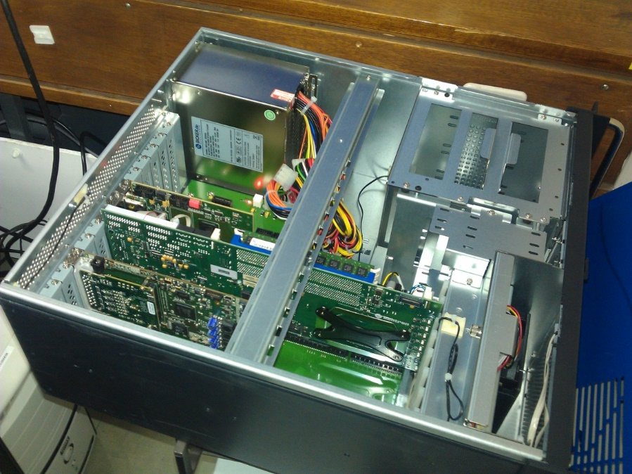
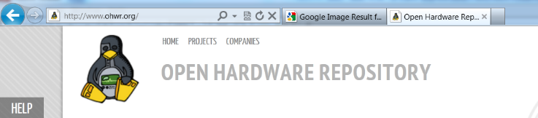


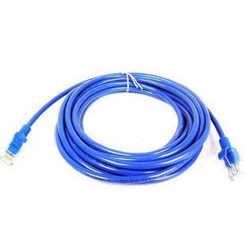
New B-train systems
Main design choices:
Modern electronics (integrator, marker trigger generator) based
upon CERN-supported solutions (Industrial PICMG1.3 PC FE, OpenHardware SPEC PCIe carried card & FMC mezzanine)
Front-End software compatible with ACCOR accelerator control systems (CERN Scientific Linux + FESA)
Field markers based on commercially available components (FMR resonator / NMR probes)
Optical-fibre serial transmission of numerical measurement results
(OpenHardware White Rabbit)
New timing-independent, streaming integration and drift/gain correction algorithms

Slide 14
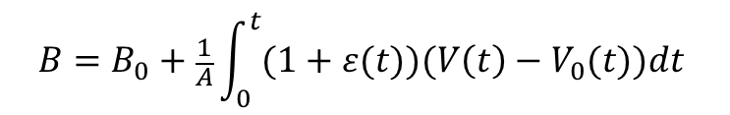
Streaming integration
New concept: continuous digital distribution of B(t) on a fast serial line to replace old pulse train
Output stream continuously updated with current B(t) values
→ no need for complex triggering and reset logic; no B₀ initialization burst
Adaptive auto-calibration of gain and offset using field markers on flat-top and flat-bottom
→ fully transparent correction of measurement error
fast and robust transmission, no more timing conflicts
but: drift correction must be applied continuously on-the-fly
ADC offset (→ integrator drift)
updated every time the same marker level is reached
$$B=B_{0}+\frac{1}{A}\int_{0}^{t}{(1+ε(t))(V\left(t\right)−V_{0}(t)})dt$$
Integrator gain error
updated every time a different marker level is reached
N different marker levels → up to 4 N corrections per cycle
Corrections smeared over a certain Δt to avoid sudden rumps

Slide 15
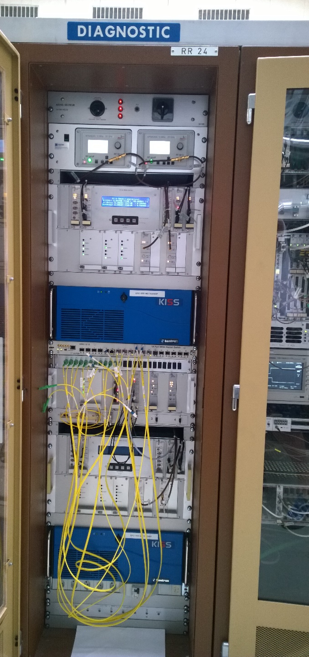
Prototype electronics in U101
2× AnaPico 20 GHz signal generators for F,D FMR
(local frequency setting only)
B-train chassis including: 8-page multi-function display,
analog and digital I/O, RF amplifier, power supplies
SPEC FMC 2-ch. integrator card
- “classic” integration reset at c₀ + weighted sum of F/D integrals
- basic offset correction
- software-configured ADC/preampli calibration with internal voltage reference, automatically done during zero cycles
(NB yearly offline calibration still necessary)
OP system
SPEC FMC 2-ch. marker card
- trigger generation with high-Q FMR
- trigger generation with NMR (tested in MedAustron)
tested
✓
Commercial White Rabbit switch
Switching chassis
- simulated/measured B-train (based on POPS being on/off)
- OP/SPARE B-train (HW signal from CCC)
SPARE system
Front End industrial PC
New high quality PFW/I8 DCCT out
Courtesy O. Michels

Slide 16
White Rabbit distribution in the PS
All cabling + spares in place
Broadcast mode with two switches tested @ 250 kHz (50 design target, 300 theoretical max.)
first test results: 5.6 µs latency seen by POPS receiver
P.C. broadcast internally measured current ⇒ 1 kHz, 1% on-the-fly B(I) simulation for:
- timing-independent marker trigger enable
- telegram-independent cycle recognition
- internal diagnostics and alarms
- simulated B-train in case of measured B-train failure (?)
field tests
OK
lab tests
OK
coming in 2015:
same as RF
In operation
Implemented now
Large headroom for expansion

Slide 17
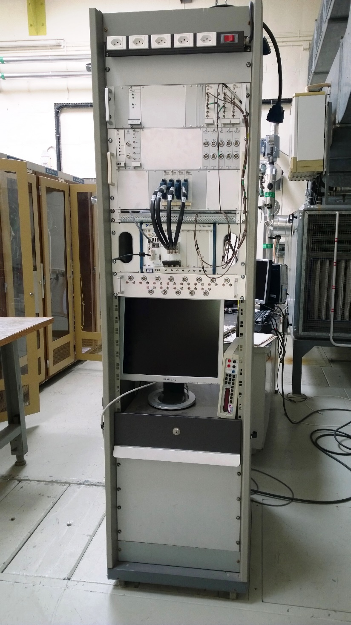
Diagnostic PS “spy” system
Based on National Instruments hardware:
PXIe chassis, RT controller, 2× 6368 DAQ cards (16×2 MHz parallel 16-bit channels + 32×10MHz digital I/O channels)
Acquisition of all sensors and B-train signals
Introduced in 2010 to track the magnetic state in F/D halves
Used to check the consistency of sensor and B-train signals, timing and currents
Testbed for the design of new sensors and acquisition algorithms
System operating at ½ channel capacity, debug ongoing
New high-quality F8 + PFW current readout from DCCT (courtesy of O. Michels) under test

Slide 18
Ongoing & planned activity
Finalization of the FPGA code
  Integrator: VHDL timing registers to check and control + DMA transfer data
  Dynamic (smoothed) adjustment of the integrator offset/gain upon reception of marker triggers
  Dynamic adjustment of calibration coefficients, marker gate (enable) etc… as a function of
  I via an internal approximated magnet model B=B(I,t)
  Automatic self-calibration during zero-cycles according to telegram index or I(t) history
Development of C++ FESA classes/Linux device drivers
  develop the classes to exchange measurement and control signals as agreed with OP team
  Local FMR frequency control (e.g. for dynamic marker point adjustment)
Component-level tests
  Statistical analysis of drift/gain error vs. machine cycling sequence, ambient conditions → definition of optimal marker levels, frequency of internal correction
  White Rabbit communication to/from all users (latency and jitter vs. data rate)
System-level tests
  Systematic offline comparison of old/new sensors, old/new system in different conditions
  Offline correlations with beam behaviour (radial instability) during different cycle combinations to validate measurement principle
  Online (with beam) tests in parallel with existing system, by feeding back one user at a time
  Online tests with the new system replacing completely the old

Slide 19
Upgraded
PSB B-train

Slide 20
Specifications
Parameter | Value | Unit
Max. magnetic field B | 1.2 | T
Min. magnetic field B | 0.1 | T
Max. field ramp rate dB/dt | 4.0 | T/s
Absolute measurement uncertainty | 100 | µT
Max. measurement resolution | 10 | µT
Min. cycle duration | 1.2 | s
Field broadcast rate | 400 | kHz

Slide 21
Overall system architecture
redundancy: 2× (OPerational + hot SPARE) chains, always running, remotely switchable
- OP sensors in rings 3 (for historical continuity …) and 4
- SPARE sensors in rings 1 and 2: get full magnetic information, but switching chains may entail more complex calibration
- or SPARE sensors in rings 3 and 4 (as today): easier cross-calibration, less fluxmeters, two empty rings remain available
LLRF/DCCT:
- inner/outer rings share B(t) from the corresponding OP chain
- or each ring is fed all the time with its own B(t):
more information, but 2× failure risk
Main advantages of PCB fluxmeters:
industry-made, multiple units relatively inexpensive
accurate measurement of (much higher) saturation/eddy current effects (avoid high-field RF corrections ?)
10⁻⁴ surface accuracy → absolute energy calibration possible
real-time field harmonics as a by-product

Slide 22
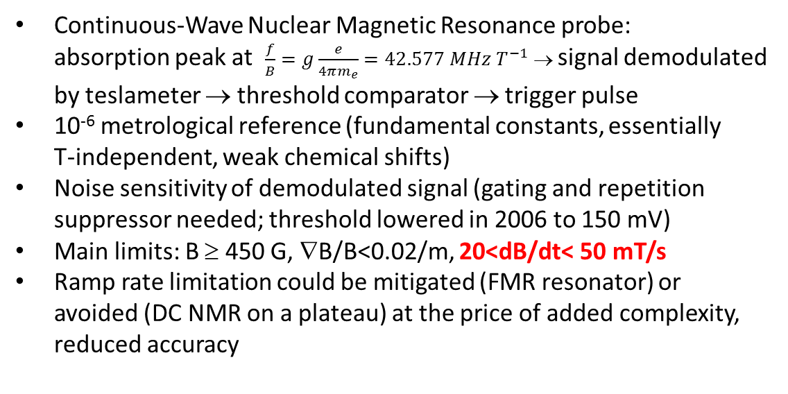
NMR marker
Continuous-Wave Nuclear Magnetic Resonance probe:
absorption peak at $\frac{f}{B}=g\frac{e}{4πm_{e}}=42.577 MHz{ T}^{−1}$→ signal demodulated by teslameter → threshold comparator → trigger pulse
10⁻⁶ metrological reference (fundamental constants, essentially
T-independent, weak chemical shifts)
Noise sensitivity of demodulated signal (gating and repetition suppressor needed; threshold lowered in 2006 to 150 mV)
Main limits: B ≥ 450 G, ∇B/B<0.02/m, 20<dB/dt< 50 mT/s
Ramp rate limitation could be mitigated (FMR resonator) or avoided (DC NMR on a plateau) at the price of added complexity, reduced accuracy
NMR marker
t ≈187 ms
B = 1107 G (Ring 3)

Slide 23
Interface signals (proposal)
Real-time (10 s) serial distribution (White Rabbit @ 400 kHz )
- From the B-train: B₁³, Ḃ₁³, B₁⁴, Ḃ₁⁴
- From the PC: I_{main14}, I_{main23}, I_{trim1}, I_{trim2}, I_{trim3}, I_{trim4}
Quasi real-time (~1 s) low-bandwidth (5 kHz) distribution (FESA + OASYS/SAMPLER ?)
- From the B-train: B₁^{r}, Ḃ₁^{r}, B₂^{r}, B₃^{r}, V_{NMR}^{r} , t_{NMR}^{r} for r=1…4
- total estimated uncertainty on all distributed measurements
- Deviation from synthetic model B_{j}=B_{j}(I_{k},t)
Configuration parameters (FESA)
- From the CCC/bldg. 30: Marker levels, windows, chain status (active/spare),
calibration parameters (extrapolation from reference magnet to whole ring)
Quasi real-time (~1 s) diagnostic parameters/alarms (FESA)
- From the B-train: for each cycle, for r=1…4: ADC gain error, integration chain drift/gain error,
difference between inner/outer rings, difference between spare and operational chains;
Diagnostic parameters (offline analysis in the Spy system)
- standard magnetic cycle analysis (as a function of current + previous users): remanence, hysteresis width, saturation amplitude, linear transfer function, ripple vs. frequency,
apparent and differential magnet inductance etc …

Slide 24
Outlook

Slide 25
CERN-wide B-train upgrade deployment
Offline tests: on regular/modified BZH/MQ spare in bldg. 867
Online tests: Installation of additional sensors in free Ring 4 + new electronic components & diagnostic (spy) in the free slots in the B-train racks (LLRF available now, DCCT in 2015, MPS ?)
tests with beam must be envisaged before LS2

Slide 26
Open questions for the WG
Overall architecture: where to put SPARE sensors / use SPARE as OP ?
NMR frequency programming: how is it done now, who will do it in operation ?
3 full-height racks needed for the production system (as close as possible to the ref magnet)
can we fill in free space in the B-train racks now ?
2 × I_{MPS} (+ 4 × I_{trim} ) broadcast via White Rabbit: in parallel or merged ?
define signals, variable and alarms to be exchanged with the CCC
what about the synthetic B-train ? Define uses and tolerances
are there any other users ?
Internal drift/gain correction may generate steps in the distributed B-train.
Maximum acceptable step size (→ need to smooth out over a certain time)

Slide 27
Ongoing & planned activities
Foreseen in the next 6-12 months:
B-train sensors
- design and procurement of fluxmeters
- status of coils in ring 1 and 2
B-train electronics:
- White Rabbit communication lab tests with LLRF
- installation of Spy system in the B-train racks
Offline (bldg. 867) magnet tests
- impact of higher saturation levels on the field quality (harmonics) of bending/quads
- evaluation of history- and field-dependent differences between inner and outer rings
- evaluation of coupling between inner and outer rings in split-coil mode
- effectiveness of laminated side plates to equalize inner and outer rings
- magnetic behavior of the insertion dipoles → evaluation of trim currents

Slide 28
Summary & conclusions
Large saturation + eddy current effects expected to impact severely the reproducibility of the magnetic behaviour of the bendings
The proposed B-train upgrade solves this problem to first order:
- integral coils measure high field and dynamic effects in the end regions
- twin parallel chains measure inner and outer rings
Second-order effects not addressed for now (but object of planned study):
- history dependence of field profile @ marker level
- differences between rings 1/4, 2/3
State-of-the-art instrumentation takes advantage of many years of R&D + extensive on-line tests carried out in the PS before deployment during LS2.
Added value:
- 10⁻⁴ absolute energy calibration possible
- real-time field harmonics measurement for free
Need to coordinate (and test) details of excitation current:
- NMR marker compatibility: need 5∼15 ms with dB/dt = 20 ∼ 40 mT/s (dI/dt = 200 ∼400 A/s)
- “Zero cycles” with short dips to I=0 as in POPS: possible impact on reproducibility, to be assessed
- ripple, overshoot, undershoot, oscillations at end of cycle, ground loops: ditto
- implications of coupling between inner and outer rings

