Slide 1
ELENA Beam Instrumentation
GEM monitors
BTV systems
Beam position monitors
Tune measurement
Profile measurement with scrapers
(Recombination monitor)
(IPM)
(New ideas for H⁻ beams)
Thanks to; Lars, Marek, Stéphane et al…..

Slide 2
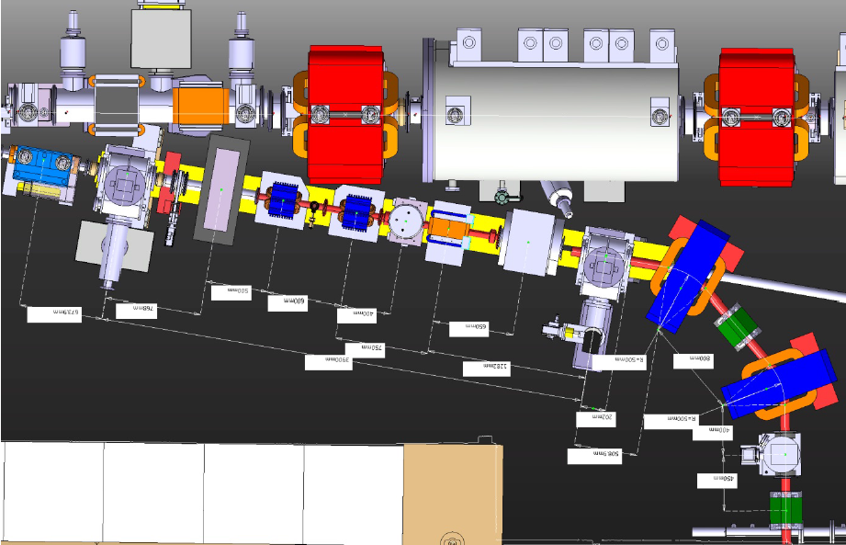
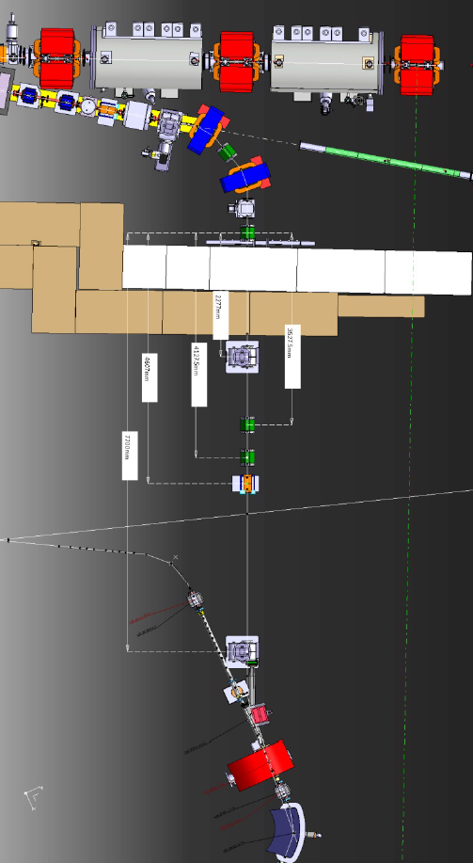
GEMs & BTVs
Re-use two existing GEM monitors
Relocation of DE.MTV7045
New BTV to measure beam at injection and after 1st turn

Slide 3
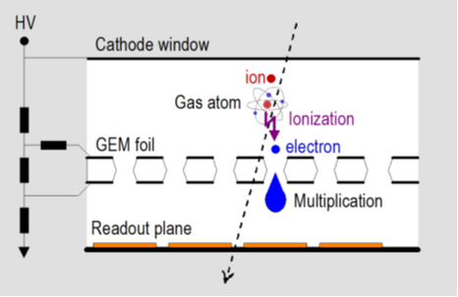
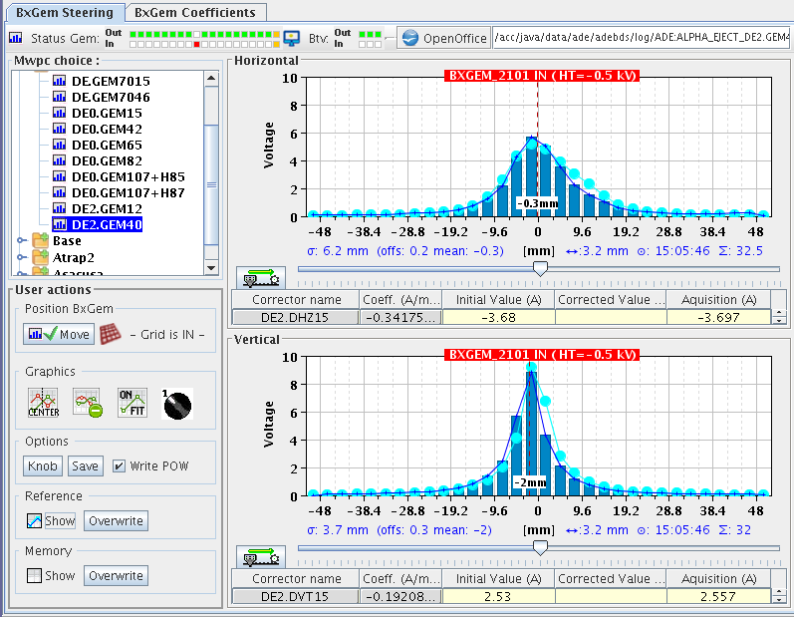
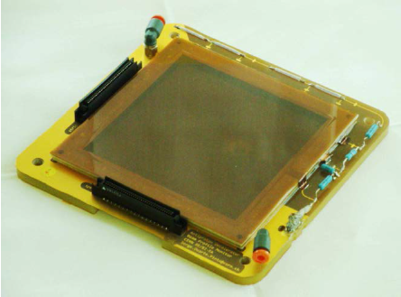
GEMs have been deployed extensively in the present AD experimental areas and give excellent results for both position and profile measurements. Like multi-wire proportional chambers these detectors are also gas-filled, and essentially the same physical phenomenon is exploited to multiply ionization charge.

Slide 5
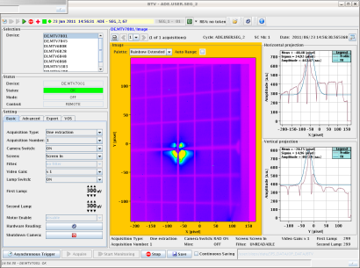
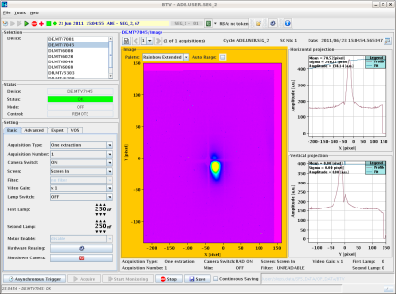
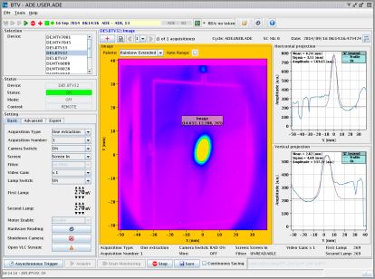
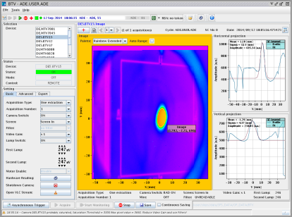
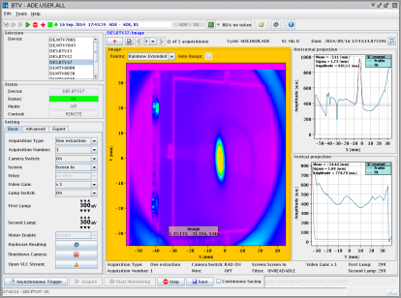

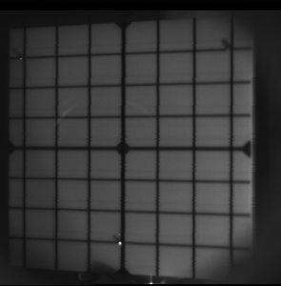
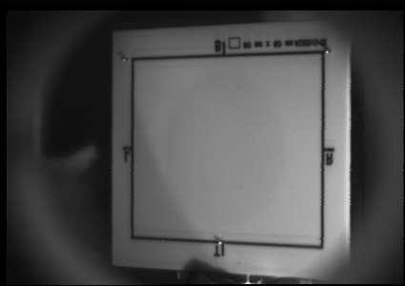
BTV measurement examples
AD extraction line
DE.MTV7001
DE.MTV7045
AD BASE line
DE5.BTV15
DE5.BTV32
DE5.BTV37
These measurements validated the use of BTV instruments for AD extraction lines (BASE + ELENA)
BTV screen type
Type Al2O3:CrO2
Thickness 1mm
Calibration marks No grid anymore to better optimize
the S/N with image digitalization

Slide 6
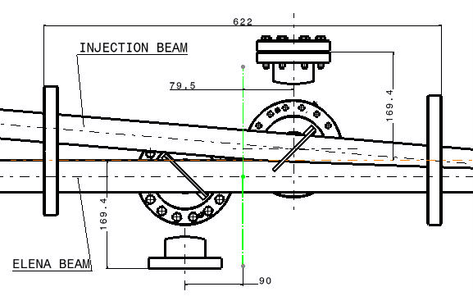
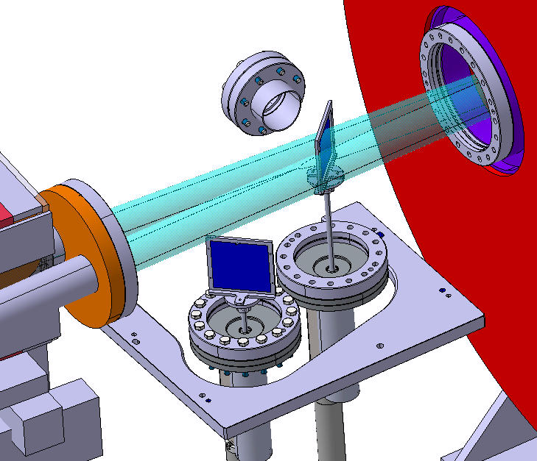
Screen Location / space constraint
SEPTUM
KICKER
622mm
(Distance between two flanges)
Push pull - With spring extend/return pneumatic system

Slide 7
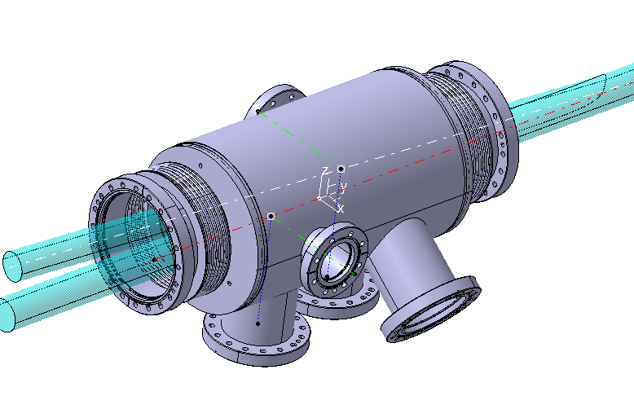
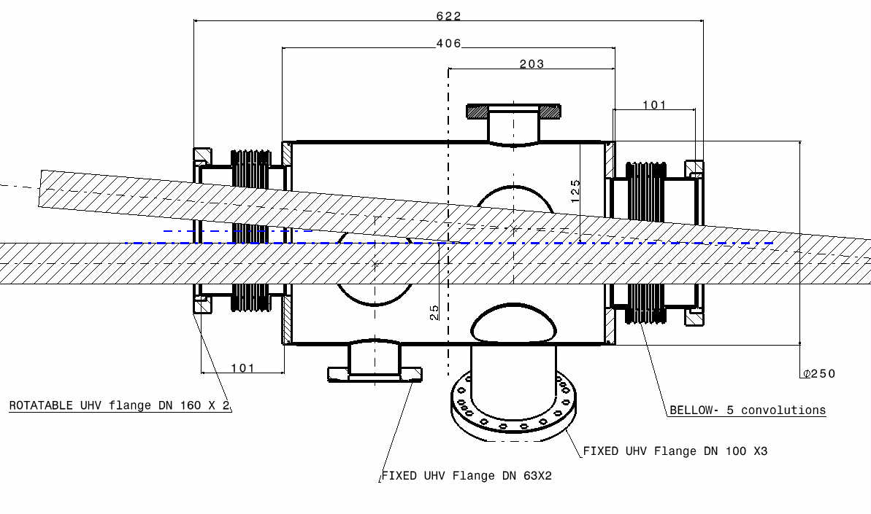
Vessel
cut Top view
Vessel thickness =3mm

Slide 8
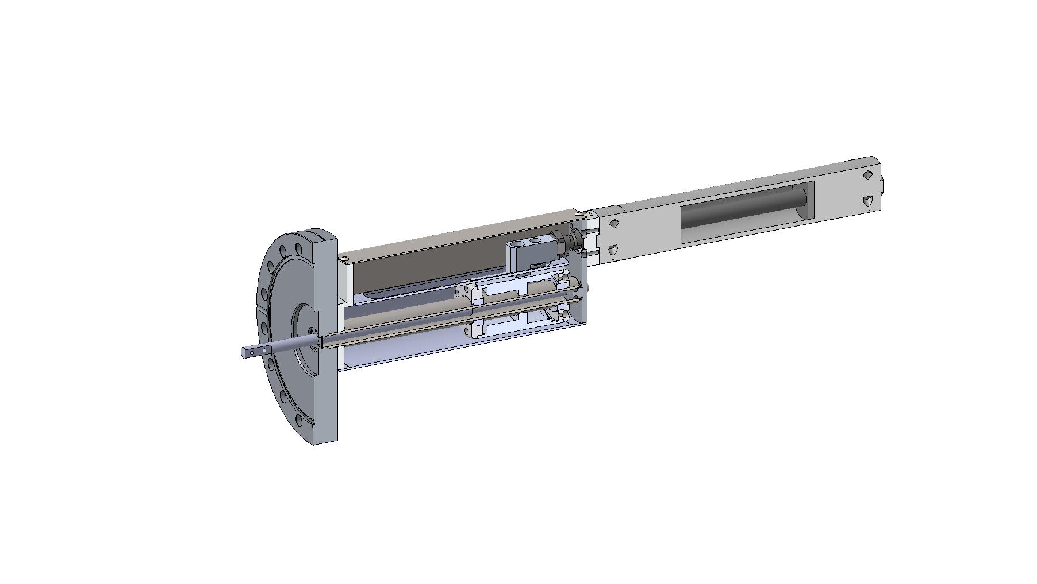
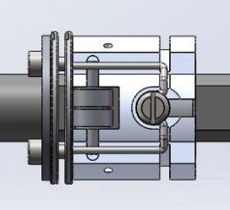
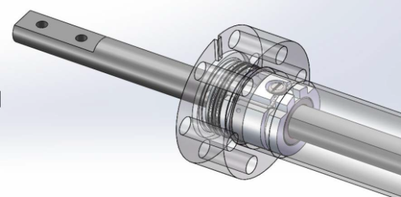
MPPL 100 – 100 – P (1)
Connection structure of Drive thimble with pneumatic Rod
Device description:
Provides linear motion of the vacuum shaft.
Vacuum shaft and Drive Thimble are magnetically coupled.
Both the driver and the follower consist of arrays of equal numbers of permanent magnets with poles.
Removes the need for edge-welded bellows ‘stacks’, incorporated within traditional ‘push/pull’ designs - their elimination maximises vacuum integrity!
Unlike a bellows-sealed device, the MPPL is not subject to the thrust due to vacuum, resulting in smooth free-moving operation.
Note : Connection structure of Drive Thimble also serves as a Anti – Rotation tool and assures linear movement of inner Vacuum Shaft !

Slide 9
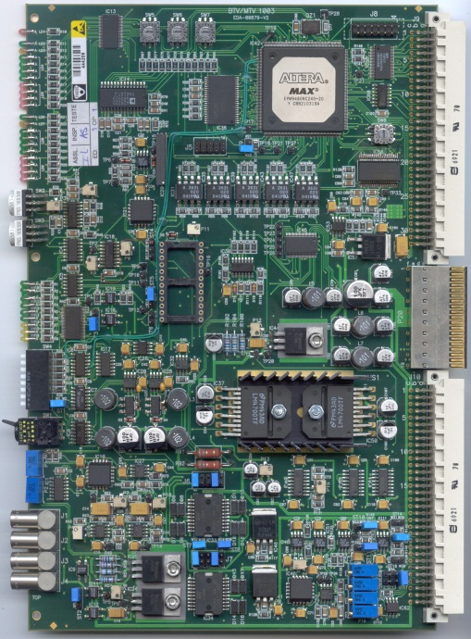
Control and acquisition chain
VME based card
  CTRL of the camera
  CTRL of the lights
  CTRL of the filter wheel (not foreseen for ELENA)
  CTRL of the movement
  Digitalization (400x300 pixels)
  Interlock interface if needed
Camera
  Analogue B/W to match the standard CERN BTV system
  S/N > 50dB
  Minimum illumination 0.0002lx (F1.4)
Rack / Crate
  No need for new hardware since space available
  for 2 BTV cards in cfv-193-btv2
  (AD extraction line + BASE)

Slide 10
Validation of the magnetically coupled push-pull device
Vacuum acceptance tests ongoing
Integration and vacuum tank design finished
Production drawings in progress (EN/MME)
Construction and tests first half 2015, installation autumn 2015

Slide 11
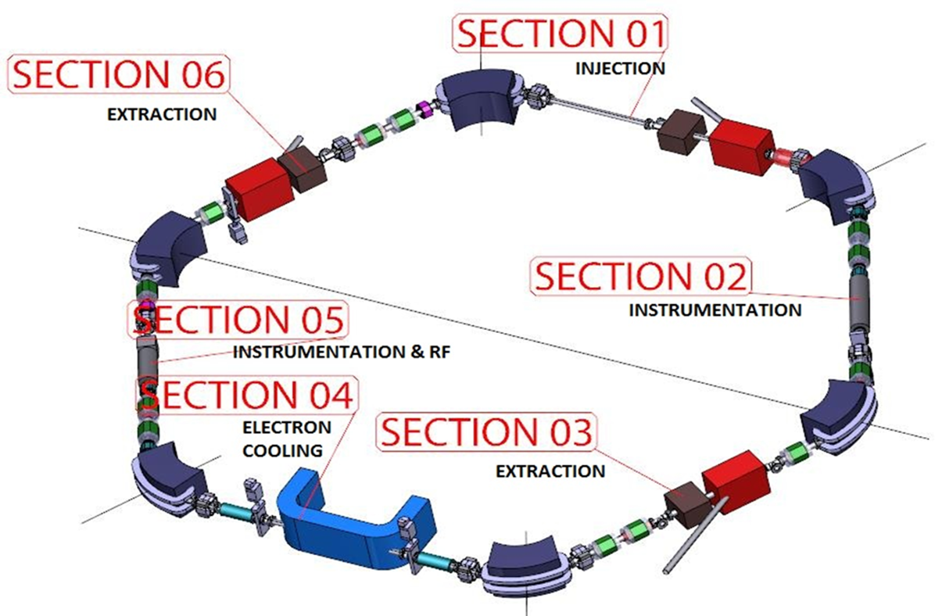

Slide 12
BPMs
The ELENA orbit measurement system will be based on 20 circular BPMs made out stainless steel with vacuum as dielectric, and mounted inside quadrupoles and dipoles.
Design of PU, analogue electronics as well as digital acquisition is optimized in view of using the 20 BPMs as one big Schottky PU.
The proposed design is based on a stainless steel body containing 2 diagonal cut BPMs. Two such elements will be inserted in to a vacuum tank, 100mm diameter, in order to have a position measurement in both planes. The sum and difference signals will be generated in the head amplifier.
After amplification of the signals, by low noise amplifiers located very near to the BPMs, the signals will be transported by ~50m cables, digitized and processed using digital Δ/Σ normalization for the position calculations.
Resolution | 0.1mm
Accuracy | 0.3-0.5mm
Precision | 0.1mm
Max. beam displacement | 33mm
Time resolution | ~10ms
Revolution frequencies | 1050-145kHz
Overall maximum length | 400mm
Inner diameter | 66mm
Bake out temperature | 250°C
Vacuum | 3 × 10⁻¹² Torr

Slide 13
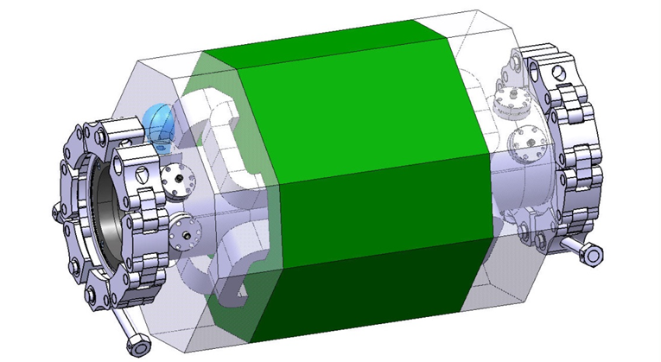
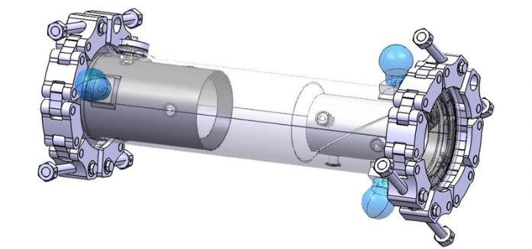
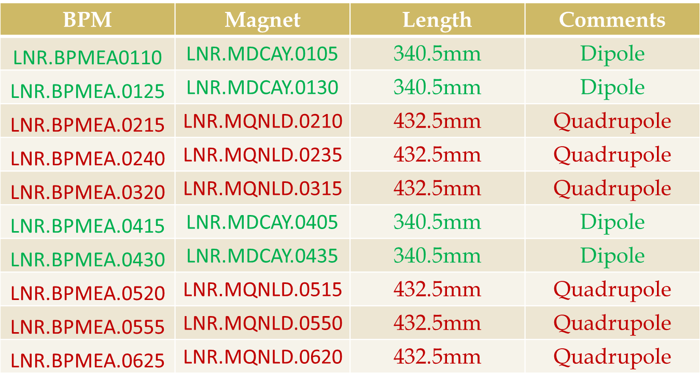

Slide 14
Proto type built and tested
  Transverse sensitivity as expected
    Fairly high inter electrode capacitance
    Electrode capacitance as foreseen (☺ longitudinal Schottky)
  Cost optimization ongoing
    Test 316L compared to 316 LN, with magnet group
    Manufacturing will start early 2015
Electron cooler BPM design started
  Simplified design
    No Schottky, long cables
    Beam in center, linearity less critical

Slide 15
BPM Electronics
Analogue
  First FE amplifier developed by Brescia university tested at CERN. Several issues identified
  Second version under development. Very good collaboration
Digital
  VFC-FMC operational in laboratory.
  FMC ADC performance being verified. On board DC-DC converters (switch mode 200-500kHz) noisy.
  Tests with beam in AD before Christmas. Extra gain needed
  Digital electronics ( being) ordered soon

Slide 16
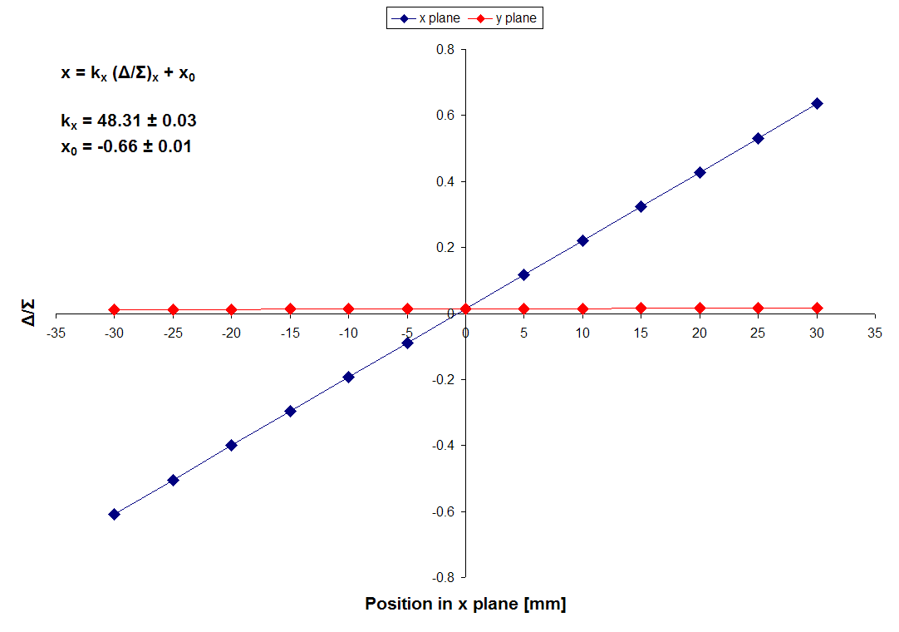
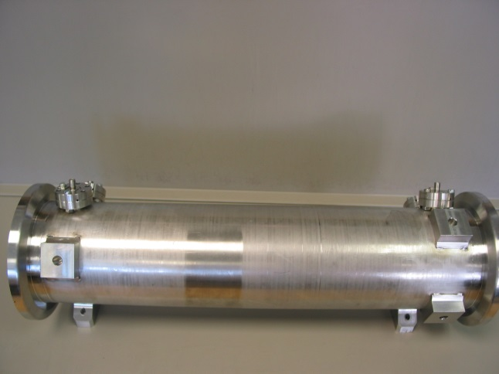
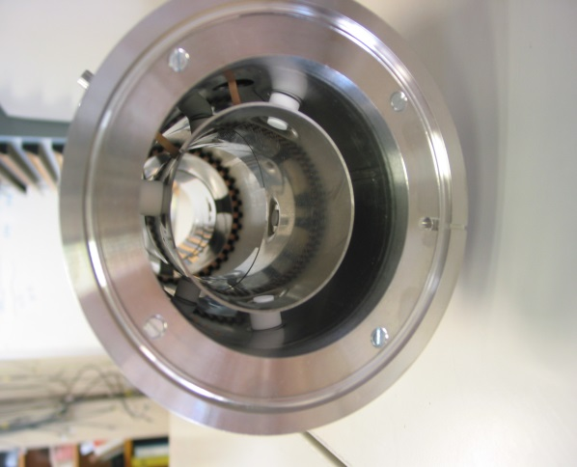
Simulation
Electrode | pF
H+ | 18.1
H- | 17.5
H+ / H- | 8.1
V+ | 17.1
V- | 17.1
V+ / V- | 8.1
Measured
Sensitivity
38.2mm
Close to theoretical values
Includes feedthrough
of capacitance of 2pF
Transverse sensitivity (38.2mm) measured with 160pF load.
Will be smaller with real load of 30pF due to
inter-electrode capacitance, i.e 45mm, very close to simulation.

Slide 17
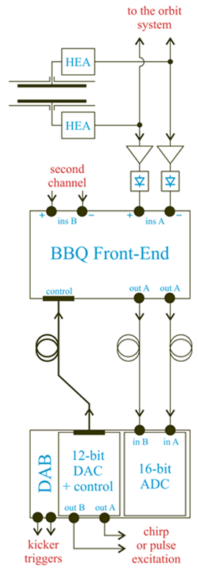
TUNE
Base-Band Tune (BBQ) measurement systems are highly sensitive and based on a direct diode detection principle. The AD will soon be equipped with such a system and it is planned to use a similar setup for ELENA.
As with all BBQ setups the system will consist of:
• Diode detectors, converting beam-induced pulses from electrodes of a position pick-up to slower varying signals, from which DC offsets corresponding to the beam orbit is removed with series capacitors.
• An analogue front-end amplifying and filtering the detector signals.
• Two 16-bit ADC for parallel acquisition of horizontal and vertical betatron oscillation signals.
• A VME, FPGA based Digital Acquisition Board (DAB) providing the read-out and processing of the ADC samples, spectra calculation, data buffering and storing for subsequent transmission through the VME bus to a front-end computer.
• Two 12-bit DACs implemented as a DAB mezzanine, used to generate signals for beam chirp excitation, independently for horizontal and vertical machine planes; the DAB can also provide tune kicker triggers synchronised with the acquisition.

Slide 18
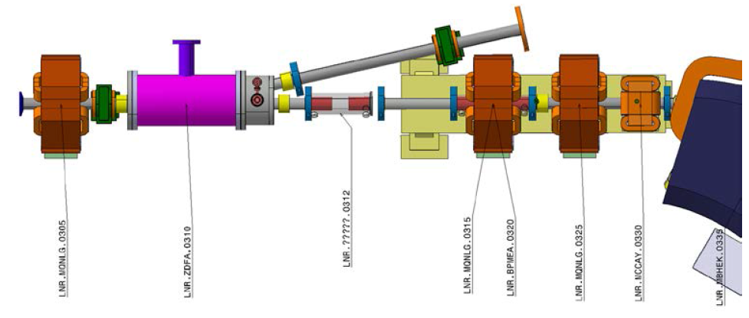
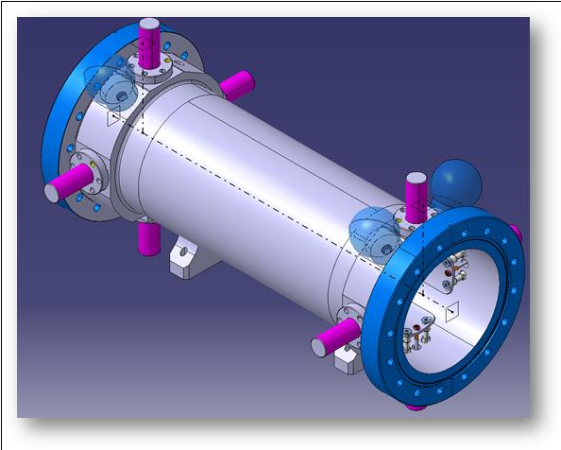
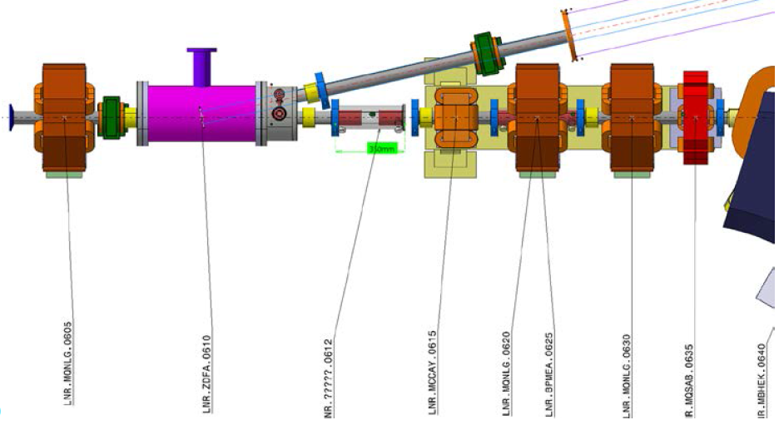
Same strip-line design for kicker and pick-up
Total pick-up length: 350mm flange to flange
Terminated strip-line equipped with 8 electrical feed-through
Installation in sections 3 and 6

Slide 19
The strip-line pick-up and kicker are being designed in the drawing office.
Work is well advanced and we expect to finalise it by the end of the year.
The electronics for ELENA is being prototyped on the AD.
New active diode detectors are being designed. They will be also tried on AD.

Slide 20
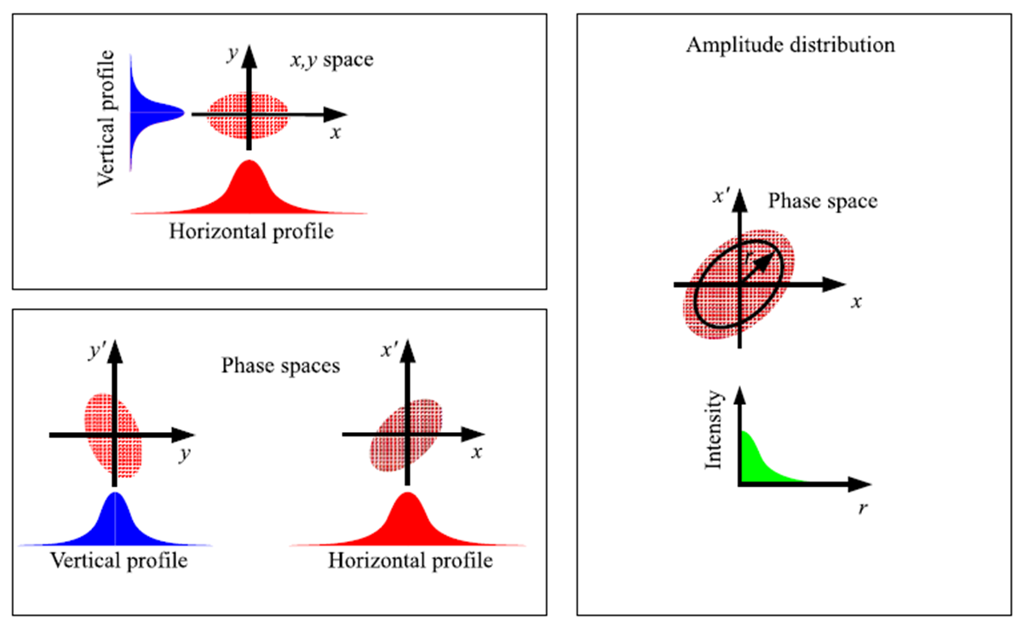
Scraper
Device to measure the transverse amplitude distribution (hence the beam size) of the circulating beam.
Consists of blades that are moved across the beam using stepping motors and recording the beam loss as a function of the blade position.
Destructive measurement, 1(2) blade(s) per plane.
Can also be used as a collimator or for acceptance measurements (RF blow up)

Slide 21
What do we measure?
Blade position as a function of time.
Circulating beam intensity vs. time, or
secondary particles on a scintillator vs. time.
Combine the two measurements to reconstruct the beam amplitude distribution.
Data is fitted to determine the beam centre and edges. The beam size and emittance can be evaluated.
Ideally the scraper should be located in a high β section with D = 0.
σ = √[εβ + (D ΔP/P)²]

Slide 22
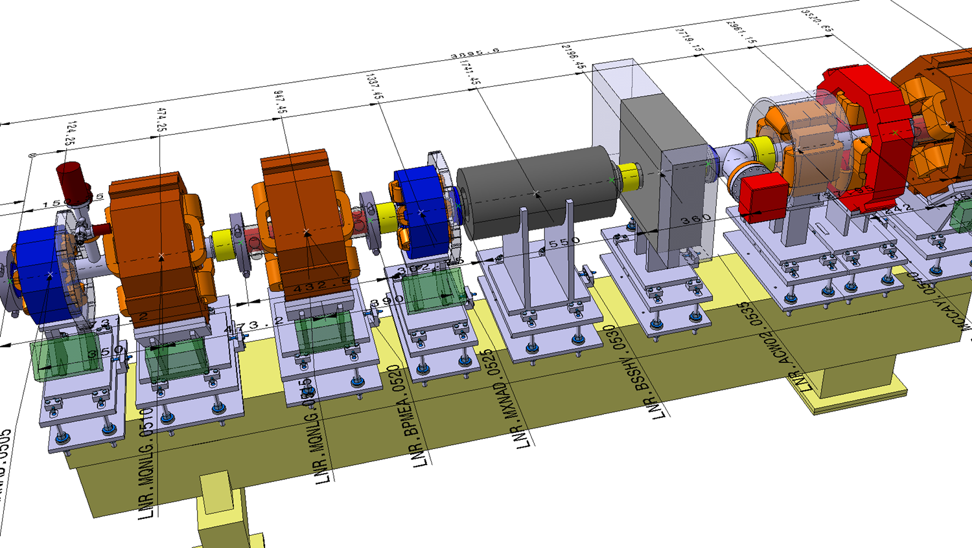
Design is under the responsibility of EN/STI and has just started
BI/EA is responsible for the signal acquisition.
Situated in section 5 (4 locations studied).
550 mm space reserved.
Fully bakeable at 250°C.
NEG coated tank.

Slide 23
Twiss parameters (centre of scraper)
 | βh (m) | D (m) | βv (m)
Original | 0.6 | 1.2 | 4
Option 1 | 0.95 | 1.11 | 4.1
Option 2 | 2.32 | 0.95 | 4.4
Option 3 | 3.5 | 0.87 | 4.6

Slide 24
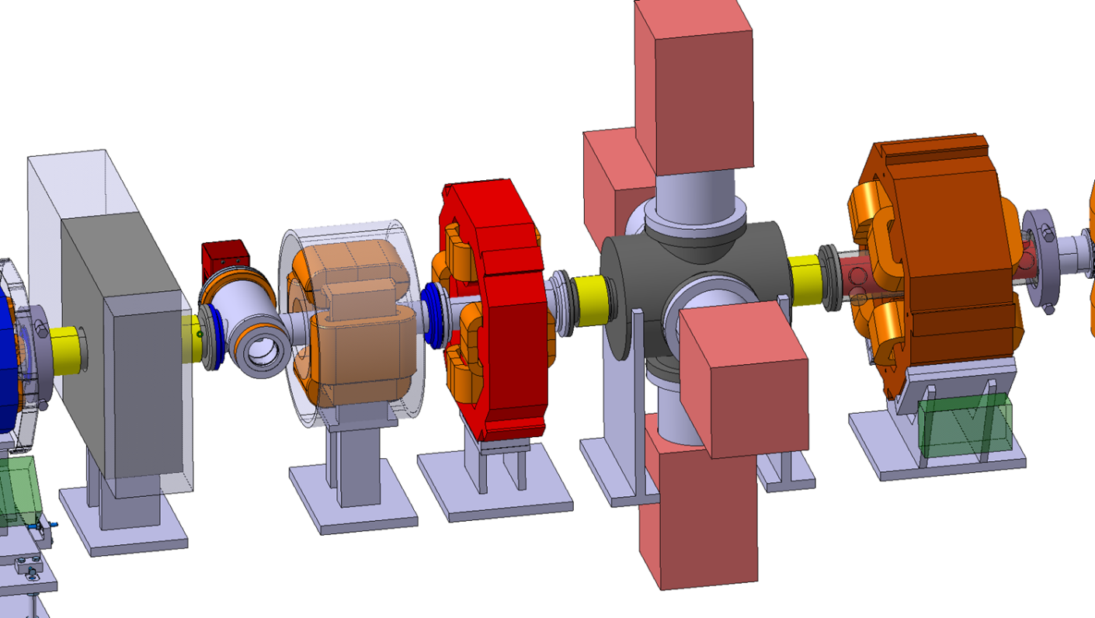
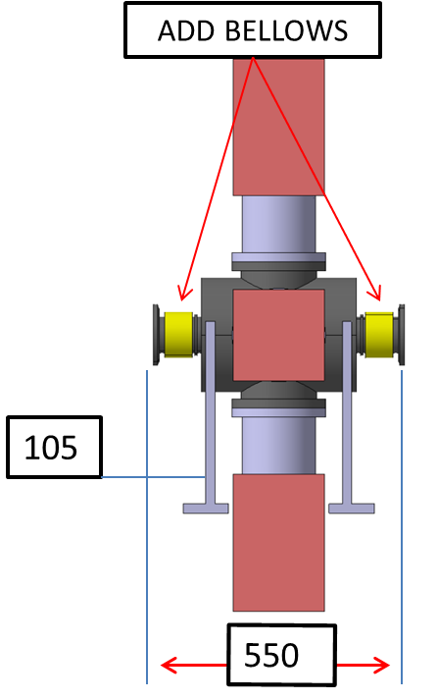
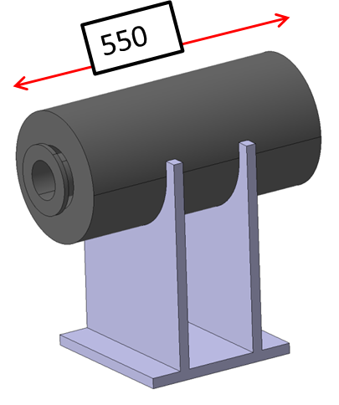
Option 3 retained for scraper position
Scraper envelope change

Slide 25
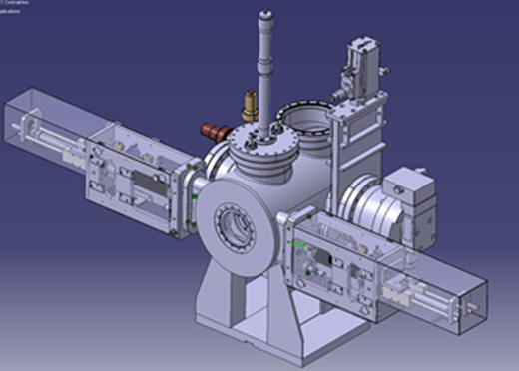
Scraper blade : 50 mm x 20 mm Al blade, 1 mm thickness
40 mm displacement of blade in 1 second (additional request for 40 mm in 0.5 s)
OUT position at 33 mm, IN position at -7 mm (based on a 63 mm diameter vacuum chamber)
Blade position read via LVDT sensors
400 Hz acquisition rate (one point every 2.5 ms to give 0.1 mm resolution in position)

Slide 26
Functional/technical specifications in preparation, EDMS 1380017
mechanical design in progress
choice of movement system
ECR for scraper position will be updated, EDMS 1411977 (version 3)
GEANT4 simulations of particle/blade interaction

Slide 27
Others
Recombination monitor:
For commissioning at 100 keV with the proton source, optimisation of the electron cooler can be performed by measuring the recombination rate of electrons with the circulating protons. The choice of detector depends on the required information.
The detector will be installed in an extension of the bending magnet vacuum chamber downstream from the electron cooler.
IPM:
Not part of the ELENA base-line instrumentation.
First estimations of electron-ion pair production look promising. Will need a gas injection system. Could be installed in section 1.
H⁻ diagnostics:
Use the fact that the outer electron has a binding energy of only 0.754 eV.
Can be easily stripped by; light from vacuum gauges, the residual gas or laser light. Use a downstream detector similar to what will be used for the recombination monitor.

