Slide 1
Cooperation among ALICE SEs
Current status and directions
(The ALICE Global Redirector. A step towards real storage robustness.)
Fabrizio Furano
CERN IT/GS
Nov 2008
ACAT ‘08
http://savannah.cern.ch/projects/xrootd
http://xrootd.slac.stanford.edu

Slide 2
Scalla/Xrootd
Most famous basic features
No weird configuration requirements
      Scale setup complexity with the requirements’ complexity. No strange SW dependencies.
Highly customizable
Fault tolerance
High, scalable transaction rate
      Open many files per second. Double the system and double the rate.
      NO DBs for filesystem-like funcs! Would you put one in front of your laptop’s file system? How long would the boot take?
      No known limitations in size and total global throughput for the repo
Very low CPU usage on servers
Happy with many clients per server
      Thousands. But check their bw consumption vs the disk/net performance!
WAN friendly (client+protocol+server)
      Enable efficient remote POSIX-like direct data access through WAN
      Read and write
WAN friendly (server clusters)
      Can set up WAN-wide huge repositories by aggregating remote clusters
      Or making them cooperate

Slide 3

Basic working principle
Client
xrootd
A small
2-level cluster.
Can hold
Up to 64 servers
cmsd
P2P-like
xrootd
xrootd
xrootd
cmsd
cmsd
cmsd

Slide 4
Using WAN needs a design
Technically, various things can be done with WANs and the xrootd
  The client can read/write efficiently
  We can group remote clusters into one meta-cluster
  Remote xrootd-based clusters can fetch files between them
In ALICE these possibilities are going to be exploited in a coordinated way to:
  Give robustness to tier-2 data access
    Without breaking the computing model
  Suggest new ideas/tricks
    For quick and robust data movement (Tier-2s)
    For maintenance, SE backups, ….

Slide 5
Cluster globalization
Up to now, xrootd clusters could be populated
  With xrdcp from an external machine
  Writing to the backend store (e.g. CASTOR/DPM/HPSS etc.)
E.g. FTD in ALICE now uses the first
    Load and resources problems
    All the external traffic of the site goes through one machine
      Close to the dest cluster
If a file is missing or lost
  For disk and/or catalog screwup
  Job failure
    ... manual intervention needed
    With 10⁷ online files finding the source of a trouble can be VERY tricky

Slide 6
Missing files?
But, what if the missing file is available in a neighbor cluster?
What if the cluster was able to detect it (in a few millisecs) and fetch it at max speed?
    After all, it was a “hole” in the repo
In the near future, this highly robust way to move files could be used as a transport mechanism
  Always coordinated by FTD
    Or any other external system as well

Slide 7
Virtual Mass Storage System – What’s that?
Basic idea:
  A request for a missing file comes at cluster X,
  X assumes that the file ought to be there
      And tries to get it from the collaborating clusters, from the fastest one
      The MPS (MSS intf) layer can do that in a very robust way
Note that X itself is part of the game
  And it’s composed by many servers
In practice
  Each cluster considers the set of ALL the others like a very big online MSS
  This is much easier than what it seems
    Slowly Into production for ALICE in tier-2s
NOTE: it is up to the computing model to decide where to send jobs (which read files)

Slide 8


The Virtual MSS in ALICE
ALICE global redirector
xrootd
all.role meta manager
all.manager meta alirdr.cern.ch:1312
cmsd
But missing a file?
Ask to the global metamgr
Get it from any other
collaborating cluster
xrootd
xrootd
xrootd
Prague
NIHAM
SUBATECH
… any other
cmsd
Local clients work
normally
cmsd
cmsd
GSI
CERN

Slide 9
The ALICE::CERN::SE July trick
All of the ALICE cond data is in ALICE:CERN::SE
      5 machines pure xrootd, and all the jobs access it, from everywhere
      There was the need to refurbish that old cluster (2 yrs old) with completely new hw
      VERY critical and VERY stable service. Stop it and every job stops.
A particular way to use the same pieces of the vMSS
In order to phase out an old SE
  Moving its content to the new one
      Can be many TBs
      rsync cannot sync 3 servers into 5 or fix the organization of the files
Advantages
  Files are spread evenly → load balancing is effective
  More used files are fetched typically first
  No service downtime, the jobs did not stop
      Server downtime of 10-20min
      The client side fault tolerance made the jobs retry with no troubles

Slide 10
The ALICE::CERN::SE July trick
Grid
Shuttle
other
LOAD
ALICE global redirector
xrootd
cmsd
xrootd
xrootd
cmsd
cmsd
New SE
(starting empty)
Old CERN::ALICE::SE
(full)

Slide 11
Virtual MSS
The mechanism is there, fully “boxed”
  The new setup does everything it’s needed
A side effect:
  Pointing an app to the “area” global redirector gives complete, load-balanced, low latency view of all the repository
  An app using the “smart” WAN mode can just run
    Probably now a full scale production/analysis won’t
      But not sure… maybe yes as well
      Anyway, what about a small debug analysis on a laptop?
      After all, HEP sometimes just copies everything, useful and not
    I cannot say that in some years we will not have a more powerful WAN infrastructure
      And using it to copy more useless data looks just ugly
      If a web browser can do it, why not a HEP app? Looks just a little more difficult.
Better if used with a clear design in mind

Slide 12
The tests at GSI and Subatech
A small test to evaluate:
  The robustness of the xfer mechanism
  The illusion of having a unique huge repository
    NB From Alien it is not available… you must use the Alien tools
  The automated fetching from one site to another
So, a functional test among “friend” sites
  But with the system in production
  BTW it “knows” all the ALICE OCDB storage

Slide 13
The tests at GSI and Subatech
Test: a small cluster at GSI and one at Subatech join the global game
  Plus a list of files (816, 1.5T in total)
  Ask those clusters to fetch the files from CERN
  Delete some files from one of them
    Verify that the files are still globally accessible
      Pointing an app to the global redirector
    Access the files
      In a local cluster, like a job
      and verify that they are immediately restored if absent
      Because they “ought to be there” by definition
  Basically it’s a functional test

Slide 14
The tests at GSI and Subatech
Very exciting results. No xfer failures reported.
Some minor setup issues to be properly fixed
  Root-made setup, combinations of trailing slashes
An app pointed to the global redirector just works
  Immediately, but this was limited to online files
  Some issues on the meta-manager to be investigated
An app pointed where the file “disappeared”
  Works after the delay of fetching the file from the neighbor site
Performance
  Just a max of 4 concurrent xfers brung about
    80MB/s at GSI (2 data servers)
    40-45MB/s at Subatech (1 data server)
    10 xfers at GSI brung more than 100MB/s
  Both have a Gb WAN
    Completely filling it up does not look like a problem
    It looks that we saturated the disks

Slide 15
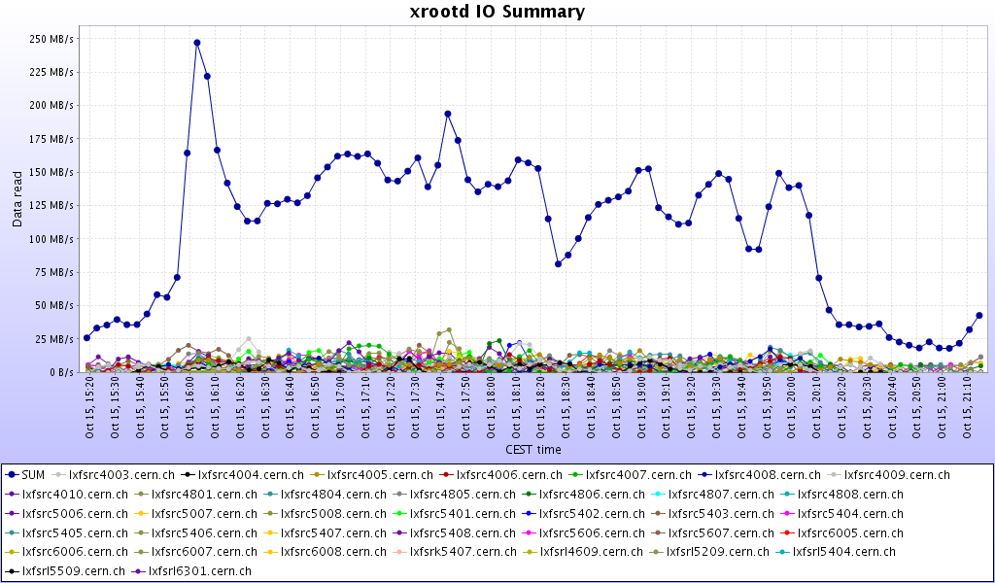
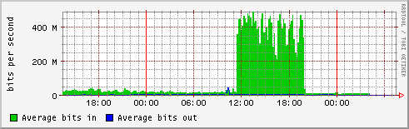
Small test’s throughputs

Slide 16
Scalla/Xrootd simple setup
Setting all this manually up can be VERY tricky
The xrd-installer setup has been refurbished to include all the discussed items
      Originally developed by A.Peters and D.Feichtinger
Usage: same of before
  Login as the xrootd user (being root is not necessary and adds complexity)
  Create a directory in $HOME
  Download the installer script
  wget http://project-arda-dev.web.cern.ch/project-arda-dev/xrootd/tarballs/installbox/xrd-installer
  Run it
    xrd-installer –install –prefix /home/xrduser/myxrootdinstall
Then, there are 2 small files containing the parameters
  For the token authorization library (if used)
  For the rest (about 10 parameters)
      Geeks can also use the internal xrootd config file template
        And have access to really everything
        Needed only for very particular things

Slide 17
Setup important parameters
VMSS_SOURCE: where this cluster tries to fetch files from, in the case they are absent.
LOCALPATHPFX: the prefix of the namespace which has to be made "facultative” (not needed by everybody)
LOCALROOT is the local (relative to the mounted disks) place where all the data is put/kept by the xrootd server.
OSSCACHE: probably your server has more than one disk to use to store data. Here you list the mountpoints to aggregate.
MANAGERHOST: the redirector’s name
SERVERONREDIRECTOR: is this machine both a server and redirector?
OFSLIB: are you using the ALICE security model?
METAMGRHOST, METAMGRPORT: host and port number of the meta-manager (default: ALICE global redirector)

Slide 18
Conclusion
We spoke about the status of
  WAN access and WAN-wide clusters
      But the WAN could be a generic ADSL (which has quite a high latency)
      We like the idea of being able to access data efficiently and without pain, no matter from where
      And this is quite difficult to achieve with typical distributed FSs
  WAN-wide clusters and inter-cluster cooperation
  With reference to the ALICE data model
A lot of work going on
  Assistance, integration, debug, deployments
  Setup robustness to config “styles” and combinations
    Different persons suppose different things (slashes, spaces, …)
  New fixes/features
  Documentation to update on the website (!)

Slide 19
Acknowledgements
Old and new Collaborators
  Andy Hanushevsky, Fabrizio Furano
  Root: Fons Rademakers, Gerri Ganis (security), Bertrand Bellenot (MS Windows porting)
  Derek Feichtinger, Andreas Peters, Guenter Kickinger
  STAR/BNL: Pavel Jakl, Jerome Lauret
  Cornell: Gregory Sharp
  Subatech: Jean-Michel Barbet
  GSI: Kilian Schwartz
  SLAC: Jacek Becla, Tofigh Azemoon, Wilko Kroeger, Bill Weeks
  Alvise Dorigo, Peter Elmer
Operational collaborators
  BNL, CERN, CNAF, FZK, INFN, IN2P3, RAL, SLAC

