Slide 1

Future Accelerator Facilities for Particle Physics
Brian Foster (Uni Hamburg/DESY/Oxford)
Natal School October 2014

Slide 2
Outline
Lecture 1: Introduction to accelerators
  Historical development & status including LHC & upgrades
Lecture 2: Overview of ideas for future facilities
  Hadron-hadron machines – LHC (& beyond)
  Lepton-lepton Machines
    e⁺e⁻ - linear, circular; μ⁺μ⁻
  Lepton-hadron machines
  Plasma-wave acceleration
Lecture 3: The future in depth – the ILC Project – status & prospects

Slide 3
Introduction
Discovery of Higgs brings us to cusp in pp – is it the
SM Higgs, ~ SM Higgs, or is it quite different but in disguise as the Higgs?
What is (are) the best machine(s) to allow us to investigate this fundamentally new type of particle in enough detail that we can really understand its implications for how the Universe works?
The obvious answer is the LHC. It will be our only source of
information for many years to come. Beyond that, what
sort of machine can be built in the next few years that will
complement LHC and go beyond it in crucial areas.
The answer to this question needs not only a view on the
maturity and capability of new machines, but also a prediction
on what LHC can achieve in the meantime.

Slide 4
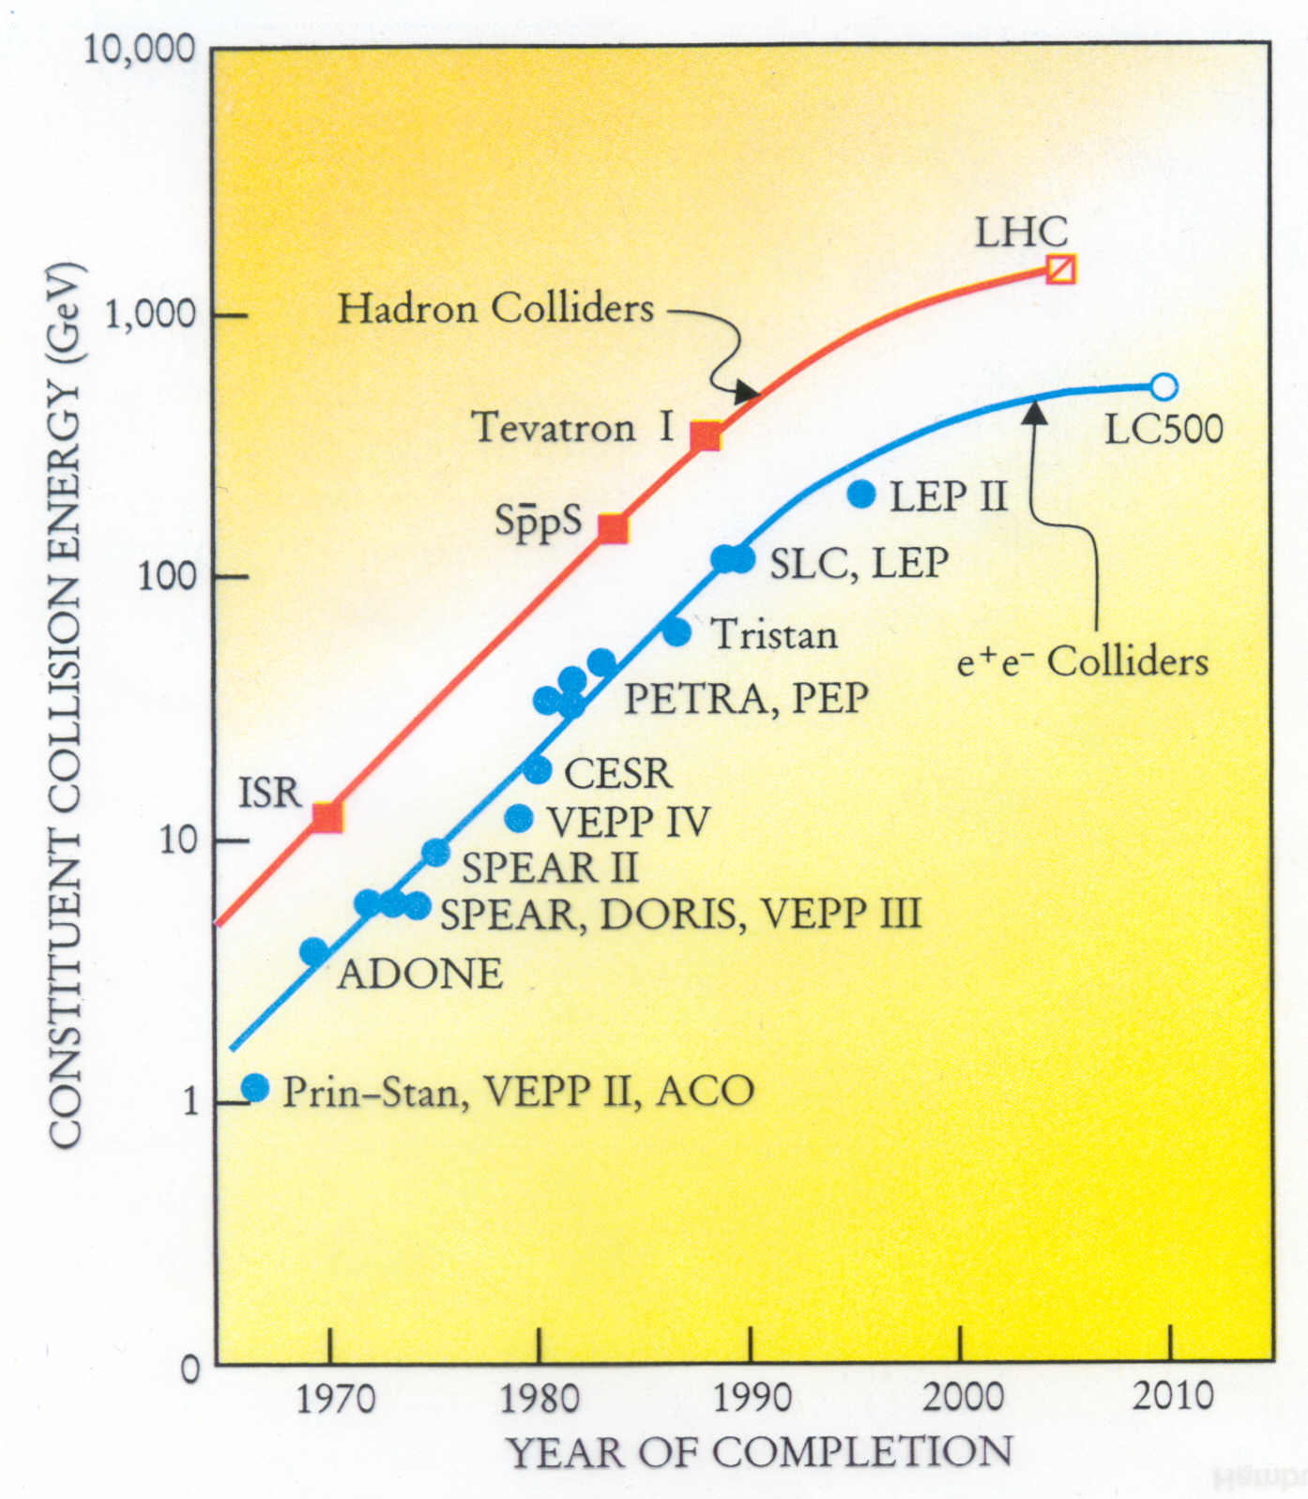
Lessons of history

Slide 5
Tentative schedule new projects
(J-P Delahaye)
There are new projects without a timeline here e.g. FCC

Slide 6
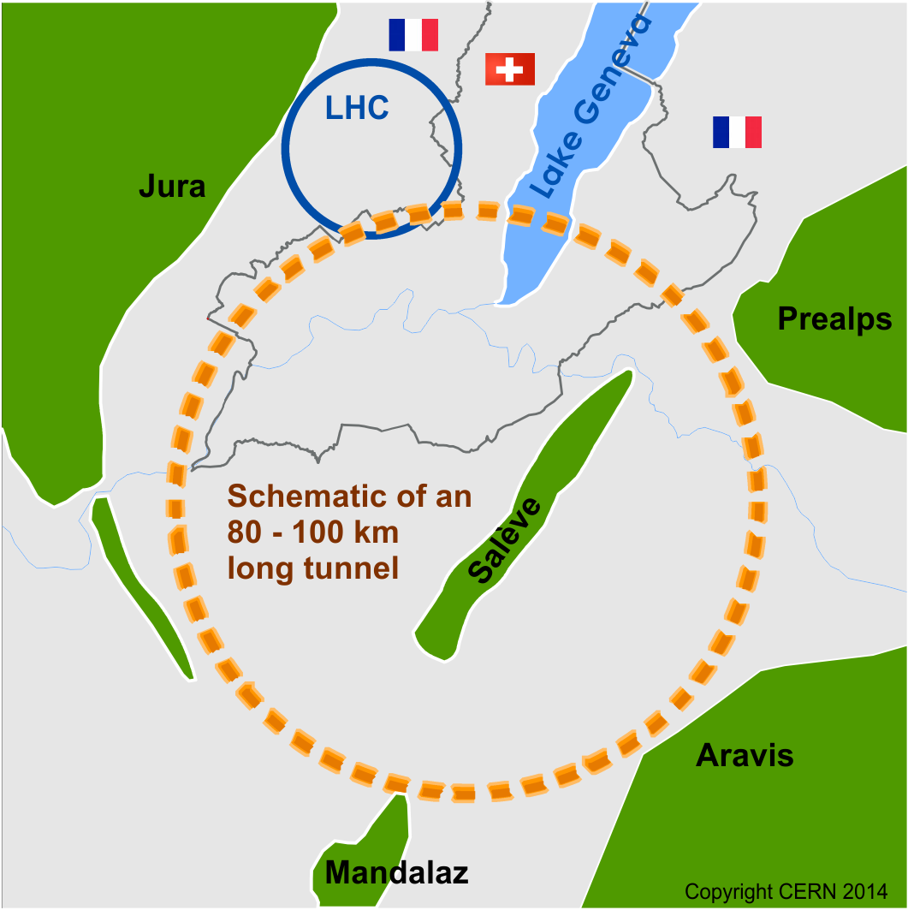
FCC Overview
FCC-hh hadron collider with 100TeV proton cms energy
FCC-ee a lepton collider as a potential intermediate step
FCC-eh lepton hadron option
International collaboration
Site studies for Geneva area
CDR for EU strategy update in 2018
~16 T ⇒ 100 TeV pp in 100 km
~20 T ⇒ 100 TeV pp in 80 km
(FCC slides thanks to D.Schulte.)

Slide 7
FCC Preliminary Layout
First layout developed (different sizes under investigation)
Collider ring design (lattice/hardware design)
Site studies
Injector studies
Machine detector interface
Input for lepton option
Will need iterations

Slide 8
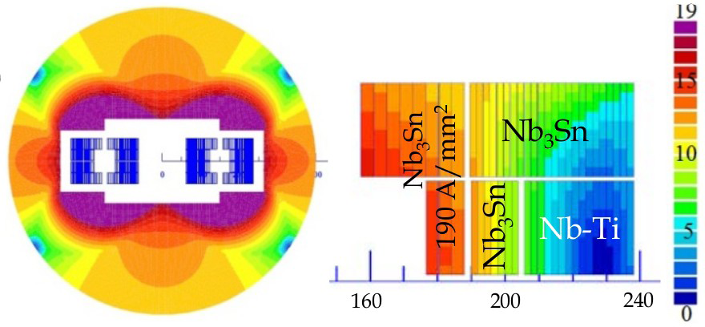
FCC Magnets
Arc dipoles are the main cost and parameter driver
Baseline is Nb₃Sn at 16T
HTS at 20T also to be studied as alternative
Coil sketch of a 15 T magnet with grading, E. Todesco
Field level is a challenge but many additional questions:
Aperture
Field quality
Different design choices (e.g. slanted solenoids) should be explored
Goal is to develop prototypes in all regions, US has world-leading expertise
Notes:
LHC magnets are 8.3 T

Slide 9
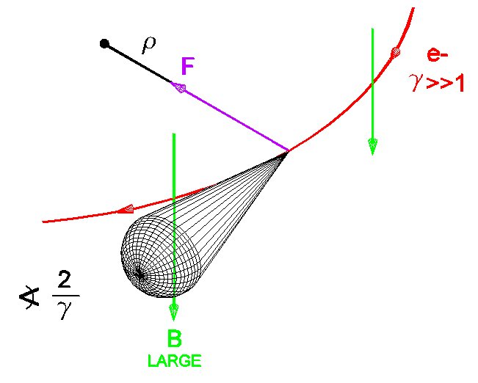
FCC Synchrotron Rad.
At 100 TeV even protons radiate significantly
Total power of 5 MW (LHC 7kW)
Needs to be cooled away
Equivalent to 30W/m /beam in the arcs
LHC <0.2W/m, total heat load 1W/m
Critical energy 4.3keV, close to B-factory
Protons loose energy
They are damped
Emittance improves with time
Typical transverse damping time 1 hour

Slide 10
FCC Machine Protection
>8GJ kinetic energy per beam
  Airbus A380 at 720km/h
  24 times larger than in LHC at 14TeV
  Can melt 12t of copper
  Or drill a 300m long hole
  Machine protection
Also small loss is important
  E.g. beam-gas scattering, non-linear dynamics
  Can quench arc magnets
  Background for the experiments
  Activation of the machine
  Collimation system

Slide 11
Backgrounds from IP
Shield (TAS)
F. Cerutti et al.
Magnets
Total power of background events 100kW per experiment (a car engine)
Already a problem in LHC and HL-LHC (heating, lifetime)
Improved shielding required. Lots of work to do before CDR.

Slide 12
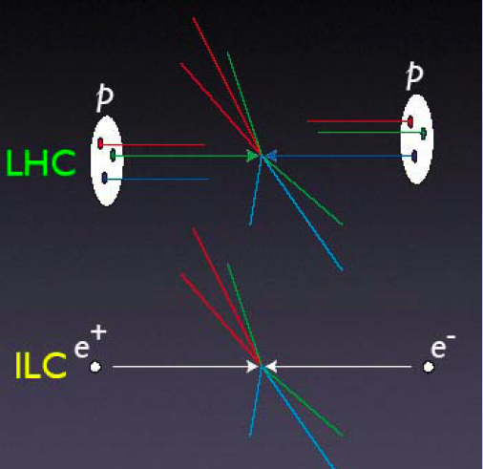
e⁺e⁻ vs pp
Simple particles
Well defined:
energy, angular mom.
E can be scanned
precisely
Particles produced
~ democratically
Final states generally
fully reconstructable

Slide 13
Circular e⁺e⁻ machines
Very approximate cost
LC vs circular based on
minimum of cost model
Cost = aE⁴/R + bR
where a,b “fixed” from
LEP – two curves are
most optimistic and
pessimistic LEP cost.
BUT – luminosity of
circular machine in
this picture dropping
steeply with E.
N. Walker & BF
LEP scaling
ILC RDR

Slide 14
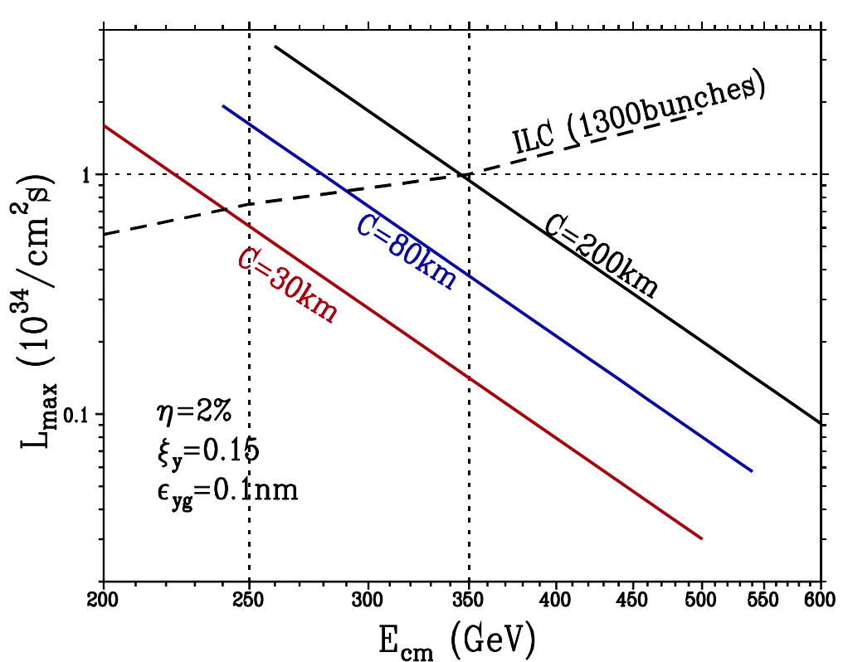
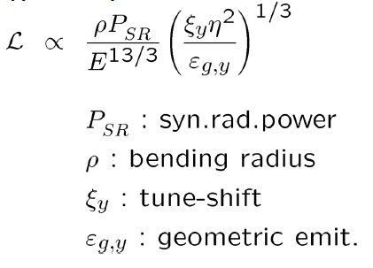
Circular e⁺e⁻ machines
At Beamstrahlung &
tune-shift limit, assuming
100 MW power consumption:
(Telnov via Yokoya)

Slide 15
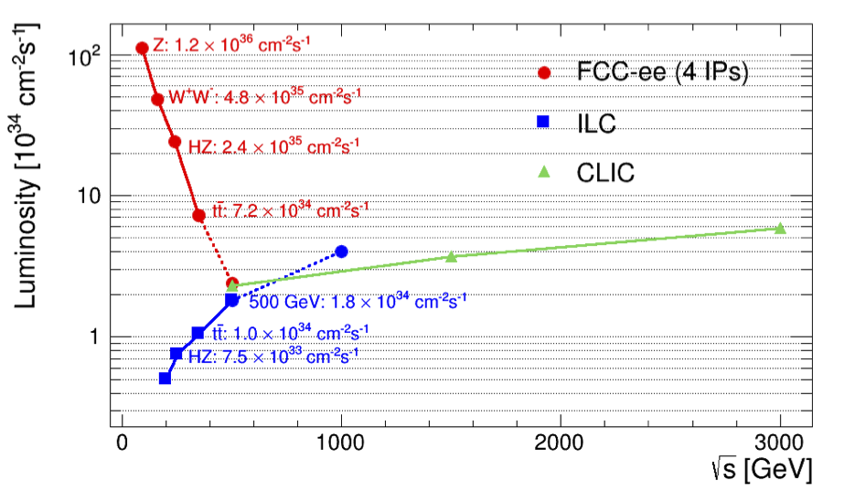
Circular e⁺e⁻ machines
Circular,
adding four experiments
Modified from original version:
http://arxiv.org/pdf/1308.6176v3.pdf
CepC (2 IPs)
Linear
(D. Schulte)

Slide 16
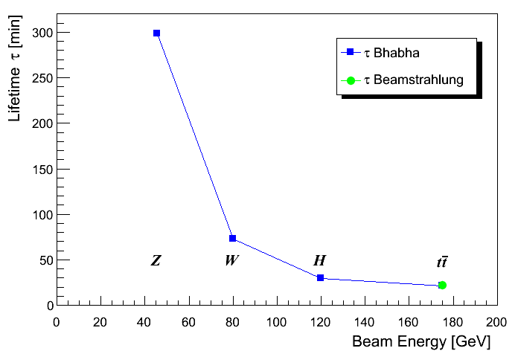
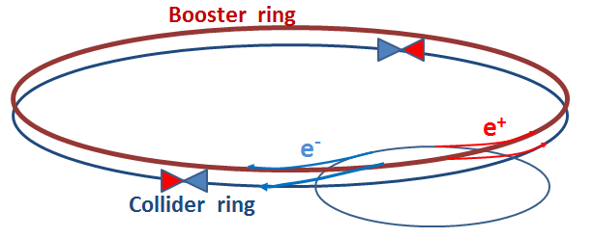
FCC-ee Luminosity Lifetime
Large particle energy loss in IPs and limited energy acceptance (2%) cause limited lifetime
Radiative Bhabha scattering is proportional to luminosity
Beamstrahlung as in linear colliders
As yet no acceptable
beam dynamics solution.
n_{ip} = 4
100
0
Need continuous injection (top-up)
Notes:
Next turn to CPC!

Slide 17
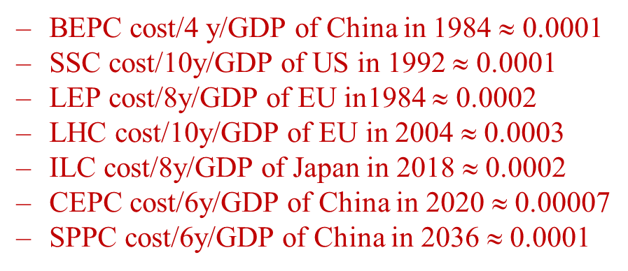
Chinese plans –
CEPC & SppC Layout
e+
e-
LTB
e+
IP1
e-
LTB
IP1
High Energy Booster(7.2Km)
BTC
e+ e- Linac
(240m)
BTC
BTC
Medium Energy Booster(4.5Km)
e+ e- Linac
(240m)
BTC
Low Energy Booster(0.4Km)
Proton Linac
(100m)
IP4
IP3
Booster(50Km)
Booster(50Km)
CEPC Collider Ring(50Km)
CEPC Collider Ring(50Km)
IP2
IP2
SppC Collider Ring(50Km)
LTB : Linac to Booster
BTC : Booster to Collider Ring
(J. Gao)

Slide 18
CEPC Parameters
Parameter | Unit | Value | Parameter | Unit | Value
Beam Energy | GeV | 120 | Circumference | km | 50
Number of IP |  | 2 | L₀ /IP (10³⁴) | cm⁻²s⁻¹ | 2.62
No. of Higgs/year/IP |  | 1E+05 | Power(wall) | MW | 200
e+ polarization |  | 0 | e- polarization |  | 0
Bending radius | km | 6.2 | N_{e}/bunch | 1E10 | 35.2
N_{b}/beam |  | 50 | Beam current | mA | 16.9
SR loss | (GeV/turn) | 2.96 | SR power/beam | MW | 50
Critical energy of SR | MeV | 0.6 | ε_{x},n | mm-mrad | 1.57E+06
ε_{y},n | mm-mrad | 7.75E+03 | β_{IP} (x/y) | mm | 200/1
Trans. size (x/y) | μm | 36.6/0.18 | Bunch length | mm | 3
Energy spread SR | % | 0.13 | Full crossing angle | mrad | 0
Lifetime due to Bhabha | sec | 930 | Damping part. No. (x/y/z) |  | 1/1/2
b-b tune shift x/y |  | 0.1/0.1 | Syn. Osci. tune |  | 0.13
RF voltage V_{rf} | GV | 4.2 | Mom. compaction | 1E-4 | 0.4
Long. Damping time | turns | 40.5 | Ave. No. of photons |  | 0.59
dB beam-beam | % | 0.014

Slide 19
SppC Parameters
Parameter | Value | Unit
Circumference | 52 | km
Beam energy | 35 | TeV
Dipole field | 20 | T
Injection energy | 2.1 | TeV
Number of IPs | 2 (4)
Peak luminosity per IP | 1.2E+35 | cm⁻²s⁻¹
Beta function at collision | 0.75 | m
Circulating beam current | 1.0 | A
Max beam-beam tune shift per IP | 0.006
Bunch separation | 25 | ns
Bunch population | 2.0E+11
SR heat load @arc dipole (per aperture) | 56 | W/m

Slide 20
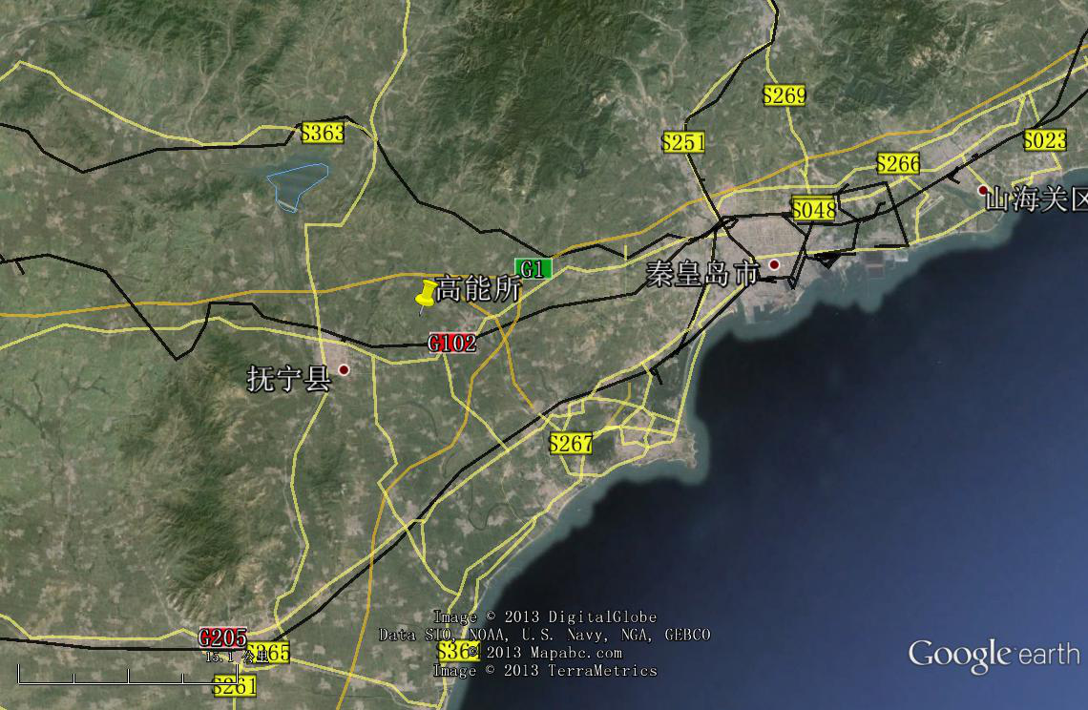
CEPC Site
Preliminary selected Qinhuangdao (秦皇岛）(one of the candidate sites)
Strong support by the local government
Base rock: granite
Base rock depth: 0.5 - 2 m
Earth quake: < 7, 0.1g
Earth vibration(RMS, nm):
< 1.9 (1 – 100 Hz)

Slide 21
CEPC & SppC Layout
e+
IP1
e-
LTB
High Energy Booster(7.2Km)
Medium Energy Booster(4.5Km)
e+ e- Linac
(240m)
BTC
BTC
Low Energy Booster(0.4Km)
Proton Linac
(100m)
IP4
IP3
Booster(50Km)
CEPC Collider Ring(50Km)
IP2
SppC Collider Ring(50Km)
SC predicts 2020 China GDP = $24.6 Trillion
=> Cost of CEPC ~ 0.07*24.6*6 B ~ 10B

Slide 22
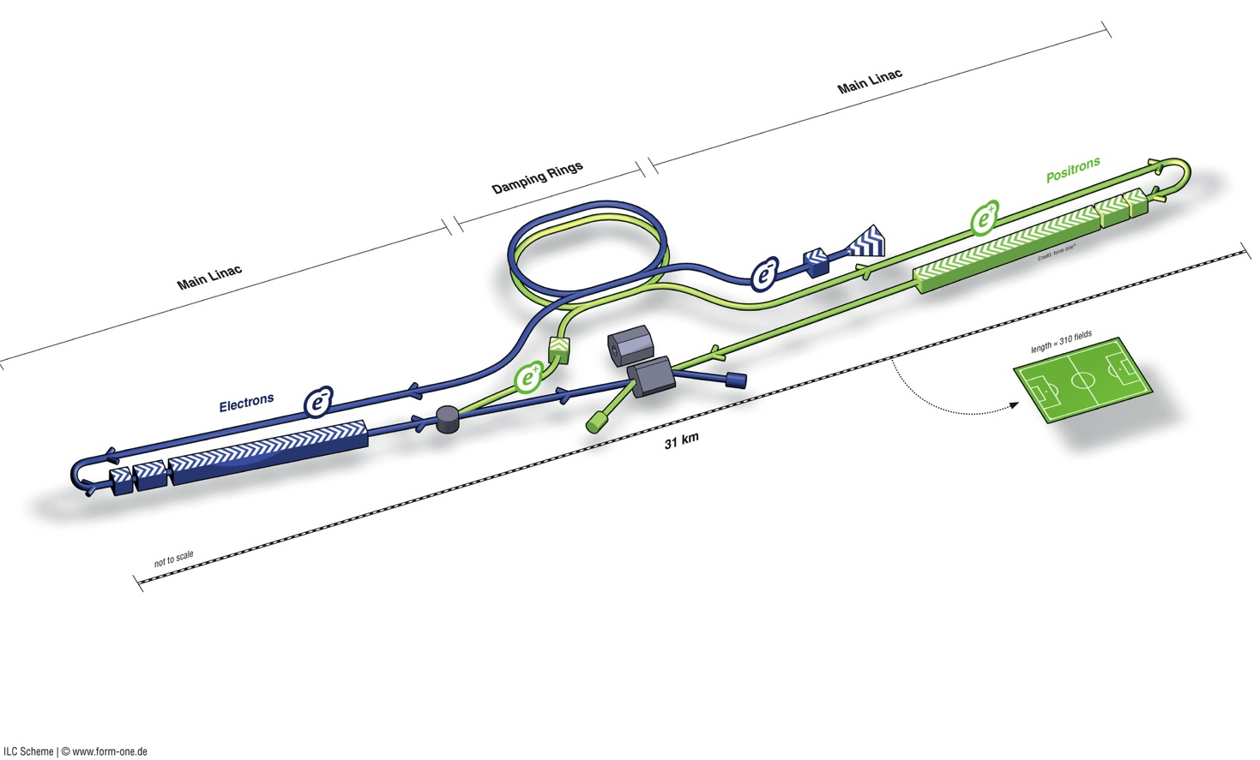
ILC Overview
Polarised electron source
Damping Rings
Ring to Main Linac (RTML)
(inc. bunch compressors)
e+ Main Linac
Beam Delivery System (BDS) & physics detectors
Polarised positron
source
Beam dump
e- Main Linac
not to scale

Slide 23
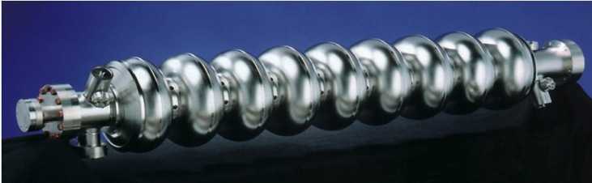
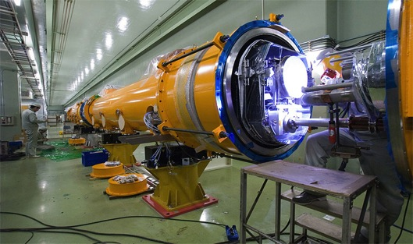
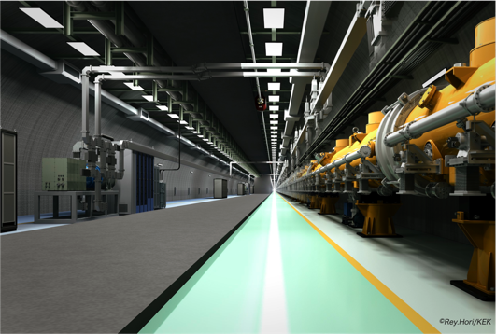
SCRF Linac Technology
1.3 GHz Nb 9-cellCavities | 16,024
Cryomodules | 1,855
SC quadrupole pkg | 673
10 MW MB Klystrons & modulators | 436 / 471 *
* site dependent
Approximately 20 years of R&D worldwide
→ Mature technology

Slide 24
CLIC

Slide 25
CLIC Power Source Concept
Delay Loop × 2
gap creation, pulse compression & frequency multiplication
Drive Beam Accelerator
efficient acceleration in fully loaded linac
RF Transverse Deflectors
Combiner Ring × 3
pulse compression &
frequency multiplication
Combiner Ring × 4
pulse compression &
frequency multiplication
CLIC RF POWER SOURCE LAYOUT
Drive Beam Decelerator Section (2 × 24 in total)
Power Extraction
Drive beam time structure - initial
Drive beam time structure - final
240 ns
240 ns
5.8 μs
140 μs train length - 24 × 24 sub-pulses
4.2 A - 2.4 GeV – 60 cm between bunches
24 pulses – 101 A – 2.5 cm between bunches

Slide 26
CLIC Accelerating Structures
CLIC acceleration travelling wave – too high Ohmic losses from standing wave
Bunches induce wakefields in the accelerating cavities
Later bunches are perturbed by these fields
Can lead to emittance growth and instabilities
Effect depends on a/λ (a iris aperture) and structure design details
Transverse wakefields roughly scale as W┴ ∝ f ³
Long-range minimised by structure design

Slide 27
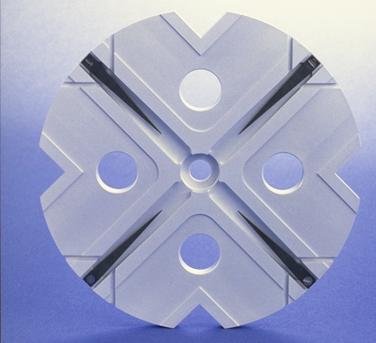
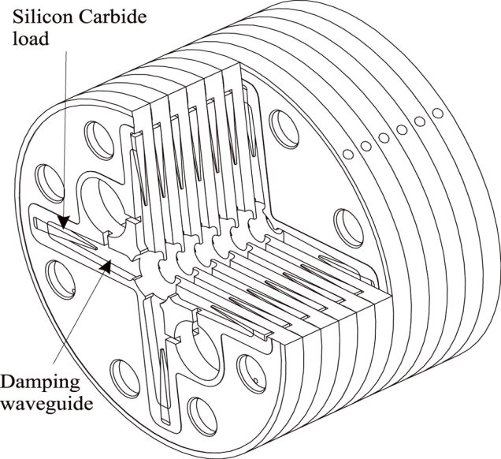
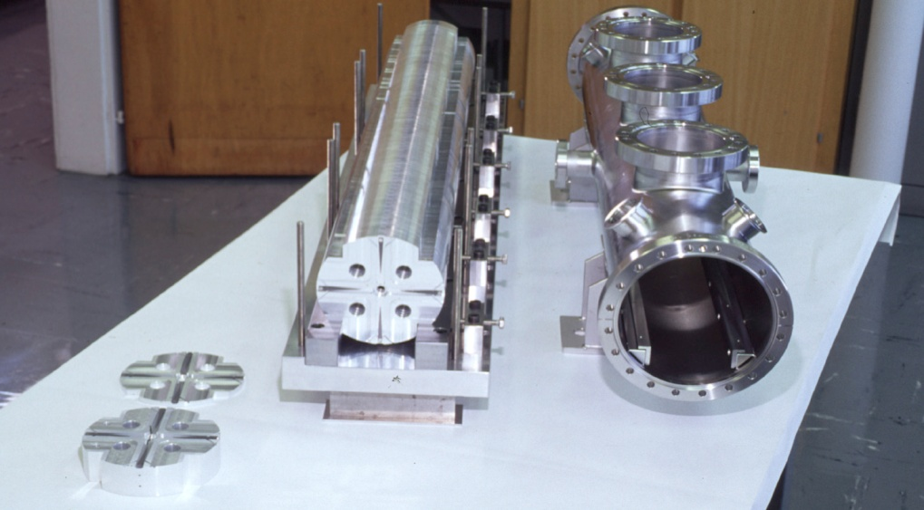
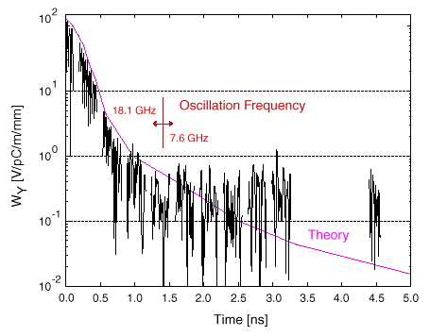
CLIC Accelerating Structures
Structures built from discs
Each cell damped by 4 radial WGs
terminated by SiC RF loads
Higher order modes (HOM)
enter WG
Long-range wakefields
efficiently damped
Test results

Slide 28
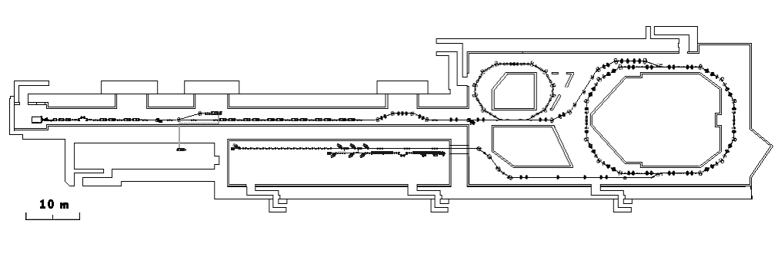
CTF3 @ CERN
Demonstrate Drive Beam generation
(fully loaded acceleration, beam intensity and bunch frequency multiplication x8)
Demonstrate RF Power Production and test Power Structures
Demonstrate Two Beam Acceleration and test Accelerating Structures
PULSE COMPRESSION
FREQUENCY MULTIPLICATION
magnetic chicane
150 MeV e-linac
30 GHz test stand
3.5 A - 1.4 μs
Delay Loop
Combiner Ring
CLEX (CLIC Experimental Area)
TWO BEAM TEST STAND
PROBE BEAM
Test Beam Line
Photo injector tests,
laser
28 A - 140 ns
Infrastructure from LEP
total length about 140 m

Slide 29
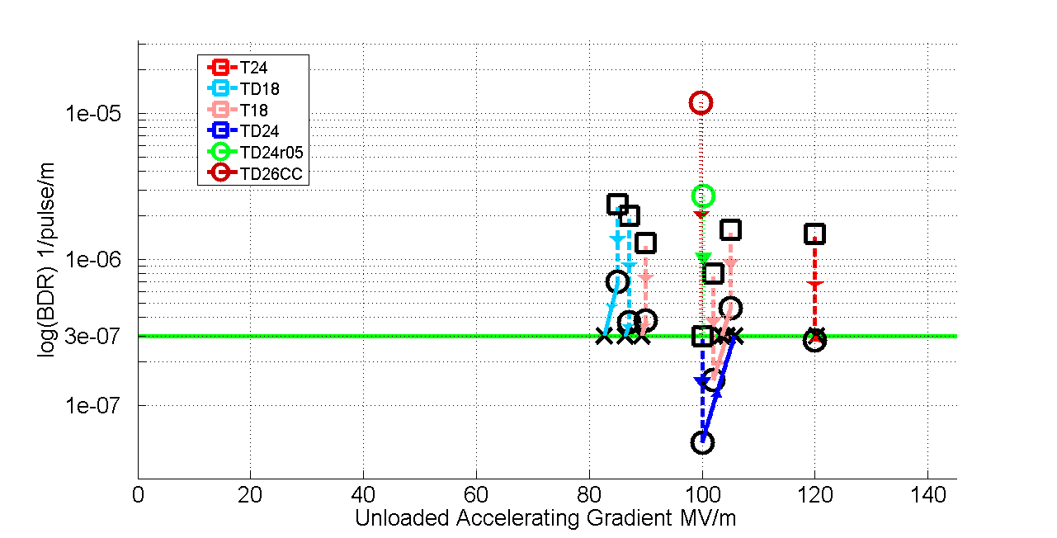
Current status of accelerating structures
Main linac gradient
Ongoing test close to or on target
Uncertainty from beam loading being tested
Results very good, design/performance more and more understood – but:
numbers limited, industrial productions also limited
basic understanding of BD mechanics improving
condition time/acceptance tests need more work
use for other applications (e.g. FELs) needs verification
In all cases test-capacity is crucial

Slide 30
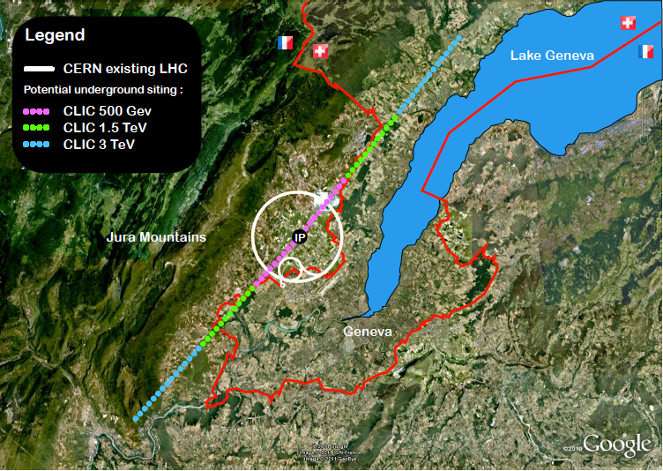
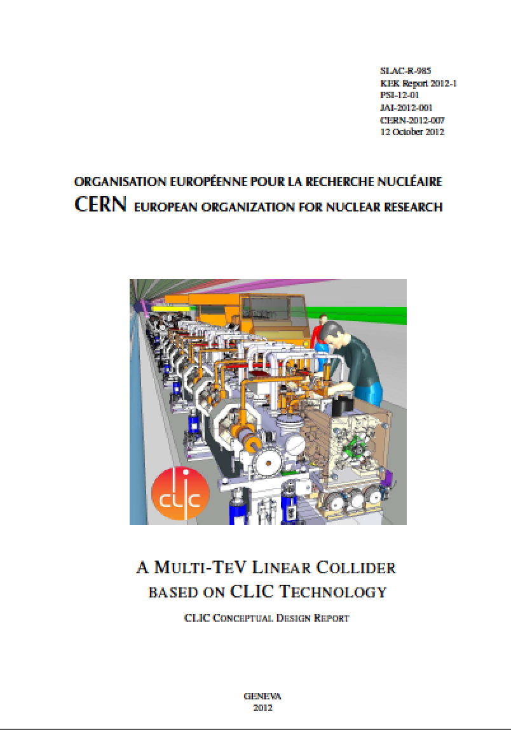
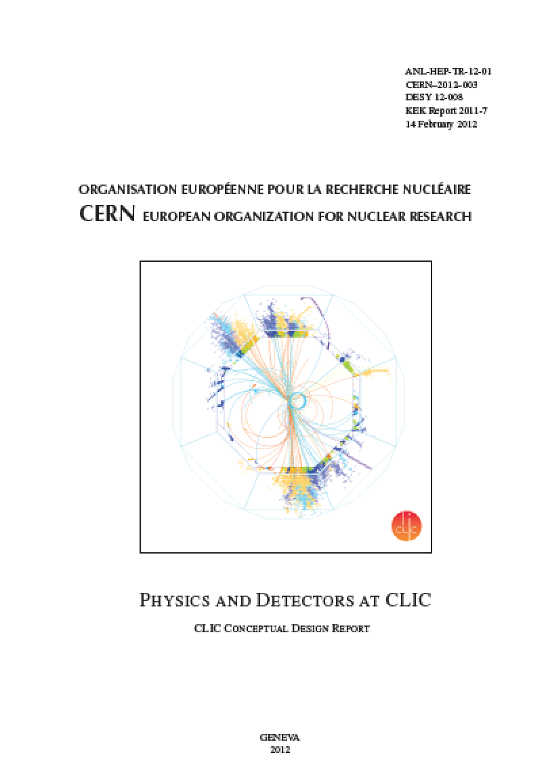
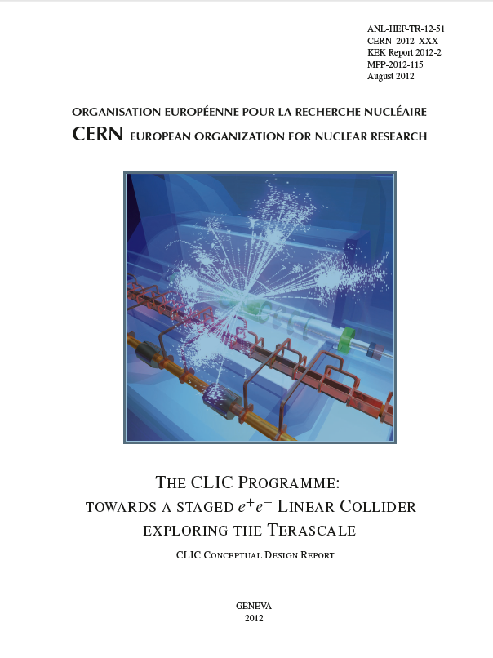
Current status
Luminosity
Luminosity
Damping ring like an ambitious light source, no show stopper
Alignment system principle demonstrated
Stabilisation system developed, benchmarked, better system in pipeline
Damping ring like an ambitious light source, no show stopper
Alignment system principle demonstrated
Stabilisation system developed, benchmarked, better system in pipeline
Simulations on or close to the target
Conceptual design complete
Operation &
Machine Protection
Start-up sequence and low energy operation defined
Most critical failure studied and first reliability studies
Implementation
Consistent staged implementation scenario defined
Schedules, cost and power developed and presented
Site and CE studies documented

Slide 31
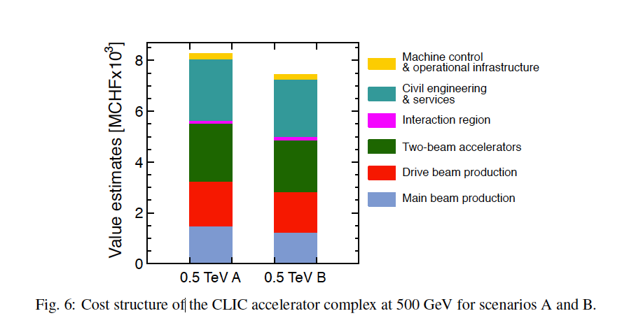
CLIC
First to second stage: 4 MCHF/GeV (i.e. initial costs are very significant)
Caveats:
  Uncertainties 20-25%
  Possible savings around 10%
  However – first stage not optimised (work for next phase), parameters largely defined for 3 TeV final stage

Slide 32
CLIC project summary
The goals and plans for 2019 are well defined for CLIC, focusing on the high energy frontier capabilities – well aligned with current strategies – also preparing to align with LHC physics as it progresses in the coming years:
Aim provide optimized stages approach up to 3 TeV with costs and power not too excessive compared to LHC
Very positive progress on Xband technology, due to availability of power sources and increased understanding of structure design parameters
  Applications in smaller systems; FEL linacs key example – with considerable interesting in the CLIC collaboration
Also recent good progress on performance verifications, drivebeam, main beam emittance conservation and final-focus studies
  CTF3 running and plan until end 2016, strategy for system tests beyond
Technical developments of key parts well underway – with increasing involvement of industry – largely limited by funding
Detector and physics programme well defined, moving ahead well – linking gradually with FCC hadron community

Slide 33
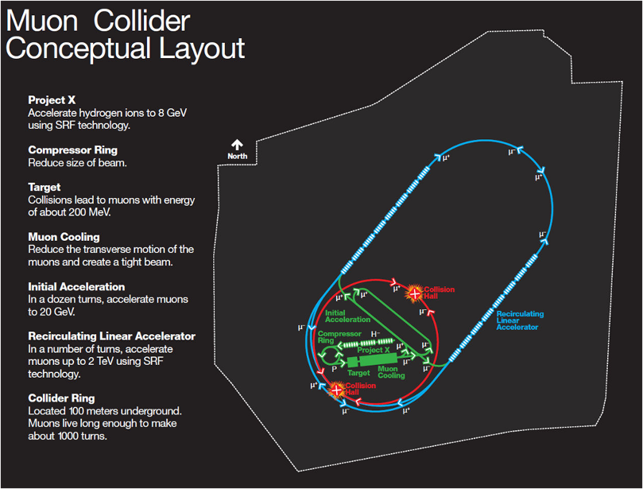
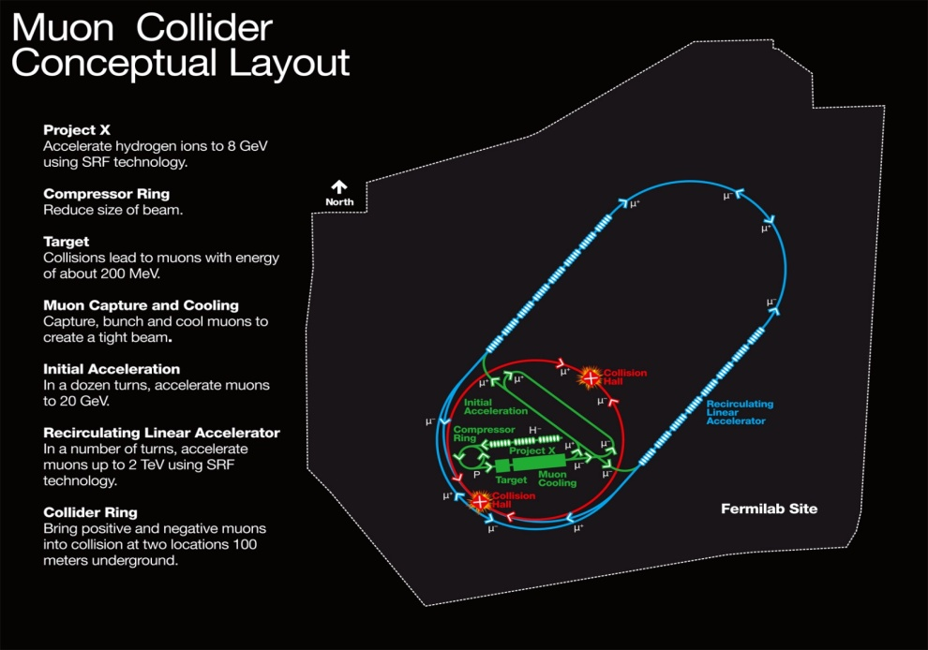
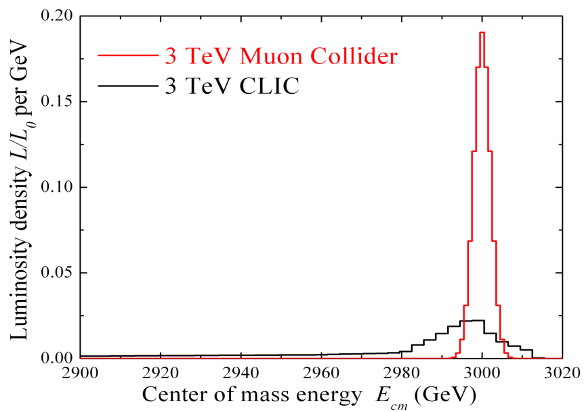
Muon Collider
COMPACT
  Fits on FNAL laboratory site
MULTI-PASS ACCELERATION
  Cost Effective
MULTIPASS COLLISIONS IN
A RING (~1000 turns)
  Relaxed emittance requirements
  & hence relaxed tolerances
NARROW ENERGY SPREAD
  Precision scans, kinematic constraints
TWO DETECTORS (2 IPs)
- ΔT_{bunch} ~ 10 μs … (e.g. 4 TeV collider)
  Lots of time for readout
  Backgrounds don’t pile up
(m_{μ}/m_{e})² = ~40000
  Enhanced s-channel rates for
  Higgs-like particles
COST
PHYSICS
Beamstrahlung in
any e+e- collider
δE/E ∝ γ²

Slide 34
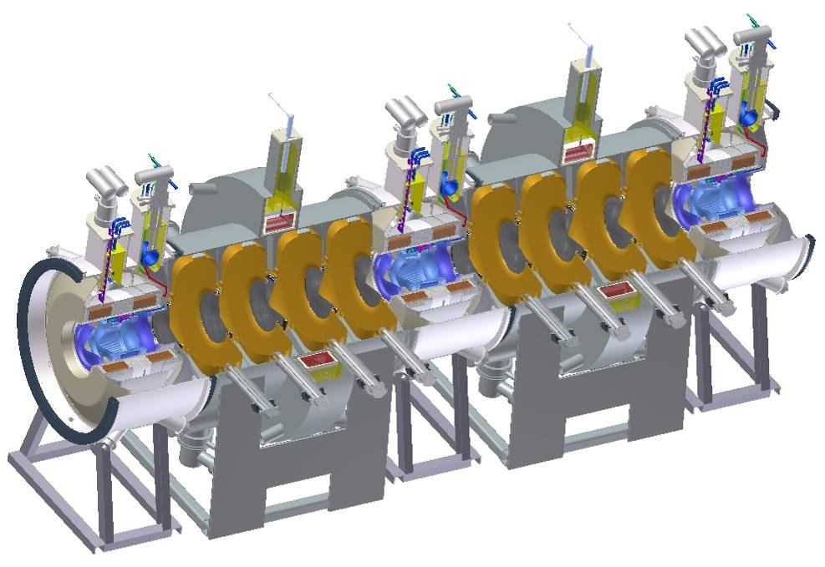
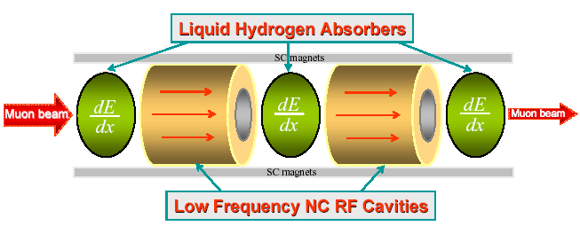
Muon Collider Cooling
Ionization cooling analogous to familiar SR damping process in electron storage rings
  energy loss (SR or dE/ds) reduces p_{x}, p_{y}, p_{z}
  energy gain (RF cavities) restores only p_{z}
  repeating this reduces p_{x,y}/p_{z} (⇒ 4D cooling)
MICE

Slide 35
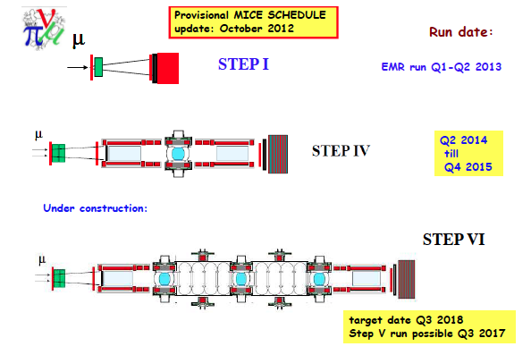
MICE Schedule
Notes:
Red are spectrometer
Light blue are tracker moduels
Deep blue in H2 absorber inside focus coils
Black lines are RF cavities.

Slide 36
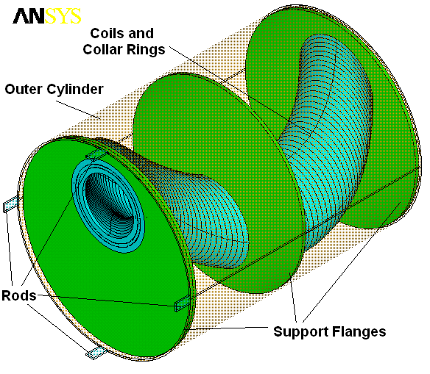
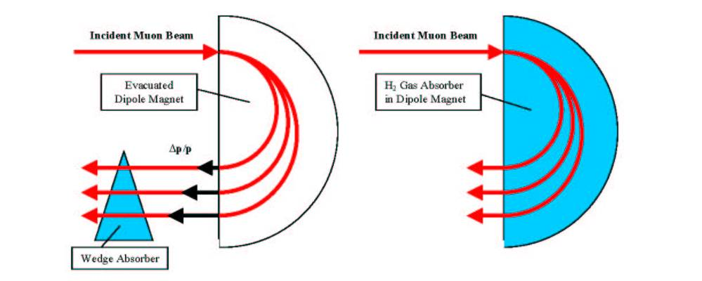

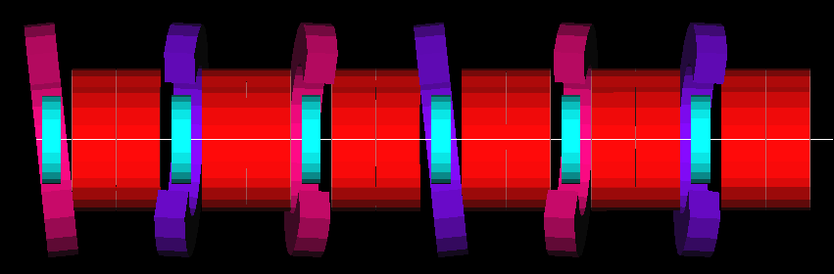
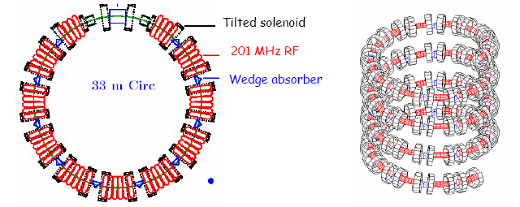
Muon Collider Cooling
Need 6D cooling (emittance exchange)
  increase energy loss for high-energy compared with low-energy muons
    put wedge-shaped absorber in dispersive region
    use extra path length in continuous absorber
HCC
FOFO Snake
Cooling ring
Single pass; avoids injection/extraction issues
“Guggenheim” channel

Slide 37
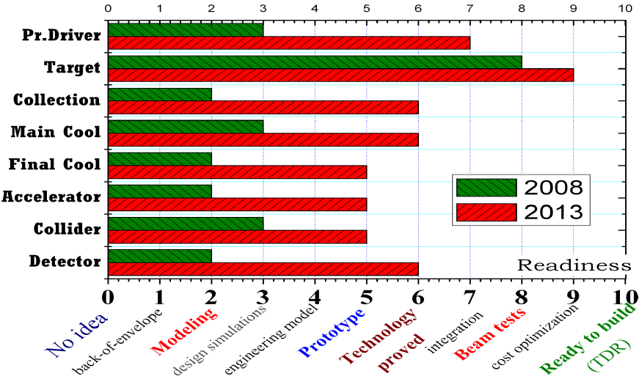
Muon Collider Cooling
Final cooling to 25 μm emittance requires strong solenoids
  not exactly a catalog item ⇒ R&D effort
  latest design uses 30 T
45 T hybrid device exists
  very high power device, so not a good “role model”
  exploring use of HTS for this task
Palmer, Fernow
P5 Recommendation 25 : Reassess the Muon Accelerator Program (MAP). Incorporate into the GARD program the MAP activities that are of general importance to accelerator R&D, and consult with international partners on the early termination of MICE.
NOW
MAP PLAN
Key component models

Slide 38

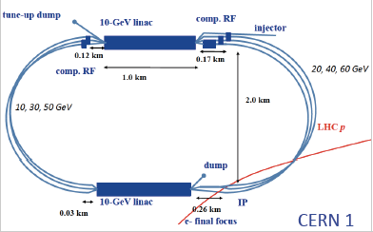
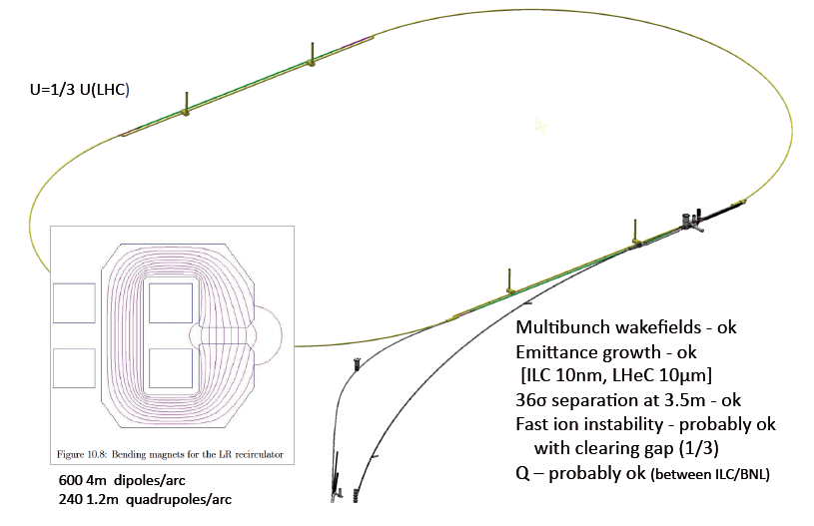
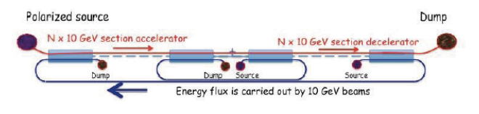
LHeC (FCC-eh) Linac
Option
THREE-PASS ERL
Single-PASS 60 GeV ERL
Future 150 GeV e ERL linac

Slide 39
Surfing the wave
We know that electric fields inside an atom
are enormous. Can we find a way to use them
to accelerate? In a plasma, yes.
Notes:
Works because of different mobility of electrons and ions – electrons pushed away by e- beam - +ve charge forms wake
tailing the e- beam – this attracts the electrons from the plasma to move in quickly behind the e- beam and so to “push” it
forwards.

Slide 40
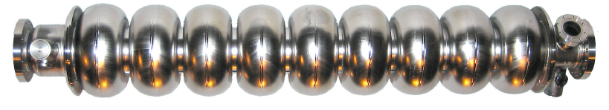
Plasma
Wake-Field Acceleration
Development of much higher gradient
accelerator not only pushes back frontier for
particle physics – also permits current
accelerators to be built much smaller/cheaper.
1 GeV electron beams on “table top”.
Leemans et al., Nature Physics 2, 696 (2006)
Notes:
Contrast with conventional cavities….
Work at Lawrence Berkeley Laboratory. 40 TW laser pulse (3 * 10 18 W/cm2) – 1 GeV in 3.3 cm
produced 33 GV/m fields. Beam quality lousy! Florian is at forefront of this table top infra-red FELs.

Slide 41
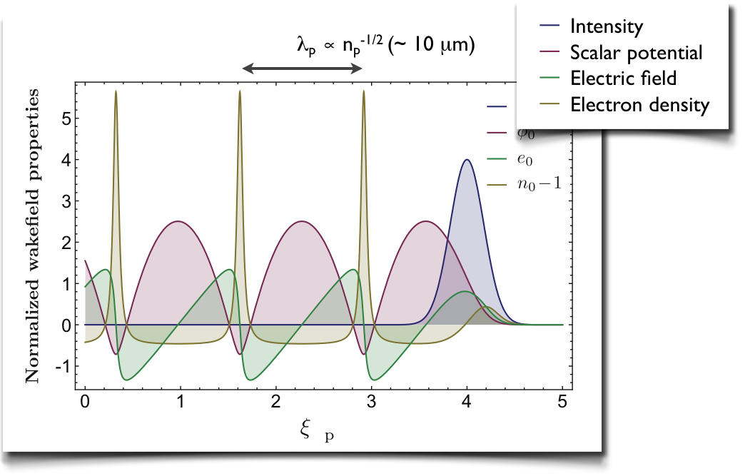
Inject beam
To understand acceleration in plasma,
inject high-quality beam into plasma –
requires excellent time and spatial precision.
Notes:
Electron bunch length must be small fraction of the plasma wavelength – otherwise energy spread too large; and jitter small fraction of inverse plasma frequency.
Some facilities under development at DESY have the right properties – PITZ – and FLASH II could be an ideal research instrument.

Slide 42
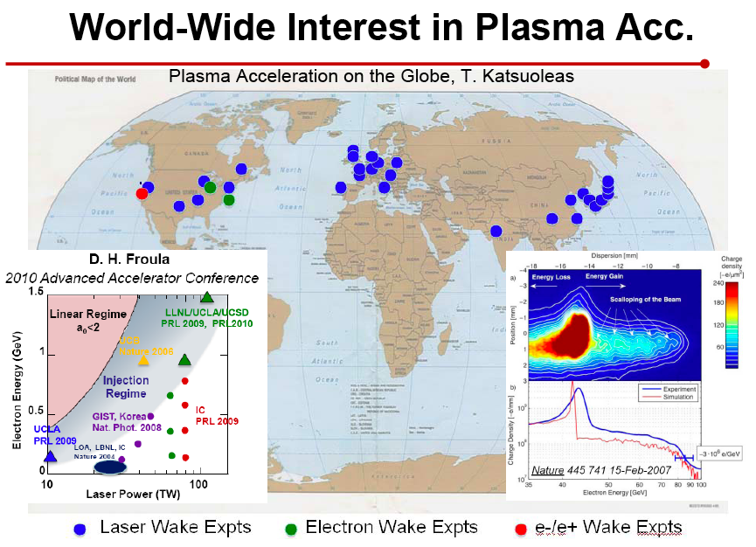
World-wide acceleration
Enormous growth in activity world-wide –
interesting experiments can be done at
Universities but most activity at accelerator
labs.
LAOLA:
Helmholtz VI,
ELI, FLASH,
PITZ, REGAE
BELLA
FACET, FACET2
Proton driven
Notes:
Electron bunch length must be small fraction of the plasma wavelength – otherwise energy spread too large; and jitter small fraction of inverse plasma frequency.
Some facilities under development at DESY have the right properties – PITZ – and FLASH II could be an ideal research instrument.

Slide 43
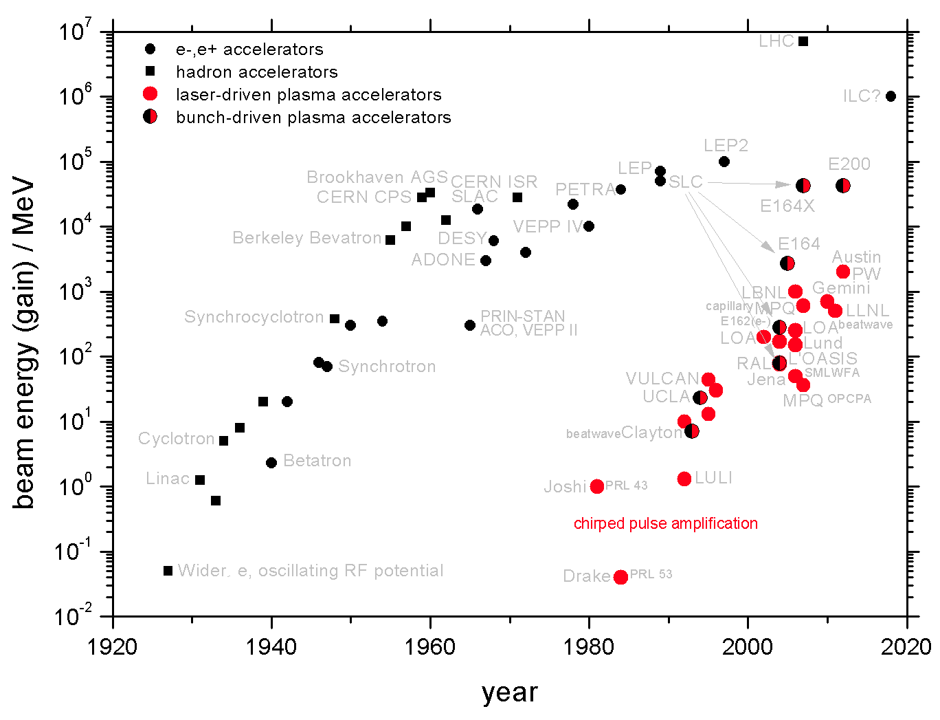
The New Livingston Plot
B. Hidding (Hamburg)

Slide 44
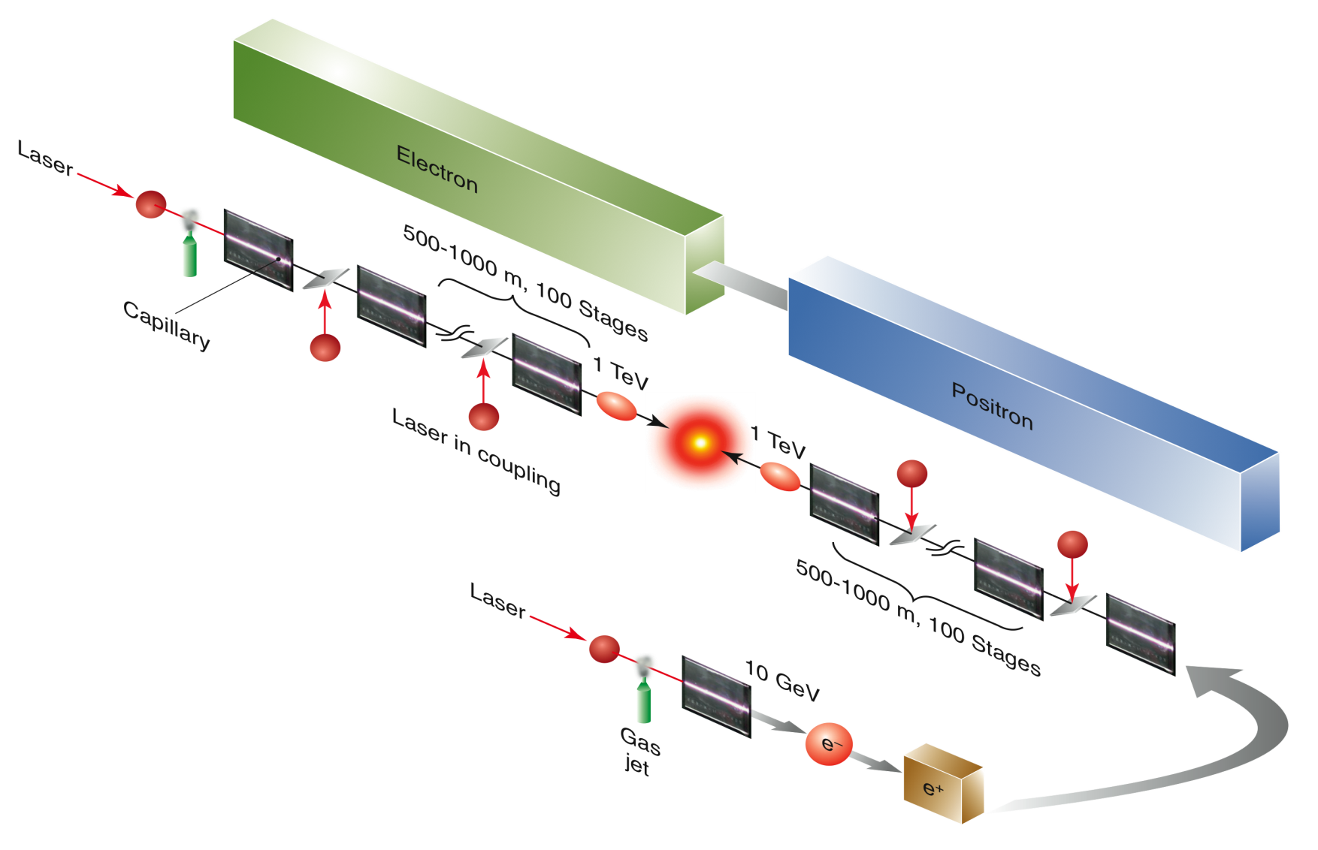
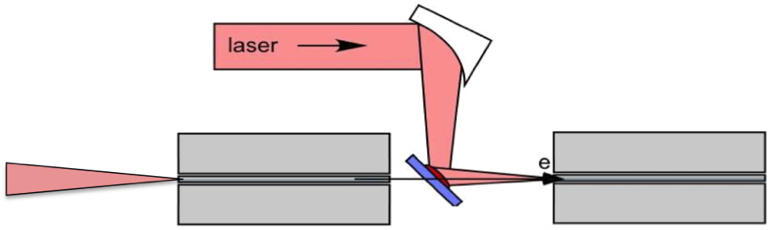
Realising the dreams?
A laser-plasma-driven linear collider?
~10 cm
~1 m

Slide 45
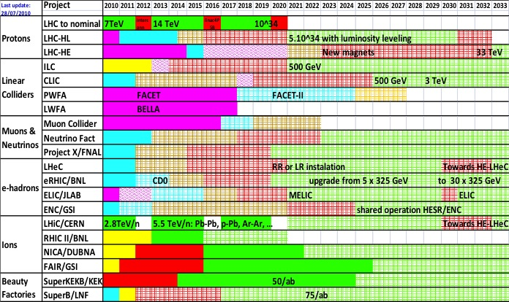
Tentative schedule new projects

Slide 46
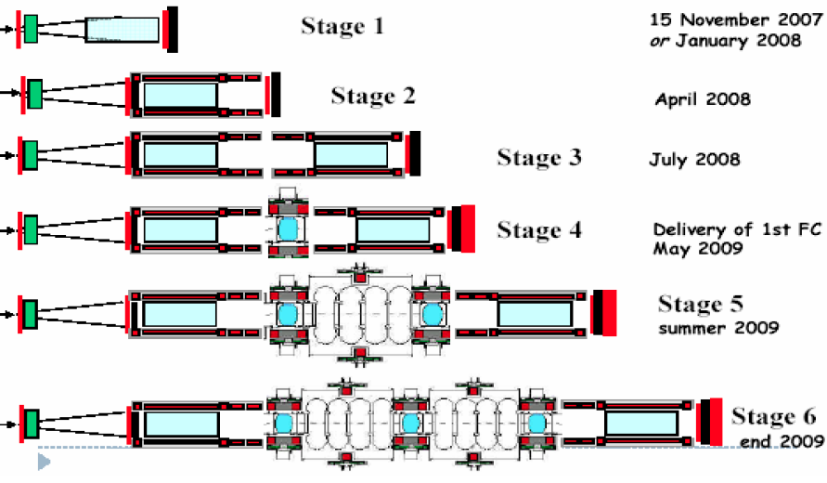
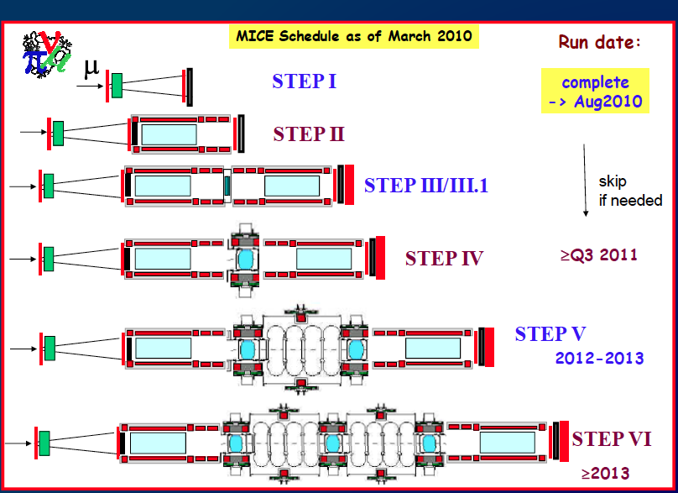
MICE Schedule

Slide 47
Summary and Outlook
Particle & accelerator physics very lively – many ideas out there.
In last ~ year, great upsurge of interest in new large rings, aimed at ~ 100 TeV pp but with possibility of initial e⁺e⁻
ILC – technically mature – but expensive
CLIC – significant development required – < 1 TeV, cost ~ ILC
Circular e⁺e⁻ – Higgs factory cheaper than LC – but not trivial
accl. physics & no energy-upgrade path…
μC – It’s a great idea but don’t hold your breath….
LHeC/FCC-eh – technically “OK” once protons there. Cost/physics?
PWA – very exciting, but long way from a LC for particle physics
A Japanese offer to host ILC is being discussed. In the next lecture we will look at its design in detail and the status of realising the project.

