Slide 1

Future Accelerator Facilities for Particle Physics
Brian Foster (Uni Hamburg/DESY/Oxford)
Natal School, October 2014

Slide 2
Outline
Lecture 1: Introduction to accelerators
  Historical development & status including LHC & upgrades
Lecture 2: Overview of ideas for future facilities
  Hadron-hadron machines – LHC (& beyond)
  Lepton-lepton Machines
    e⁺e⁻ - linear (circular); μ⁺μ⁻
  Lepton-hadron machines
  Plasma-wave acceleration
Lecture 3: The future in depth – the ILC Project – status & prospects

Slide 3
Lecture 3
A very brief resume of the physics case
for ILC
An even briefer mention of the detectors
The ILC machine
SCRF, Damping Rings, Sources, Beam Delivery
Site & Site-dependent design
Political situation & prospects
Summary & outlook

Slide 4






ILC - Introduction
On June 12th, 2013 ILC TDR was published in Worldwide Event.

Slide 5
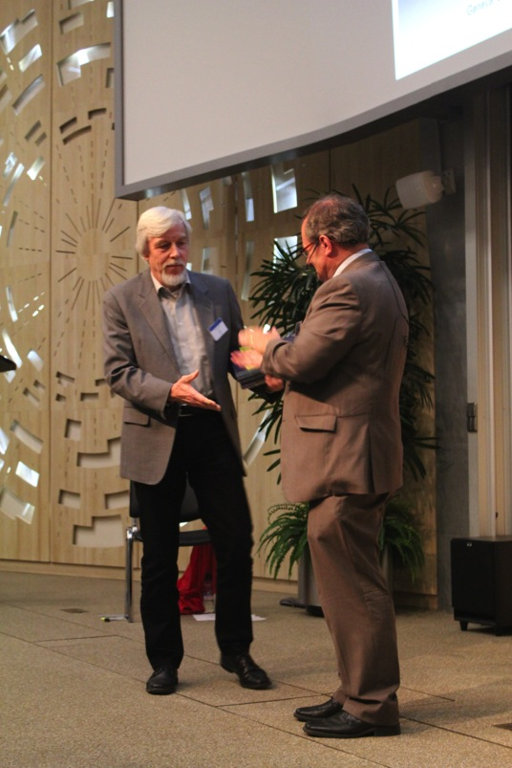
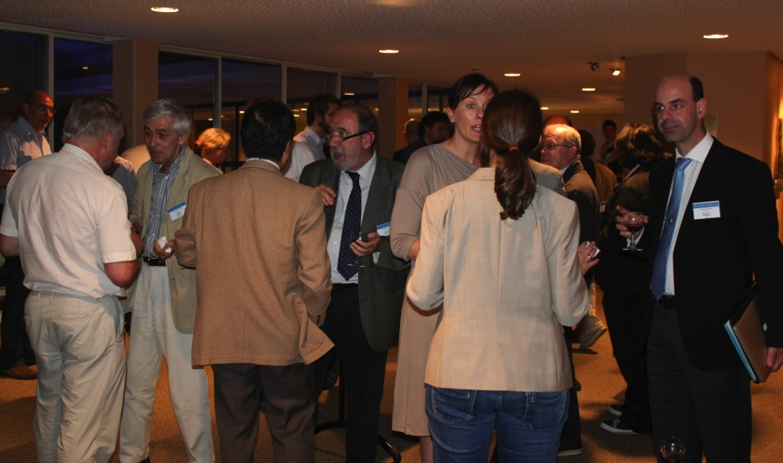
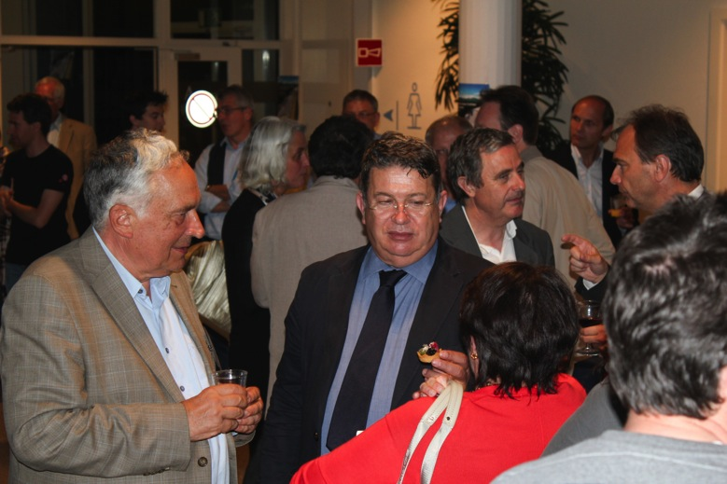
World-wide Event
On June 12th, 2013 ILC TDR was published in Worldwide Event.
End of major phase in ILC development – now what?

Slide 6
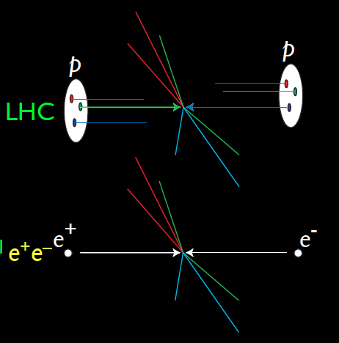
ILC Physics Overview
Simple particles
Well defined energy,
angular mom., e+/e-
polarisation
E can be scanned
precisely
Particles produced
~ democratically
ILC data qualitatively
different to LHC
Final states fully
reconstructable
Backgrounds ~ 0
-> triggerless DAQ
-> no trigger bias
Theoretical
interpretation clean.

Slide 7
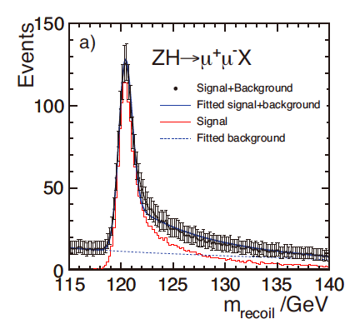
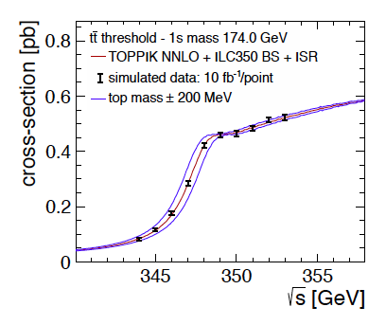
ILC Physics Overview
Very difficult, but essential, to estimate what LHC will do
before ILC can enter the scene.
However, broad agreement that some physics channels
unique to ILC – Higgs invisible BRs, c, light-quark
couplings, precision top mass, many new physics
signatures….

Slide 8
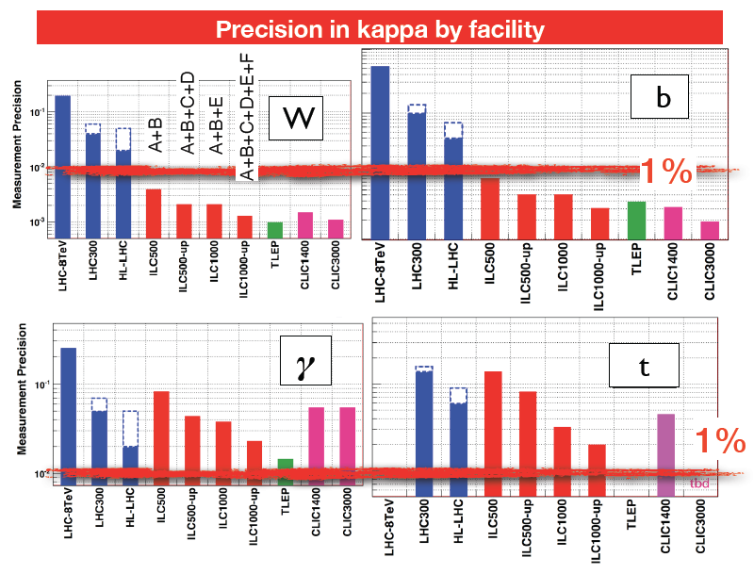
Brock Snowmass Summary

Slide 9
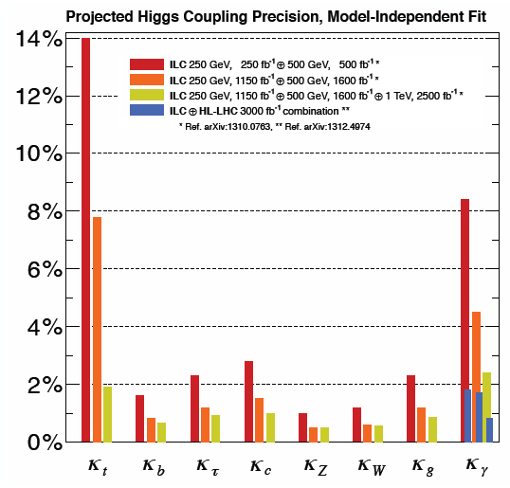
Model Independent Higgs
Running at 500 GeV
(preferably 550 GeV)
is essential to deliver
this precision. Running
Only @ 250 GeV is
MUCH (at least factors
2-3) worse than
leftmost column.

Slide 10
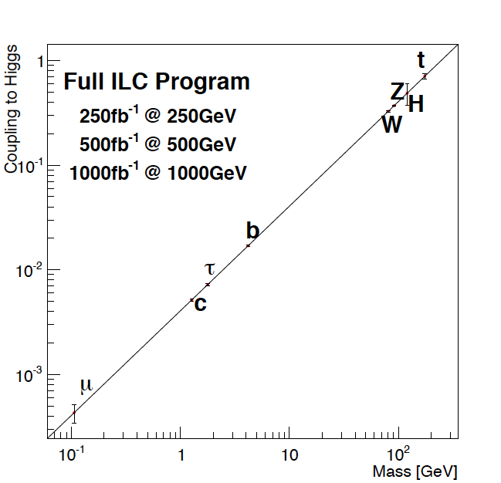
Higgs Couplings Summary
Extra
Dimensions
Exquisitely sensitive
Window on new physics
Anomalous
Couplings

Slide 11
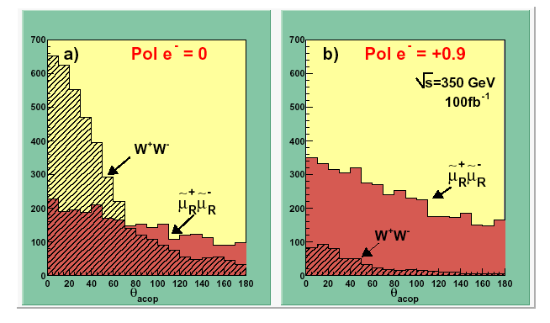
Polarisation is another dimension
Specifies the intermediate state
  Right-handed e⁻ turns off A⁰
    Information on the gauge structure of the final state
Increases rates
  e.g. P⁻ /P⁺ = −0.8/0.3 :
  Increases the H production mode
  σ(ννH) by X 2.34 (=1.8 x1.3 )
Background rejection
  Right-handed e- turns off W
e⁺
γ,Z
(B,A⁰)
e⁻
e⁺
W⁺
e⁻
W⁻
e.g. acoplanar muon pair produciton
such as smuon pair production

Slide 12
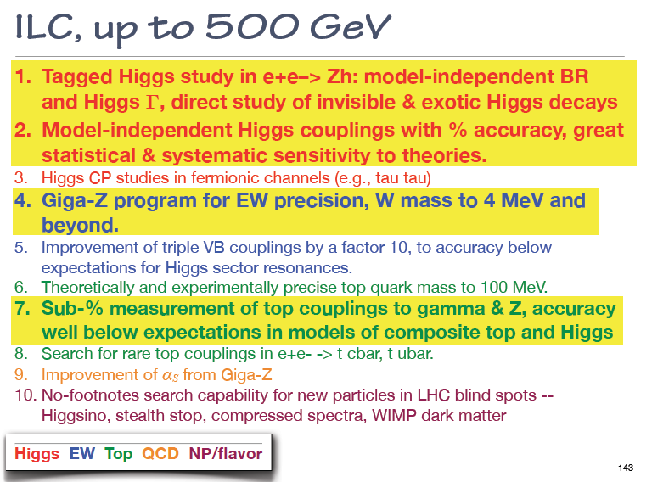
Brock Snowmass Summary

Slide 13
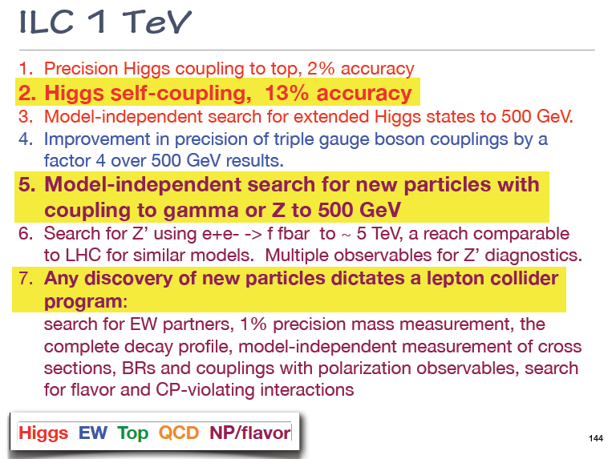
Brock Snowmass Summary

Slide 14
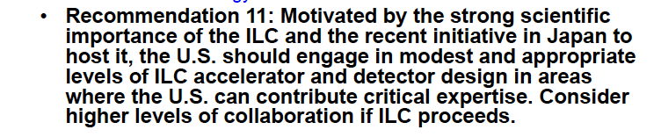
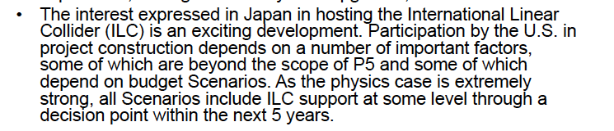
P5 conclusions on ILC

Slide 15
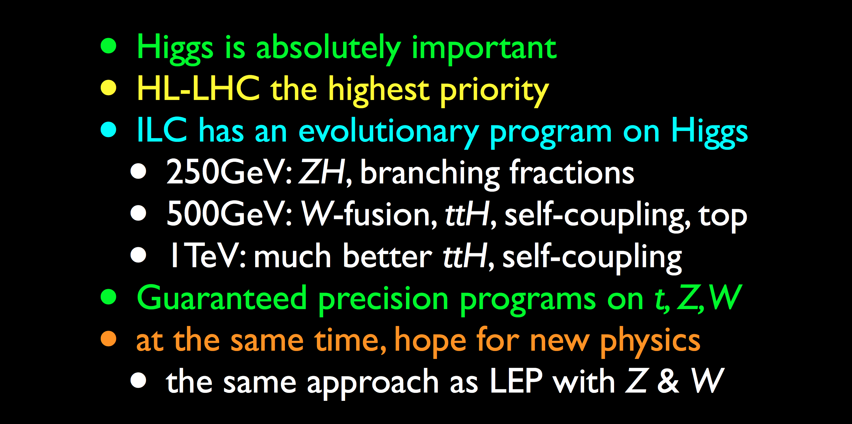
ILC Physics Case
Summary

Slide 16
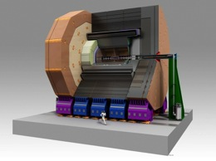
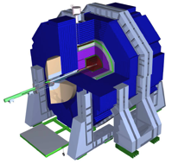
2 Detector Concepts:
Detailed Baseline Design
ILD
SiD
Large R with TPC tracker
  32 countries,
  151 institutions,
  ~700 members
B=3.5T, TPC+Si trackers, ECal(R=1.8m)
High B with Si strip tracker
  18 countries,
  77 institutions,
  ~240 members
B=5T, Si only tracker, Ecal(R=1.27m)
  Basic requirements：
  E_{cm} : 200 – 500 GeV, and the ability to scan
  Luminosity : ∫Ldt = 500 fb⁻¹ in 4 years
  E stability and precision: < 0.1%
Extendability：
  Energy upgrade: 500 → 1,000 GeV

Slide 17
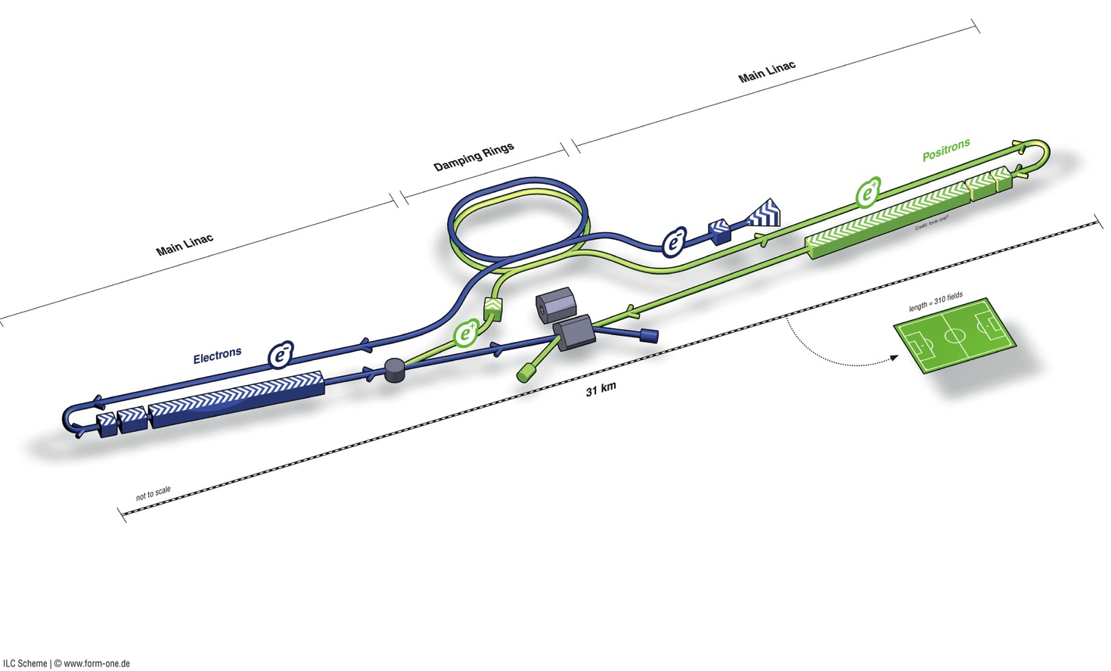
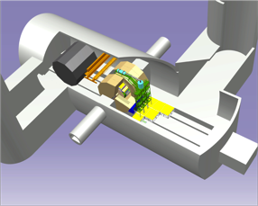
LC Overview
Polarised electron source
Damping Rings
e+ Main Linac
Ring to Main Linac (RTML)
(inc. bunch compressors)
Parameters | Value
C.M. Energy | 500 GeV
Peak luminosity | 1.8 x10³⁴ cm⁻²s⁻¹
Beam Rep. rate | 5 Hz
Pulse duration | 0.73 ms
Average current | 5.8 mA (in pulse)
E gradient in SCRF acc. cavity | 31.5 MV/m +/-20% Q₀ = 1E10
Beam dump
Beam Delivery System (BDS) & physics detectors
Polarised positron
source
e- Main Linac
not to scale

Slide 18
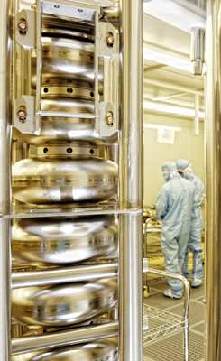
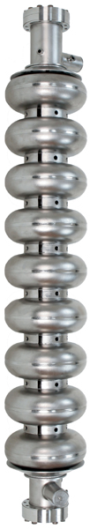
SCRF Linac Technology
solid niobium
standing wave
9 cells
operated at 2K (Lqd. He)
35 MV/m
Q₀ ≥ 10¹⁰
1.3 GHz Nb 9-cell Cavities | 16,024
Cryomodules | 1,855
SC quadrupole package | 673
10 MW MB Klystrons & modulators | 436 / 471*
* site dependent
Approximately 20 years of R&D
Worldwide → Mature technology

Slide 19
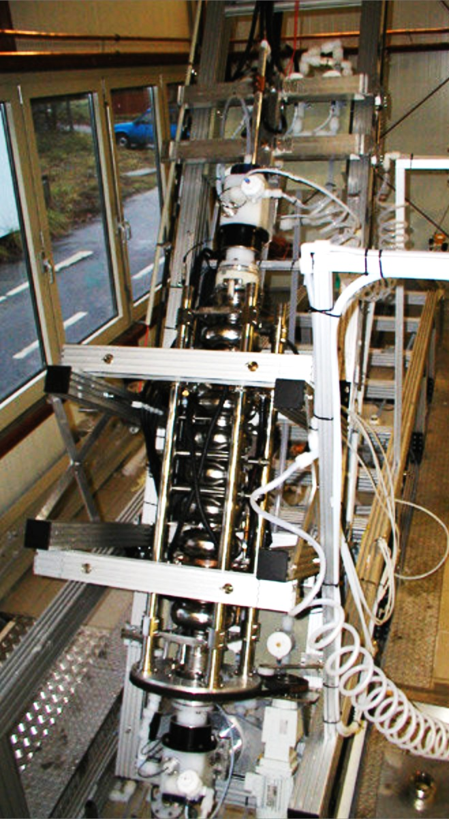
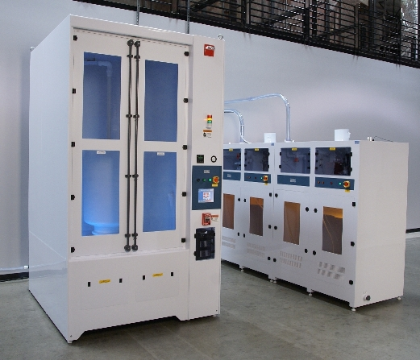
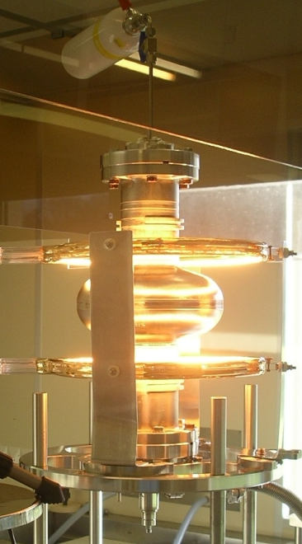
Road to High Performance
Electropolishing
High-Pressure Rinse (HPR)
800° C annealing and 120° C baking

Slide 20
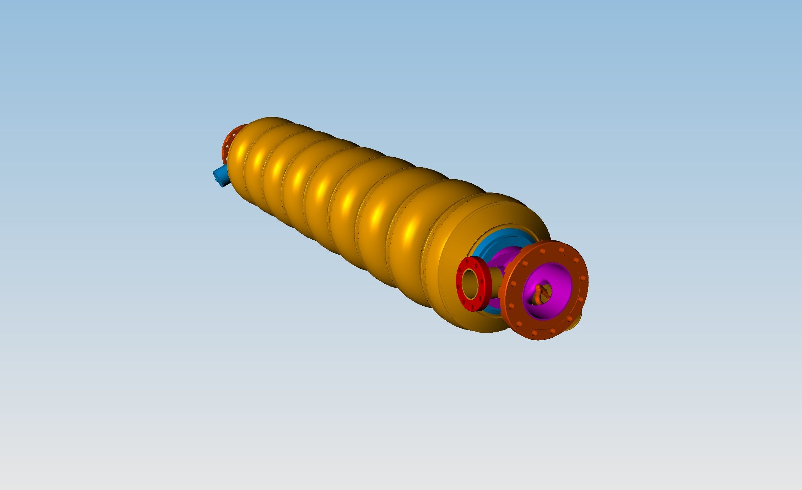
Cryomodule construction

Slide 21
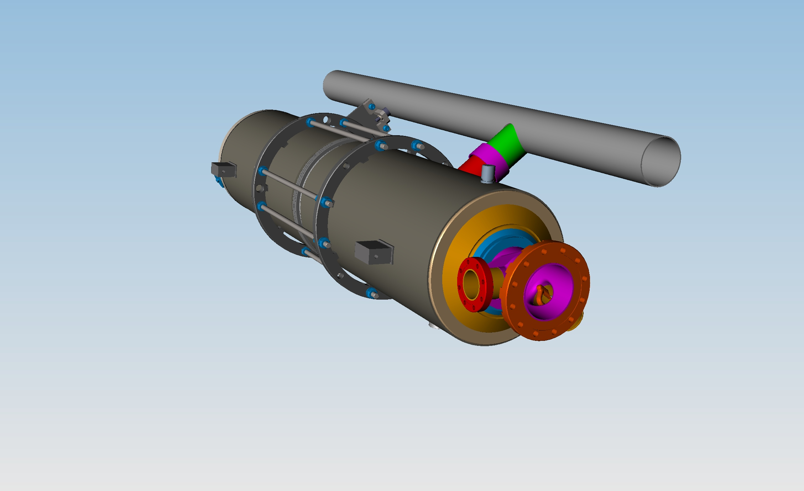
Cryomodule construction

Slide 22
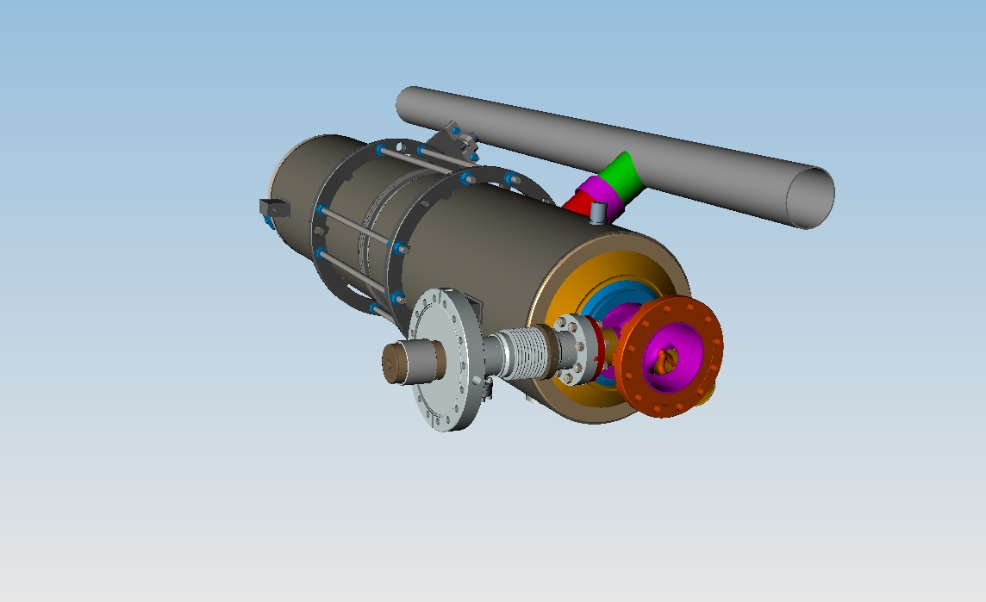
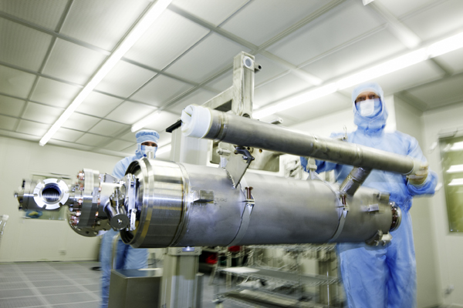
Cryomodule construction

Slide 23
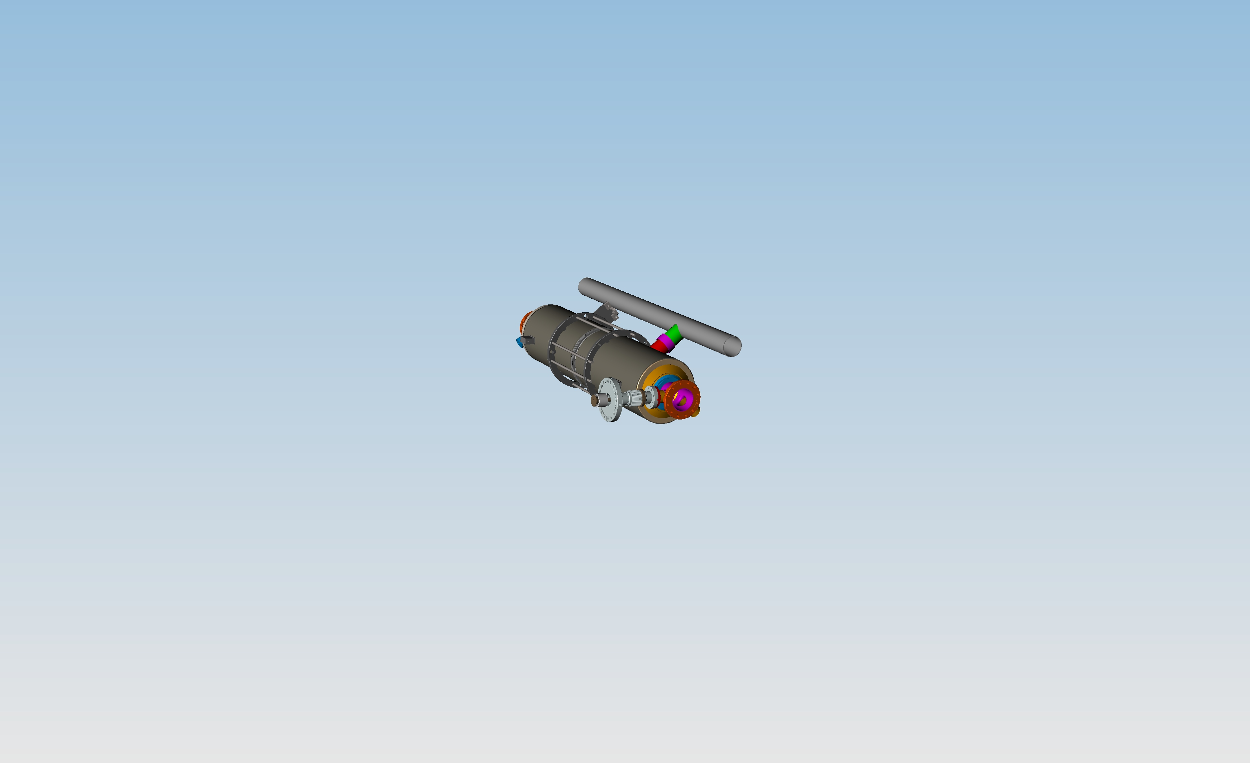
Cryomodule construction

Slide 24
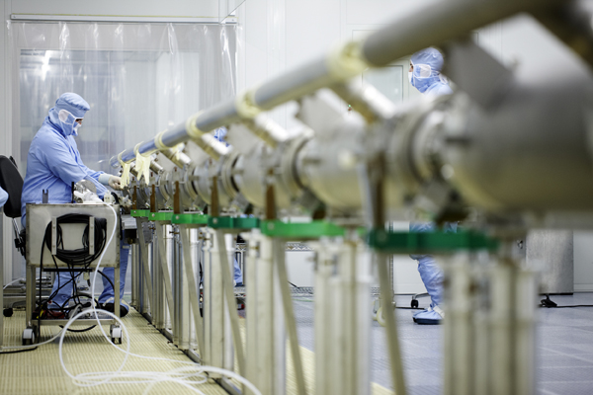
Cryomodule construction

Slide 25
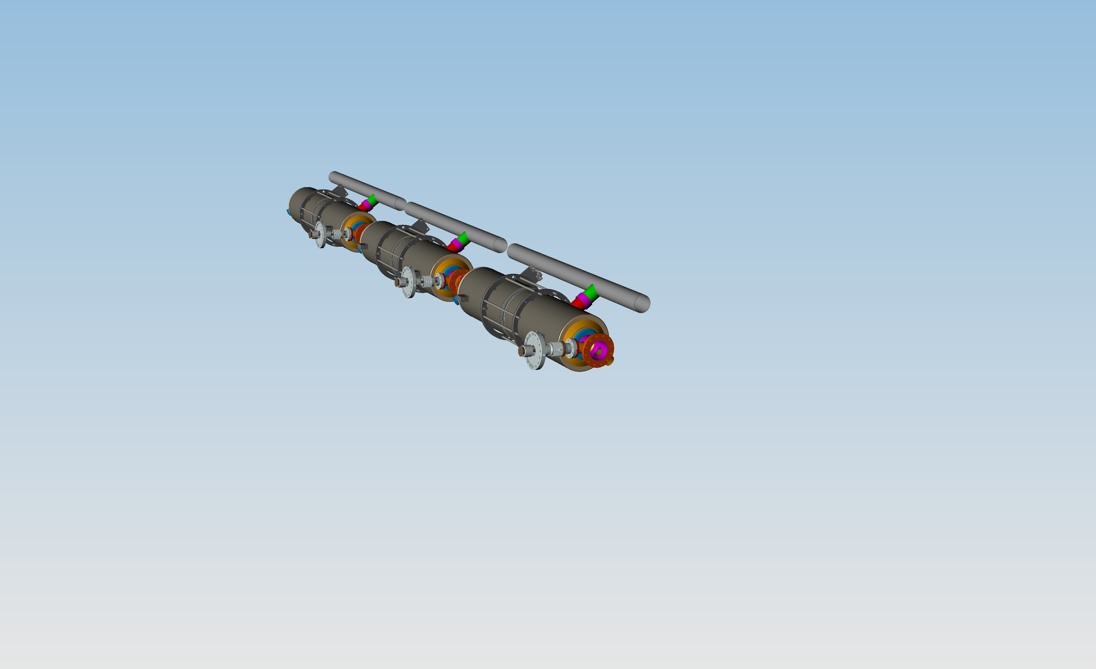
Cryomodule construction

Slide 26
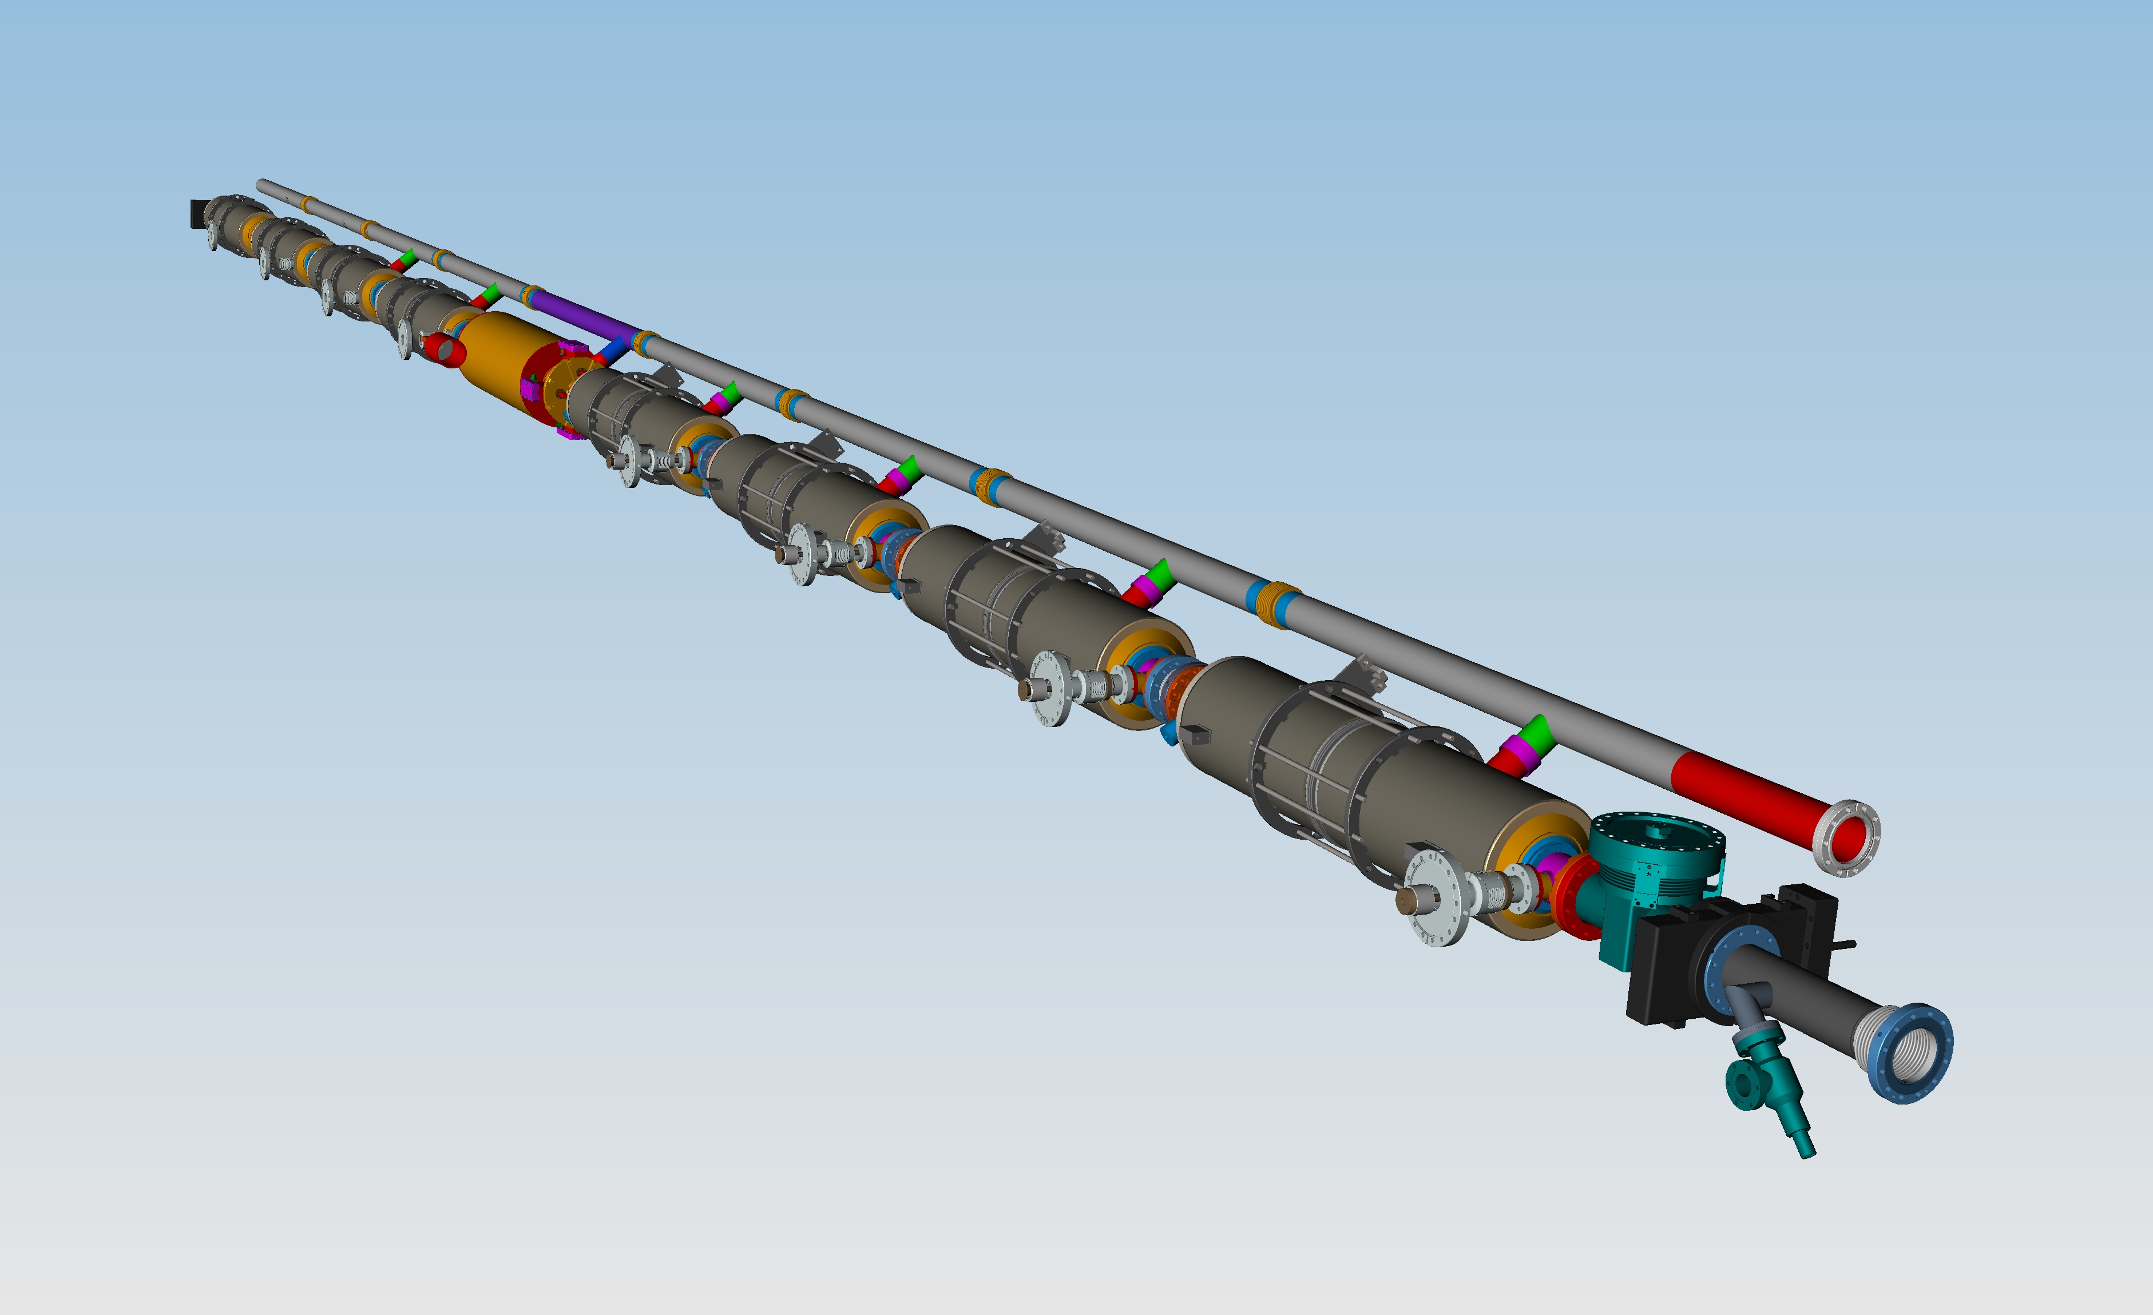
Cryomodule construction

Slide 27
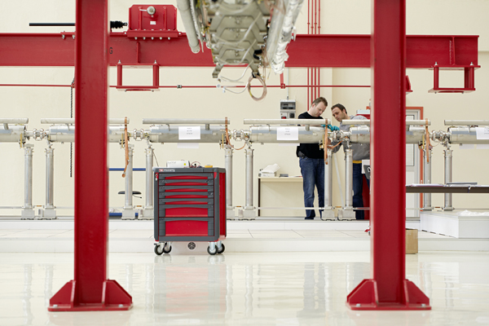
Cryomodule construction

Slide 28
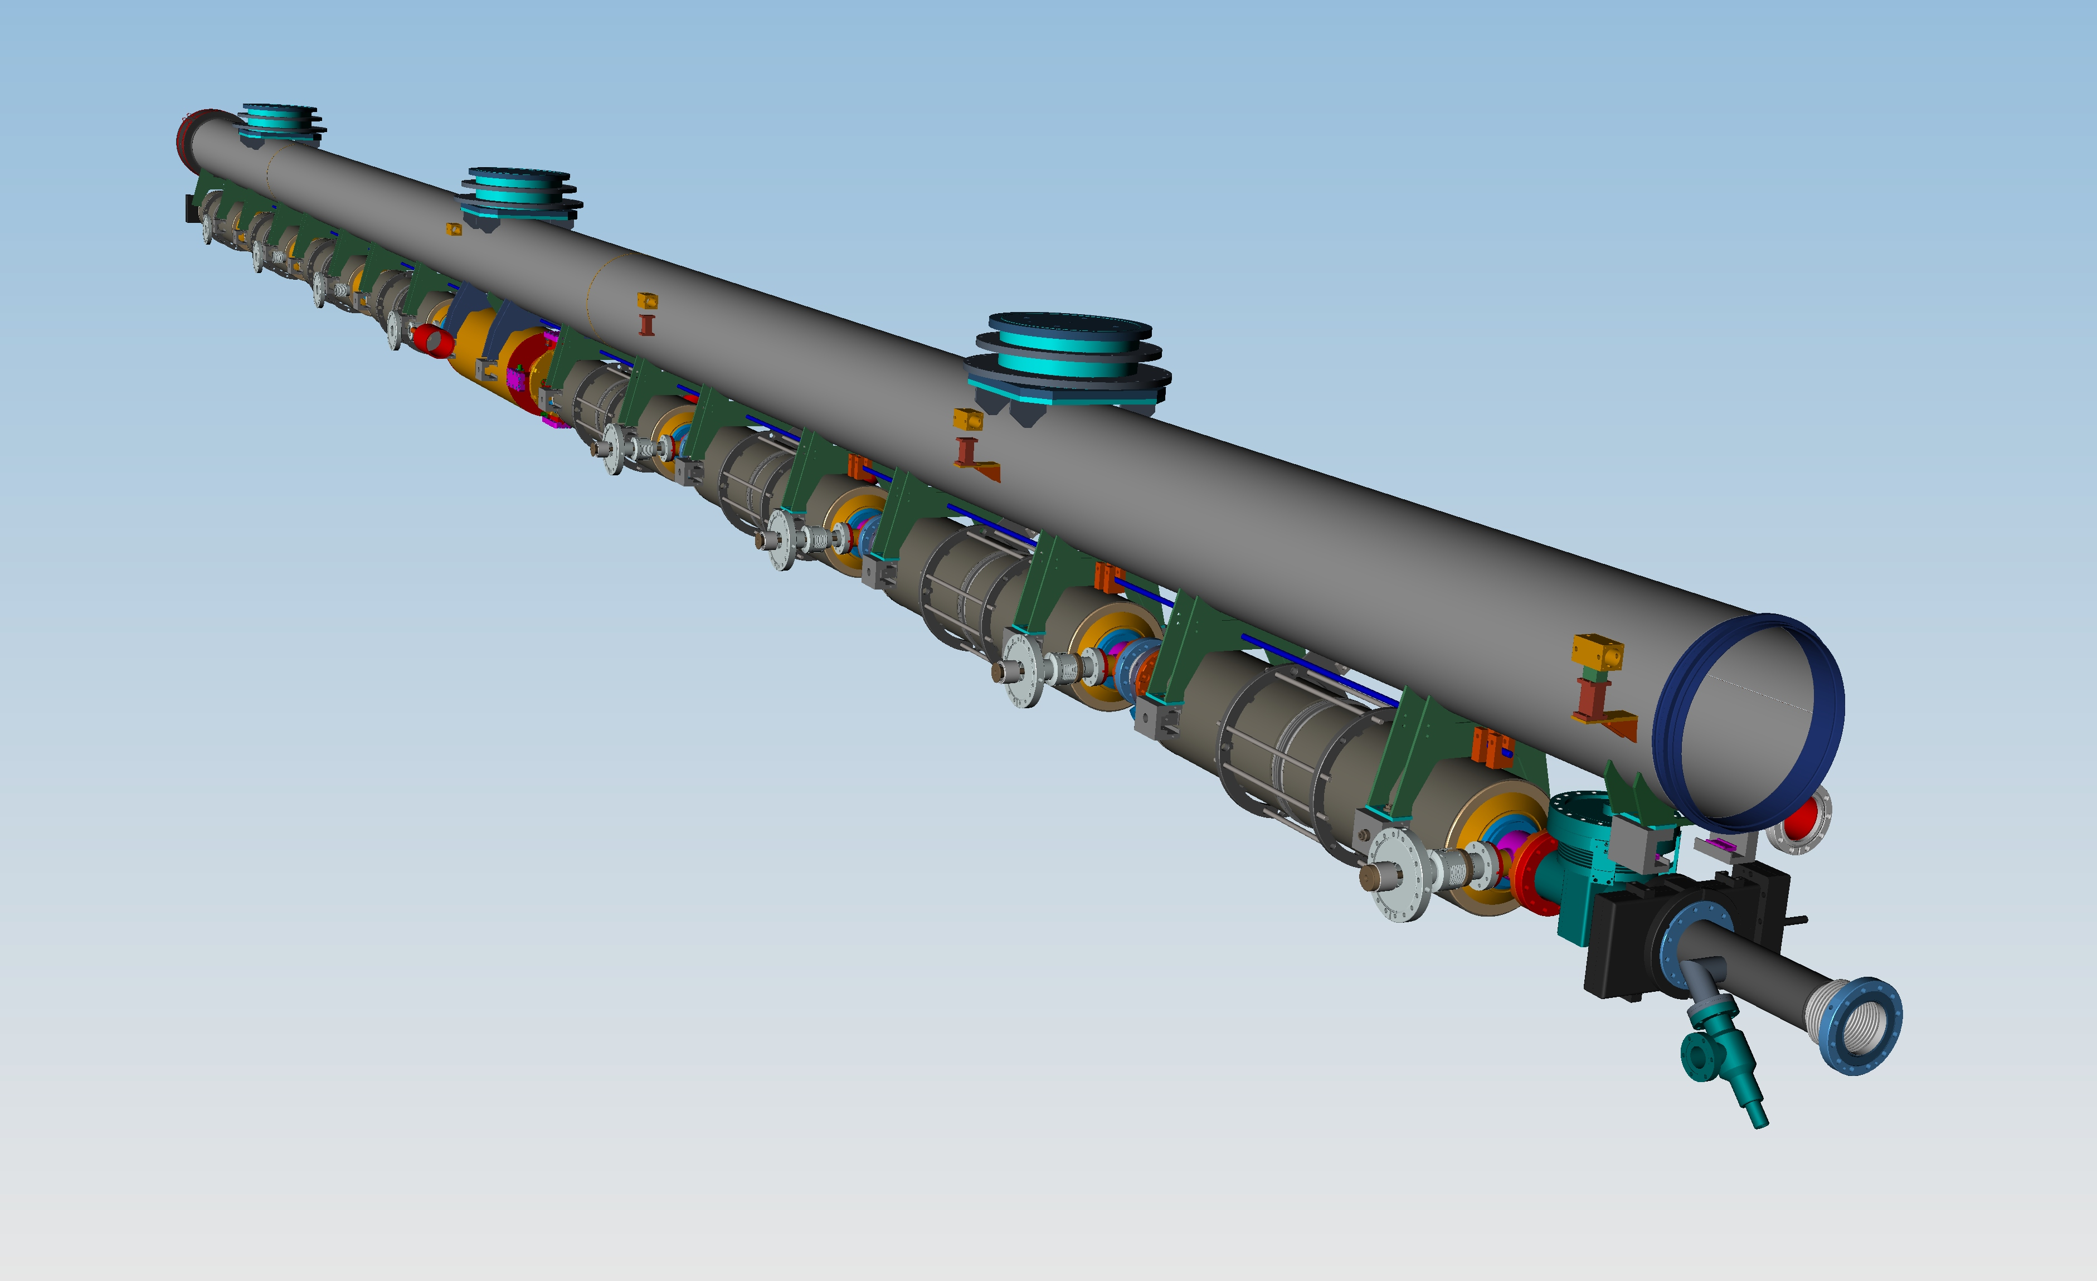
Cryomodule construction

Slide 29
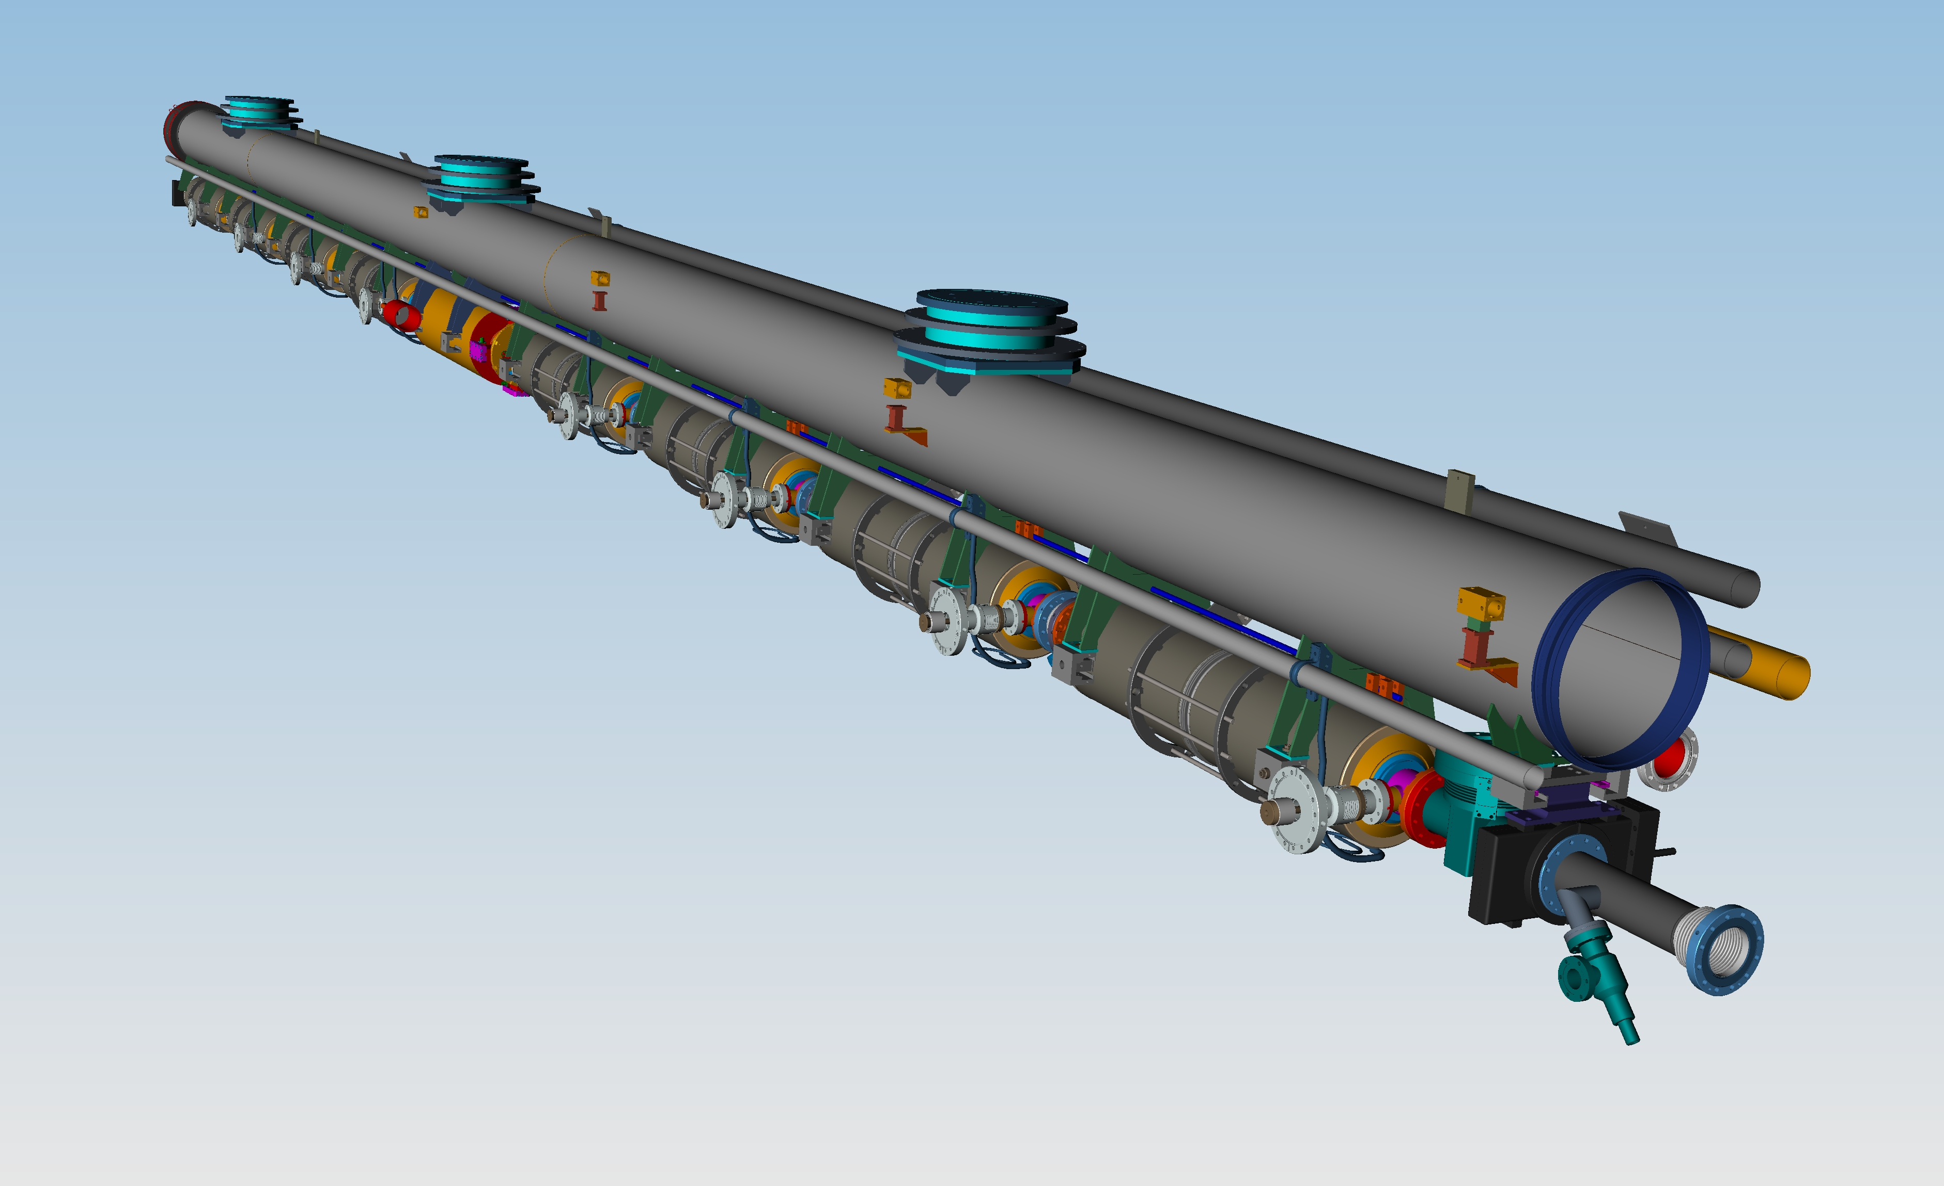
Cryomodule construction

Slide 30
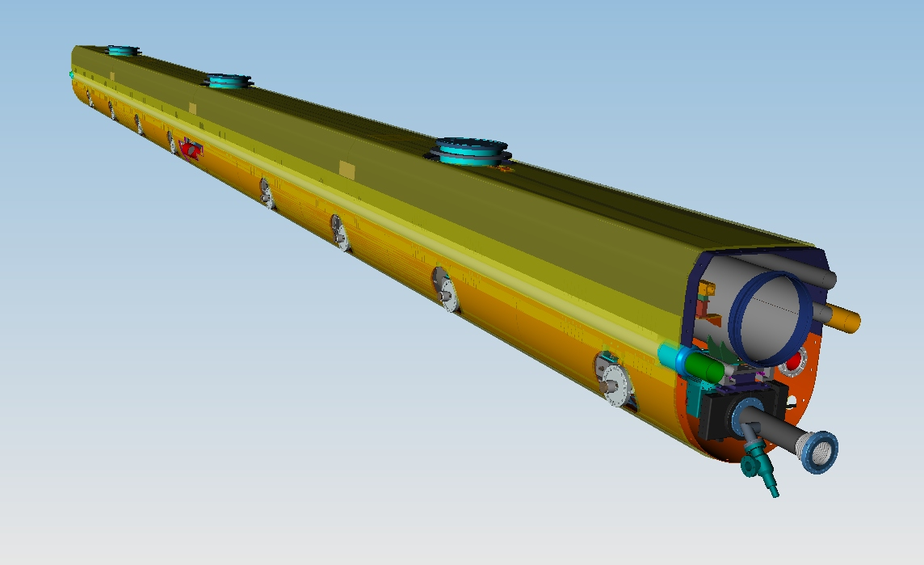
Cryomodule construction

Slide 31
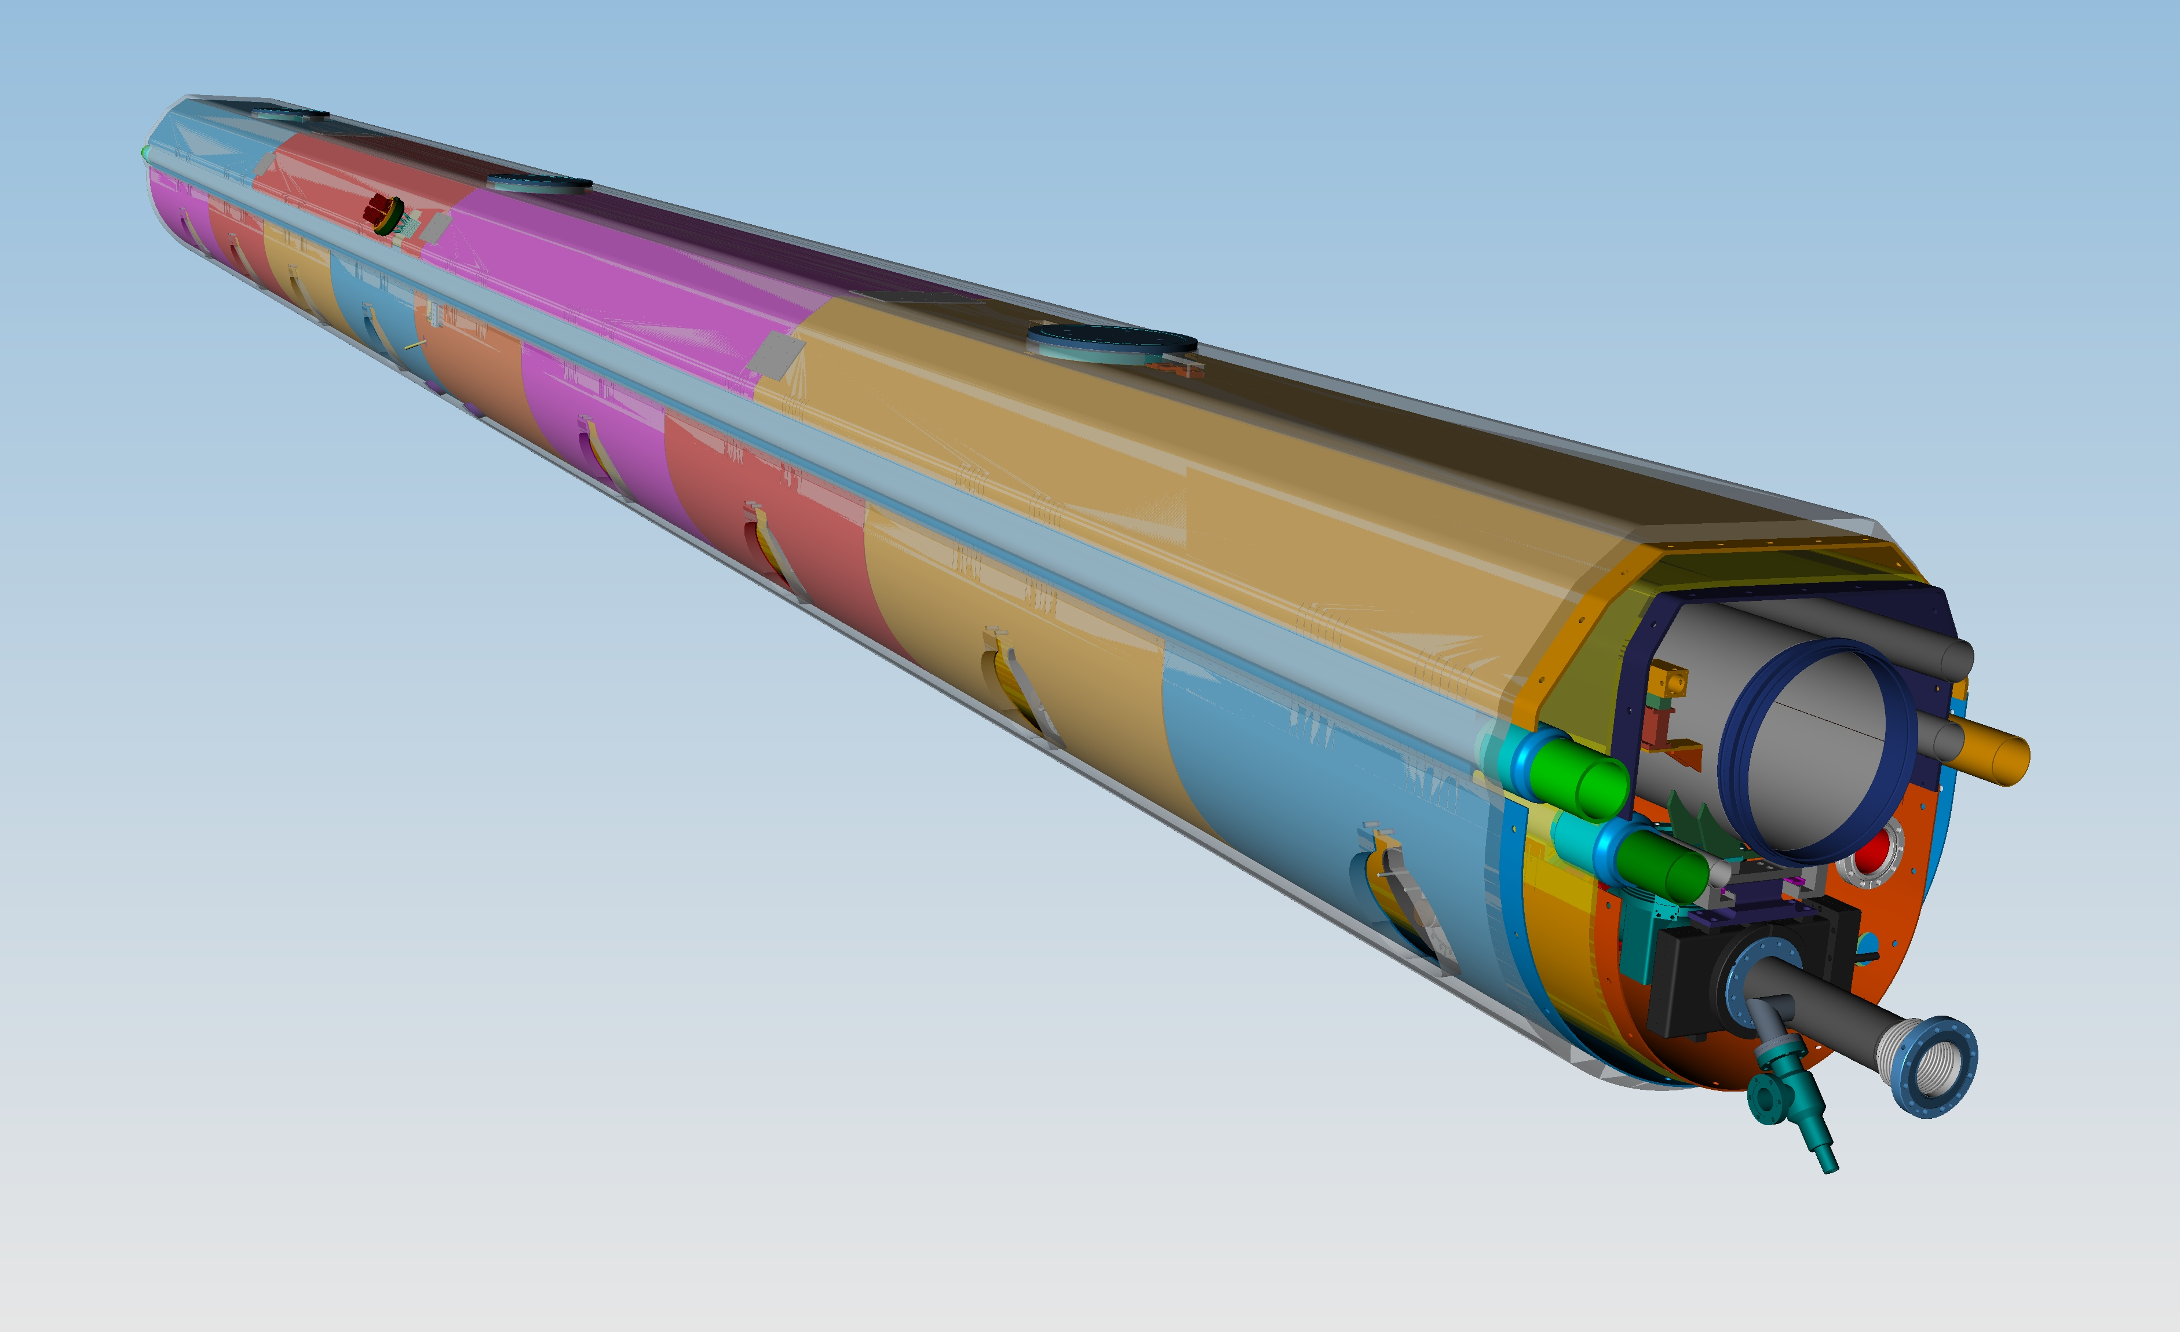
Cryomodule construction

Slide 32
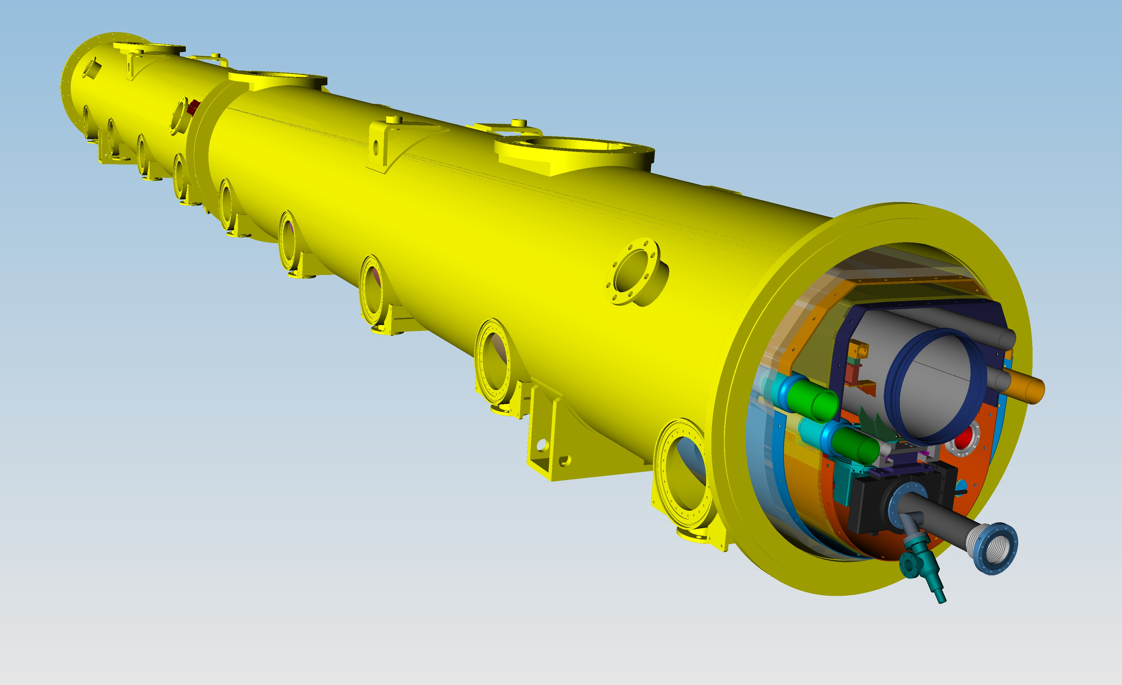
Cryomodule construction

Slide 33
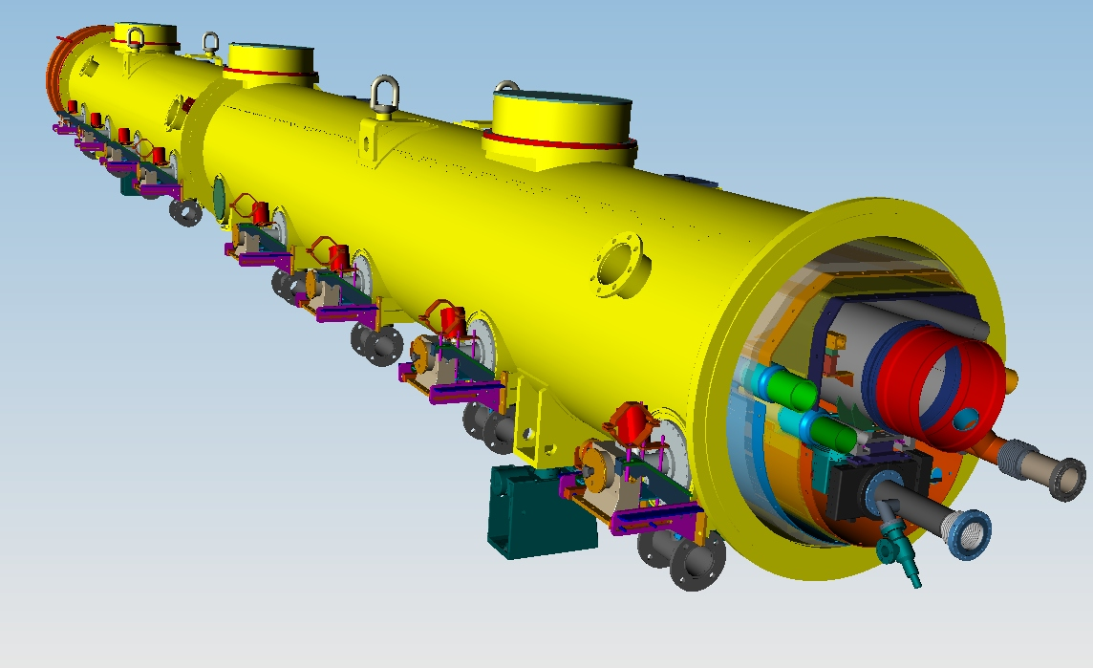
Cryomodule construction

Slide 34
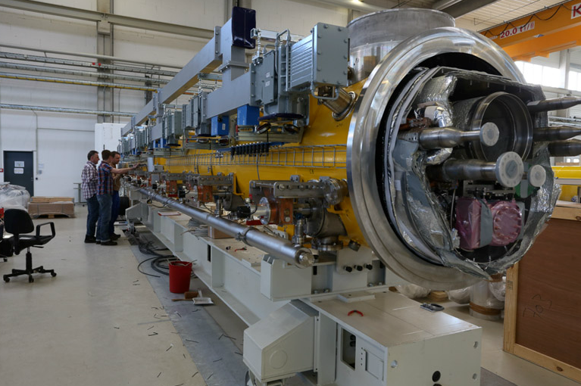
Cryomodule construction

Slide 35
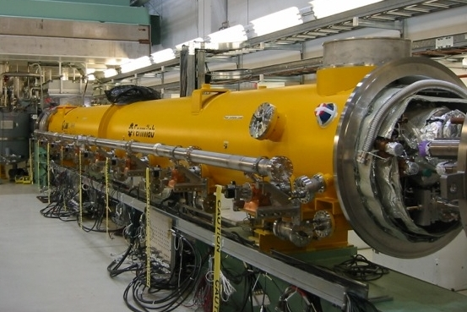
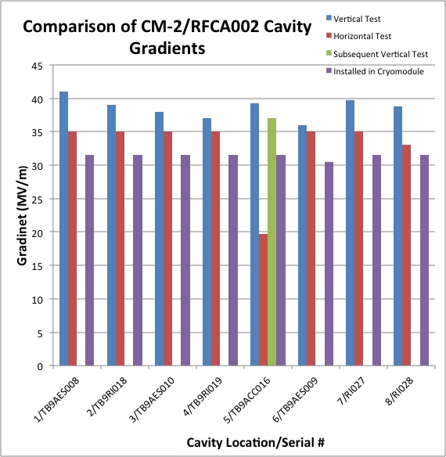
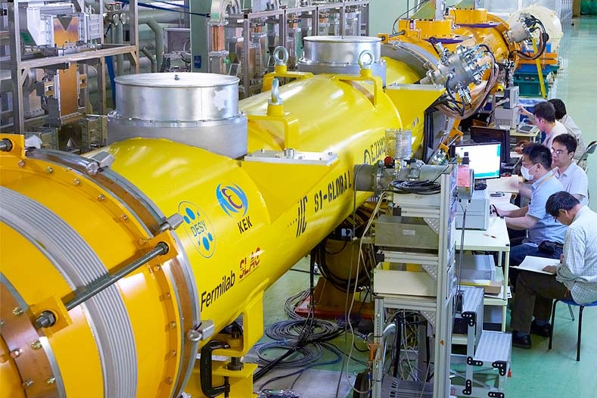
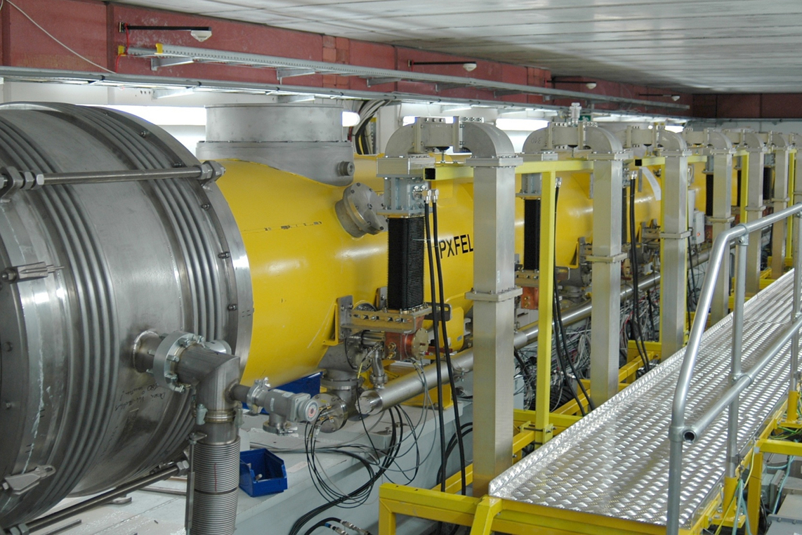
Worldwide Cryomodule
Development
CM1 at FNAL NML module test facility
S1 Global at KEK SRF Test Facility (STF)
PXFEL 1 installed at FLASH, DESY, Hamburg

Slide 36
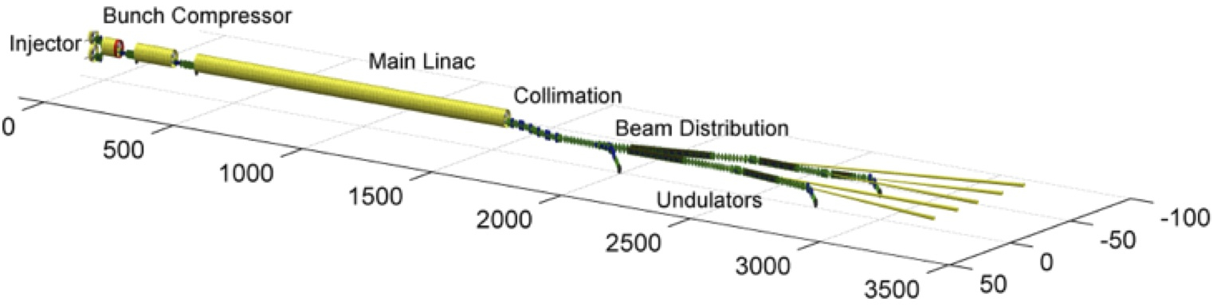
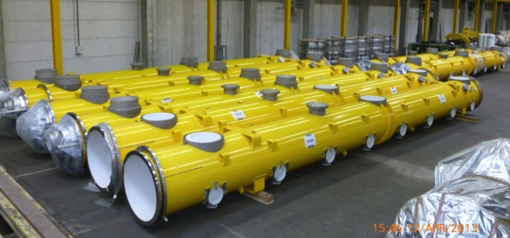
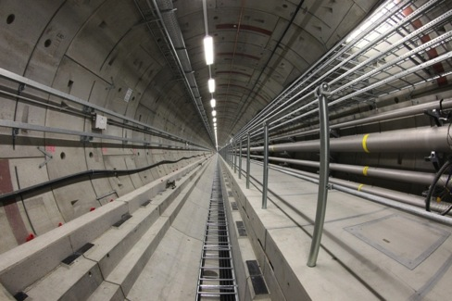
European XFEL @ DESY
Largest deployment of this technology to date
100 cryomodules
800 cavities
17.5 GeV
~25 MV/m
The ultimate ‘integrated systems test’ for ILC. Commissioning with beam begins 2016

Slide 37
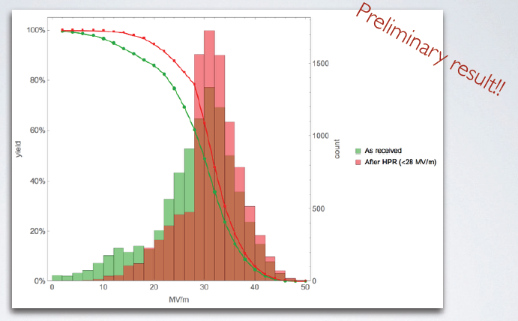
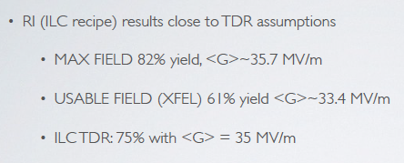
Industrial production - XFEL

Slide 38
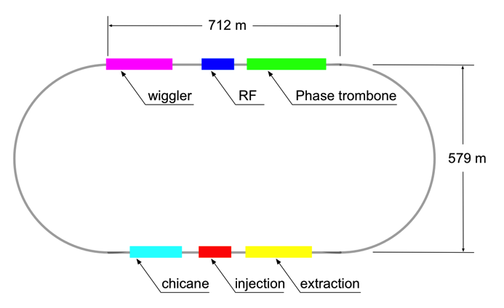
Damping Rings
Circumference |  | 3.2 | km
Energy |  | 5 | GeV
RF frequency |  | 650 | MHz
Beam current |  | 390 | mA
Store time |  | 200 (100) | ms
Trans. damping time |  | 24 (13) | ms
Extracted emittance | x | 5.5 | μm
(normalised) | y | 20 | nm
No. cavities |  | 10 (12)
Total voltage |  | 14 (22) | MV
RF power / coupler |  | 176 (272) | kW
No.wiggler magnets |  | 54
Total length wiggler |  | 113 | m
Wiggler field |  | 1.5 (2.2) | T
Beam power |  | 1.76 (2.38) | MW
Values in () are for 10-Hz mode
Many similarities to modern 3rd-generation light sources

Slide 39



DR: Critical R&D
(Electron Cloud)
Extensive R&D programme at CESR, Cornell (CesrTA)
Instrumentation of wiggler, dipole and quad vacuum chambers for e-cloud measurements
  RFA
low emittance lattice
Example: wiggler vacuum chamber
Benchmarking of simulation codes
  cloud build-up
  beam dynamics (head-tail instabilities)
Cu
TiN
reduced SYE
grooved
electrode

Slide 40

Polarised Electron Source
Laser-driven photo cathode (GaAs)
DC gun
Integrated into common tunnel with positron BDS

Slide 41

Positron Source
located at exit of electron Main Linac
147m SC helical undulator
driven by primary electron beam (150-250 GeV)
produces ~30 MeV photons
converted in thin target into e⁺e⁻ pairs
yield = 1.5
not to scale!

Slide 42

Beam Delivery System
not to scale!

Slide 43

Central Region Integration
Damping Rings
detector
RTML return line
e⁺ main beam dump
e⁻ BDS muon shield
e⁺ source
e⁻ BDS
3D CAD has been used to developed beamline layouts and tunnel requirements.
Complete model of ILC available.

Slide 44

Japanese Sites for ILC

Slide 45







Japanese Sites for ILC
LCC Directorate/CF&S official site visits taken place.

Slide 46

Japanese Site

Slide 47

Japanese Site

Slide 48
Site-specific work plan
2014 |  | 2015 |  | 2016 |  | 2017 |  | 2018
Planning
Basic Design
Detailed Design
Tendering
Cost Estimate
Geological Survey
Basic Survey
Detailed Survey
Additional.
Topographical Survey
Basic
Detailed
Construction works
Land Acquisition
Compensation
Site Decision
Land Negotiation
Acquisition
Environmental Impact Study
Preparation
Environmental Impact Survey
Permission
2014 |  | 2015 |  | 2016 |  | 2017 |  | 2018

Slide 49

Virtual reality tools
Directed by: Steven Spielberg

Slide 50
Detector Hall Evolution
Baseline (TDR) | Hybrid - A (ADI-CFS Joint Meeting)
2 Vertical Shafts (SiD Proposal) | Hybrid - A’ (KEK-CFS Proposal)
Assembly
Yd
DR
Surface
Yd
Assembly
Yd
DR Surface
Yd
UT Sht
Main Sht
DR/ AT
W8m Grad10%
DH/AT
W11m Grad7%
DR/ AT
W8m Grad10%
DH/AT
W8m Grad10%
D/H
D/R
D/H
D/R
DR
Surface Yd
Assembly
Yd
DR
Surface Yd
Assembly
Yd
UT Sht
UT Sht
DR/AT
W8m Grad10%
DR-DH Common AT
W8m Grad10%
Second Sht
Main Sht
D/H
D/R
D/H
D/R
From Miyahara at al

Slide 51
Access Tunnel ex.
Beam Tunnel excavation
BDS Tunnel excavation
Survey & supports set-out
Concrete Lining
BDS Service Tunnel excavation
Electrical general services
Cavern ex.
Invert & Drainage
Piping & ventilation
Hall ex.
Shield Wall
Cabling
Supports
Machine installation
AH-4
AH-3
AH-2
AH-1
AH+1
AH+2
AH+3
AH+4
RTML
(1.35km)
e- Main Linac
(11.19km)
e-BDS
(3.33km)
e+BDS
(2.25km)
e+ Main Linac
(11.07km)
RTML
(1.35km)
1
2
3
4
5
61.9
61.9
62.0
60.3
61.9
61.9
6
7
120m/week
8
250m/week
9
100m/week
10
51

Slide 52



Technology optimisation
Bi-polar EP – Faraday Technology Co
Vertical EP - Saclay
Barrel Polishing DESY – No EP ?

Slide 53


Technology optimisation
– N₂
Cornell
Fermilab
Higher Q via nitrogen doping surface processing
High Q via efficient flux expulsion cooling
No high gradient yet

Slide 54
Final Focus R&D – ATF2
Formal international collaboration

Slide 55
ATF2 beam-size success
Beam Size 44 nm observed,
(Goal : 37 nm)
Field quality improvements, orbit stabilisation through feedback, shorted turn in 6-pole magnet, beam size monitor improvements

Slide 56


Political Developments on ILC
Lyn Evans, Profs. Koshiba &
Murayama meet Prime Minister Abe
& ex-Minister Kawamura ~1 year ago.
Lyn Evans, BF & H. Weerts meet
Mr Kawamura & leaders of Diet
Federation for ILC 6 months ago.

Slide 57
ILC Political Developments
Talk of Chair of Diet ILC Federation, Mr Kawamura@ LCWS
Tokyo, Dec. 2013
“The Technical Design Report of ILC was issued in December 2012 (sic)…I would again like to express my appreciation of this effort. I understand that it is now the turn of politicians to respond
to this effort, and to construct a worldwide partnership to realize this project.”
“I think that most Diet members' knowledge of physics is at high school students’ level. If you allow me, let me take the liberty of pointing out that the understanding of political dynamics by most particle physicists is also at high school students’ level. If physicists and politicians collaborate by using each other's area of expertise, it is certain that we can accelerate the realization of the ILC project.”

Slide 58
ILC Political Developments
The MEXT Minister has visited the US Secretary of Energy in January; ILC was discussed at the meeting. In February he sent the Secretary of Energy a letter following up that discussion in which he proposes inter-governmental discussion of the ILC project. A similar letter was subsequently sent to DG – designated by Council as European contact - cc EU Commission.
The MEXT Deputy Minister was in Europe in February and July and has had dinner meetings with the DG of CERN and Robert-Jan Smits, the Director of the EC Directorate of Research and Technology. The purpose of the meeting was to discuss ILC and the next steps. At the second meeting, representatives of funding authorities of major European countries and the USA also attended. All agreed that the meetings were very useful and further meetings are scheduled to follow.

Slide 59
Most Recent Developments
ILC was discussed again at ICFA meeting in Valencia, particularly in the context of Chinese proposal for a circular machine, starting with e⁺e⁻ at 250 GeV and then moving to high-energy pp. Important statement agreed: “ICFA endorses the particle physics strategic plans produced in Europe, Asia and the United States and the globally aligned priorities contained therein. Here, ICFA reaffirms its support of the ILC, which is in a mature state of technical development and offers unprecedented opportunities for precision studies of the newly discovered Higgs boson. In addition, ICFA continues to encourage international studies of circular colliders, with an ultimate goal of proton-proton collisions at energies much higher than those of the LHC.”

Slide 60
Summary and Outlook
The discovery of the Higgs and the necessity to understand this extraordinary particle has brought the case for a new e⁺e⁻ machine even more sharply into focus. A LC has the advantage of energy flexibility and that a design exists for the ILC that is ready to build.
There is a world-wide strategic consensus via regional roadmaps that the ILC is the right machine to build to explore the physics of the Higgs.
Japan has expressed interest in hosting the ILC. A single site has now been selected and the political process has momentum. There is a great deal of activity, although much of it is necessarily behind the scenes.
Ministerial-level meetings have begun – still in a very early stage.
The next 2 – 3 years will be decisive…..

