Slide 1




Experimental Particle Physics
at the LHC: Standard Model
Albert De Roeck
CERN, Geneva, Switzerland
Antwerp University Belgium
UC-Davis California USA
IPPP, Durham UK
BUE, Cairo, Egypt
27nd October 2014

Slide 2
Lecture Plan
Overview of the 3 lectures in the next days
Lecture 1: Introduction to Experimental Particle Physics at the LHC
Lecture 2: Measurements and test of the Standard Model, (excluding the Higgs)
Lecture 3: Searches beyond the Standard Model at the LHC

Slide 3
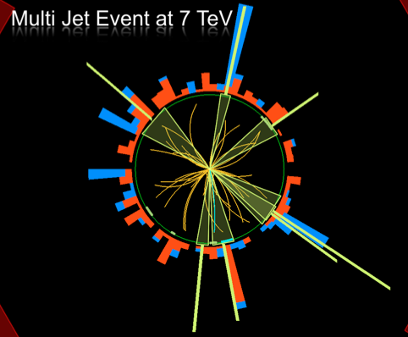
Outline Lecture II
pp collision characteristics
Soft pp collisions and multi-
particle production
QCD hard scattering
Electroweak processes
Top production
(The Higgs particle)
Summary

Slide 4
A Proton-Proton Collider…

Slide 5
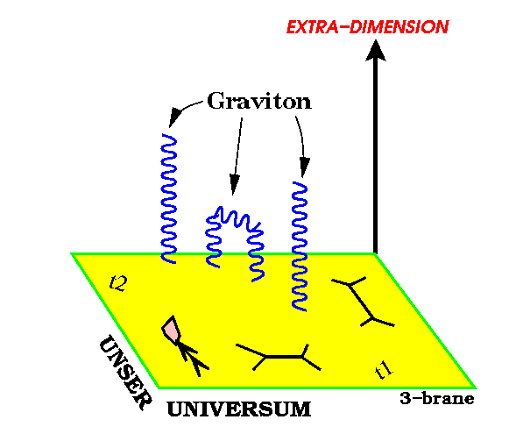
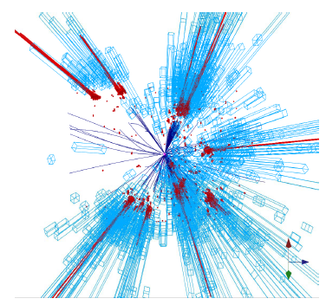
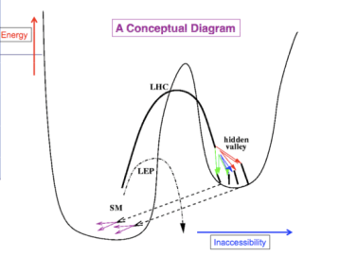
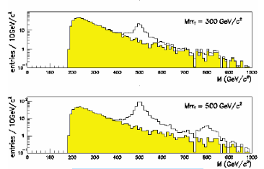
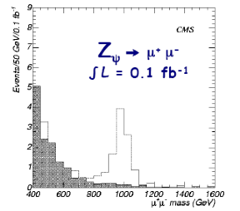
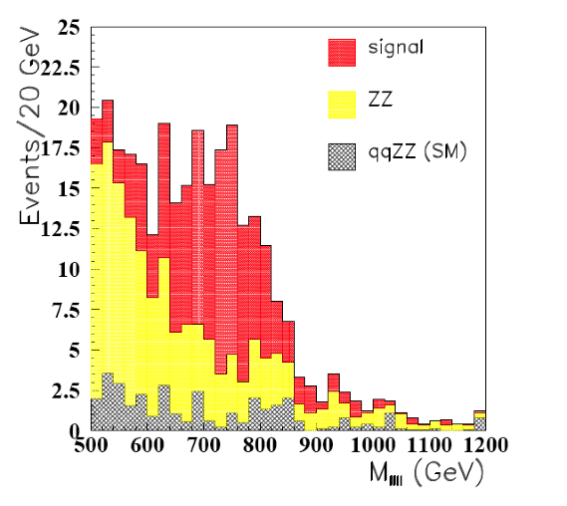
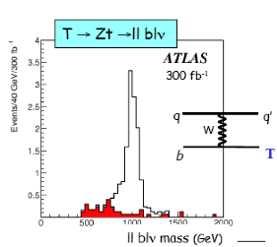
Search for New Physics?
New Gauge Bosons?
Supersymmetry
ZZ/WW resonances?
Technicolor?
Little Higgs?
Extra Dimensions?
Hidden Valleys?
Black Holes???
What stabelizes the Higgs Mass? Many ideas, not all viable any more
A large variety of possible signals. We have to be ready for that
Notes:
4

Slide 6
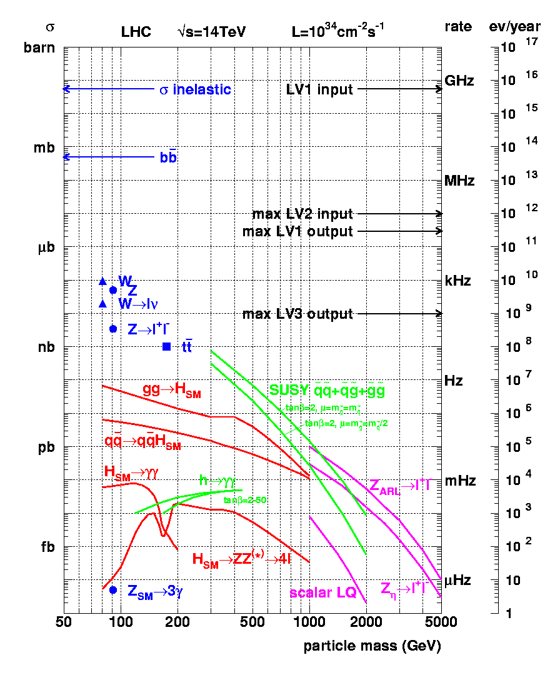
Cross sections at the LHC
“Well known” processes, don’t need to keep all of them …
New Physics!!
This we want to keep!!

Slide 7
Proton-proton Collisions
Most interactions due to collisions at large distance between incoming
protons where protons interact as “ a whole ”
→ small momentum transfer (Δp ≈  /Δx )
particles in final state have large longitudinal momentum but small
transverse momentum (scattering at large angle is small)
< p_{T} > ≈ 500 MeV of charged particles in final state
Most energy escapes down the beam pipe.
These are called soft events…
A minimum bias data event sample is dominated by soft events

Slide 8
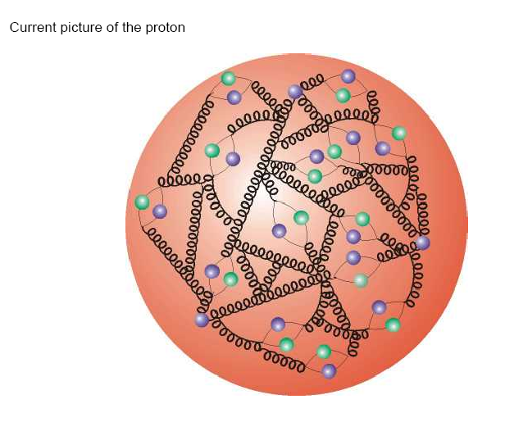
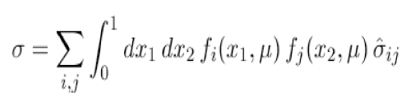
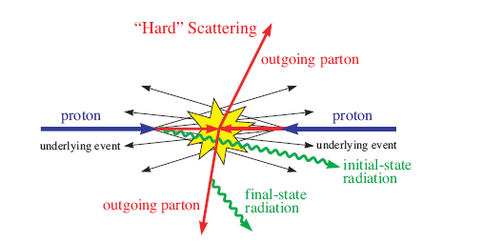
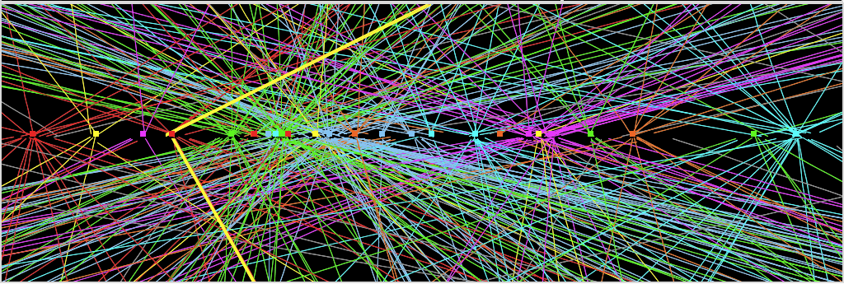
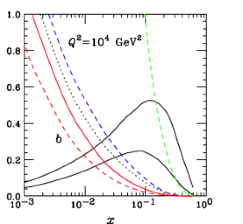
Pp Collisions : Complications
Protons have structure
Parton
distributions
Underlying event
Pile-up: approximate 20 collisions per
bunch crossing in 2012 (more in future)
Z→ μμ event with ~20 reconstructed vertices (2012)

Slide 9
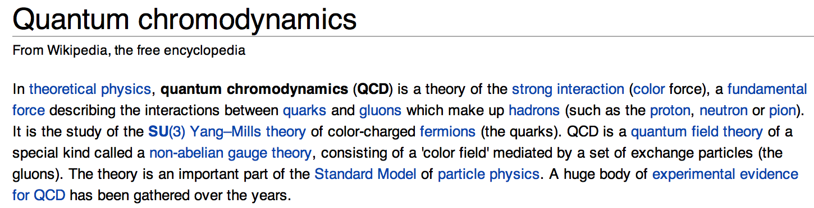
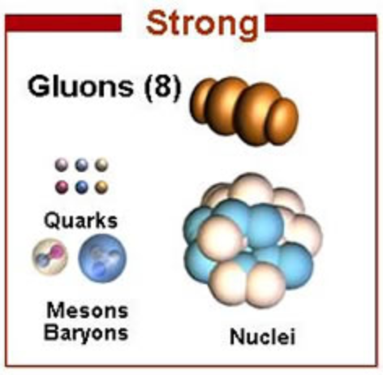
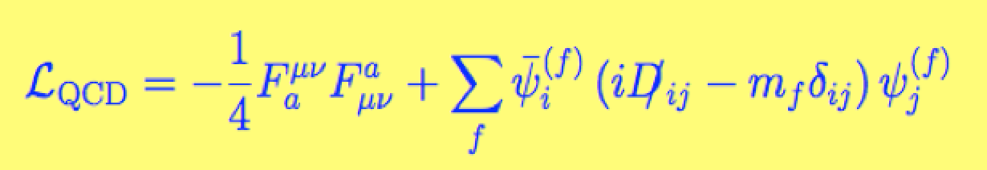
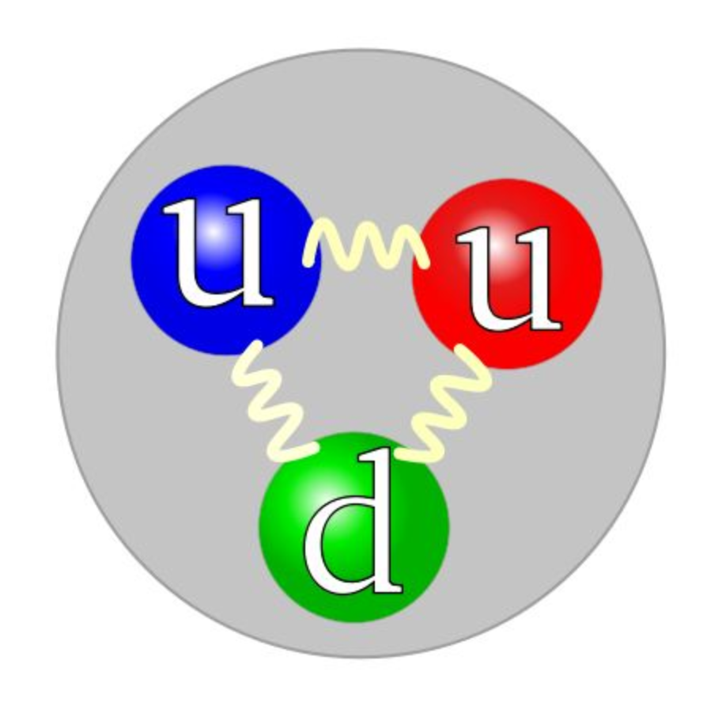

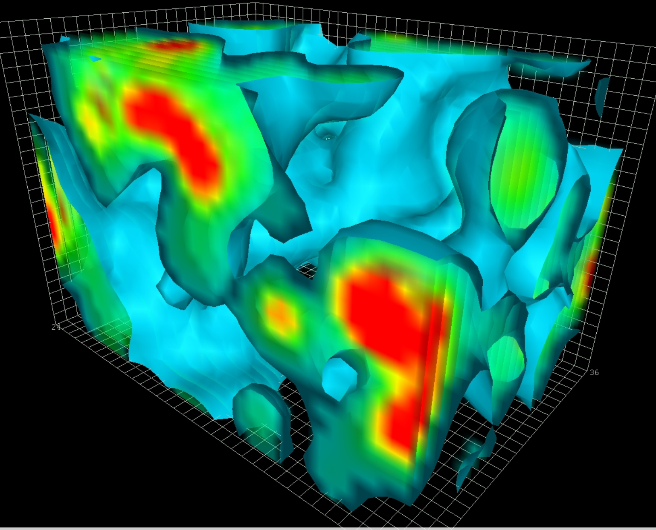

QCD
QCD plays a major role in basically every topic under discussion at this
Symposium. For precision physics, or discovery physics we need to
understand the role of QCD corrections: QCD is all around us at the LHC

Slide 10
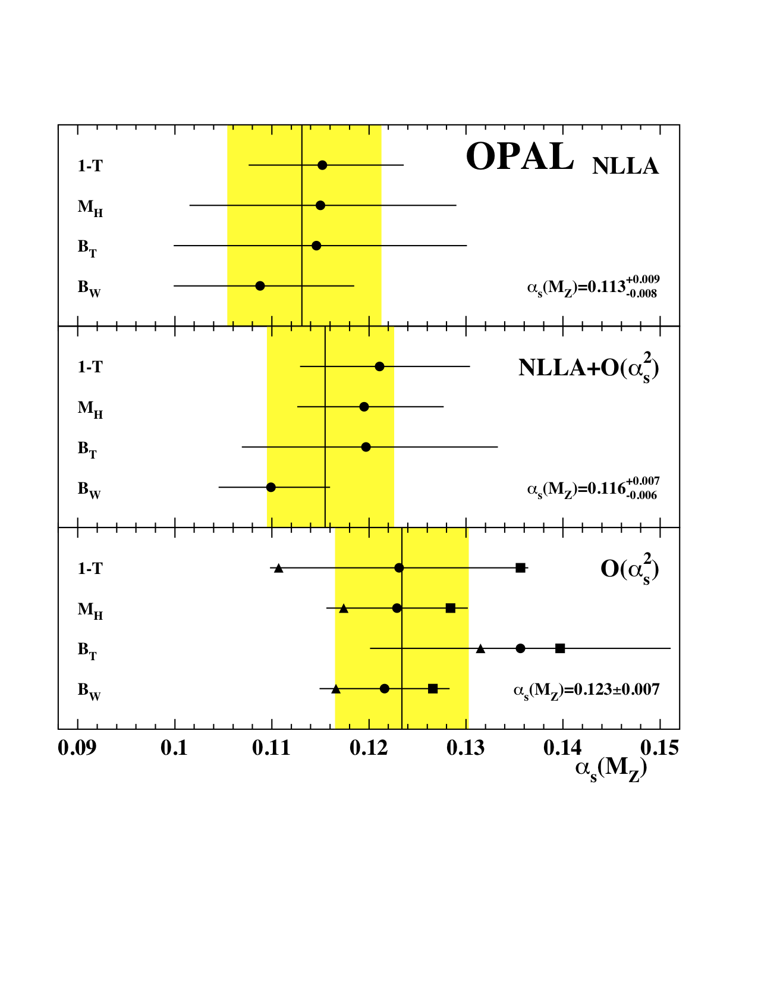
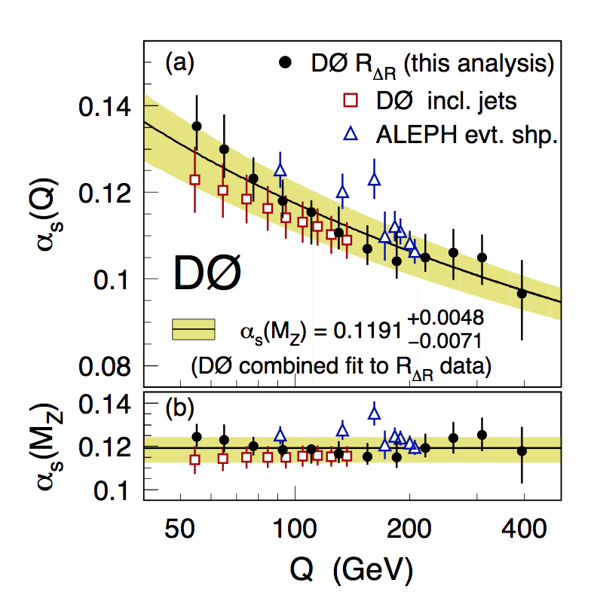
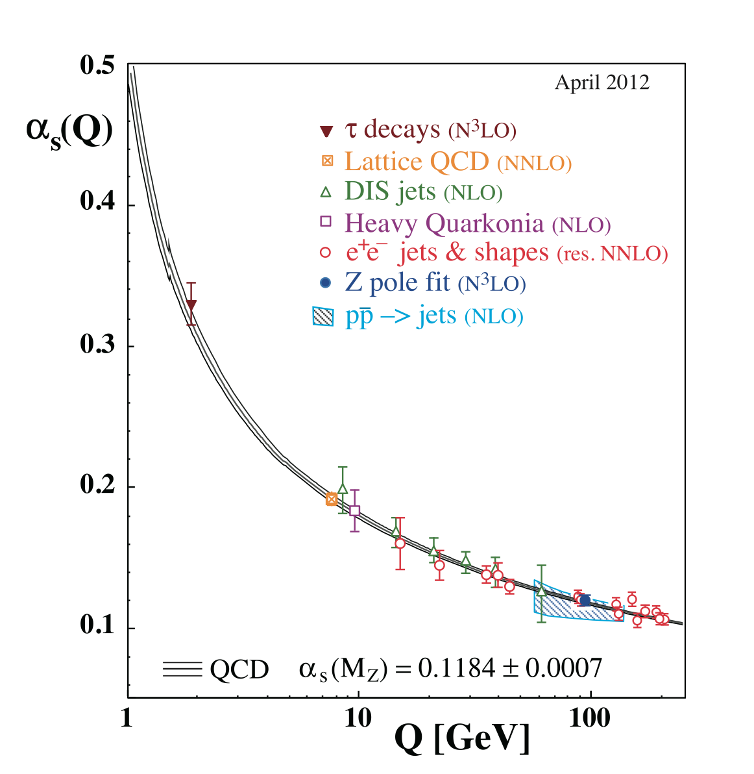
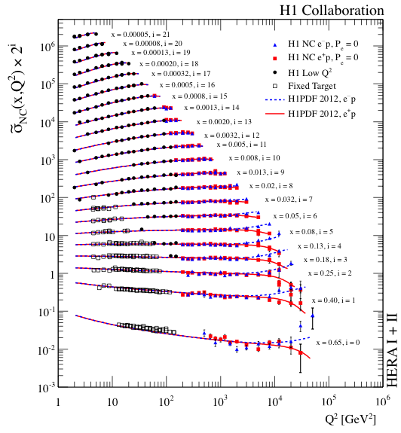
QCD at Recent Colliders
Precision measurements
of the proton structure
at HERA
Precision measurements
at the Z factory LEP
QCD studies at the
hadron collider
Tevatron
Summary on
α_{s} results

Slide 11
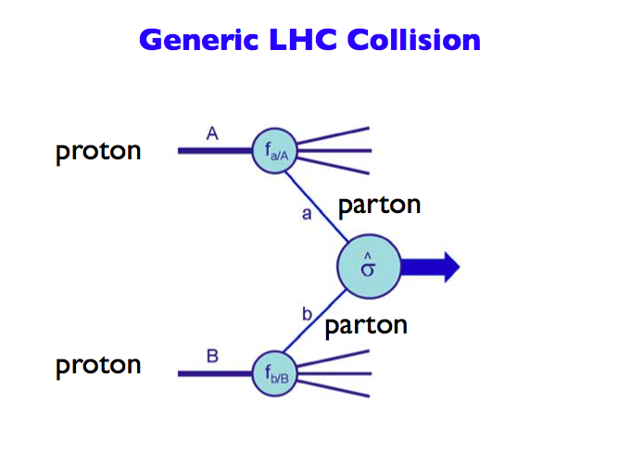
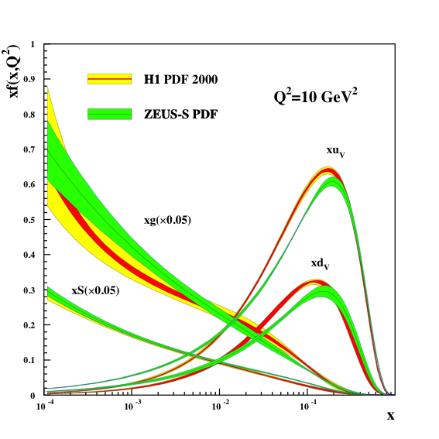
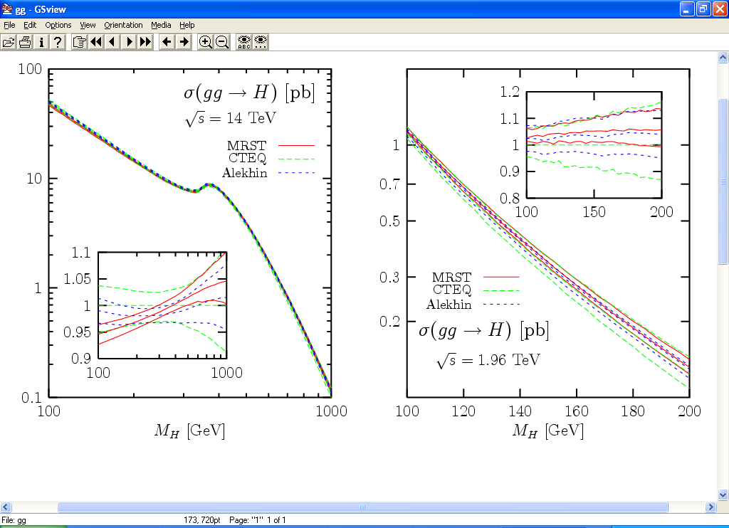
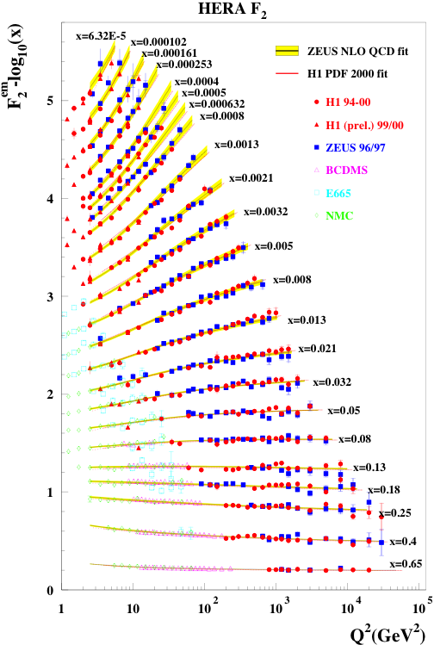
Proton-proton collisions and PDFs
Parton Distribution Functions: the probability of finding
a parton with momentum fraction x in the proton
Structure function
measurements eg
from HERA
Simple spread of existing PDFs gives
up to 10% uncertainty on Higgs cross
section. Possible gain ~ factor of 2
with final HERA data (PDF4LHC)

Slide 12
Soft QCD Dynamics

Slide 13
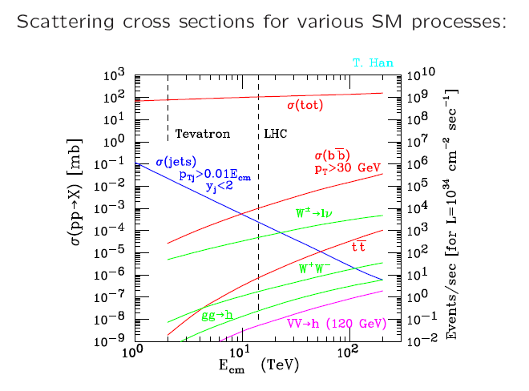
Understanding Soft Collisions
Most collisions at the LHC do not involve a hard scattering scale: these are so
called soft collisions. They make up most of a “minimum bias” event sample
•Detailed studies of multi-particle production in pp
•Monte Carlos tunes, eg for describing the pile-up
Z→ μμ event from 2012 data with 25 reconstructed vertices
Pile-up 2012!!
Much more in 2015+
Z→ μμ

Slide 14
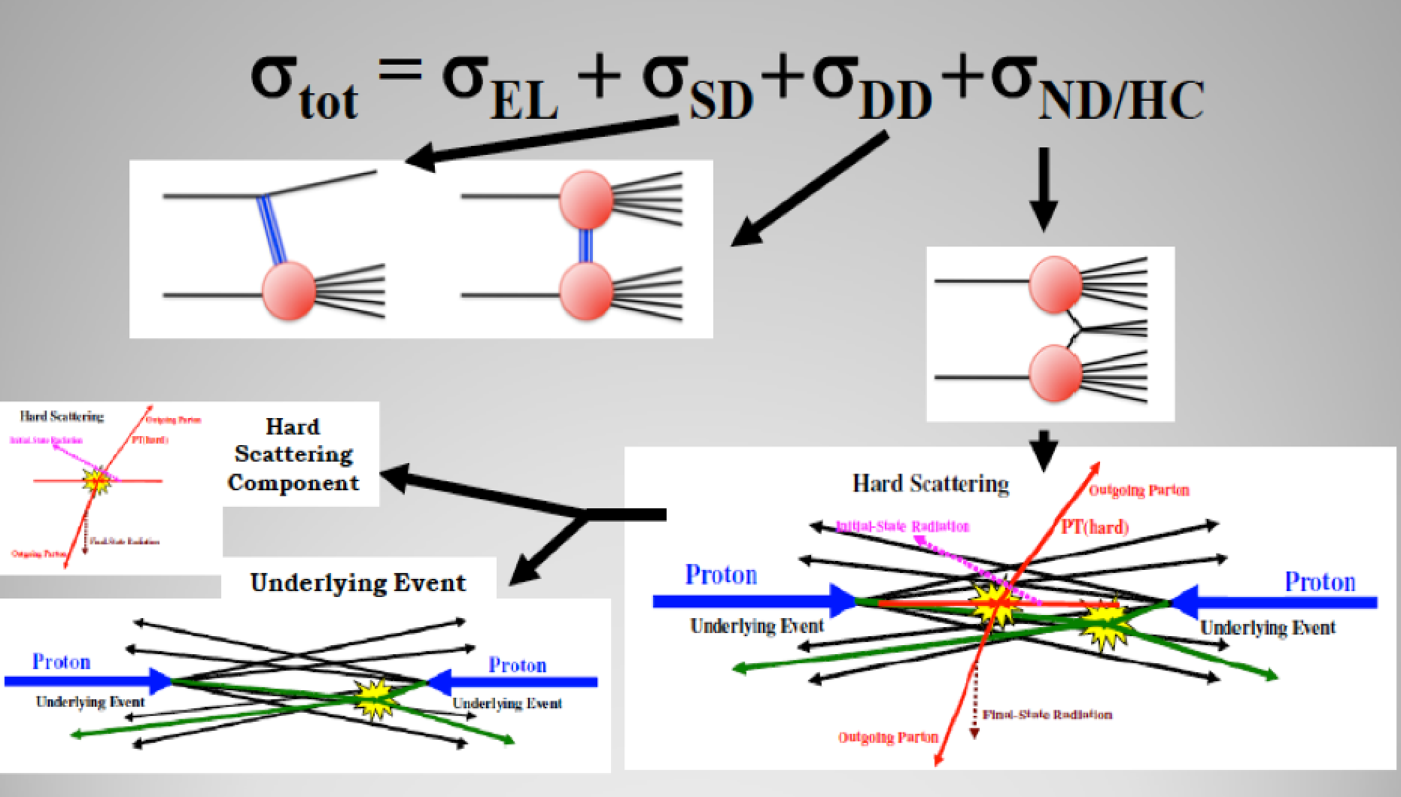
Event Types and Underlying Event
•Elastic Scattering
•Single diffraction
•Double diffraction
•Non-diffraction
…Not always easy to classify individual events

Slide 15
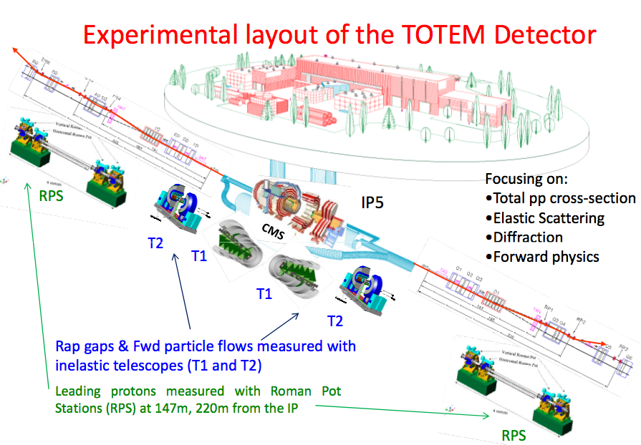
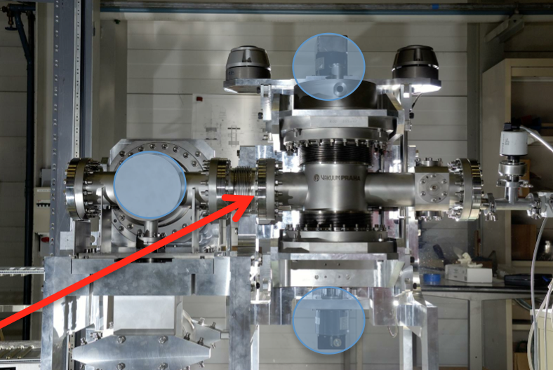
CMS + TOTEM

Slide 16
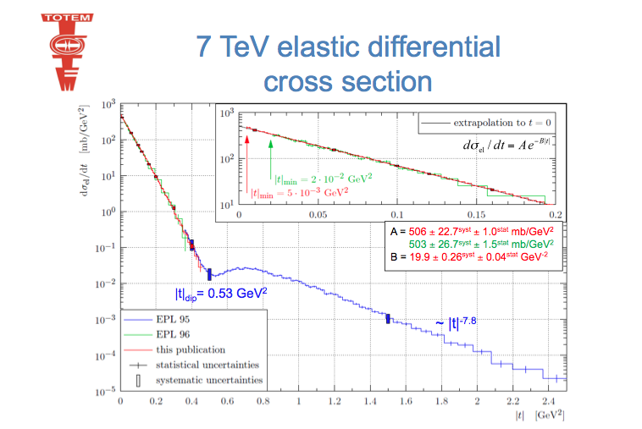
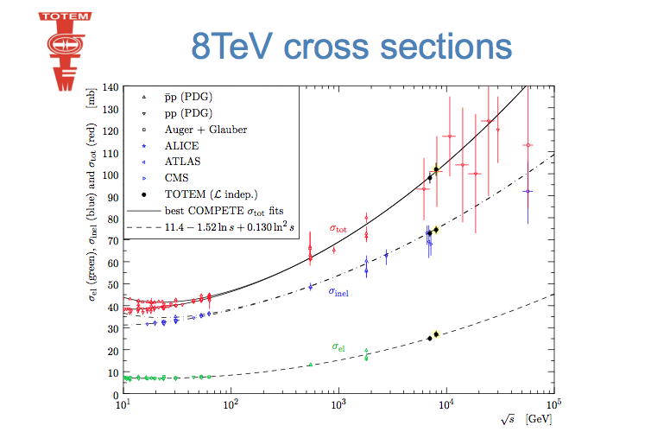
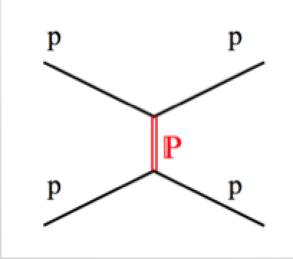

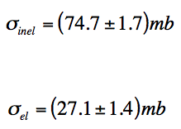

Elastic/Total pp Cross Section
TOTEM = Roman Pots + Forward Detectors
TOTEM uses the same IP as CMS (IP5)
EPL 101 21004 (2003)
Future: •High beta measurements for Coulomb-Nuclear interference, ALFA

Slide 17
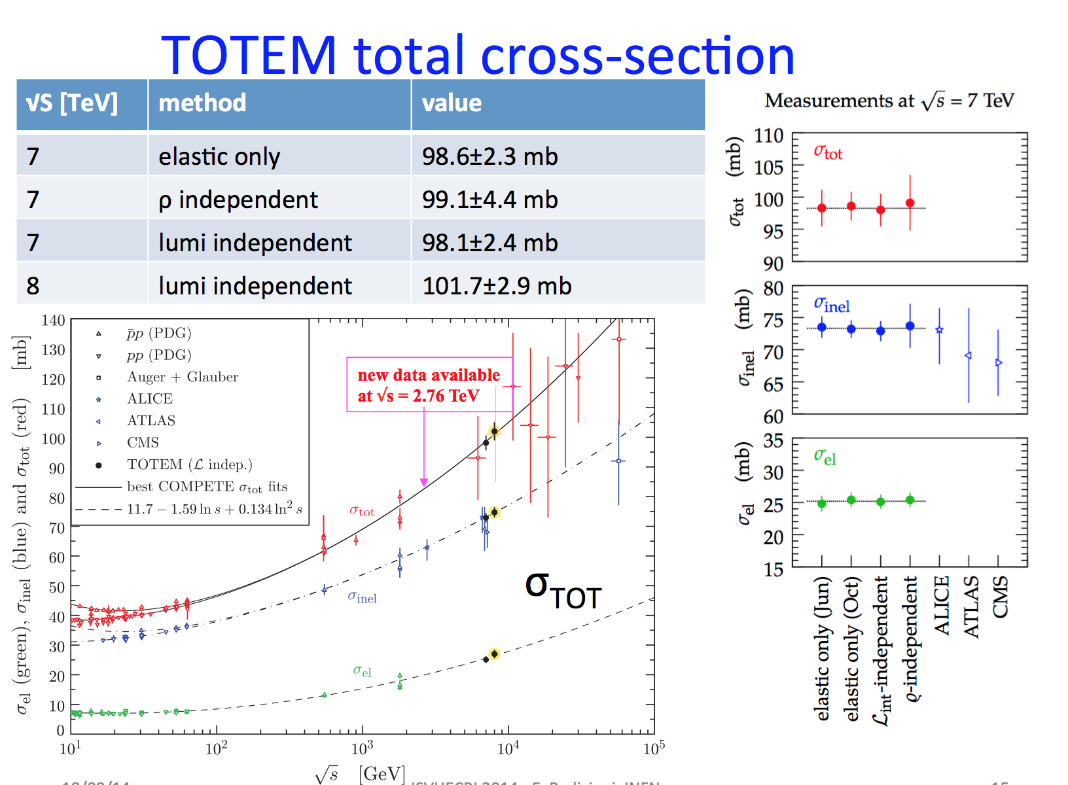
Elastic/Total pp Cross Section
Alfa result

Slide 18
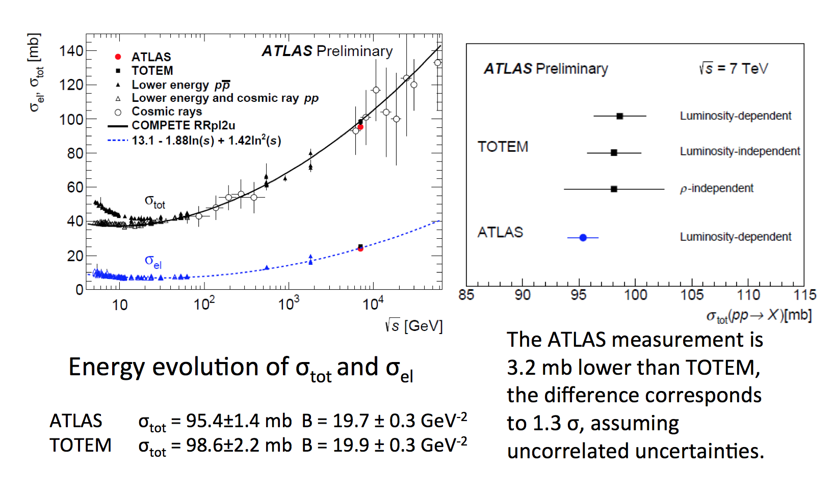
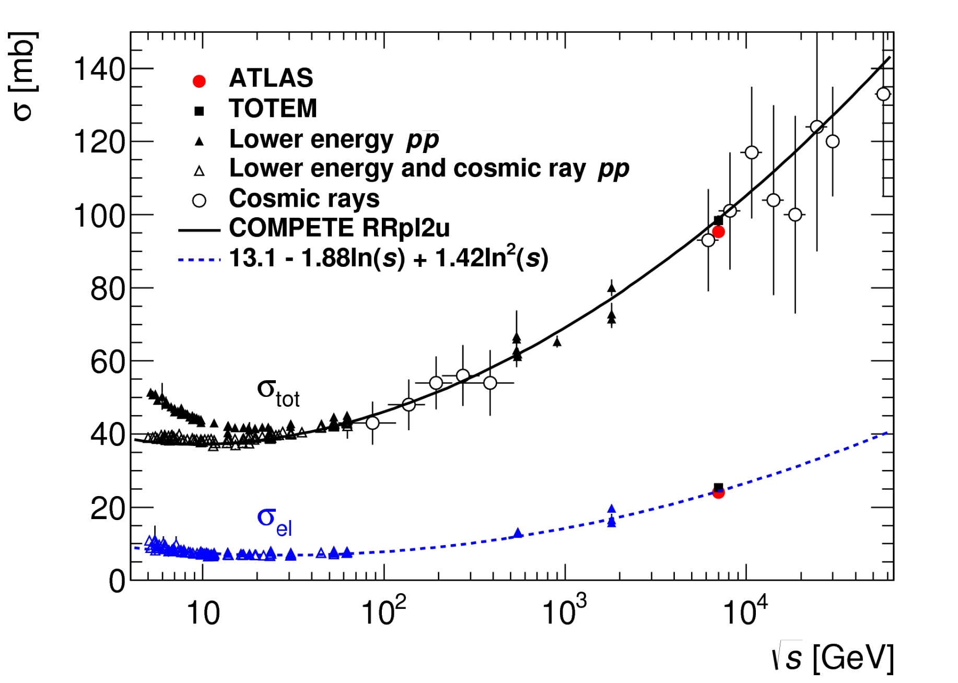
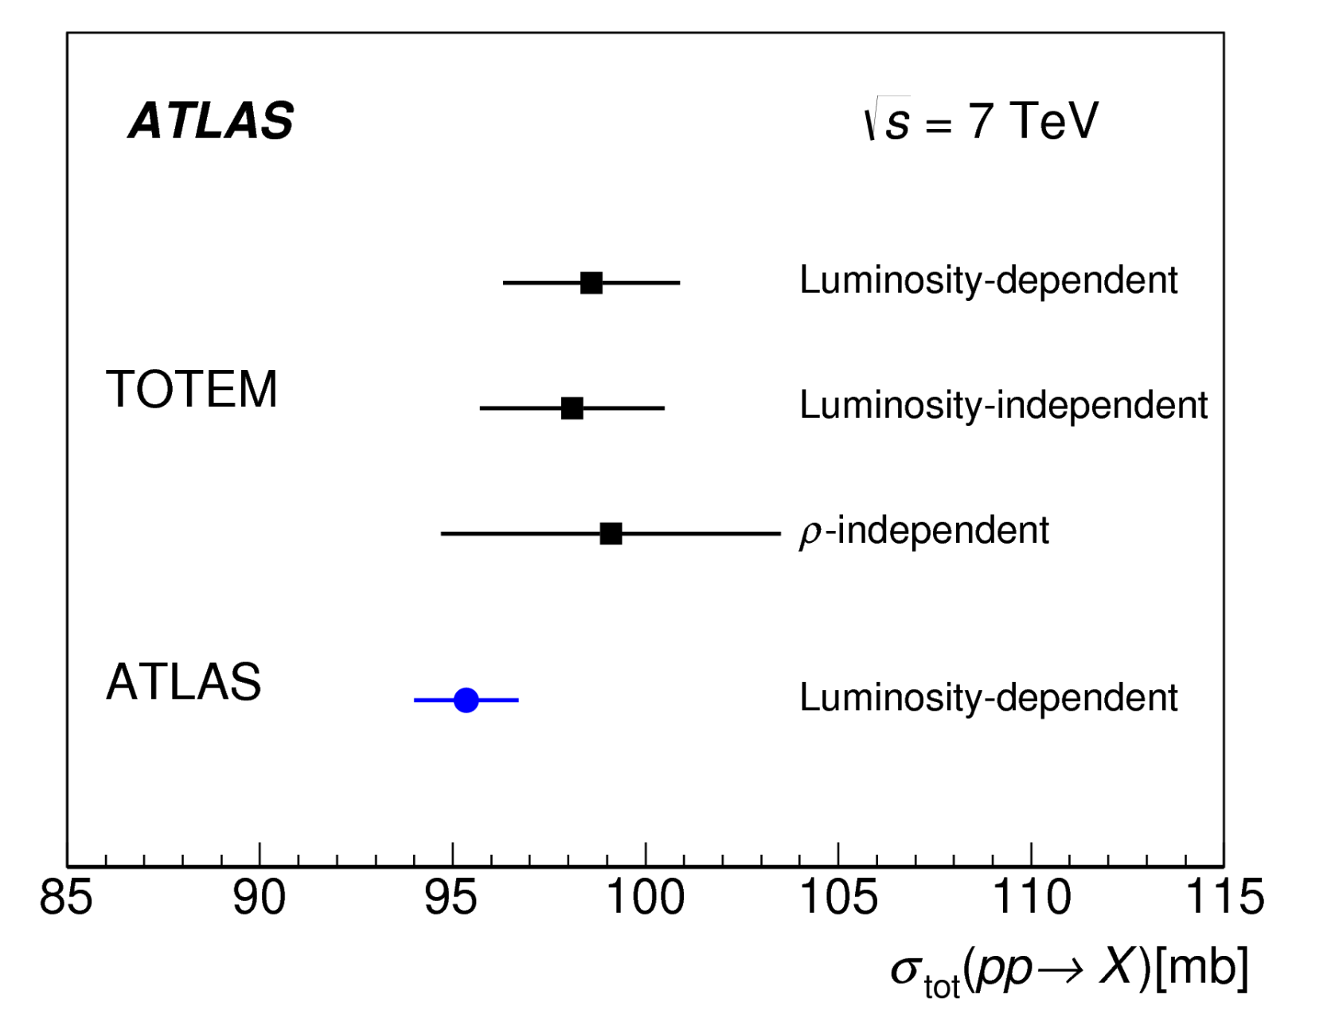
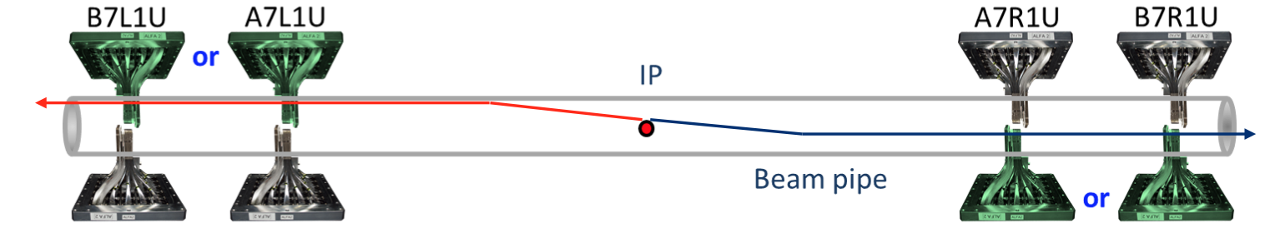
Elastic/Total pp Cross Section
Alfa result
arXiv:1408.5778

Slide 19
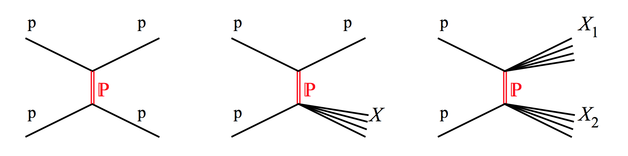
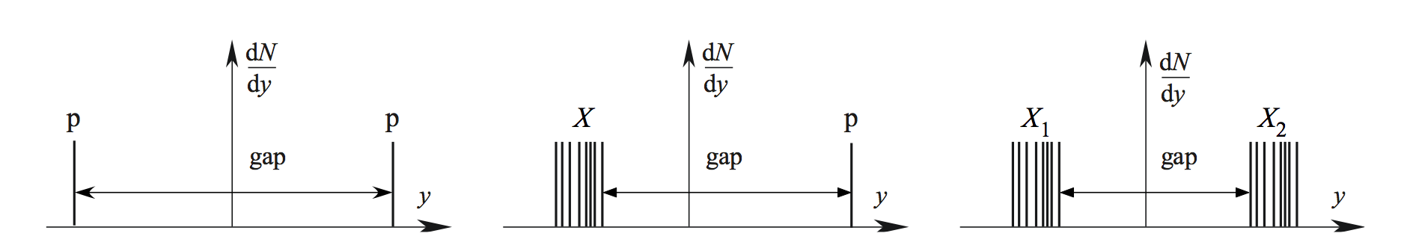
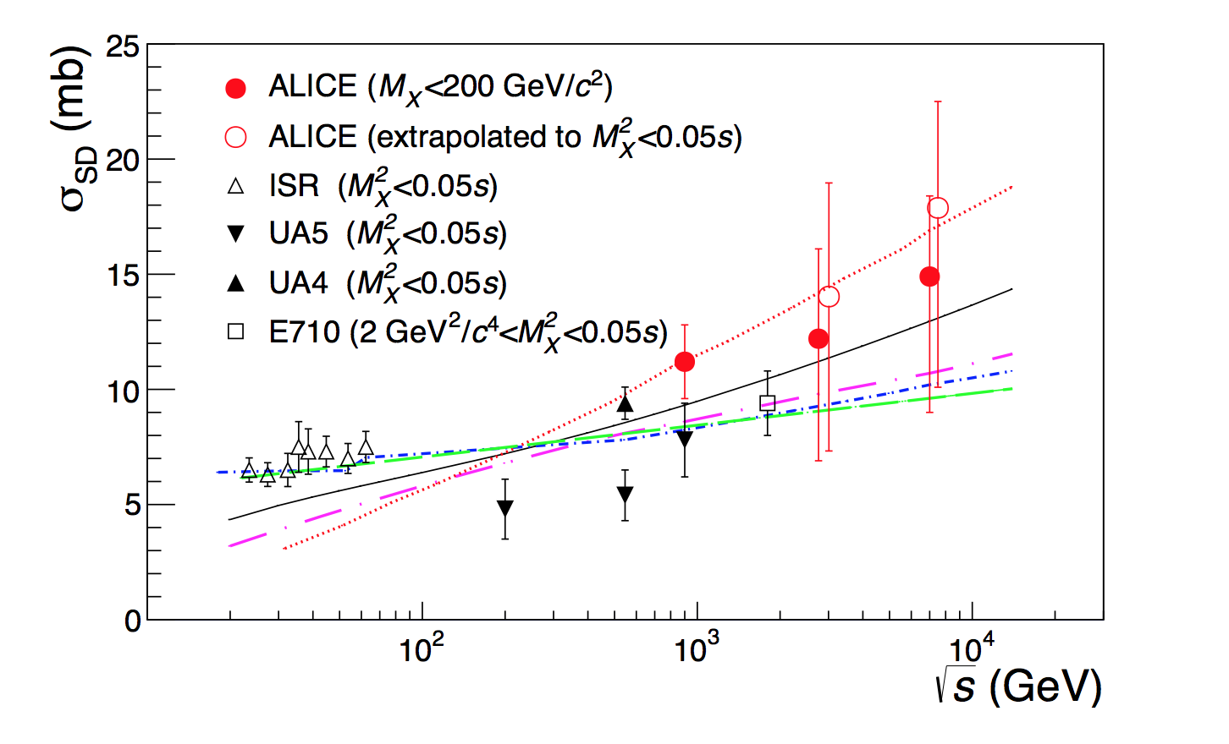
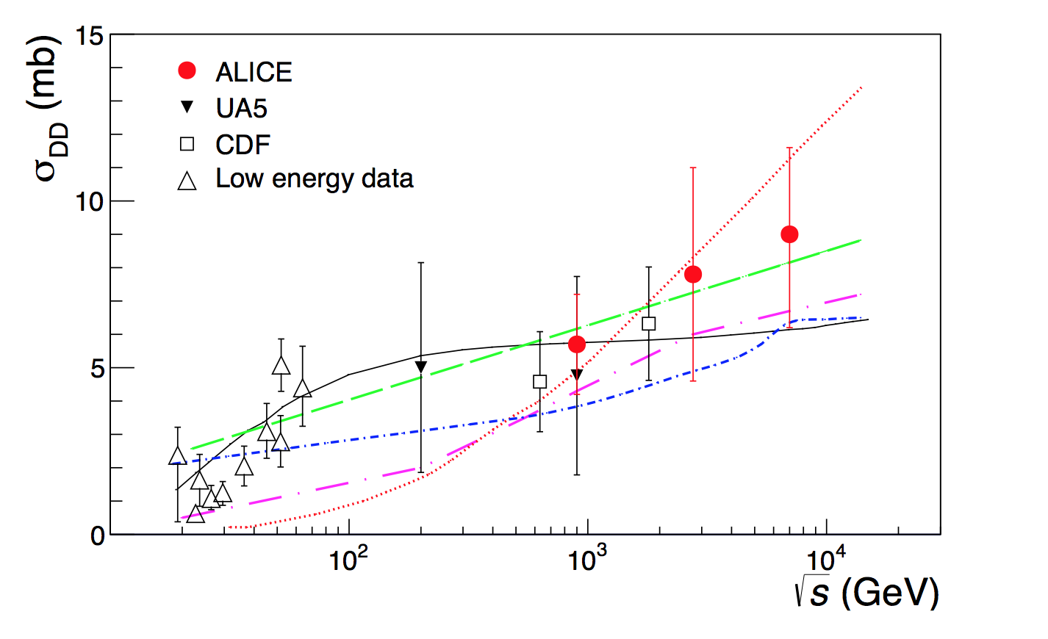
Diffractive Cross Sections
arXiv:1208.4968
Single diffraction
Double diffraction

Slide 20
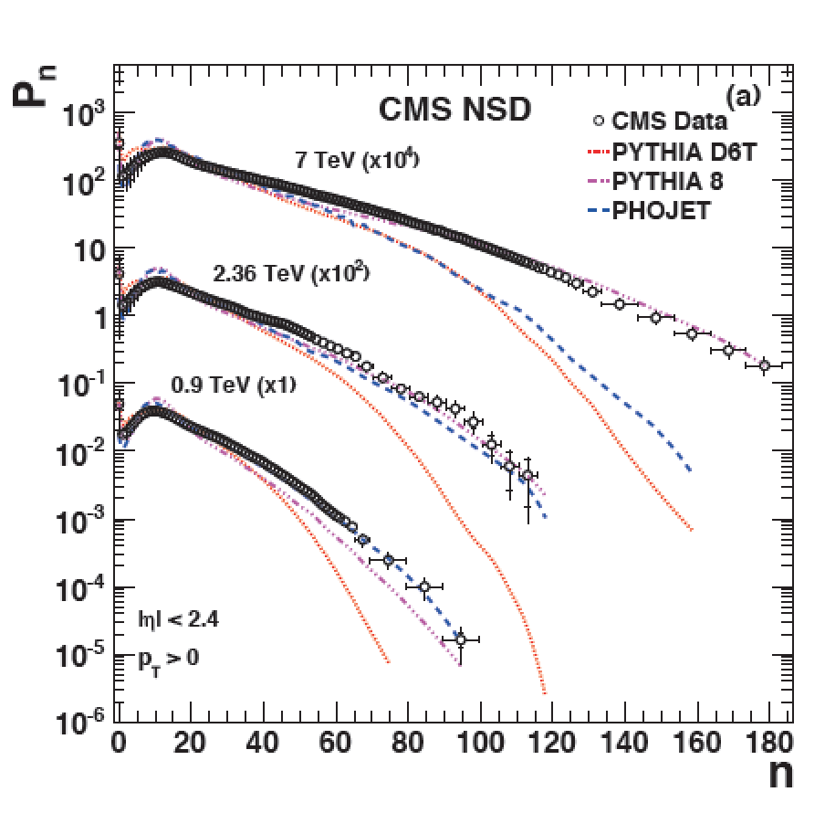
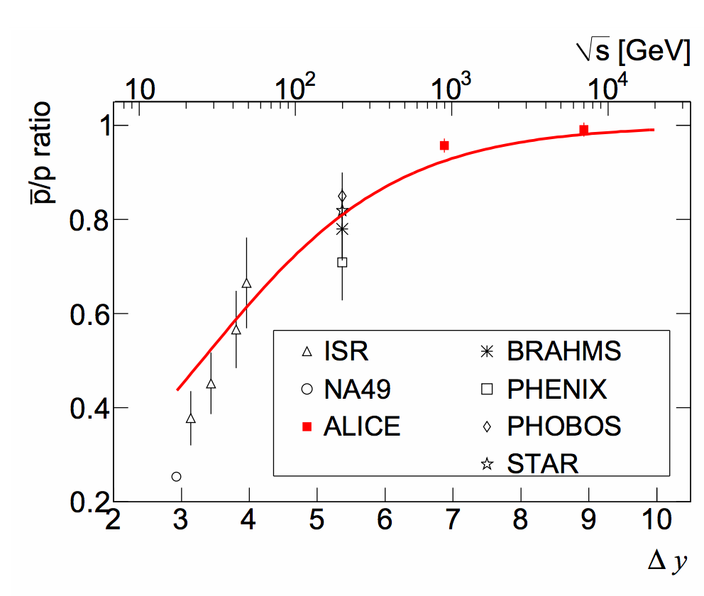
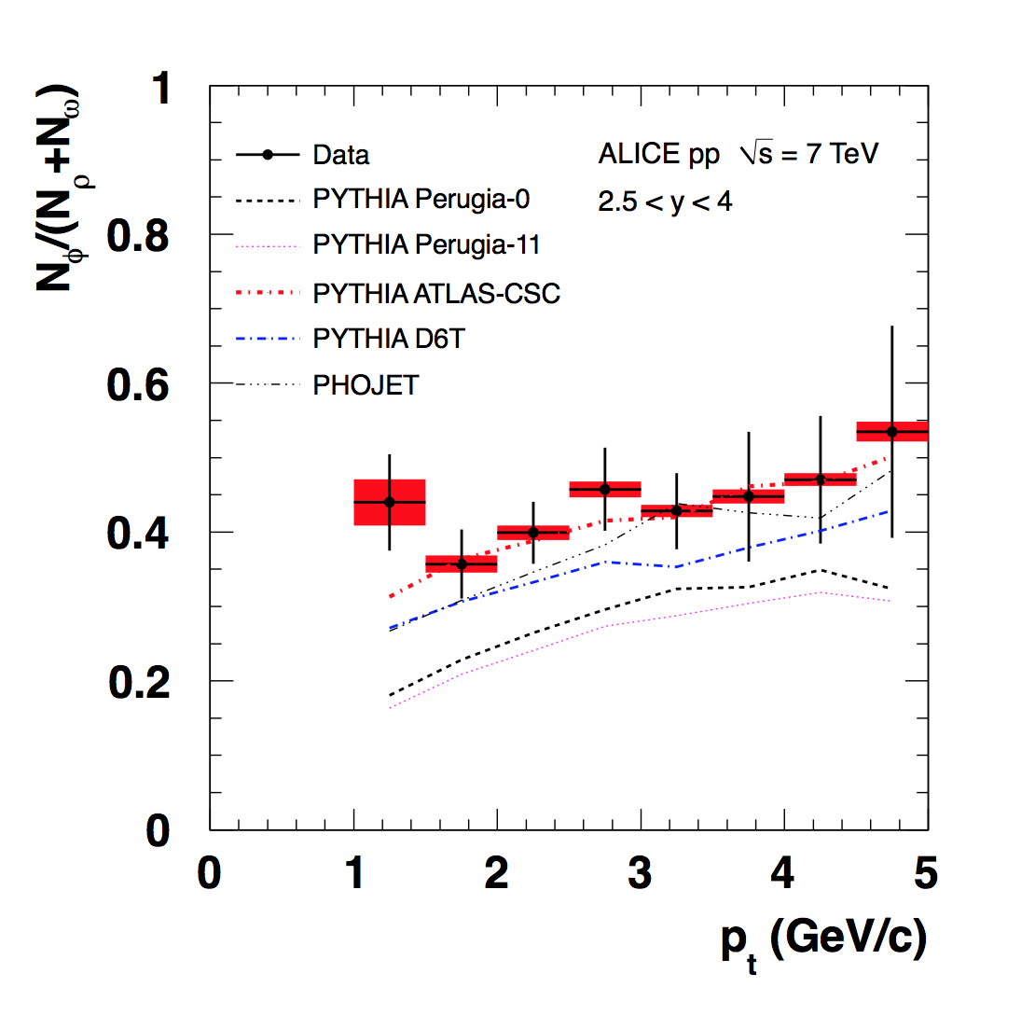
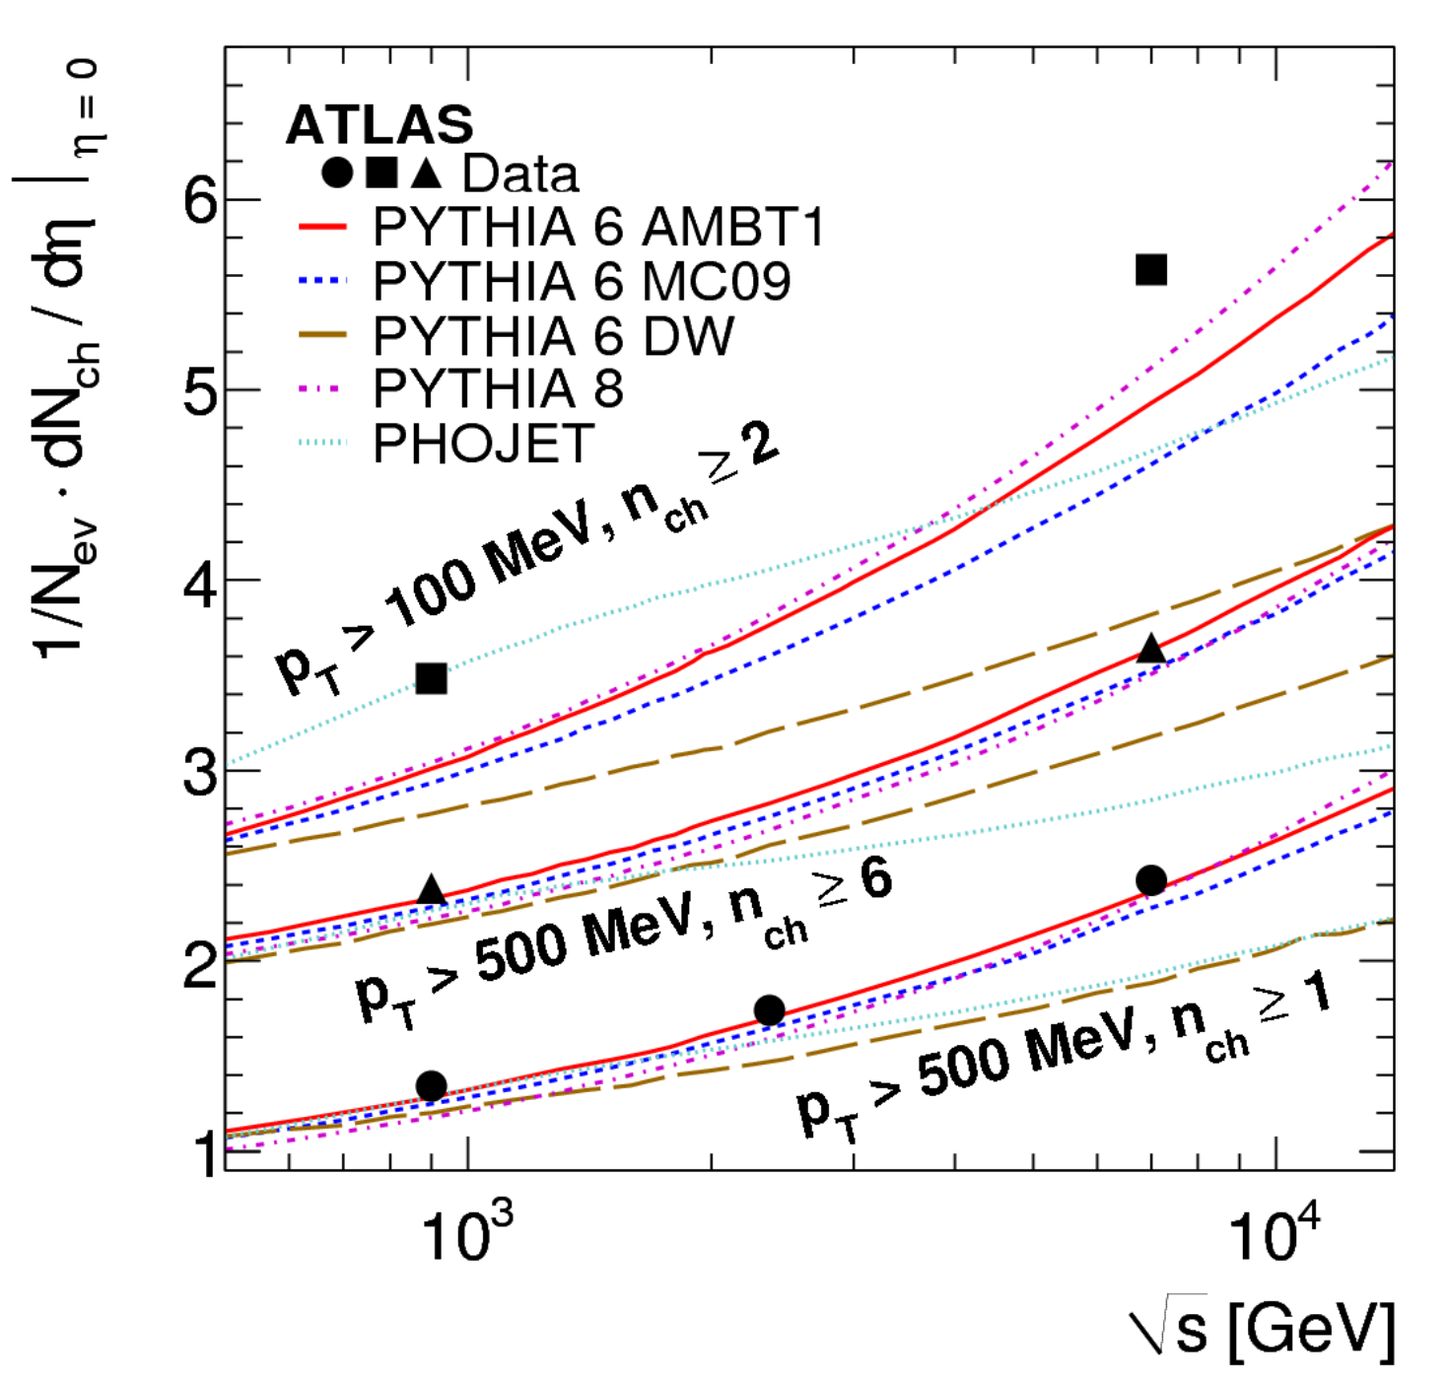
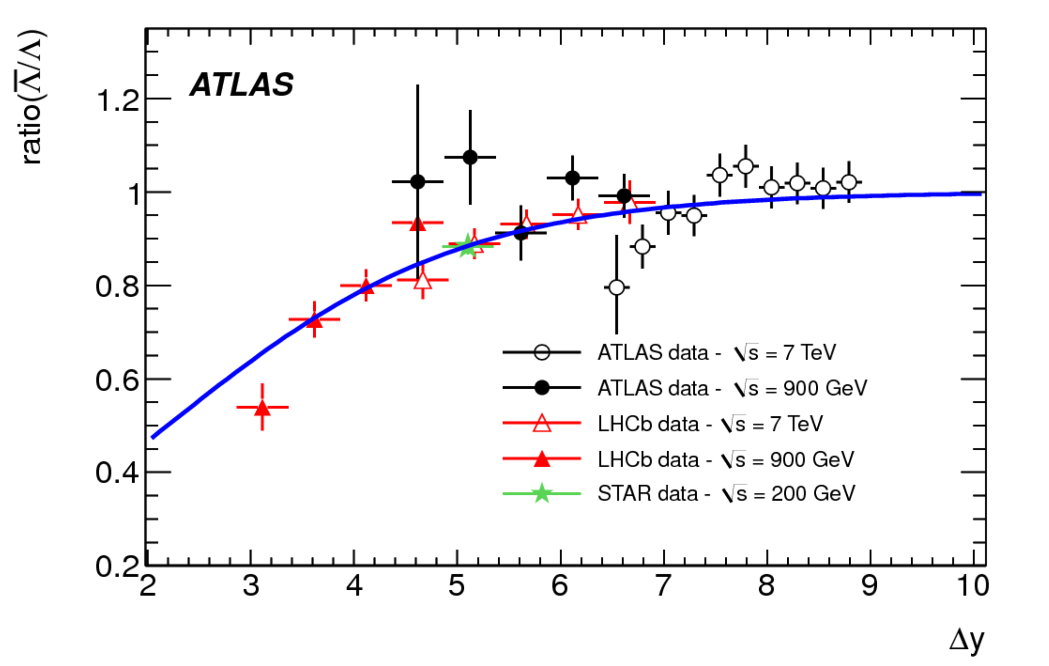
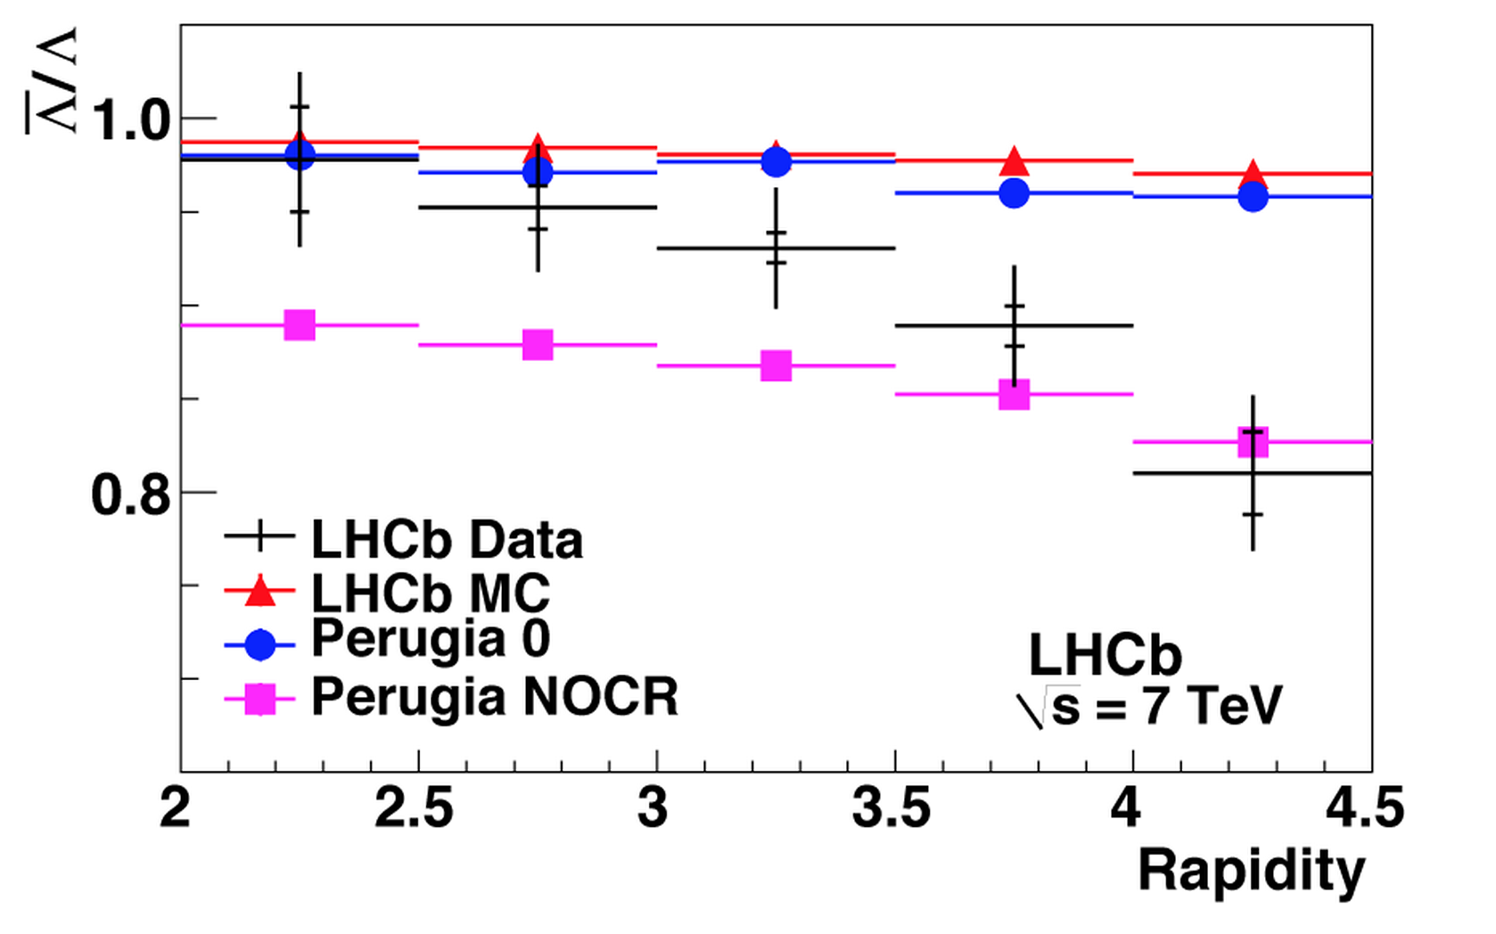

Understanding Particle Production
•Single particles, multiplicities etc. vs phenomenological models…
•LHC detectors are excellent and complementary for such studies
p/pbar
Φ/ρ+
Φ/ρ+ω
Multiplicities
Density at η=0
Λ/Λbar
Φ

Slide 21




Underlying Event Studies
An important systematic effect for precision measurements, eg top mass
All central detectors have made measurements in the ‘transverse’ region:
Measure the particle
flow in transverse
region as function
of the hard scale
7 TeV
900 GeV

Slide 22



Double Parton Scattering
Example: angular correlations study of W+ 2jet events: The fraction of the
cross section attributed to DPS= 0.08 ± 0.01 (stat.) ± 0.02 (sys.)
arXiv:1301.6872
Basic process
DPS
Difference between the transverse momenta
of the two jets (p_{T} > 20 GeV)
DPS can be important for searches where after cuts only a few events remain…

Slide 23



Correlations Between Produced Particles
•Select high multiplicity events
•Study the correlation between
two charged particles in the
angles φ (transverse):
Δφ and θ (longitudinal): Δθ
η= -ln tanθ/2
All events
High multiplicity events
A new phenomenon
in the ‘stronge force’?
•Multiple interactions?
•Glass condensates?
•Hydrodynamic models?
…
JHEP 1009 (2010) 091

Slide 24




Forward Particles Measurements
•LHCf uses the same Interaction Point as ATLAS (IP1)
•LHCf has forward detectors at zero degrees seen from the IP (140 away
from the IP): Measure the forward photons/pions for cosmic ray studies
PLB 703 (2011) 128
Forward gamma measurement compared
to Monte Carlos for Cosmic Ray studies
No model reproduces the data well !!
Important for understanding of cosmic ray data

Slide 25
Hard Scattering
Perturbative QCD

Slide 26



Strong Interaction: Jets Production!
Study the strong force using jet production
Di-jet invariant mass = 5.15 TeV (R=1.1 jets)
In this event more than 60% of the full
proton-proton energy
ends up in jets
Jets of particles
emerge after a high
energy parton-parton
Scattering

Slide 27


Early Measurements of Multi-jets
Early 2010 data…
Jet Multiplicity distribution
Eur.Phys.J. C71 (2011) 1763
A six jet event
Multi-jet distribution in good agreement with theory - LO matrix elements plus
matched parton showers - apart from normalization

Slide 28



Inclusive Jet Production (7 TeV)
Phys.Rev. D86 (2012) 014022
Check conclusions: D=0.4 and 0.6?
Agreement with NLO calculations over the full range, up to 2 TeV jets
The anti-kT jet algorithm is used in most studies. The ‘cone’ chosen for this
algorithm is different for ATLAS and CMS -> no direct comparison possible
ATLAS uses R=0.4 and R=0.6

Slide 29


Inclusive Jet Production (8 TeV)
CMS-PAS-SMP-12-012
Agreement with NLO calculations over the full range, up to and beyond
2 TeV jets

Slide 30

Inclusive Jet Production
Comparison with NLO calculations with the data in some detail,
for different proton structure function parameterizations.
Deviations for highest y range?

Slide 31




Extracting the Strong Coupling Constant
Measure the ratio of 3-jet to 2-jet events
This measurement is sensitive to the fundamental QCD parameter α_{s}
Di-jets within the range of 420 - 1390 GeV, p_{T} of all jets larger than 150 GeV
More methods are being used
World average
arXiv:1304.7498

Slide 32




New Directions: Boosted Jets & Substructure
Analyse boosted/merged jets
arXiv:0802.2470
•Start from Cambridge-Aachen FAT jets and apply jet “pruning” to find sub-jets
•Many methods being developed to analyse the jet substructure: grooming->
mass drop filtering, trimming, pruning…
Example: Boosted top events with b-jet and two merged jets from the W

Slide 33



Detailed QCD Jet-structure Studies
Detailed QCD jet studies such as substructure grooming are important to get:
  Deeper insight into pQCD evolution in jets
  To perform searches for New Physics in a new way
CMS-QCD-10-41
arXiv:1203:4606
Subjet multiplicity
k_{T} splitting scale
Jet width

Slide 34


Low-x Studies at the LHC
High energy of the LHC allows to
access regions of low Bjorken-x
Detector coverage to large |η| is
important! Typical measurements:
• Low mass Drell-Yan, Jpsi…
Prompt photon production
Jet production with large rapidity
QCD Dynamics studies:
DGLAP: Dokshitzer, Gribov, Lipatov, Altarelli Parisi
BFKL: Balitskii, Fadin, Kuraev, Lipatov

Slide 35








Low-x: Mueller-Navelet Jet Studies
•Look at correlations between jets -with p_{T}> 35 GeV- at large rapidity distance
•Proposed in the early ‘90’s to as sensitivity test to BFKL and DGLAP evolution
CMS-PAS-FSQ-12-002
central + forward jet
azimuthal correlation vs Δy
Δy
No model describes all
these measurements
very well

Slide 36
W and Z Boson Production

Slide 37




W and Z Boson Production
Select final states with leptons
arXiv:1107.4789
arXiv:1109.5141
Missing transverse energy
from the W → μ+ν decays
Z peak (di-lepton pair
mass distributions)

Slide 38

W and Z Boson Production

Slide 39
Top Quark Production

Slide 40




Top Quark Physics
•The heaviest known elementary particle: ~173 GeV
•Coupling to the Higgs ~1 → Special role in EWK symmetry breaking?
•Special sector to searches for new physics

Slide 41


Candidate Event for Top Production

Slide 42





Top Pair Production at 7/8 TeV
ATLAS and CMS have made top anti-top pair cross-section measurements at 7 and
8 TeV, and are in agreement with NLO QCD expectations. Present precision ~ 6%

Slide 43



The Mass of the Top Quark
Using Tevatron and
LHC combination of the
mass measurements
The best value
on the top mass
to date!!

Slide 44


Top Quark Production at 7/8 TeV
EWK production
of single-top
Measurements at 7/8 TeV in agreement with NLO QCD expectations.

Slide 45


Vector Boson+Jets and Top+Jets
arXiv:1304.7098
High statistics and precision at the LHC
allows for W/Z+jets and top+jets studies
arXiv:1404.3171
top+jets
Z+jets
Good description by theory for both processes
Important backgrounds for searches, eg for SUSY searches

Slide 46

Summary: Cross Sections at 7/8 TeV
Measurements in good agreement with the Standard Model predictions

Slide 47


Anomalous WW Production?
Di-boson production: This should not be a problem for theory, no?
Bizar: all measurements so far gave a systematically higher value!
Less the case for ZZ and WZ as far as we can see…

Slide 48

Anomalous WW Production?
What was missing until now was the ATLAS 8 TeV result
ATLAS-CONF-2014-033
Important: how well do we control the theory? Now NLO, Higgs included

Slide 49





New Physics in WW Cross Sections?
Both these phenomenology papers appeared on June 3rd …
Da
arXiv:1406.0858
arXiv:1406.0848
Interpretation in the two papers
(Overall analyses of WW, and
available SUSY searches):
→ Stop pair production -- with m_{stop}
~ 200 GeV– plus decay to chargino
leading to the WW excess
Da Costa
ICHEP14
My take:
•Need to have a careful look at QCD
corrections, effects of the jet veto…
•Need other measurements eg
WW→lνjj, WW+0/1/2 jets…
•Tests in other channels?
ATLAS already excluded this point?
•WW excess at 13 TeV?

Slide 50





Precision Measurements: B_{s(d)} →μμ
•A B_{s} particle is a particle consisting of a beauty-quark
and strangeness-quark, with a mass of ~ 10 GeV
•Three B_{s} particles in a million will decay into two
muons. This decay has been chased since 30 years.
•New physics modifies these Standard Models predictions
CMS-BPH-13-007
arXiv:1211.2674
Results from
LHCb +CMS
experiments
combined
But no sign of New Physics here…☹

Slide 51



Higgs!
We discovered a Higgs particle!
December 2013

Slide 52





Brief Higgs Summary
We know already a lot on this Brand New Higgs Particle!!
Width =
A: < 24 MeV
C: < 22 MeV
(95%CL)
Mass =
A: 125.4 ±0.4 GeV
C: 125.0 ±0.3 GeV
Couplings are
within 20% of
the SM values
Spin =
0⁺ preferred
over 0⁻,1,2
SM-like behaviour for most properties, but we look of course for anomalies,
i.e. unexpected decay modes or couplings, multi-higgs production…

Slide 53


Search for LFV Decays: H →μτ
CMS-PAS-HIG-14-005
On public demand
from our theory
friends ☺

Slide 54

Search for LFV Decays: H →μτ
Mild excess giving a 2.5σ effect… To be watched!!!

Slide 55
Summary
Run-I delivered many measurements of Standard Model processes, eg on the top quark, EWK and in QCD. Some features of multi-particle production are not understood.
Electroweak measurements show agreement with the data in general. Some effect in WW production?
The LHC is a top-factory. Very detailed study of the top quarks ongoing. No surprises yet!
A prime target of the LHC was the discovery of “a” or “the” Higgs particle. Particle found/Mission accomplished! ☺
The new particle has properties compatible with a Higgs, but surprises are still possible. This will be one of the topics for the coming run.
But where is everybody else? → Lecture III

Slide 56

Parton Distributions
Parton distributions (PDFs) are an essential ingredient of the LHC program
Several PDFs available at NNLO: ABM, MSTW, CT, NNPDF, HERAPDF,…
Studied within the experiments in PDF groups, and across experiments with the fitters in PDF4LHC
PDFs groups provide central values and error envelopes that differ
-> different choice of data used as input, different TH treatment especially
for heavy flavors,…

Slide 57

PDF Precision Impact LHC Physics
J. Rojo DIS’13

Slide 58




PDF Precision
Precision on Higgs
cross section from
PDFs (and α_{s} )
What is the ultimate
precision on PDFs?
Now and in future?
Include LHC data!
(wish list in appendix)
W, Z data included
Top quark data included
W+c data to tag s-quark
->strangeness supp. ~0.5

