Slide 1
GeantV scheduler, concurrency
Andrei Gheata
GeantV FNAL meeting
Fermilab, October 20, 2014

Slide 2
Parallelism
Threads
  1 master: initialization
    idle during transport
  N workers: transport, re-basketizing
    No cross-talk during transport
    Concurrent write to pending baskets (N to 1)
  1 scheduler: trigger priority mode, garbage collections
    Concurrent write with workers to pending baskets (N+1 to 1)
Queues – a lot of work done to improve here
  1 work queue, 1 output queue (removed)
    ~1E5 transactions/sec
  N volumes basketizer queues
    Pre-allocate baskets, activate current one (take from queue)
    Lower throughput than main work queue
Amdahl in both thread communication and queues
  First can be alleviated by changing basketizing policy
    E.g. thread “ownership” for basketizers

Slide 3
Basketizing -> filtering
Basket manager
Transport threads
Basket manager
Basket manager
Basket manager
Filter 1,2,3
Transport threads
Basket manager
Basket manager
Filter 4,5,6

Slide 4
MPMC queues
MPMC = multi producer multi consumer concurrent queues
We exchange baskets and individual tracks between threads using concurrent queues
  Major component for optimizing GeantV performance
Many flavors of MPMC
  Sync type: atomic (aka lockfree) versus mutex based
  Memory management: bounded versus infinite
  Functionality: provide priority mechanisms or not
  Implementation: ring buffer versus linked list, …
Performance measured in transactions/second
  Queues give generally best throughput in single thread mode: one does not measure scalability, but only throughput degradation with NTHREADS

Slide 5
Queues in GeantV
Mutex based dcqueue
  In production as work queue, provides priority
Mutex/atomic hybrid priority_atomic
  Mutexed only in high concurrency regime, provides priority
Atomic CAS (compare and swap) mpmc_atomic
  In production for basketiser queues, replacing dcqueue
  Circular buffer, no priority
Array lockfree carray_lockfree (ported by Omar)
  Another implementation of circular buffer queue
Boost lock free queue boost_lockfree (ported by Omar)
  Boost implementation of lcck free queue

Slide 6
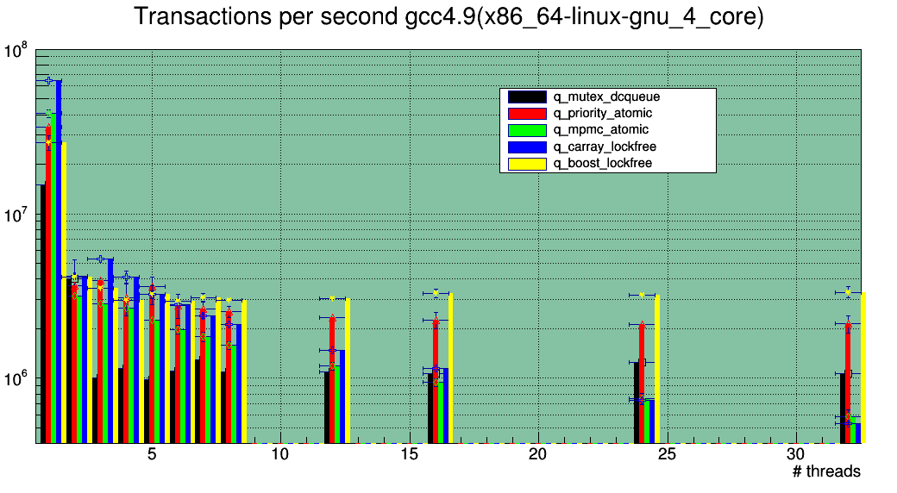
Performance x86_64_4_core

Slide 7
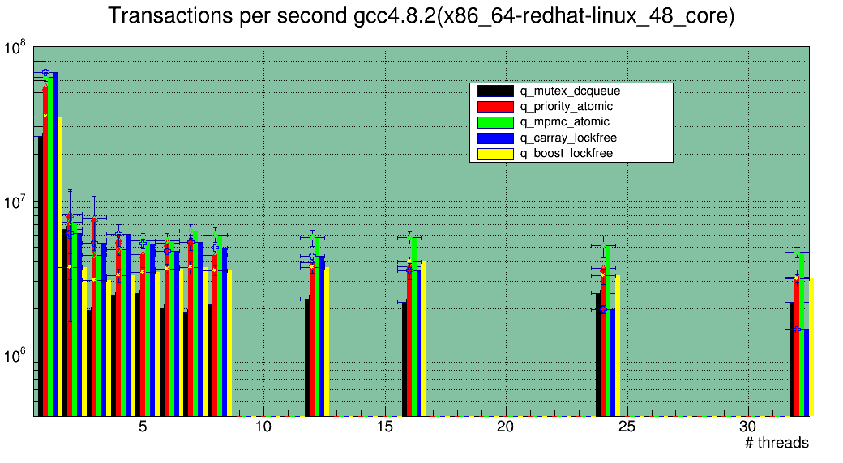
Performance x86_64_48_core

Slide 8
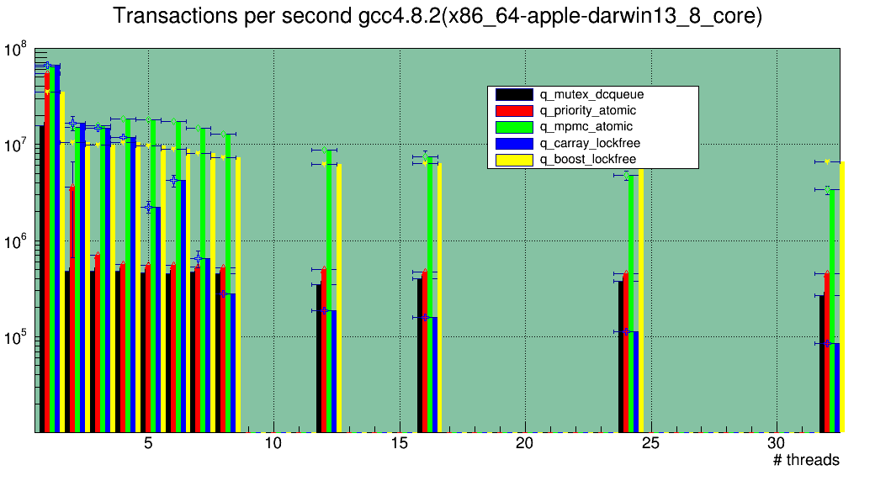
Performance x86_64_apple_8_core

Slide 9
Queues summary
Our current dcqueue is outperformed by all the others on all platforms
  We currently work at ~10⁵ transactions/sec
Lockfree queues are doing great on Mac compared to mutex-based ones (50x factor!)
priority_atomic is the only current replacement for dcqueue (must provide priority)
  We can expect a factor of 2 queueing improvement on x86_64 linux
Reducing Amdahl requires revisiting the basketizing model

Slide 10
To do - scheduling
Generic basketizers
  Move from a volume oriented basket manager to a “filter” concept
  Filters have to be complementary (F1+F2+…+Fn=ALL)
  Parallelism model upgrade: no concurrency per filter
    A thread can only invoke a subset of filters (owns the associated baskets)
Integrate a working GPU scheduler
  What gets filled in GeantTrackV?
  What are the blockers?
  GPU basketizer?
  I hope to clarify the issues related to GPU scheduling during this workshop
Integrate I/O with the scheduler
  First step: User data structures (hits/digits)
  Second step: kinematics
    Requires event model (e.g HepMC, custom, …)

