Slide 1
Status of Vectorized Physics
Soon Yung Jun
(FNAL)

Slide 2
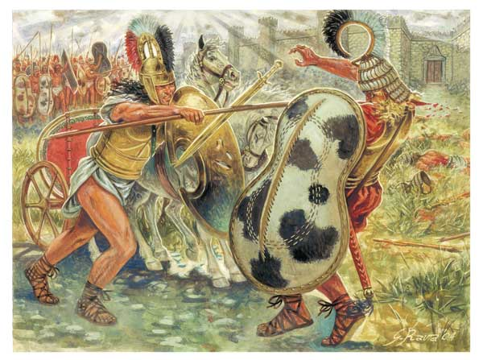
25C Ago: Death of Hector
Τροψ
Achilles
Hector

Slide 3
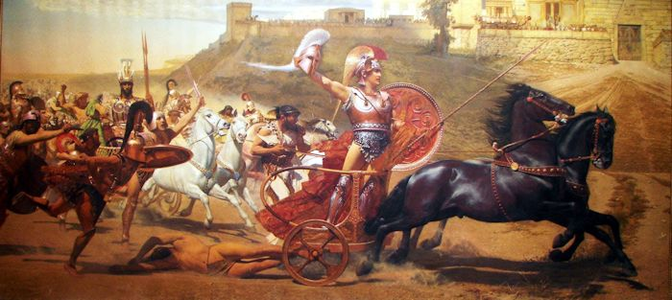
2 Decades Ago: Death of Vector
HEP
Microprocessor
×
HVector

Slide 4

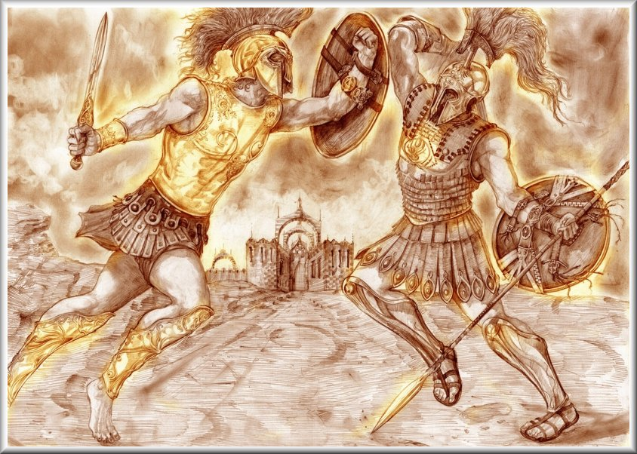

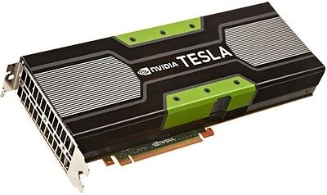
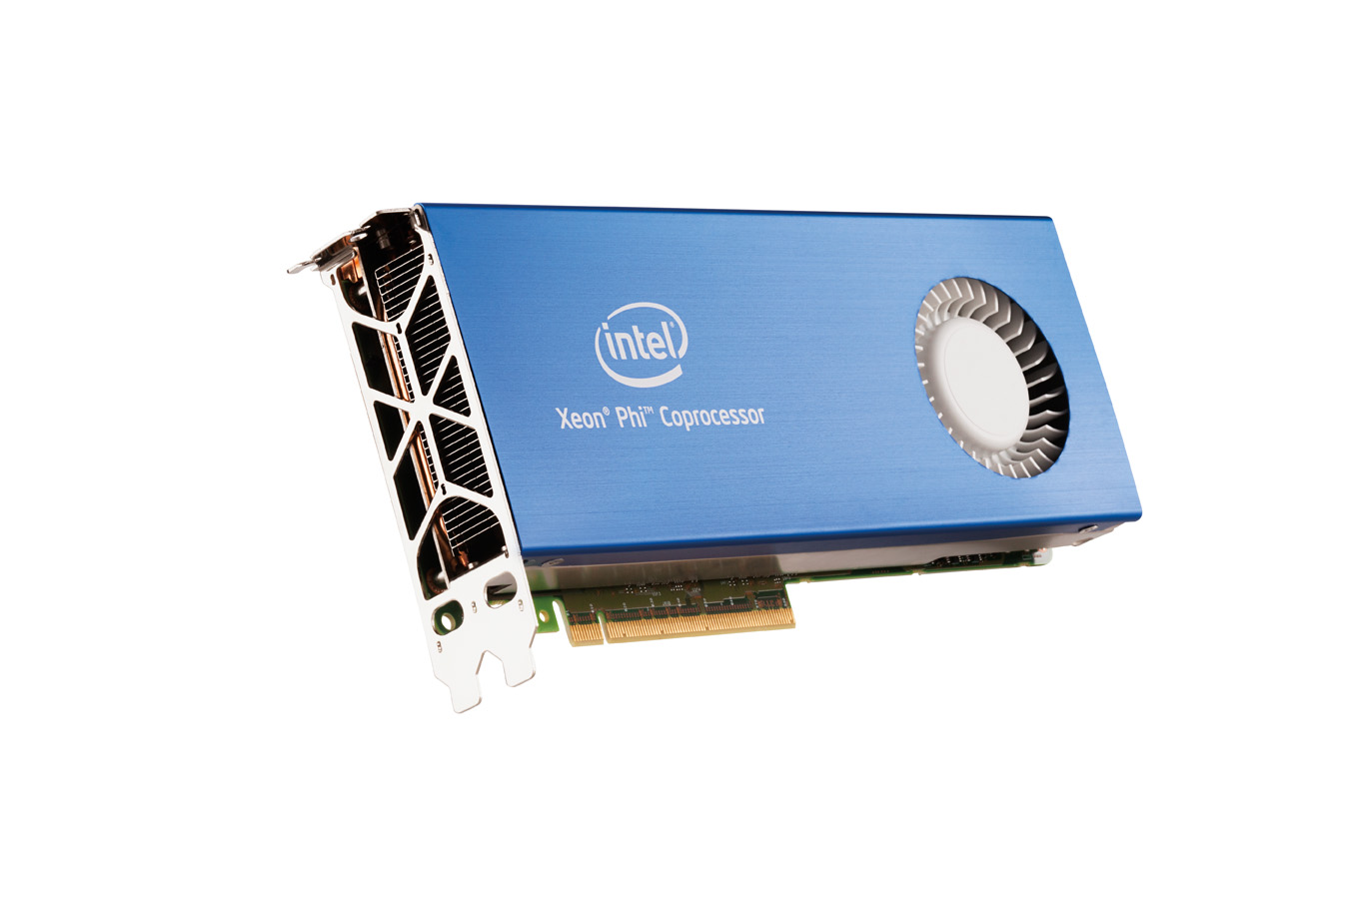
Today: Vector is still on HPC Battle Field
HPC
GPGPU
MIC

Slide 5

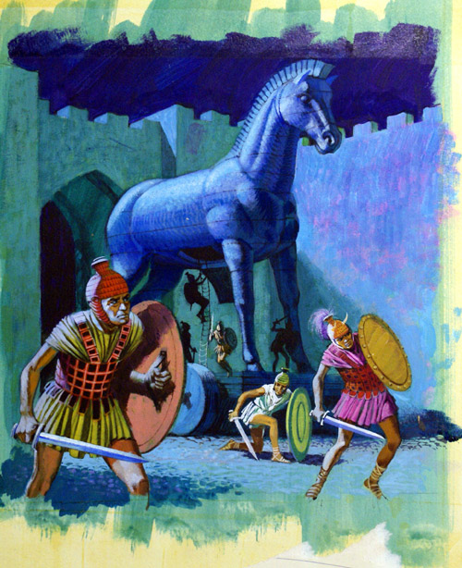



Allies of GeantV
FNAL
G.Lima
Philippe
HEP
Rene
GeantV
Mihaly
Sandro
S.
Federico
Andrei
JohnA.

Slide 6
Specialized Applications
Vector: no good for convention physics model!
  pipelined instruction/data throughput
  locality (spatial, temporal)
GPU : no good for convention physics model!
  arithmetic intensity
  substantial parallelism
  throughput over latency
Common strategies or potential solutions?
  decompose tasks
  minimize branches and data dependencies
  share or reuse data

Slide 7
High Performance Physics Models
Physics processes and models cannot be easily vectorized or parallelized: Why?
  stochastic process (random-ness kills parallelism)
  decision trees (branches and switches)
Paradigm swift
  task level parallelism
  algorithmic changes (performance over …)
  tabulated physics
  alias method (replace loops with conditional breaks)

Slide 8
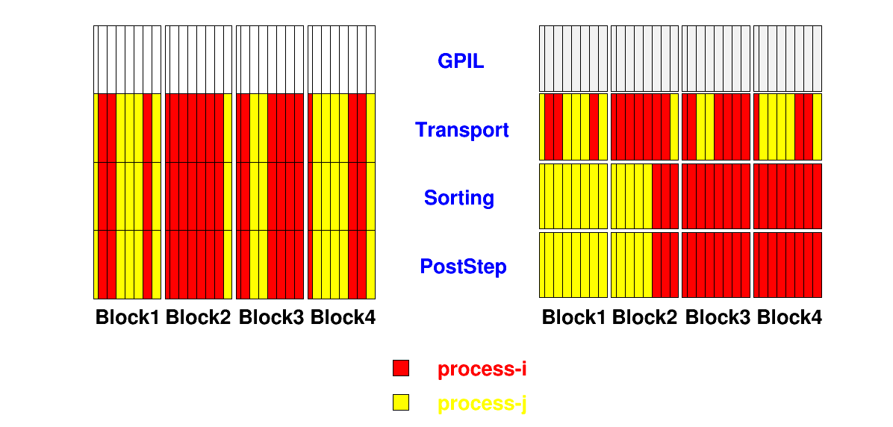
Task Decomposition
Task by the particle type (e⁻,γ, h) or geometry
Regroup particles (tracks) by the same task

Slide 9
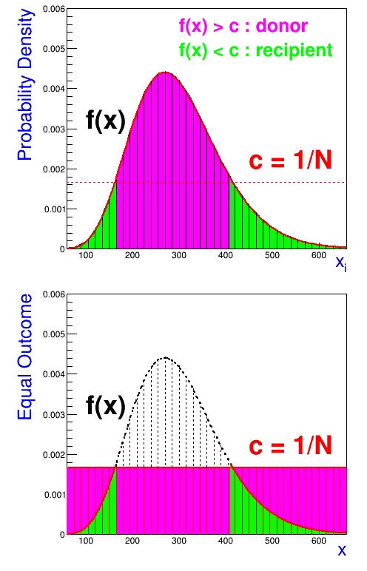
Alias Method: Sampling
Recast p.d.f f(x) to N equal probable events, each with likelihood 1/N=c
Alias table
  a[recipient]=donor
  q[N] = non-alias probability
Sampling x_{j} : random u₁, u₂
  bin index: N x u₁ = i + α
  If (q [i] < u₂) : take j=i
  else take j = a[i]
  x_{j} = [α j + (1-α) (j+1)]δx

Slide 10
Particle Tracking
Process
  mean free path analysis (step length)
  sampling physics process
Associated
  multiple scattering (true path length)
  transport (geometry limited step)
Interaction
  sampling secondary particles
  other collision analysis

Slide 11
Applications of Alias Methods
Replace non-vectorizable conditional branches
  composition and rejection methods (do-while)
    no bias compared with Geant4 in secondary particle sampling (see the next page)
  conditional exit to select (if-break)
    physics process (relative weight of cross sections)
    random element of composite material
    (can have pre-built alias tables from xsec data table?)
To vectorize alias method effectively
  coalesced random array
  gather scatter memory accesses

Slide 12
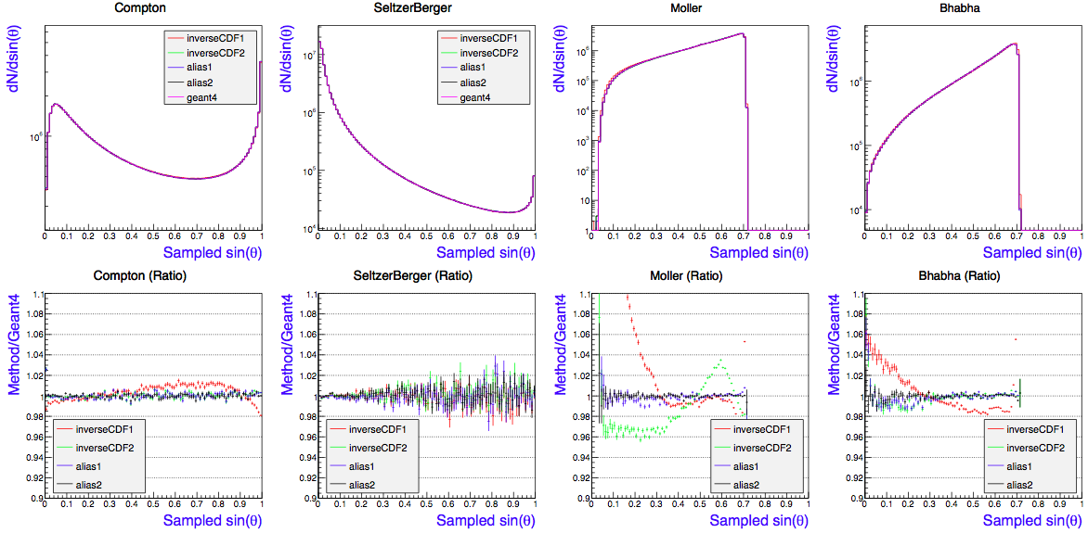
Alias Method: Validation
Angles of scatter particles

Slide 13
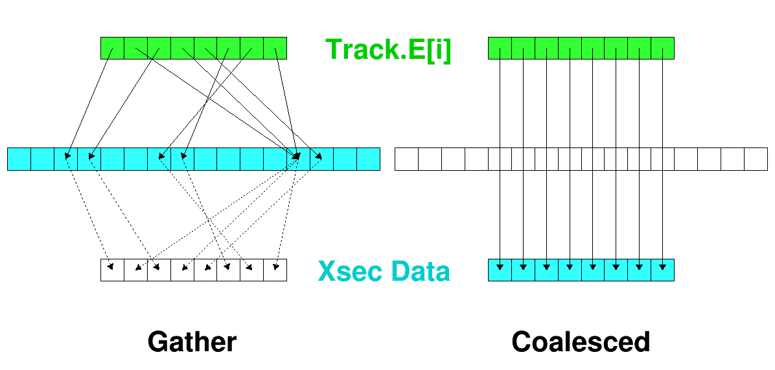
Gather
Gather operations may be very expensive if associated arithmetic intensity is light (overhead > gain)

Slide 14
Sampling Physics Process
Inclusive sampling vs. explicit sampling
 | Inclusive | Explicit
step length (d) physics process | d=min(d_{t},d_{g}) d_{t}=-log(u)/σ_{t} sampling by xsec weights | d=min(d_{i},d_{g}) d_{i}=-log(u)/σ_{i} Process for the smallest d_{i}
N_{int} left | process independent | material independent
N random N log(rand) | less than nv + (np-1) nv nv | nv x np nv x np
Consideration for vectorization | conditional exit to select a process Σwgt[i] < u | if test to select d and a physics process
implementation | holistic approach with a fixed number of processes | modularized (OO) design

Slide 15
Remarks
Statically, explicit sampling = inclusive sampling
  validation for passage through inhomogeneous materials (Geant4 vs. GeantV inclusive sampling?)
  Independent of process history?
Cons and Pros
  performance-wise: implicit
  flexibility-wise: explicit
  vectorization-wise: explicit
Performance, accuracy, portability

Slide 16
Status
Implemented alternative secondary particle sampling (alias, inverse CDF) for
  electron models
    Bremstraahlung (Seltzer Berger)
    Ionization (Moller Bhabha)
  photon models
    Compton (Klein Nishina)
Working on vectorization schema for the mean free path analysis: need to converge
  tracking strategies (inclusive vs. explicit)
  simd layers (outer vs. inner loop)

Slide 17
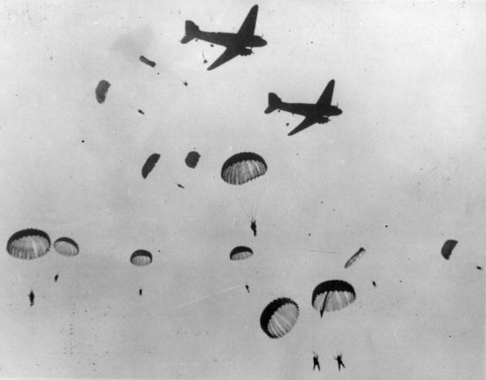
Toward HP Physics Library
Efficient random number handling and data layout
More task decomposition
Adopt the template approach (portability)
Need more troops

Slide 18
Backup

Slide 19
What to vectorize?
Ex1: do-while loop
Alternative: alias method for sampling from p.d.f (differential cross sections)
xo = f(Z); // common data
for(i = 0; i < ntracks ; ++i) { // for the problem-size
yo = g((track.E)[i],xo); // for a given constraint
\end{verbatim}
{\color{magenta} \begin{verbatim}
do { // sample x and y
x[i] = h(r1);
y[i] = s(x[i],r2);
} while (y[i] < yo);
}

Slide 20
What to vectorize?
Ex2: conditional exit to select a physics process
Alternative: alias method with the normalized weight of cross sections (physics processes)
// np = number of process
// w[np] = relative weight of cross sections
int ip = np;
double w = 0;
double fu = rand()
for (int i=0 ; i < np-1 ; ++i) {
w += w[i];
if (w < fu) { ip = i; break; }
}

Slide 21
What to vectorize?
Ex3: conditional exit to select a physics process
Alternative: alias method with the normalized weight of cross sections (physics processes)
// np = number of process
// w[np] = relative weight of cross sections
int ip = np;
double w = 0;
double fu = rand()
for (int i=0 ; i < np-1 ; ++i) {
w += w[i];
if (w < fu) { ip = i; break; }
}

Slide 22
What to vectorize?
Ex4: if-test to select a random atom
Alternative: mask
// np = number of processes
// s[np] = proposed step lengths
int ip;
double s = 0;
double tmp = MAX;
for(int i=0 ; i < np ; ++i) {
if(s[i] < tmp) { s = s[i]; tmp = s; }
}

