Slide 1
Accelerator-based neutrino physics: past, present and future

Slide 2


Fundamental
  Particles &
  forces
Understanding:
  Symmetries
  Conservation laws
  Dynamics
And yet:
  The neutrino seems to be the exception that proves the rule!
The Standard Model
u
c
t
g
up
charm
top
gluon
Quarks
s
γ
d
b
down
strange
bottom
photon
Force Carriers
ν_{e}
ν
ν
ν_{e}
ν
ν
W
μ
τ
μ
τ
Leptons
e-neutrino
μ-neutrino
τ-neutrino
τ
W boson
e
μ-neutrino
τ-neutrino
e-neutrino
μ
Z
electron
muon
tau
Z boson
Generations of matter
I
II
III
Higgs
Boson
Higgs
Boson
Discovered completing the picture …

Slide 3
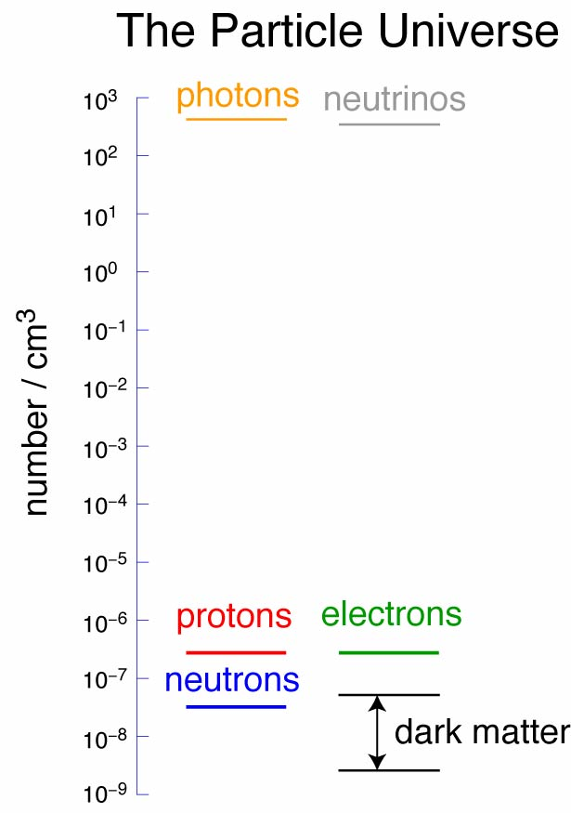
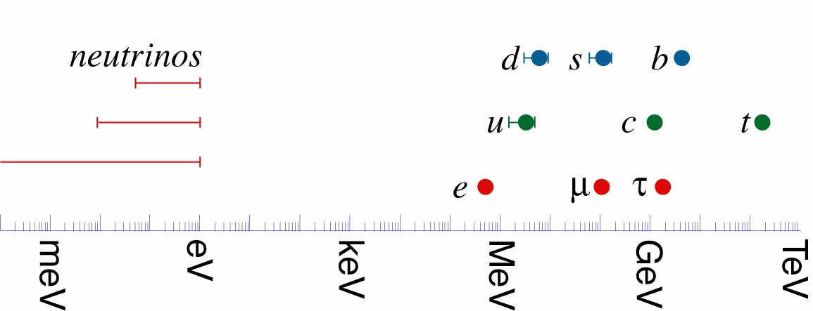

Slide 4
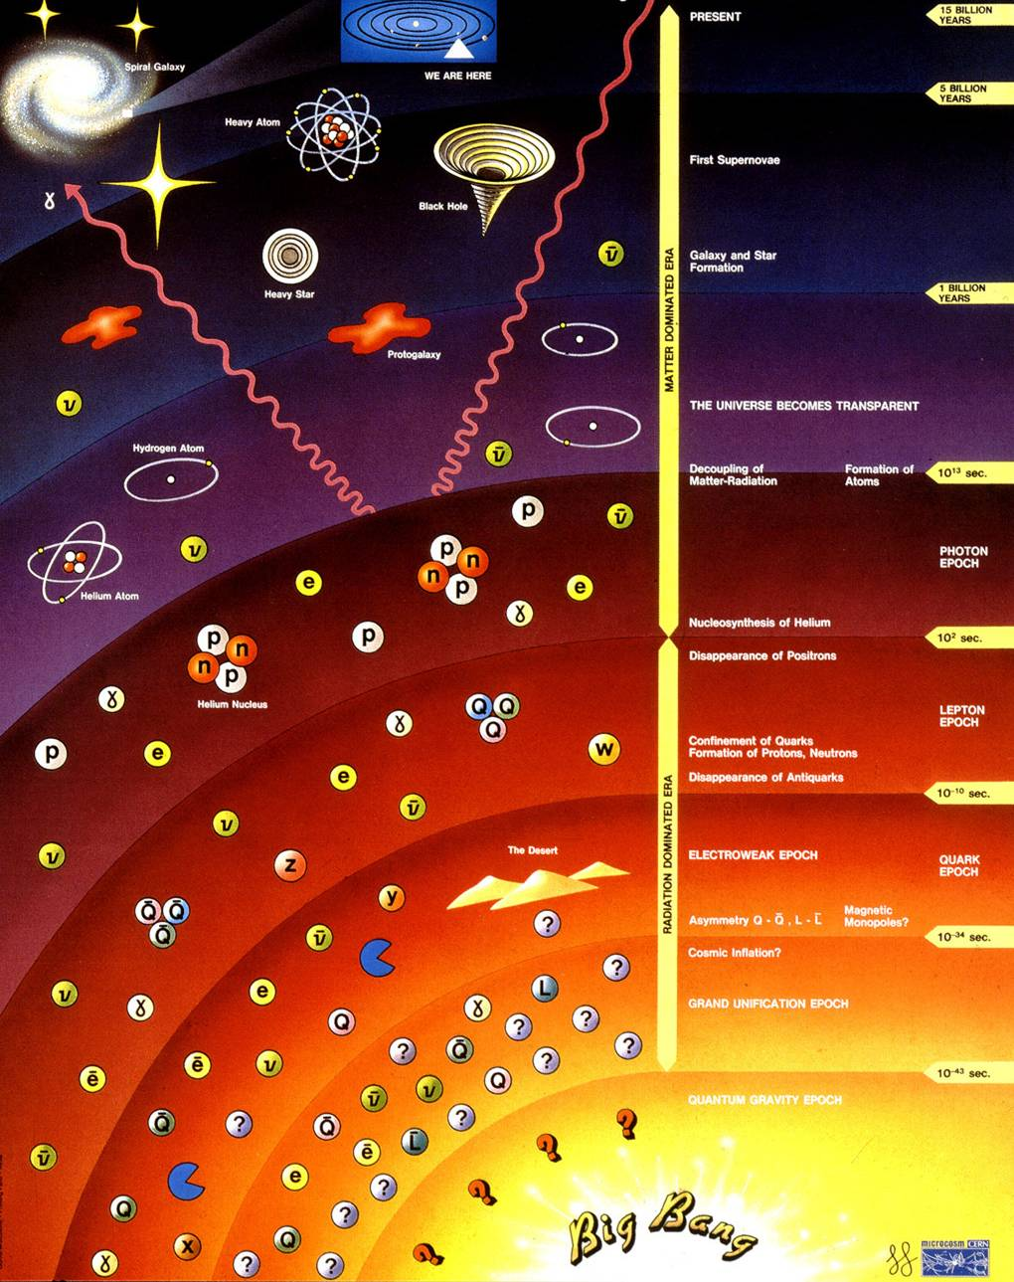
Dark matter
Galaxy/star
formation
Removal of
anti-matter
Inflation
Is the neutrino responsible for today’s Universe?

Slide 5
The Standard NEUTRINO Model
To understand particle physics, cosmology, our Universe …
… we must measure the properties of the neutrino.

Slide 6
Contents:
Pedigree and provenance
Oscillations
(the present generation)
Sensitivity and precision
(the search for CP-invariance violation)
Industrialisation
The Neutrino Factory and MICE
Closing the circle

Slide 7
Pedigree and provenance
Accelerator-based neutrino physics: past, present and future

Slide 8
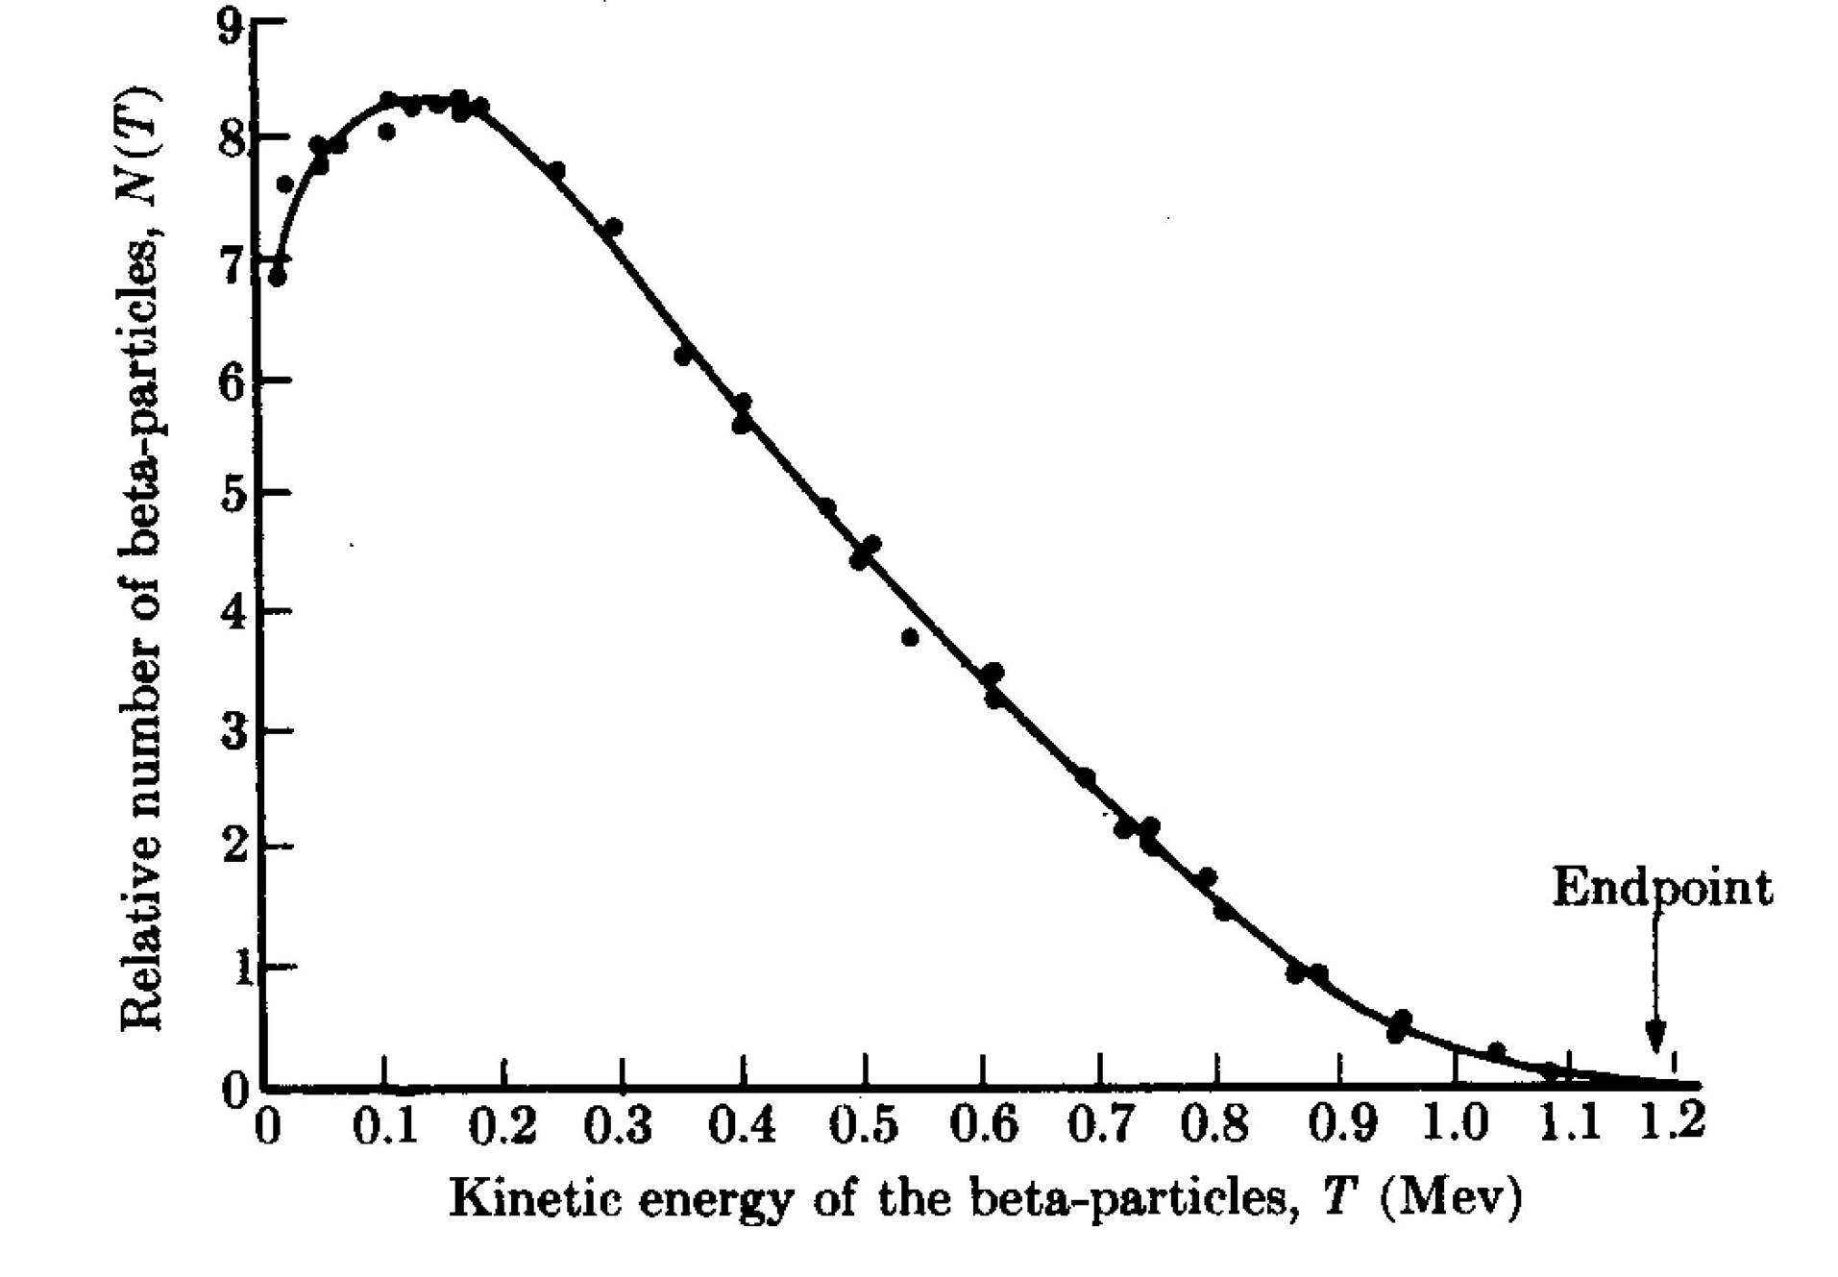
Neutrinos; the first generation:
Neutrino
hypothesis
Electron-anti-neutrino
discovery
Neutrino hypothesis:
  Postulated to conserve energy in nuclear beta decay (Dirac):
  Properties:
    Electrically neutral
    Very light
    Weakly interacting
Inverse beta decay:
  Using v_{e} from reactors
Reines
1956
Cowan

Slide 9
Discovery of muon neutrino: ν_{μ}
Brookhaven; Alternating Gradient Synchrotron
Beryllium
target
Protons
Neutrinos
Neutrino
detector
Lederman,
Schwarz,
Steinberger
Steinberger,
Ledermann,
Swartz

Slide 10
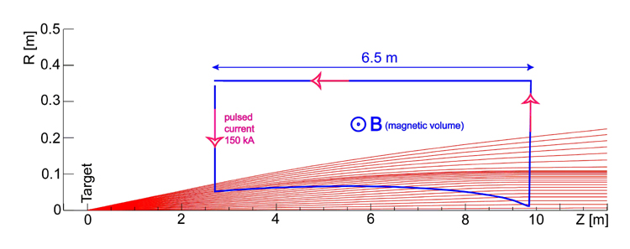
Innovation, the first neutrino beam:
Increase neutrino flux by order of magnitude:
  Focus π/K produced in proton-target interaction:
    Ideally point to parallel;
      Requires toroidal magnetic field
Requires:
  Extracted, pulsed proton beam

Slide 11
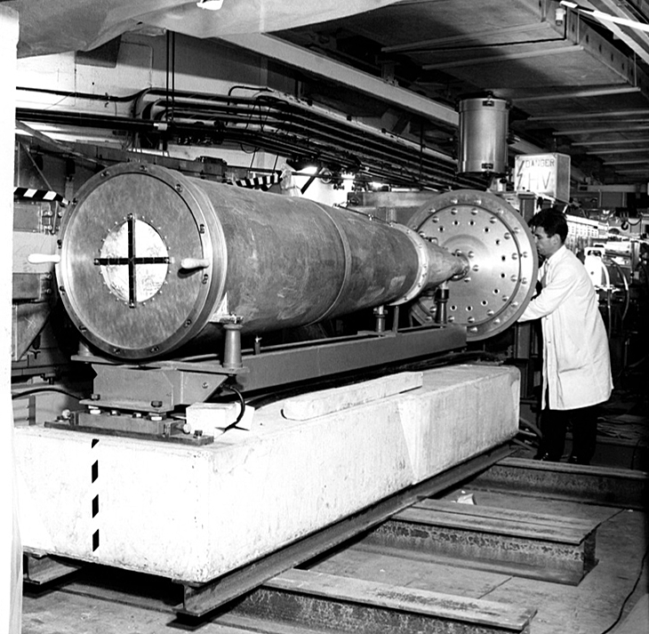
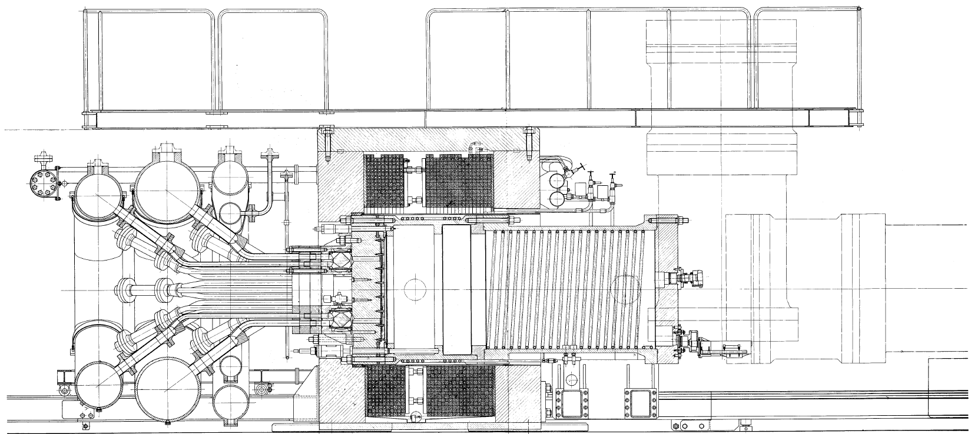
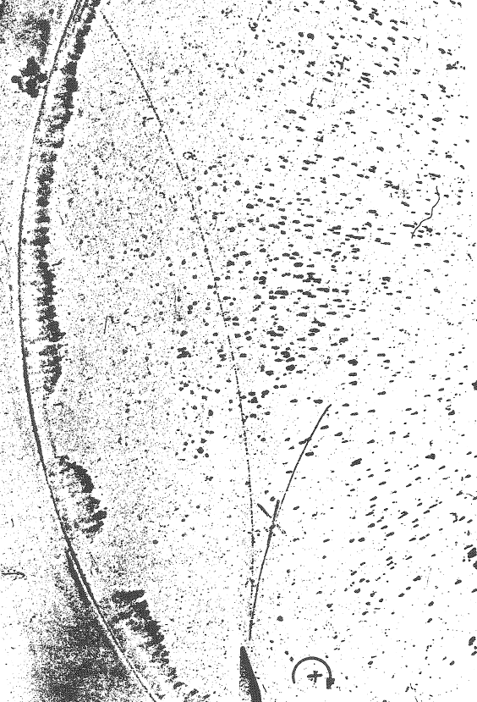
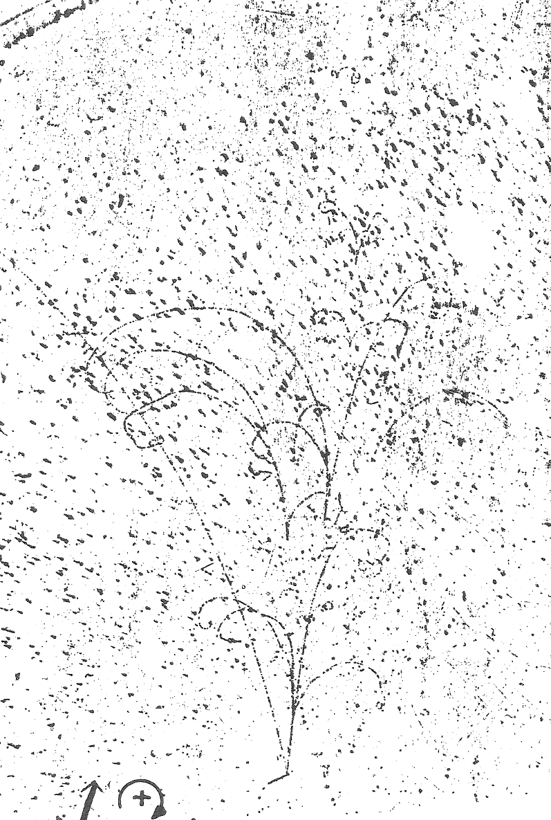
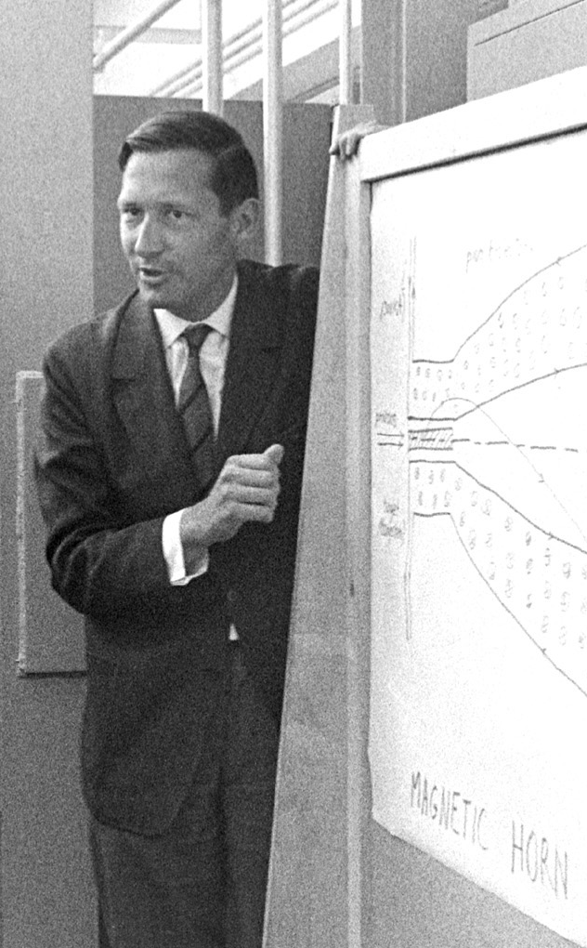
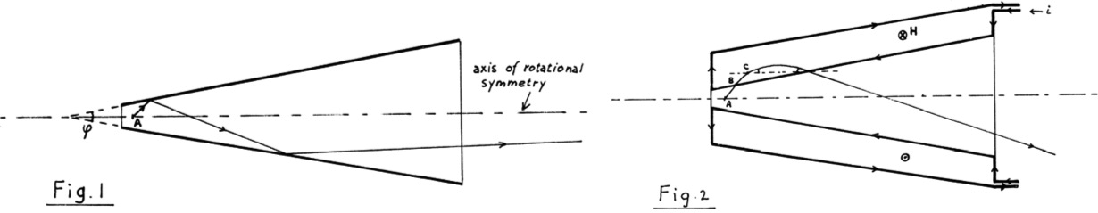
Innovation, the first magnetic horn:
Simon van der Meer
CERN, 1961
Confirmation:
muon-/electron-neutrino universality
Further innovation:
  The bubble chamber

Slide 12
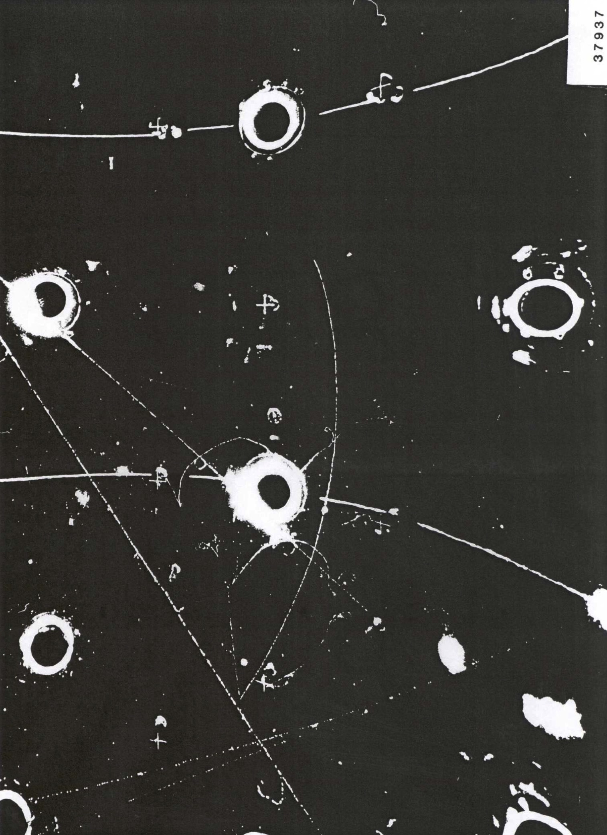
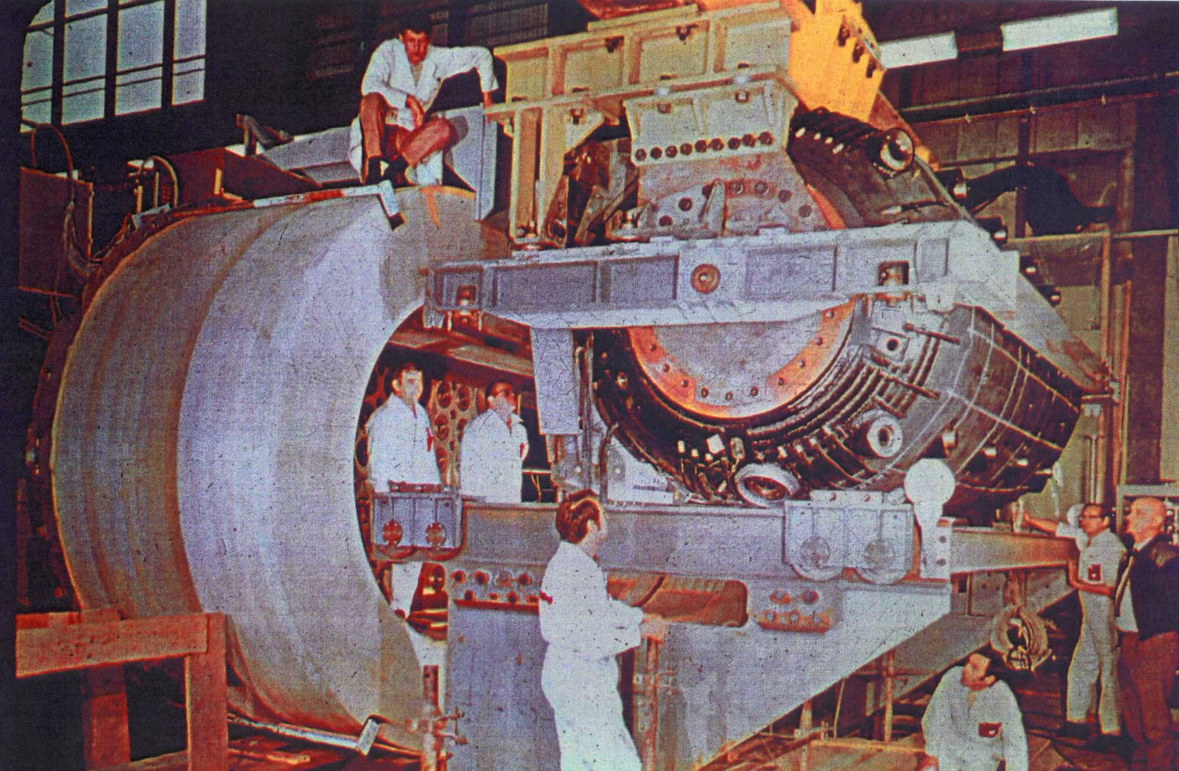
Discovery of neutral currents:
Development …
of beam and detector:
  Improved horn:
    Parabolic; with neck and downstream toroids
  Improved detector:
    Gargamelle
1971

Slide 13
Neutrino beams:
S.E. Kopp; Phys. Rep. 439 (2007) 101

Slide 14
Neutrino & the Standard Model
CERN
Horn and bubble chamber
First neutrino beam
IHEP
SKAT, JINR
CERN
Gargamelle, Aachen/Padova, CDHS,
CHARM, BEBC, CCFR, NOMAD, CHORUS
BNL
first neutrino
“beam”
BNL/FNAL
CITF, HPWF, 7’ BC, 15’ BC, E605,
E613, E734, E776, NuTEV
CERN
Horn #2 & Gargamelle
1950
1960
1970
1980
1990
2000
2010
2020
2030
ν_{μ}
discovery
Development of
E/w SM, QPM, QCD
ν_{e}/ν_{μ}
universality
Neutral
Current
discovery

Slide 15
Oscillations
(the present generation)
Accelerator-based neutrino physics: past, present and future

Slide 16
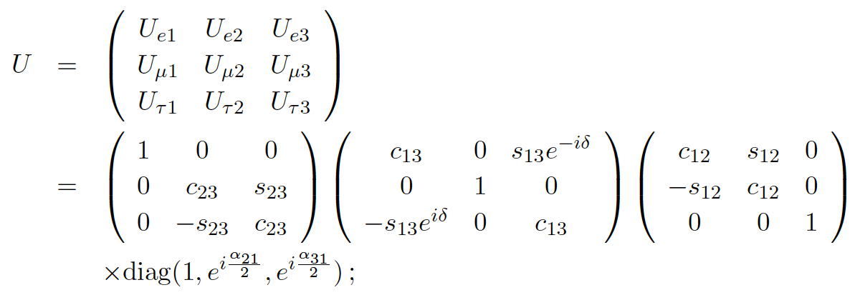
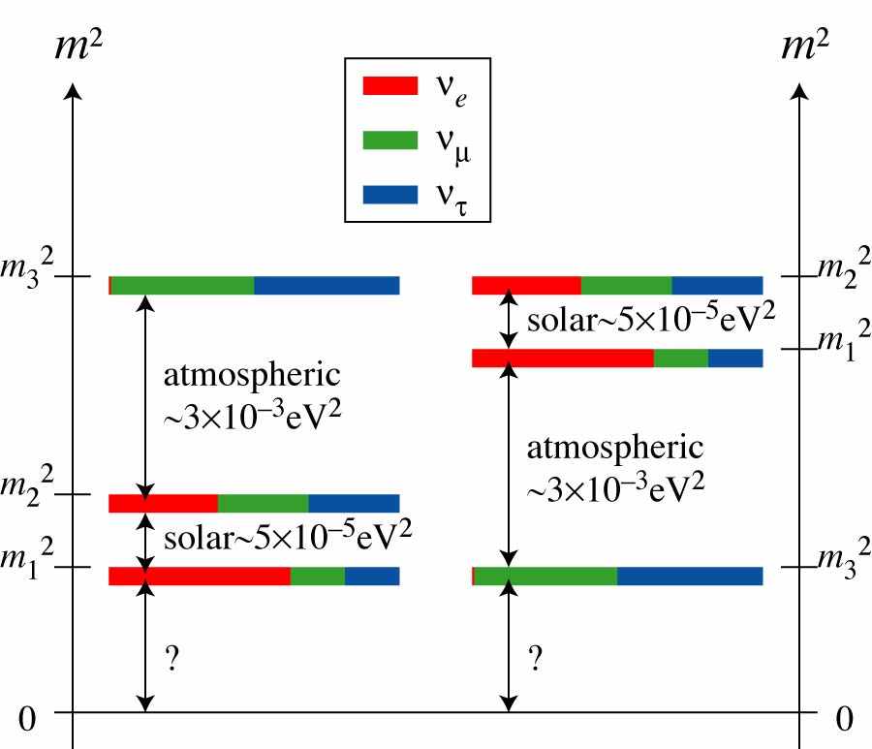
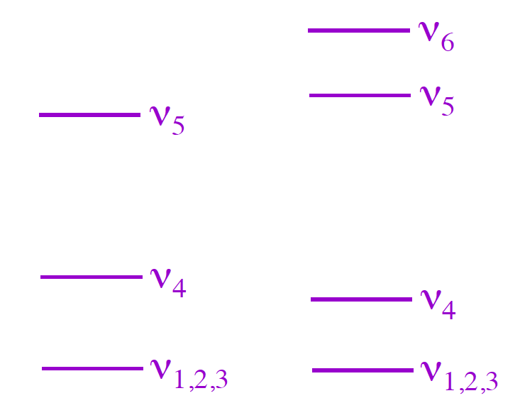
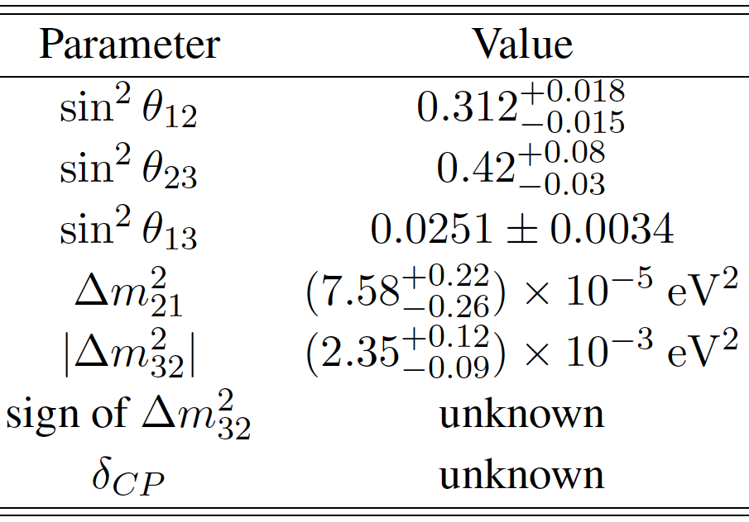
Steriles

Slide 18
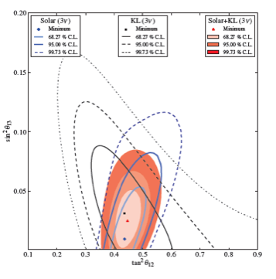
Solar:
G. D. Orebi Gann; NNN’14
ν_{e}
disappearance

Slide 19
Reactor:
M. Göger-Neff; NNN’14

Slide 20
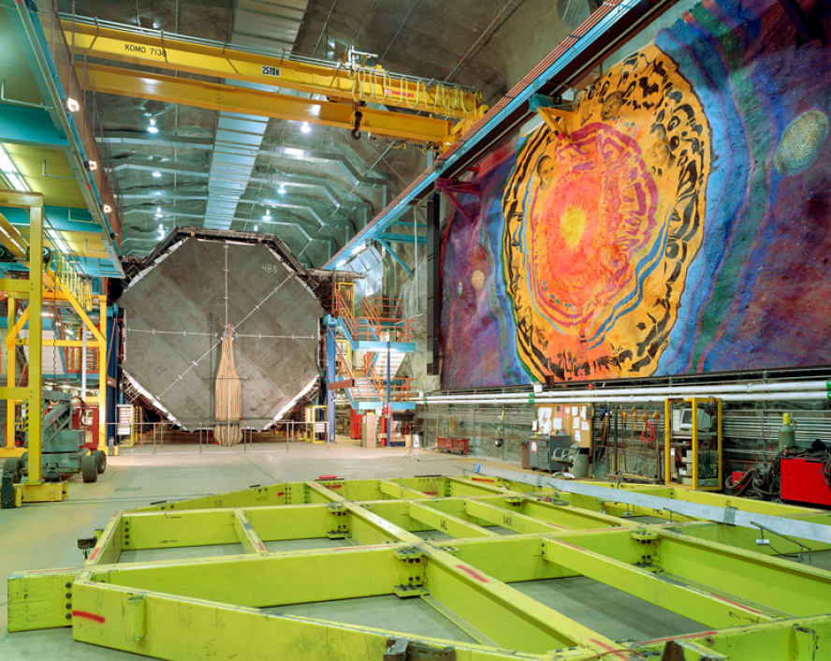
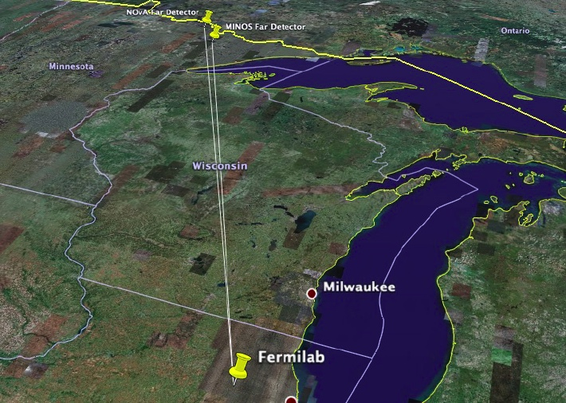
Long-baseline neutrino oscillation programme:
Present long-baseline experiments:
  Europe: OPERA, ICARUS
  Japan: T2K
  US: MINOS, MINOS+, NOvA
Next generation long-baseline experiments:
  Japan: T2HK; selected as one of 27 high-priority large projects
  US: LBNF

Slide 21
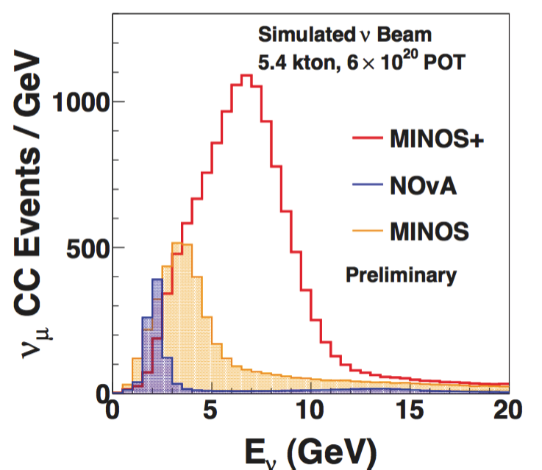
MINOS and MINOS+:
ν_{μ}
disappearance
Sousa; Neutrino’14

Slide 22
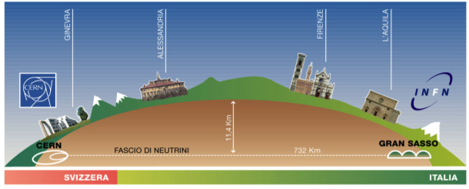
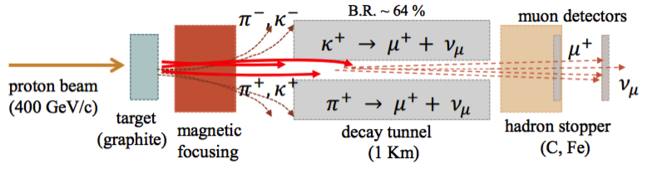
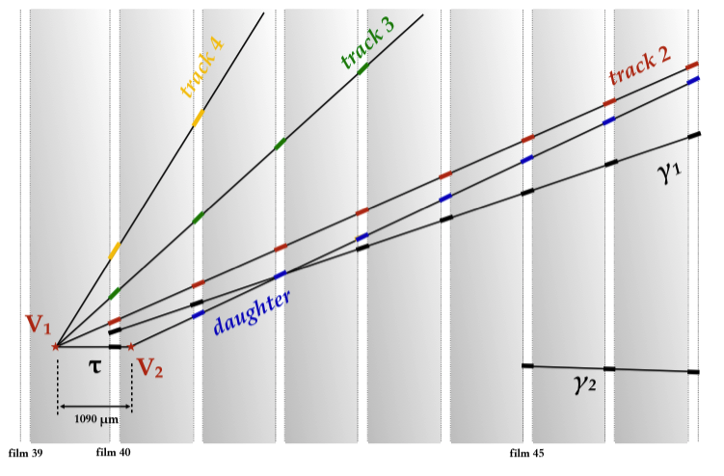
CERN to Gran Sasso:
Farnese; Neutrino ‘14
Opera: ν_{τ} appearance

Slide 23
CERN to Gran Sasso:
Dusini; Neutrino ‘14
ICARUS: ν_{e} appearance
  LAr TPC [innovation]:
    Electronic, high-resolution
    event reconstruction
  6 ν_{e} appearance events:
    No evidence for “LSND-like”
    sterile neutrinos
    Oscillation explanation of
    MiniBooNE excess excluded

Slide 24
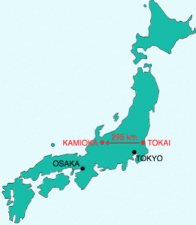
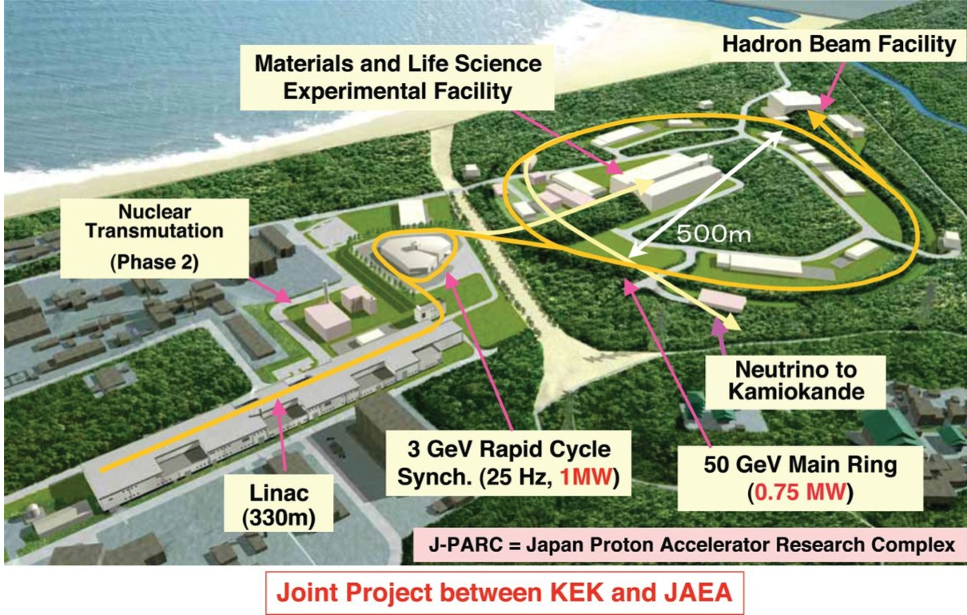
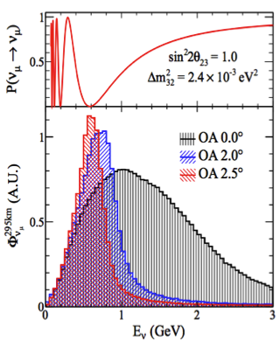
T2K: electron-neutrino appearance:
Bordoni, Neutrino’14

Slide 25
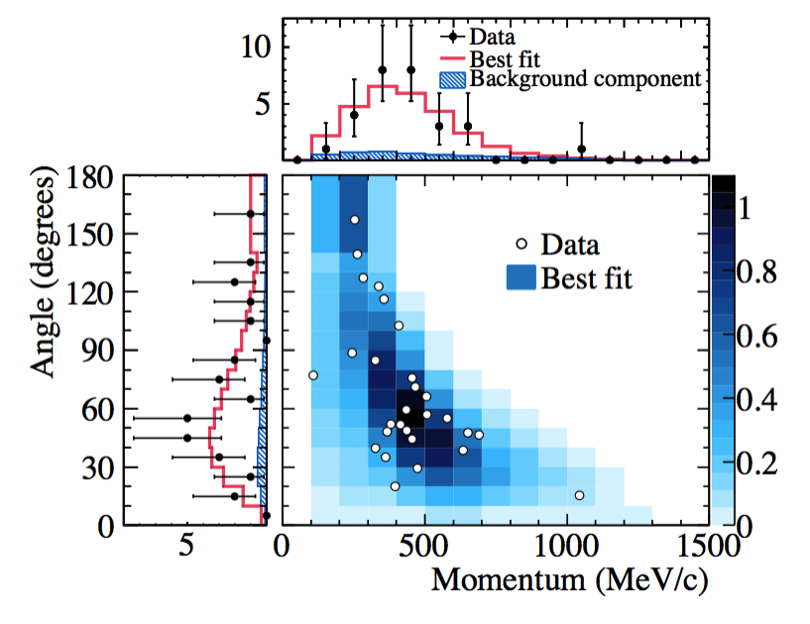
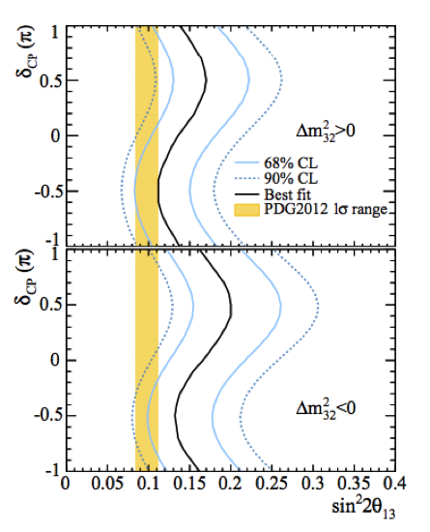
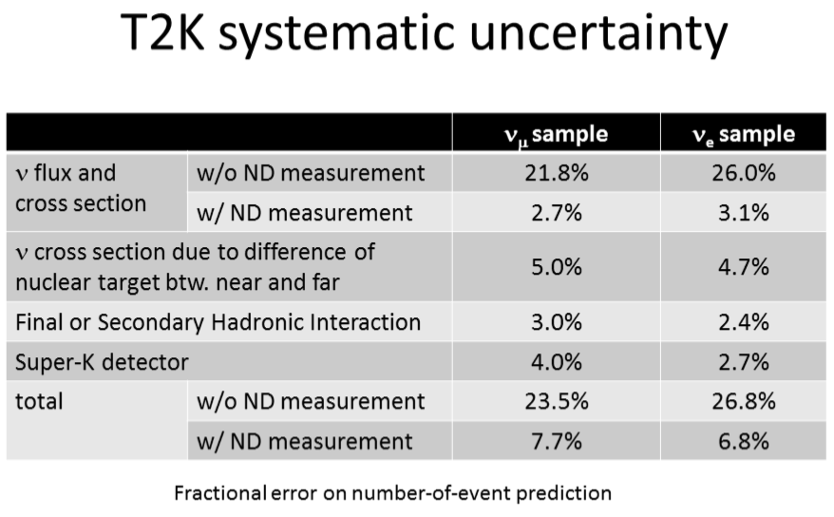
T2K: electron-neutrino appearance:
Bordoni, Neutrino’14

Slide 26
Standard Neutrino Model:
Fogli et al; 10.1103/PhysRevD.89.093018
Schwetz et al; 10.1007/JHEP11(2014)052
Notes:
The Double Chooz collaboration, by measuring the "disappearance" of electron antineutrinos, presents hints for oscillation also involving the third angle with the following value: sin^2(2theta_13) = 0.085 +/- 0.051. The probability given by preliminary results that there is no oscillation is only 7.9%.

Slide 27
Steriles:

Slide 28
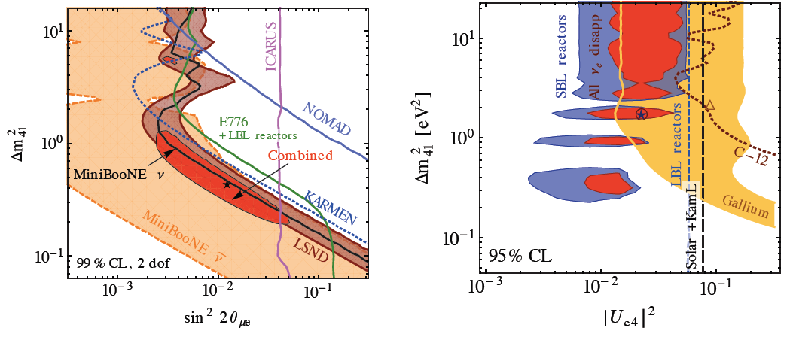
Global constraints [1]:
Appearance and disappearance data sets self-consistent
Tension between parameter regions in measurements consistent with the null hypothesis and those which are inconsistent with it
ν_{e} appearance data in tension with exclusion limits from disappearance searches

Slide 29
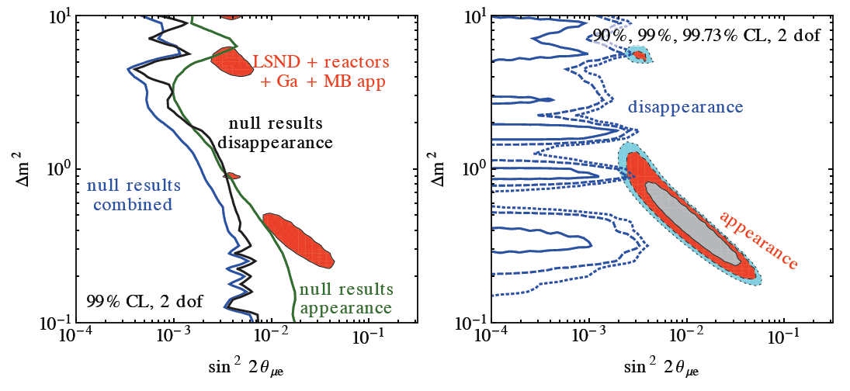
Global constraints [2]:
Appearance and disappearance data sets self-consistent
Tension between parameter regions in measurements consistent with the null hypothesis and those which are inconsistent with it
ν_{e} appearance data in tension with exclusion limits from disappearance searches

Slide 30
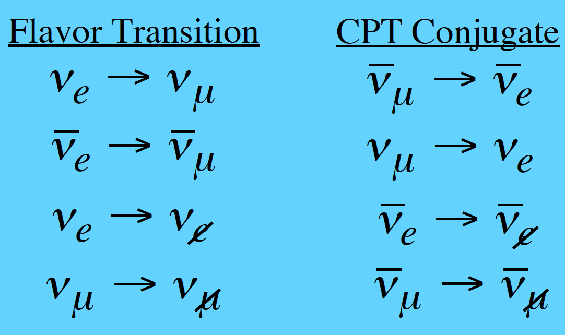
What we need to measure:
Present, inconclusive, information from ν_{e}➔ν_{X} and ν_{μ}➔ν_{X} transitions
Ideally, study:
and
  Determine neutral current rate
    oscillation to steriles will change neutral current rate
  Study ν_{e}N and ν_{μ}N scattering
    including hadronic final states to eliminate background uncertainties

Slide 31
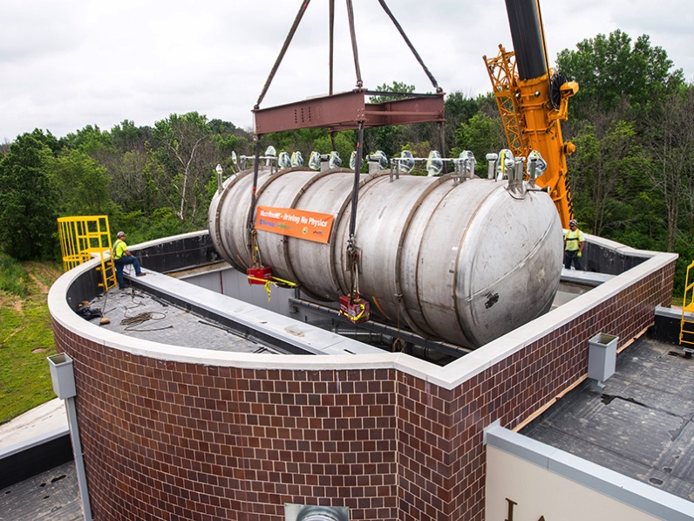
Near future: MicroBooNE:
Goals:
  Resolve short-baseline anomalies in ν_{μ}  ν_{e} searches
  Measure ν_{μ}-Ar cross sections
  Develop LAr TPC technology
Timetable:
  Jan15: Fill with Lar
  Spring/summer: commission and start data taking

Slide 32
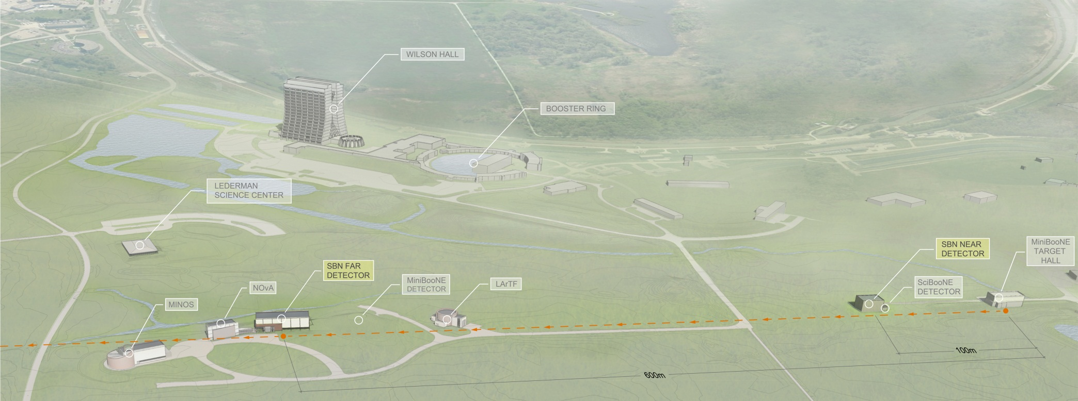
Short baseline programme @ FNAL booster:
SBN based on Booster Neutrino Beam (BNB):
  2015: MicroBooNE
  2018: Three-detector sterile neutrino programme:
    Near detector @ 110m; LAr1ND
    Middle detector @ 470m; MicroBooNE
    Far detector @ 600m; ICARUS T600
      Refurbished at CERN as part of CERN Neutrino Platform
  Also under consideration for SBN @ BNB:
    NESSiE (magnetic spectrometer); ANNIE (optical TPC); CAPTAIN (LAr for xSect)

Slide 33
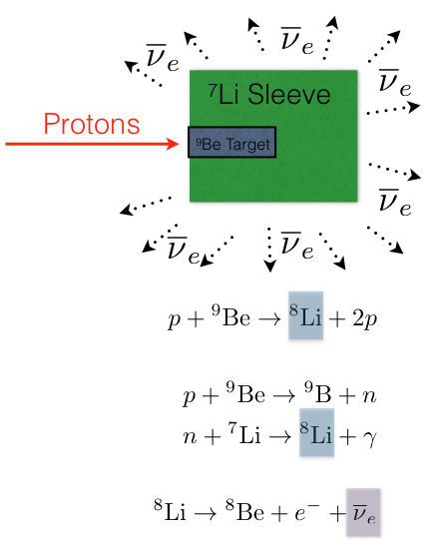
ISODAR:
Example of sensitivity:
  High-power cyclotron (MW class) illuminating Kamland;
  Baseline 16m
  Five years of running

Slide 34
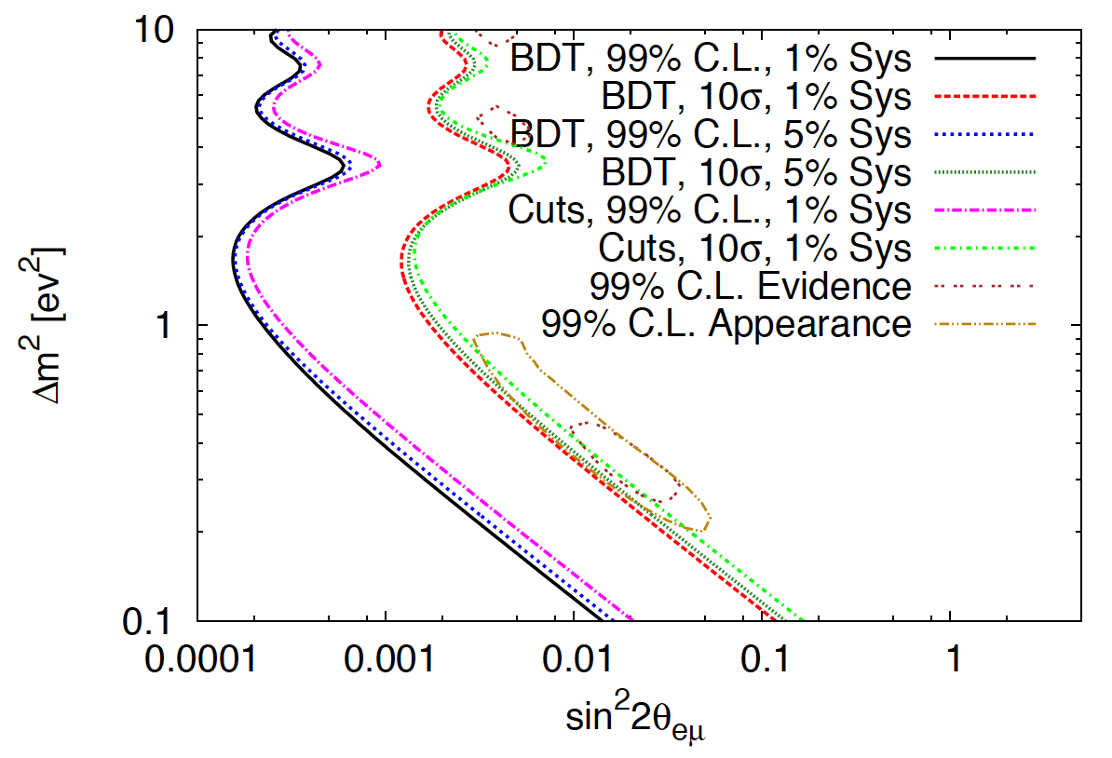
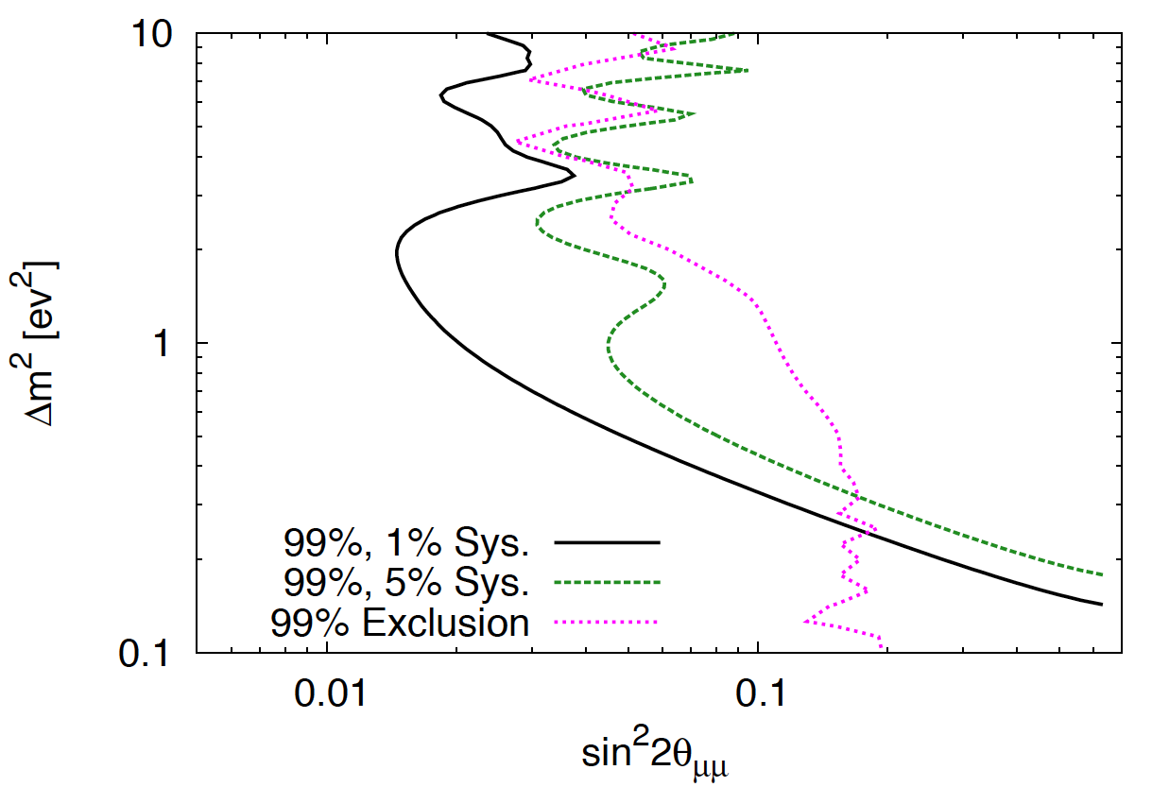
nuSTORM [1]:

Slide 35
Standard model and LBL oscillations
CERN
Horn and bubble chamber
First neutrino beam
IHEP
SKAT, JINR
CERN
Gargamelle, Aachen/Padova, CDHS,
CHARM, BEBC, CCFR, NOMAD, CHORUS
FNAL
MINOS, MINOS+, NOvA
CERN
OPERA, ICARUS
BNL
first neutrino
“beam”
BNL/FNAL
CITF, HPWF, 7’ BC, 15’ BC, E605,
E613, E734, E776, NuTEV
KEK/J-PARC
K2K, T2K
CERN
Horn #2 & Gargamelle
1950
1960
1970
1980
1990
2000
2010
2020
2030
ν_{μ}
discovery
Development of
E/w SM, QPM, QCD
Development of
Standard Neutrino
Model
ν_{e}/ν_{μ}
universality
Neutral
Current
discovery

Slide 36
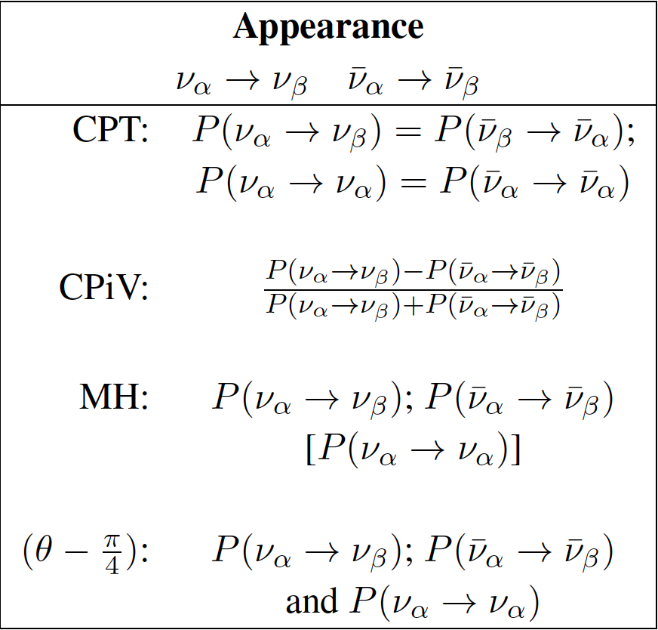
The SνM measurement programme:
Looking beyond MINOS(+), T2K,
NOνA, DChooz, Daya Bay, Reno, …
  θ₁₃ will be very well known
Therefore future programme
must:
  Complete the “Standard
  Neutrino Model” (SνM):
    Determine the mass hierarchy
    Search for (and discover?) leptonic
    CP-invariance violation
  Establish the SνM as the correct
  description of nature:
    Determine precisely the degree to which θ₂₃ differs from π/4
    Determine θ₁₃ precisely
    Determine θ₁₂ precisely
  Search for deviations from the SνM:
    Test the unitarity of the neutrino mixing matrix
    Search for sterile neutrinos, non-standard interactions, …
arXiv:1203.5651
Notes:
Peroration:
Goals of the presentation:
Show sensitivity and precision of the beta beam and neutrino factoru
Show maturity of R&D
Demonstrate that there are short-term contributions, especially nuSTORM

Slide 37
Sensitivity and precision
(the next generation)
Accelerator-based neutrino physics: past, present and future

Slide 38
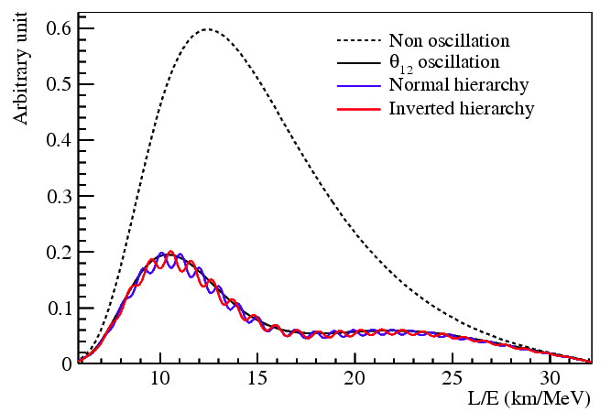
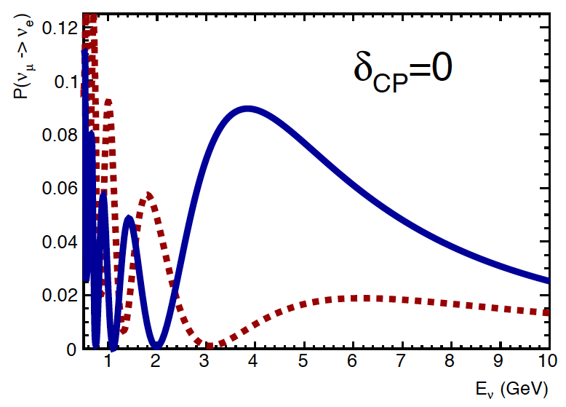
Mass hierarchy:
Two options:
  Exploit L/E spectrum:
  Exploit matter effect:
Phys.Rev.D78:111103,2008
CERN-SPSC-2012-021;
SPSC-EOI-007

Slide 39
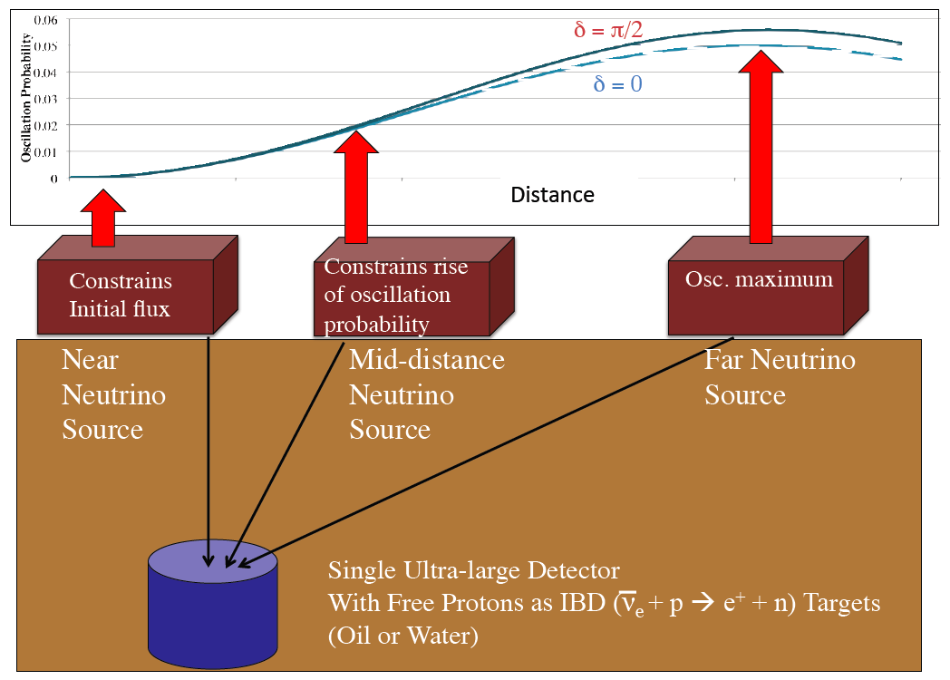
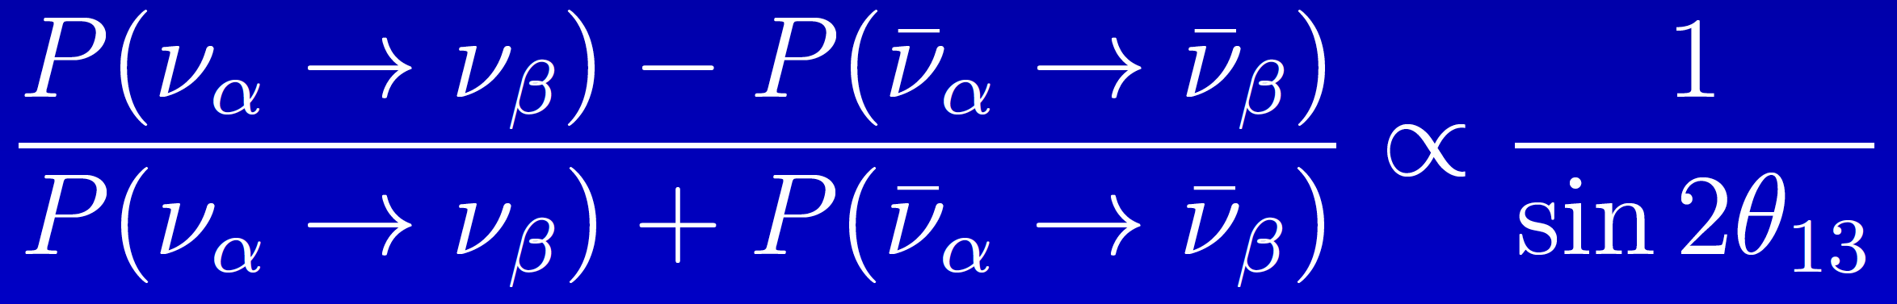
CPiV:
Two options:
  Exploit L/E spectrum:
    DAEδALUS
  Measure asymmetry:
    Large θ₁₃ makes discovery conceivable, but:
      Places premium on the control of systematic uncertainties
Phys.Rev.D78:111103,2008
Shaevitz
CERN-SPSC-2012-021;
SPSC-EOI-007

Slide 40
MH & CPiV: reactor and decay at rest:

Slide 41
Reactor:
M. Göger-Neff; NNN’14

Slide 42
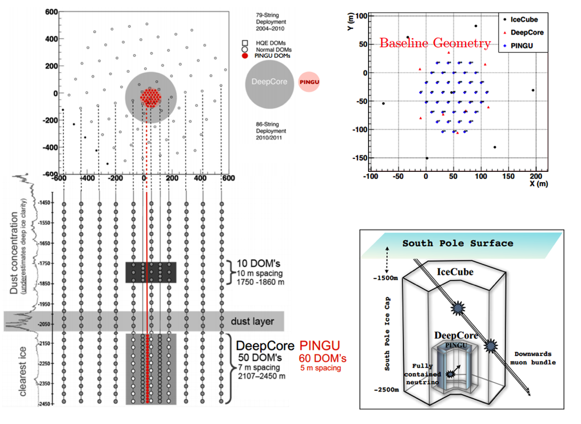
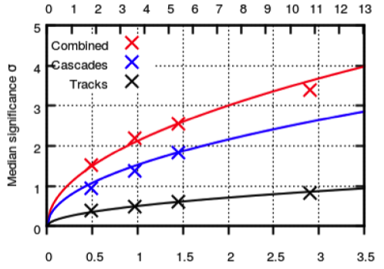
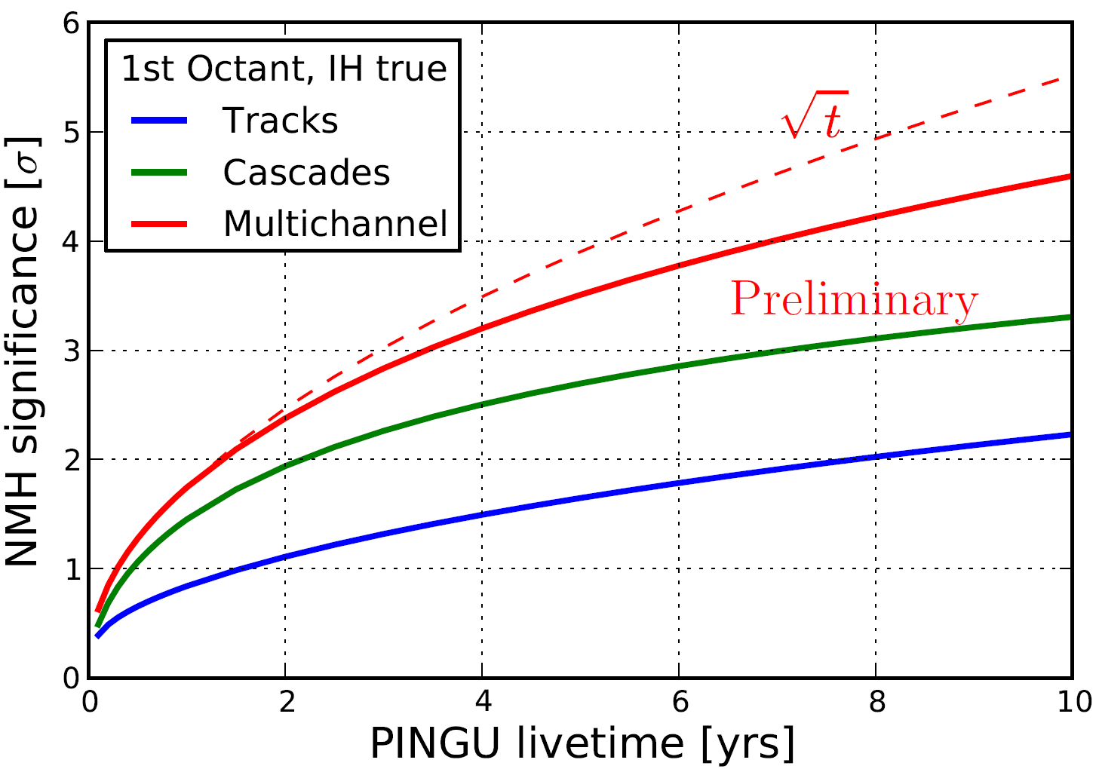
Atmospheric:
K. Hanson; NNN’14

Slide 43
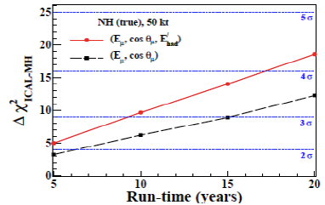
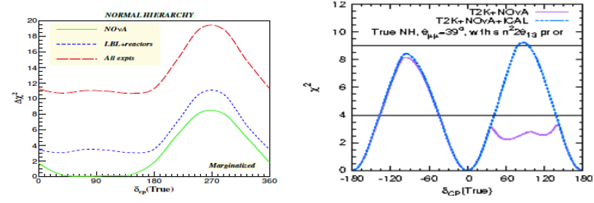
Atmospheric:

Slide 44
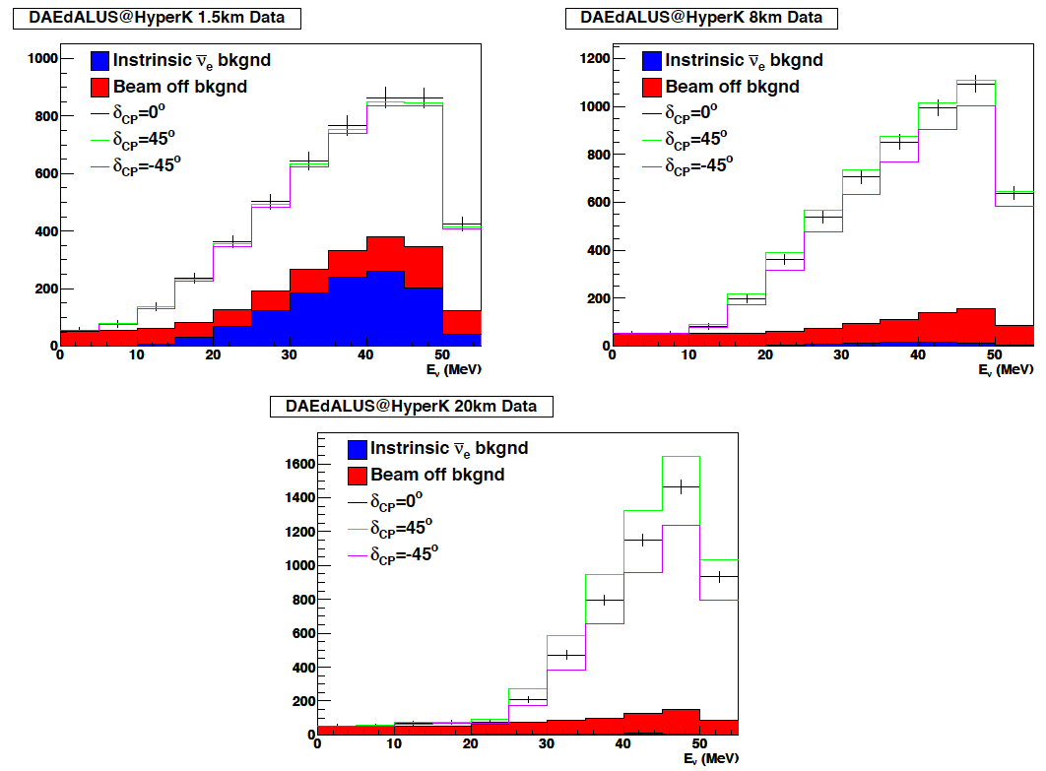
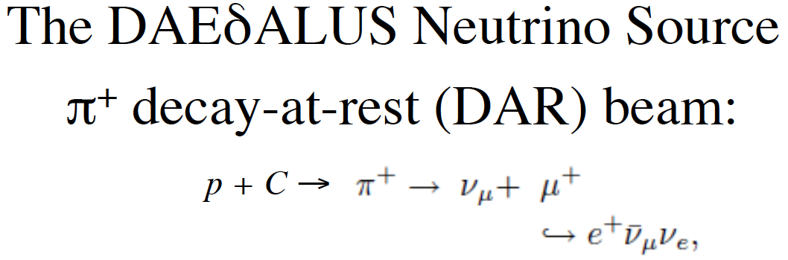


1307.6465
1307.2949
1006.0260v1
D⁺ cyclotrons:
  1 MW (1.5 km); 2 MW (8 km); 5 MW (20 km)

Slide 45
MH & CPiV: super-beams:

Slide 46
MH and CPiV at LBL experiments:
P. Coloma
0.3 GeV
~1.2 GeV
~1.7 GeV
Mass hierarchy and CPiV modulate oscillation probability:
  Need to measure as a function of L/E [measure E spectrum]
MH sensitivity grows with L [matter effect]
CPiV modulation grows with L/E [but, measure E spectrum]

Slide 47


T2 Hyper-Kamiokande:
arXiv:1109.3262
Source:
  JPARC neutrino beam:
  upgrade path to 1.66 MW
Detector: water Cherenkov
  Fiducial mass: 560 kTonne
  Site:
    2.5° off axis;
    Baseline ~290 km
0.3 GeV

Slide 48

T2 Hyper-Kamiokande:
arXiv:1109.3262
Systematic uncertainties:
  Signal: 5%
  νμ induced background: 5%
  νe induced background: 5%
  Relative neutrino/anti-neutrino normalisation: 5%

Slide 49



Long-Baseline Neutrino Experiment:
1110.6249, 1307.7335
Near detector options:
  HiResMnu
  Lar TPC

Slide 50


Long-Baseline Neutrino Experiment:
Source:
  FNAL MI: 700 kW
  Project X: 2.3 MW [upgrade]
Detector: LAr TPC
  Fiducial mass: 10 kTonne
    Upgrade to 34 kTonne
  Site: SURF
    On axis; upgrade u/g 4850 ft
    Baseline 1300 km
~1.2 GeV
arXiv:1307.7335

Slide 51


Long-Baseline Neutrino Experiment:
Systematic uncertainties:
  Signal: 1%
  Background: 5%
arXiv:1307.7335

Slide 52




Long-Baseline Neutrino Observatory:
CERN-SPSC-2012-021;
SPSC-EOI-007
Source:
  CERN SPS: 700 kW
  PS 2: 2 MW [possible upgrade]
Detector: LAr TPC + MIND
  LAr fiducial mass: 20 kTonne
  MIND fiducial mass: 25 kTonne
  Site: Phyasalmi, Finland
    On axis
    Baseline 2300 km
Suite of detectors:
  High-pressure Ar + MIND
  L-scintillator

Slide 53


LBNO:
CERN-SPSC-2012-021;
SPSC-EOI-007
~1.7 GeV
Limited sensitivity to second oscillation maximum
Correlated and uncorrelated systematic uncertainties considered:
  Signal: 5%
  Background: 5% [but see table]

Slide 54




LBNO:
CERN-SPSC-2012-021;
SPSC-EOI-007
CERN-SPSC-2012-021;
SPSC-EOI-007
Benefit of long baseline clearly visible in excellent MH reach:
  Study of matter effect in neutrino propagation
CPiV reach competitive with LBNE

Slide 55
ESSnuSB:
Exploit second oscillation maximum:
  Large CPiV effect;
  Requires very high power and large detector mass
ESS:
  Double power (to 10MW) by adding H- acceleration and compressor/accumulator rings;
“MEMPHYS”:
  Can be hosted in one of the Nordic countries:
    Various sites considered

Slide 56
Delivering capability, realising the full potential:

Slide 57
M. Nessi; CERN Neutrino Platform

Slide 59
M. Nessi; CERN Neutrino Platform

Slide 60
M. Nessi; CERN Neutrino Platform

Slide 61
M. Nessi; CERN Neutrino Platform

Slide 62
Effect of systematics:
Performance rapidly degrades if systematic error is not controlled at the several % level
  Cross section error makes a critical contribution

Slide 63

Limiting systematics in the LBL programme:
Bias as well as uncertainty
Nuclear
effects
1307.1243
Coloma, Huber

Slide 64

nuSTORM and cross section measurement:
LOI to FNAL PAC: 1206.0294;
EoI to CERN: CERN-SPSC-2013-015, SPSC-EOI-009,1305.1419;
Proposal to FNAL PAC, May 2013
nuSTORM event rate is large:
  Statistical precision high:
    Can measure double-differential cross sections
Events per 100 Tonne
Events per 100 Tonne

Slide 65

CCQE cross section measurement:
Systematic uncertainties for CCQE measurement at nuSTORM:
  Six-fold improvement in systematic uncertainty compared with “state of the art”
  Electron-neutrino cross section measurement unique

Slide 66



nuSTORM serving the CERN Neutrino Platform
under study; M. Nessi et al

Slide 67
Opportunity (for CERN)?
Is it true that accurate measurements of ν_{e}N cross sections are critical to realising the potential of the LBL programme?
  If it is, nuSTORM seems to be the only way to achieve few-% precision
NuSTEC, NuInt and NNN perhaps ideally placed to address the “in principal” physics question:
  ICFA Panel:
    Seeks to find a way to promote this discussion

Slide 68
Standard model and LBL oscillations
CERN
Horn and bubble chamber
First neutrino beam
IHEP
SKAT, JINR
CERN
Gargamelle, Aachen/Padova, CDHS,
CHARM, BEBC, CCFR, NOMAD, CHORUS
FNAL
MINOS, MINOS+, NOvA
Global neutrino
progamme
Hyper-K
LBNF
CERN Neutrino Platform
CERN
OPERA, ICARUS
BNL
first neutrino
“beam”
BNL/FNAL
CITF, HPWF, 7’ BC, 15’ BC, E605,
E613, E734, E776, NuTEV
KEK/J-PARC
K2K, T2K
CERN
Horn #2 & Gargamelle
1950
1960
1970
1980
1990
2000
2010
2020
2030
ν_{μ}
discovery
Development of
E/w SM, QPM, QCD
Development of
Standard Neutrino
Model
ν_{e}/ν_{μ}
universality
Neutral
Current
discovery
Discovery of
CP-invariance violation?

Slide 69
Industrialisation: the Neutrino Factory and mice
Accelerator-based neutrino physics: past, present and future

Slide 70
Neutrino Factory:
Optimise discovery potential for CP and MH:
  Requirements:
    Large ν_{e} (ν_{e}) flux
      Detailed study of
      sub-leading effects
Unique:
    (Large) high-energy
    ν_{e} (ν_{e}) flux
      Optimise event rate at
      fixed L/E
      Optimise MH sensitivity
      Optimise CP sensitivity

Slide 71

Neutrino Factory:
arXiv:1112.2853
Two approaches:
  Optimise L and E to match detector threshold
    IDS-NF approach:
      1.4% signal
      20% background

Slide 72

Neutrino Factory:
arXiv:1112.2853; 1308.0494v1
Two approaches:
  Optimise L and E to match detector threshold
    IDS-NF approach:
  Exploit LAr detector sited 1300 km from FNAL
    MAP/MASS approach:

Slide 73
Neutrino Factory:
Bayes, Coloma
IDS-NF
NuMAX

Slide 74
Accelerator challenges:
Proton driver:
  4 MW; 5 < Ep < 15 GeV; bunch length 1—3 ns
  Linac (CERN, FNAL) and ring (RAL, JPARC) options: Progress: costing based on SPL
Pion-production target:
  Baseline: liquid mercury jet
  Options: powder jet or solid
  Progress: particle shielding, magnetic lattice
Muon front end:
  Chicane (new) to remove secondary hadrons:
    Bent solenoid transport & beryllium absorber
  Buncher & rotator:
    Progress: lattice revision in response to engineering study
  Cooling:
    Baseline: solenoid transport, LiH absorber
    Options: bucked coils or high-pressure H2
    Progress: lattice revision in response to engineering study
Rapid acceleration:
  Two options considered for acceleration to 10 GeV:
    Linac, RLA I and RLA II;
    Linac, RLA I and FFAG
  Choice based on cost and performance estimates
Proton driver:
  Development of high-power, pulsed proton source underway at proton labs
Pion-production target:
  MERIT experiment at CERN proved principle of mercury jet target
  Progress: particle shielding, magnetic lattice
Muon front end:
  Chicane (new) to remove secondary hadrons:
    Bent solenoid transport & beryllium absorber
  MuCool programme at FNAL:
    Study of effect of magnetic field on high-gradient, warm, copper cavities;
  MICE experiment at RAL:
    Proof of principle of ionization-cooling technique
    Progress: lattice revision in response to engineering stud
Rapid acceleration:
  EMMA experiment at DL:
    Proof of principal of non-scaling FFAG technique;
      Novel technology allows circular acceleration without magnet ramp

Slide 75
Muon front-end:
Neuffer, Rogers
Optimised bunching,
phase-rotator, and ionisation-cooling lattice is reduced

Slide 76

Ionisation cooling formalism:
Exponential decrease in normalised emittance:
Competition between:
  dE/dx [cooling] and MCS [heating]
Optimum:
  Low Z, large X₀
  Tight focus
  H₂ gives best
  performance

Slide 77
MICE:
ISIS
RAL
MICE

Slide 78
Cooling demonstration; performance:
Transmission
Cooling

Slide 79

Reminder; the “cooling equation”:
Paraxial (and other) approximation:
Emittance:
  MICE Muon Beam optics and diffuser settings
Material:
  Absorber change (LH2; LiH);
p, E and β:
  Vary beam momentum, optics

Slide 80



MICE:
Study of material, lattice, momentum and emittance (Step IV) will start Q2 2015;
Ionization cooling demonstration:
  Revised configuration developed in response to P5 recommendations;
  Cooling demonstration configuration complete: summer 2017
    All components fabricated
Essential technology demonstration imminent

Slide 81
Closing the circle
Accelerator-based neutrino physics: past, present and future

Slide 82
The accelerator-based programme:
Combination of accelerator & non-accelerator-based programmes can:
  Confirm or refute the existence of sterile neutrinos;
  Determine the mass hierarchy; and
  Make a first sweep of the CP parameter space
Next generation of LBL experiments have the potential to:
  To complete the Standard Neutrino Model (SνM)
To establish the SνM as the correct description of nature requires:
  Development of a capability to produce large, high-energy data sets; and
  To control systematic uncertainties
    This requires a dedicated programme
An incremental programme can be (has been) articulated:
  Scientific imperative: develop three-pronged programme:
    Deliver critical oscillation measurements through super-beam programme;
    Establish systematic-uncertainty control programme
      Including measurement of ν_{e}N cross sections at nuSTORM
    Develop capability required to implement the Neutrino Factory
      Including MICE, the critical system demonstration for ionization cooling
Realisation of fantastic programme requires international coordination

Slide 83
A time of change and …:
Pressures changing the way we work:
  The scale of the ambition:
    Hyper-K and LBNF seek to reach the systematic limit for a super-beam-based long-baseline neutrino-oscillation experiment:
      Delivery of scientific programme requires global coordination:
        The “headline” and the “supporting” programmes; and
        Accelerator and detector R&D for the “industrial” future
  The scale of the investment:
    Hyper-K, LBNF and the CERN Neutrino Platform;
    a substantial investment:
      Hyper-K and LBNF each cost more than any previous neutrino facility
Co-working of accelerator and detector communities:
  Delivery of scientific programme requires innovation:
    In accelerators and beams as well as in detector techniques
  Contribution to accelerator increasingly accepted as “qualifying contribution” to experiment:
    Already happening: e.g. UK delivery of target for T2K

Slide 84
… opportunity:
LBNF
and the Americas:
J-PARC
Hyper-K and Asia:
Short-baseline neutrinos:
Sterile-neutrino search
E@LBNF:
CP-invariance violation
Mass hierarchy
Atmospheric neutrinos
Proton decay
Astro-particle
Hyper-K:
CP-invariance violation
Mass hierarchy
Atmospheric neutrinos
Proton decay
Astro-particle
Reactor:
Precision θ_{ij}
MH & CPiV
CERN neutrino platform:
Innovation and capability;
beam & detector
Liquid argon TPC
Hadro-production (SHINE)
MICE & nuSTORM
Opportunity for discovery:
CP-invariance violation
Sterile neutrinos
and Europe:
CERN

Slide 85
… opportunity:
CERN
and Europe:
CERN neutrino platform:
Innovation and capability;
beam & detector
Liquid argon TPC
Hadro-production (SHINE)
MICE & nuSTORM
Essential
contribution for
programme to reach its full potential …
… and
potential to establish
a new technique for particle physics.

Slide 86
All together a wonderful programme!
Thank you

