Slide 1

HEPiX Spring 2015
Oxford University, UK
Workshop Wrap-Up
Helge Meinhard

Slide 2
Attendees
134 registered participants
  Probably the record – can somebody confirm?
  Including many first-timers!
  101 from Europe (including 36 from UK), 10 from North America, 6 from Asia, 19 from companies
45 different affiliations
  30 from Europe (including 8 from UK), 5 from North America, 2 from Asia, 8 companies

Slide 3
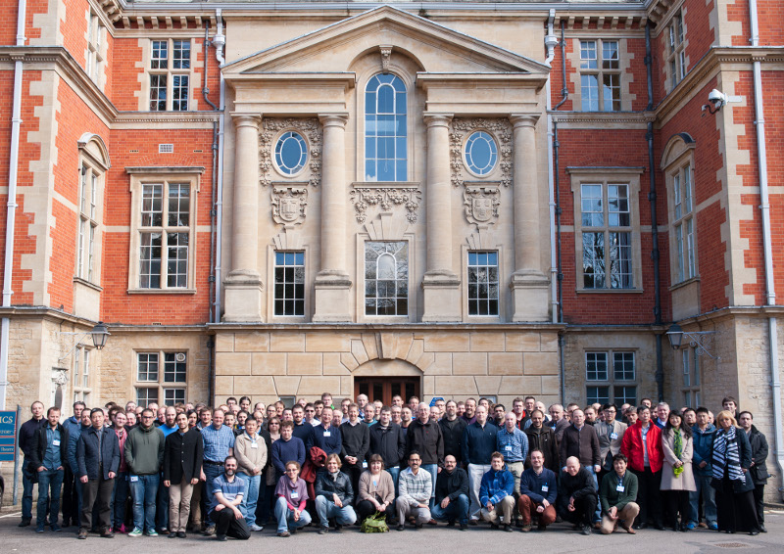

Slide 4
Presentations
83 contributions
  Scheduled total duration: 30 hours 25 minutes
  Rich, very interesting, heavy program
  Had to cut down all standard slots to 25 minutes, site reports to 15 minutes, still needed speakers finishing early in order to fit everything in
    Speakers played this very well, excellent time-keeping – thanks to speakers and session chairs
  High quality of presentations
IPv6 tutorial
BoF session: Ask the CEPH experts

Slide 5
Tracks and Trends… (1)
Security and networking: 9 total
  Threats continue to evolve
  Preventing security incidents more important than ever
  Appropriate monitoring and traceability vital for handling incidents
  TCP performance on high-speed wide-area links
  Lots of activity moving towards production dual-stack (IPv6/IPv4) storage services for WLCG
  IPv6 Tutorial popular (~45 people)
Storage and file systems: 8 total
  CEPH as an interesting building block of many newer services; CEPH FS
  CEPH BoF session with experts much appreciated
  Data taking for photon science
  Care of long term storage by intensive monitoring tape environment
  Things are not simplifying, storage remains a hot topic for all in IT

Slide 6
Tracks and Trends… (2)
Grids/clouds: 8 total
  Clouds increasingly used for workloads
  Public clouds used in production
  Containers: Docker
  Looking beyond PaaS
Computing: 17 total, 9 on batch systems
  CPU benchmarking – new SPECcpu, fast benchmark
  Alternative CPU architectures: SoC (ARM, Atom), OpenPower
  Tendency away from PBS family, OSS very popular (in particular Condor)
  UGE okay, other GE variants disappearing
IT facilities and business continuity: 2 total
  Murphy’s law confirmed
  How to protect tapes

Slide 7
Tracks and Trends… (3)
Basic IT services: 7 total
  ElasticSearch, Logstash, Kibana; integrating audio and visual tools
  Puppet, Mcollective maturing (scalability, automation, etc), linked with continuous integration (Jenkins)
  Quattor alive and doing well
  VoIP on the rise everywhere, unified communication (Lync)
End-user IT services and operating systems: 10 total
  Scientific Linux and CentOS status
  HEP Software Foundation
  SciDB and farm usage efficiency tips
  social and interactive - conferencing services, search and social for the web, Zimbra email, software collaboration
  volunteer computing
Site reports – 19 total
  OpenStack; GPFS; Graphite/Grafana; Webdav

Slide 8
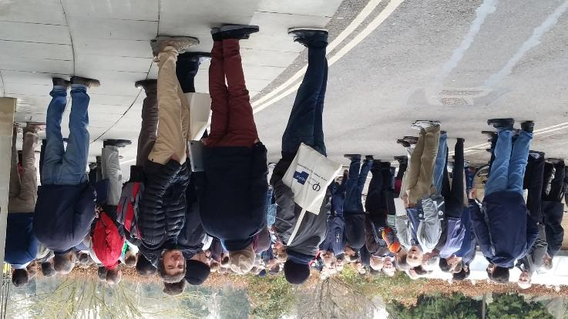
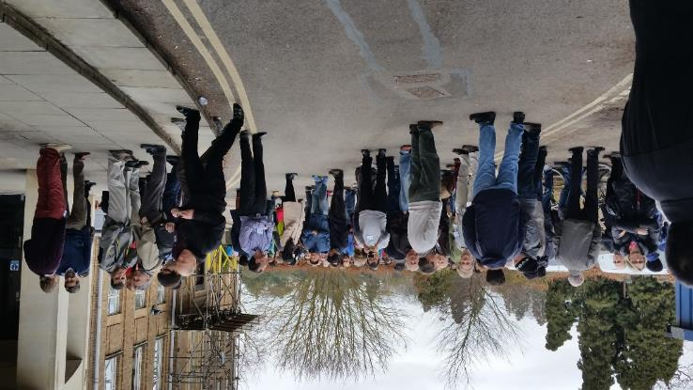
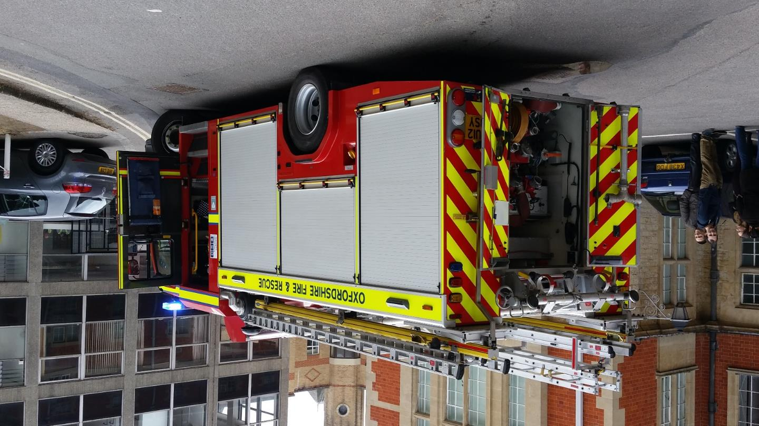
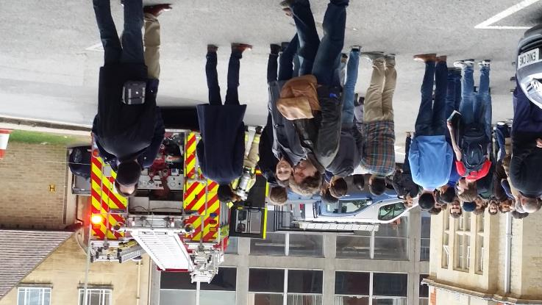
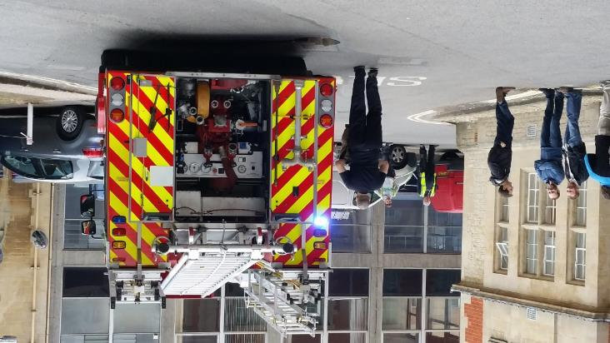
… and a special session

Slide 9
Breaks
Fire alarm…
Coffee breaks
Lunches
Dinner, evening discussions
  Welcome reception
  Social event
Countless hours of valuable discussion

Slide 10
Board Meeting (1)
Current and next meetings
Working groups
  IPv6: in full swing, participation by ALL major sites required (in particular WLCG Tier-1s)
  Benchmarking: No immediate issue with HS06, in standby for next SPECcpu; short benchmark
  Batch: Rich session here, collaboration with WLCG pre-GDB
  Configuration management: moving into moderator mode (like batch)
  Bit preservation: not much going on now, but work on the horizon

Slide 11
Board Meeting (2)
Web site: Board agreed to accept offer by DESY HH to host
  Thanks to Peter van der Reest and colleagues
  All HEPiX contributers who need an account can get it
  Old site at FNAL (Plone) to be switched off by August at the latest
  Maintenance on rotational basis
    Board members and track conveners have all (been) volunteered – more volunteers welcome
DNS: LAL Orsay becoming owner of hepix.org
  Thanks to Michel Jouvin and colleagues
Mailing lists to be moved to DESY as well
Wikis to be considered in due time

Slide 12
Next meetings
Fall 2015: Brookhaven National Lab, Upton (NY), USA
  12 – 16 October 2015
  Same tracks as this time
  Grids, clouds, virtualisation track to be held jointly with WLCG Grid Deployment Board
  First public announcement in May
Spring 2016: DESY Zeuthen, DE
  18 – 22 April 2016
Proposals received for subsequent meetings
May need to swap European/N-American meeting every now and then
Expressions of interest and proposals are always welcome

Slide 13
Thanks
… to all participants
… to all speakers
  … for their contribution and for having accepted constraints
… to the track convenors and chairs
  … for having solicited contributions, and having kept things well within schedule

Slide 14





Special thanks
Viglen and Boston
Western Digital
DataDirect Networks
Amazon Web Services
Without their support and their participation, many things would not have been possible

Slide 15
Special thanks (cont’d)
Local organising
committee:
Peter Gronbech
Sue Geddes
Ewan MacMahon
Sean Brisbane
Kashif Mohammad
  Local organisers
  (cont’d):
Greg Agacinski
Stig Topp-Jorgensen
Duncan Vivian
Stephen Lee

Slide 16
Final Words
Have a good trip back…
… and …

