Slide 1
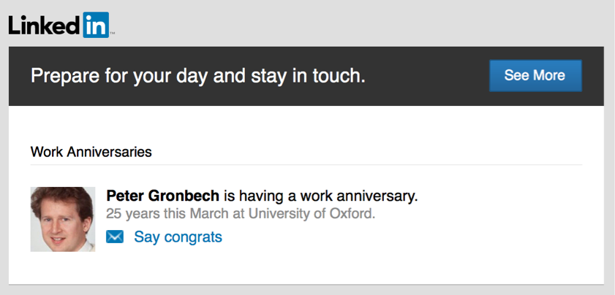
Phishing, anyone?
Received a strange email this week?
Had a ~9% click rate!
  Just below academic average…
  Come on HEPiX, you know better!
This email was:
  Sent with many suspicious fields
  IP address: a dedicated “fake mail service” in eastern Europe IP
  No LinkedIn headers or any link pointing to LinkedIn.com
  Had non-LinkedIn URLs including the word “phishing” in the code
  Pete has no LinkedIn account anyway…
Some people “thought” this was not a real phishing
  But user-agents suggest no evidence of that
  Could have tried to exploit you anyway!
“If we can get the target to visit us in some sort of Web browser, we can probably own them. The only limitation is “how”.” —NSA report
Romain Wartel

