Slide 2
CERN Cloud
Infrastructure Report
Bruno Bompastor
for the CERN Cloud Team
HEPiX Spring 2015
Oxford University, UK

Slide 3
Outline
CERN Cloud
  Recap
  Numbers
Improvements
  Deployed
  Pipeline
Extras
Summary

Slide 4
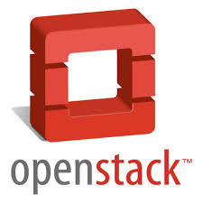
CERN Cloud Recap
CERN Cloud Service one of the three
major components in IT’s AI project
  Policy: Servers in CERN IT shall be virtual
Based on OpenStack
  Production service since July 2013
  Performed three rolling upgrades (Juno almost finished)
  Components: Compute (Nova), Image Management (Glance), Identity (Keystone), Dashboard/UI (Horizon), Block Storage (Cinder), Telemetry (Ceilometer)
Notes:
Explain openstack services

Slide 5
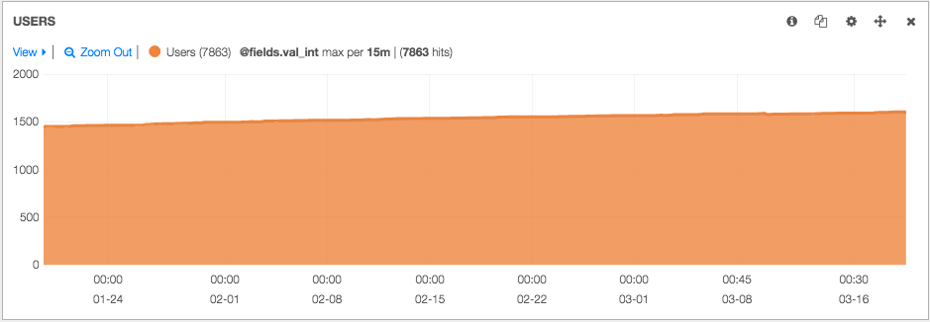
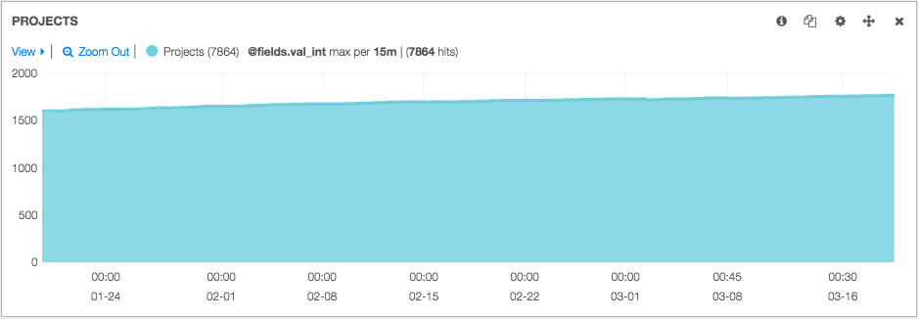
CERN Cloud in Numbers (1)
~3500 hypervisors at the moment
  Vast majority qemu/kvm (~150 Hyper-V hosts)
  ~220 HVs on critical power
  ~2000 HVs used by batch, rest shared by users, services, experiments
  ~800 HVs at Wigner in Hungary
  Additional ~1800 hypervisors are being added since 2015
~1600 users
~1700 projects
  ~1500 personal and ~200 shared
~100k Cores
~200 TB RAM
~1550 images/snapshots (17 TB on Ceph)
~1100 volumes (143 TB on Ceph)
Notes:
- 3500 hypervisors, most of them are KVM
- Continually adding more through out the year
- Users and projects continues to grow

Slide 6
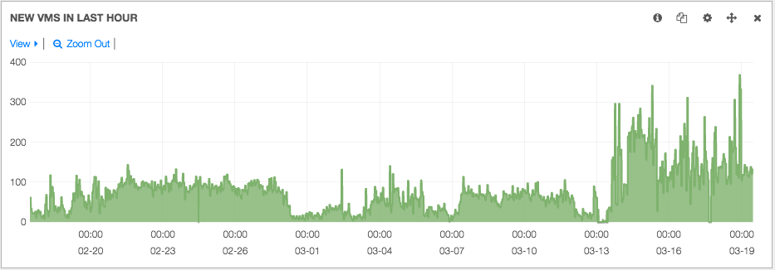
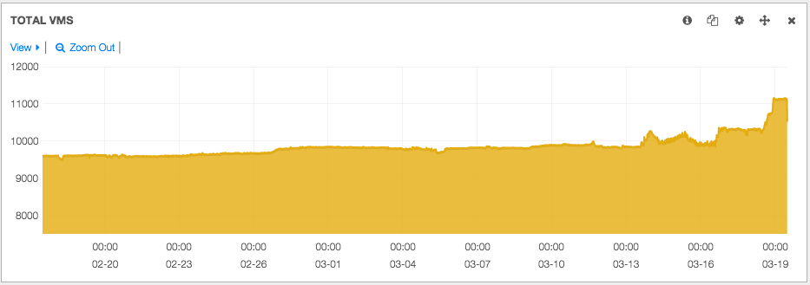
CERN Cloud in Numbers (2)
Number of VMs
Milestone: VM number 1000000 (one million)
  Mostly short lived VMs
~10000 active VMs
  Batch: ~2600
Notes:
Our cloud continues to grow very quickly, a proof of that is the creation of more than one million VMs
- New VMs In last hour (last month)
- Mostly short lived VMs based on CernVM images (LHCB and ATLAS) and CMS “Glidein” jobs

Slide 7
Outline
CERN Cloud
  Recap
  Numbers
Improvements
  Deployed
  Pipeline
Extras
Summary

Slide 8
Improvements Deployed
Juno Upgrade
CentOS 7
CVI phase-out campaign
External Authentication
Rundeck
Rally

Slide 9

Juno Upgrade
Rolling upgrade to
‘Juno’
Done:
  Cinder, Glance, Keystone, Ceilometer
Next:
  Nova, Horizon
New Features:
  Enable multiple identity drivers for different domains (keystone)
  Allow users to specify an image to use for rescue instead of the original base image (nova)
Notes:
Tenth release from upstream done every 6 months

Slide 10
CentOS 7
All service nodes now on CC7
New compute nodes (Nova) also being installed with CC7
Open question: what to do with 3500 compute nodes running SLC6?
  Many will be retired in the coming year
CERN CentOS 7 images available since end 2014
  CC7 Base: To be used for Puppet
  CC7 Extra: Includes AFS, Kerberos, user account, etc.

Slide 11
CVI phase-out campaign (1)
CVI: CERN Virtual Infrastructure based on Microsoft’s System Center Virtual Machine Manager (SCVMM) 2008
Phase-out strategy:
  Help users to recreate VMs on OpenStack
  Migrate VMs to OpenStack where appropriate
***[Mar 25] CVI still hosts 1475 VMs
Objective: most VMs moved to OpenStack by the end of 2015

Slide 12
CVI phase-out campaign (2)
VM creations blocked since Summer 2014
  Migration to OpenStack underway:
52% of CVI Virtual Machines already gone
Notes:
Top: 3641 VMs in June 2013
Jan 2015: 2320
Explain the legend – VMs on last 5 years

Slide 13







External Authentication
Released at CERN on Nov 2014
  Secure way to authenticate (Kerberos, X.509)
  Enable federated use-cases (SSO)
  Upstream code in Kilo based on CERN implementation
catalog
v2
basic
load
balancer
catalog
v3
Kerberos
X.509
SSO
Notes:
We wanted to offer more authentication options integrated with CERN environment
We worked with openstack community to integrate these methods
We implemented this architecture:
Green line: basic authentication
Blue line: Advanced authentication with kerberos, x.509 and sso
Same token on both methods

Slide 14
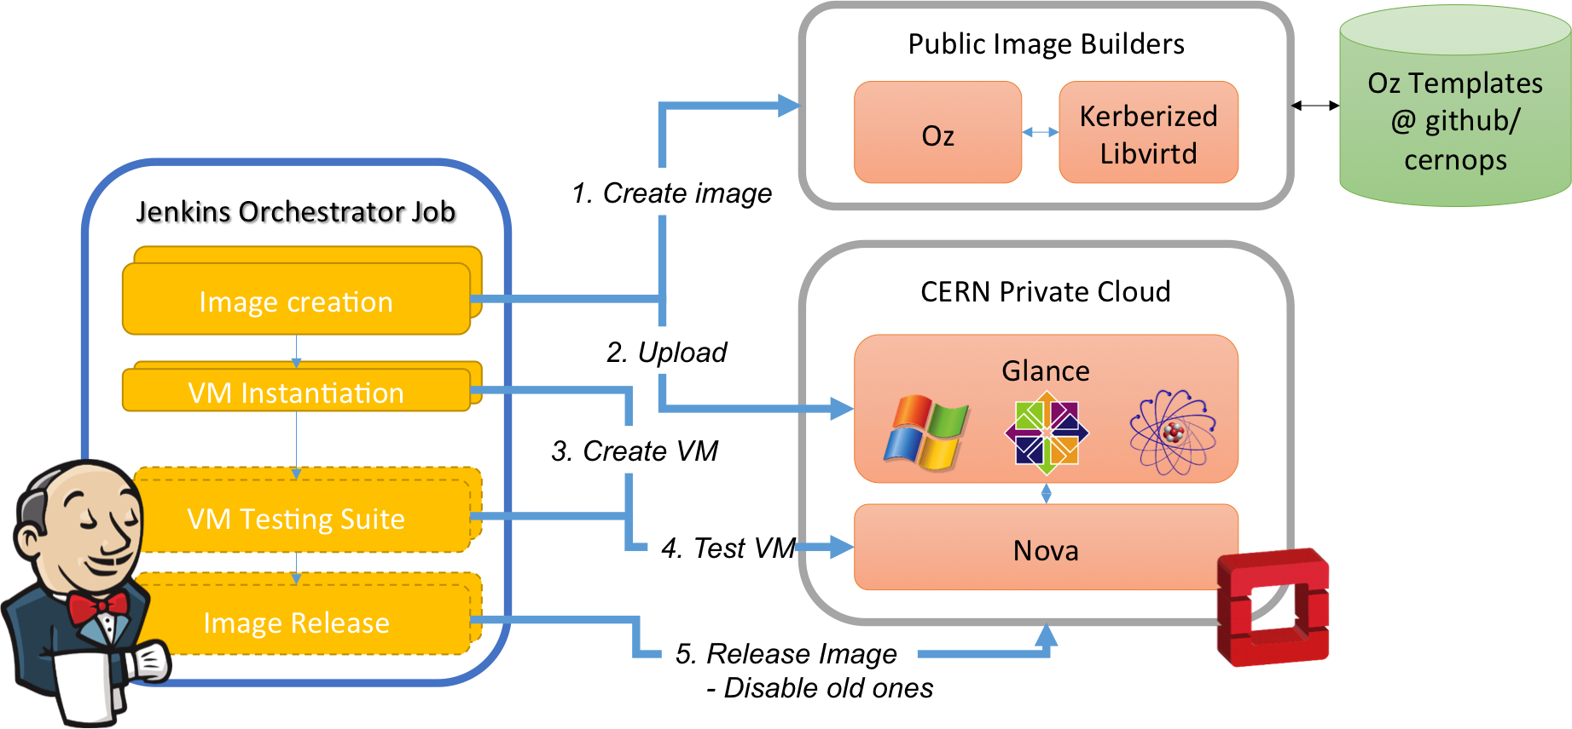
Image Lifecycle (I): Automation
Notes:
General view:
Jenkins allow us to automate the image creation

Slide 15
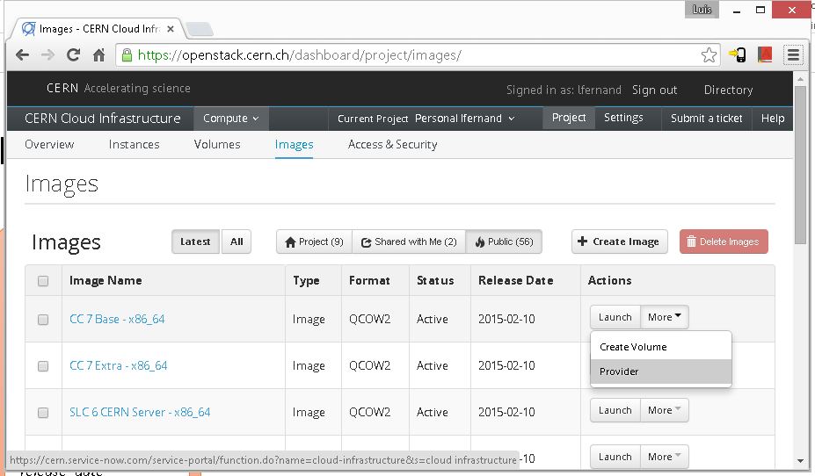



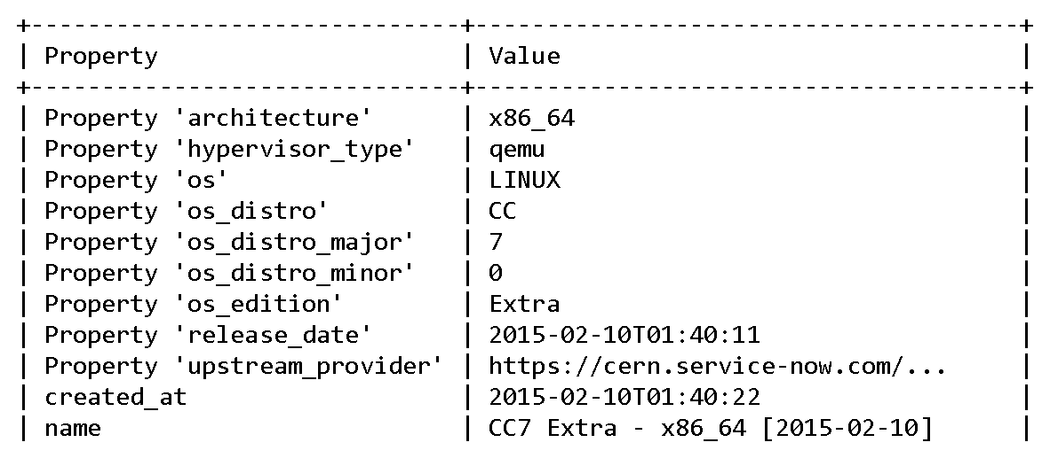
Image Lifecycle (II): Visualization
Glance
Metadata
architecture
os
os_distro
os_distro_major
os_distro_minor
os_edition
release_date
upstream_provider
Notes:
Number of available images on openstack starting to grow
Not able to remove images due to resizing, migrating and rebuilding
Created an easy view for users to choose CERN images based on metadata

Slide 16

Friendly and easy interface from where we can organize and launch jobs on our hosts
  Sharing of sensitive tasks to other groups without exposing credentials or procedures
Use Cases
  SysAdmins: Workflows related to hypervisor maintenance (h/w intervention, notify users…)
  Cloud-Operations: Project creation, Health reports, Quota update
Notes:
Not openstack specific
Run operations much faster

Slide 17
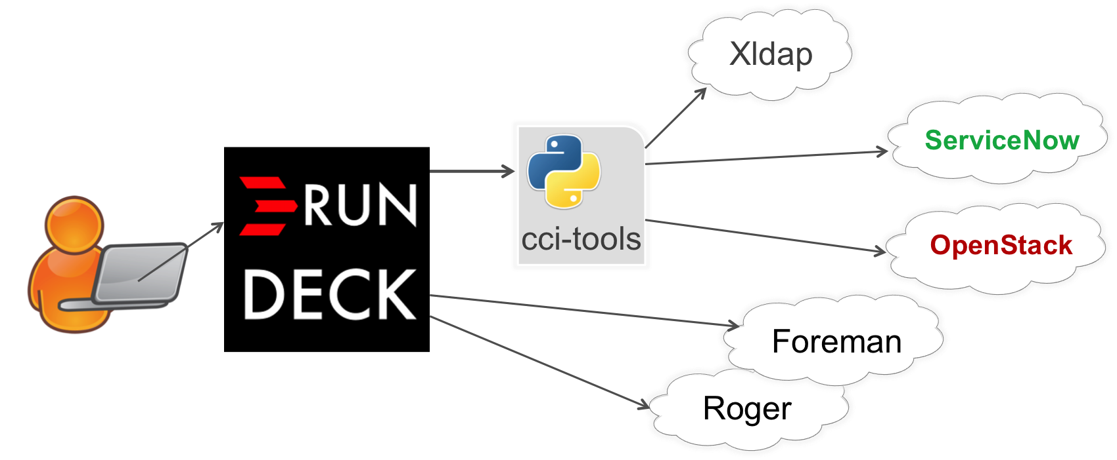
Rundeck Integration
Notes:
Created library to integrate Rundeck jobs with CERN environment
Roger – alarm system for VMs

Slide 18
OpenStack Rally
Benchmarking tool for OpenStack
Performance test
Cloud verification
Used for OpenStack Continuous Integration
Check if services work correctly.
  Rally runs against QA and Production environments regularly.
  We can compare results between the environments.

Slide 19
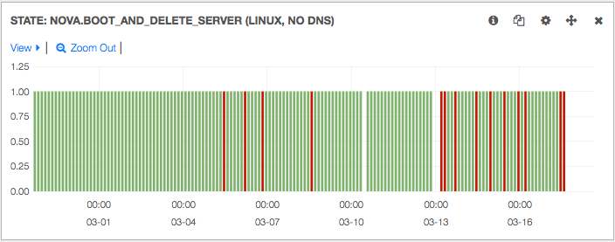
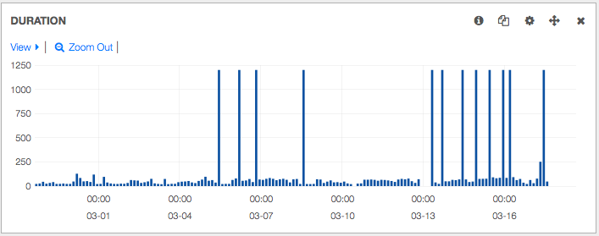
Rally on Kibana (Elasticsearch)
Notes:
Explain plot
Rally in last 20 days

Slide 20
Outline
CERN Cloud
  Recap
  Numbers
Improvements
  Deployed
  Pipeline
Extras
Summary

Slide 21
Improvements In The Pipeline
OpenStack Neutron
Cloud Federation
Nested Projects in OpenStack
Containers: LXC, Docker
Orchestration with Heat

Slide 22
Nova-network -> Neutron
Nova-network being deprecated
Our strategy
  First, deploy functional replacement
  Afterwards, explore new features
    Example: project network, LBaaS, FWaaS
Requires migration plan
  Upstream WIP, but requires (lots of) local testing of integration into CERN environment
First deployment: Q3, Q4

Slide 23

Cloud Federation
OpenStack support for identity federation
  Available with Icehouse and stable in Juno
  OpenStack Identity Service (Keystone) acts as a Service
  Provider mapping SAML assertions to roles
  Support for SAML2 (OpenID and ABFAB to come)
Implementation through Rackspace's membership of CERN Openlab
  Assisted by IBM, Red Hat, HP, Kent University
Cloud federation status at CERN
  Successfully tested with INFN’s IdP
  CERN joined EduGAIN federation, this will provide cloud resources to other federation members

Slide 24




Nested Projects in OpenStack
Collaboration between CERN and the BARC institute (India)
ATLAS resource manager
Creates sub-projects
Sets quota for sub-projects
Nominates sub-project managers
ATLAS resources
Cloud manager
Creates top level project
Sets quota
Nominates ATLAS resource manager
Production
Analysis
Sub-project managers
(roles as above)
Higgs
Susy
Exotics
Notes:
Projects are flat right now, and the cloud admin has to micro-manage all of them (ex: quota increase requests)
Way to delegate administration of projects like assignment of roles and quota

Slide 25

Containers: LXC, Docker
Idea: deploy containers integrated with OpenStack Nova
Use cases:
  Some customers require bare metal performance
  Maximize hardware utilization (Container + hypervisor)
  Re-use of OpenStack provisioning/accounting workflows
  No customer wants to worry about hardware maintenance, BIOS settings, firmware upgrades,…
  Testing functionality and integration into CERN environment has recently started
Notes:
-- some servers have too many cores for EOS usage, and too good n/w bandwidth for hypervisor

Slide 26

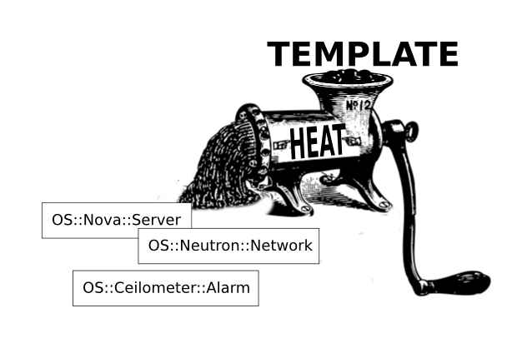
Orchestration with Heat
Heat provides a mechanism for orchestrating OpenStack resources through templates
  See my talk on “OpenStack Heat @ CERN” later

Slide 27
Outline
CERN Cloud
  Recap
  Numbers
Improvements
  Deployed
  Pipeline
Extras
Summary

Slide 28
Extras
Testing block storage based on NetApp as an alternative for Windows volumes
RDO stopped providing Juno RPMs for EL6
  We are working with RDO and CentOS communities to build Nova, Ceilometer, Neutron and CLI packages for Juno/EL6

Slide 29
Summary
OpenStack Cloud service continues to grow
  5000 compute nodes, 10000+ VMs
Operations generally smooth
  Increased involvement of Sysadmin team
  3 rolling upgrades
Many service improvements in the pipeline
  Heat, Neutron, Federation, Docker

Slide 30
Thank you!
Questions?

