Slide 1
Instrument Modeling Response
- FEC response
Yuki Shimizu
SEUC/JAXA

Slide 2
Contents
Calibration of detector response
Proposals how to introduce FEC response to simulation data

Slide 3
Detector response calibration
Detector components (scintillators, photosensors and amplifiers etc.) have each characteristics such as yield, gain and linearity. While these characteristics have been investigated during trial production, those of the flight model itself must be measured by flight model tests and introduced into our simulation in order to improve the accuracy.
The pulse height corresponding to the MIP energy deposit (muon) and the response function of FEC measured in the ground tests are available.
FEC
deposit
energy
Photons
(Photoelectrons)
digital
data
charge
voltage
Scintillator
Photosensor
Amplifier
ADC
light yield
gain
gain
linearity
saturation
linearity
muon measurement (MIP calibration)
electric performance test (response curve)

Slide 4
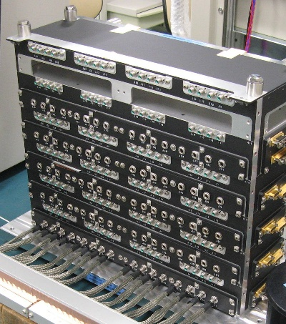
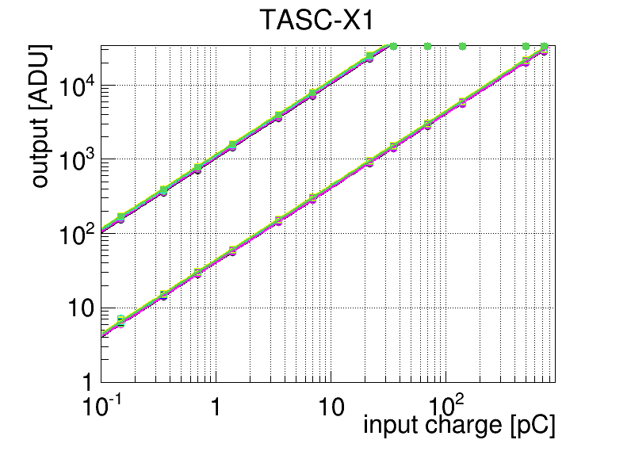
Electrical performance test for FECs
TASC-FEC (X side)
The response curves of FECs has been measured in functional tests.
The output of FECs is shown as a function of the input charge.
(Further analysis is necessary to fix parameters as told yesterday.)
Capacitor
C
Pulse
generator
V
Q=CV
high gain
×～30
 | Photo detector | Shower particle range | Output charge range
CHD | PMT | 1 – 1400MIP | 500fC - 700pC
IMC | 64 anode | 1 – 2500MIP | 8fC - 20pC
 | dynode | 1 – 400MIP | 40fC – 8pC
TASC | PMT | 1 – 1800MIP | 400fC – 700pC
 | APD | 1 – 5000MIP | 2fC - 10pC
 | PD | 10³ – 5×10⁶MIP | 2fC – 10pC
low gain

Slide 5
Proposal to introduce FEC response to simulation
Taking into account the detector response to muons, the deposit energy that is calculated in simulation shall be converted to the charge linearly. The charge shall be digitized with employing the response curve. Saturation of ADC shall be also taken into account (usually 2¹⁵-1).The charge could be converted to pseud-energy with a nominal factor (mean MIP energy / corresponding charge) (e.g. 22MeV / 400fC for PWO-PMTs of TASC, depending on the PMT gain).The pseud-energy [MeV] and digitized output [ADU] shall be introduced to the unified data format. Details must be discussed among M&S team.
saturation
high gain
Such conversion is also necessary for generation of simulated level0 and 1 data.
Should be discussed with DHA team.
low gain
response curve function

