Slide 1
CGBM Data Transfer/Handling and Reduction
Taka Sakamoto, Satoshi Nakahira,
Kazumasa Senuma
On behalf of CGBM team

Slide 2
Scheme of CGBM Data Flow

Slide 3
CALET
Gamma-ray burst Coordinated Network (GCN)
Real time downlink (~70%)
Trigger information
Real time
CGBM Real time Data Analysis (prepare by AGU)
Raw
Data
Raw data
Level 1.1 Data
On-board trigger
Ground trigger
TH data
Light curve data (WCOC server)
Data server
Once an hour
Level 0 Data
Level 1 Data
Level 0 data
Level 2 Data
JAXA Tsukuba Space Center
Waseda CALET Operations Center
Level 3 Data
CGBM institutions

Slide 4
CALET
Gamma-ray burst Coordinated Network (GCN)
Real time downlink (~70%)
Trigger information
Real time
CGBM Real time Data Analysis (prepare by AGU)
Raw
Data
Raw data
Level 1.1 Data
On-board trigger
Ground trigger
TH data
Light curve data (WCOC server)
Data server
Once an hour
Level 0 Data
Level 1 Data
Level 0 data
Level 2 Data
JAXA Tsukuba Space Center
Waseda CALET Operations Center
Level 3 Data
CGBM institutions

Slide 5
CALET
Gamma-ray burst Coordinated Network (GCN)
Real time downlink (~70%)
Trigger information
Real time
CGBM Real time Data Analysis (prepare by AGU)
Raw
Data
Raw data
Level 1.1 Data
On-board trigger
Ground trigger
TH data
Light curve data (WCOC server)
Data server
Once an hour
Level 0 Data
Level 1 Data
Level 0 data
Level 2 Data
JAXA Tsukuba Space Center
Waseda CALET Operations Center
Level 3 Data
CGBM institutions

Slide 6
Plan for GRB alerts

Slide 7
Gamma-ray burst Coordinated Network (GCN)
Follow-up observation from space and ground
GRB detection by spacecraft
Swift
Fermi
MAXI
Etc.
Radio telescope
IR telescope
Optical telescope
X-ray telescope
TeV telescope
Gamma-ray burst Coordinated Network (GCN)
Follow up observations start a few minutes up to days after the trigger
CGBM must contribute this part
Within a few second to a few minutes after the trigger
All the big discoveries of GRBs can not be achieved without GCN!

Slide 8
Status of Currently operating
GRB instruments
 | Automatic distribution | Delivering Products | Distribution
MAXI | Y | Trigger time, Position | GCN
Fermi | Y | Trigger time, Position | GCN
Swift | Y | Trigger time, Light curve, Position | GCN
INTEGRAL | Y | Trigger time, Position | GCN
Konus-Wind | Y | Trigger time, Light curve | GCN
Suzaku | Y | Trigger time, Light curve | GCN
AGILE(*) | Y | Trigger time, Position | GCN
All the currently operating GRB instruments deliver the alert through GCN automatically (no-human-in-the-loop)

Slide 9
CGBM Trigger Alert (1)
On-board triggered event (CGBM: Flight GRB Notice)
Ground triggered event (CGBM: Ground GRB Notice)
(Running the ground triggering code on TH data in near real-time)
Contents (plan):
GRB trigger time (UT)
GRB trigger number
ISS Location
Trigger significance (sigma)
Foreground integration time (s)
Background integration time (s)
Energy band
Note: we only obtain “triggered flag” info from the real-time data (raw data) for the on-board trigger.
Goal: Within 10 seconds after the event

Slide 10
CGBM Trigger Alert (2)
Publically available CGBM Light curve
Put the CGBM light curve data from T₀-50 s (TBD) to T₀+300 s (TBD) using TH data for the triggered events at the publically accessible web page
png or jpg image and ascii data of the light curve
Single energy band light curve (HXM and SGN)
Three different time resolutions (e.g., 0.125 s, 1.25 s, 12.5 s)
ascii data in 0.125 s resolution in single energy band
Web site: WCOC public web page
Goal: Within 10 minutes after the event

Slide 11
Real-time Telemetry of ISS
Example of MAXI
Frequency distribution
Data completeness
10⁰
10¹
10²
10³
10⁴
10⁵
Time Delay(s)
~75% of real-time data (black) within 10 second delay

Slide 12
Current Status
Done:
Delivered two CGBM computers (GRB alert and QL) to WCOC
Sign-up for the GCN socket connection account
Need to be done:
“Receive only” socket connection test with GCN
Software to extract required info from the raw data
Communication with GCN (Scott Barthelmy) to finalize the GCN Notice format
“Receive and send” packet test with GCN

Slide 13
Current Status of Software

Slide 14
CGBM Data Format
CGBM analysis data are in FITS (Flexible Image Transport System) format.
  Following the standard FITS format to be able to use already available software
  Easy for archiving the data in a future (e.g., NASA/GSFC HEASARC archives the data in the FITS format)
(FITS is a standard data format in astronomy community)

Slide 15
Level 1 binary Data (@ Waseda CALET Operations Center)
Reuse MAXI library
ISS information
Inst FOV, etc.
(a) Time conversion
Reuse MAXI library
(A) Aspect data FITS conversion
(B) HK data FITS conversion
(C) Event data FITS conversion
(D) TH data FITS conversion
(E) PH data FITS conversion
New
New
New
New
New
FITS aspect file
FITS HK file
FITS event file
FITS TH file
FITS PH file
Level 2 FITS file
New
(G) Energy conversion PHA rebin
New
(F) PI column conversion
Energy calibrated FITS event file
Energy calibrated FITS PH file
Level 2 FITS file

Slide 16
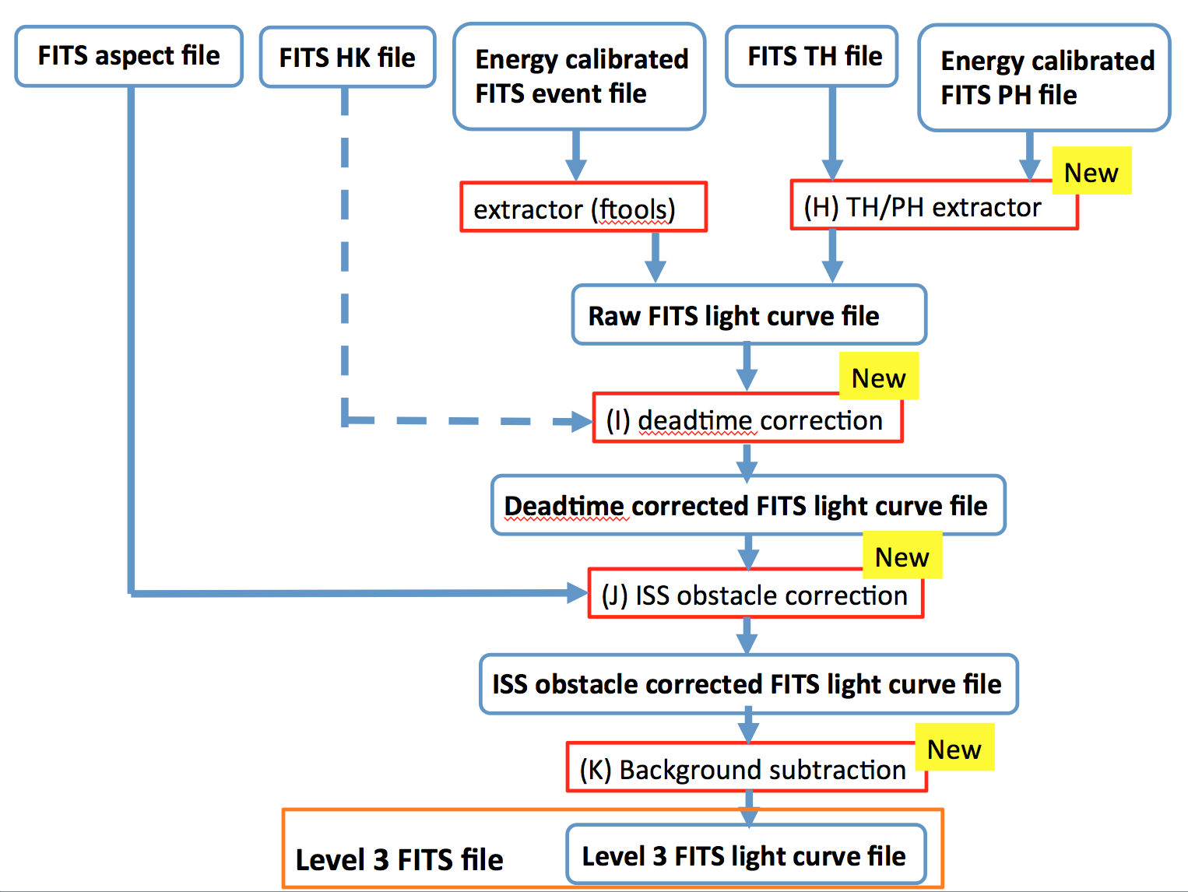
Level 3: Light curve file

Slide 17
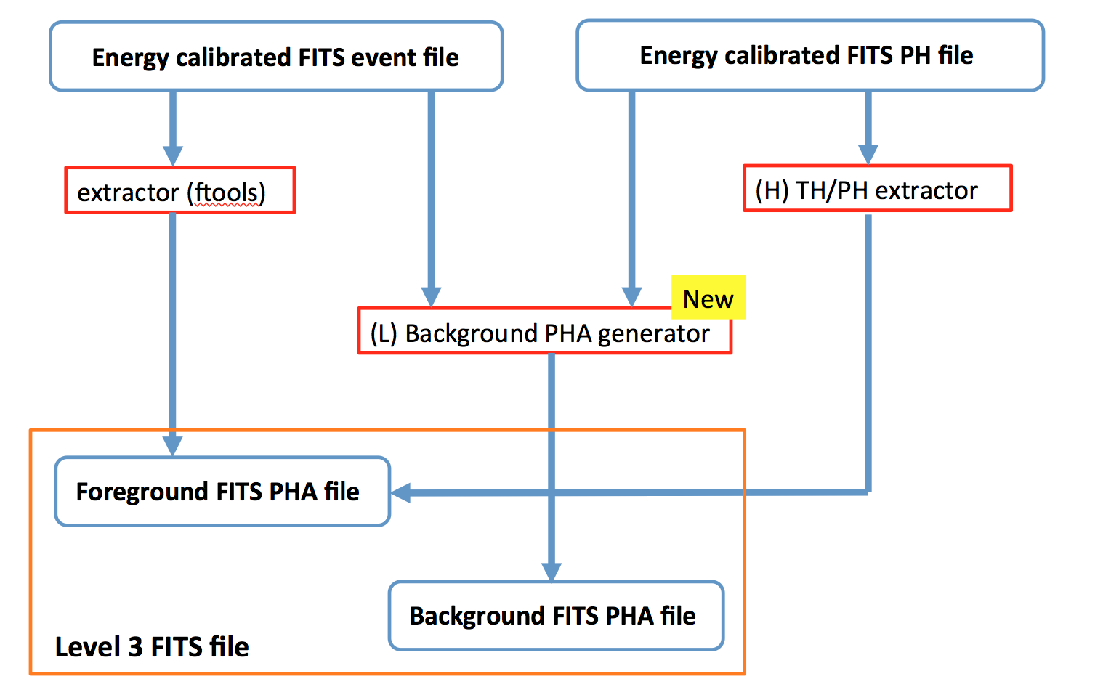
Level 3: PHA (spectral) file
- Energy response FITS file

Slide 18
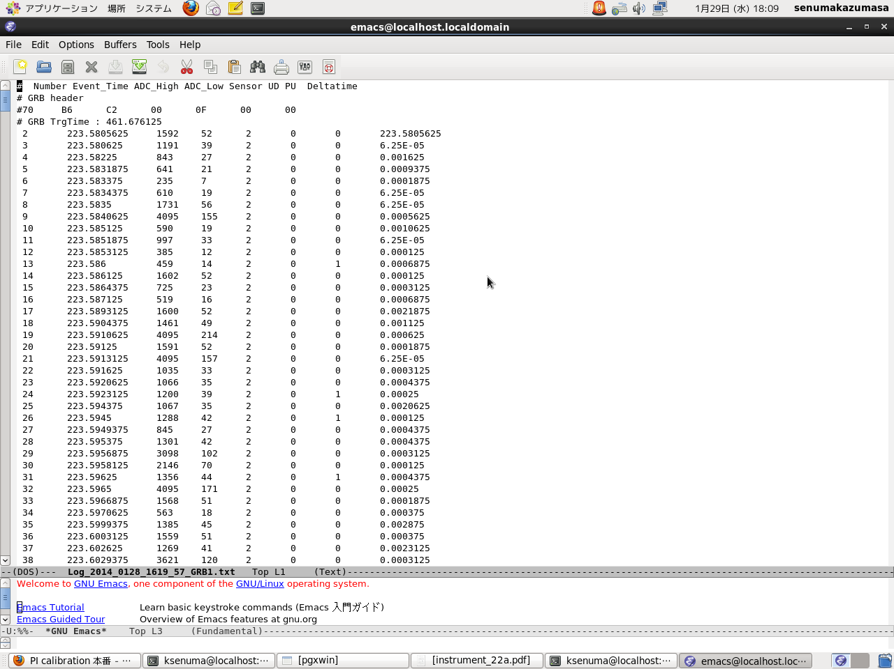
1. CGBM Event FITS Conversion
- Python (pyfits, numpy)
TIME
S
PHA_HIGH
CHANNEL
PHA_LOW
CHANNEL
Input: ascii file (PI calibration’s trigger test)
TIME
PHA_HIGH
PHA_LOW
Sensor
0 : HXM1 1 : HXM2 2 : SGM

Slide 19
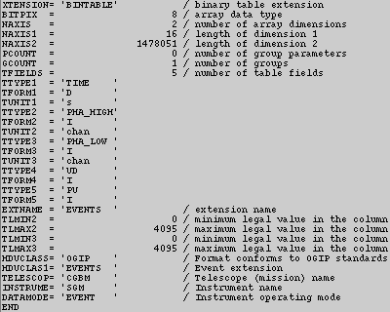
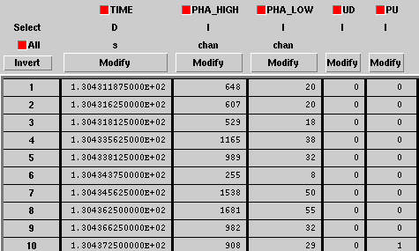
1. CGBM Event FITS Conversion
> ~/work/CALET/cgbm_tool/fits_conversion_ver2.py cgbm_evt_good.txt
> ls
cgbm_evt_good.txt cgbm_evt_good.txt_hxm2.evt
cgbm_evt_good.txt_hxm1.evt cgbm_evt_good.txt_sgm.evt
> extractor cgbm_evt_good.txt_hxm1.evt NONE timefile=NONE gti=GTI imgfile=NONE phafile=NONE fitsbinlc=cgbm_1s_hxm1.lc binlc=1.0 regionfile=NONE gtinam=GTI xcolf=NONE ycolf=NONE tcol=TIME ecol=PHA_LOW xcolh=NONE ycolh=NONE
> extractor cgbm_evt_good.txt_hxm1.evt NONE timefile=NONE gti=GTI imgfile=NONE phafile=cgbm_low_hxm1.pha fitsbinlc=NONE regionfile=NONE gtinam=GTI xcolf=NONE ycolf=NONE tcol=TIME ecol=PHA_LOW wtmapb=no

Slide 20
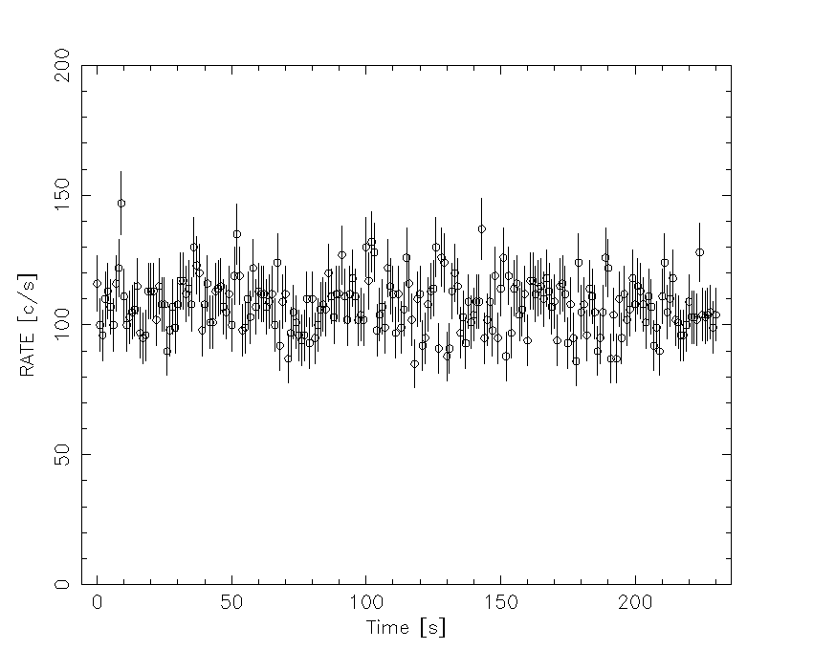
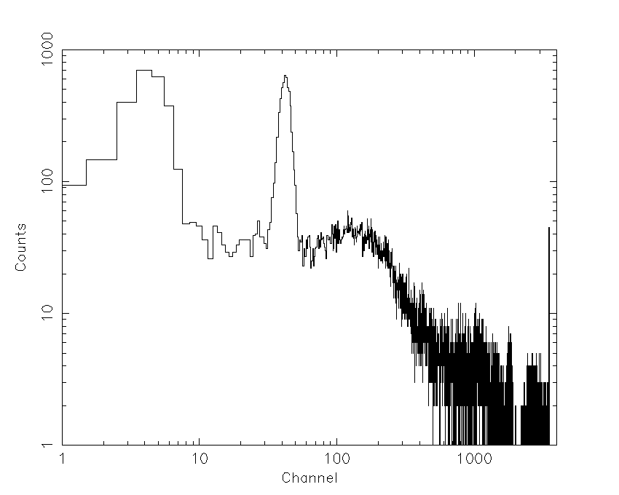
1. CGBM Event FITS Conversion
Light curve and spectrum created by standard ftools “extractor” from CGBM FITS event file
cgbm_1s_hxm1.lc
cgbm_low_hxm1.pha

Slide 21
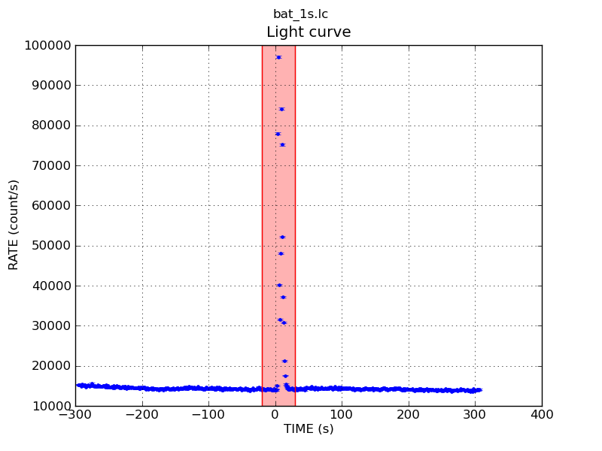
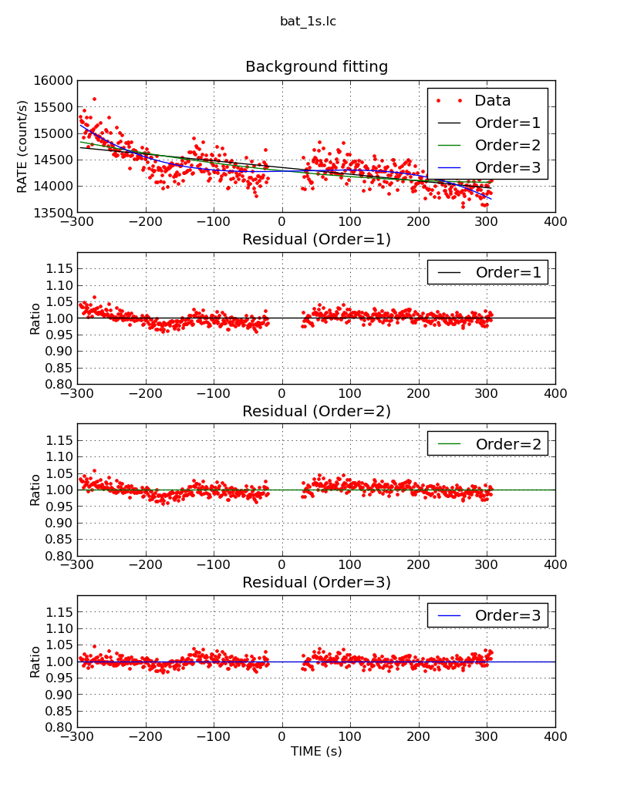
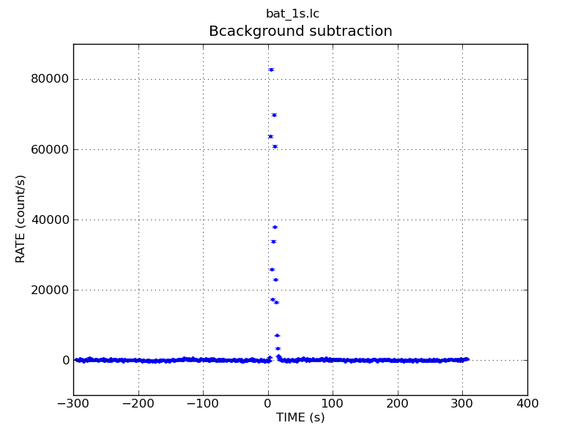
2. Light curve background subtraction
- Python (pyfits, numpy)
Raw FITS light curve
Background subtracted
FITS light curve
Interactive tool:
Input FITS light curve
Specify a burst interval
Automatic polynomial fit (1-5 orders)
Background subtracted FITS light curve

Slide 22
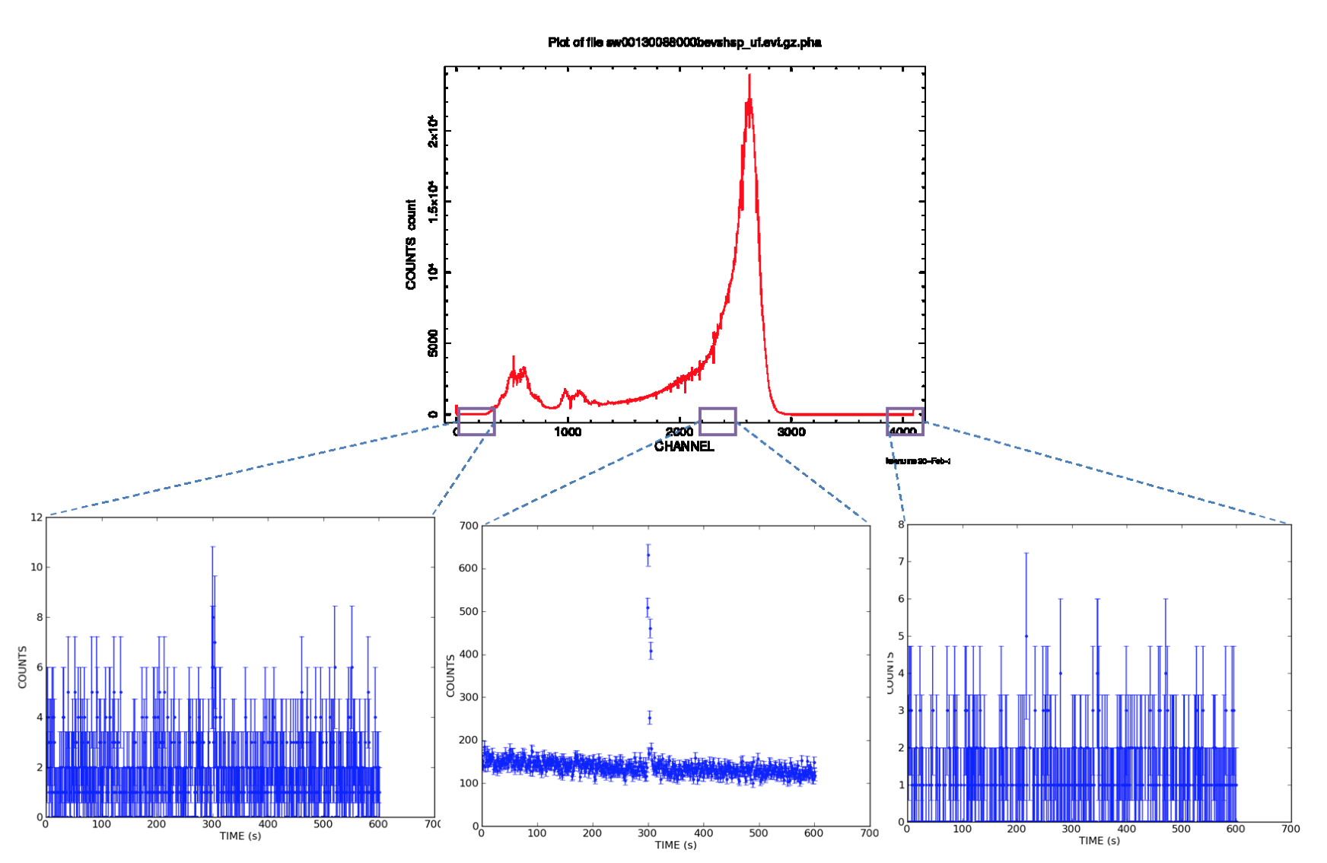
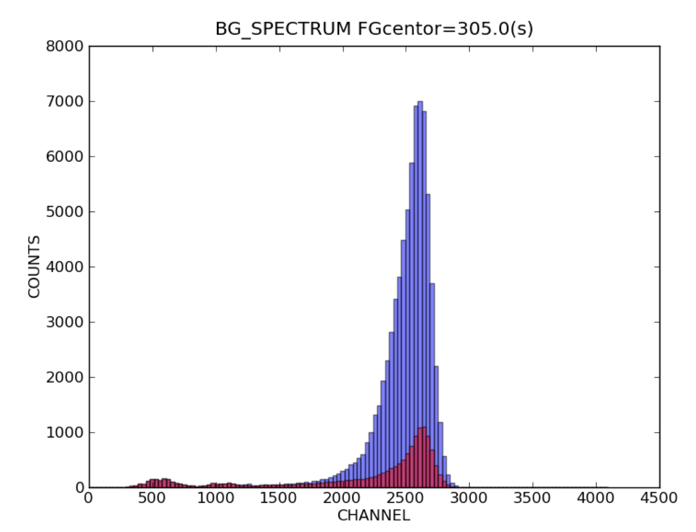
3. Background PHA file
Background spectrum
- Input event FITS data
Input background subtracted FITS light curve
Fit the multi-channel light curves using the same burst interval and the order of polynomial function.
Estimate the background counts for each channel.
Write the results to the FITS PHA file.

Slide 23
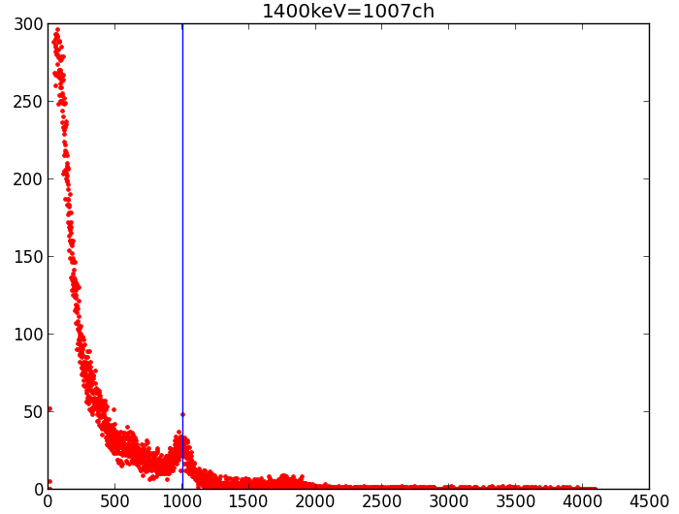
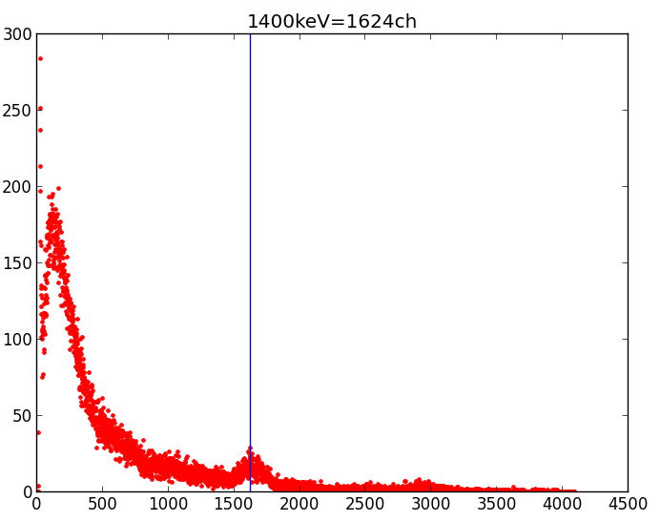
4. Gain Correction
Currently under development….
Instrument’s gain changes due to the temperature variation.
SGM BBM: ISAS thermal vacuum test data
1.4 MeV = 1007 ch @26℃
1.4 MeV = 1624 ch @ -28℃
Count
Count
Channel
Channel
Python script to find a peak channel from the background spectra

Slide 24
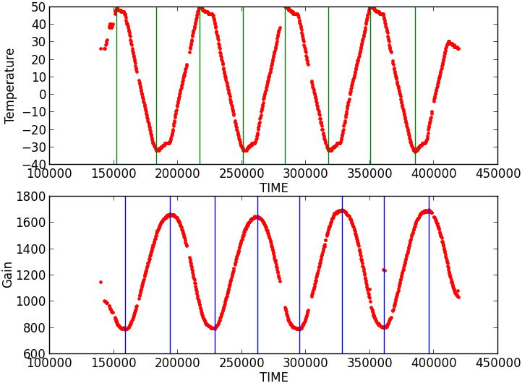
4. Gain Correction
Currently under development….
Peak channel of 1.4 MeV
Investigating the coefficient of heat transfer between thermocouple and the temperature of crystal.

Slide 25
Level 1 binary Data (@ Waseda CALET Operations Center)
Reuse MAXI library
ISS information
Inst FOV, etc.
(a) Time conversion
Reuse MAXI library
(A) Aspect data FITS conversion
(B) HK data FITS conversion
(C) Event data FITS conversion
(D) TH data FITS conversion
(E) PH data FITS conversion
New
Done
New
New
New
New
FITS aspect file
FITS HK file
FITS event file
FITS TH file
FITS PH file
Level 2 FITS file
New
(G) Energy conversion PHA rebin
New
Working
(F) PI column conversion
Energy calibrated FITS event file
Energy calibrated FITS PH file
Level 2 FITS file

Slide 26
Level 3: Light curve file
Done

Slide 27
Level 3: PHA (spectral) file
Done
- Energy response FITS file

Slide 28
Future Plan
Development of FITS converter as the highest priority
Provide the example of CGBM FITS files and developed software to the team
We will communicate to the team member using cgbm_int@phys.aoyama.ac.jp

