Slide 1
Proton Tracking Procedure
Masakatsu Ichimura
Hirosaki University, JAPAN
CALET TIM , Oct. 15, 2014

Slide 2
Motivation
・Proton identification in the CHD module become difficult
in high energy region because of many back scattering
particles.
・SCIFIs in the IMC module may be useful for proton
identification instead of CHD scintillators.
・Tracking accuracy should be less than 1mm because width
of fibers is 1mm
Accurate tracking method is required specially for proton !!

Slide 3
Simulation Data
Code: Epics 9.154 + Cosmos 7.635 with Config4.3
Primary: proton
Energy : ∝ E^{-2.66} (E>1TeV)
Geometrical Condition :
Isotropic incident
Orbit line crosses both top and bottom surface of the detector
10⁵ events are generated
32309 events are triggered by high energy trigger condition.
(E_{TASC}@1st layer > 55MIP and E_{IMC}@7th-8th layers > 15MIP)

Slide 4
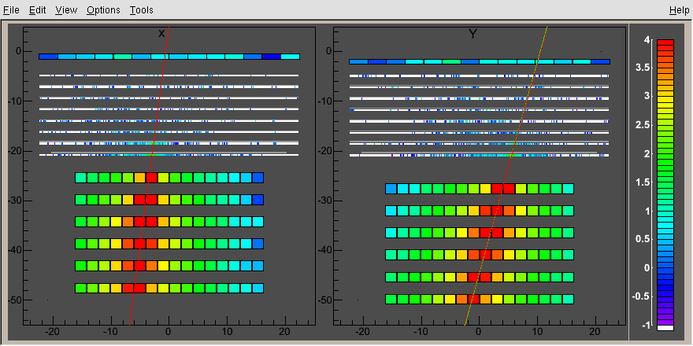
Image of Simulation Data

Slide 5
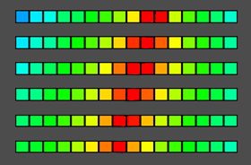
Line fitting on TASC signals
Find the PWO log with the highest signal on each layer.
Take the one of neighbors which has larger signal, and make the signal weighted center of these two points. These are took as the representative point for each layer.
Make a line fitting on these points with using the sum of two signals as a weight.

Slide 6
Line fitting on TASC signals
Find the PWO log with the highest signal on each layer.
Take the one of neighbors which has larger signal, and make the signal weighted center of these two points. These are took as the representative point for each layer.
Make a line fitting on these points with using the sum of two signals as a weight.

Slide 7
Line fitting on TASC signals
Find the PWO log with the highest signal on each layer.
Take the one of neighbors which has larger signal, and make the signal weighted center of these two points. These are took as the representative point for each layer.
Make a line fitting on these points with using the sum of two signals as a weight.

Slide 8
Line fitting on TASC signals
Find the PWO log with the highest signal on each layer.
Take the one of neighbors which has larger signal, and make the signal weighted center of these two points. These are took as the representative point for each layer.
Make a line fitting on these points with using the sum of two signals as a weight.

Slide 9
Line fitting on TASC signals
Find the PWO log with the highest signal on each layer.
Take the one of neighbors which has larger signal, and make the signal weighted center of these two points. These are took as the representative point for each layer.
Make a line fitting on these points with using the sum of two signals as a weight.

Slide 10
Line fitting on TASC signals
Find the PWO log with the highest signal on each layer.
Take the one of neighbors which has larger signal, and make the signal weighted center of these two points. These are took as the representative point for each layer.
Make a line fitting on these points with using the sum of two signals as a weight.

Slide 11
Line fitting on TASC signals
Find the PWO log with the highest signal on each layer.
Take the one of neighbors which has larger signal, and make the signal weighted center of these two points. These are took as the representative point for each layer.
Make a line fitting on these points with using the sum of two signals as a weight.

Slide 12
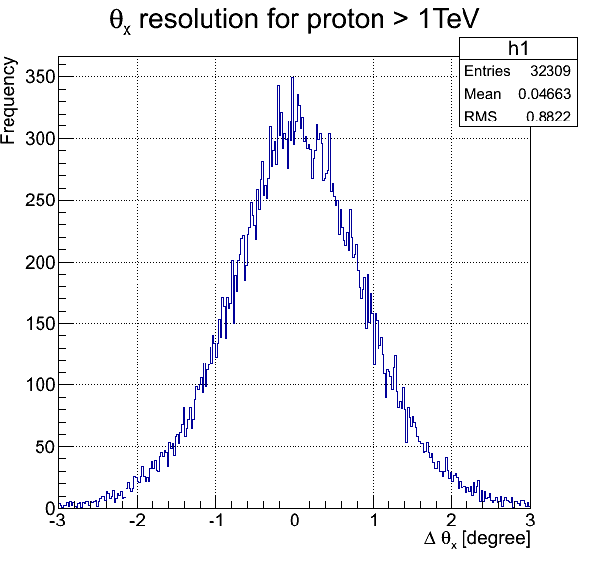
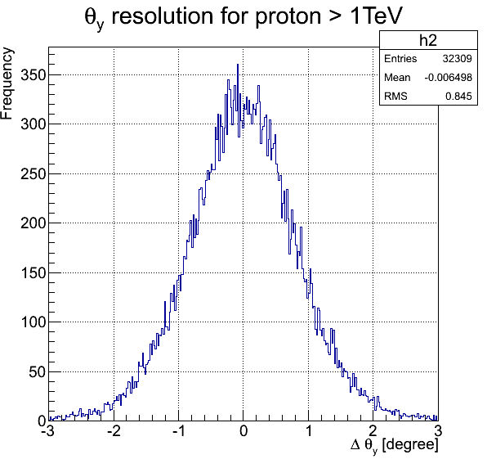
Results of TASC tracking
Distribution of ⊿ θ (=θ_{est}-θ_{true} )
σ : width of 68%
σθx:
0.86 degree
σθy:
0.81 degree

Slide 13
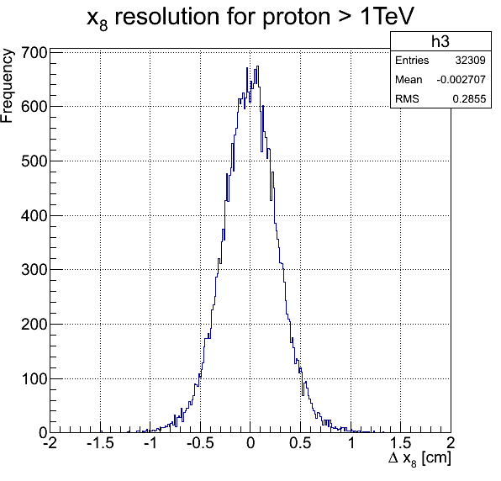
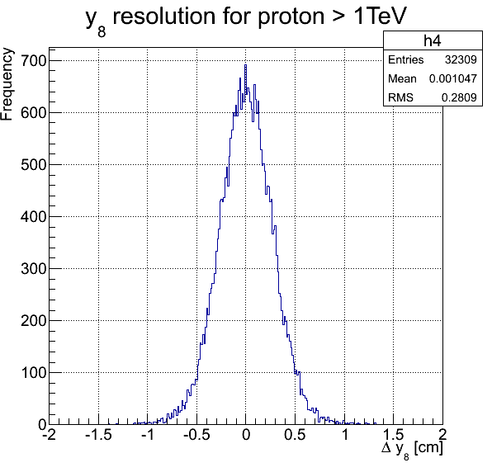
Results of TASC tracking
Distribution of estimated position on the 8th layer of IMC module by TASC tracking
σ_{x8}: 0.27 cm
σ_{y8}: 0.27 cm

Slide 14
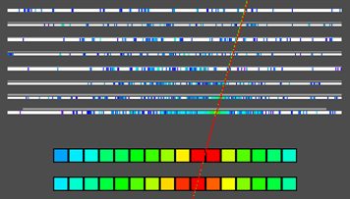
IMC tracking
Set the allowable region in the IMC module with use of
the line made by TASC signal.
Allowed region(yellow part):
±1cm for 7th and 8th layer
±2cm for other layers

Slide 15
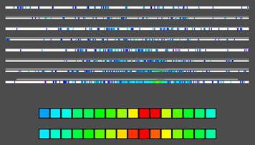
IMC tracking
Make a peak detection in the allowed region. All of peak points in the allowed region are picked up and recorded. Peak point means the point greater than both neighbors.

Slide 16
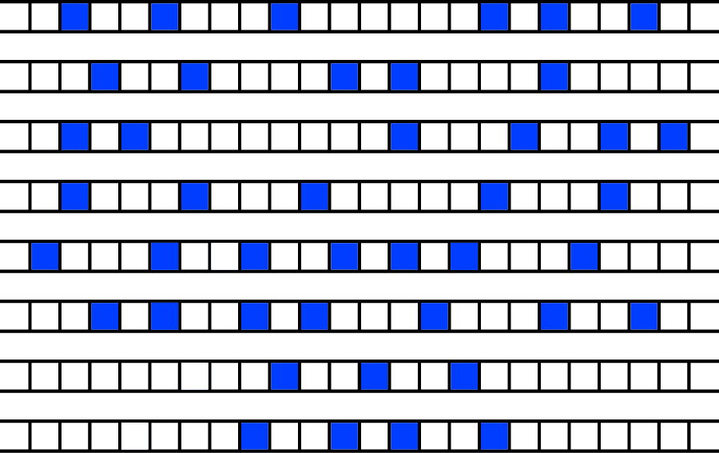
IMC tracking
Pick one point up from TOP and BOTTOM group, and make a line with connecting them. Check the zenith angle of the line. (⊿θ＜3 degree with TASC line is allowable)
Layer
1
TOP group
2
3
4
5
6
7
BOTTOM group
8

Slide 17
IMC tracking
Pick one point up from TOP and BOTTOM group, and make a line with connecting them. Check whether zenith angle is allowable or not. (⊿θ＜3 degree with TASC line is allowable)
Layer
1
TOP group
2
3
Allowable range
TASC line ± 3 degree
4
5
6
7
BOTTOM group
8

Slide 18
IMC tracking
Find the closest peak point within 2mm from the line for each
layer. They will be saved as candidates of track signals, if the
number of points greater than 5.
Layer
1
TOP group
2
3
Allowable range
TASC line ± 3 degree
4
5
6
7
BOTTOM group
8

Slide 19
IMC tracking
Do above for all combination of TOP and BOTTOM
points, then closest line to the TASC component with
maximum energy deposit will be selected as the primary
track signals. Finally, the line parameters are calculated by
selected IMC coordinates.

Slide 20
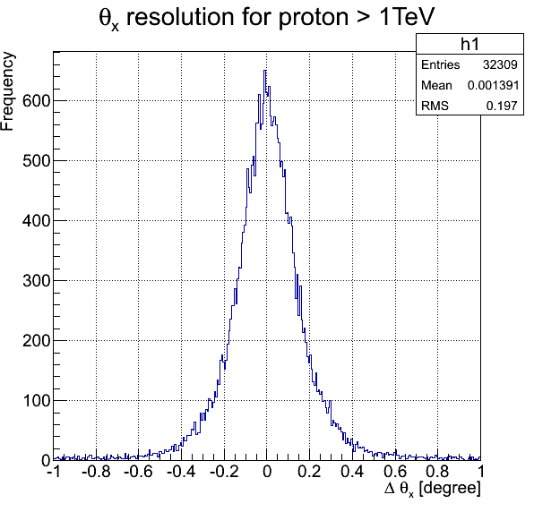
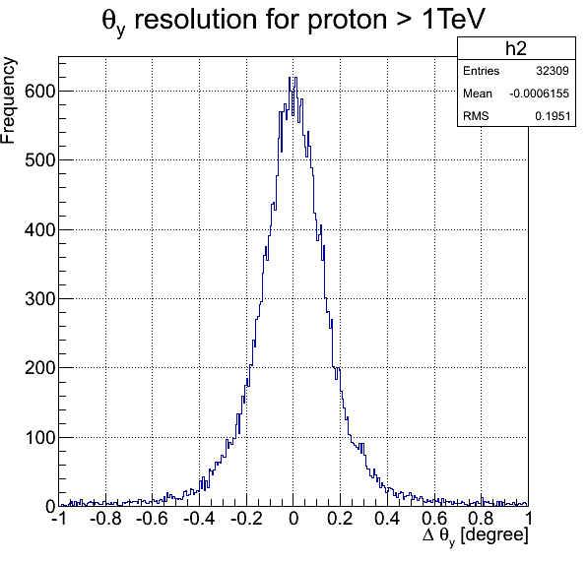
Results of IMC tracking
Distribution of ⊿ θ (=θ_{est}-θ_{true} )
σθx:
0.16 degree
σθy:
0.16 degree

Slide 21
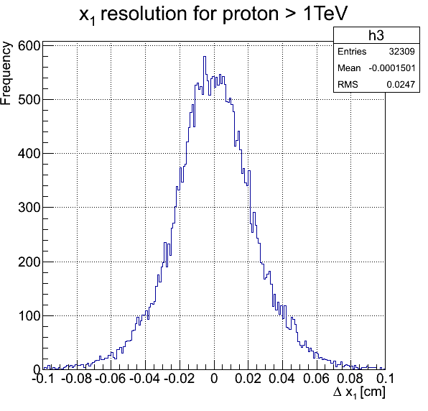
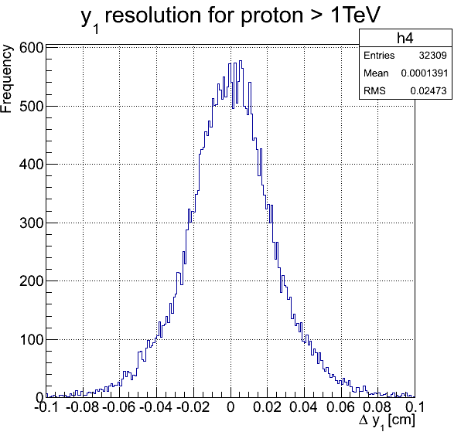
Results of IMC tracking
Distribution of estimated position on the 1st layer of IMC module
σ_{x1}:
0.025 cm
σ_{y1}:
0.025 cm

Slide 22
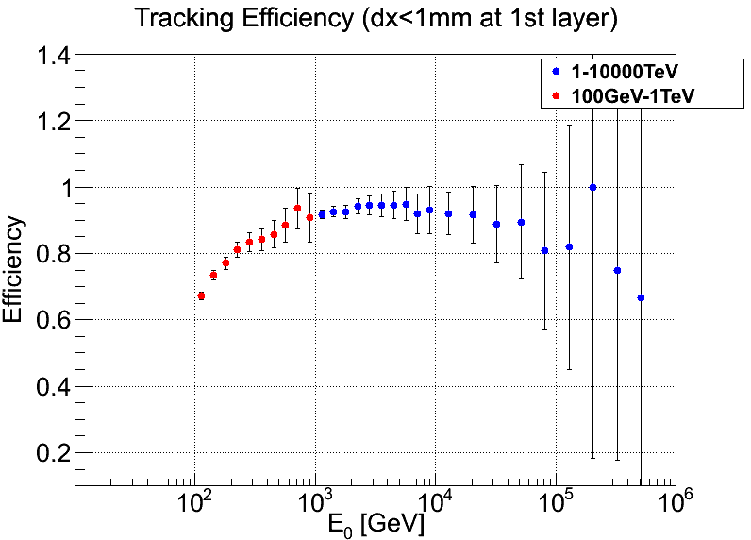
Tracking Efficiency(⊿x₁ < 1mm)
The fraction of the event which has a difference of position
less than 1mm at the 1st layer of IMC.
More than 90 %
for E > 1TeV
Poor statistics

Slide 23
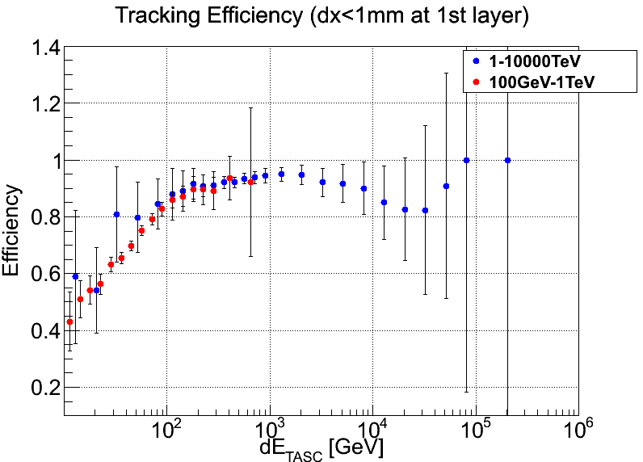
The same tracking efficiency
vs
the sum of energy deposit in TASC

Slide 24
Summary
The study of tracking procedure for proton primaries is under going on.
The tracking efficiency of more than 90% is obtained with angular resolution 0.16 degree of angular resolution and 250 micron of position resolution for E>1TeV region.
In ~100 GeV region, it become worth.
More statistics are required for E>10TeV region
Future issues:
Method of charge measurement for proton with SCIFI
Apply to other heavy primaries, He, C, O, …. Fe

