Slide 1
US CALET Data Center
Doug Granger
LSU
CALET TIM October 2014

Slide 2
US-CDC Purpose
Designed to be the centralized CALET Data storage Center for the US group of CALET.
  Storage for Official CALET Data Products (Level1.X, Level2.x, etc)
  Storage for Process and Analysis Tools
  Capability to distribute data packages to all US Members
Interface with Foreign Collaborators for Data Handling and Analysis product sharing
  Retrieval of Flight Data from The WCOC
  Sharing of analysis tools
  Data sharing for Analysis
Provide a system for communication to all members
  Data Quality Checks
  Data Logging Server
  Data Quality Discussions
  Document Host Server
  LSU HPC Simulation Log Server

Slide 3
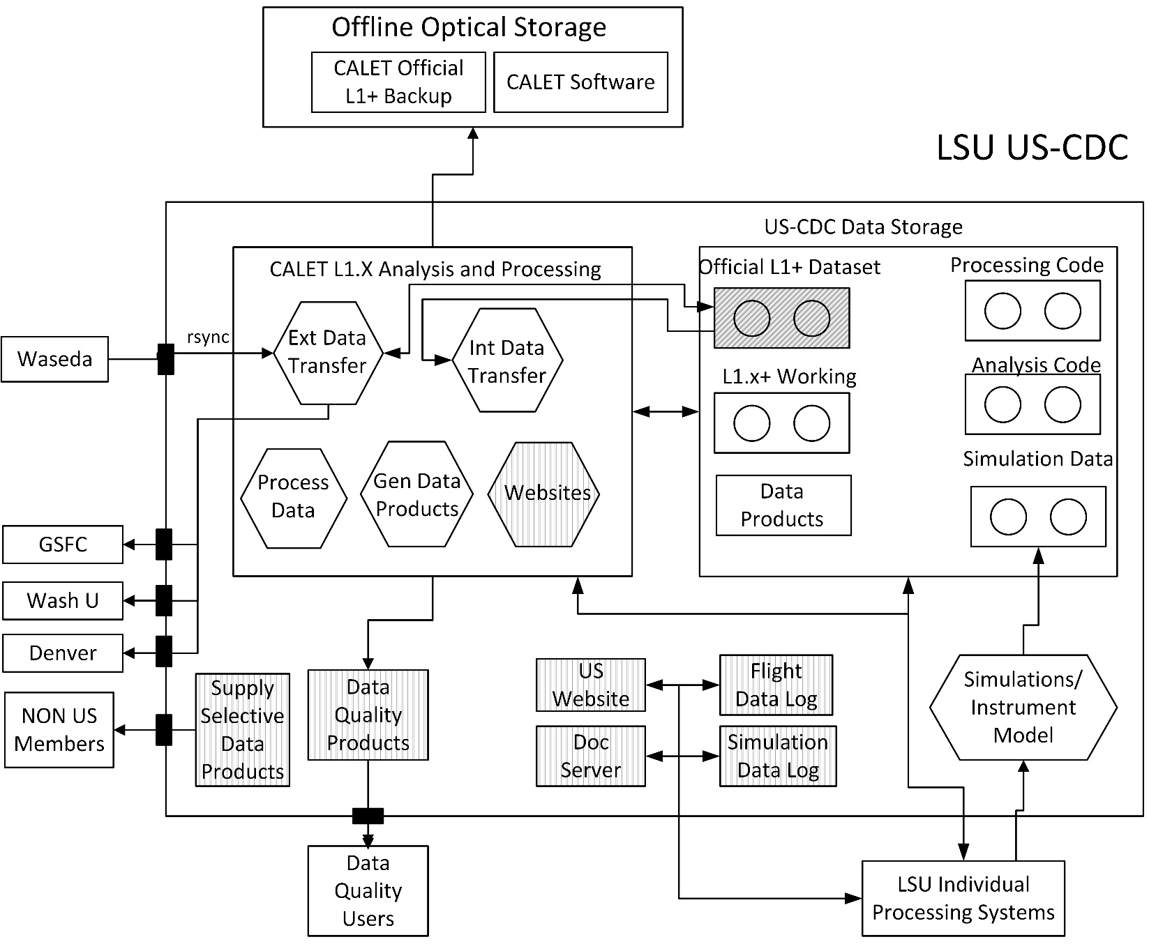
High Level System Design

Slide 4
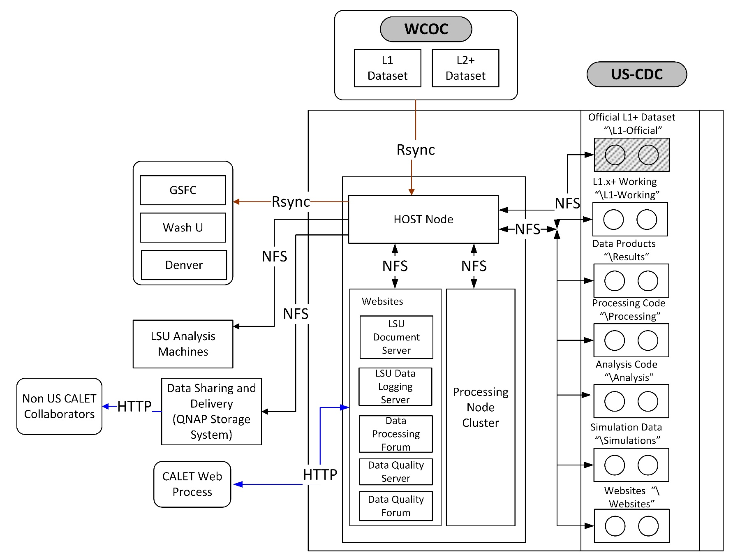
Software Data Flow

Slide 5
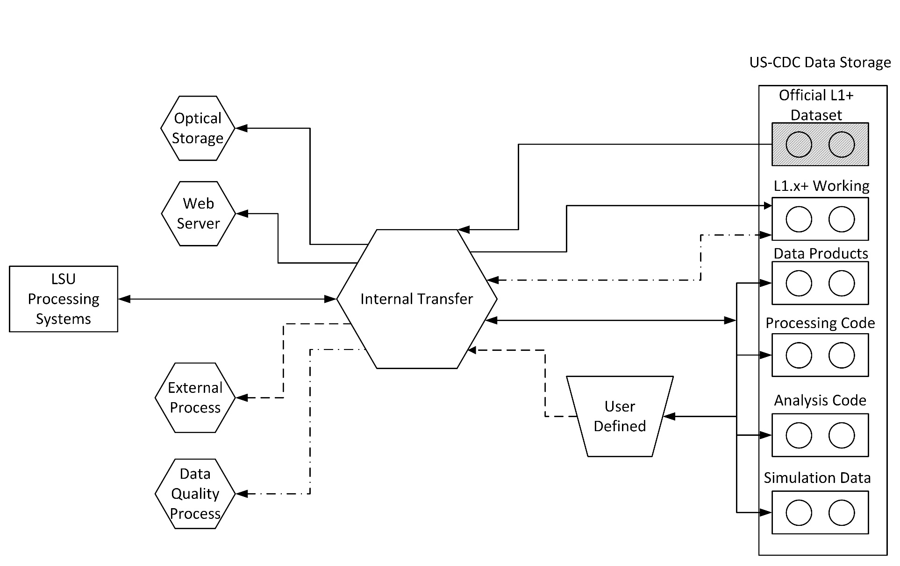
External Data Transfer Process

Slide 6
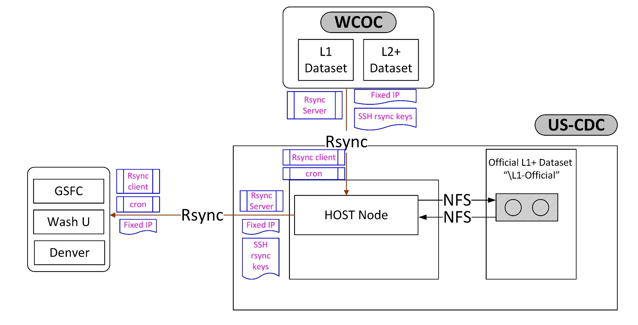
CALET Level 1.X Data
Transfer Process

Slide 7
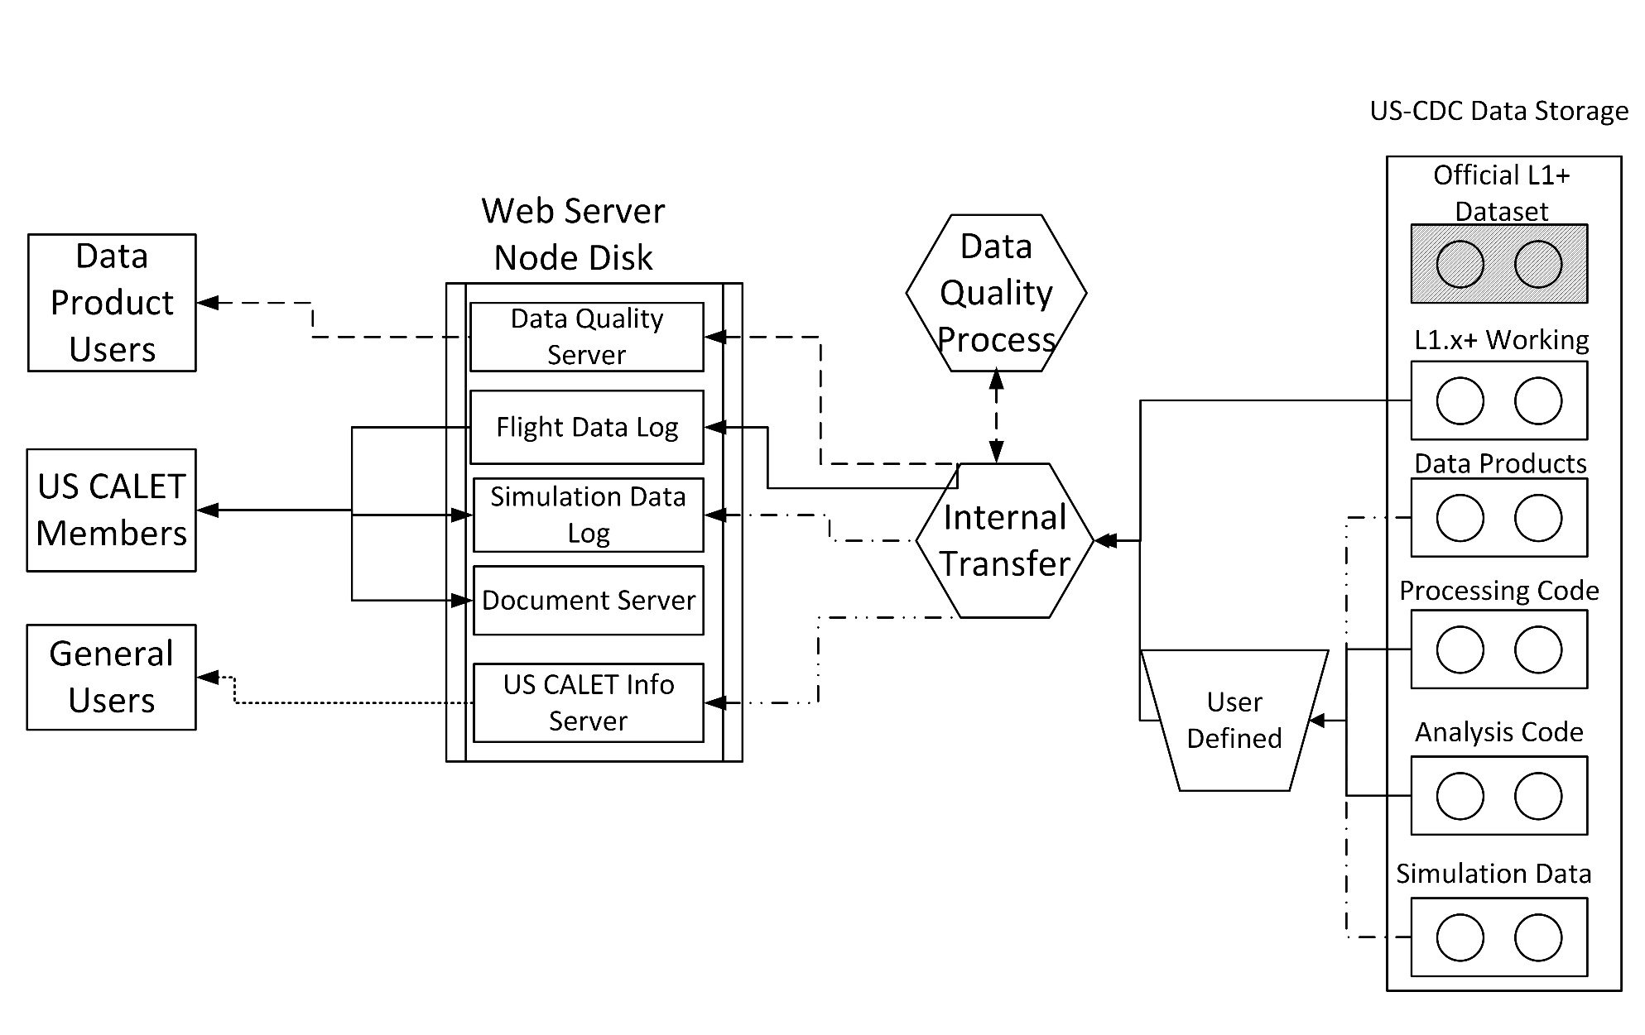
Web Systems Process

Slide 8
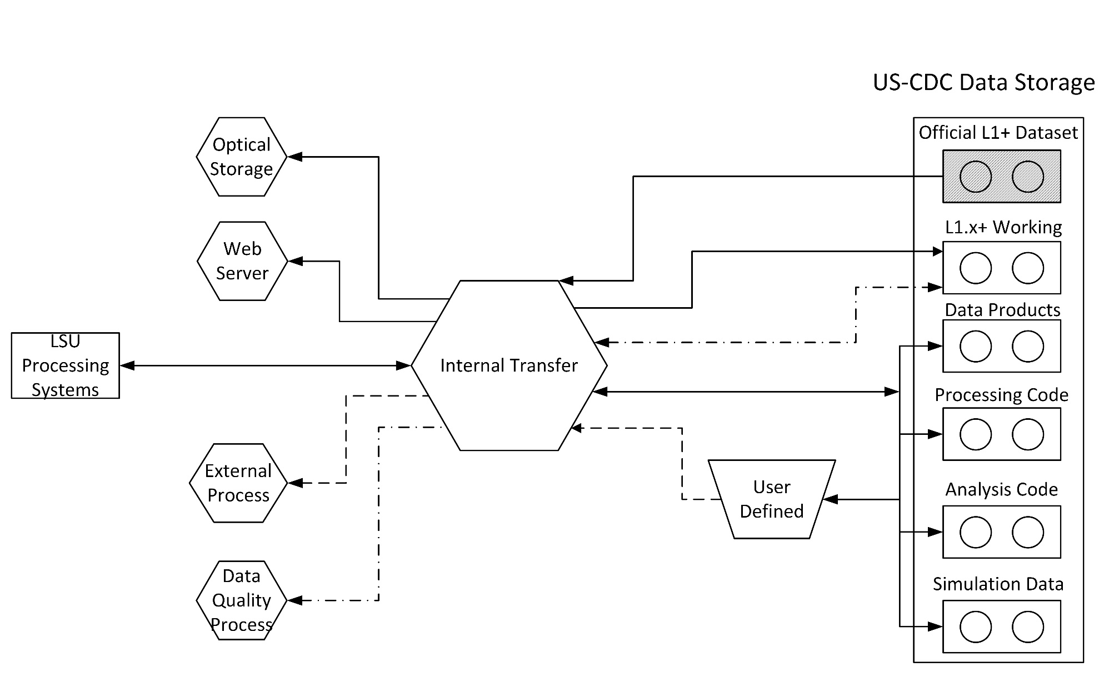
Internal Transfer System Process

Slide 9
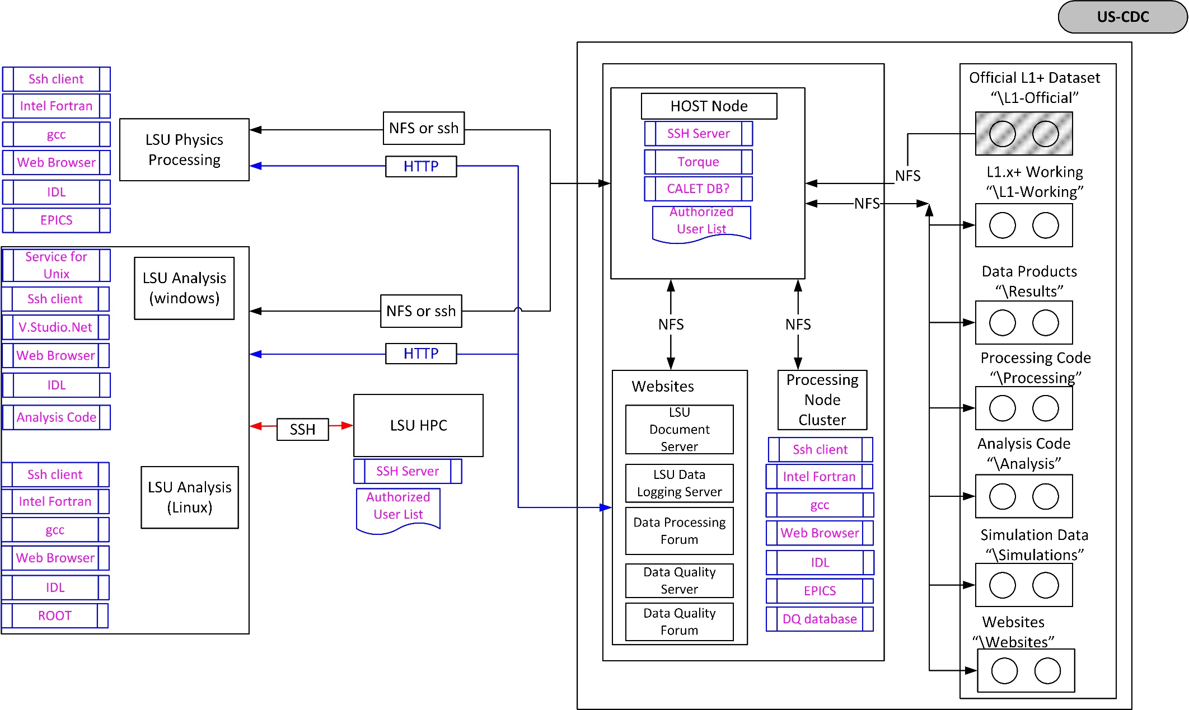
LSU Internal System Design

Slide 10
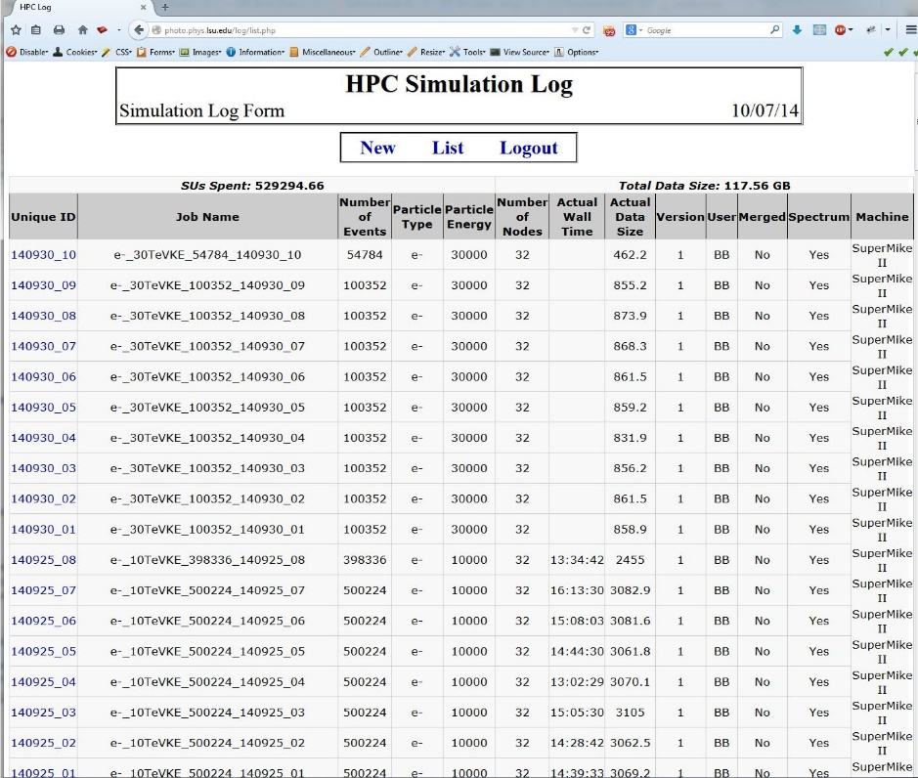
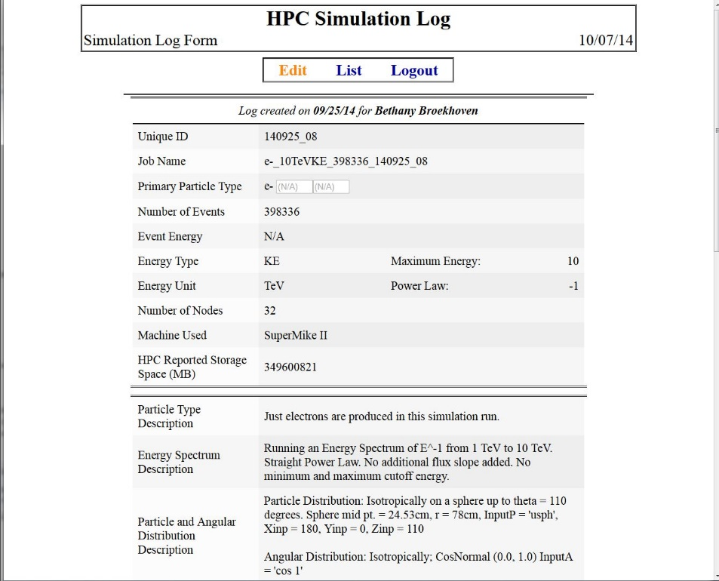
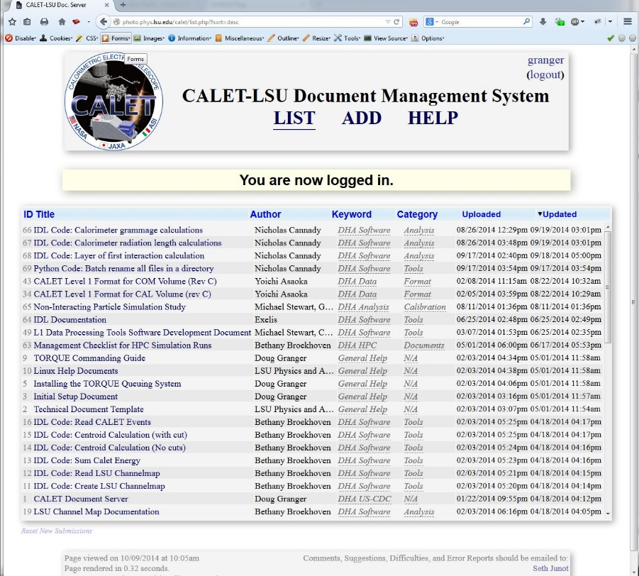
US-CDC Usage
US CALET website
US flight data repository
Analysis Code repository
Data Quality Checks
HPC Simulation Data Log Server
Document server

Slide 11
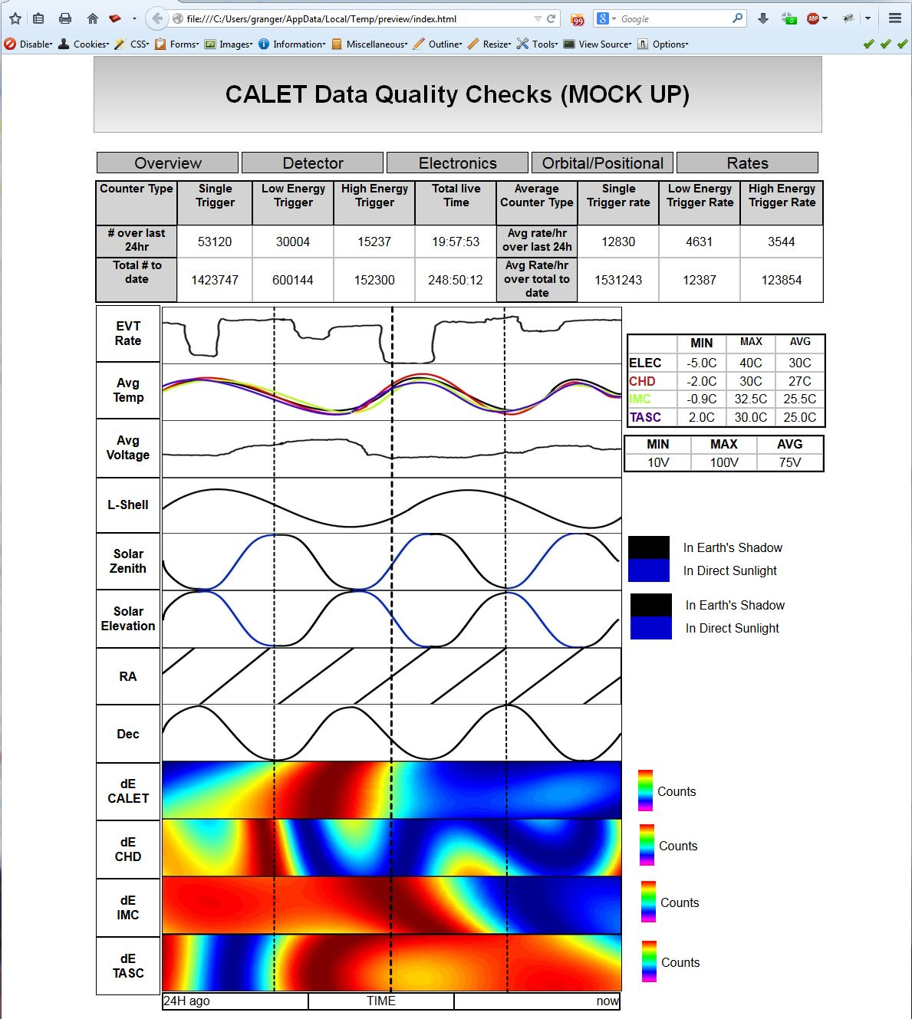
Data Quality Checks
Data Quality Checks is to monitor the overall status of CALET using Level 1 data provided from WCOC
The 5 Main sections of DQCs.
  Overview
  Detector
  Electronics
  Orbital/Positional
  Rates
Display checks for the previous 24 hours of data.

Slide 12
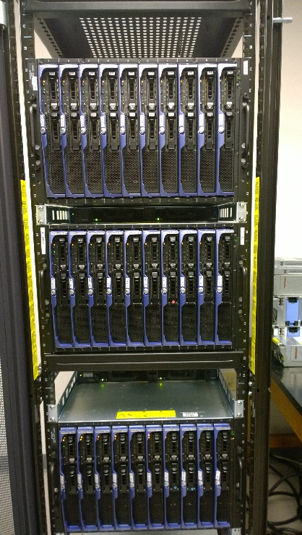
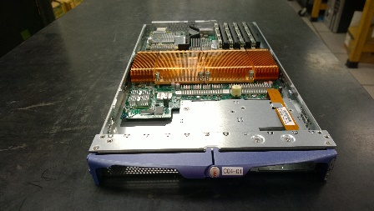
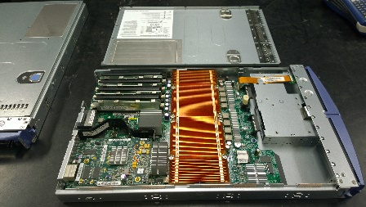
Description of US-CDC hardware
30 Blade Rack
  4 Processors per Blade
    2 dual Core CPUs per Blade (4 total Processors)
    2.66GHz Xeon 64-Bit
  4GB of Ram (currently)
  120 Maximum Processors
30 TB Direct Access Disk Array
  RAID6 build
  15 X 2TB SAS Hard Drives
Additional 30TB NAS (Possible)
  16 X 2TB SATA Hard Drives

Slide 13
Current Status
System has been installed into the Server Room
  Power re-wire is almost complete
    3 of the 4 220V 30AMP circuits are functioning
    Awaiting new circuit breakers panels for server room to complete re-wire.
  Network capabilities are already in place
Individual Blade system check out has begun.
  Order any replacement parts if needed
  Reinstalling operating systems will begin as soon as this is completed.
Disk Array systems need to be ordered
  Hard Drives need to be ordered as well

Slide 14
Questions/Comments?

