Slide 1
Calibrations and tests carried out in manufacturing
Yuki Shimizu
SEUC/JAXA
2014. Oct. 14th

Slide 2
Contents
Manufacturing process
Test/calibration and some preliminary results
  FEC electric performance test
  Functional test for detector assemblies
  Thermal vacuum test for detector assemblies
  Functional test for system assembly
Current status and future plan of the flight model test
Calibration and characteristics parameters of detector components

Slide 3
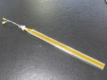
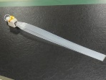
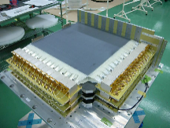
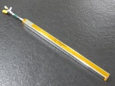
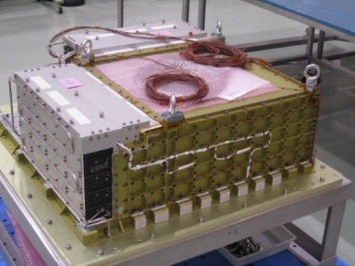
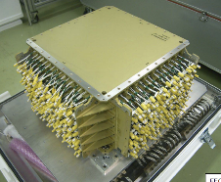
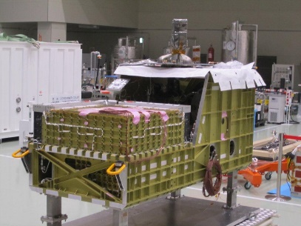
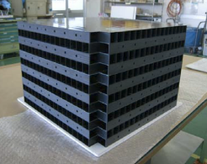
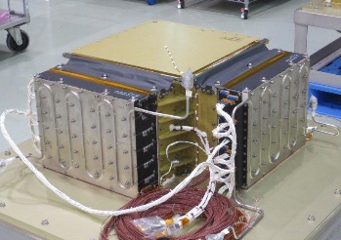
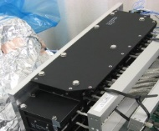
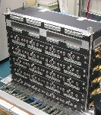
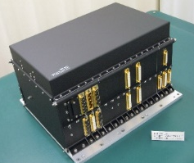
Manufacturing process
Scintillator
Detector structure
Detector Assembly
To launch site
System Assembly
Structure
FEC
MDC
Function test
Signal check
Electrical performance (FEC)
Cosmic-ray simulated pulse test
(function of FEC and MDC)
Alignment measurement
Discharge resistance test (IMC)
Function test
Cosmic ray
UV pulsed laser test
Thermal vacuum test
Cosmic ray
Function test
Cosmic ray
Acoustic test
EM compatibility test
Thermal vacuum test
Cosmic ray
Alignment measurement

Slide 4

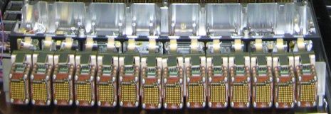
Electrical performance test for FECs
TASC-FEC (X side)
As a part of functional test of FECs, the following electrical properties has been measured. Instead of photosensors, pulsed charge was input to each channel.
Pedestal
Onboard test pulse (fixed charge)
Linearity of readout (dynamic range)
Discriminator response
Capacitor
C
Pulse
generator
V
Q=CV
 | Photo detector | Shower particle range | Output charge range
CHD | PMT | 1 – 1400MIP | 500fC - 700pC
IMC | 64 anode | 1 – 2500MIP | 8fC - 20pC
 | dynode | 1 – 400MIP | 40fC – 8pC
TASC | PMT | 1 – 1800MIP | 400fC – 700pC
 | APD | 1 – 5000MIP | 2fC - 10pC
 | PD | 10³ – 5×10⁶MIP | 2fC – 10pC
IMC-FEC (single layer)
Charge
injection
VA chip ASSY

Slide 5
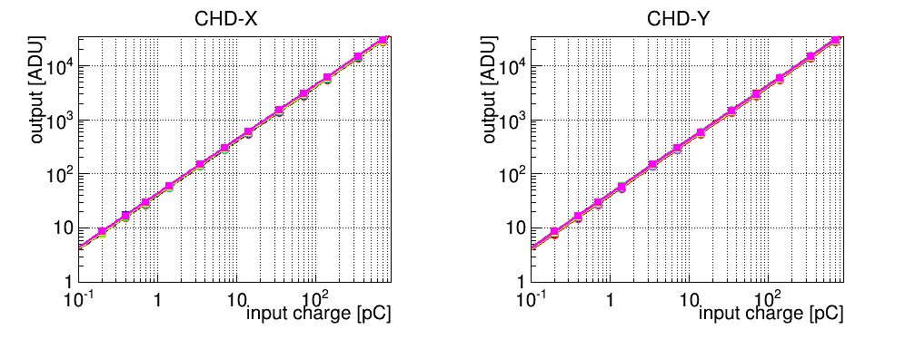
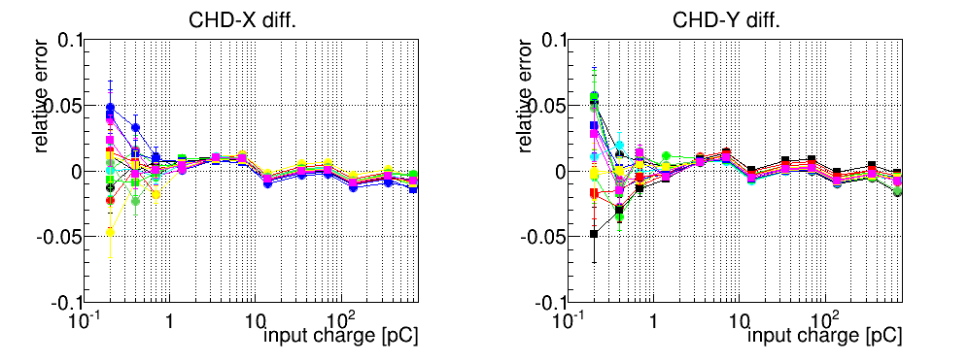
CHD-FEC
Measurement range
- 500fC～700pC
Fitting line
Relative errors from the best fitting lines are less than 2% above 600fC.
The curves tend to fall to the right. One more parameter could be introduced.

Slide 6
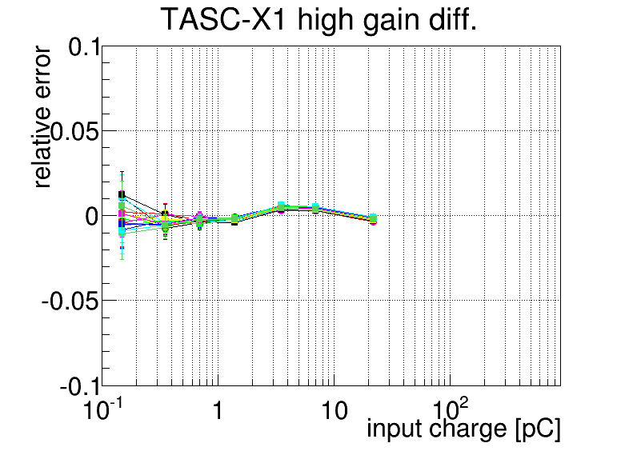
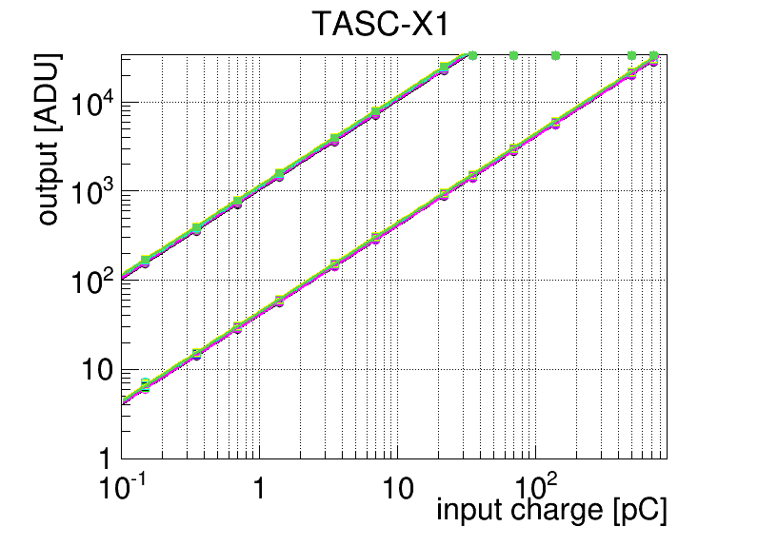
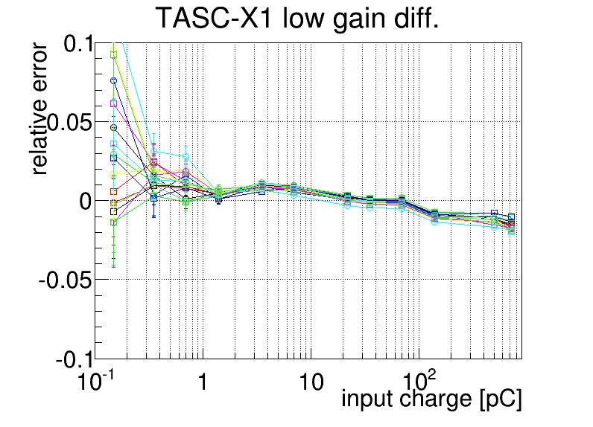
TASC-FEC-X1 (PMT)
Measurement range - 400fC～700pC
high gain
×～30
overlap
low gain
Range of use
Relative errors from the best fitting lines are less than 2% in the range of use.
The curves of the low gain tend to fall to the right (similar with CHD).
overlap
Range of use

Slide 7
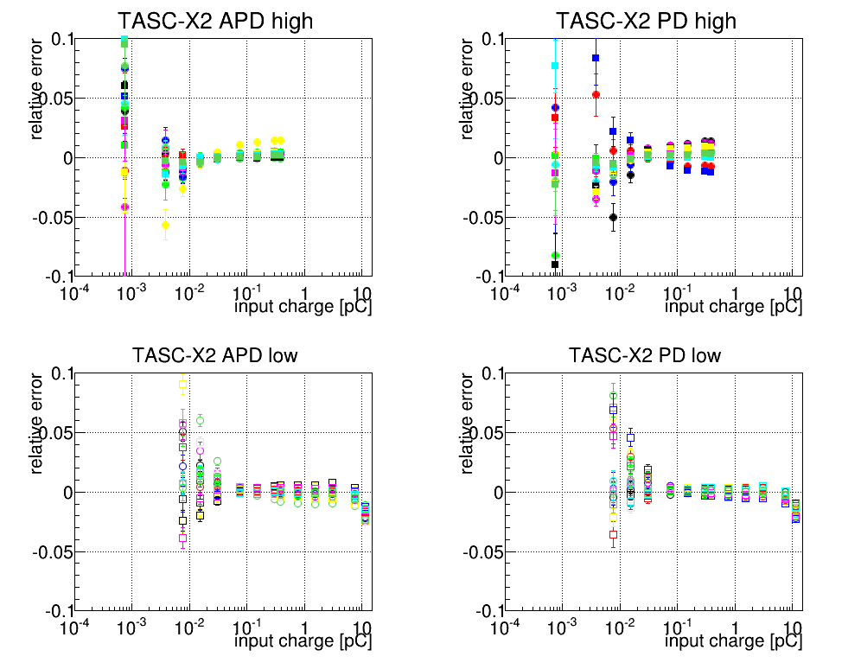
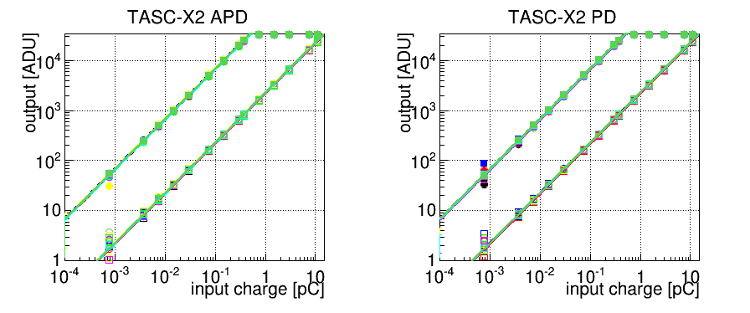
TASC-FEC (PD/APD)
Measurement range
APD - 2fC～15pC
PD - 2fC～15pC
high gain
×～30
overlap
overlap
Range of use
Range of use
low gain
Relative errors from the best fitting lines are mostly less than 2% above 10fC.
The maximum measured points (12pC) fall comparing with other points.
Below 10fC, errors of some channels are large due to noise.
⇒Further investigation is necessary.
overlap
overlap
Range of use
Range of use

Slide 8
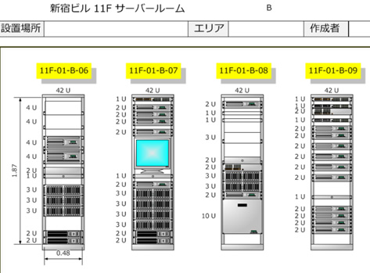
Functional test for detector assemblies
Plastic scintillator
During construction, functional tests were conducted for every two layers.
Electric functional test
  Pedestal
  Onboard test pulse
Muon measurement
  MIP calibration
  Discriminator response
UV pulsed laser test (PD/APD)
  Response check for PDs
  Dynamic range of PD/APDs
  ⇒ Ozawa and Asaoka’s talk
Test equipment
FEC
Detector
Power supply,
Data transfer etc.
Trigger circuit
(NIM/VME)
Trigger signal
CHD FEC
TASC FEC
IMC FEC
CHD/IMC detector assembly
TASC detector assembly

Slide 9
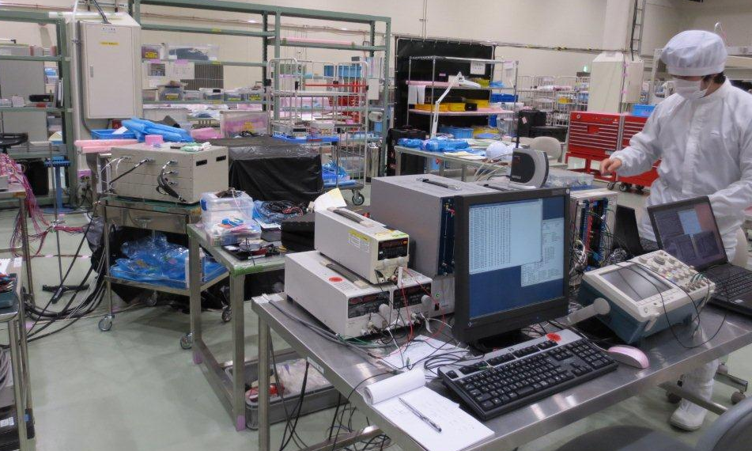
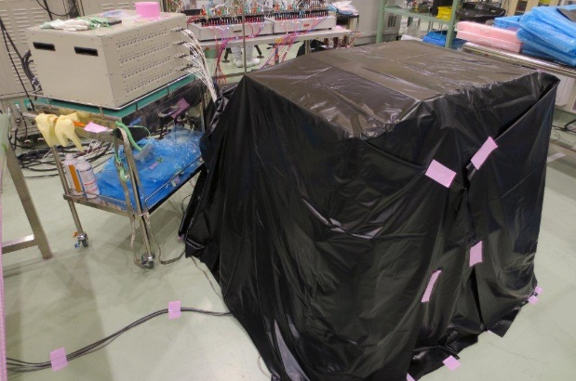
Detector assembly
Detector with
black plastic sheets
(light shielding)
NIM and VME system
(for trigger scintillators)

Slide 10
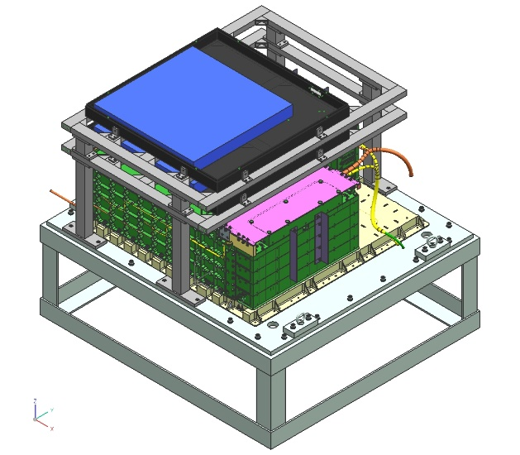
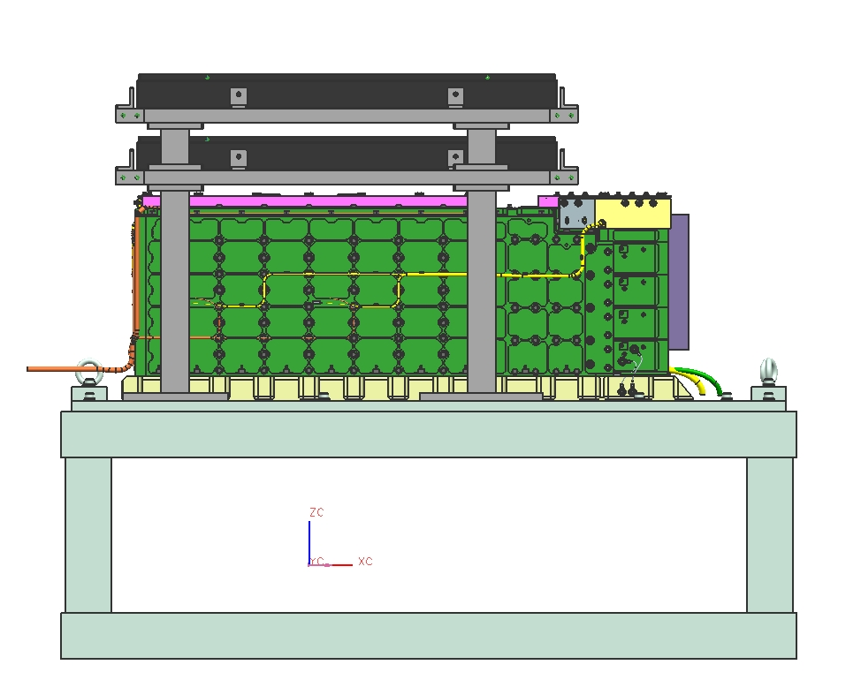
Setup of cosmic-ray measurement
Trigger
scintillator
Detector
assembly

Slide 11
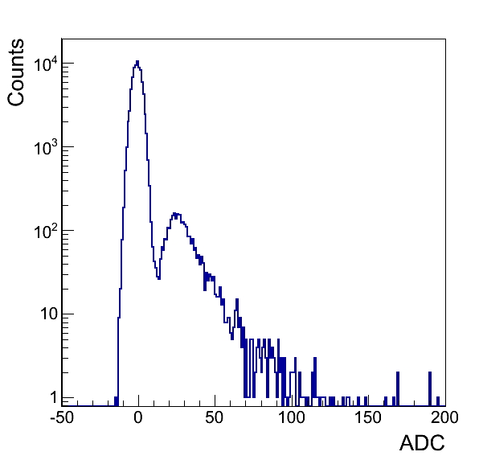
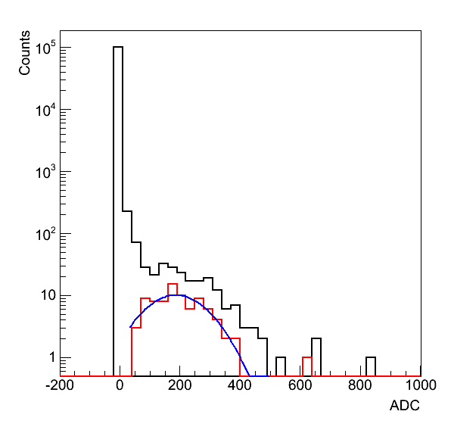
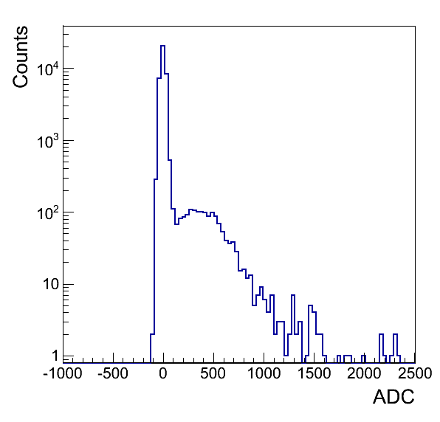
Muon deposit energy distribution
CHD
IMC
TASC (PMT)
X, Paddle #6
X-1, fiber #225
X-1, log #9
All events
Tracking selection
These results have been used to adjust the PMT gain of each channel.
The gain of all the channels should be even in each layer equipped with LD circuits.

Slide 12
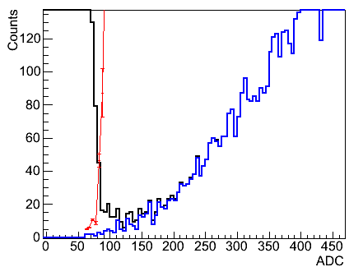
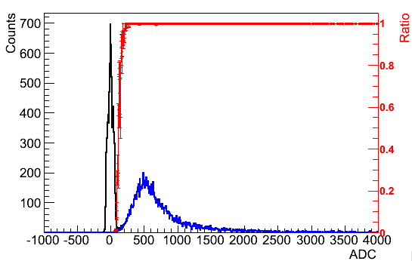
Discriminator response
IMC-Y4 (Dynode)
100% efficiency
All events
Events with a LD flag(single)
Discriminator efficiency

Slide 13
Thermal vacuum test for detector assemblies
The detector components of CAL were subjected to thermal vacuum test which simulated space environment for the following purposes:
Verify thermal design of IMC/CHD and TASC detectors
Confirm discharge resistance of CHD and TASC
Validate operation of the instruments between 5 and 45℃.
coolant
Power for FECs were supplied by MDC-FEM (function equivalent model).
HV were supplied by a spare of HV-BOX (provided by IC).
During the test, detectors were set to cosmic-ray measurement except power-off or functional test.
HV-BOX
(spare)
MDC
(FEM)
TASC
IMC/CHD
Thermal vacuum chamber

Slide 14
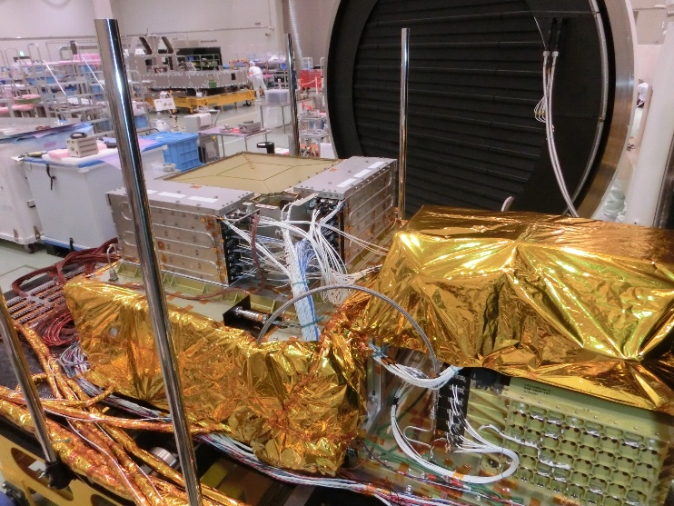
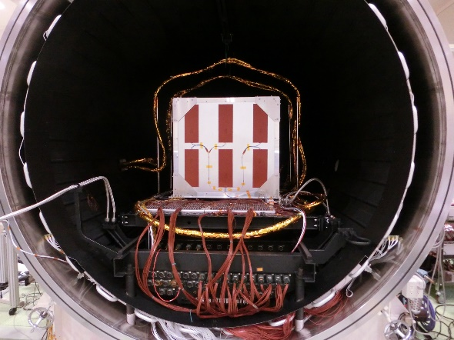
Experimental setup
IMC/CHD
MDC
HV-BOX
TASC
Thermal vacuum chamber in IHI Aerospace
CHD/IMC and TASC were separately placed and operated.

Slide 15
Temperature profile
Function test
Function test
～+45℃
Muon measurement
～+5℃
Function test
Function test

Slide 16
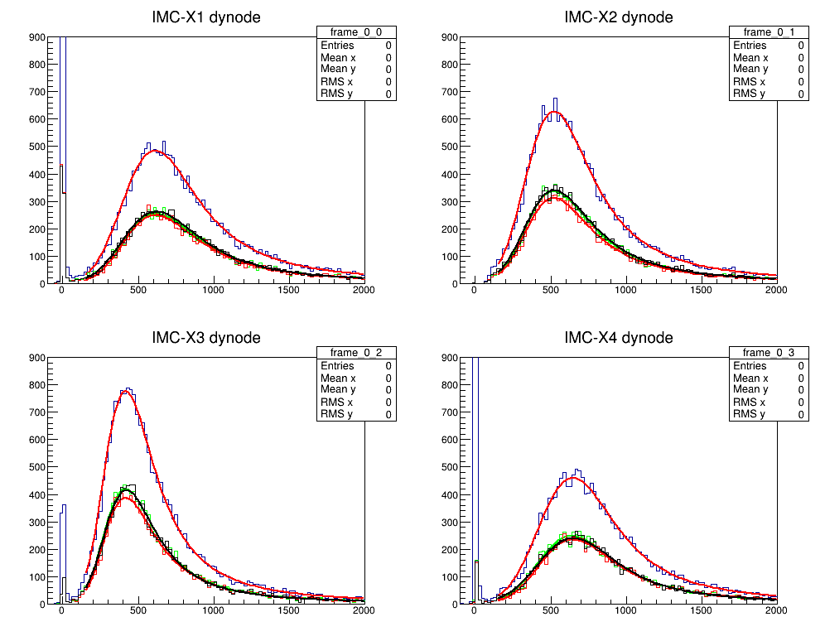
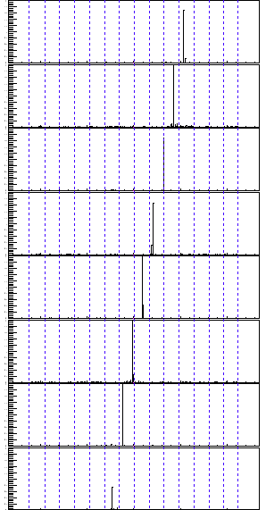
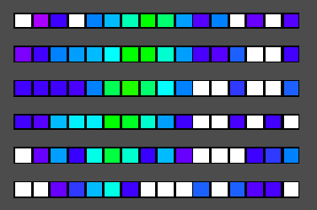
Examples of cosmic-ray data
PMT gain adjustment (IMC dynode)
Example of muon track (IMC)
layer #1
layer #2
layer #3
layer #4
Counts [ADU]
layer #5
Example of cosmic ray shower (TASC)
layer #6
layer #7
layer #8
Channel Number

Slide 17
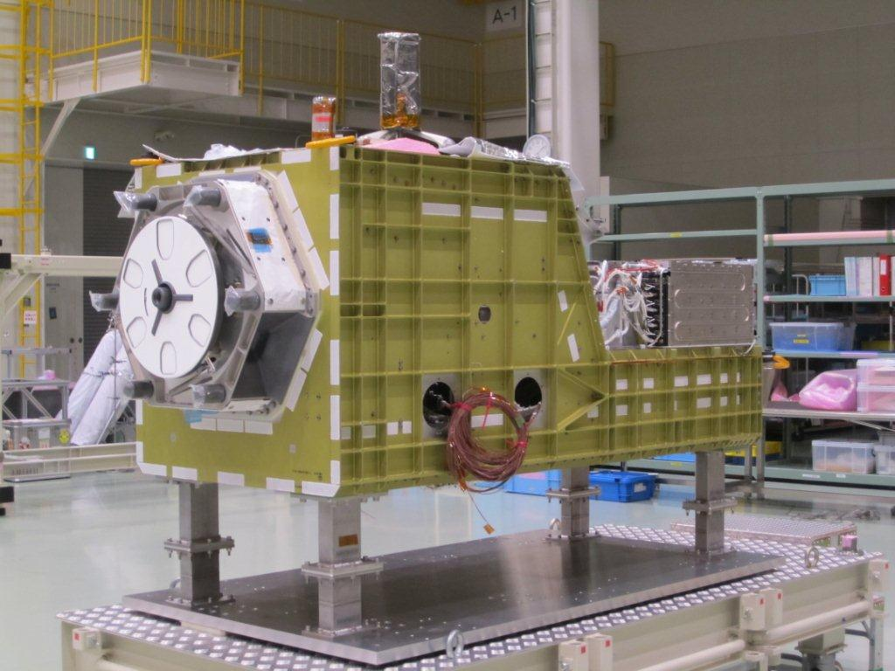
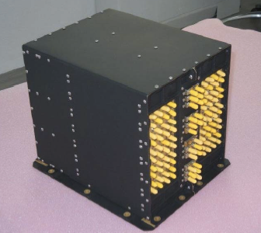

System assembly test
CALET system assembly
20℃
coolant
After assembling of all the components into the main structure, function test was carried out with supplying power to all the components including CAL and CGBM.
CAL
Cosmic ray measurement (single track setting)
CGBM
Background spectrum measurement (PH, GRB)
Low rate
data
Middle rate
data
HV-BOX
MDC

Slide 18
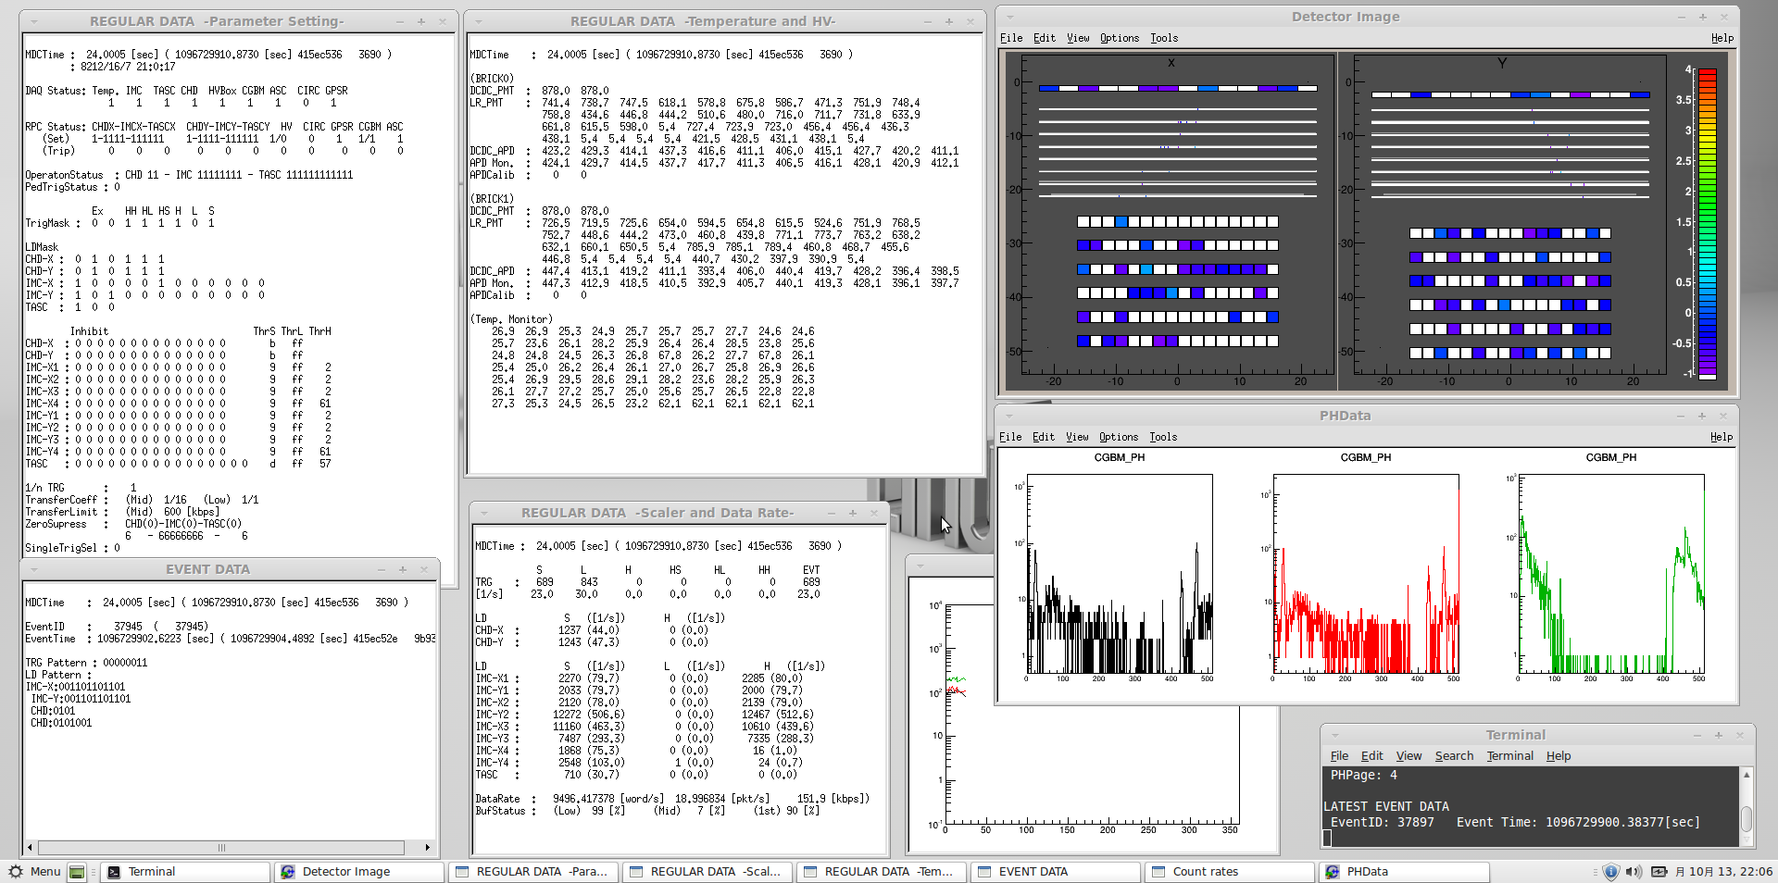
Screenshot of data monitor

Slide 19
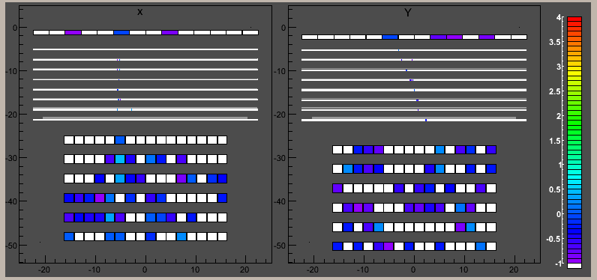
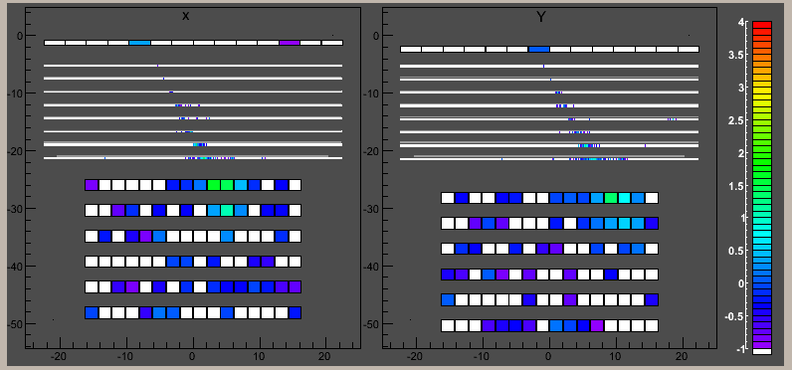
Examples of CAL events
Muon event
log( pulse height )
Gain correction of each channel in the analysis has not been completed.
Further analysis is on-going.
Showering event

Slide 20
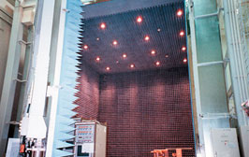
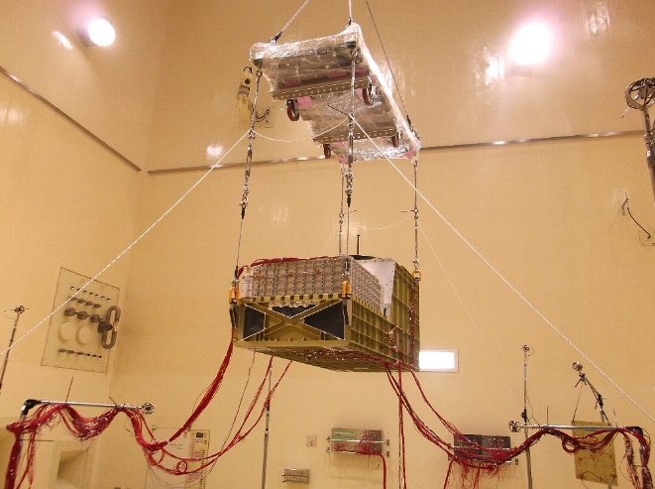
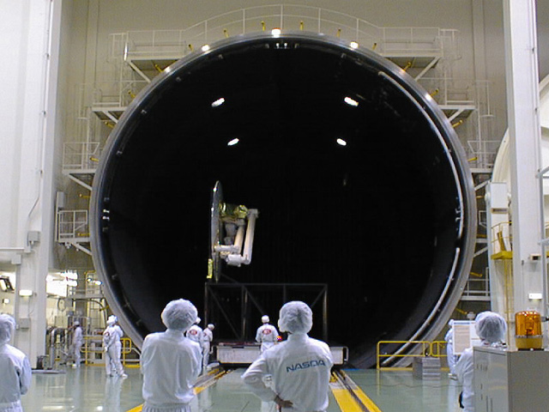
Current status and future plan
Last week, Initial functional test of the system assembly was finished in IHI Aerospace.
CALET PFM will be transferred to Tsukuba in this week.
In Tsukuba, environmental tests are going to be conducted (EMC, acoustic, thermal vacuum tests).
During these tests, cosmic-ray measurements are expected to be carried out as parts of functional tests.
After the environmental tests, final functional test is planed to be performed. Then, CALET PFM will be transferred to the launch site (Tanegashima Space Center).
EMC test room (Tsukuba)
Acoustic test for CALET STM
13mΦ space chamber (Tsukuba)

Slide 21
Calibration and characteristics parameters of components
List of parameters obtained from component level tests
Response curve function of FECs
Mean or peak pulse heights of muon energy deposit distribution
RMS noise (including electronics and leakage current)
Mean pulse height of onboard test pulses
Response function of discriminators
Efficiency curves of discriminators
These parameters will be distributed to international collaboration after further analysis.

Slide 23
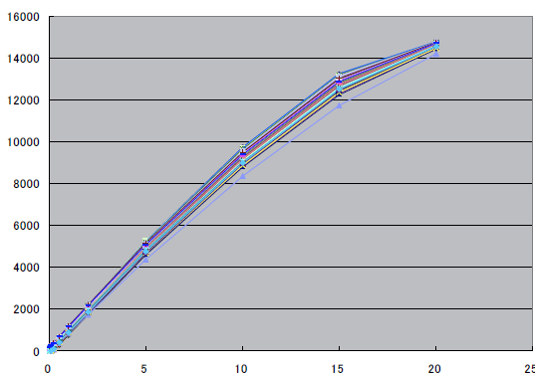
IMC-FEC
Output [ADU]
Input charge [pC]

Slide 24
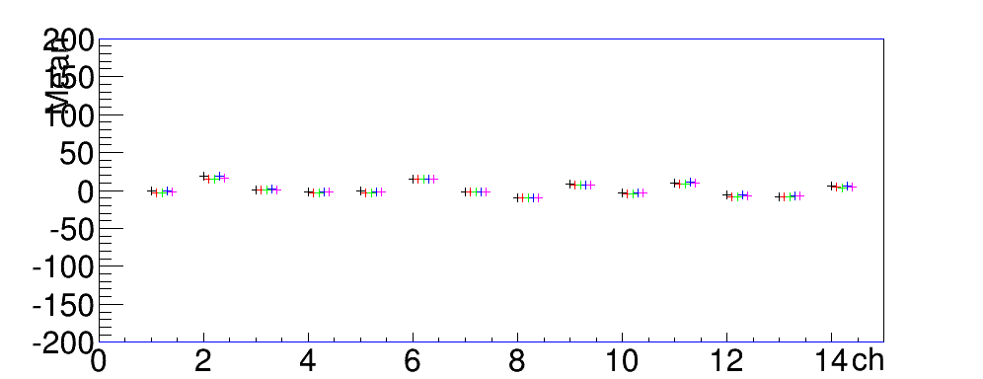
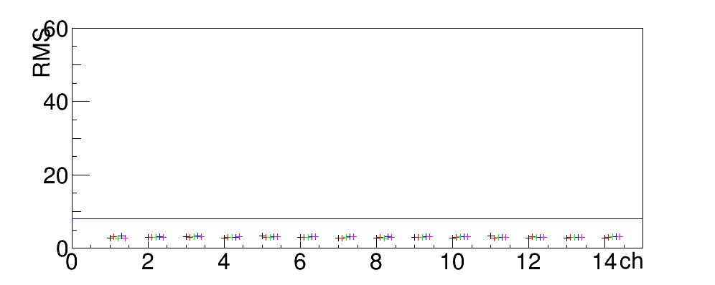
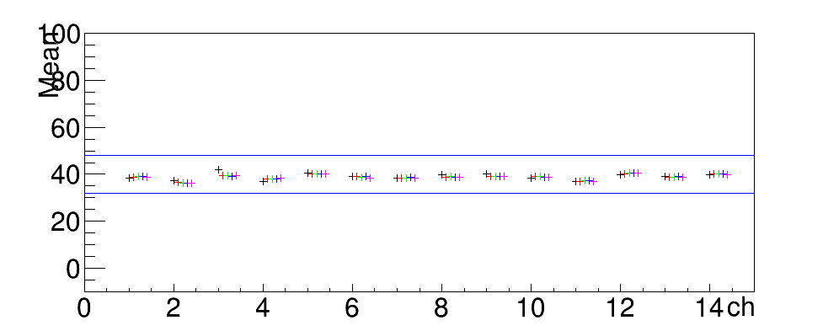
CHD
Offset
Noise
160fC
7/16 15:30 (high temp.)
7/17 19:30 (low temp.)
7/18 20:00 (low temp.)
7/19 10:40 (high temp.)
7/19 16:40 (room temp.)
Test pulse

Slide 25
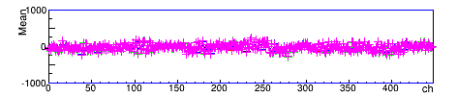
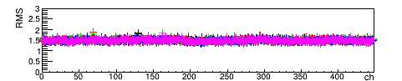
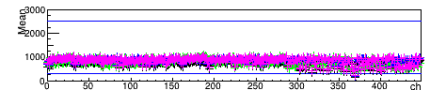
IMC
Offset
Noise
2fC
7/16 15:30 (high temp.)
7/17 19:30 (low temp.)
7/18 20:00 (low temp.)
7/19 10:40 (high temp.)
7/19 16:40 (room temp.)
Test
pulse

Slide 26



TASC (APD)
Offset
Noise
1fC
7/16 15:30 (high temp.)
7/17 19:30 (low temp.)
7/18 20:00 (low temp.)
7/19 10:40 (high temp.)
7/19 16:40 (room temp.)
Test
pulse

