Slide 1


WCOC Status
Waseda CALET Operations Center
DH&A Japan Y. Asaoka
2014.10.16 CALET TIM @ Waseda Univ.
141016CALET-WCOC-asaoka-en.pptx

Slide 2
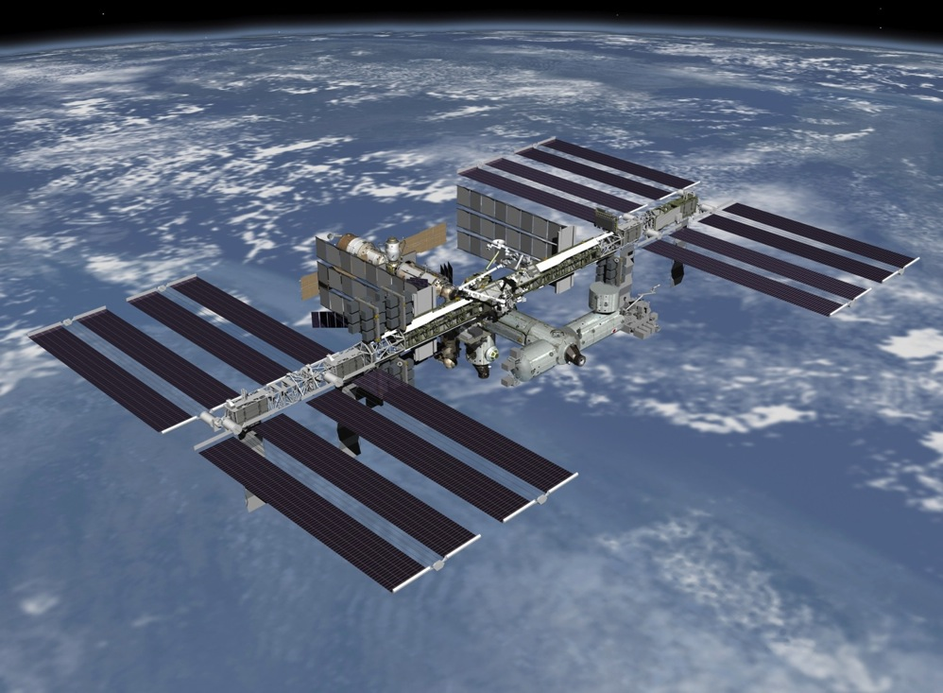
Contents
CALET Ground System
Role of WCOC
= Mission Operation
  Operation Planning
  Real-Time Monitoring
  Scientific Data Processing
Interface Test between
JAXA and WCOC
Summary

Slide 3
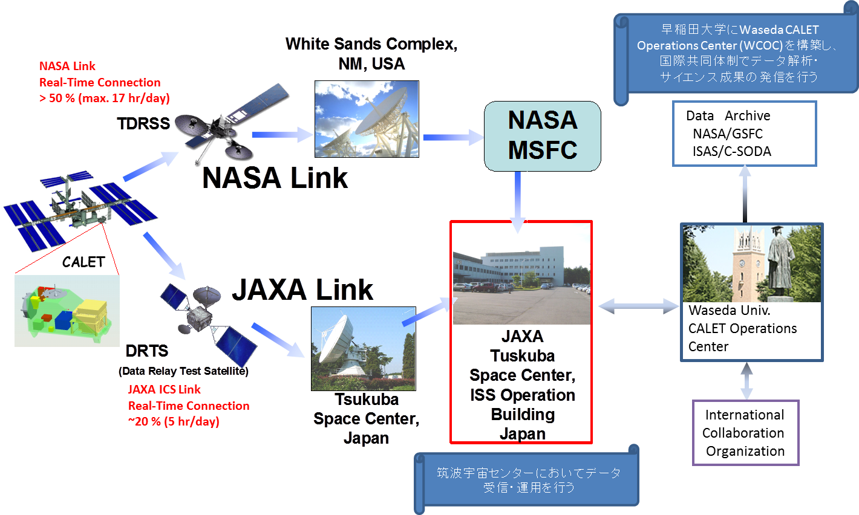
CALET Dataflow (from Orbit to Ground)
International
Space Station
(ISS)
2 down link path
NASA link will be mainly used
All the data is received at JAXA and transferred to WCOC.
Instrument Operations
Health & Status (H&S)
Mission Operations
Science Data Quality
Notes:
最下流までまず説明
筑波宇宙センターに設置されるCALET地上運用システム
WCOC
データダウンリンクスピード

Slide 4
Mission Operation Image
Instrumental Operations
Mission Operations
Real-Time Monitoring (JAXA)
Real Time Monitoring (WCOC)
Operation Planning
Observation Status (CALET Status)
CALET
Changing discriminator threshold, etc.
HV Off, etc.
Time
Notes:
装置の安全
効率的な観測
状況に応じた最適化

Slide 5
Mission Operation Method
Observation Planning
  Schedule Command File
  Macro Command File
Real-Time Monitoring
  Receiving CALET Telemetry
  Monitor w/ QL ⇒ Command Request
Scientific Data Processing
  Receiving Level0 Data⇒ Validation
  Level1 Data Production ⇒ Distribution
CALET
feedback
Notes:
「ゼロサプレスファイル等作成」はずれる
HV設定ファイル

Slide 6
CALET Ground System Dataflow Summary
Summarized in terms of WCOC role in CALET operations
Interfaces to JAXA corresponding to each role of WCOC
CALET
onboard ISS
Uplink
Source
Files
Obs. Planning
Phys. Target
Calibration Data
Command
Uplink File
Raw data
Raw data
Real Time Monitor
Quick Look
CALET
Level0
CALET
Level0
Sci. Data Processing
Level0 to Level1
CALET
Level1
JAXA CALET GSE
WCOC
GSE: Ground Support Equipment

Slide 7
CALET Ground System Dataflow Summary
CALET
onboard ISS
Uplink
Source
Files
Obs. Planning
Phys. Target
Calibration Data
Command
Uplink File
Raw data
Raw data
Real Time Monitor
Quick Look
CALET
Level0
CALET
Level0
Sci. Data Processing
Level0 to Level1
CALET
Level1
JAXA CALET GSE
WCOC
GSE: Ground Support Equipment

Slide 8
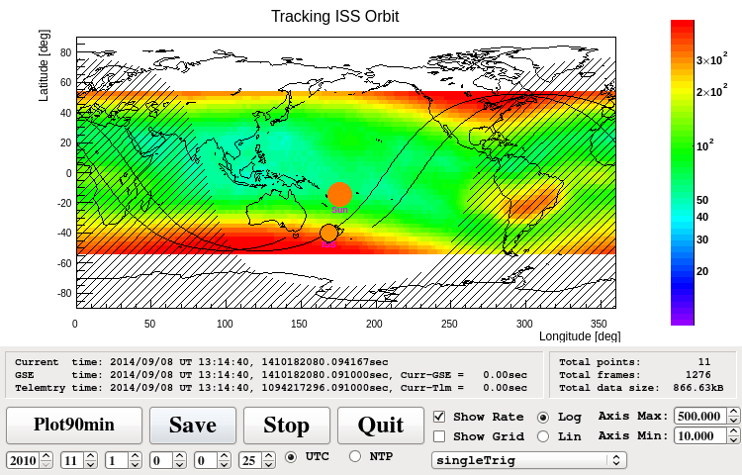
Operation Planning
Optimization of observation condition
  Stable and continuous data taking to accumulate HE electron events is the primary and the most important task of the nominal operation.
  Need to schedule calibrations runs (pedestal, penetrating p/He)
  We can think of other trigger mode as long as it does not affect high energy electron data statistics
Every day observation plan
  realization with schedule command file
    changing of observation mode
Pedestal data
acquisition
Schedule file：
sequence of
time and
command
HE electron trigger is ALWAYS ON

Slide 9
CALET Ground System Dataflow Summary
CALET
onboard ISS
Uplink
Source
Files
Obs. Planning
Phys. Target
Calibration Data
Command
Uplink File
Raw data
Raw data
Real Time Monitor
Quick Look
CALET
Level0
CALET
Level0
Sci. Data Processing
Level0 to Level1
CALET
Level1
JAXA CALET GSE
WCOC
GSE: Ground Support Equipment

Slide 10
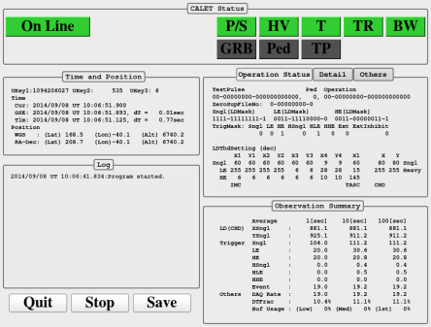
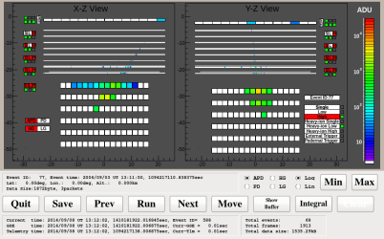
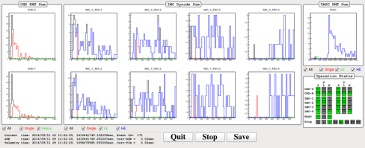
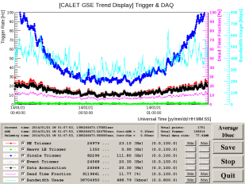
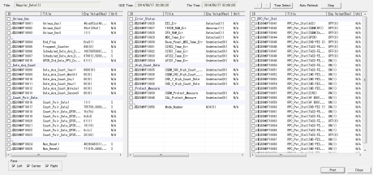
Real Time Monitor
CALET telemetry data packets are transferred from JAXA in real time
Software development environment was prepared.
  Radiation Model
  Mission Data Controller (MDC) simulator
QLs are in preparation by considering various operation situation
  Holding observation status in one window
  Detecting malfunction ASAP
  Verifying detailed information as needed
Concept of QL Monitoring System
Summary Display
Event Display
ISS Orbit Monitor
Histogram Monitor
Trend Display
Text Monitor

Slide 11


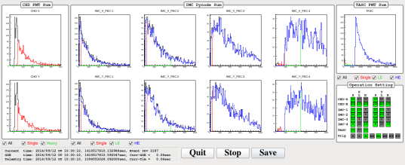
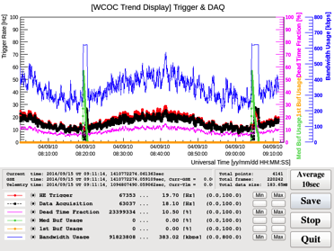

Real Time Data Monitoring System
Concept of QL Monitoring System
QLモニタ画面のイメージ
Summary Display
Event Display
ISS Orbit Monitor
Summary Display
Showing CALET operation status in ONE WINDOW. Alerting operator by color and sound if something unexpected happens.
Event Display
Intuitive understanding of the detector status
Sensor health (dead/noisy channels)
ISS Orbit Monitor
Inform scheduled operation based on orbit prediction
Histogram Monitor
Trend Display
Text Monitor
Histogram Monitor
Obtaining detailed information
Trend Display
Check temporal variation
Predict future malfunction and estimate the cause
Text Monitor
Obtaining detailed information
Notes:
以上のような改良を重ねた模擬データや、そのテレメトリの内容を理解した上で実際の運用を想定したQLモニターを開発しています。
まずその具体的な運用イメージを説明します。

Slide 12

QL Example: Summary Display
CALET Observation Status Summary
Time and Position
Observation Condition Summary
Log
Observation Status Summary
PRELIMINARY
Notes:
特に重要な項目についてその状態を確認することができる
それぞれの運用状態について、緑色は正常であることを表している
電源、温度、HV値などの重要な項目の状態を表しています。
警告、異常状態になると、黄色や赤色になってさらに音でオペレータに異常を知らせる
いつ何が起こったかを状態ログに出力します。
その他の枠は〜オペレータが知っておくべき最小限の情報をまとめています。
CALETの必要最小限の状態を色で示す
緑：正常, 黄：警告, 赤：異常， 黒：Off
異常状態時に音で警告
→クリックで解除

Slide 13
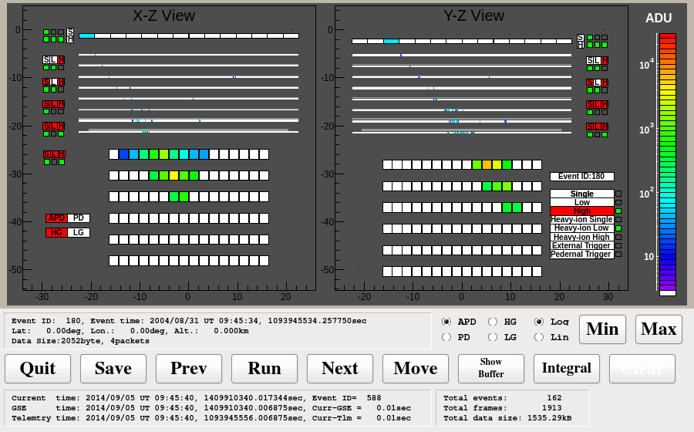
QL Example: Event Display
Trigger
information
PRELIMINARY
Notes:
トリガーしたイベントについてそれぞれのチャンネルのシグナル強度を視覚的に表示し、CALETの物理に最も直結する検出器の状態を直感的に把握することができます。
例えばデッドチャンネルの有無ですが〜 （ムービーを見せる）

Slide 14
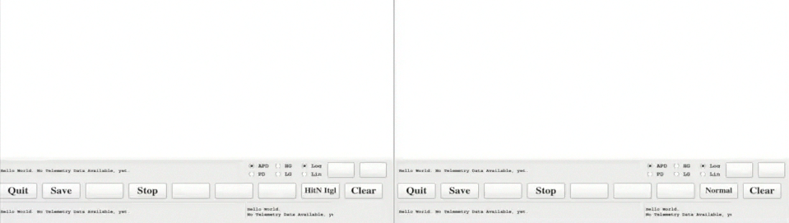
QL Example: Event Display [Integral Mode]
ADC Value Integral Mode
Number of Hit Integral Mode
PRELIMINARY
PRELIMINARY
Integral display modes are implemented.
  Find Dead Channels
  Find Hot Channels
Notes:
ADCデータを積分して表示することでより確認を簡単にする
ADCデータではセンサのシグナルのバイアスで色情報にバイアスがかかるため、ヒット数を表示するモードも備える
ノイズの多いホットチャンネルの発見も期待できる

Slide 15

QL Example: ISS Orbit Monitor in World Geodetic System [WGS]
PRELIMINARY
Accurate orbit prediction is possible by using latest TLE
（Two Line Element）
Predicted ISS orbit
（±90min）[1]
Sun [2]
Observation schedule will be displayed to help online monitoring
Earth’s shadow
ISS(CALET)
Display setting
[1]Vallado, David A., Paul Crawford, Richard Hujsak, and T.S. Kelso, "Revisiting Spacetrack Report #3," presented at the AIAA/AAS Astrodynamics Specialist Conference, Keystone, CO, 2006 August 21–24.
[2]Blanco-Muriel M, Alarcón-Padilla DC, López-Moratalla T, Lara-Coira MÍ. Computing the solar vector. Solar Energy. 2001 ;70:431 – 441.
Notes:
背景にレートをプロットし、軌道予測、太陽の位置（昼と夜）などの情報から適切に今後のオペレーション計画を把握する
ISSのモニターで、CALETの現在位置を示す
軌道予測と予測トリガーレートにより、CALETの直近のルートやオペレーションの内容を確認する
軌道予測の色でオペレーションの内容を確認できるようにする
運用計画を確認するだけじゃなくて、正しいものかを判断できる

Slide 16
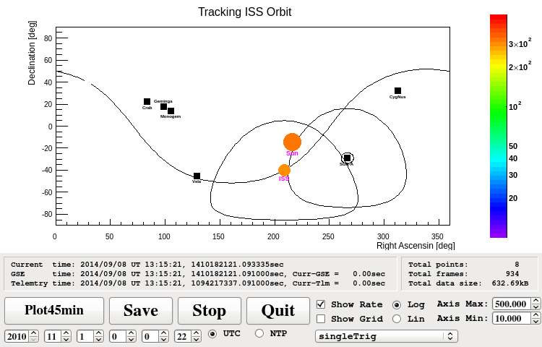
QL Example: ISS Orbit Monitor in Equatorial Coordinate System [ECS]
PRELIMINARY
CALET FOV
（45°）
CygnusLoop
45°
from GC
It is possible to check currently and soon visible astronomical objects
SNRs
Crab,Geminga
Monogem,Vela
Galactic Center
[1]Vallado, David A., Paul Crawford, Richard Hujsak, and T.S. Kelso, "Revisiting Spacetrack Report #3," presented at the AIAA/AAS Astrodynamics Specialist Conference, Keystone, CO, 2006 August 21–24.
[2]Blanco-Muriel M, Alarcón-Padilla DC, López-Moratalla T, Lara-Coira MÍ. Computing the solar vector. Solar Energy. 2001 ;70:431 – 441.
Notes:
CALETの物理対象との位置関係から運用計画を把握することができる
主要な宇宙線ソースとの位置関係をもとに運用計画を確認できる
こちらはRA-Dec表示で、代表的な宇宙線ソースの視野を確認できる
オペレーションの計画確認に幅を持たせる

Slide 17
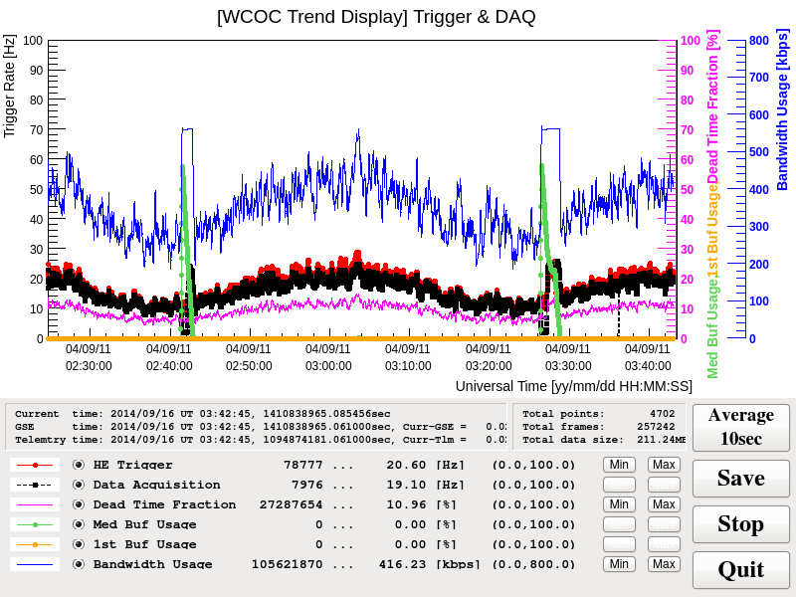
QL Example: Trend Display
Trend display:
Based on Qt + Root
Update time axis every 100sec
Can be used for other trend displays such as temperature and high voltage.
pedestal
PRELIMINARY
Data amount
received
Time
Info.
Average time
Save data/plot
Stop update
シンボル
Finish QL
Description
Trigger rate
Range
Legend
raw value
Change Range
Display or not
Notes:
様々な観測データをこの画面に出力することができるので、過去情報との対比による
異常の発見や原因推定を行うことができる

Slide 18
CALET Ground System Dataflow Summary
CALET
onboard ISS
Uplink
Source
Files
Obs. Planning
Phys. Target
Calibration Data
Command
Uplink File
Raw data
Raw data
Real Time Monitor
Quick Look
CALET
Level0
CALET
Level0
Sci. Data Processing
Level0 to Level1
CALET
Level1
JAXA CALET GSE
WCOC
GSE: Ground Support Equipment

Slide 19
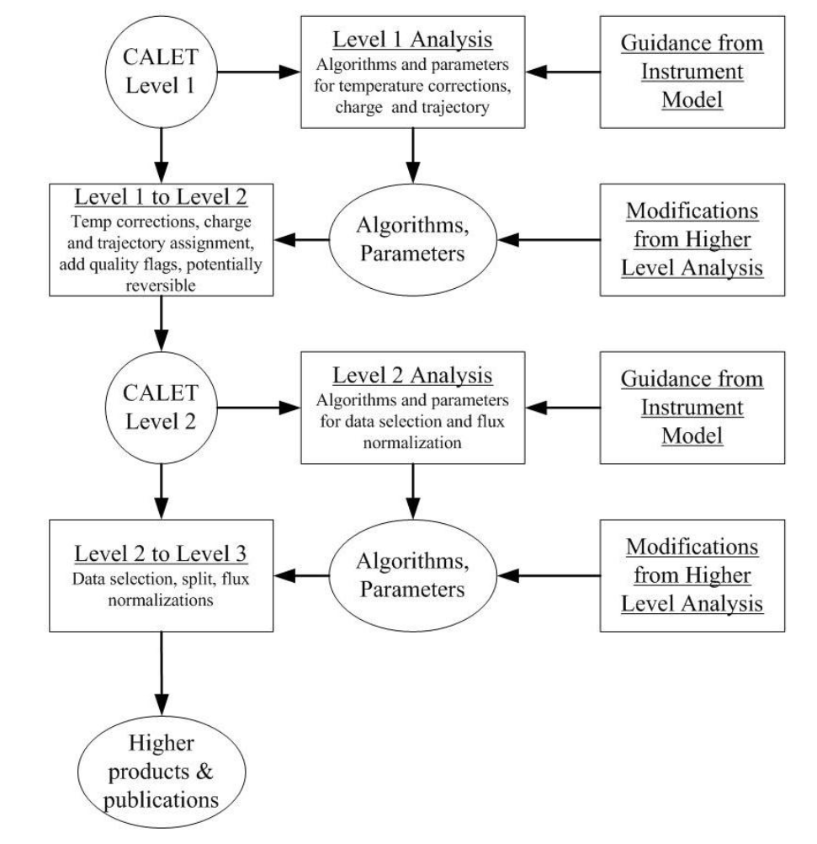
Analysis Procedure
CALET
on ISS
WCOC
International Collaboration
Level0 to Level1
GPS time correction
Pseudo energy
CALET
Level0
CALET
Level0
Raw data
Raw data
JAXA CALET GSE
Quick Look
Maintains Data Quality
Mission Operation

Slide 20
Analysis Procedure
CALET
on ISS
WCOC
International Collaboration
Base Data for Scientific Analysis
For detector calibration
MIP calibration
temperature/position
correction
Level0 to Level1
GPS time correction
Pseudo energy
CALET
Level0
CALET
Level0
Calibrated Data
For physics analysis
particle ID
algorithm optimization
Raw Data for Scientific Analysis
Combined packet data
time order correction
lack data supplement
Raw data
Raw data
JAXA CALET GSE
Quick Look
Maintains Data Quality
Mission Operation
Higher Level Data
spectrum data and/or data subset for specific physics target

Slide 21
Analysis Procedure
CALET
on ISS
WCOC
International Collaboration
Base Data for Scientific Analysis
For detector calibration
MIP calibration
temperature/position
correction
Level0 to Level1
GPS time correction
Pseudo energy
CALET
Level0
CALET
Level0
Level1 Data Process Status:
Data defined and Read/Write routine prepared.
Analysis procedure is under development using simulated on orbit data
⇒ Sample Data is ready.
Calibrated Data
For physics analysis
particle ID
algorithm optimization
Raw data
Raw data
Raw Data for Scientific Analysis
Combined packet data
time order correction
lack data supplement
JAXA CALET GSE
Quick Look
Maintains Data Quality
Mission Operation
Higher Level Data
spectrum data and/or data subset for specific physics target

Slide 22
CALET Ground System Dataflow Summary
CALET MDC Data Replay
Uplink
Source
Files
Obs. Planning
Phys. Target
Calibration Data
Command
Uplink File
Raw data
Raw data
Real Time Monitor
Quick Look
CALET
DB
CALET
Level0
CALET
Level0
Sci. Data Processing
Level0 to Level1
CALET
Level1
JAXA CALET GSE
WCOC
GSE: Ground Support Equipment

Slide 23
CALET Ground System Dataflow Summary
CALET MDC Data Replay
Requirement：
> 600kbps
(Real time data only)
Uplink
Source
Files
Obs. Planning
Phys. Target
Calibration Data
Command
Uplink File
Raw data
Raw data
Real Time Monitor
Quick Look
CALET
DB
CALET
Level0
CALET
Level0
Sci. Data Processing
Level0 to Level1
CALET
Level1
JAXA CALET GSE
WCOC
GSE: Ground Support Equipment

Slide 24
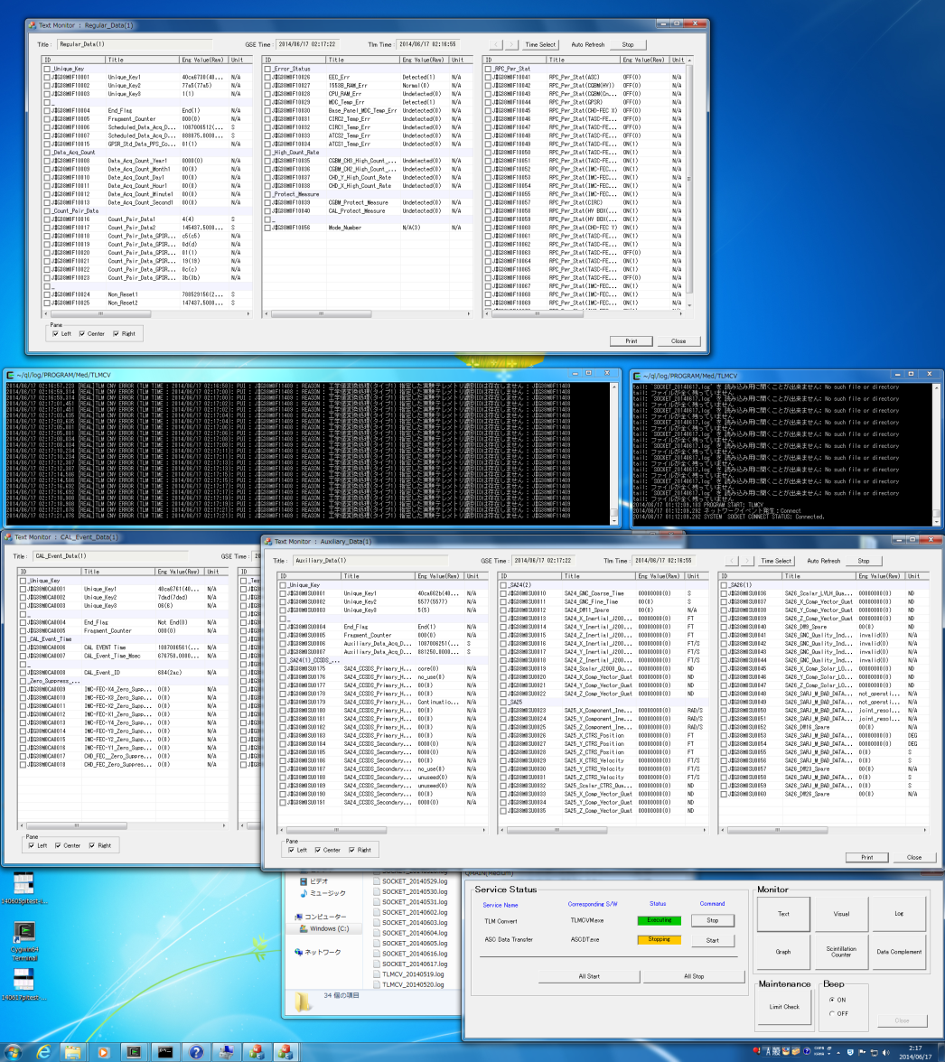
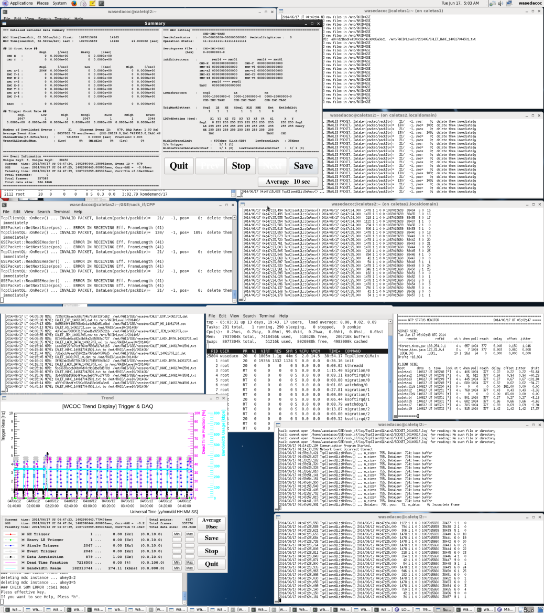
JAXA/WCOC IF Test：Screen shots
WCOC TASK REVIEW material
All the test cases are successfully carried out!
Real time Communication：
Requirement：>600kbps
Performance：1.2Mbps
limited speed is mainly due to small packets received and relayed individually. But actual performance is enough to receive real-time data.
text summary
ＱＬ log
text monitor (1)
trend display
packet receive log
text monitor (2), (3)
caletql1: JAXA-QL (Windows)
caletql2: WCOC-QL (SF Linux)

Slide 25
JAXA/WCOC IF Test：Screen shots
WCOC TASK REVIEW material
All the test cases are successfully carried out!
text summary
ＱＬ log
text monitor (1)
trend display
packet receive log
text monitor (2), (3)
caletql1: JAXA-QL (Windows)
caletql2: WCOC-QL (SF Linux)

Slide 26
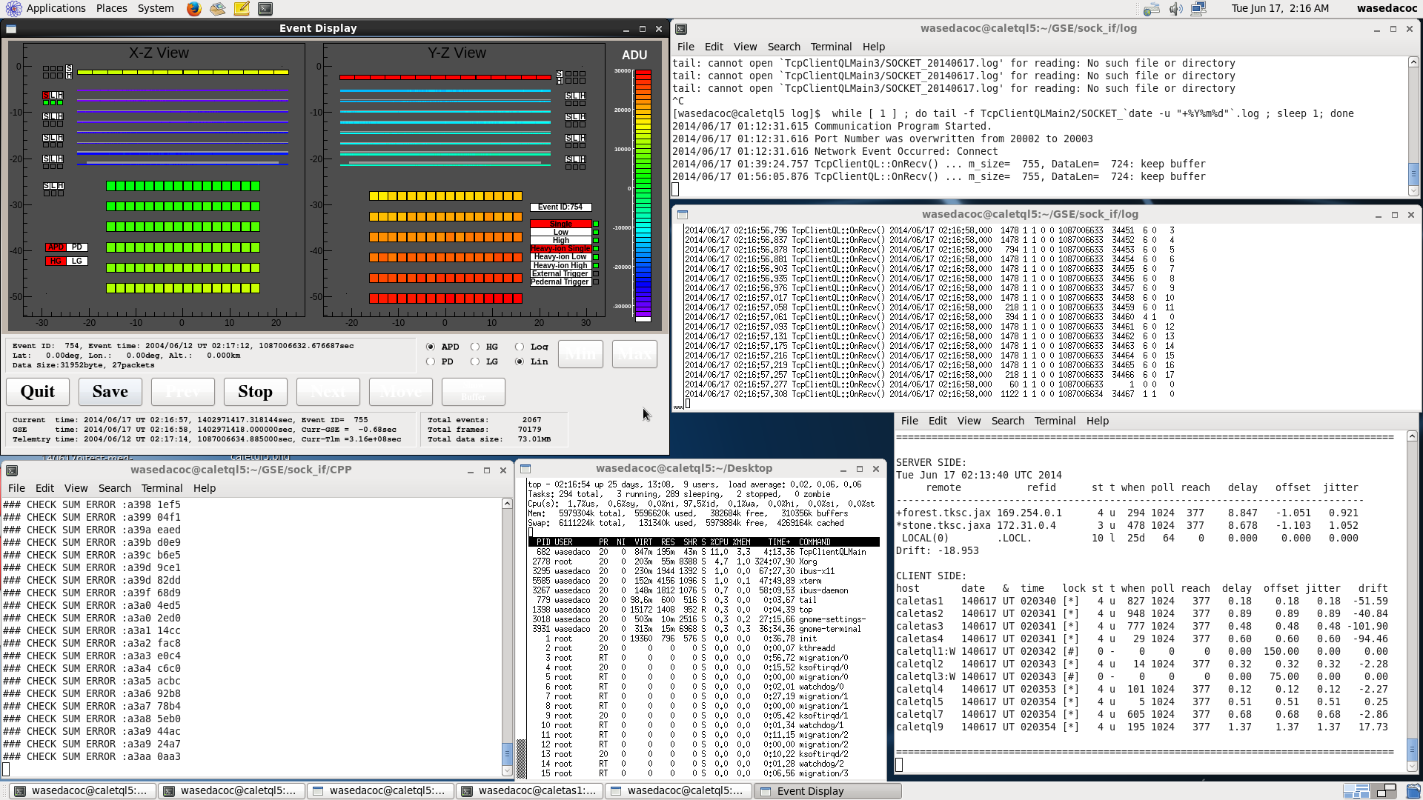
JAXA/WCOC IF Test：Screen shots
WCOC TASK REVIEW material
All the test cases are successfully carried out!
address pattern
(MDC Output)
packet receive log
time synchronization monitor (NTP)
caletql5: WCOC-QL (SF Linux)

Slide 27
CALET Ground System Dataflow Summary
Simulated Data and Replay Program prepared by WCOC
Uplink
Source
Files
Obs. Planning
Phys. Target
Calibration Data
Command
Uplink File
Raw data
Raw data
Real Time Monitor
Quick Look
CALET
DB
CALET
Level0
CALET
Level0
Sci. Data Processing
Level0 to Level1
CALET
Level1
JAXA CALET GSE
WCOC
GSE: Ground Support Equipment

Slide 28
CALET Ground System Dataflow Summary
Simulated Data and Replay Program prepared by WCOC
Requirement：
> 600kbps
(Real time data only)
Uplink
Source
Files
Obs. Planning
Phys. Target
Calibration Data
Command
Uplink File
Raw data
Raw data
Real Time Monitor
Quick Look
CALET
Level0
Requirement：At maximum >3Mbps + 600kbps
(Real time data and replay data)
CALET
DB
CALET
Level0
Sci. Data Processing
Level0 to Level1
CALET
Level1
JAXA CALET GSE
WCOC
GSE: Ground Support Equipment

Slide 29
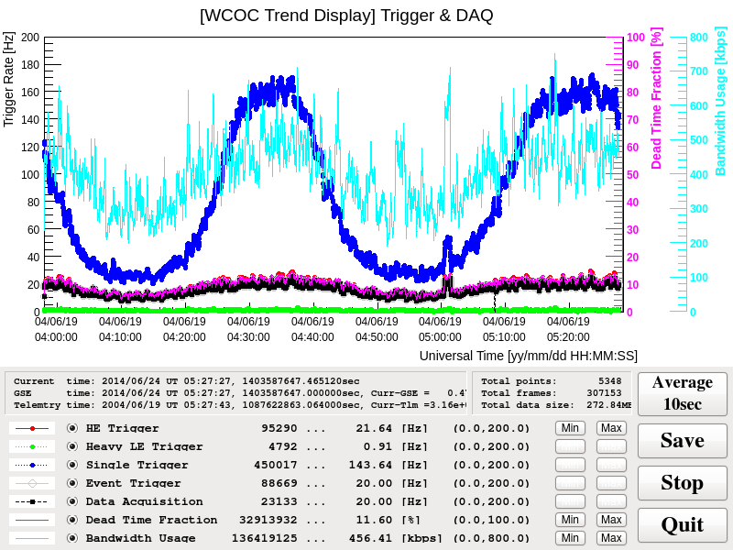
Performance Test using
Simulated CALET Telemetry Data
Using simulated CALET telemetry data, we made packets for CALET-GSE at JAXA and send them in the same way they receive the real CALET telemetry data.
⇒ Realistic perfornance test
  Bandwidth
  Packet rate
  Data contents
Validation of CALET-GSE
  DB registration is the key.
  succeeded in meeting
  requirement by using
  buffers
⇒ We will use this
method to validate
CALET-GSE
in the final test.
Data Taken for 1.5hrs
Single Trigger (No DAQ )
Bandwidth
Usage
HE Trigger
= DAQ Rate
Dead time
Fraction

Slide 30
Summary and Prospects
Role of WCOC
  Operation Planning
  Real-Time Monitoring
  Science Data Processing
WCOC Preparation Status
  Completed the interface test between JAXA CALET-GSE and WCOC
  Completed to determine the WCOC security rules to receive JAXA data
  Preparation for operation planning, real-time monitoring, and science data processing are in progress.
Plan
  Preparation to start operation
  Test of whole CALET-GSE
CALET Mission Operations
Consistent with the schedule of
CALET project
Notes:
http://www.jsps.go.jp/j-grantsinaid/16_rule/rule.html

