Slide 1
Expected gamma-ray events in the CALET observations, and gamma-ray signals from Kaluza-Klein dark matter
Masaki Mori
Dept. Physical Sciences, Ritsumeikan Univeristy
CALET TIM meeting, Waseda University, October 14-17, 2014

Slide 2
Event generator
1FHL (514 sources >10GeV) ApJS 209,34 (2013)
Fermi-LAT products
FITSIO
Random event generator
(samples
E, ΔE;
GL, GB, Δθ)
Isotropic
(FITS)
Isotropic
Galactic diffuse (map)
Galactic diffuse
(FITS)
Point source (1FHL)
1FHL
(FITS)
(FITS binary table)
CALET Exposure
(1yr, 0.125° bin)

Slide 3
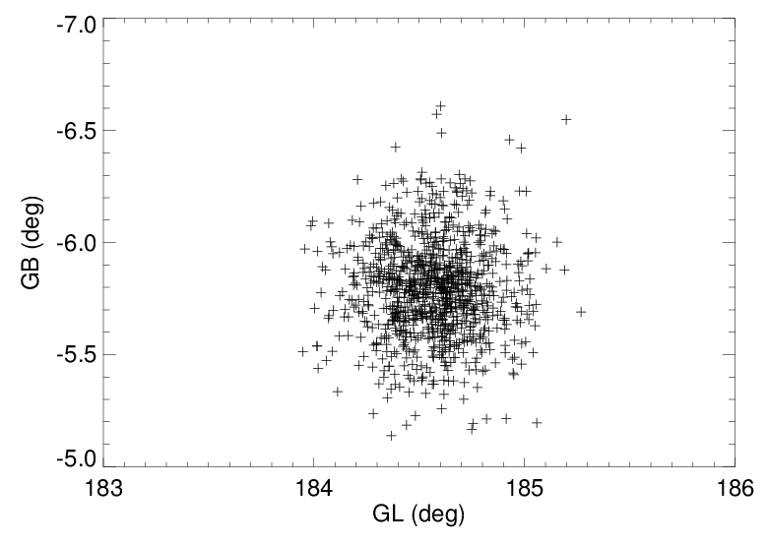
Angular spread (GL, GB)
>12 GeV
Assumed source: Geminga
Sampled following the Akaike-san’s preliminary point spread function

Slide 4
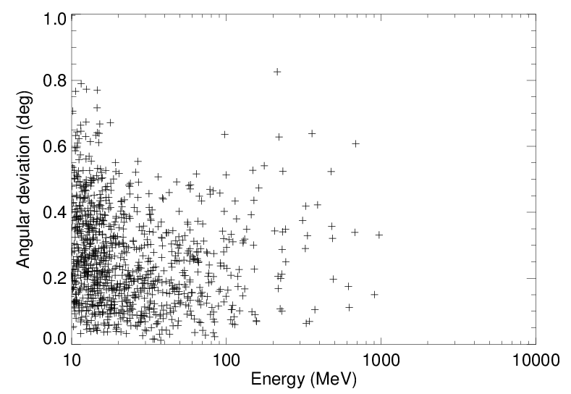
Angular spread vs Energy

Slide 5
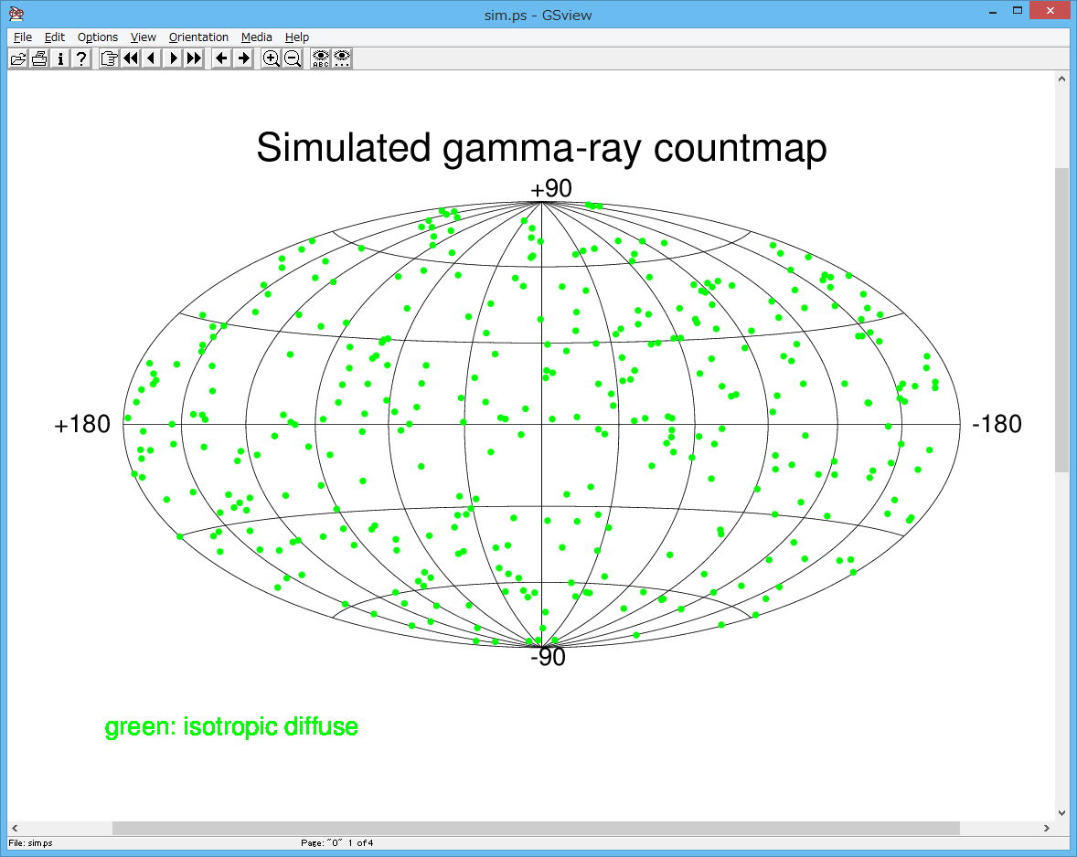
Preliminary

Slide 6
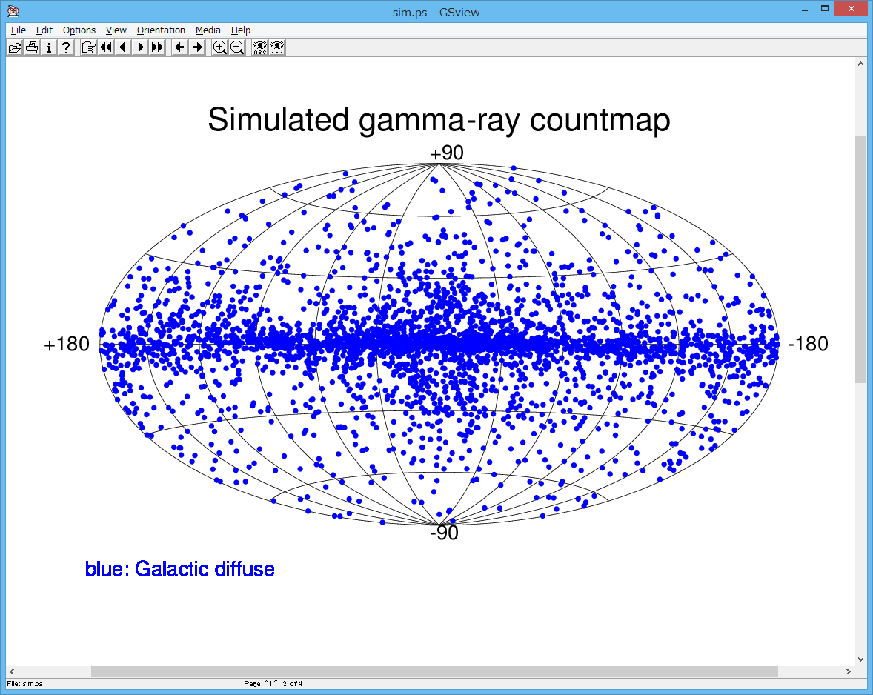
Preliminary

Slide 7
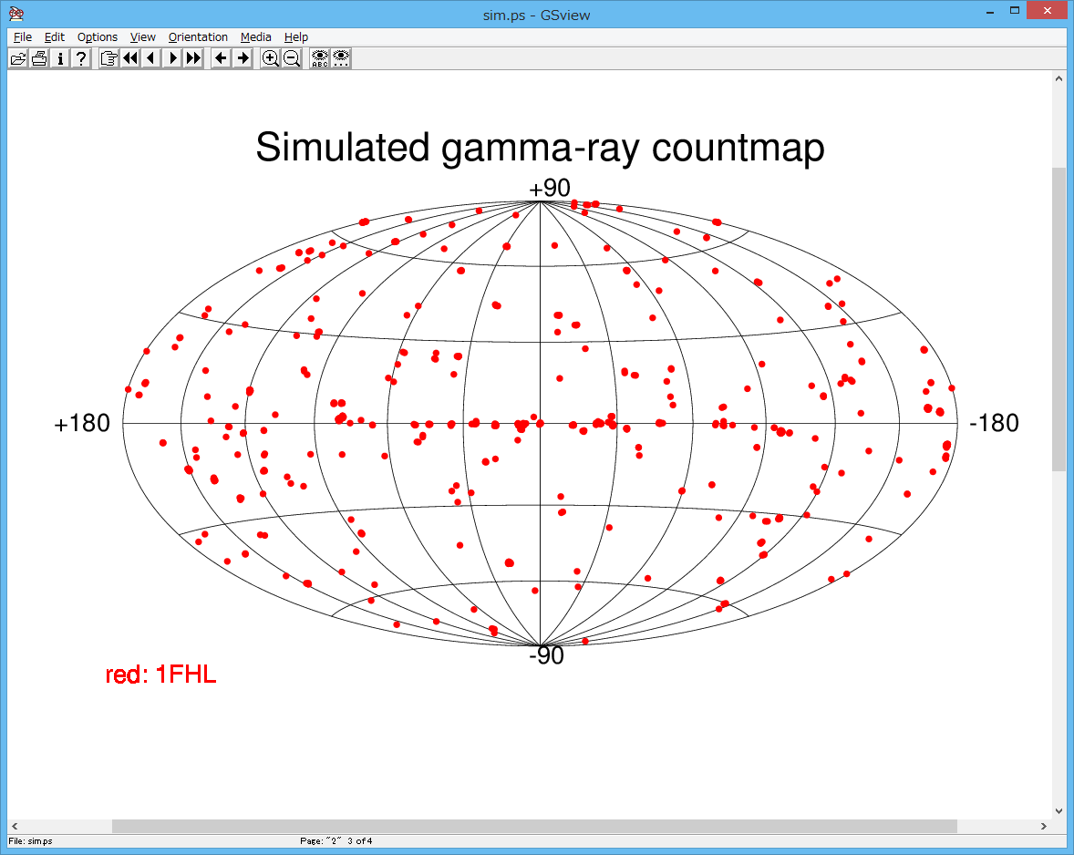
Preliminary
1FHL (514 sources >10GeV) ApJS 209,34 (2013)

Slide 8
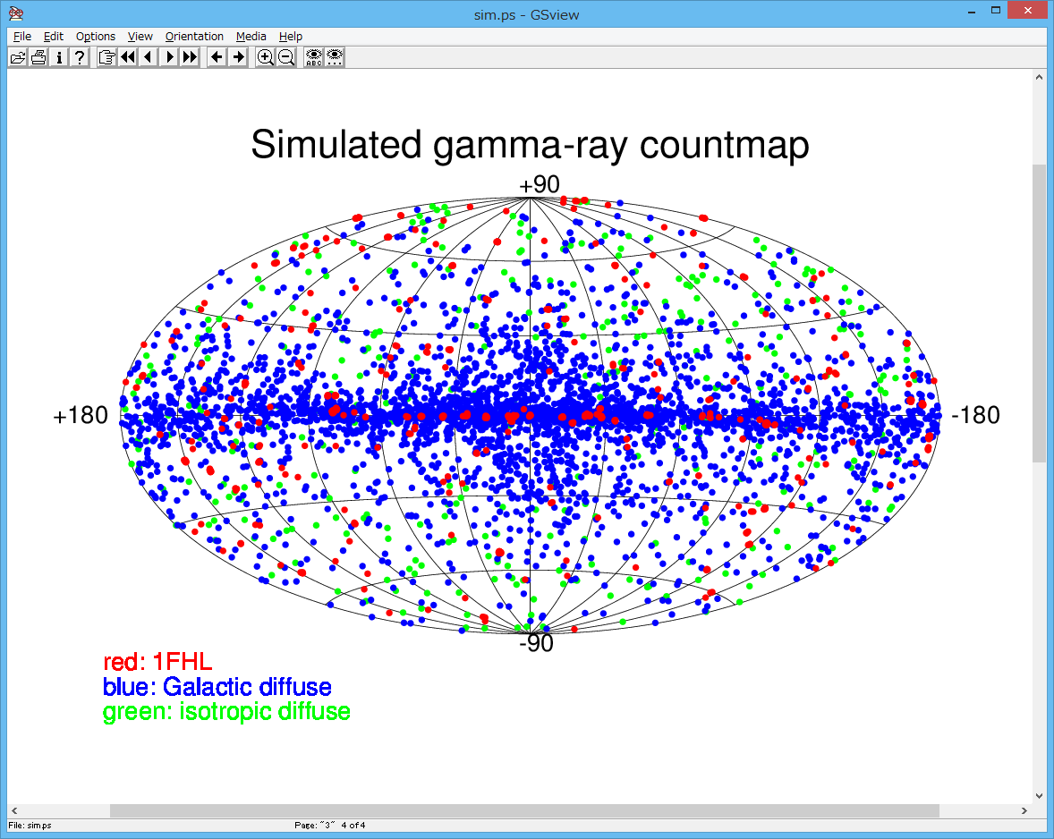
Preliminary

Slide 9
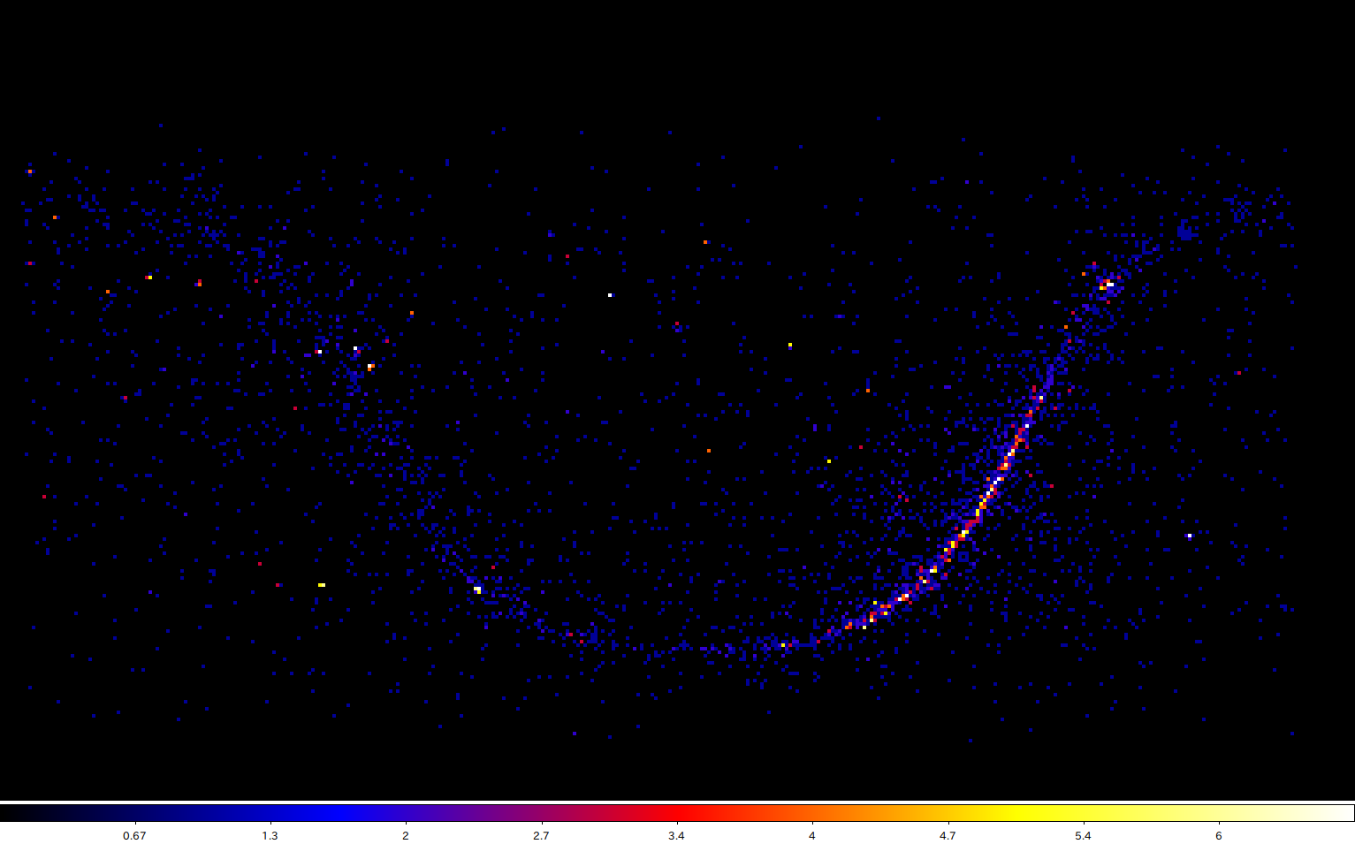
Preliminary
In equatorial coordinates (with DS9)

Slide 10
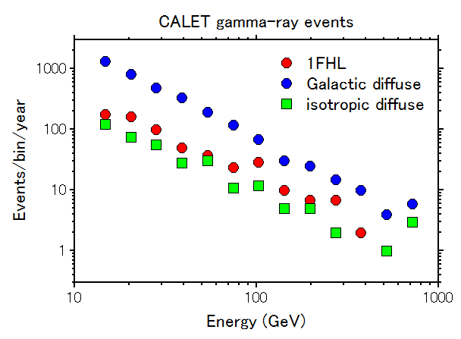
Statistics (1yr)
Preliminary
1FHL
  616 photons
  (from 239 sources)
  31 sources (>4 events)
Galactic diffuse
  3480 photons
Isotropic diffuse
  353 photons

Slide 11
Expected number of events for extragalactic diffuse emission
Preliminary
LAT (Phys.Rev.Lett. 104, 101101 (2011))
  1.03×10⁻⁵ cm⁻²s⁻¹sr⁻¹ (>100MeV), Γ=2.41
Exposure (5.8-6.5)×10⁹ cm²s [“DIFFUSE” class]
  → 6×10⁹ cm²s, 4π sr
E_threshold (GeV) | Events/yr | Moiseev (ICRC #627) | Mori
0.1 | 8.14×10⁵
1 | 3.02×10⁴ | 20,000
5 | 3,100 | 7,000
10 | 1,200
12 | 900 |  | 353

Slide 12
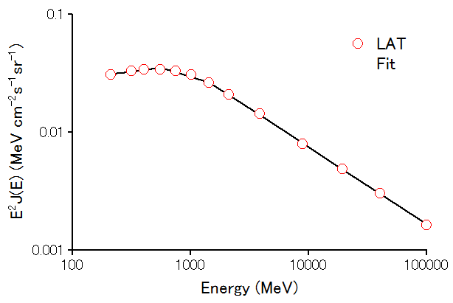
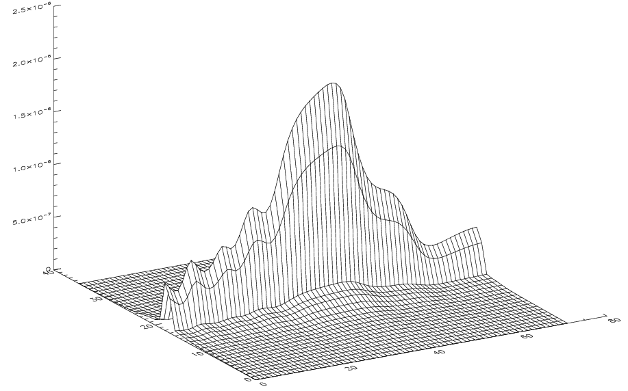
Galactic diffuse emission – simple model calculation
LAT (ApJ 750:3 (2012))
  Fig.20&21→ simple model
J(E) ∝ E^{-1.9} (E<540 MeV)
E^{-2.3} (540<E<1400 MeV)
E^{-2.65} (E>1400 MeV)
Galactic latitude
Galactic longitude
→ Total 2.0×10⁻⁴ cm⁻²s⁻¹ (200-1600MeV)

Slide 13
Expected number of events for Galactic diffuse emission
Preliminary
E_threshold (GeV) | Events/yr | Moiseev (ICRC #627) | Mori
1 | 1.64×10⁵ | 1.2×10⁵
5 | 1.18×10⁴ | 2.5×10⁴
10 | 3,770
12 | 2,794 |  | 3,480

Slide 14
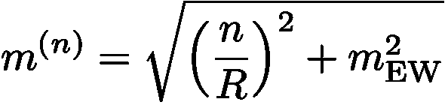
Kaluza-Klein dark matter
Work with Satoshi Tsuchida (Ritsumeikan University),
Submitted for publication
Assuming UED (Universal Extra Dimension)
  One extra dimension
Mass of Kaluza-Klein dark matter
Here we consider n=1 state:
L. Bergström et al, Phys. Rev. Lett 94(2005) 131301
G. Servant & T. Tait, Nucl. Phys. B 650, 391 (2003)

Slide 15
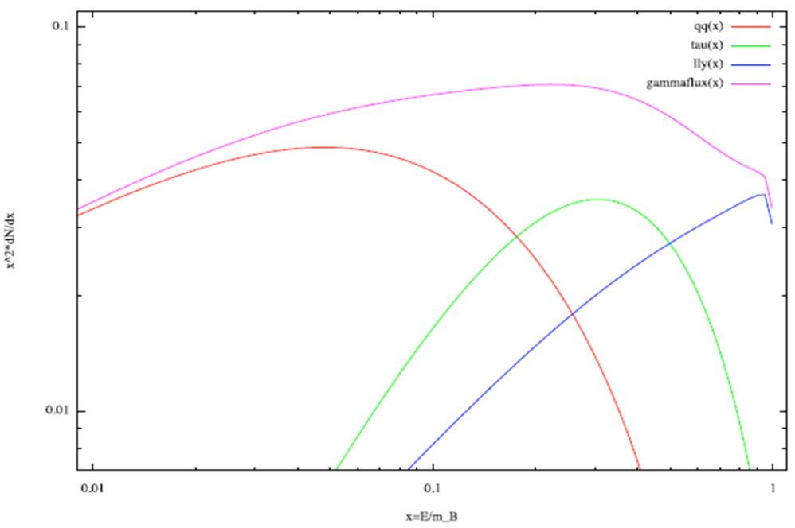


Gamma-ray spectrum from pair annihilation
χ + χ →
Continuum
  Quark pair
  Lepton pair
  Lepton-lepton-gamma
Line
  Gamma-gamma
  → Line at E_{γ} = m_{B}
→ fragmentation
L. Bergström et al, JCAP04(2005)004
No parameters for branching ratios other than mass!
Branching ratio for line is one-order larger than those for neutralinos!

Slide 16
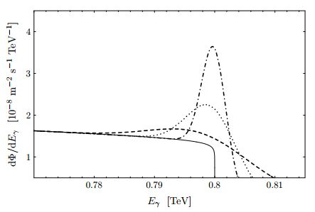
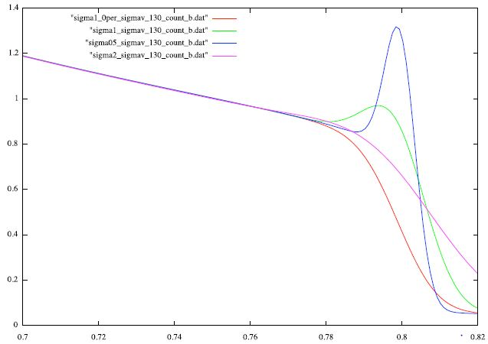
Effect of energy resolution
m_{B} = 800 GeV
Gaussian distribution
σ_{E}/E = 0.5, 1, 2%
Line (0.5%)
Line (0.5%)
dN/dE
Line (1%)
Line (1%)
Line
(2%)
Continuum (1%)
Line
(2%)
Continuum
E (TeV)
L. Bergström et al, JCAP04(2005)004
Energy resolution not included for continuum

Slide 17
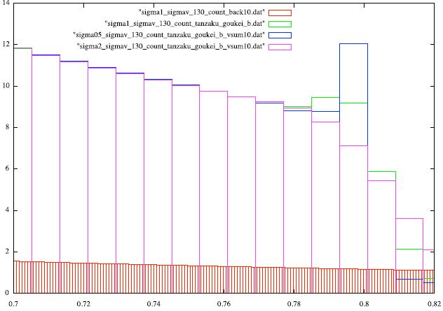
Count spectrum
m_{B} = 800 GeV, boost factor = 1000, 1000cm², 1yr
0.5%
1%
Count / bin
2%
HESS J1745-290
E (TeV)

Slide 18
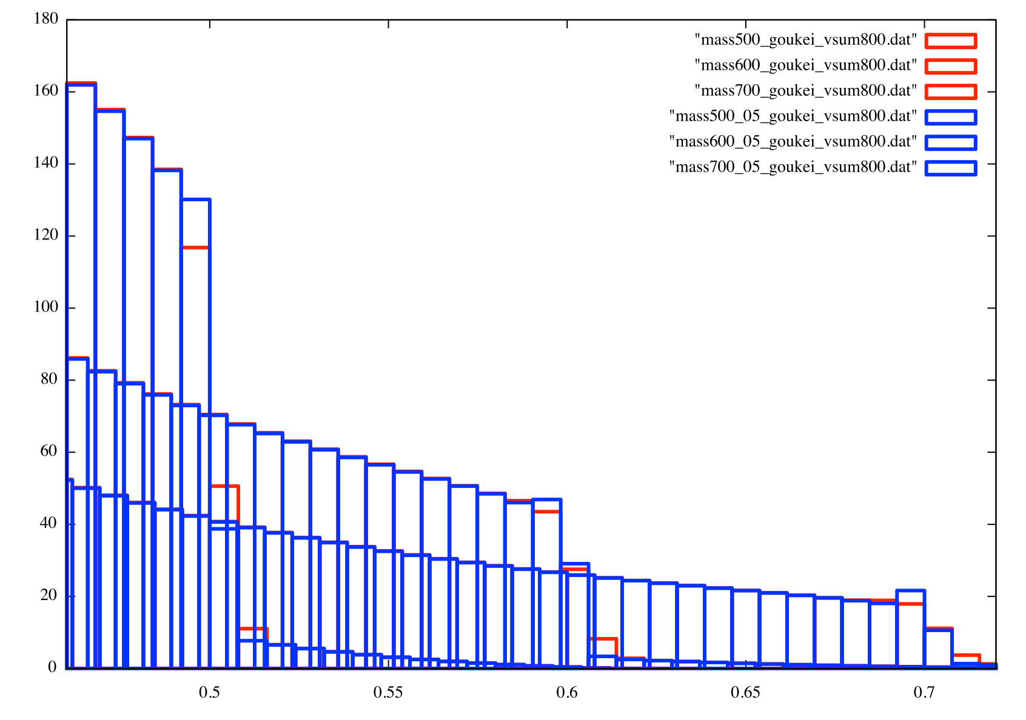
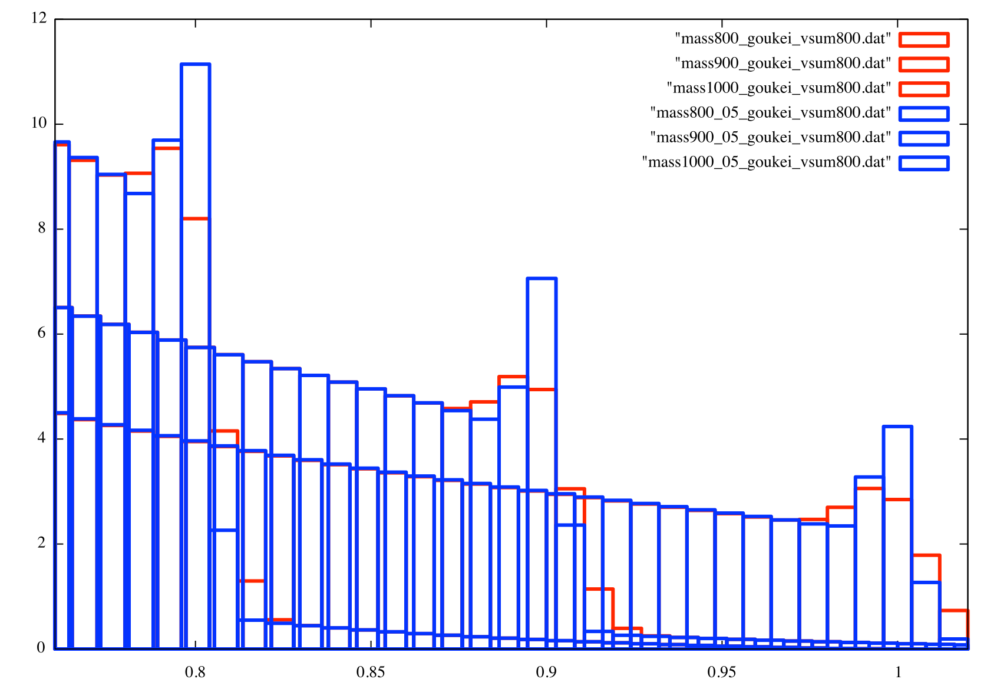
Kaluza-Klein DM detectability
Good energy resolution (1% level) is required.
CALET (1000 cm², 1yr) can explore it to the boost factor of order several hundreds.
S/N to identify lines becomes better for heavier DM.
800GeV
500GeV
900GeV
1000GeV
600GeV
700GeV
E (TeV)
E (TeV)

Slide 19

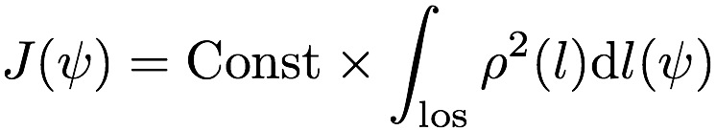




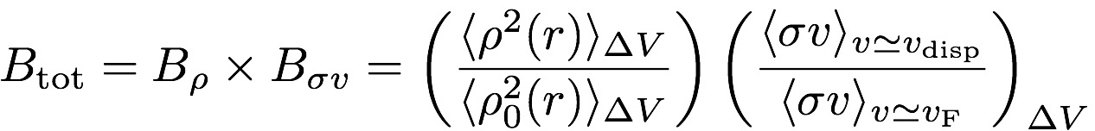

Boost factor
Gamma-ray flux
: DM density along the line-of-sight
: number of gamma-rays / annihilation
Boost Factor
: density profile by NFW
L. Bergström, New Journal of Physics 11(2009) 105006

