Slide 1
CALET Calibration on ISS Orbit Using Cosmic Ray Protons & Helium
2014. 10. 16
T. Niita

Slide 2
Calibration on the ISS orbit
For continuous high performance of the detector, on-orbit calibration considering detector condition is required.
We use the measured response to MIP (Minimum Ionizing Particle) for the calibration. Applicability of the basic method has been confirmed in several beam tests using muons.
There are few muons in space, so we use protons and helium nuclei for on-orbit calibration.
What we should confirm :
number of penetrating events obtained during 1 orbit
efficiency and accuracy of off-line event selection
expected calibration error
Notes:
2

Slide 3
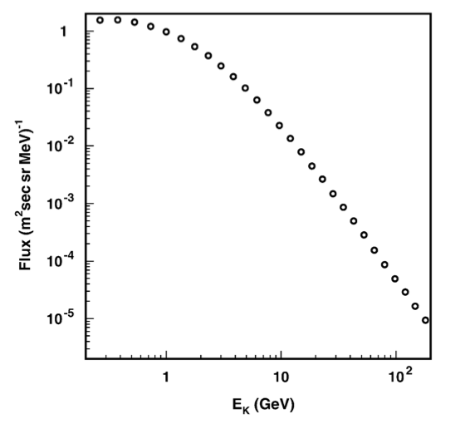
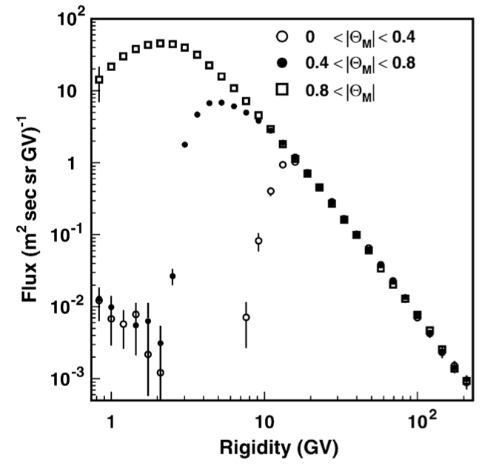
1. Simulation data
1.1. Interstellar flux
AMS-01 (M. Aguilar et al., Phys. Rep., 366, (2002), 331-405)
flight: June 1998, altitude: 320-390 km
the data in high rigidity region can be fitted to a power law Φ = Φ₀ R^{-γ}
Proton
Φ₀ = 17.1 [GV^{2.78}/m²/s/sr/MV]
γ = 2.78
Helium
Φ₀ = 2.52 [GV^{2.74}/m²/s/sr/MV]
γ = 2.74
Notes:
3

Slide 4
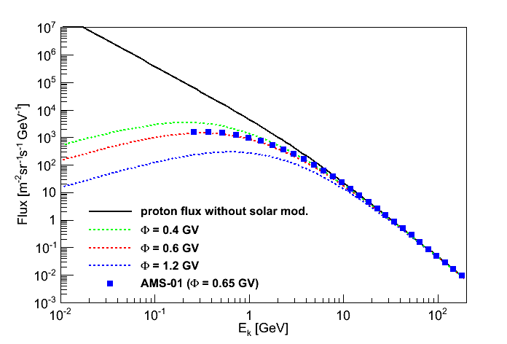
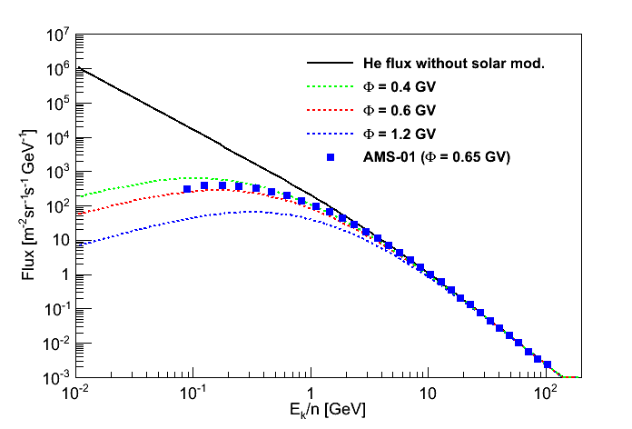
1. Simulation data
1.2. Solar modulation effect
extrapolate the power law to the lower energy region
calculate the solar modulation effect by Force-Field approximation
(L. J. Gleeson et al., ApJ, 154, (1968), 1011-1026)
when creating simulation data, we assume φ as
φ = 0.591 [GV]
Proton
He
Notes:
4

Slide 5
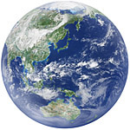
1. Simulation data
1.3. Effect of geomagnetic field on primary particles
It takes time to calculate the geomagnetic effect on all particles at a long distance (most of them wouldn’t reach to the ISS orbit), so we use the following method.
Prepare a data set of protons and helium nuclei
(considering solar modulation effect as in p.5)
Invert the sign of the charge (p->p, He->He), and inject them from an altitude of 400km toward the outside.
If the antiparticle (p, He) escape from the geomagnetic field, the original particle (p, He) with opposite direction is supposed to be able to reach to the altitude from the outside. So we select those event.
R_{earth}+400km
R_{earth}×10
Notes:
5

Slide 6
1. Simulation data
1.3. Effect of geomagnetic field on primary particles
It takes time to calculate the geomagnetic effect on all particles at a long distance (most of them wouldn’t reach to the ISS orbit), so we use the following method.
Prepare a data set of protons and helium nuclei
(considering solar modulation effect as in p.5)
Invert the sign of the charge (p->p, He->He), and inject them from an altitude of 400km toward the outside.
If the antiparticle (p, He) escape from the geomagnetic field, the original particle (p, He) with opposite direction is supposed to be able to reach to the altitude from the outside. So we select those event.
Amount of data
number of events : N₀ = 4×10⁸ (protons), 2×10⁷ (He)
integral flux : F = 3083 [/m²/sr/s] (proton), 262.8 [/m²/sr/s] (He)
geometrical factor : S₀Ω₀ = 4π (R_{earth}+400,001 m)²×π = 1.81×10¹⁵ [m²sr]
corresponding time :
T₀ = N₀ / F / S₀Ω₀ = 7.15×10⁻¹¹ [s] (proton), 4.20×10⁻¹¹ [s] (He)
R_{earth}+400km
R_{earth}×10
Notes:
6

Slide 7
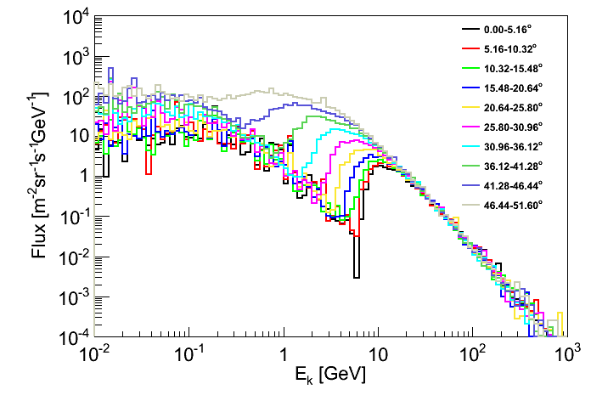
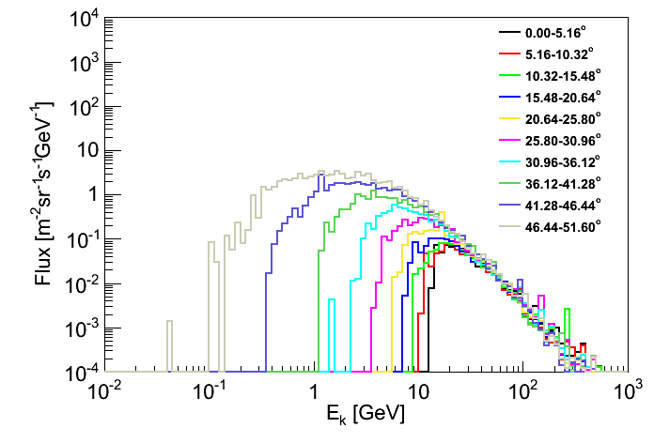
1. Simulation data
1.4. Flux of primary & albedo particles on the ISS orbit
Simulation code : ATMNC3
Atmospheric structure model : US-standard 1976
Geomagnetic field model : IGRF2010
Minimum energy of incident particles : 10 MeV (p), 100 MeV/n (He)
Minimum hadron/elemag interaction energy : 20 MeV (p), 200 MeV/n (He)
Incident altitude : 400.001 km
Output : momentum, position (x, y, z)
of particles which reach to the altitude of 400.000 km
He
Proton
Notes:
7

Slide 8
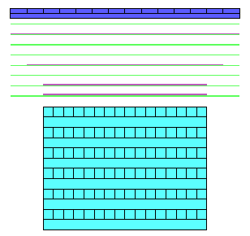
1. Simulation data
1.5. Calculation of the detector-response
Simulation code : EPICS
Incident surface : sphere around the detector (radius 0.48 m)
Incident direction : as recorded by ATMNC3
Incident position :
as the particle pass a random point in a cross section of the sphere
R = R_{earth} + 400 km
r = 48 cm
θ
θ
Φ
Notes:
8

Slide 9
1. Simulation data
1.5. Calculation of the detector-response
Simulation code : EPICS
Incident surface : sphere around the detector (radius 0.48 m)
Incident direction : as recorded by ATMNC3
Incident position :
as the particle pass a random point in a cross section of the sphere
incident area in ATMNC3 calculation :
S₀(Φ) = 2 × (R_{earth}+400,001m)² × 2π(sinΦ’-sinΦ)
incident area in EPICS calculation :
S = π(0.48)² × cosθ
corresponding observation time : t = T₀ ・ S₀ / S
R = R_{earth} + 400 km
r = 48 cm
S₀
θ
θ
Φ
Notes:
9

Slide 10
1. Simulation data
1.5. Calculation of the detector-response
Simulation code : EPICS
Incident surface : sphere around the detector (radius 0.48 m)
Incident direction : as recorded by ATMNC3
Incident position :
as the particle pass a random point in a cross section of the sphere
incident area in ATMNC3 calculation :
S₀(Φ) = 2 × (R_{earth}+400,001m)² × 2π(sinΦ’-sinΦ)
incident area in EPICS calculation :
S = π(0.48)² × cosθ
corresponding observation time : t = T₀ ・ S₀ / S
R = R_{earth} + 400 km
Latitude [deg] | S₀×10¹³ [m²] | ISS transit time [s] | t (p) [period] | t (He) [period]
0.00-5.16 | 5.19 | 395 | 13.0 | 7.61
5.16-10.32 | 5.15 | 397 | 12.8 | 7.61
10.32-15.48 | 5.07 | 402 | 12.5 | 7.31
15.48-20.64 | 4.94 | 409 | 11.9 | 7.00
20.64-25.80 | 4.78 | 420 | 11.2 | 6.59
25.80-30.96 | 4.57 | 438 | 10.3 | 6.06
30.96-36.12 | 4.33 | 465 | 9.20 | 5.40
36.12-41.28 | 4.06 | 513 | 7.81 | 4.58
41.28-46.44 | 3.75 | 617 | 6.00 | 3.52
46.44-51.60 | 3.41 | 1343 | 2.51 | 1.47
r = 48 cm
S₀
θ
θ
Φ
Notes:
10

Slide 11
2. Rate estimation
2.1. Trigger rate
 | High Energy Shower | Low Energy Shower | Calibration
CHD | - | > 0.7 MIP | > 0.7 MIP
IMC layer 1-6 | - | > 0.7 MIP | > 0.7 MIP
IMC layer 7-8 | > 7.5 MIP | > 2.5 MIP | > 0.7 MIP
TASC layer 1 | > 55 MIP | > 7 MIP | > 0.7 MIP
Latitude [deg] | proton [/s] | He [/s]
0.00-5.16 | 36.6 | 6.53
5.16-10.32 | 38.2 | 7.01
10.32-15.48 | 40.9 | 7.83
15.48-20.64 | 46.8 | 8.93
20.64-25.80 | 57.4 | 11.5
25.80-30.96 | 73.8 | 15.4
30.96-36.12 | 100 | 20.6
36.12-41.28 | 143 | 28.2
41.28-46.44 | 202 | 37.1
46.44-51.60 | 273 | 45.9
Counts / period | 7.34×10⁵ | 1.32×10⁵
Notes:
11

Slide 12
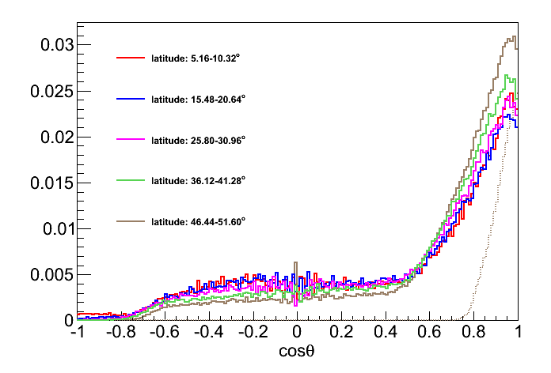
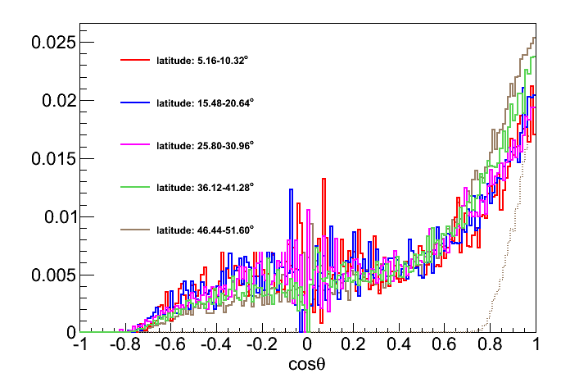
2. Rate estimation
2.2. Angular distribution of triggered events
Proton
He
all
all
top to bottom
top to bottom
Latitude [deg] | proton | He
 | B/A | B/A
0.00-5.16 | 0.182 | 0.125
5.16-10.32 | 0.181 | 0.123
10.32-15.48 | 0.176 | 0.126
15.48-20.64 | 0.170 | 0.126
20.64-25.80 | 0.170 | 0.120
25.80-30.96 | 0.182 | 0.125
30.96-36.12 | 0.194 | 0.137
36.12-41.28 | 0.205 | 0.154
41.28-46.44 | 0.225 | 0.168
46.44-51.60 | 0.241 | 0.178
Condition
triggered
(A) & meet the geometrical condition (top to bottom i.e. CHD layer1 to TASC layer12)
Notes:
12

Slide 13
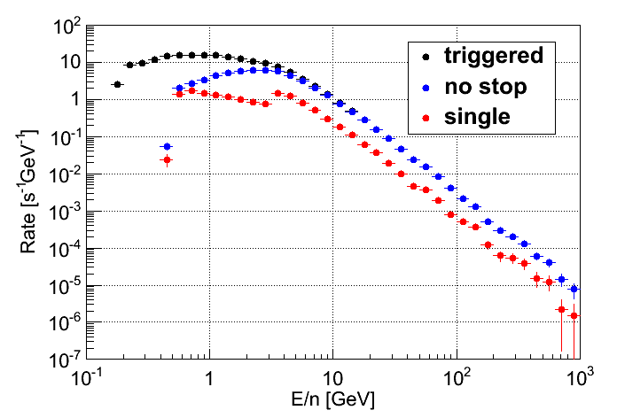
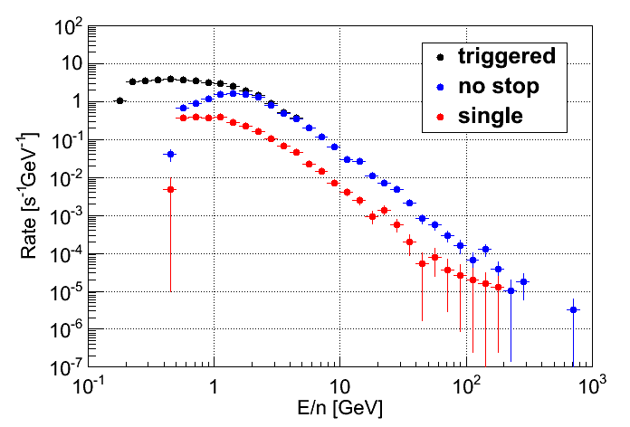
2. Rate estimation
2.3. Interaction probability
Below 4 GeV, elastic scattering is treated as “interaction” in current EPICS.
Proton
latitude : 46.44-51.60°
He
latitude : 46.44-51.60°
Latitude [deg] | proton |  | He
 | C/B | D/C | C/B | D/C
0.00-5.16 | 0.860 | 0.232 | 0.999 | 0.123
5.16-10.32 | 0.868 | 0.234 | 0.995 | 0.115
10.32-15.48 | 0.891 | 0.230 | 0.994 | 0.114
15.48-20.64 | 0.926 | 0.226 | 0.993 | 0.112
20.64-25.80 | 0.930 | 0.234 | 0.981 | 0.117
25.80-30.96 | 0.920 | 0.239 | 0.958 | 0.110
30.96-36.12 | 0.884 | 0.236 | 0.898 | 0.131
36.12-41.28 | 0.811 | 0.227 | 0.788 | 0.144
41.28-46.44 | 0.701 | 0.228 | 0.667 | 0.159
46.44-51.60 | 0.606 | 0.235 | 0.595 | 0.169
Condition
triggered
(A) & meet the geometrical condition (top to bottom)
(B) & reach to the bottom layer (without losing all its energy in upper layers)
(C) & penetrate the bottom layer without interaction
※ Total depth of the detector :
1.3 m.f.p. for protons (in a vertical direction)
Notes:
13

Slide 14
2. Rate estimation
2.4. Rate of penetrating events
By selecting the events in condition (D) (i.e. penetrating the detector without interaction), we get the event rate as below.
Latitude [deg] | proton [/s] |  | He [/s]
 | per layer | per log | per layer | per log
0.00-5.16 | 1.33 | 0.049 - 0.096 | 0.10 | 0.0028 - 0.0070
5.16-10.32 | 1.41 | 0.066 - 0.097 | 0.099 | 0.0046 - 0.0085
10.32-15.48 | 1.48 | 0.066 - 0.099 | 0.11 | 0.0038 - 0.0090
15.48-20.64 | 1.67 | 0.072 - 0.11 | 0.12 | 0.0030 - 0.0063
20.64-25.80 | 2.12 | 0.083 - 0.16 | 0.16 | 0.0071 - 0.0099
25.80-30.96 | 2.95 | 0.12 - 0.20 | 0.20 | 0.010 - 0.012
30.96-36.12 | 4.06 | 0.17 - 0.29 | 0.33 | 0.012 - 0.020
36.12-41.28 | 5.40 | 0.22 - 0.35 | 0.50 | 0.021 - 0.036
41.28-46.44 | 7.28 | 0.30 - 0.52 | 0.66 | 0.027 - 0.046
46.44-51.60 | 9.37 | 0.37 - 0.67 | 0.82 | 0.030 - 0.073
Counts / period | 26287 | 1066 - 1856 | 2252 | 87 - 176
Notes:
14

Slide 15
2. Rate estimation
2.4. Rate of penetrating events
Latitude [deg] | proton [/s] |  |  | He [/s]
 | trigger | geometry | single penetrating | trigger | geometry | single penetrating
0.00-5.16 | 36.6 (100 %) | 6.68 (18.2 %) | 1.33 (3.64 %) | 6.53 (100 %) | 0.82 (12.5 %) | 0.10 (1.54 %)
5.16-10.32 | 38.2 (100 %) | 6.92 (18.1 %) | 1.41 (3.69 %) | 7.01 (100 %) | 0.86 (12.3 %) | 0.099 (1.41 %)
10.32-15.48 | 40.9 (100 %) | 7.22 (17.6 %) | 1.48 (3.61 %) | 7.83 (100 %) | 0.98 (12.6 %) | 0.11 (1.43 %)
15.48-20.64 | 46.8 (100 %) | 7.98 (17.0%) | 1.67 (3.57 %) | 8.93 (100 %) | 1.12 (12.6 %) | 0.12 (1.40 %)
20.64-25.80 | 57.4 (100%) | 9.77 (17.0 %) | 2.12 (3.70 %) | 11.5 (100 %) | 1.37 (12.0 %) | 0.16 (1.37 %)
25.80-30.96 | 73.8 (100 %) | 13.4 (18.2 %) | 2.95 (4.00 %) | 15.4 (100 %) | 1.93 (12.5 %) | 0.20 (1.32 %)
30.96-36.12 | 100 (100 %) | 19.4 (19.4 %) | 4.06 (4.05 %) | 20.6 (100 %) | 2.82 (13.7 %) | 0.33 (1.61 %)
36.12-41.28 | 143 (100 %) | 29.3 (20.5 %) | 5.40 (3.78 %) | 28.2 (100 %) | 4.36 (15.4 %) | 0.50 (1.76 %)
41.28-46.44 | 202 (100 %) | 45.6 (22.5 %) | 7.28 (3.60 %) | 37.1 (100 %) | 6.22 (16.8 %) | 0.66 (1.78 %)
46.44-51.60 | 273 (100 %) | 65.9 (24.1 %) | 9.37 (3.43 %) | 45.9 (100 %) | 8.18 (17.8 %) | 0.82 (1.80 %)
Counts / period | 7.34×10⁵ (100 %) | 1.62×10⁵ (22.1 %) | 0.26×10⁵ (3.58 %) | 1.32×10⁵ (100 %) | 0.21×10⁵ (16.1 %) | 0.023×10⁵ (1.70 %)
Notes:
15

Slide 16
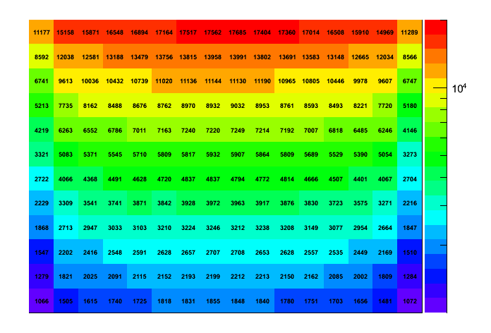
2. Rate estimation
2.5. Rate of penetrating events for each PWO log (protons)
1
2
3
4
5
6
7
8
9
10
11
12
Layer
1 2 3 4 5 6 7 8 9 10 11 12 13 14 15 16
Notes:
16

Slide 17
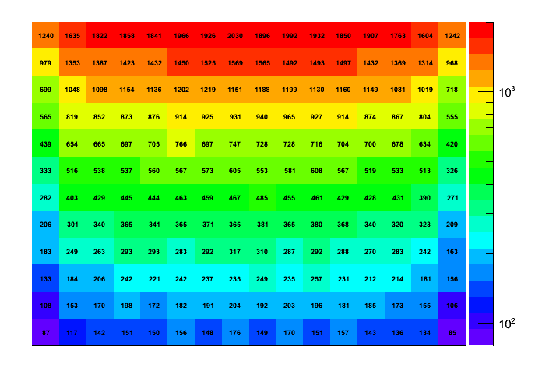
2. Rate estimation
2.5. Rate of penetrating events for each PWO log (He nuclei)
1
2
3
4
5
6
7
8
9
10
11
12
Layer
1 2 3 4 5 6 7 8 9 10 11 12 13 14 15 16
Notes:
17

Slide 18
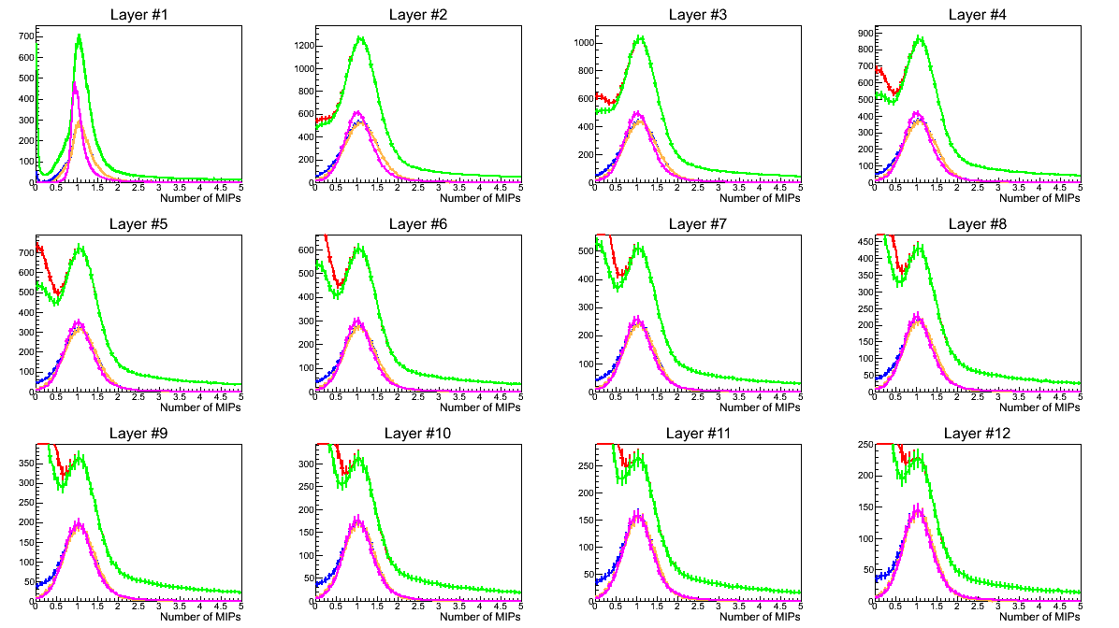
3. Signal distribution
incident axis geometrically pass the layer
penetrate the layer
penetrate the layer without interaction
deposited energy on the axis is largest in the layer
with correction of zenith angle
3.1. Signal distribution
x axis is normalized by MPV of deposited
energy by 2GeV muons (= 20.47 MeV).
Notes:
18

Slide 19
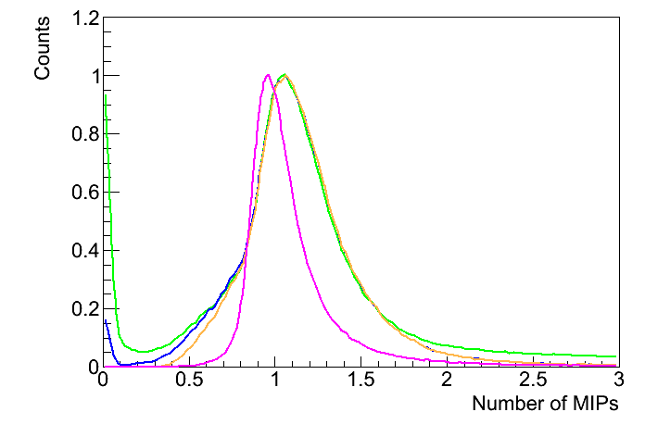
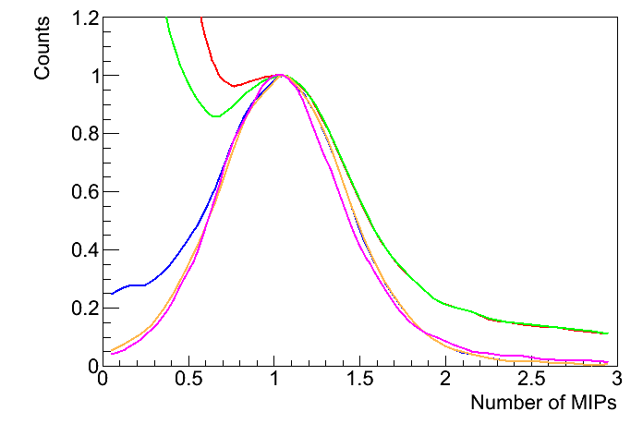
3. Signal distribution
incident axis geometrically pass the layer
penetrate the layer
penetrate the layer without interaction
deposited energy on the axis is largest in the layer
with correction of zenith angle
3.1. Signal distribution
y axis is normalized at the peak.
Layer #1 (PMT, S/N=30)
Layer #12 (APD, S/N=3.3)
Notes:
19

Slide 20
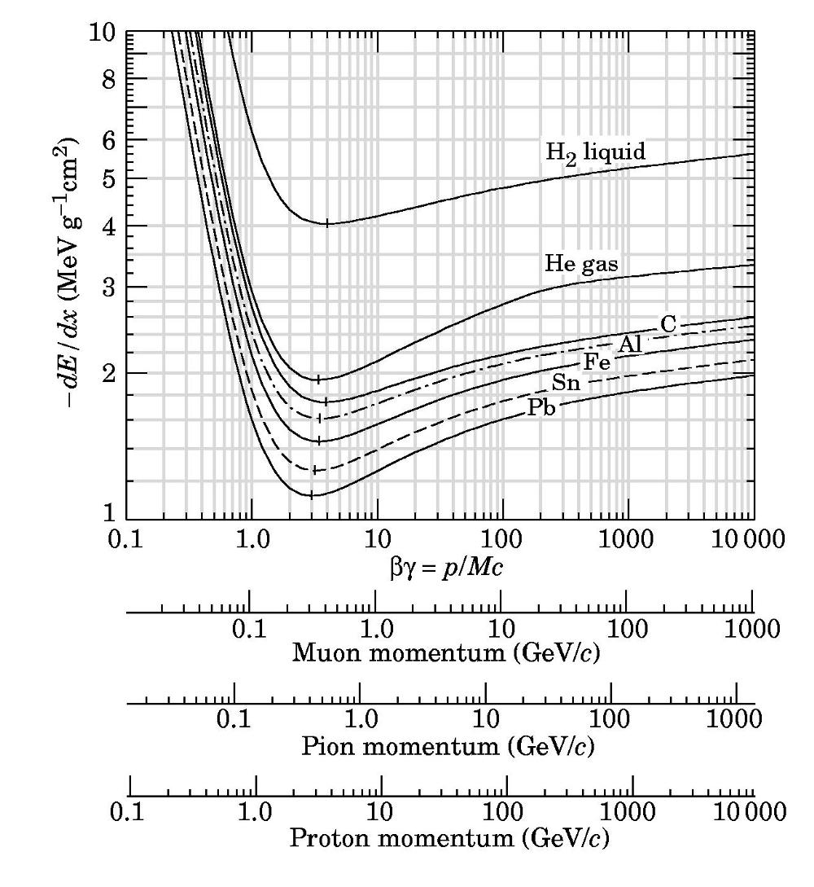
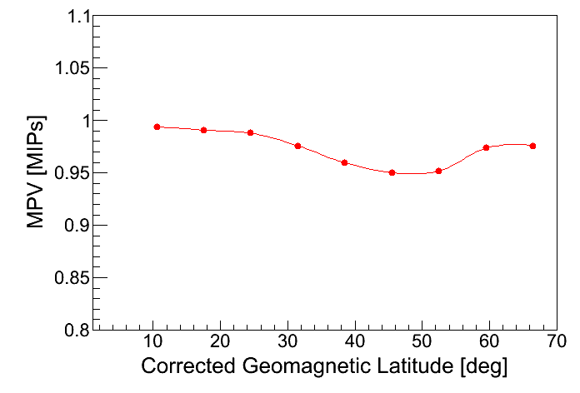
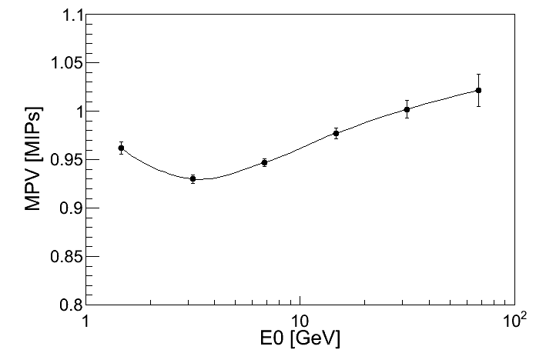
3. Signal distribution
3.2. Energy-dependence of deposited energy
Energy deposition vary with particle energy as described in Bethe-Bloch equation. Average energy of particles vary with geomagnetic intensity, so MIP value may shift as a function of geomagnetic latitude.
We can use this function as a correction factor when we combine the data obtained at different geomagnetic latitudes.
Notes:
20

Slide 21
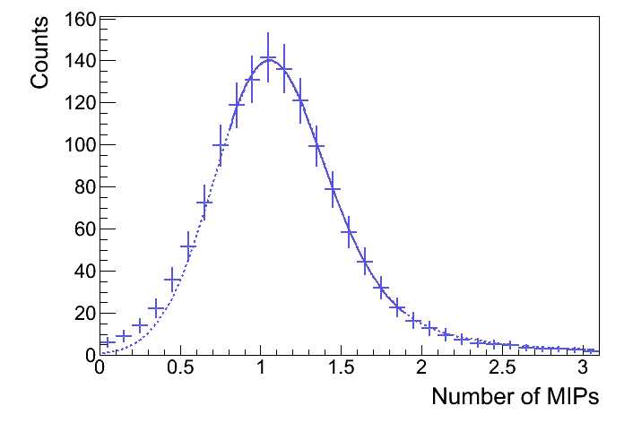
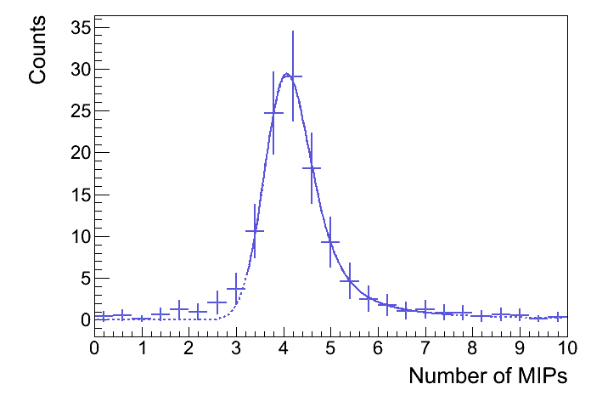
3. Signal distribution
3.3. Fitting the distributions
Fit the distribution to Landau Function convoluted with a Gaussian.
Proton
He
Fitting result (bottom layer)
 | proton |  | Helium
 | number of events (average of 16 logs) | calibration error | number of events (average of 16 logs) | calibration error
1 period | 1380 | 3.52 % | 117 | 1.76 %
5 period | 6899 | 1.57 % | 584 | 0.79 %
Notes:
21

Slide 22
End

Slide 23
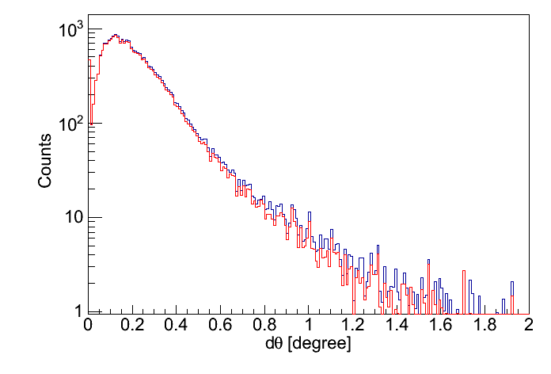
4. Event selection method
4.1. Track reconstruction using IMC
For all the single penetrating protons,
- Reconstruct rate : 99.9 %
- Percentage of hitting the most luminous PWO in the bottom layer : 96.2 %
- Angular resolution : 0.26 degree
all events
hit the most luminous PWO in layer #12
Notes:
23

Slide 24
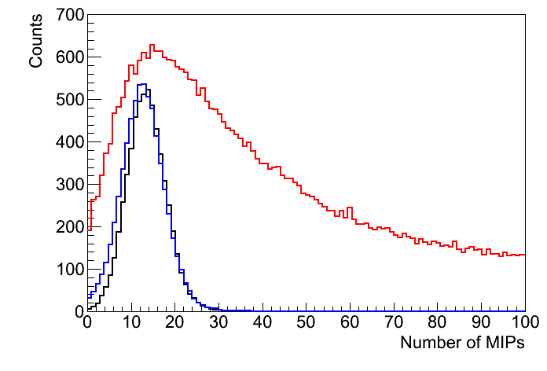
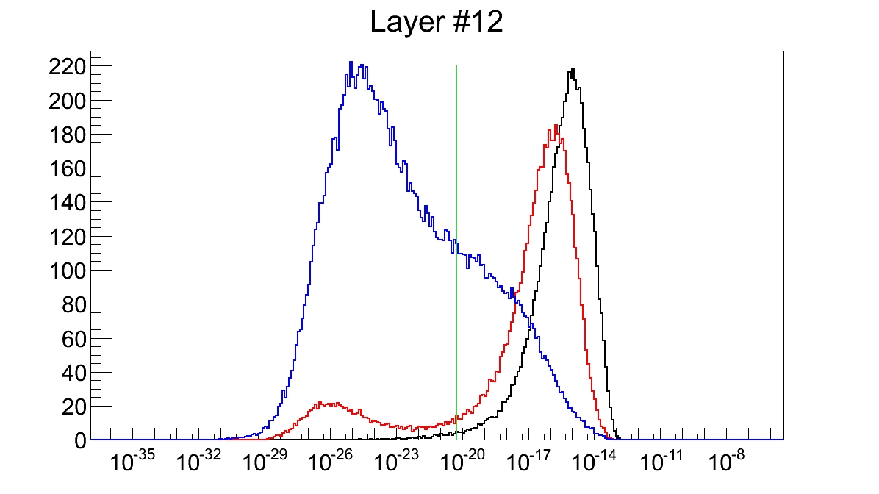
4. Event selection method
4.2. Rejection of interacted events using TASC
Cut by total deposited energy in TASC
Cut by likelihood
Notes:
24

Slide 25
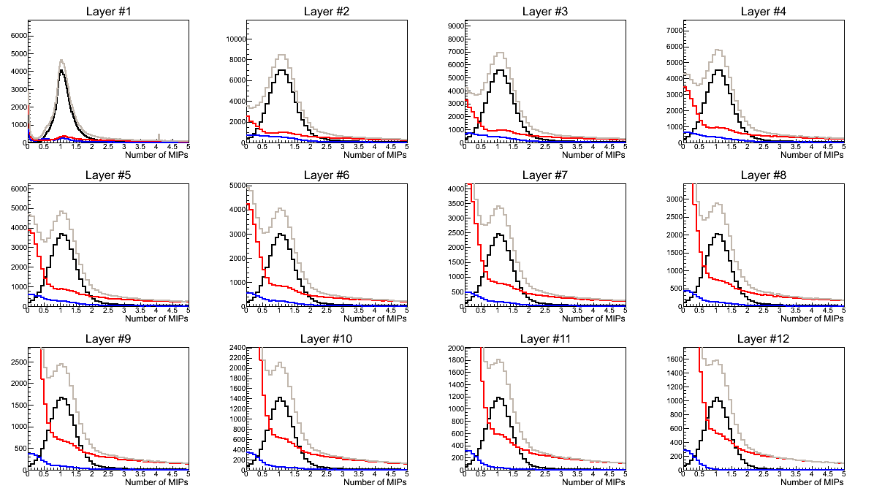
4. Event selection method
single penetrating
interacted
dead in upper layer
total
4.3. Distribution without any selection
Notes:
25

Slide 26
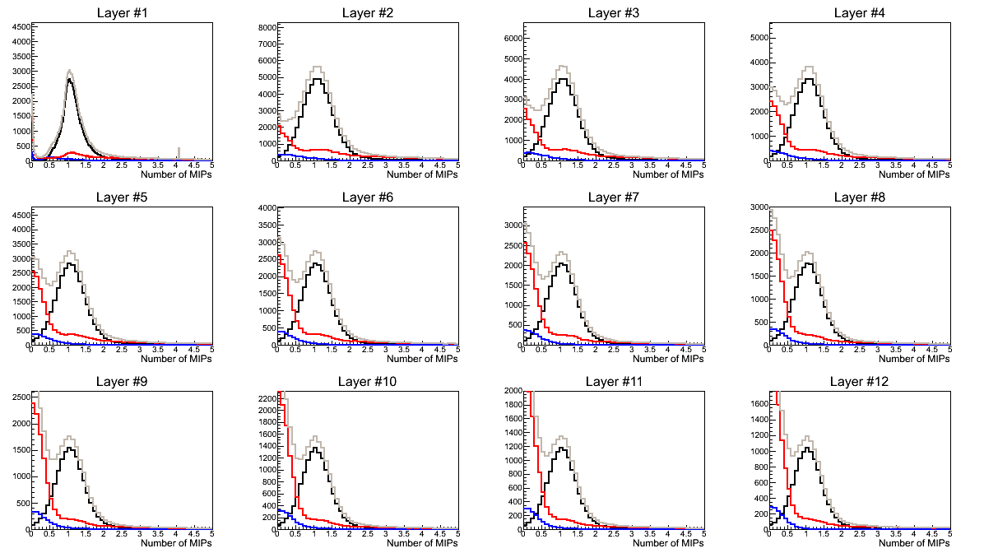
4. Event selection method
single penetrating
interacted
dead in upper layer
total
4.4. Distribution after the cut by total deposit energy
Notes:
26

Slide 27
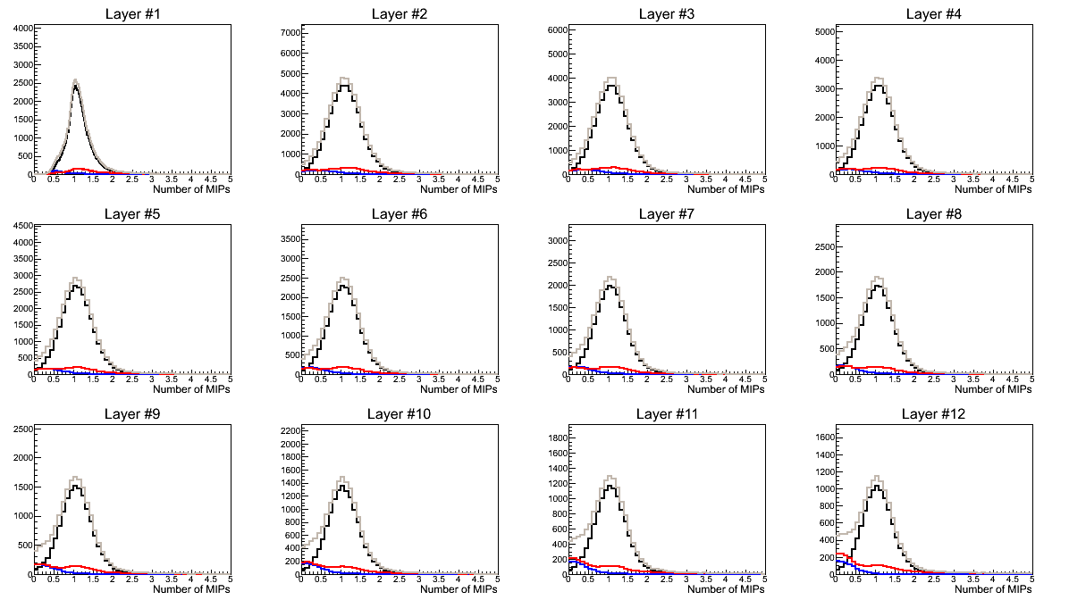
4. Event selection method
single penetrating
interacted
dead in upper layer
total
4.5. Distribution after the cut by likelihood
Notes:
27

Slide 28
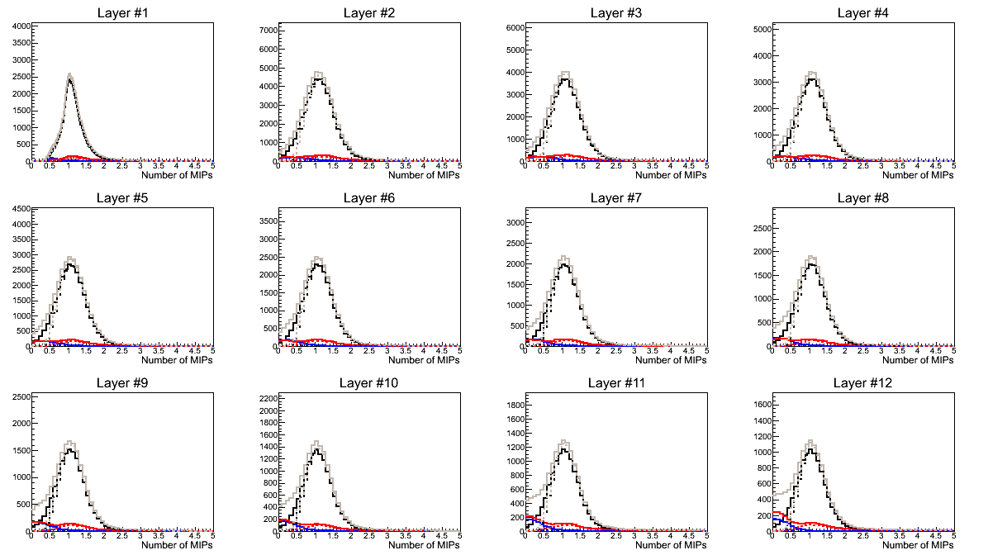
4. Event selection method
single penetrating
interacted
dead in upper layer
total
4.6. If we require the PWO to have maximum dE..
Notes:
28

