Slide 1
Performance tests in
Tsukuba SC and results
(“PI calibration”)
T. Sakamoto, R. Inoue, Y. Kawakubo,
S. Terasawa, I. Takahashi (AGU)
on behalf of CGBM team

Slide 2
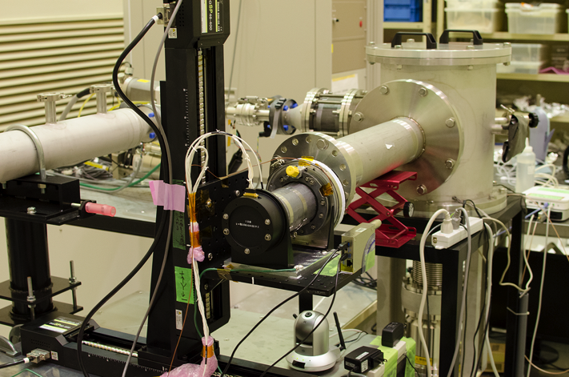
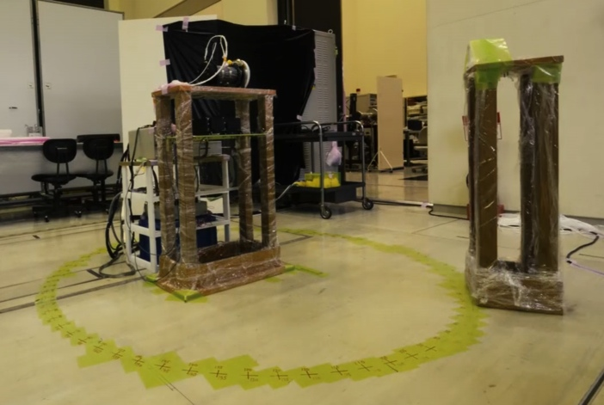
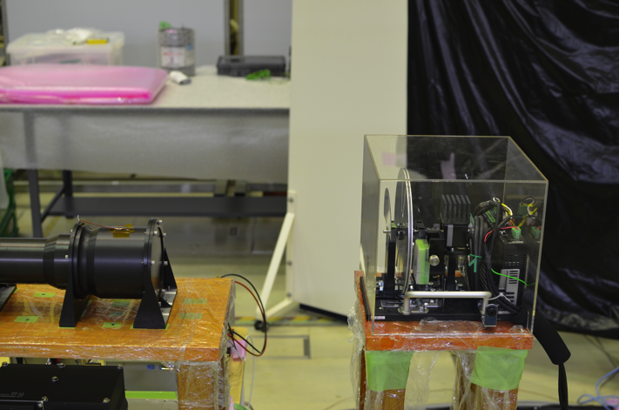
Goal:
Collect the fundamental data using the flight detectors for the development of the energy response function.
Date:
2014/01/14 – 01/28 Tsukuba Space Center
Test contents:
2D scan of the surface of the detectors by the collimated X-rays and gamma-rays (HXM).
Energy linearity and resolution (HXM/SGM)
Angular response (HXM/SGM)
GRB trigger test (SGM)

Slide 3
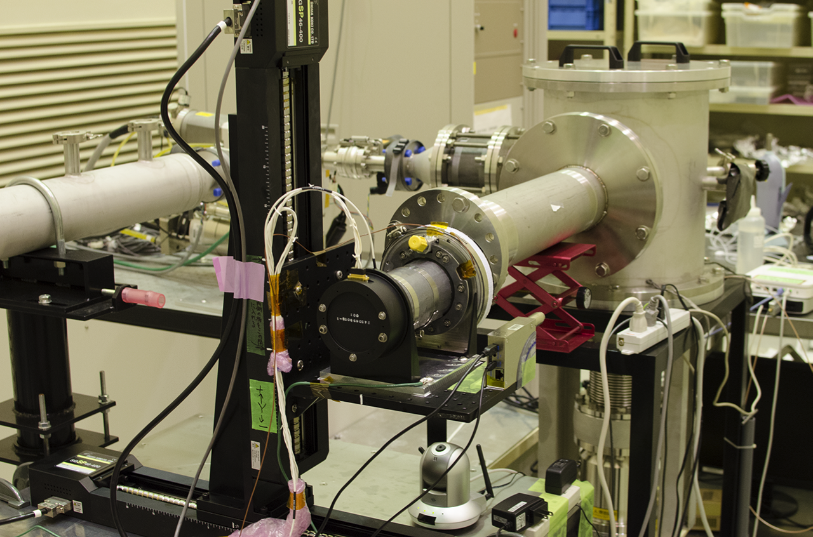
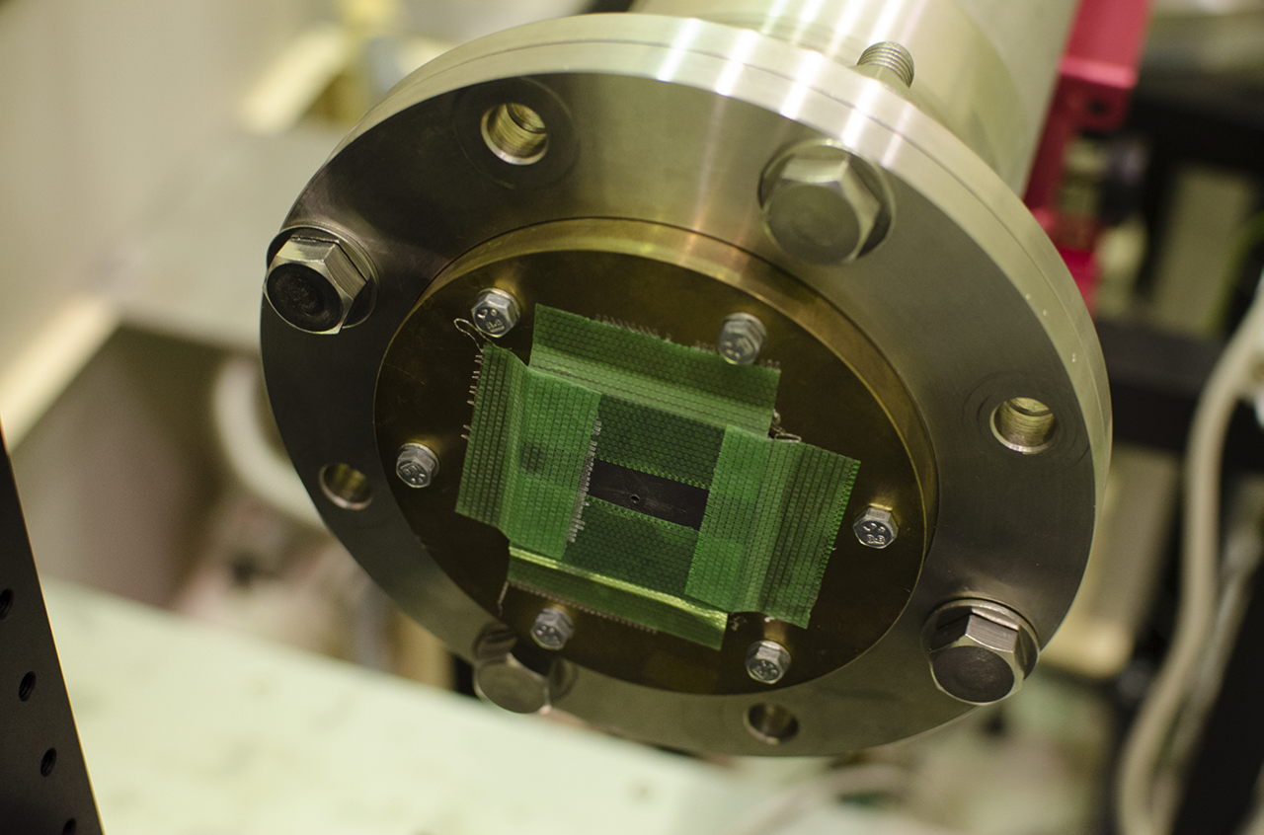
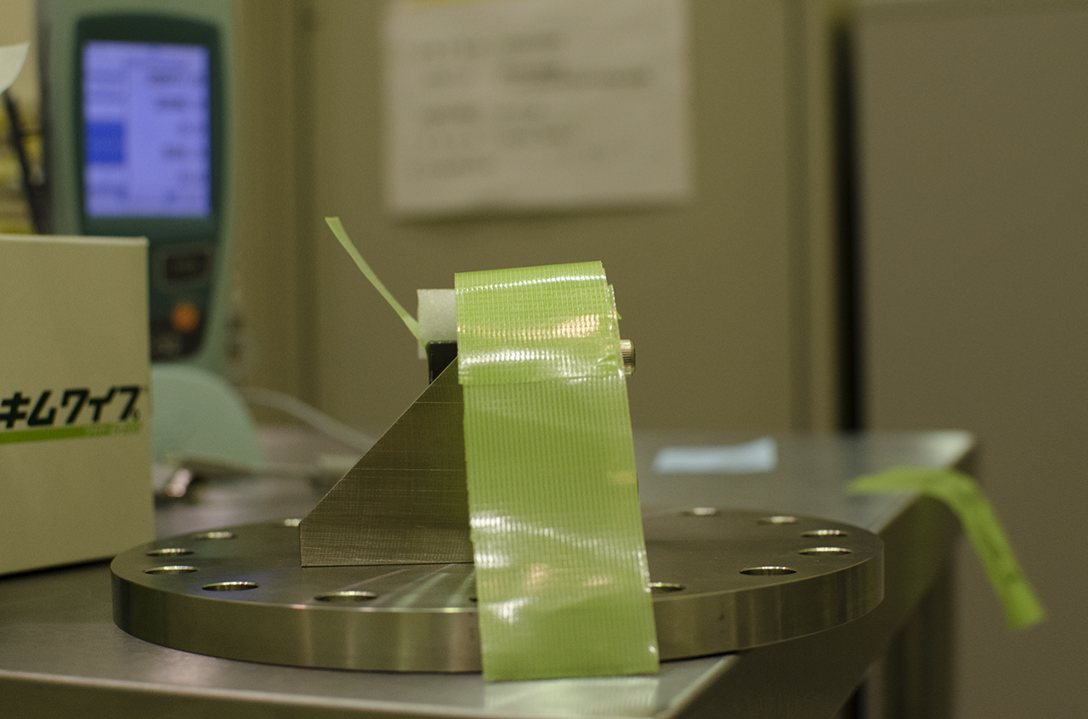
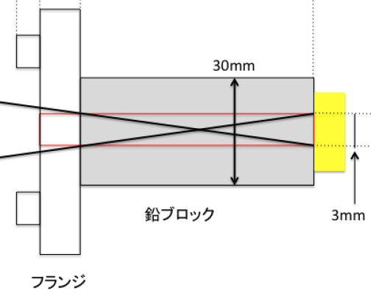
2D scan of HXM
X-Y stage
X-Y ステージ
X-ray Generator
X線発生装置
_{CGBM}
_{試験ラック}
Collimator of X-ray Generator
(φ 1.5 mm)
Collimator of RI
(φ 3 mm)
RI
Lead block

Slide 4
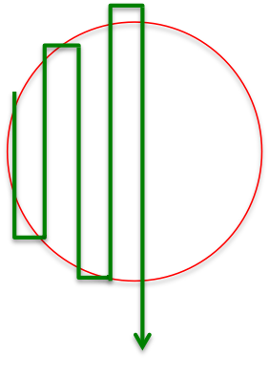
Scanning points
Fe@6.4keV
Y@14.9keV
Na@511keV
Y[mm]
Y[mm]
Y[mm]
X[mm]
X[mm]
X[mm]
5mm pitch, total 149 points
X-ray generator
5mm pitch total 197 points
X-ray generator
6mm pitch, Total 149 points
Radio isotope (²²Na)
Al
Al
Blue circle : PMT’s diameter 60.96 mm
Red circle : Crystal surface diameter 66.04 mm
Green circle : Crystal bottom diameter 71.76 mm
LaBr₃(Ce)
PMT
Scanning order

Slide 5
HXM: 6.4 keV (Fe) 2D map
Gain map
Count rate map
Energy resolution map
HXM
1
HXM
2
HXM1: No count-rate at the upper part (Y > 0) of the crystal
HXM2: Donuts shape feature in the gain map
HXM1 & 2: Count-rate is not uniform across the crystal surface

Slide 6
HXM: 6.4 keV spectrum
6.4keV
6.4keV
HXM1
HXM2
HXM1: 6.4 keV spectrum at X=0
HXM2: 6.4 keV spectrum at X=0
Red: Y=0, green: Y=-20, blue: Y=-30, light blue: Y=20, pink: Y=30
Strength of 6.4 keV line of HXM1 decrease at off-center points. Overall strength of 6.4 keV line is weaker for HXM1 comparing to that of HXM2.
HXM2 doesn’t show a strong position dependence.

Slide 7
HXM: 511 keV (²²Na) 2D map
Gain map
Count rate map
Energy resolution map
HXM
1
HXM
2
HXM1 & 2: Count-rate is uniform up to the diameter of the crystal surface (66 mm).
HXM2: Both gain and energy resolution show a donuts shape variation at the surface.

Slide 8
HXM: 511 keV spectrum
HXM1
HXM2
HXM1: 511 keV spectrum at X=0
HXM2: 511 keV spectrum at X=0
Red: Y=0, green: Y=20, blue: Y=30, light blue: Y=-20, pink: Y=-30
・No big difference in the count rate between HXM１ and HXM2.
・Gain shifts at the lower channel range from center to edge of the surface.
・HXM2 shows the highest gain at Y=±10 mm position.

Slide 9
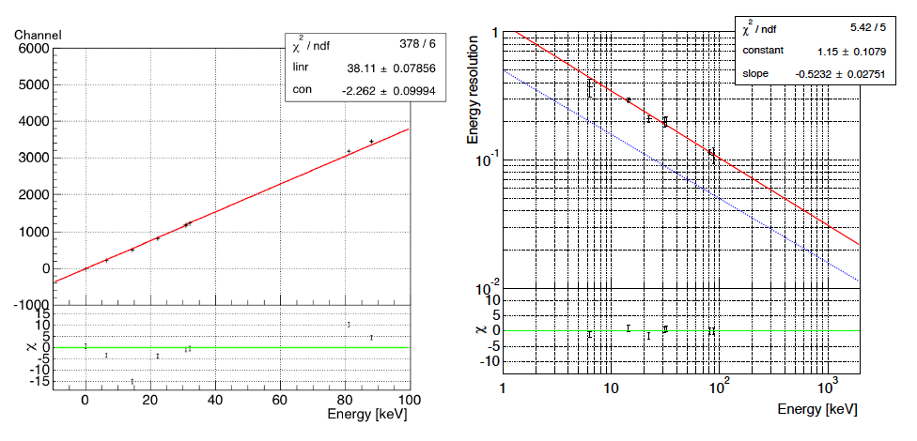
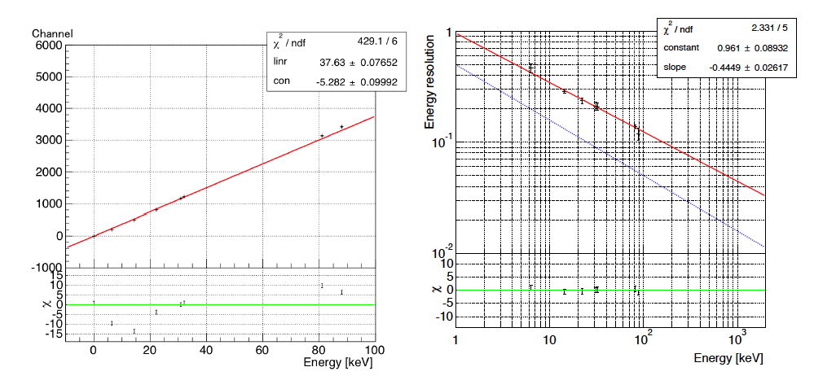
HXM: Linearity and Energy resolution (High gain)
-0.52 ± 0.11
HXM1
-0.44 ± 0.03
HXM2

Slide 10
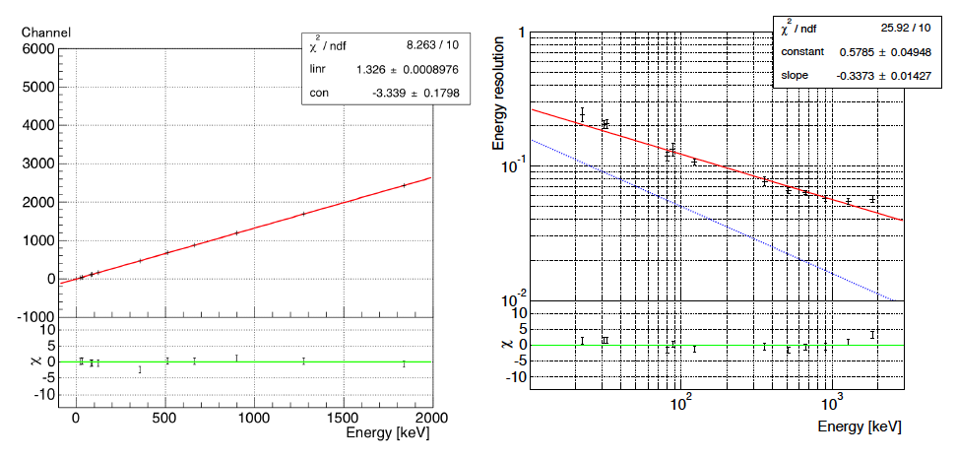
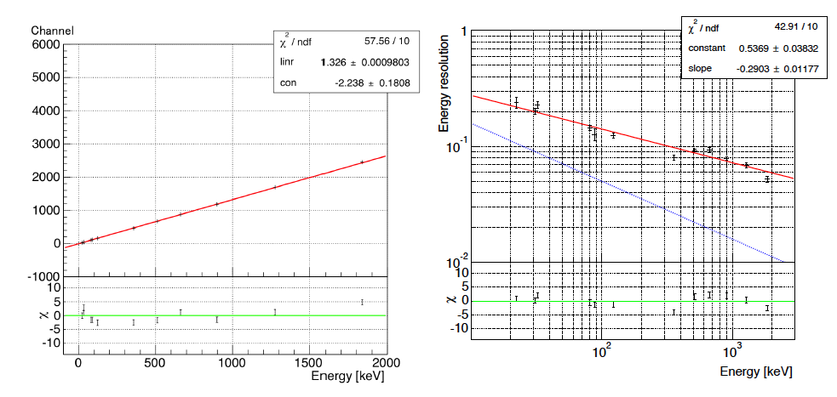
HXM: Linearity and Energy resolution (Low gain)
-0.34 ± 0.01
HXM1
-0.29 ± 0.01
HXM2

Slide 11
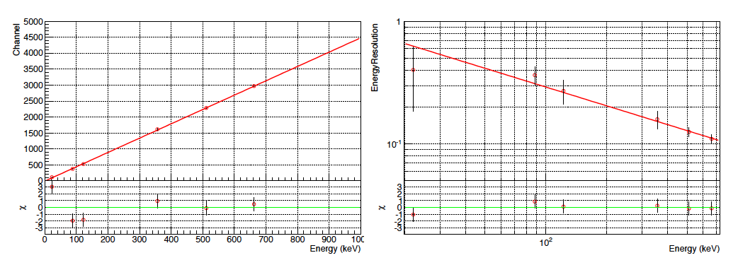
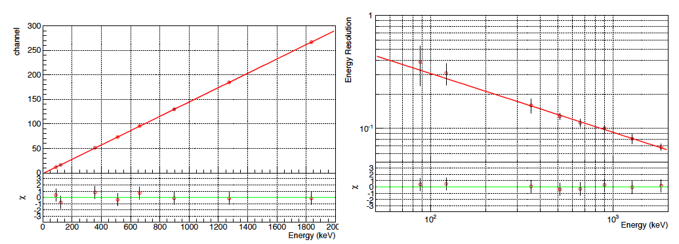
SGM: Linearity and Energy resolution
High gain
0.51 ± 0.07
Low gain
0.52 ± 0.05

Slide 12
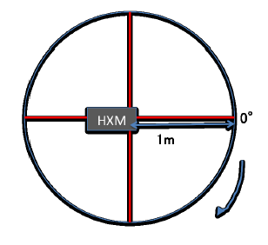
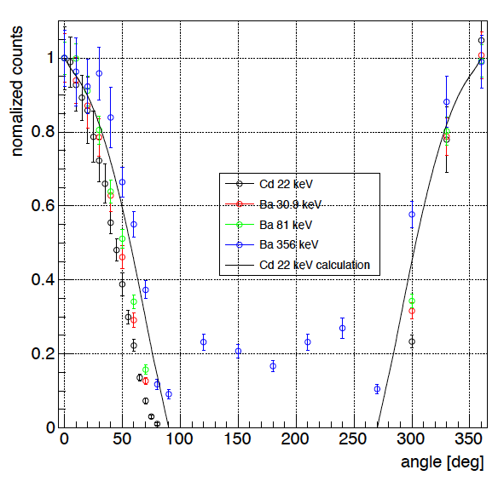
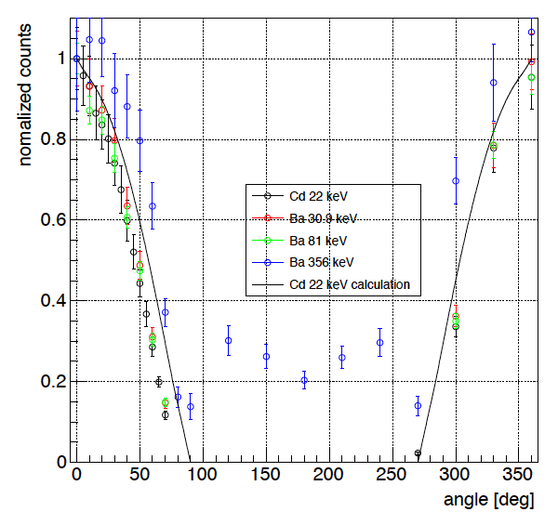
HXM: Angular response
HXM1
HXM2

Slide 13
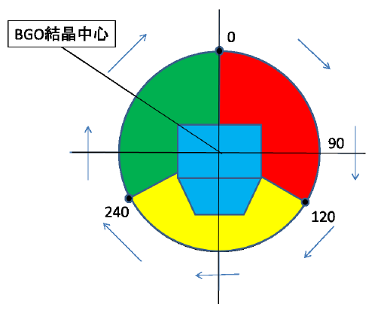
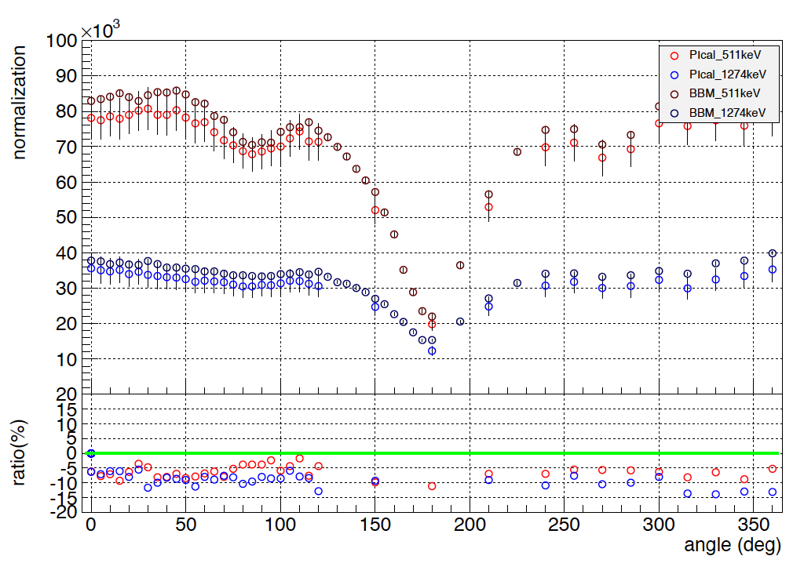
SGM: Angular response

Slide 14
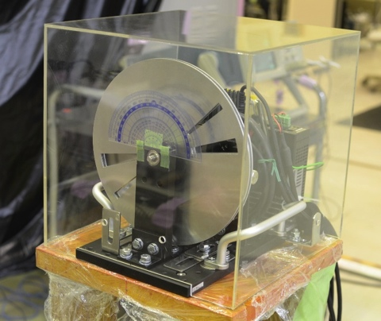
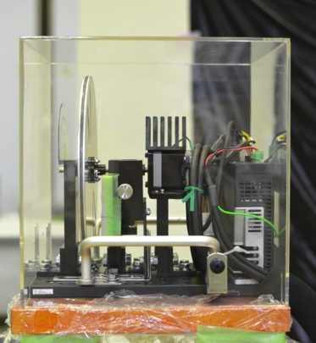
SGM: GRB trigger test
Disk
(Test #1)
7σ
RI
 | Test | Result
Test #1 | High SNR: should trigger | Y
Test #2 | Low SNR: should not trigger | N
Test #3 | Short and high SNR: should trigger | Y
(Test #2)
13σ
(Test #3)
5.5σ
Time since trigger [s]

Slide 15
Possible Explanation of HXM1 issue
HXM1: 6.4 keV Count-rate map
LaBr₃ itself (somehow) becomes an X-ray absorber
  10-25 μm thick LaBr₃ can explain the result.
It is very important to monitor the low energy performance of HXM1.

Slide 16
Summary
Successfully collected a fundamental data to construct the energy response function of CGBM
Low energy efficiency issue for HXM1
Proposing future test plan
Irradiate ⁵⁷Co to HXM1 to investigate whether the low energy performance degrades as a function of time or not
Irradiate ¹⁰⁹Cd and ²²Na at the several positions

Slide 18
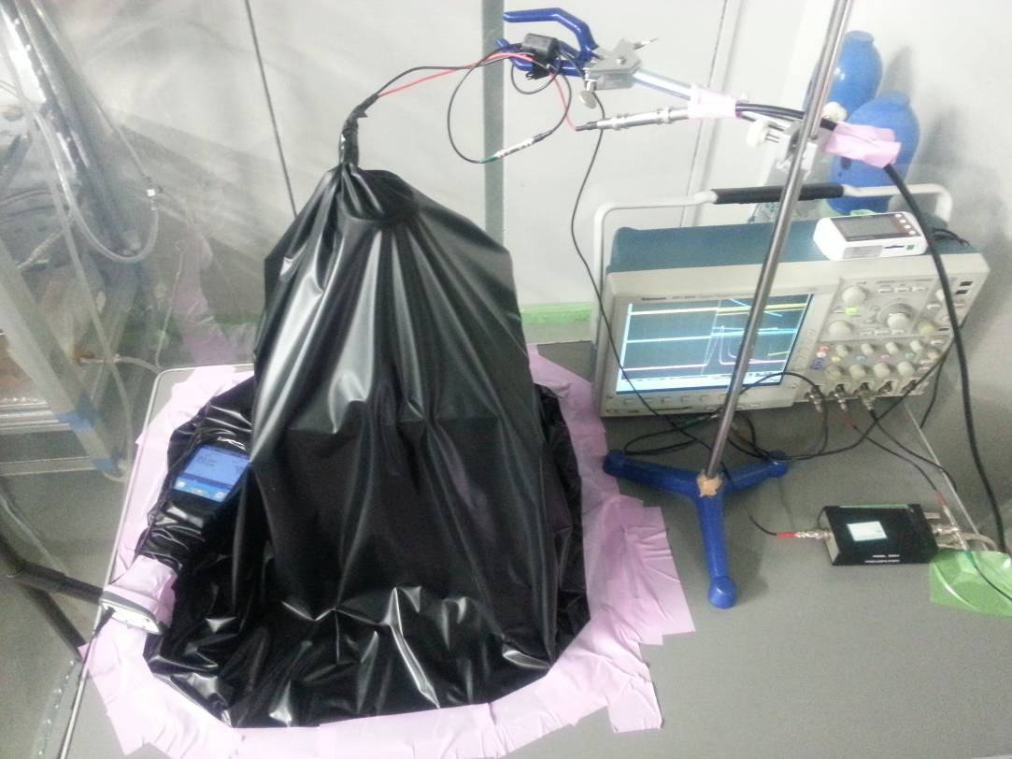
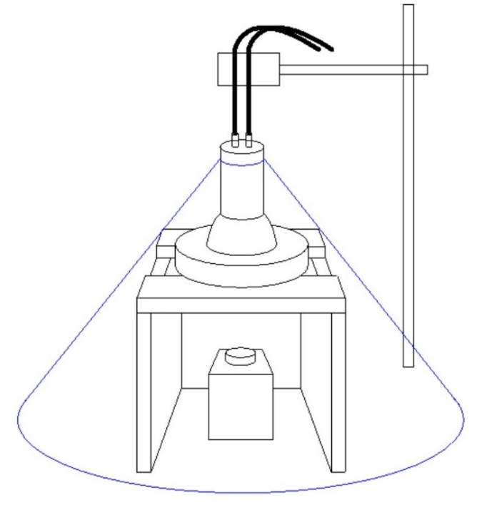
Measurement of Spare HXM (HXM0)
Setup
2-inch PMT
HXM0
⁵⁷Co
Black sheet
Date: April 22-26, 2014

Slide 19
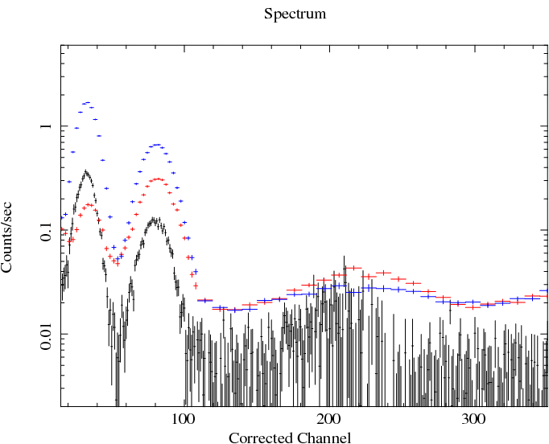
Measurement of Spare HXM (HXM0)
6.4keV
HXM0
HXM1
HXM2
14.4keV
PI Cal
PI Cal
No correction
Absorption by the air
Corrected value
Relative intensity to 122 keV

Slide 20
HXM: 14.9 keV (Y) 2D map
Gain map
Count rate map
Energy resolution map
HXM
1
HXM
2
HXM1: Count rate of HXM1 decreases at Y>0 surface.
HXM2: Donuts shape feature in the gain map (similar to the 6.4 keV map)

Slide 21
HXM: 14.9 keV spectrum
14.9keV
14.9keV
HXM1: 14.9 keV spectrum at X=0
HXM2: 14. 9 keV spectrum at X=0
Red: Y=0, green: Y=-20, blue: Y=-30, light blue: Y=20, pink: Y=30
Strength of 14.9 keV line of HXM1 decrease at off-center points. Overall strength of 14.9 keV line is weaker for HXM1 comparing to that of HXM2.
HXM2 doesn’t show a strong position dependence.

