Slide 1
Software Development Plan in Japan
DH&A Japan Y. Asaoka
141016 CALET TIM @ Waseda Univ.
141016SWDevJC.pptx

Slide 2
Git in WCOC software development
For software development in WCOC, we’re using git from the last TIM following the Nicola’s suggestion at that time.
Now it becomes an indispensable tool for our software development.
  speedy merging capability
  portability of software package in different PCs
We will use git for our software development and if it is OK, we want to use git to distribute software packages.

Slide 3
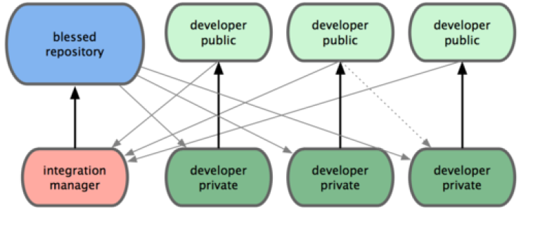
Proposal for Level1 tool development
Example: level1_if
Waseda
Analysis Center
Japanese
Colleague
Italian
Colleague
American
Colleague
WCOC
Ref: Figure 5.2 Integration-manager workflow in ProGit

