Slide 1

CALET Development Status
&
On-orbit Checkout Plan
JAXA CALET Project Team
Oct. 17, 2014

Slide 2



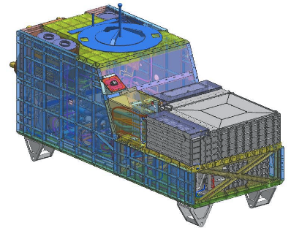

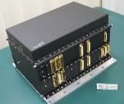
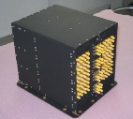
CALET Development Status
All components of CALET were assembled in/on CALET’s structure.
HXM
SGM
ASC
GPSR
MDC
CHD
HV-BOX
IMC
TASC

Slide 3

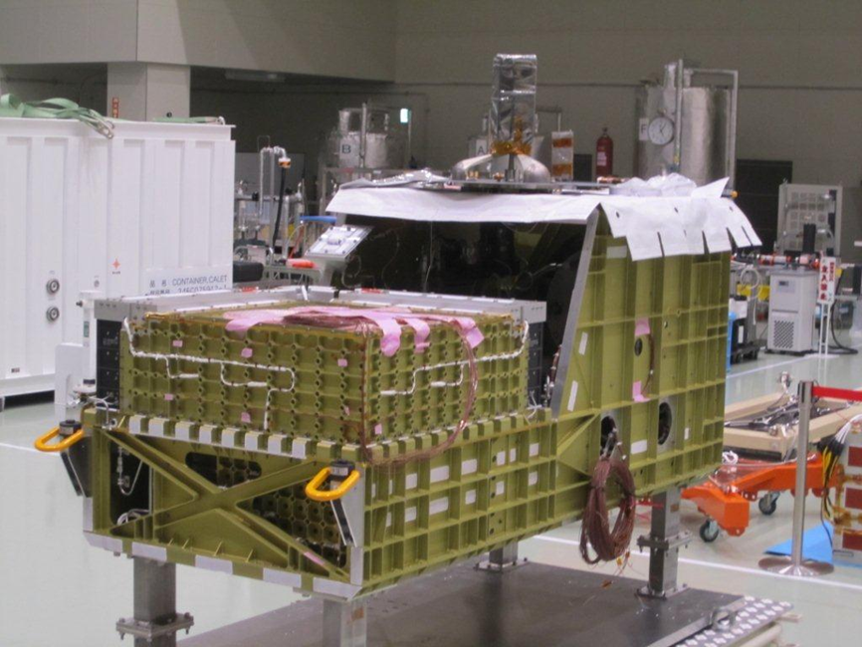
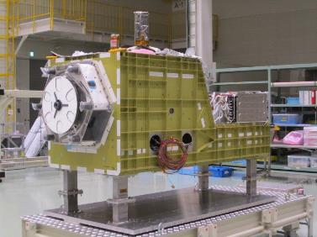
CALET Development Status
CALET system Integration and initial performance test had been completed on Oct. 10, 2014.
CALET PFT will be continued in JAXA/TKSC from Oct. 20 to Feb. , 2015.
CALET will be launched by HTV5, which is now targeted in summer of 2015 (still under coordination w/NASA).
©JAXA/IA
©JAXA/IA

Slide 4
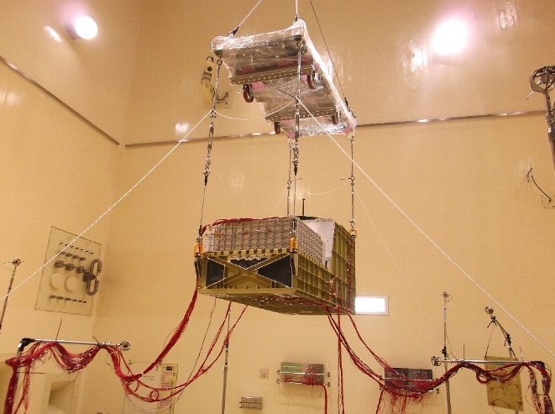
Acoustic Vibration Test
Acoustic Level : 141.3dB (O.A.) @PFT level
Duration : 60sec
©JAXA/IA
Acoustic Vibration Test Room
※Test condition is according to HTV Interface Control Document
(JHX-2010085B).

Slide 5
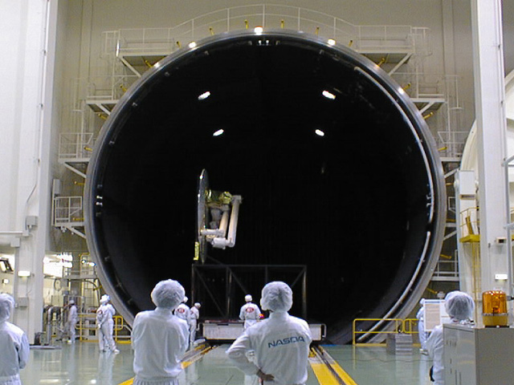
Thermal Vacuum Test
Temperature : -20degC to +50degC
Vacuum Condition : Less than 1x10⁻⁵Torr
φ13m Space Chamber

Slide 6
EMC Test
EMC (Electro-Magnetic Compatibility) Test
To verify:
CALET has enough tolerance against radiation noise & conductive noise.
Noise emitted by CALET is less than Interface Requirement.
Anechoic Chamber
※Test condition is according to ISS standard requirement
(SSP30237, 30238).

Slide 7
Functional Tests
During T/V, EMC and after each environmental test, following functional tests will be performed to check CALET system.
MDC activation
Activation of Mission Sensors (CAL, CGBM) and Support Sensors (GPSR, ASC) and heaters
Experiment data and H&S data from each sensors will be checked.
Muon observation tests with CAL will be performed.
Deactivation of the sensors and MDC
These tests will be also performed after shipment to the launch site.

Slide 8
On Orbit Activation & Checkout Plan
Scheduled to obtain “minimum mission success” observation result in 90days after launch
Constraint for HV activation to wait more than one month for sufficient vacuum condition
Starting routine observation operations 90 days after launch

Slide 9
On Orbit Activation & Checkout Summary (1 of 3)
Activation
Coolant supply from JEM-EF
Power supply from JEM-EF: MDC activated in stand-by mode
Heater activation
MDC C/O
Data communications (low-rate[1553], midium-rate[ethernet], FTP)
Macro file command
Scheduled(Time-tagged) command
GPSR C/O
GPS time
“Cold start” (GPS satellite acquisition with no almanac data)
ASC C/O
Attitude determination
Raw Image & Jpeg Image acquisition
Observation mode transition
LD function
noise & offset measurement
test pulse
CHD-FEC C/O
IMC-FEC C/O
non-HV checkouts
[ditto]
TASC-FEC C/O
[ditto]

Slide 10
On Orbit Activation & Checkout Summary (2 of 3)
Observation/Diagnostics modes transitions
LD function
noise & offset measurement
test pulse
TH/PH data
Pseudo GRB & event data
GBM E-BOX
C/O
CIRC* C/O
[*Infrared earth observation camera; piggy back payload]
non-HV(or very low HV)
checkouts
“HOT”part/”COLD”part activation
All LR_PMTs set upto 30V
All APD_DCDCs on with no HV
HV-BOX C/O
CAL event trigger trial
HV protection to regional high density radiations
HV protection to extreme count rate
ASC imaging in GRB event
SYSTEM C/O
HV application
HV protection to regional high dencity radiations
noise & offset measurement
test pulse
GRB trigger & event data
CGBM C/O
HV checkouts

Slide 11
On Orbit Activation & Checkout Summary (3 of 3)
HV application
noise & offset measurement
test pulse
LD function & trigger & event data
PMT(MaPMT/PD/APD) signal measurement
zero surpression on event data
CHD C/O
IMC C/O
[ditto]
TASC C/O
[ditto]
HV application on all CHD/IMC/TASC
noise & offset measurement
event data filtering for single event
Single event obaservation trial
HV protection to extreme count rate
HV checkouts
CAL C/O
All H/W activated & configured
CAL single event obaservation trial
CGBM TH/PH data
CGBM GRB trigger
CALET ALL LOAD C/O
72hrs(TBD)
run
“nominal” H/W & S/W configuration for observation
Starting CAL calibration for “minimum mission success”
calibration& observation trial
CAL calibration & observation for “minimum mission success”
CGBM calibration & observation trial to establish routine process

