Slide 1
Injection protection commissioning
Changes for 2015 startup
W. Bartmann, M.J. Barnes, C. Bracco, E. Carlier, L. Drosdal, M. Fraser, B. Goddard, M. Meddahi, V. Kain, J. Uythoven, F.M. Velotti, N. Voumard, J. Wenninger
MPP, 24th October 2014

Slide 2
Outline
Existing test list
Changes
  TCDI validation - Transfer line loss maps
  TCDI gap control – Virtual β*
  MKI vacuum
  TDI validation
  BETS interlocks TDI/MSI/TCDQ

Slide 3
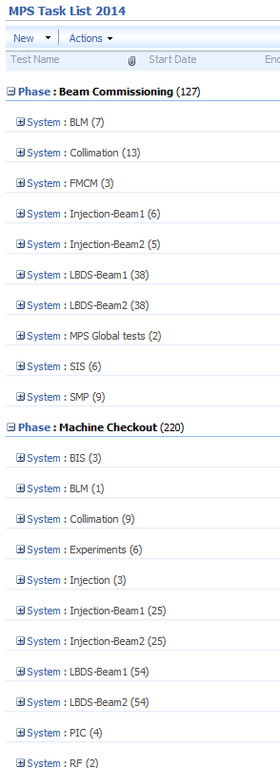
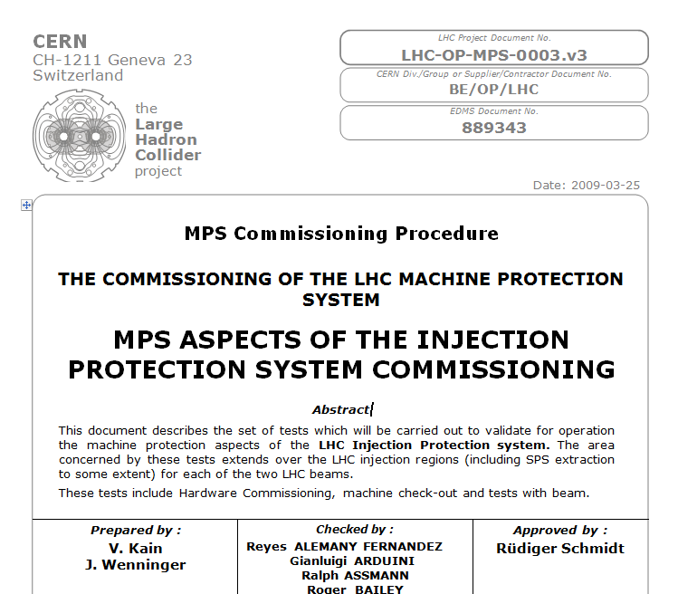
Existing test list

Slide 4
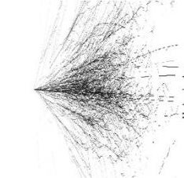
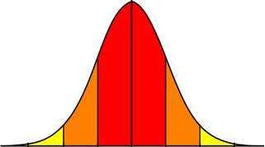
TCDI Alignment Procedure
BLM
4.5σ
BLM
4.5σ
Reference trajectory
4.5σ
4.5σ
Set up TCDI jaws at ± 4.5σ around reference trajectory
Pilot beam (5E9 ➔ 1E10) in Inject&Dump
Move one TCDI jaw, keeping gap fixed, into the beam with 0.5σ steps ➔ beam ➔ BLM losses ➔ next step
Repeat with other jaw
Beam Centre = -0.243σ

Slide 5
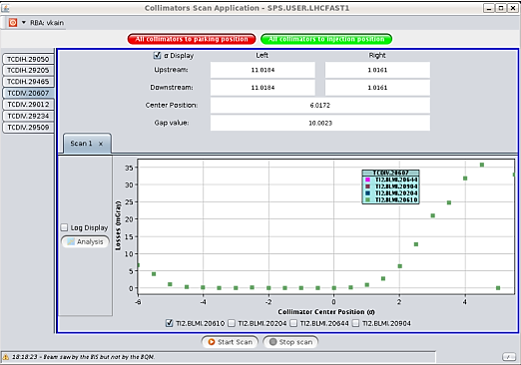
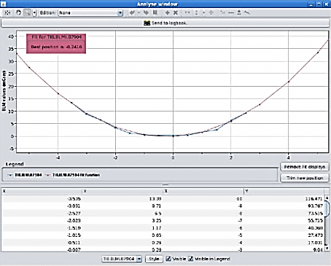
TCDI Alignment Procedure
Automatic JAVA-tool:
Send command to move collimator jaws
Check beam extraction from SPS into TL
Record BLM signal
If no beam extracted ➔ wait for next shot before moving collimator
Perform the data analysis: beam centre!
Possible sending beam centre position to LHC “TRIM” application (operational settings)
Y. Le Borgne

Slide 6
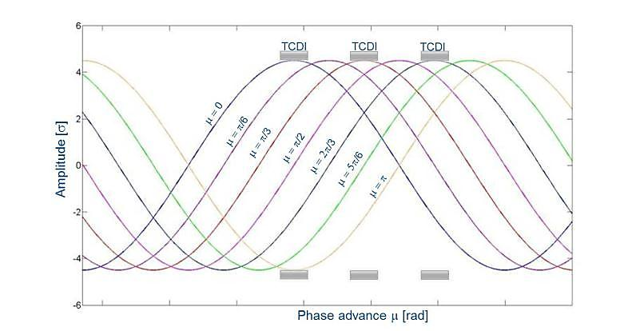
TCDI Setup Validation
All collimators at 4.5σ (σ calculated for nominal emittance and β function)
Knob: oscillations with varying phase and amplitude (using correctors in TL)
  Phase from 0 ➔ 2π
  Amplitude from 4σ ➔ 5σ (0.5σ step)
  Repeat in H and V plane

Slide 7
TCDI Setup Validation
Calibration procedure:
Measure emittance ε_{r} and Δp/p in SPS
Define σ_{r} using ε_{r} and taking into account the dispersion
TCDI Collimator set @ 1σ (other TCDIs open) ➔ convert into nσ_{r} ➔ nσ_{r} = xx% beam intercepted (from theory for a perfect Gaussian distribution)
Extract beam on TCDI ➔ K = BLM signal normalised wrt beam intensity (FBCT) ➔ reference value K for xx% intercepted beam
Calibration
TCDI
BLM
1σ_{r}
1σ

Slide 8
TCDI Setup Validation
Calibration
Calibration procedure:
Measure emittance ε_{r} and Δp/p in SPS
Define σ_{r} using ε_{r} and taking into account the dispersion
TCDI Collimator set @ 1σ (other TCDIs open) ➔ convert into nσ_{r} ➔ nσ_{r} = xx% beam intercepted (from theory for a perfect Gaussian distribution)
Extract beam on TCDI ➔ K = BLM signal normalised wrt beam intensity (FBCT) ➔ reference value K for xx% intercepted beam
Validation:
All TCDIs at 4.5σ
Oscillations with increasing amplitude ➔ BLM signal normalised wrt beam intensity ➔ xx% intercepted beam (normalising wrt K) ➔ nσ_{r} (from theory for perfect Gaussian)
TCDI
BLM
1σ_{r}
1σ
Validation
TCDI
BLM
4.5σ
4.5σ_{r}

Slide 9
TCDI Setup Validation
Real Measurement

Slide 10
TCDI Setup Validation
Real Measurement
Limits:
Still nominal β and dispersion (very close to nominal)
Perfect Gaussian beam
Post LS1 operation: use reference loss maps for validation!

Slide 11
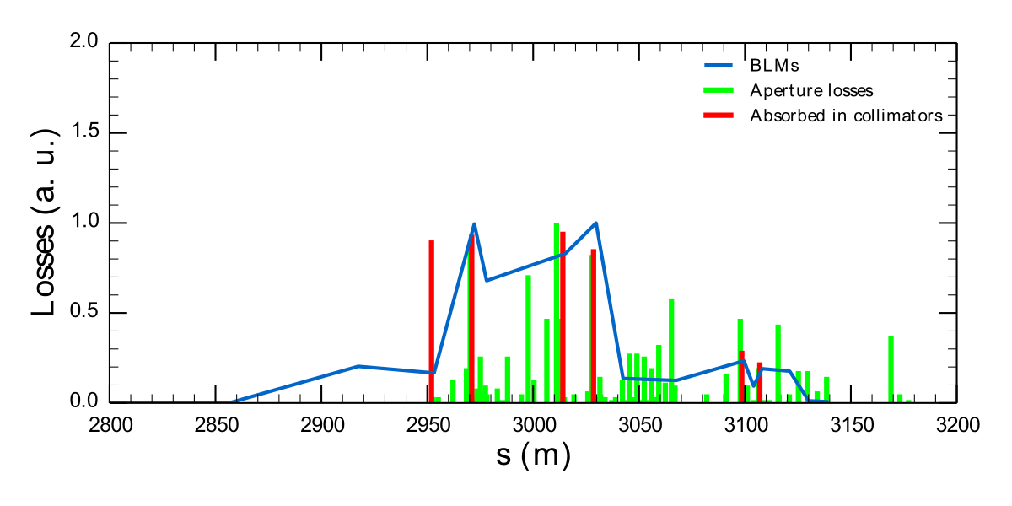
Additional new TCDI validation
Calculate loss maps with Francesco’s pyCollimate code for each phase and compare expected/measured losses

Slide 12
TCDI gap control (virtual β*)
Automatic check of TCDI gaps vs optics in TL
For each optics
  Store all quad currents as critical settings in LSA
  Associate unique β*
SIS compares for every cycle reference settings and published currents
If current settings in tolerance publish virtual β* which is checked on TCDI side if in limit
Needs about half a day of implementation for database and code
Can be checked without beam during checkout
  Play wrong cycle
  Set wrong TCDI gap
  Set wrong quadrupole current

Slide 13
MKI
Vacuum interlock level
  Within Vacuum controls for reasons of noise on the analog value
  Vacuum controls sends digital value to MKI for interlocking
  Envisage a ‘sign off’ procedure of the pressure level to be interlocked on

Slide 14
TDI validation
Measure attenuation
  Record losses ds TDI for different impact parameters
  Focus on most likely MKI failure of 10% miskick
  Establish reference attenuation map
    to be compared to after full beam impact
    to be compared to in case of heating issues
Compare to simulated loss maps (Francesco’s pyCollimate results)
  Also for TCLI
Verify TCP-TDI hierarchy (X-measurement)
  Angle validation

Slide 15
TDI monitoring
To be checked continuously during the run
  TDI Position drifts
  TDI Temperature drifts

Slide 16
Beam Energy Tracking System
BETS already existed during Run I on beam dumping system
  Main Bends, 4 sectors
  MKD, MKB and MSD (dump and dilution kickers, dump septum)
  Q4 quadrupole L/R 6
Run II: add similar system on
  MSI (injection septum)
    RMSI power converter has become an LHC type pc → ramp down
    These functions need to be defined as well together with OP, including degauss cycle to be applied
  TDI (Injection absorber)
  TCDQ (dump absorber)
See also MPP meeting 19/7/2013:
http://lhc-mpwg.web.cern.ch/lhc-mpwg/MPP-Meetings/No79-19-07-2013/NVoumard_BETS%20on%20MSI%20TDI%20and%20TCDQ_v2.pptx

Slide 17
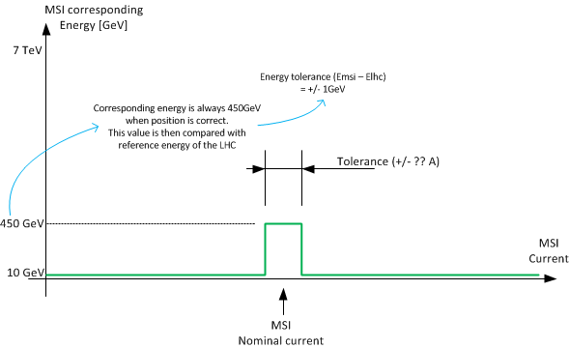
BETS transfer function for MSI
  Change of transfer function to be done locally in the tunnel
  Transfer function to be checked by MCS
  Arming sequence for BETS on MSI not needed (standalone)

Slide 18
BETS on MSI
Description
  Works on absolute current
  Maskable interlock, connected to injection BIC
  Proposed tolerance 7 μrad ≈ 1 sigma oscillation = 5e-4 tolerance on the MSI current
Proposed procedure / actions:
  Preparation:
    Contact EPC and ask for current stability measurements (Hugues Thiesen)
    Set BETS transfer function to +/- 5e-4 relative error (Nicolas Voumard)
    Check we have rights to move the MSI current outside the above window
      MCS rights & trim rights
  Test:
    Close Injection BIS loop with MSI at nominal current. Move current of MSI outside tolerance window both ways and check each time the BETS stops injection permit
    Change BETSIM to 452 GeV and check injection BETS stops injection permit
    Check if MCS reference not correct, cannot arm injection BIS

Slide 19
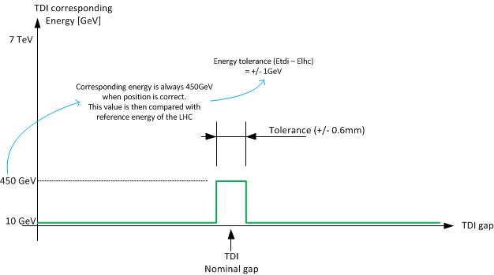
BETS transfer function for TDI
  Change of transfer function to be done locally in the tunnel
  Transfer function to be checked by MCS
  Arming sequence for BETS on TDI not needed (standalone)

Slide 20
BETS on TDI
Description
  Works on gap between the two jaws
    To start with LVDT, 2016 on interferometry if all goes well
  Maskable interlock, connected to injection BIC
  Proposed tolerance ±1 sigma, about ± 0.6 mm
Proposed procedure / actions:
  Preparation:
    Check stability of LVDT / interferometry gap measurement
    Set new BETS interlock window +/- 0.6 mm (Nicolas Voumard)
    Check energy limit used (+/- 1 GeV)
    Check we have rights to move the TDI (collimator role & MCS for BETS)
  Test:
    Close Injection BIS loop with TDI at nominal position. Move current TDI position outside tolerance window by moving first one jaw and then repeat with other jaw, check each time the BETS stops injection permit
    Set BETSIM to 452 GeV and check one cannot inject
    Check if MCS reference not correct, cannot arm injection BIS

Slide 21
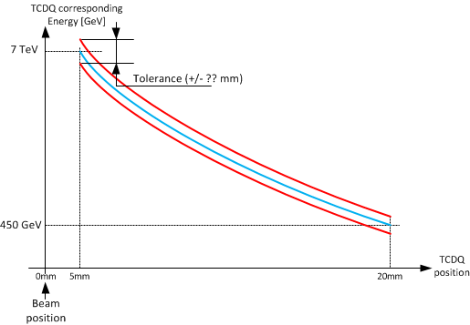
TCDQ transfer function
  Change of transfer function to be done locally in the tunnel
  Transfer function to be placed in MCS
  BETS on TCDQ needed during the arming sequence of the LBDS

Slide 22
BETS on TCDQ
Description
  Works on absolute position of upstream and downstream side of jaw
  Maskable interlock to BIS in point 6
  Proposed tolerance ±1 sigma, about ± 0.XXX mm → to be determined
Proposed procedure / actions:
  Preparation:
    Check stability position readings up and downstream
    Set new BETS interlock function +/- 0.XXX mm around ‘random’ reference function for up and downstream position (Nicolas Voumard)
    Check we have rights to move the TCDQ (collimator role & MCS for BETS)
  Test:
    At injection energy move TCDQ upstream outside tolerance window and check that interlock is generated. Repeat for downstream part of jaw.
    Repeat for both jaws at 6.5 TeV beam energy (real or BETSIM)
    Modify TCDQ ramp function so that requested position of one jaw is 2 x tolerance at 3 TeV, perform energy ramp (with nominal machine if available or with BETSIM) and check interlock is generated.
    Check if MCS reference not correct, cannot close BIS

Slide 23
Summary
Quite some modified or new HW (Realignment, MKI, TDI, BETS)
  Existing tests remain essential
Additional tests
  TCDI alignment automatised
  TCDI/TDI protection validation by loss maps – transparent in beam time
  TDI attenuation, hierarchy – extra beam time for X measurement required
  TCDI gap control – without beam
  MKI vacuum interlock level – sign off
  BETS tests for MSI, TDI, TCDQ – without beam

