Slide 1
Highlights/challenges of
Public Talks
D. Barney et al

Slide 2
Public talks are to interest the audience, not for you to show how much you know
Know your audience & tailor the talk accordingly
  Rehearse the talk with representatives of THAT audience
What is interesting to us, as physicists, is not necessarily interesting to the audience
Plan the main messages carefully
Don’t over-complicate things for the sake of “completeness”
Simple slides – or none at all!
These guidelines are exactly the same
as giving a talk at a conference!

Slide 3
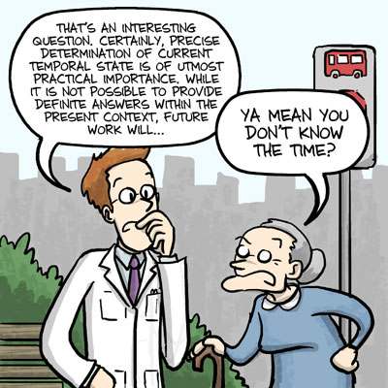

Slide 4
If your aim is to teach, make it as interactive as possible
Powerpoint presentations do not facilitate interaction
Chalk-boards or white-boards are still excellent tools (if the audience is small enough)
Real objects are very powerful e.g. detector pieces
  YOU are one of the interesting objects!

Slide 5
I recently gave a talk about particle detectors without a computer
High school students determined (nearly) everything
  Particles to detect
  What we want to know about them
  How we determine these things
  How particles interact with materials
  Ordering of the detector layers
Only “props” were some detector pieces
Very good feedback from the students & teachers

Slide 6
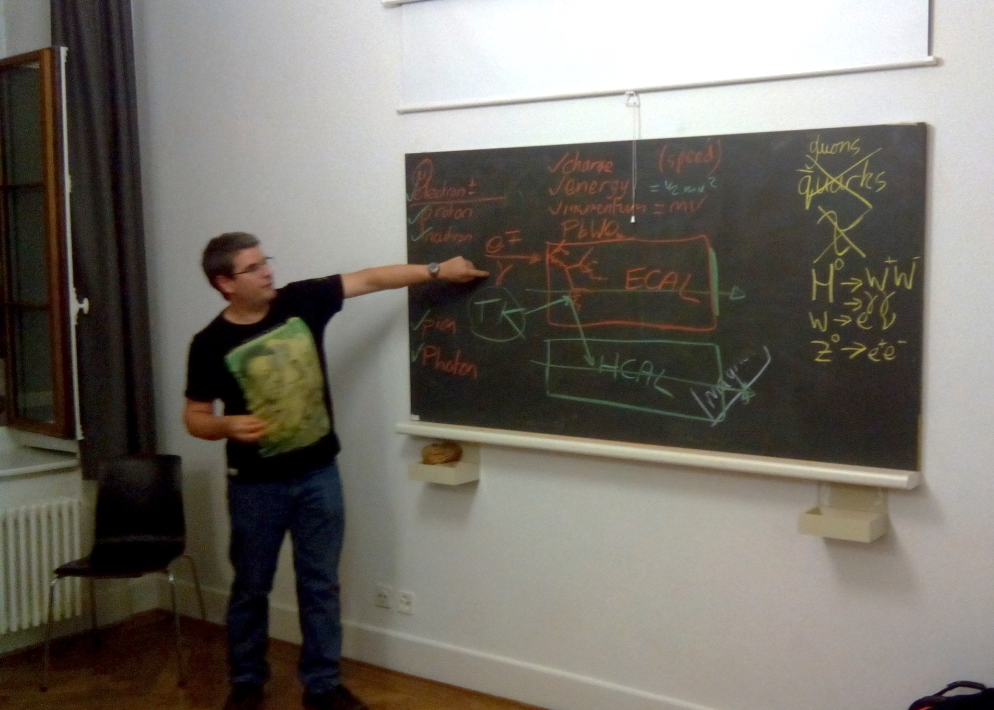

Slide 7
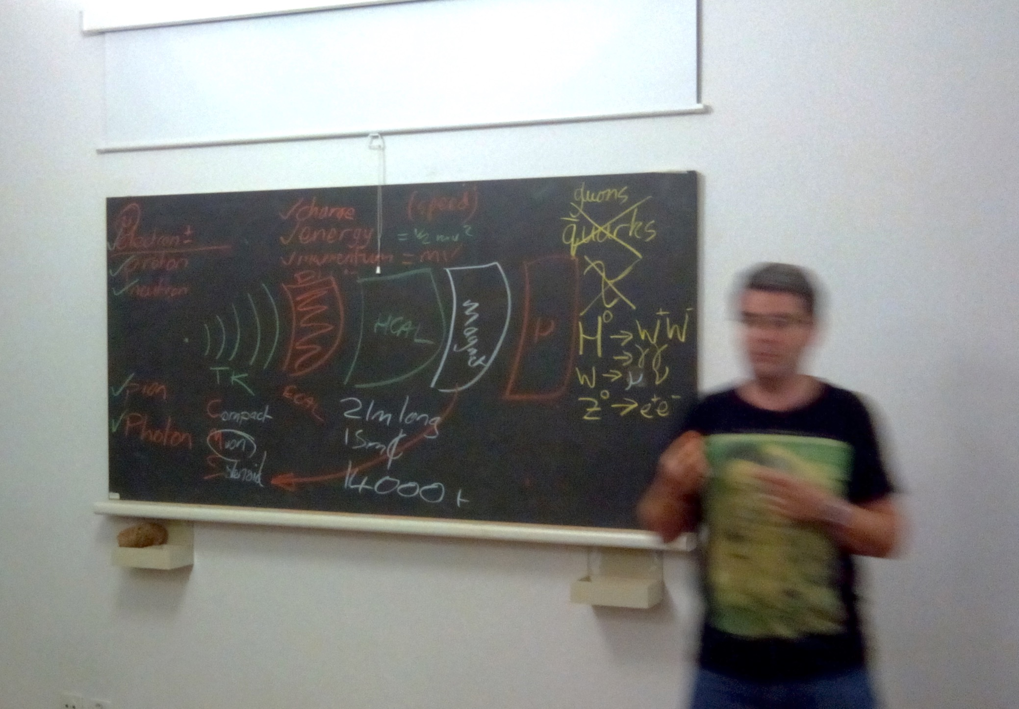

Slide 8

There are a variety of resources for communicators
http://www.principiae.be/X0800.php
Excellent web-site and book on communication for scientists
Includes section on communicating to non-scientists
Jean-Luc recently gave a 2-hour seminar for CMS in the full main auditorium

