Slide 1

Beam Line for Schools
A tiny bit of history:
Initiated in the CERN-60 context
Open to teams of high school students from any country
November 2013: Announcement of the first competition
  Advertised via CERN social media and IPPOG/EPPCN
  IPOG/EPPCN also helped to find national contact persons
  → 2014 feedback (292 teams) shows that there is not one dominating channel for advertising the competition
  → Obviously it is crucial to reach the teachers and to have their support
31 January 2014: 455 teams registered
31 March 2014: 292 teams (65%) proposed an experiment and uploaded a video
April - June 2014:
  Evaluation teams of 3 experts reduced the number of proposals to ~50
  BL4S organizers reduced the number further to 16
  Members of the SPSC and the BL4S team nominated 2 winners
  7 – 17 September: Winning teams executed their experiments at CERN
http://beamline-for-schools.web.cern.ch/

Slide 2
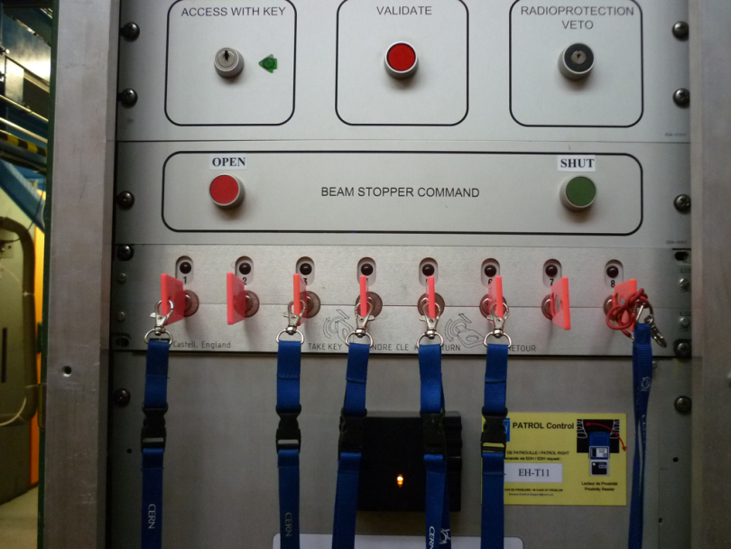
Beam Line for Schools
Some figures:
Number of students that actively participated: More then 3000
Number of people required to organize the event:
  Full time: 2
  Part time: ~15
  Sporadic help (e.g. evaluation of proposals): ~50
Budget: CHF 150.000
Sponsors: Danfysik and National Instruments (need more…)

Slide 3
Beam Line for Schools
Feedback from participants (team coaches):
great learning opportunity - Canada
I can ensure you that, although we did not win anything, we all have enjoyed this competition very much. We look forward to participating in next year's competition! - Portugal
We all had a lot of fun and emotions and learn many new facts in science but also in communication skills and sharing - Italy
It has been a pleasure being part of this incredible experience - Spain
We really enjoyed this experience of working in a team for the sake of learning Particle Physics - Qatar

Slide 4
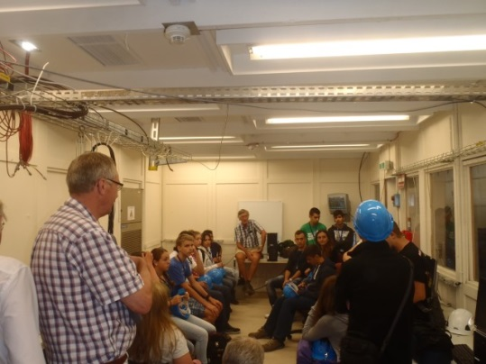
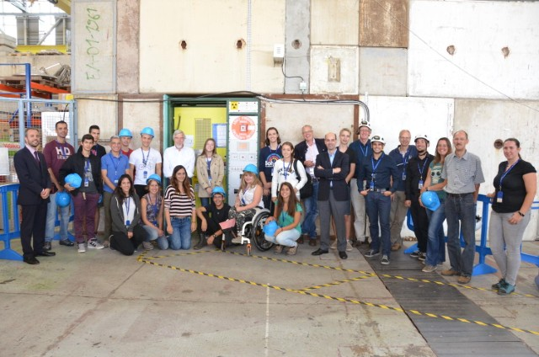
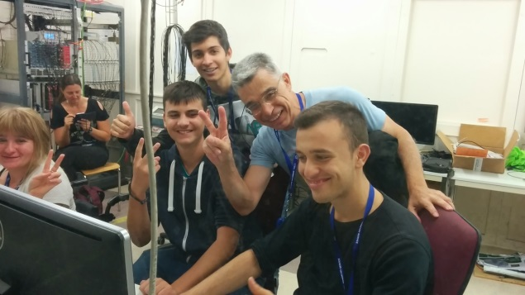
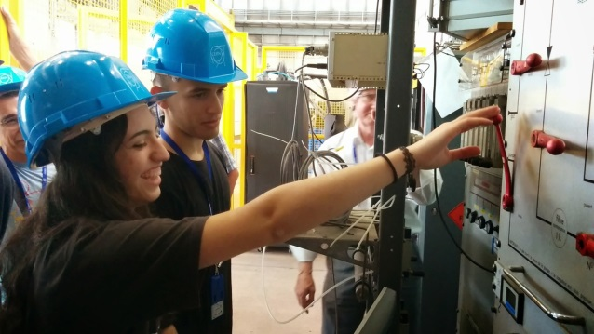
Beam Line for Schools
Execution of the experiments (7.-17.9.2014):
The proposals of the winning team were complementary
Students enjoyed to work in mixed team
Members of both teams were able to communicate well in English
Proposals for 2015:
Require proposals to be formulated in English (i.e. remove French)
Require winners to have a minimum level of English skills

Slide 5
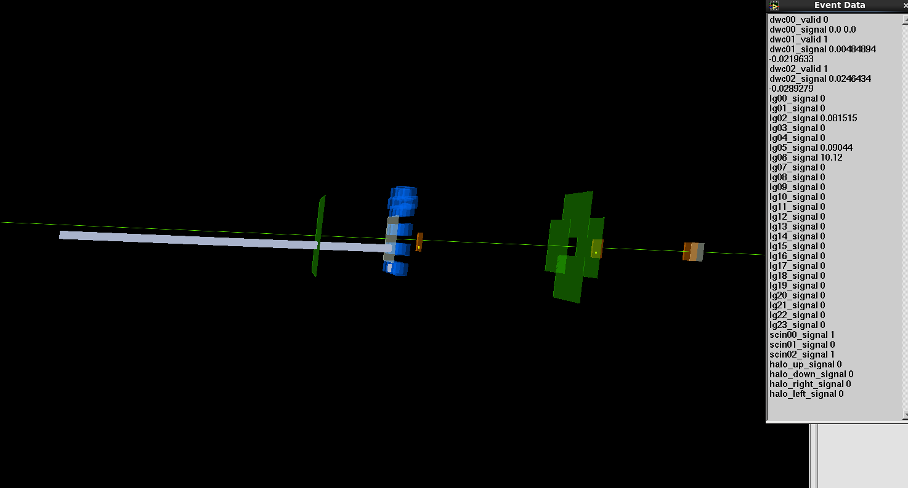
Beam Line for Schools
2014 follow up:
Winning teams were asked to write a paper about the results of their experiment
Experimental data will be made available to all 292 participating teams
  LabView based event viewer (free LabView license provided by NI)
  Allows students to:
    Analyse documented events
    Discuss undocumented events
    Understand the detectors and beam properties
  Data will also be made accessible to 2015 candidate teams
From the 2014 announcement: The groups will receive priority should they wish to (…) take part in a particle physics masterclass

Slide 6
Beam Line for Schools
The 2015 competition:
CERN management fully supports a BL4S competition in 2015
Announcement to be made on 17 November via CERN official and other channels
Deadline for registration of the teams: 31 January 2015
Deadline for submission of proposals and videos: 31 March 2015
Selection of the winner(s): 31 May 2015
Execution of the experiment: August – October 2015

Slide 7
Beam Line for Schools
Potential IPPOG involvement in 2015:
Making publicity for the competition: 17.Nov.14 – 31.Jan.15
Assisting the teams with their proposals: Feb-Mar. 2015
  One or several contact persons(not necessarily IPPOG members) per nation
  How to cover nations without IPPOG representative?
Participation in the selection committees
Identification of potential sponsors
Open issues:
Ask team coaches at time of first registration to agree to be contacted by national representative
  Was not done in 2014
Disclose selection results to IPPOG/EPPCN
Special price for developing countries?

