Slide 1







Activities and challenges in IPPOG member countries

Slide 3


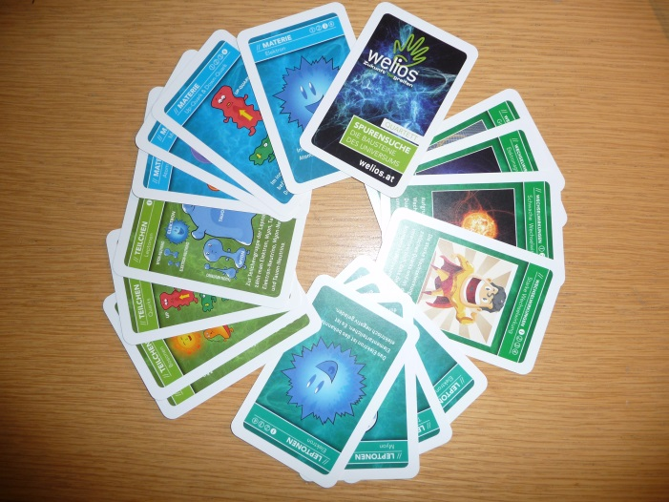
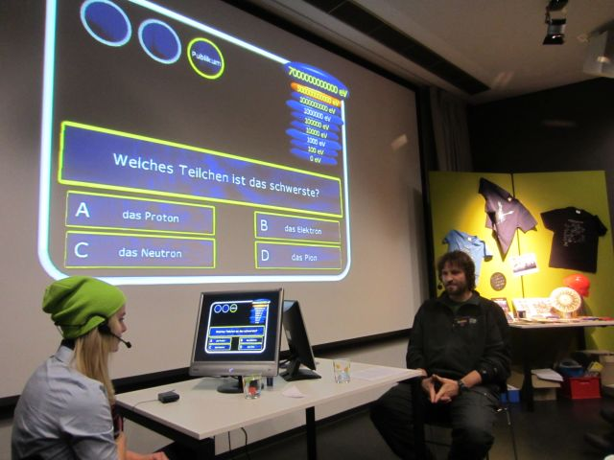
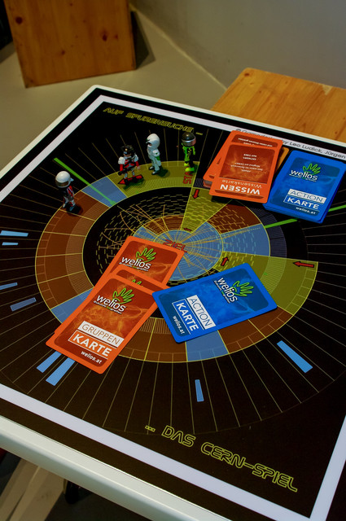
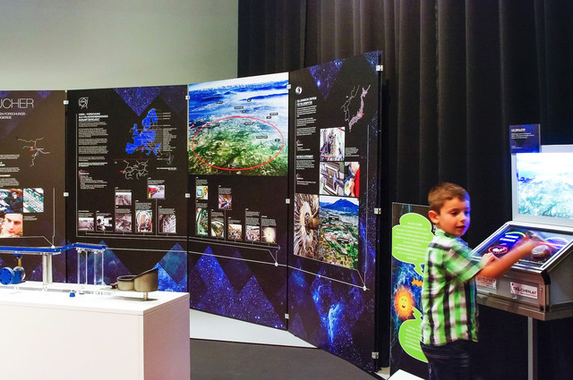
Welios Exhibition in Austria
Science Center Welios (Wels)
Special Exhibition “Tracking the elements of the universe”
11th Sept. 2014 – 1st March 2015
Cooperation of Welios, Institute of High Energy Physics (HEPHY), CERN & Weltmaschine.de (exhibits)
New exhibits layout
Masterclasses and Laurenz 7 Billionen Electron volt Quiz Show (Dez. 2014)
Teacher designed a particle physics card game and a board game ® Mag. Leo Ludick
8th Nov. 2014
  www.welios.at
Natascha

Slide 4
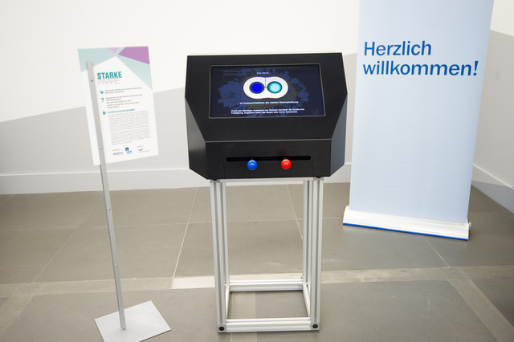
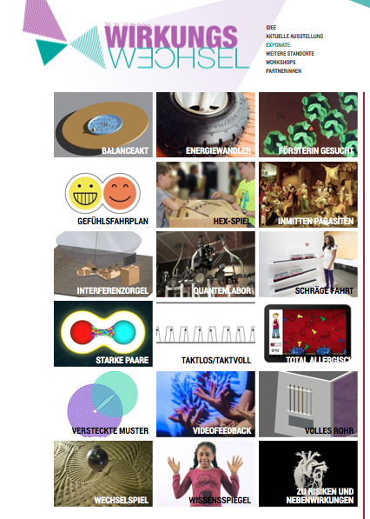
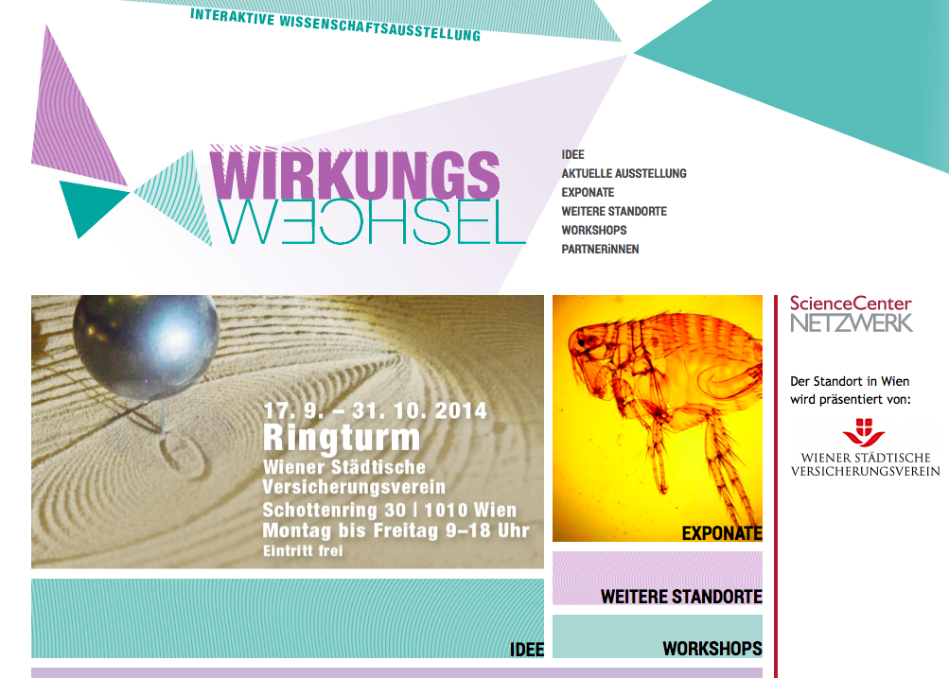
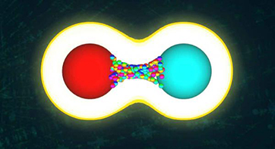
Exhibition Wirkungswechsel
Effects-exchange in Austria
Ringturm (Vienna)
ScienceCenter Netzwerk
17th Sep.-31st Oct.2014
Wirkungswechsel – Wechselwirkung,
Effects-exchange – Interactions
Traveling exhibition, hands-on exhibits, 20 stations of different research fields, 4000 visitors
Exhibit “Strong pairs”, HEPHY institute, FWF project (research funding)
  www.wirkungswechsel.at/exponate, www.science-center-net.at

Slide 5

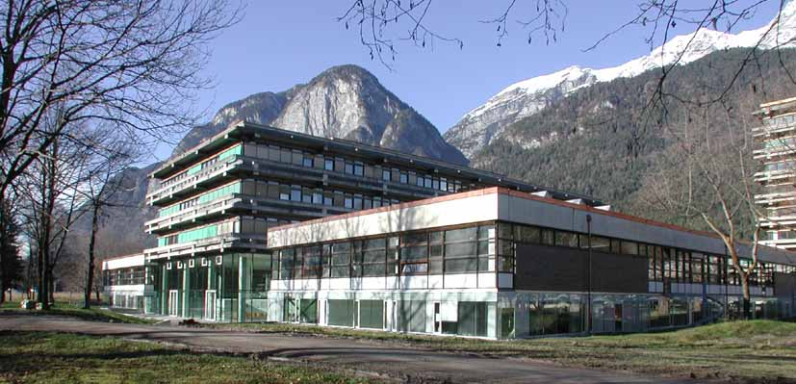
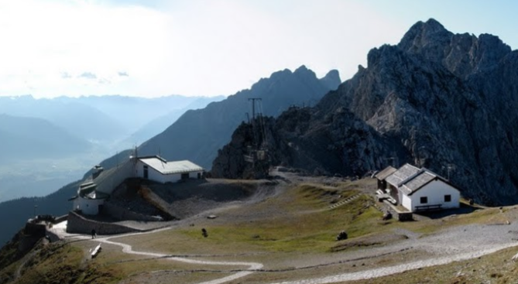
Events in Austria
Vienna
Movie „Particle Fever“, 27th Nov. 2014, „Cine Center” cinema, with Martin Aleksa as star guest
Innsbruck
School classes at university (ATLAS lectures, cloud diffusion chamber)
CERN excursion (33 students)
Guided tour to Victor-Franz-Hess laboratory (cosmic rays) on Hafelekar (33 persons)
Planned lecture “Discovery of the Higgs particle” (50 students)
  particlefever.com

Slide 6
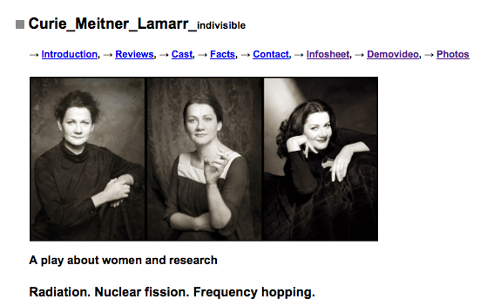
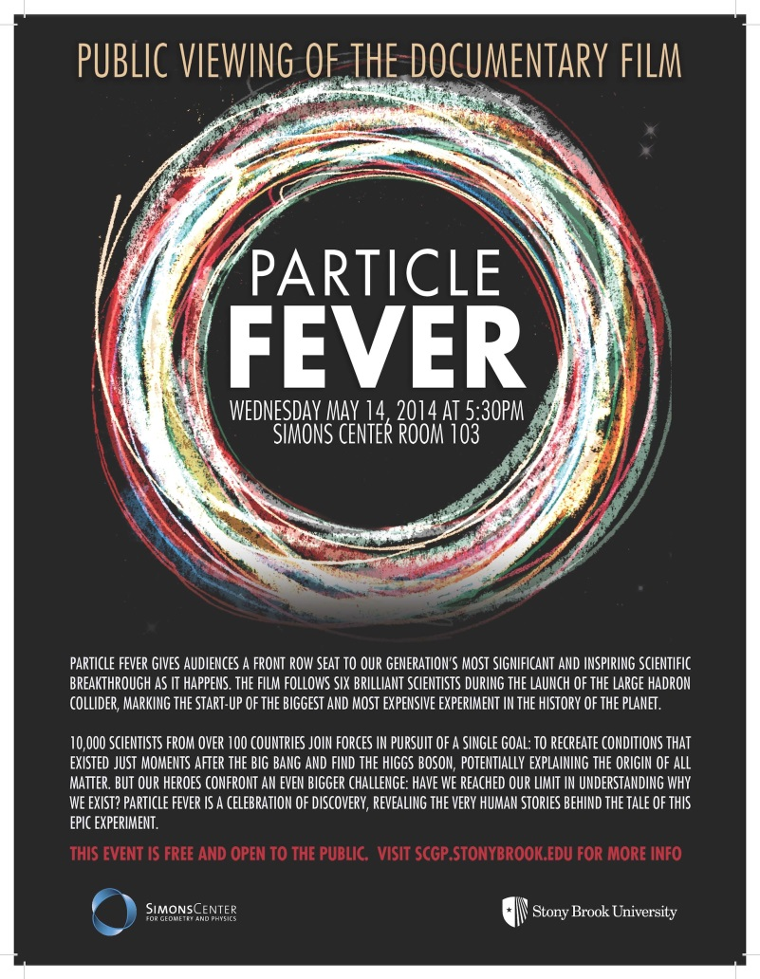
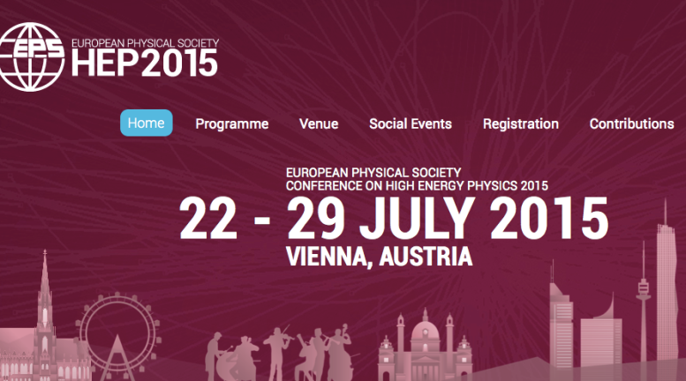
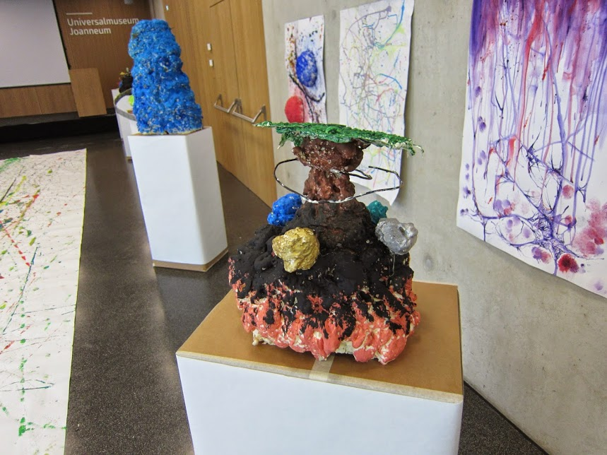
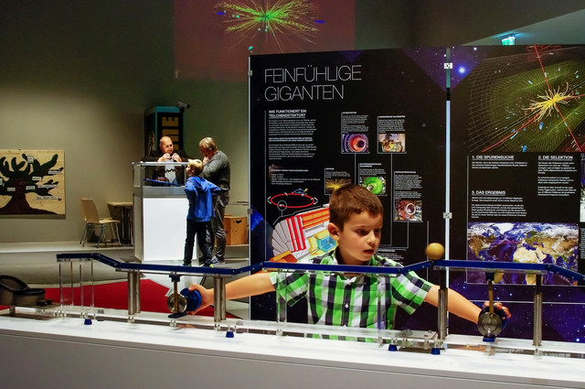
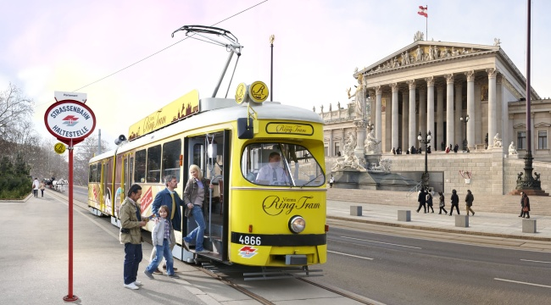
EPS-HEP 2015 Conference in Vienna
University of Vienna
22nd-29th July 2015
Outreach events
Outreach and eduction session
Summer cinema „Particle Fever“, Old AKH (uni campus)
Particle physics exhibition, Hall of Science, Austrian Academy of Science
Ring lectures – ring tramway (planned)
Art & Science together with the University of Applied Arts Vienna (planned)
Portrait theater “Curie Meitner Lamarr indivisible” www.portraittheater.net
  eps-hep2015.eu

Slide 8
(PP) Outreach in Belgium
Dirk Ryckbosch

Slide 9
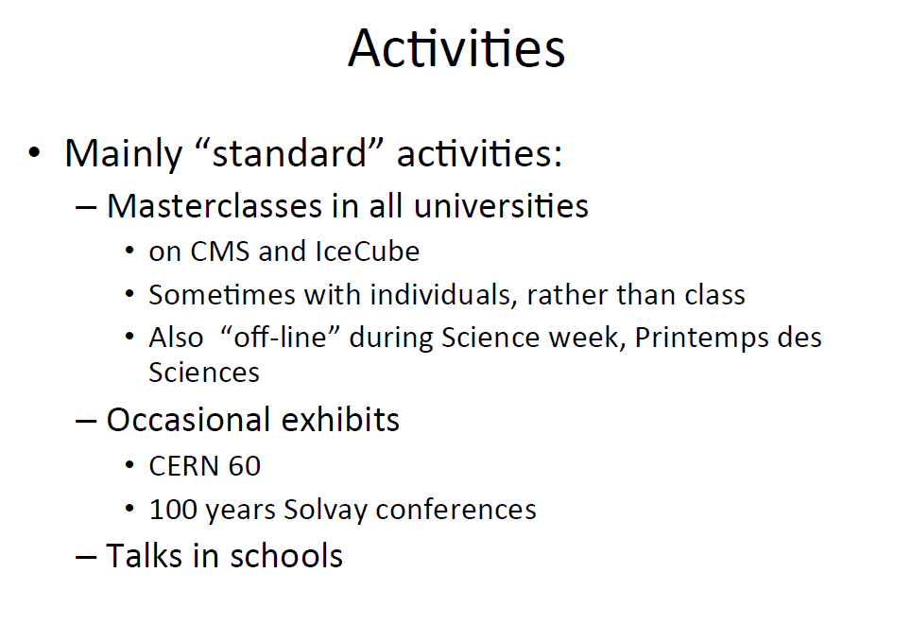

Slide 10
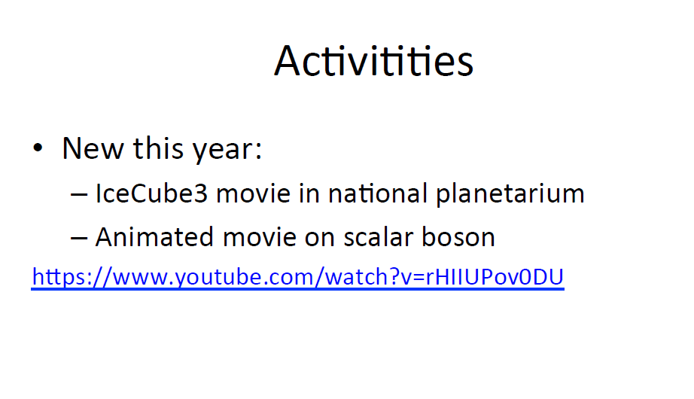

Slide 11
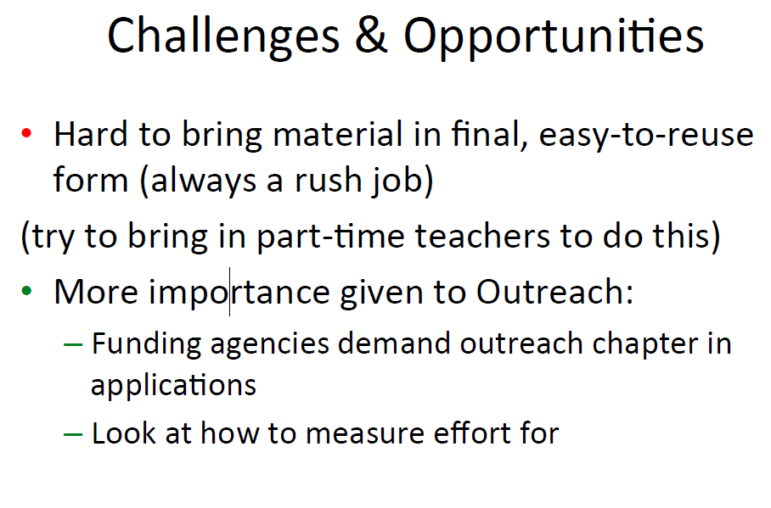

Slide 13

Activities and challenges in IPPOG member countries
How we celebrated
Jiří Rameš, Prague, IPPOG Meeting at CERN, November 7 2014

Slide 14
The main public events connected with the 60th anniversary of CERN
Interactive exhibition “60 years of CERN”, September 2 – October 12, building of the Czech Academy of Sciences in the center of Prague
Opened daily 9 a.m. – 6 p.m.
Visited by ~2500 students from different types of schools (~100 one-hour guided tours of classes with teachers) and estimated 1000-1200 other visitors
Highlights
  CERN interactive tunnel
  Cloud chamber built by a group of enthusiastic students from one Prague high schools
Other exhibits included posters, videos, pieces of hardware…
The opening had been extensively covered by media.
~

Slide 15
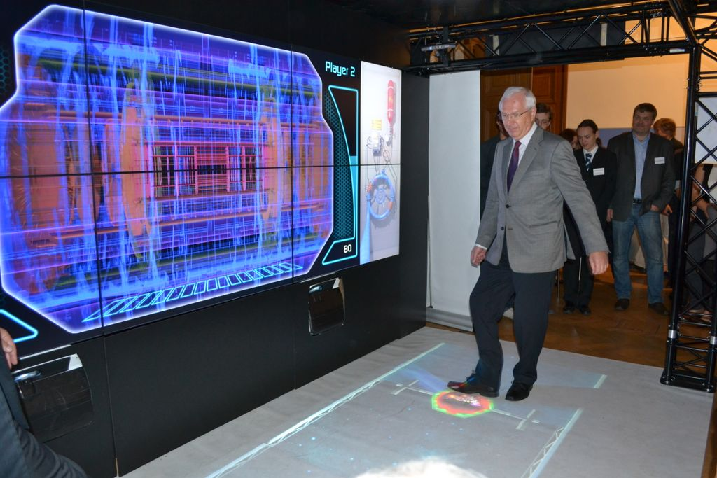
Exhibition kickoff, Prague, September 2 (president of the Czech Academy of Sciences
Prof. Jiří Drahoš playing proton football in CERN’s interactive tunnel)

Slide 16
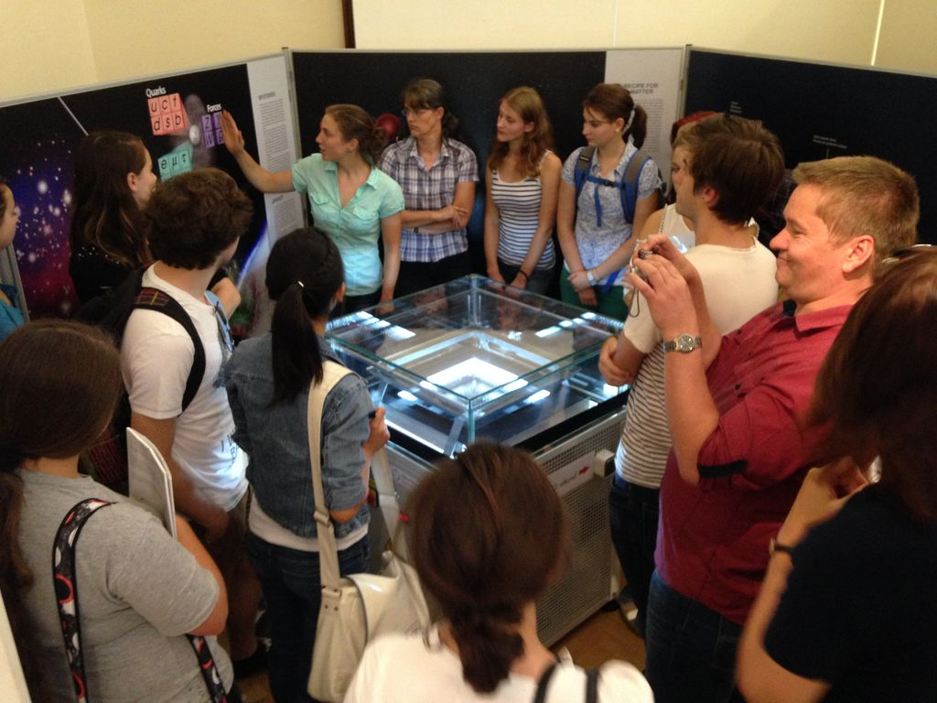
High school students at the cloud chamber

Slide 17
The main public events connected with the 60th anniversary of CERN
Top event: Visit of CERN DG R.-D. Heuer in Prague, September 8
and events connected with it:
DG’s visit of the Charles University, opening of morning part of the lecture series by Czech physicists (~150-200 visitors), meeting with the rector
Meeting with the president of the Czech Academy of Sciences , the CERN 60 exhibition
Public lecture „CERN - 60 Years of Science for Peace“ - ~300 visitors
R.-D. Heuer was a guest of the popular science talk show of the Czech TV „Hyde Park Civilization“ – recorded during his visit, broadcast on Saturday 13 at 8 p.m. His visit was covered by media – daily news, interviews in radio and a leading newspaper
Presentation of S. Schmelling and E. Tolosa „Would you like to become a part of CERN?“
~

Slide 18
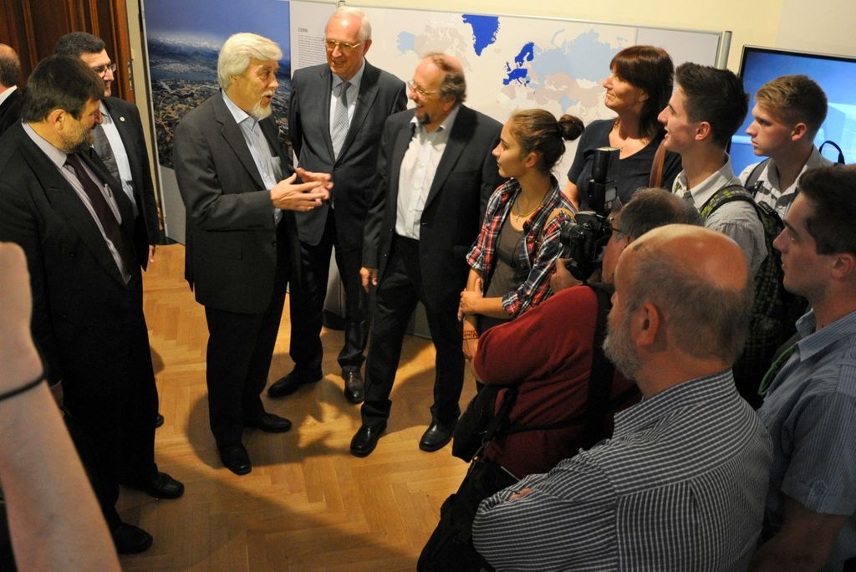
CERN DG with students at the Prague CERN 60 exhibition, September 8

Slide 19
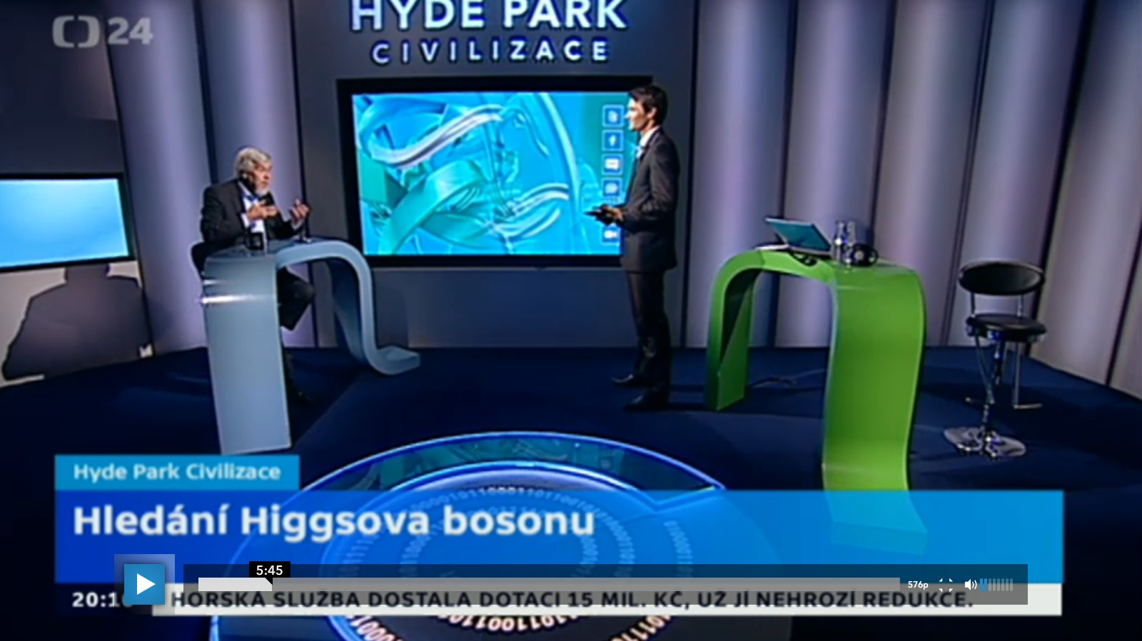
R.-D. Heuer on Czech TV, broadcast September 13

Slide 20
An attempt to generalize
Most of larger scale particle physics outreach activities
in the Czech Republic have been occurring on the occasion
of important events or anniversaries.
Among other things, such occasions attract the attention
of media, which in turn increase the impact on broader
audience.
Such events
rise awareness of particle physics and basic science values
in general
give opportunity to emphasize the benefits of basic research
in particle physics for society – new technologies, applications
in medicine, new forms of collaboration and education …
help to build positive perception of natural sciences among young
people

Slide 22
Remarks
Nothing new from Denmark…
High-school outreach
Particle physics in high-school curriculum
A couple of old/on-going projects…

Slide 23
High-school outreach
Three levels offered:
  The classic outreach lecture
  A day at the institute
  (more often than not a lecture + a master class)
  Assistance with ”actual learning” of particle physics

Slide 24
High-school curriculum
Curriculum contains ”Physics of the 21st century”.
Topic is changed every few years
These years, it is particle physics
  Official teaching material written by former IPPOG delegate.
  National written exam questions in particle physics (threshold values, possible decays etc)
Short term gain is obvious
Longer term:
  Teachers are now educated in particle physics (by the NBI)
  Teaching materials exist

Slide 25
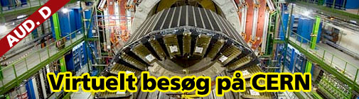
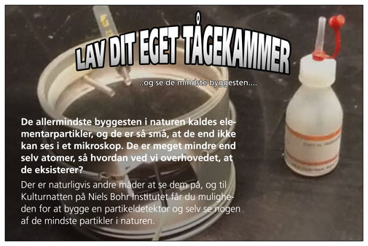
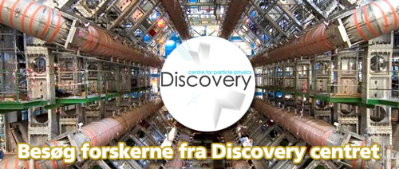
Old/on-going
Culture night
Yearly event (biiiig)
Lectures, meet-a-scientist, build a cloud chamber

Slide 26

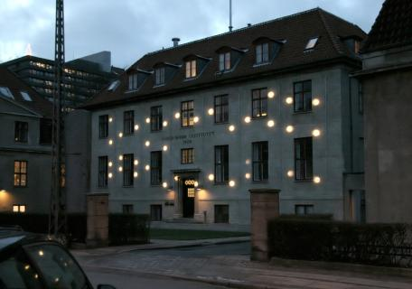
Old/on-going
Lego models
Colliderscope
Visualization of ATLAS data
Filmed lectures for national television

Slide 28
Possible activities:
Exhibitions (example May 2014 Athens)
Mini masterclasses@schools (~50 in Greece)
Preparation for students’ visit to CERN
Teachers’ workshops
Support for above activities->EU outreach programs

Slide 29
Challenges:
Get the best high school students to study physics
Inform the general public and the stakeholders
Keep the interest up (even in case of no discoveries)
Connect basic research with technology and applications

Slide 30
The past EU projects:
1)The PATHWAY IBSE Project( 2011-2013)
Focused on teachers
FP7-Science-in-Society-2010-1
http://www.pathway-project.eu/
2) Discover the_COSMOS (Sept 2011-Sept13)
Focused on teachers +Students (HEP+Astronomy)
FP7 Coordination action (UoA+CERN+TUDresden+UBirmigham)
http://portal.discoverthecosmos.eu/
FINISHED@ end of 2013
FINISHED@end of Aug. 2013
But thousands of resources on portal
C.Kourkoumelis. UoA
30

Slide 31


Activities supported by the new EU projects:
Go-Lab (Nov.2012-Nov.2016, 20 partners)
http://www.go-lab-project.eu/
Inspiring Science Education
(April 2013+40mo,31 partners)
http://inspiring-science-education.org/

Slide 32
Accelerating science
CERN exhibition in Athens
The exhibition was organized by:
  CERN
  Ellinogermaniki Agogi school
  Eugenides Foundation
  Go-lab EU project http://www.go-lab-project.eu/
  Inspiring Science Education EU project http://inspiring-science-education.org
In collaboration with
  University of Athens
  IASA
  National Technical University
  Hellenic Physical Society

Slide 33
Accelerating science
CERN exhibition in Athens
11,238 visitors (!!)
4014 students 10-17 years old mostly in organized school visits (a guide always present) from 92 schools (who came from as far as 500km from Athens)
115 teachers attended 6 seminars (4 of them three hour long dedicated on ATLAS and hands-on HYPATIA tool)
HYPATIA “demo” on-line version running during exhibition
4 different press releases
474 publications in all types of media
  Magazines, newspapers 35 articles
  Internet 422 articles
  TV 8 appearances
  Radio 9 appearances

Slide 34
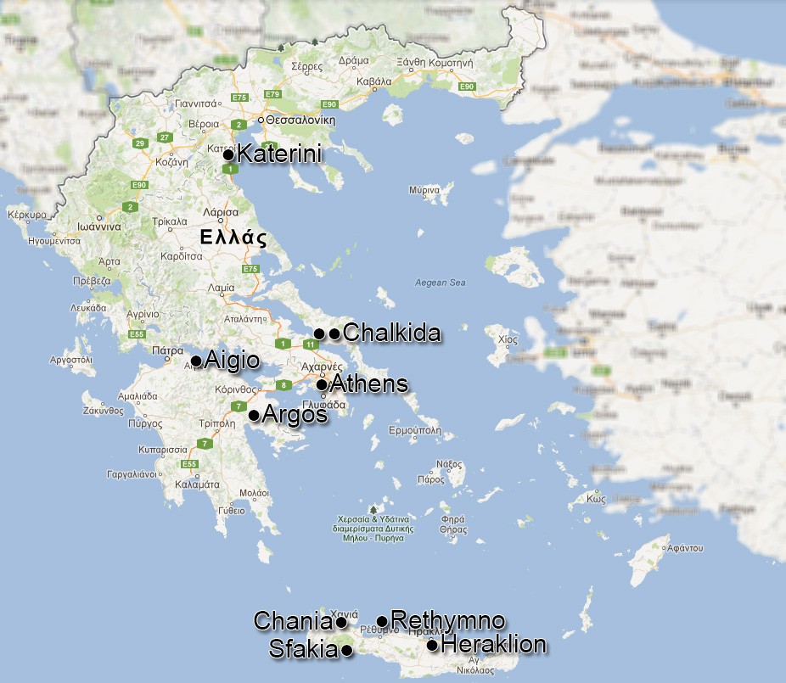
Mini masterclass@Greek schools
Lectures, VV, hands-on event analysis with HYPATIA tool
Serres 2 schools VV
Evros 4 schools VV
Corfu 2 schools VV

Slide 36
Activities and challenges in Israel
Daniel Lellouch

Slide 37
(not so) Small (a) country
Three labs in experimental HEP: Weizmann Institute, Tel-Aviv University, Technion-Haifa.
Theorists : as above + Jerusalem and Beer Sheva
Fairly high interest of public in science and HEP (“start-up country”).
Many heard of the LHC because:
  “It almost triggered the end of the world”
  “The God particle was found”
  Many heard of the superluminal neutrinos:
  - “next time I’m arrested by the police for over speeding, I’ll tell them
  it’s because a bad connection of my GPS”
Good relations with the Press

Slide 38
Challenges
Several initiatives by enthusiastic researchers and teachers: lectures, open days, master classes, high school students visiting CERN, teachers’ program at CERN, ...
However:
Challenge #1: manpower
  The size of the pool of researchers and students who routinely agree to lecture to high school students/teachers or to general public is ~10 (a bit more than one speaker per million inhabitants).
  Only one (finishing her Ph.D) Arabic speaker ( for ~20% of the public).
  Workshops in labs are deeply involved in LHC/BNL/LNGS activities: no time for developing “hands on” equipment, but we would be happy to
  to buy it from somebody else.
Challenge #2 : have the information flow internally

Slide 39
Target audience
Our priority : educational more than outreach towards general public.
However, educational system very heterogeneous
  Government high schools with regular curriculum
    ** Hebrew speakers
    * Arabic speakers
  *** Science oriented high schools with special curriculum
  Religious non government schools
New project: identify top talented (~20) high school students and “treat them well” to attract them to physics thru two “sexy” fields: HEP and astrophysics

Slide 40
Masterclasses
One man (high school teacher, HEP Ph.D. ) show !
  Very active and enthusiastic
From what I understood from him, the main problems he faces are:
  Find a location inside an academic institution misunderstanding
  Find local speakers to give introductory talks
  Keep students focused until the end of the day, in spite of sound quality and language barrier
What could be improved from our side ?
  Again and again: information flow to avoid effort duplication

Slide 41
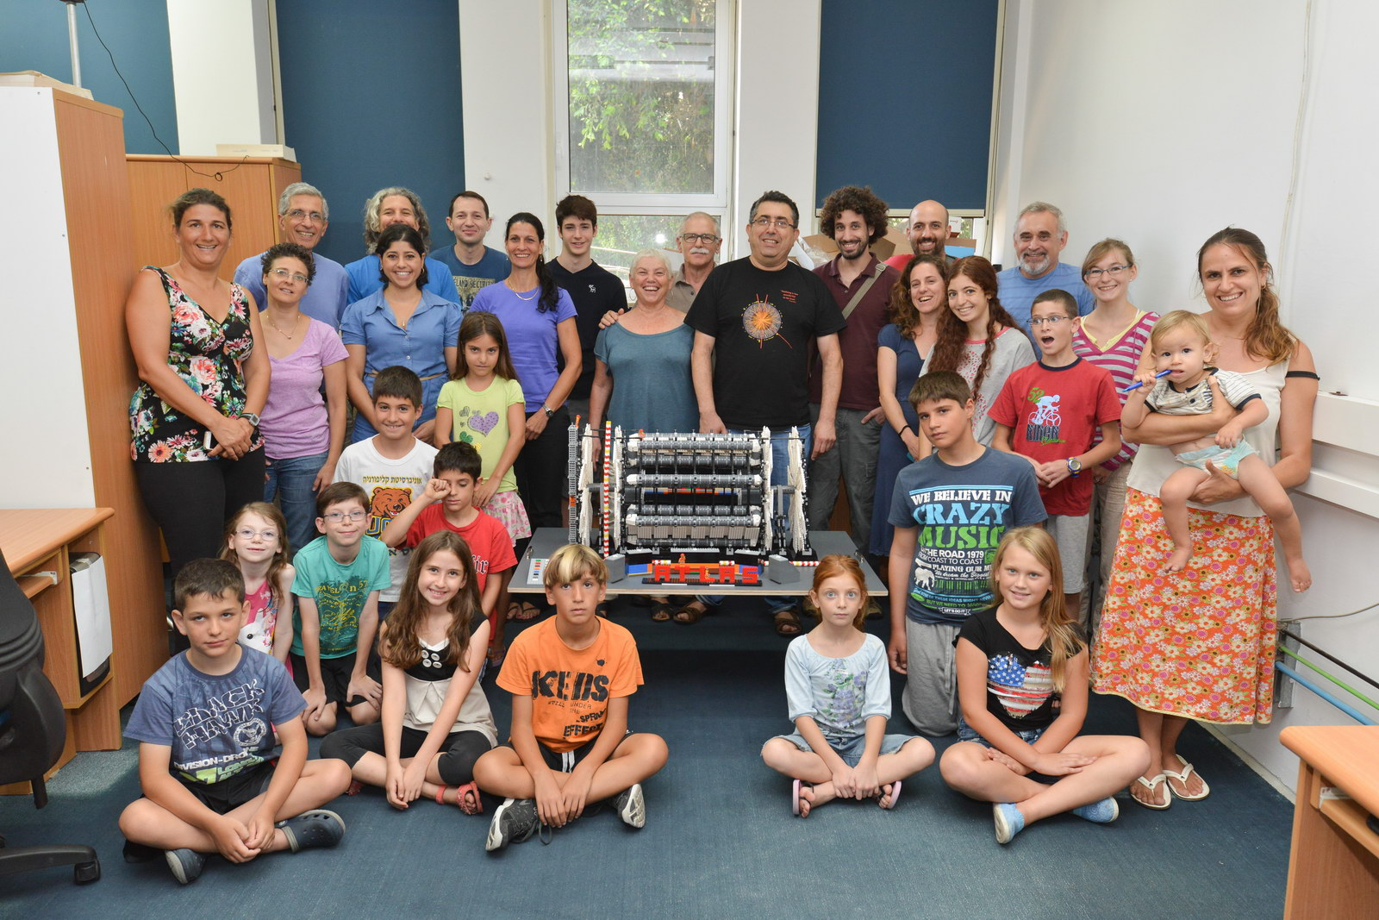

Slide 43


Activities and Challenges in South Africa
Sahal Yacoob
University of KwaZulu-Natal

Slide 44
2014 Activities
Masterclasses at 3 (one outside of the official programme) venues in 2014
  Growing number of venues
Public lectures to school groups
  15-18 year olds
Beamline for schools
  One school on the highly commended list
  No one contacted me as the South African Rep

Slide 45
Challenges
Remoteness and Conectivity
  The unstableness of the internet combined with our remoteness from CERN leads to a disconnect
    Cannot really schedule visits to CERN, and
    Virtual visits / masterclass conferences are often difficult to set-up, and even then can fail due to a local connectivity failure
Manpower / Time
  The particle physics community is still small (but growing)
  Difficult to get lines of communication to larger projects
    National Science week
  Generally communication with organisers, and even between and within institutes is difficult

Slide 46
2015 Activities
Still aiming to be involved in the SciFest Africa
  http://www.scifest.org.za/
If there is another Beamline for Schools I have arranged with the South African Institute of Physics to bring the ‘best South African entry’ to the annual SAIP conference
Masterclasses and talks (of course)

