Slide 1
PDG solutions from Elsevier
Eleonora Presani
e.presani@elsevier.com

Slide 2
Present situation
Production and delivery cost for 14,000 copies of a 1650 page book
  From $100,000 to $150,000 depending on the delivery option
Production and delivery cost for 32,000 copies of a spiral bound booklet of 320 pages
  $60,000
Reducing the number of pages will reduce the costs, but will not get even close to a $50,000 total expense
Notes:
Costs, with a zero profit margin, are considerably higher than the available funds that PDG has at hands.
Reducing the number of pages, even of considerably, will reduce enormously the costs, but will hardly be within the $50k that was requested last year. In two years time costs will probably get higher rather than lower, so maintaining the same distribution method is not going to be helpful.

Slide 3
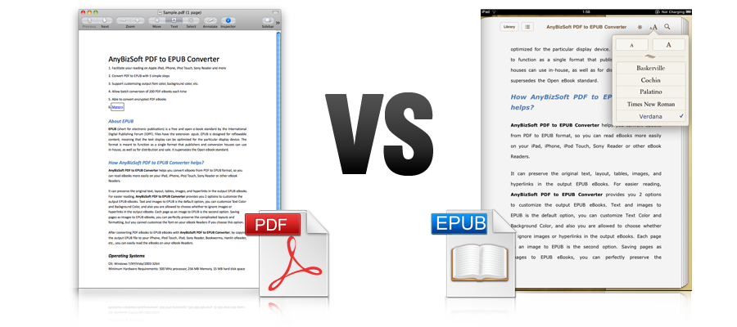
Digital Solutions
Epub for the Review book, print for the booklet
Epub is an XML format and completely reflowable, self adapting to any screen size, different fonts, different devices
Notes:
Solutions are possible and are many.
A very simple and straight forward solution is to transform the Review book in a epub electronic book, while keeping the booklet in print.
Epub (or mobi) is the most common digital book format and has a few great advantages with respect to PDF. The main one is that it is a full XML format, so it feature fully reflowable content. In practice this means that the same book page can be read from a tablet (such an iPad) a phone of any screen size, a e-reader such an Amazon Kindle, and it will self adapt for the best reading experience. Formulas, tables and figures are fully supported and the reader can change font, font size and format.

Slide 4
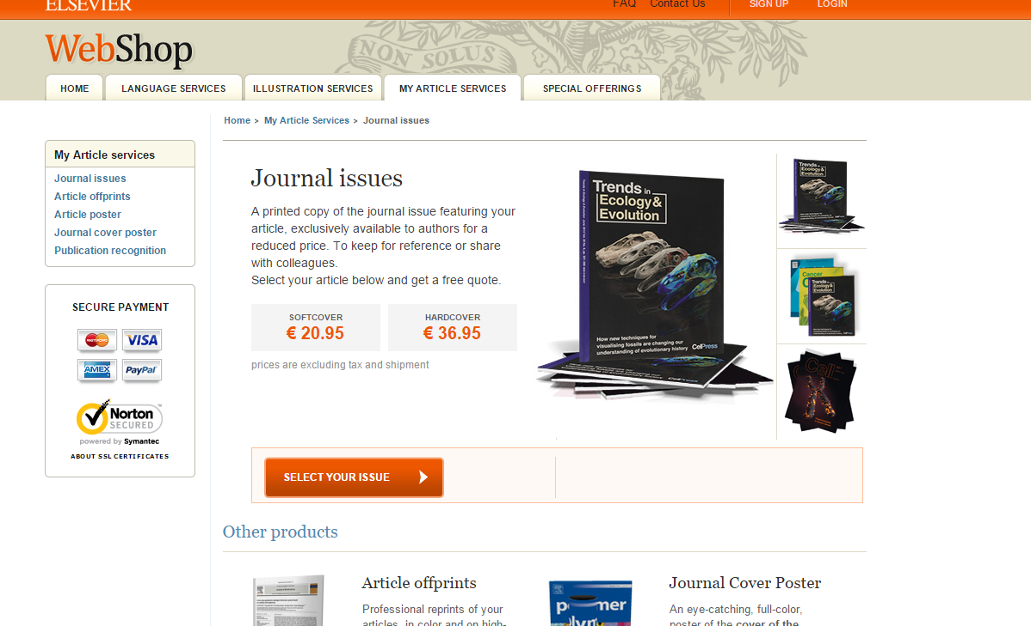
Print on demand solutions
Next to digital solutions, the Review book (and additional booklets) can be printed “on demand” (Payments/shipping handled by Elsevier).
  Each chapter can be printed separately, so the user can “build” their own book
  Institutions can buy
  bulk orders
  Single researchers
  can buy their copy
Notes:
In addition to the digital solution of having a cheap ebook for the Reviews, a “print on demand” solution can be set up.
The Elsevier Webshop can set up a special page for the PDG (with logos and credits), from where Universities and various institutions around the world can make their own orders. They can order large numbers for all their members, or single researchers can buy single copies. It is also possible to buy single chapters or to “build” you own book, selecting the type of content you want.
With this solution we can easily make available also extra copies of the booklet, or even have the Particle Physicist Agenda for a few euros/dollars.

Slide 5
Summary
Reviews of Particle Physics
  Published digitally as ebook (epub and mobi)
  Print on Demand from Elsevier Webshop, highly customizable
Particle Physics Booklet
  Printed copies to be sent around, as always
  Extra copies available on the Webshop on demand

