Slide 1

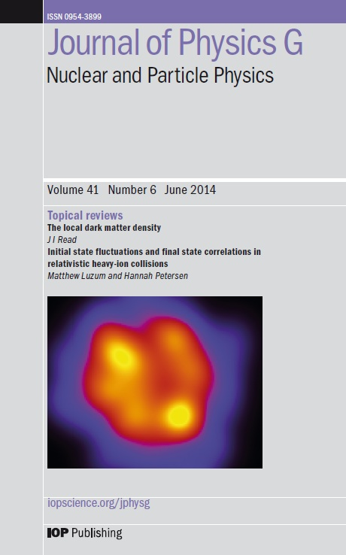
The future of the Review of Particle Physics
Colin Adcock (colin.adcock@iop.org)
Journal of Physics G: Nuclear and Particle Physics
Publisher of the 2006 and 2010 Review of Particle Physics
6 November, 2014
Notes:
Thank you for inviting us to present at this meeting. I apologise that I cannot be there in person to put forward our ideas to the PDG. Please feel free to contact me personally on colin.adcock@iop.org. I am very happy to answer any questions about this presentation or about IOP Publishing’s processes.

Slide 2
Why discuss this?
The RPP & PPB are a critical publication for particle physicists everywhere.
These are highly valued products, so why consider change?
  Publishing technology is changing and improving
  The RPP is growing every year
  Usage habits are shifting to online and mobile
  Costs are increasing for print and distribution
  But crucially:
  New technology allows us to improve the RPP & PPB for the PDG and its users.
Notes:
The RPP & PPB are extremely well respected publications, and will continue to be a cornerstone of the particle physics community for many years to come. It is essential that we upgrade them to meet with current publishing technology, as well as modernise them to suit the researchers it serves. The time and monetary cost must also be streamlined to produce a product which is sustainable.

Slide 3
IOP’s proposal for an online-first platform
We will work with the PDG for a part digital and part print solution for 2016 and beyond.
We propose:
  An online-first RPP with state-of-the-art digital production
  To bring the PPB online, whilst retaining print
This will:
  Provide superior online usability over all previous editions
  Save the PDG significant time and money
  Utilise print-on-demand where required
Notes:
55.6% of PDG users could do without the printed book – despite the limitations of the current PDF-only online edition. This number will increase every year as trends show researchers moving to online resources. With the new functionality we propose today this number will increase further still, making an online solution the firm destination of choice. Given the current print & distribution of the RPP, those not requiring print corresponds to a ‘waste’ of over $100,000. Even with a reduced size, the print and distribution of the RPP still carries significant cost. With our digital publication we can provide additional print-on-demand to those who require it.

Slide 4
Advantages for the PDG at publication
An IOP-produced digital RPP will be a stronger RPP. We will:
  Save the PDG time by working with original source files
    We’ll perform typesetting work for you
  Put no size limitations on the RPP
    The online publication could keep the existing format, or any new format
  Provide more flexibility for future editions
    New additions or technology can be more easily incorporated
  Create a product which is sustainable for the future
    For cost, usability and environmental impact
  Professionally produce articles to the highest standards in the industry
  Plus, major usage advantages by publishing online-first….
Notes:
We can take the finished articles and data tables from the PDG in source format and professionally typeset them for the PDG. This will save the PDG a significant amount of time, whilst enabling major advantages for the published article (next slide). The RPP will of course still be cited as a single article in the journal.

Slide 5
Advantages for users of the RPP
An online RPP will give users a greatly enhanced experience.
  Full text online XML for every review and data listing
    Alongside individual PDFs
  Increased visibility & discoverability everywhere on the web
    Full, searchable metadata so every review and data listing appears on Google
  Full forward and backward reference linking in each article
  Increased mobile & tablet usability even without an app
  The RPP (and individual chapters) as an eBook for any e-reader
  The RPP will be a high-quality online-first product which is easy to find, easy to navigate and easy to read and use.
Notes:
By using IOP’s professional digital production techniques we will make the RPP a product which can be used however the user wants. Full online XML split per-chapter will make the RPP easily navigable on the web, whether using a computer or a mobile device. With full reference linking, it will be even easier for researchers to make the most of the RPP.

Slide 6
What about the PPB?
IOP will retain the print for the booklet:
Over 85% of PDG users would like to keep the booklet
Represents value for money
We will publish the booklet digitally:
Can create a full XML booklet
Could be optimised for mobile & tablet use
  Opens the option of a simple booklet app
Save typesetting time of PDG contributors
In the future, the booklet could be complemented or replaced by a full mobile/tablet app.
Notes:
The booklet is an extremely useful print publication appreciated by the majority of PDG users. We therefore propose to keep this, whether in current or shortened form.

Slide 7
What could an app do?
An app will make life easier, and be a valuable tool for the community.
  Provide access to PDG products anywhere, at any time
  Give rapid access to pdgLive and the latest data
  Save data & reviews for offline use
  Complement an online-first RPP and further boost usability
Utilising IOP’s expertise in publishing and app development, we could create a partnership to produce a valuable app for all PDG users.
Download our latest Physics World app for iOS or Android for a taste.
Notes:
An App would make the RPP & the PDG’s data even more accessible for all. It would provide instant access to data listings and reviews anytime and anywhere – whilst being able to save articles & listings for offline use. This would complement an online-first RPP, and we hope that the PDG will work with experienced Publishers to develop an app of this kind.

Slide 8
What would the next RPP look like in JPhysG?
IOP can offer:
  A RPP built for the digital age with far greater online usability
  A PPB both in print and online, available direct from the Publisher
  A new, independently built app to support the PDG’s users
  All with significant cost and time savings to the PDG.
We look forward to working with you to produce future PDG products.
Notes:
IOP is flexible in our approach and we are happy to discuss alternatives and other ideas put forward by the PDG. We look forward to working with the PDG to ensure that future editions of the RPP offer increased usability, time & cost savings as well as being sustainable and forward looking.

Slide 9
Further reading
  IOP Publishing’s award-winning eBooks program:
    http://iopscience.iop.org/books
  Our new Physics World app:
    http://physicsworld.com/cws/pwapp
  Visit the Journal of Physics G: Nuclear and Particle Physics website:
    http://iopscience.iop.org/jphysg
  Contact me at any time: colin.adcock@iop.org

Slide 10
An illustration of the cost of the RPP & PPB
PDG Budget (2014)
Figure: Approximate cost of the RPP & PPB
Online cost includes full production service from IOP with typesetting of the full ~1650 page RPP. Other data includes print & delivery as per previous years.
Notes:
Additional information not included in presentation. Online first is total cost for the production of the online RPP. This includes (and is not limited to) full text HTML, forward and backward reference linking, full eBook production and complete metadata inclusion for discoverability. The cost is as per the 2014 RFP, and would be reduced further if a shortened RPP was considered.

