Slide 1
PDG Japan
Tohoku
•
KEK
•
Nagoya
•
•
IPMU-Tokyo
K. Hikasa (Tohoku U.)

Slide 2
PDG-Japan
Data Listing (currently 5 encoders/overseers)
Review Authors
Mirror site at KEK (1997)
Funding by KEK (since 1986, Japan-US Program)

Slide 3
RPP Sections Handled
Neutrinos (astrophysical)
Top quark
4th generation quarks
Higgs bosons
Axions and light bosons
Heavy bosons (W’, Z’, leptoquarks, etc.)
Technicolor
Compositeness (contact int., excited q/l, etc.)
WIMPs and other searches
(formerly Supersymmetry)

Slide 4
Current Encoders
Name | Period | Present responsibility
K. Hagiwara† K. Hikasa M. Tanabashi K. Nakamura F. Takahashi | 1986-91, 94- 1989- 1994- 1995- 2010- | Top, 4th Gen. Quarks Higgs, WIMPs, Other Searches Heavy Bosons, Technicolor, Compositeness Neutrinos (astrophysical) Axions
†will be retiring soon

Slide 5
Papers examined
code | section | encoder | 2007 | 2008 | 2009 | 2010 | 2011 | 2012 | 2013
S066/67 | neutrinos | Nakamura | 2 | 9 | 7 | 9 | 8 | 11 | 18
Q007 | top quark | Hagiwara | 16 | 17 | 27 | 23 | 34 | 37 | 26
Q008/09 | fourth generation | Hagiwara | 2 | 2 | 3 | 4 | 9 | 12 | 6
S055 | Higgs bosons | Hikasa | 8 | 21 | 27 | 14 | 29 | 57 | 40
S029 | axions | Takahashi* | 9 | 8 | 18 | 14 | 19 | 15 | 28
S056 | heavy bosons | Tanabashi | 11 | 14 | 15 | 15 | 37 | 37 | 19
S054 | compositeness | Tanabashi | 1 | 3 | 1 | 7 | 6 | 11 | 9
S057 | technicolor | Tanabashi | 1 | 0 | 1 | 2 | 1 | 2 | 0
S030 | other searches | Hikasa | 38 | 27 | 37 | 43 | 55 | 67 | 87
total # of papers examined |  |  | 88 | 101 | 136 | 131 | 198 | 249 | 233
*Replaced Murayama in 2010
LHC Effect!

Slide 6
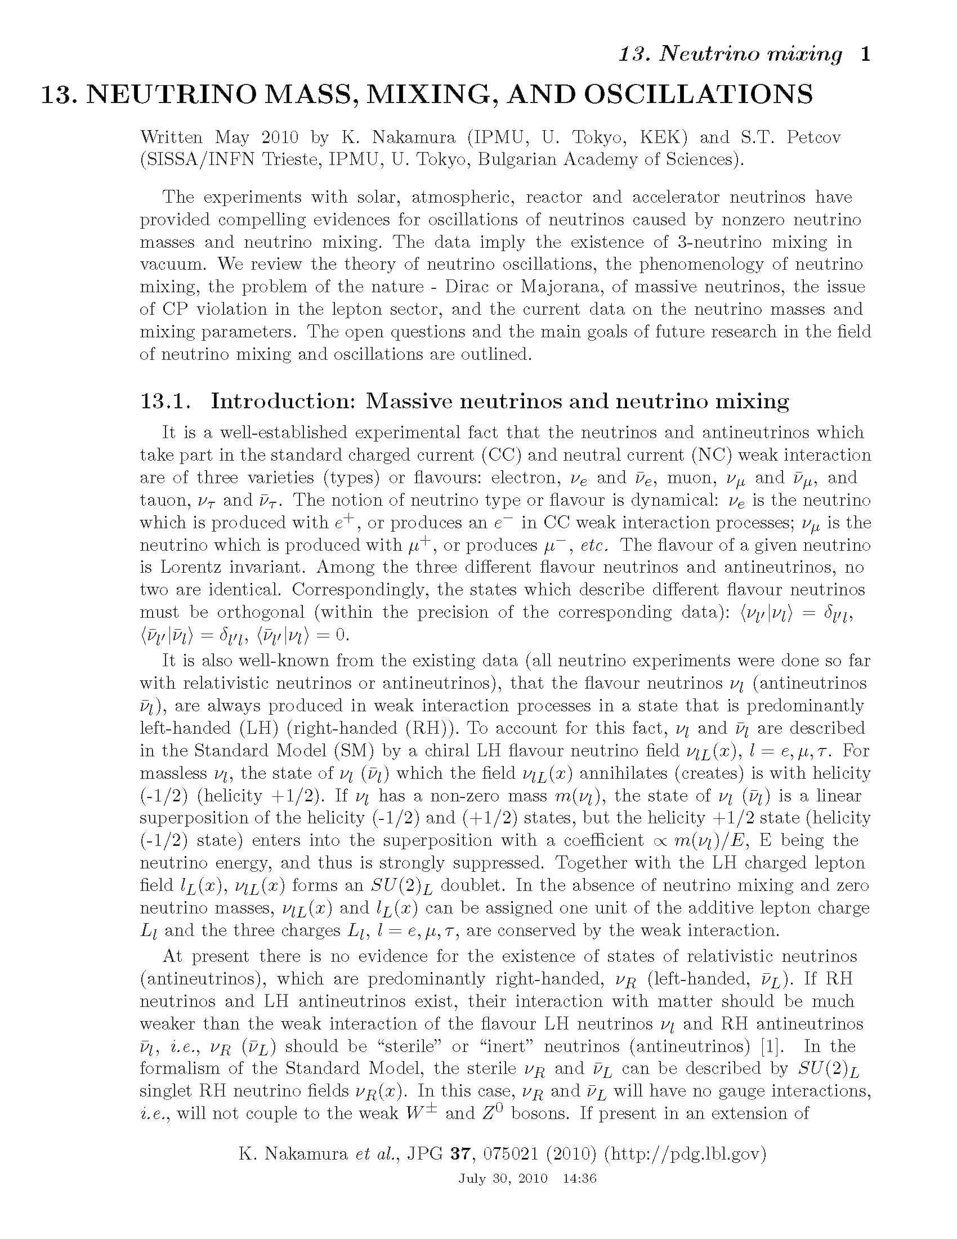
Review authors
Review authors
  Y. Sakai (CKM)
  T. Sumiyoshi (γ detectors)
  A. Yamamoto (SC magnets)
  K. Nakamura (ν)
  M. Tanabashi (leptoquark)
  K. Hagiwara/K. Hikasa
Past authors
  A.I. Sanda
  M. Fukugita

Slide 7
Finance (KEK: Japan-US Program)
PDG-Japan Budget:
Rather stable for more than ten years, despite the whole program shrunk
(Exchange rate much more unstable…)
Budget for JFY2014: JPY15M (~US$145k)
*Japanese fiscal year 2014: April 2014-March 2015
Continuing effort to maintain this level

